Slide 1
The Highest Energy Gamma Sky
Zhen Cao
IHEP, China, Beijing
1st APPIC Meeting at APC, Paris, May, 2014

Slide 2
Contenet
1. Major Observers
2. The Sky
3. In Our Galaxy
4. Outside the Galaxy
5. Summary
6. Lookout

Slide 3
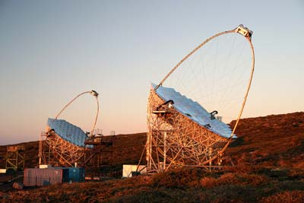
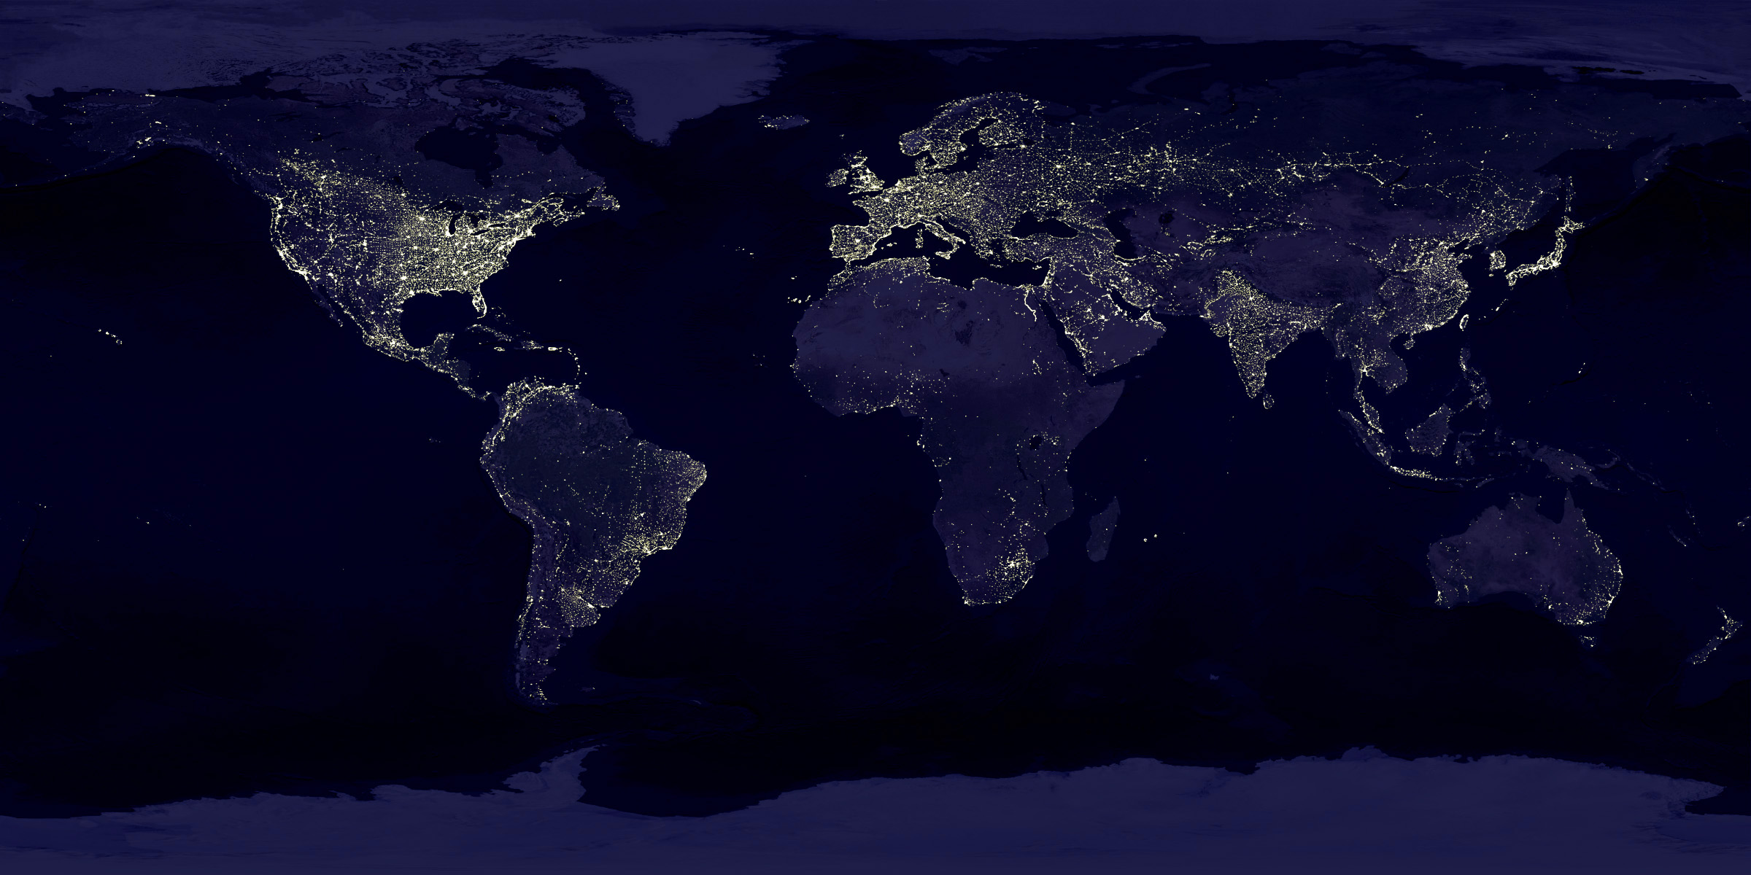
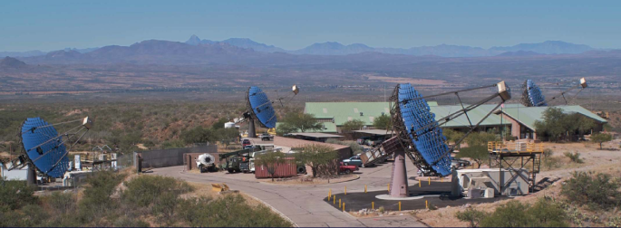
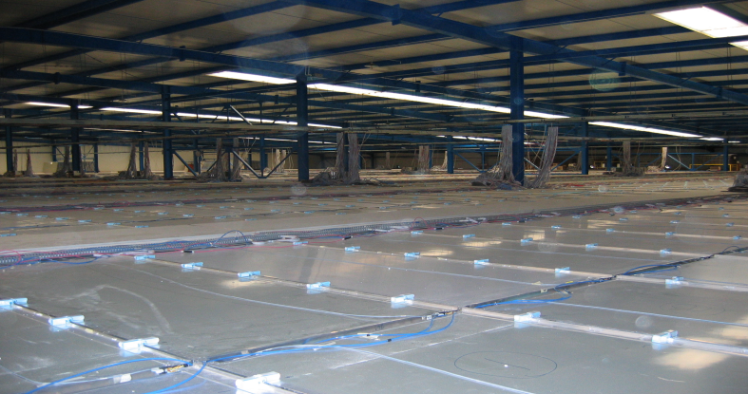
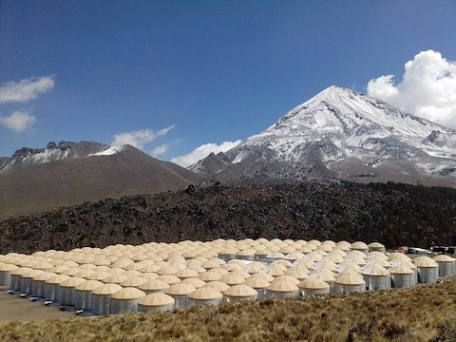
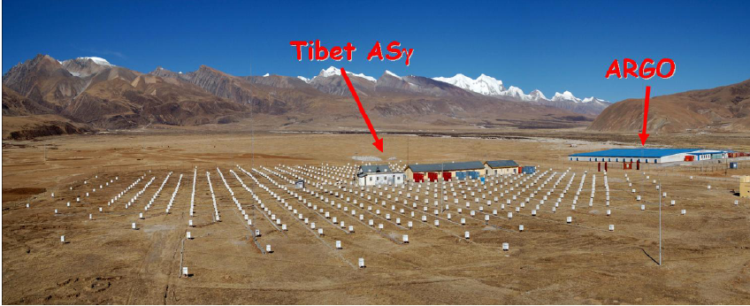
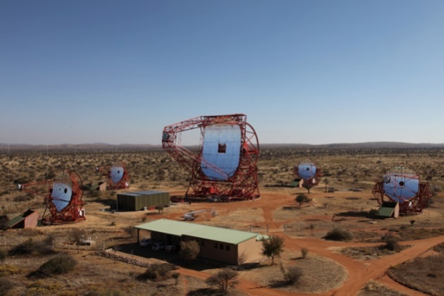
1. Global Instruments of VHE Gamma Ray Astronomy
MAGIC
VERITAS
ARGO-YBJ
Tibet ASγ
HAWC
HEES

Slide 4
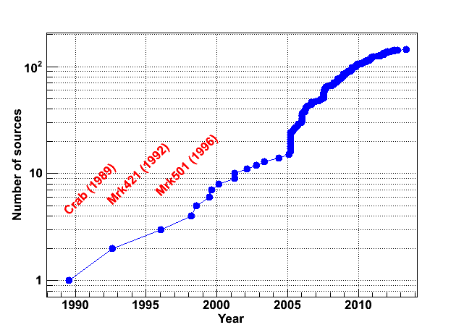
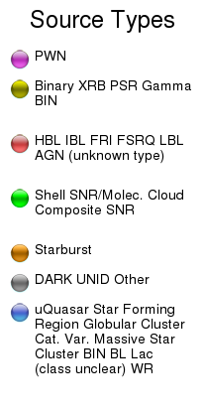
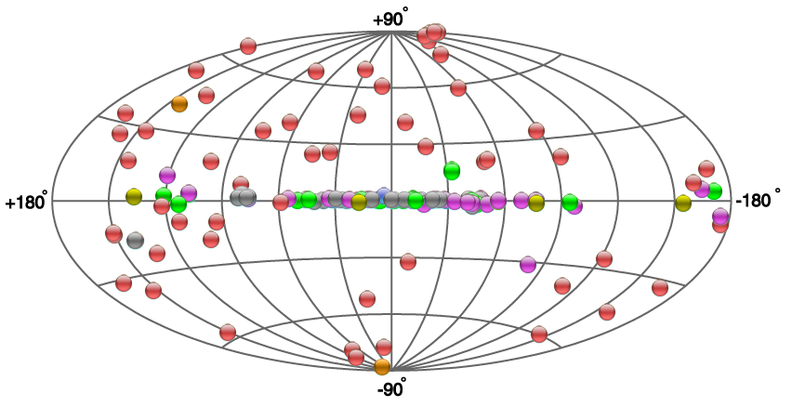
2. Map and number of
the γ ray sources
147 sources
FERMI
Catalog
releasing
MAGIC
Switch on
HESS
Switch on

Slide 5
3. In Our Galaxy
PWNs
SNRs
Binaries
…
Regions:
  Cygnus region: Cocoon
  G.C. and FERMI Bubble
  Diffuse γ rays

Slide 6
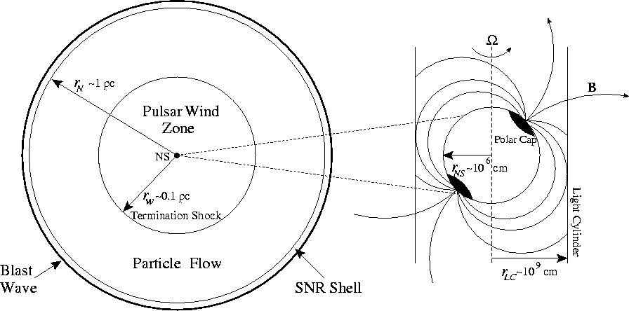
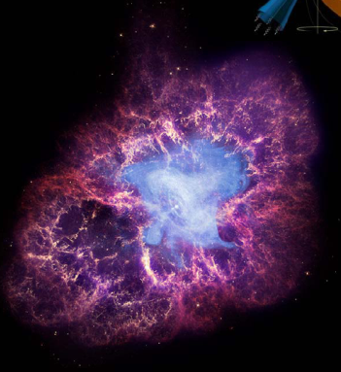
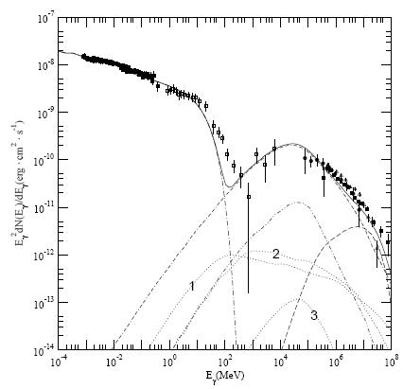
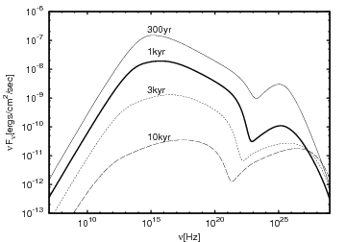
34 Pulsar Wind Nebula
Standard Candle Crab Nebula
Evolution
Spatial drifting
A&A 548, A46 (2012)

Slide 7
23 SNRs (Shell or Composite w/clouds)

Slide 8
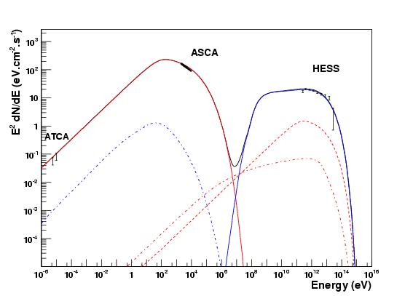
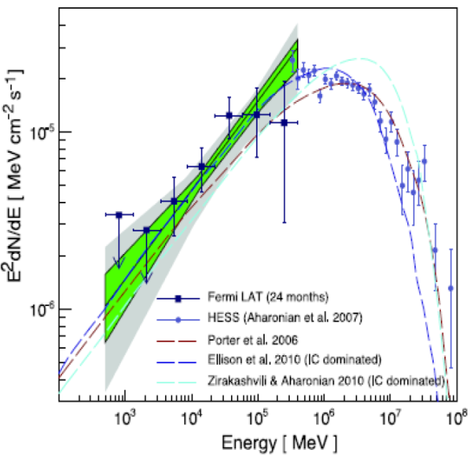
RXJ 1713.7-3946
Morphology is important,
Spectroscopy is even more!

Slide 9
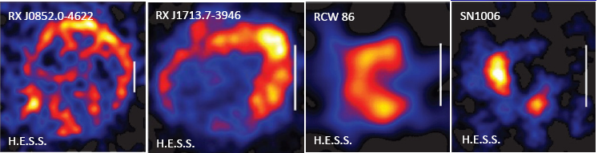
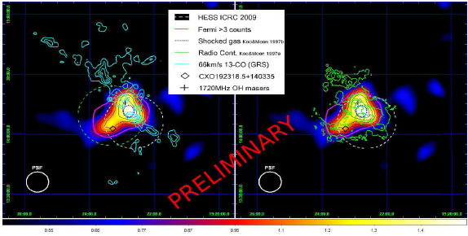
SNRs
Young SNRs
Old SNRs
Science 339, 807 (2013)
CR sources?

Slide 10
5 Binaries
: Variation of γ flux in orbiting phase. Binaries have different behaviors, though.

Slide 11
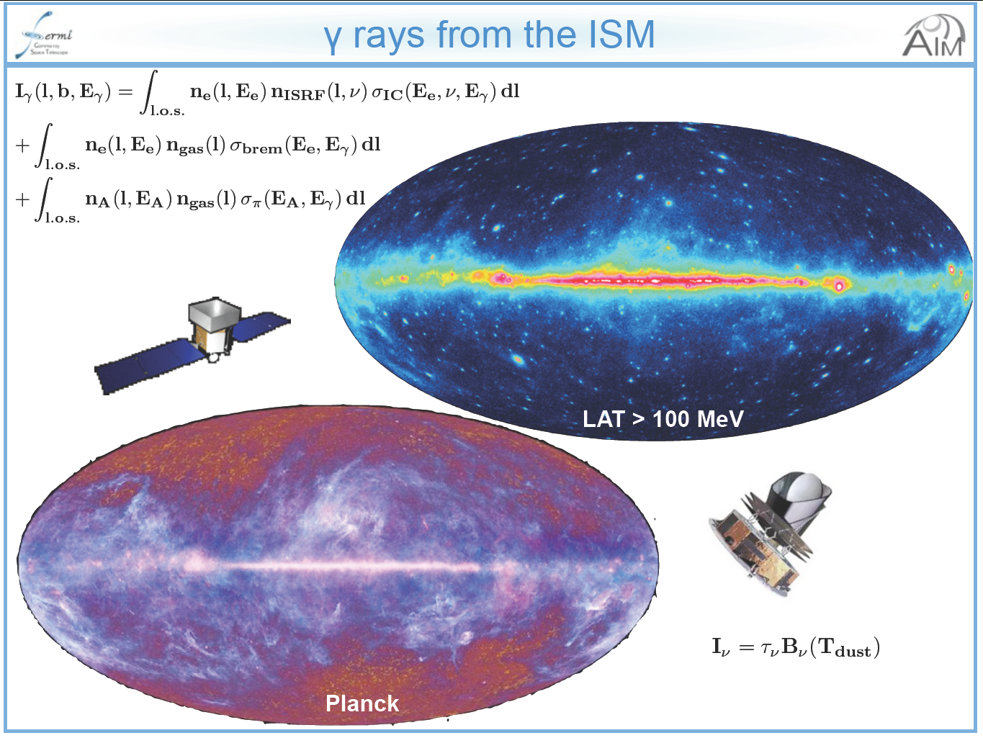
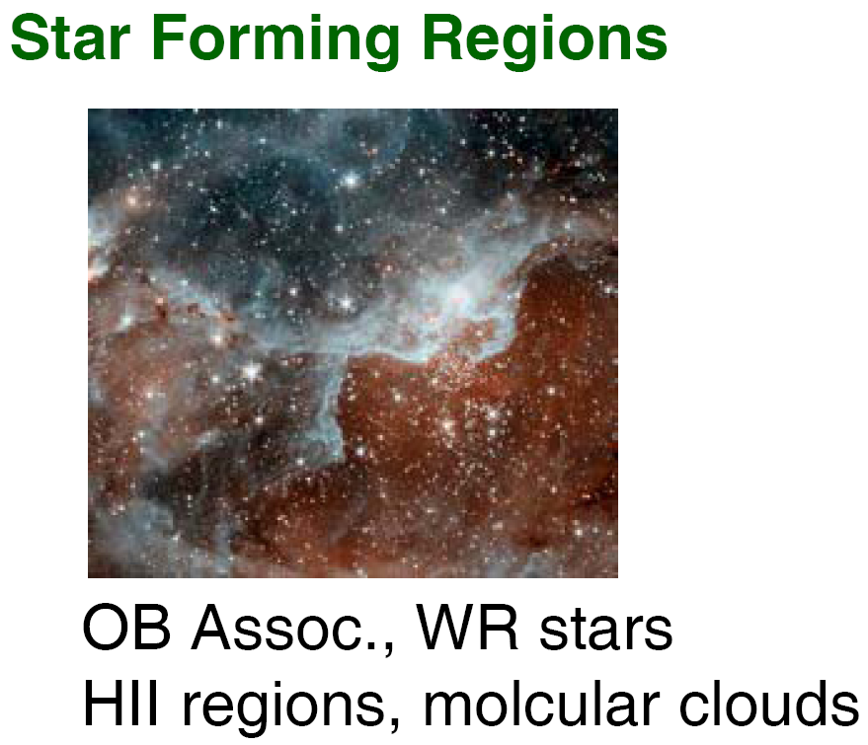
Cygnus Region
Isabelle Grenier
Université Paris Diderot & CEA Saclay

Slide 12
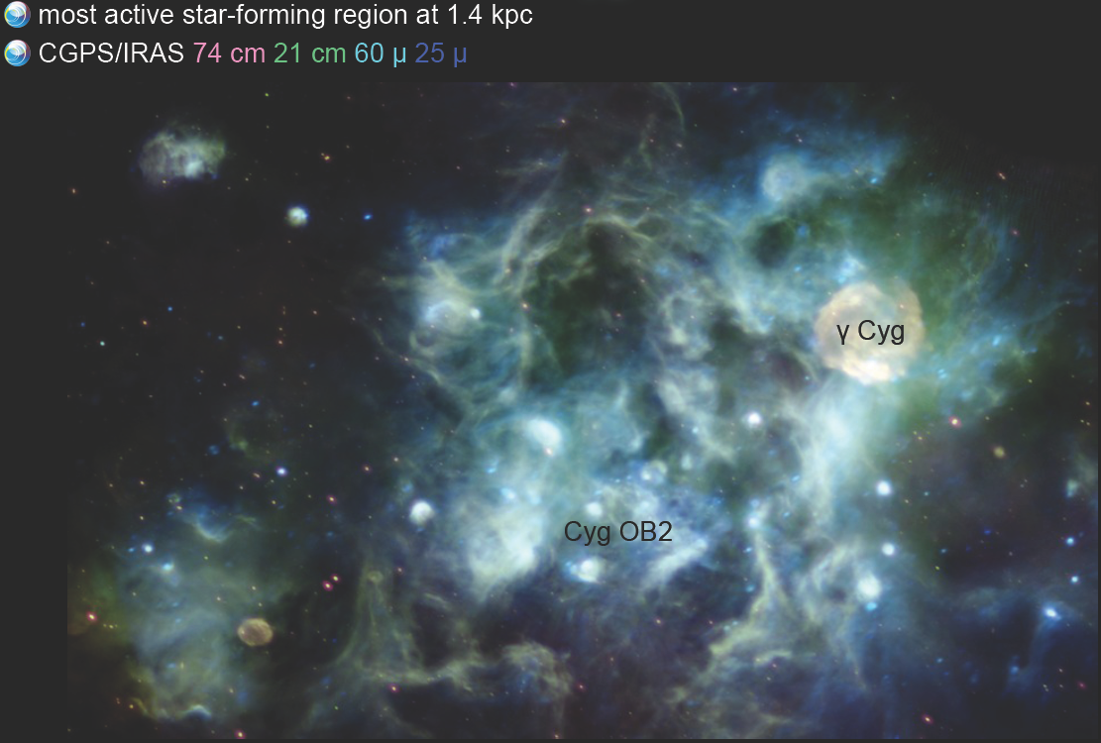
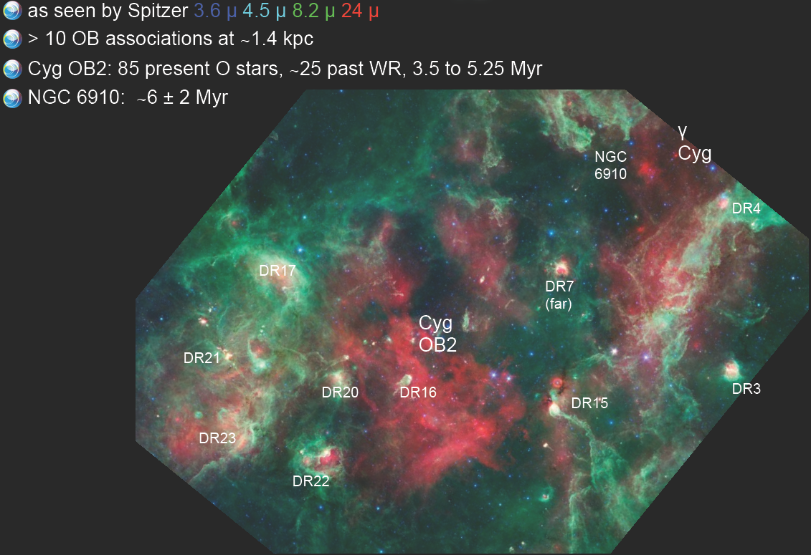
The most active region in the northern sky

Slide 13
Cygnus Cocoon (FERMI Cocoon)
FERMI Cocoon
ARGO J3031+4157
The first γ ray Superbubble
it is too big to IACT
Could be a possible hadronic source w/ total hadronic energy of 1.5x10⁵⁰ erg，E_{cut}=150TeV
Science 334, 1103 (2011)
To be submitted to ApJ

Slide 14
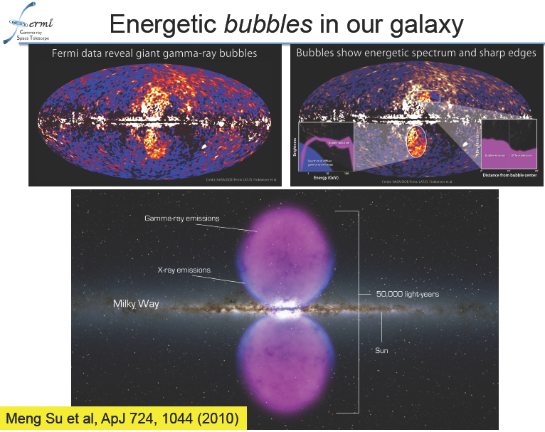
LHAASO FOV
7.6kpc
42°

Slide 15
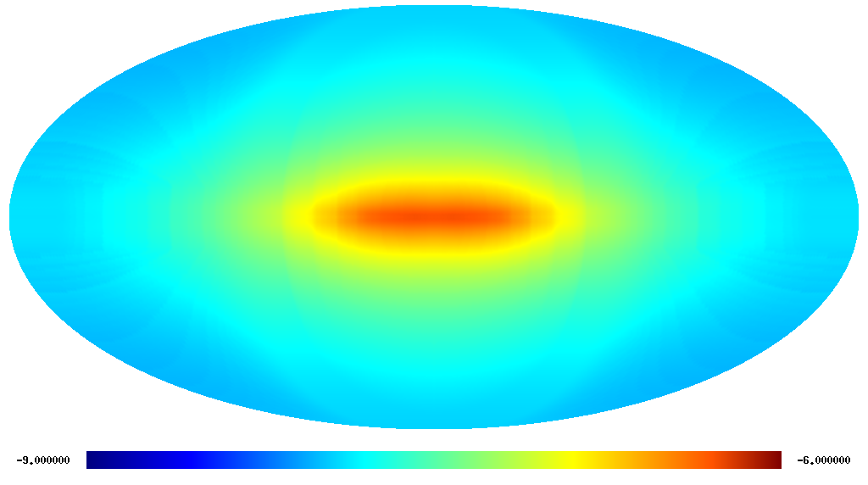
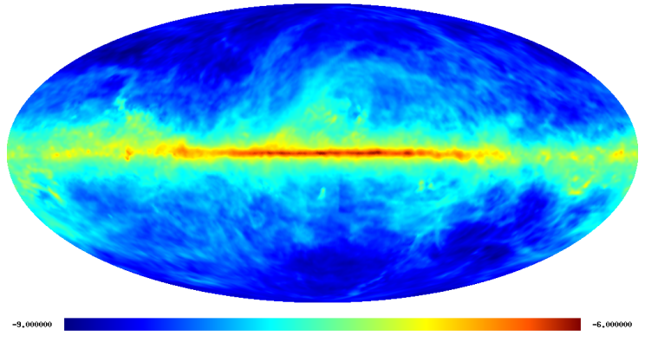
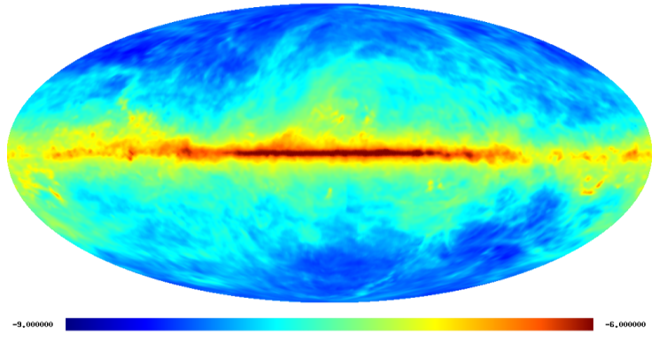
4. Galactic plane diffuse gamma-ray
Inverse Compton π⁰-decay
Bremsstrahlung
Diffuse gamma rays produced by interactions of cosmic rays with the interstellar medium and radiation fields. They can be used to probe the cosmic ray spectrum and density throughout the whole Galaxy.

Slide 16



Diffuse γ rays: EGRET, FERMI, ARGO-YBJ and MILAGRO
Cygnus region
From 30MeV to 20TeV, traces CR propagation well.
To be submitted to ApJ

Slide 17
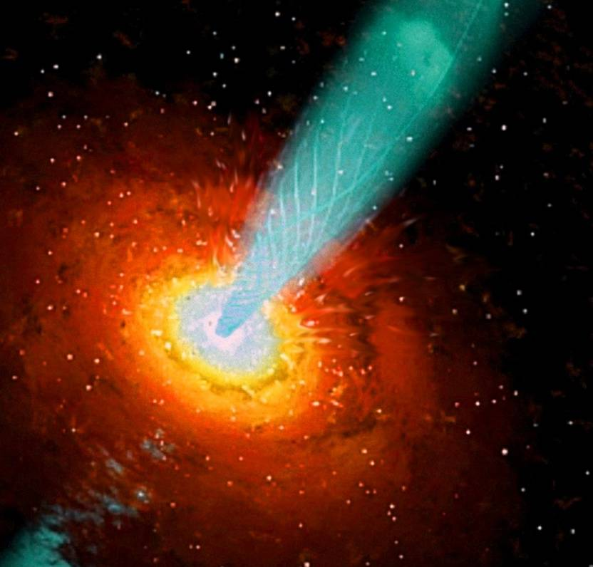
4. AGNs
Leptonic SSC, EC? Hadronic?
？
Different models will predict different correlations between low and high energy components. Thus, long-term continuously multi-wavelength observations, especially at X-ray and TeV band, are crucial to understand the emission mechanisms and underline processes of the outbursts.

Slide 18
Mrk421
An excellent candidate to study the jets of AGN. With frequent major outbursts about once every two years.
Tibet ASr
ARGO-YBJ
RXTE/2-12keV

Slide 19
ARGO-YBJ observation
A good several years long-term correlation between X-ray and TeV gamma-ray including both active and quiet phases.
Bartoli et al. ApJ 734:110 (2011)

Slide 20
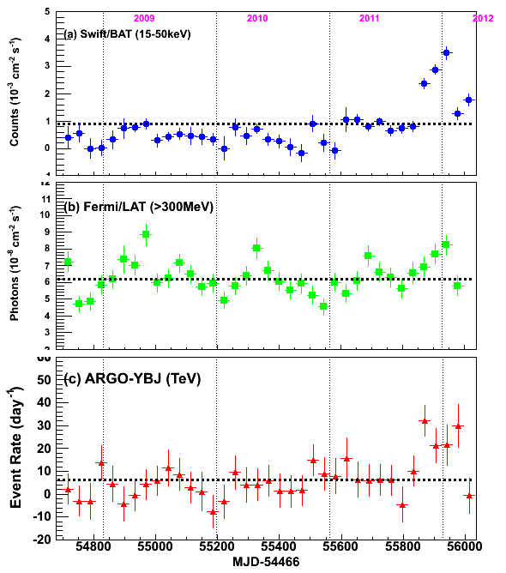
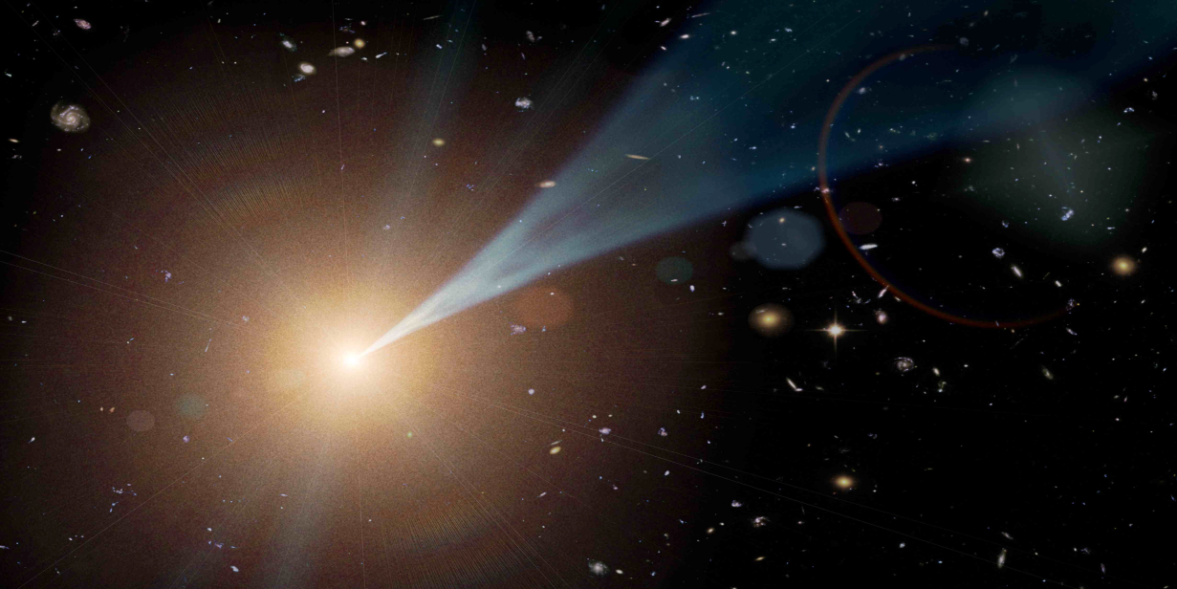
Transient AGNs： Mrk501
Survey of transient AGNs

Slide 21
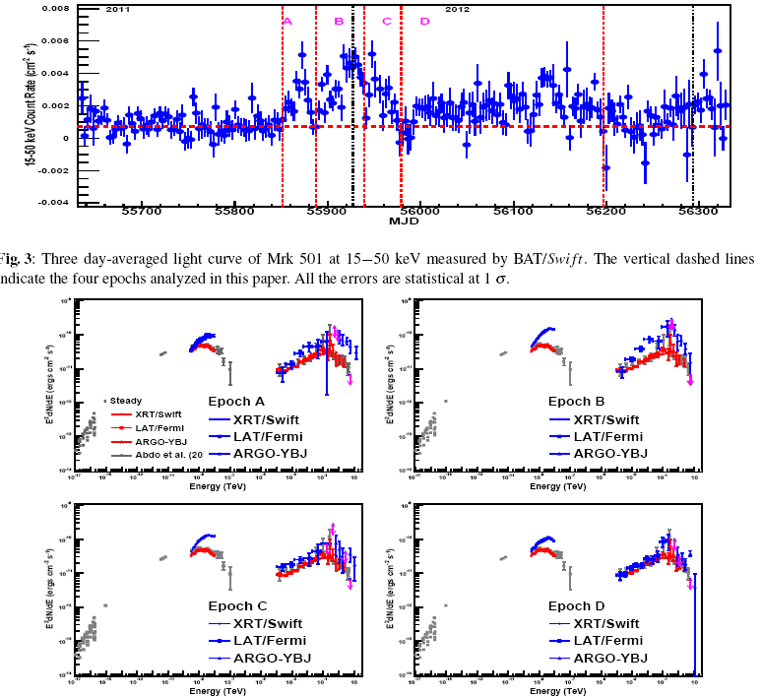
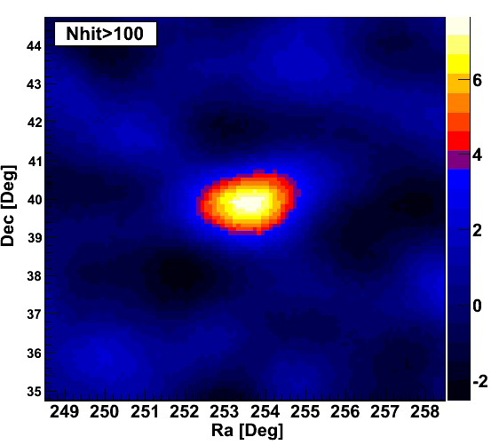
2011flare
S=7.7σ
The evolution
of the Spectrum
during flares
IGMF measurement
Emitting Mechanism

Slide 22
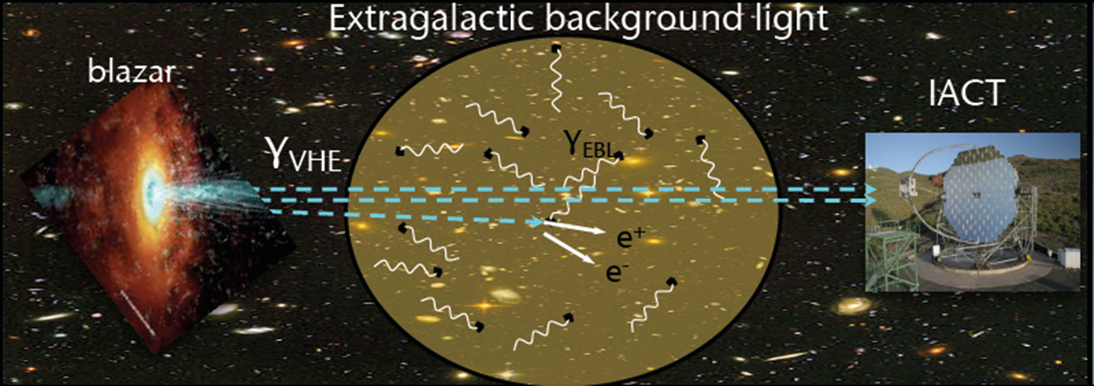
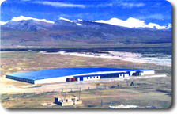
Probing the EBL with VHE gamma-rays
On their way from the AGNs to us, a fraction of the VHE gamma-rays are absorbed by the extragalactic background light (EBL), due to electron-positron pair production.
The imprint on VHE spectra can thus be used to probe the EBL density.
ARGO-YBJ observation on Mrk 501 2011-2012 flare favor least absorption EBL models.

Slide 23
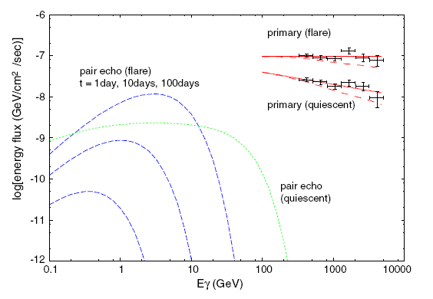
Probing the intergalactic magnetic fields (IGMFs) with VHE gamma-rays
IF IGMF is weak, TeV flare could lead to delay GeV flare. The GeV-TeV observation could be used to constrain IGMF.
According to Takahashi et al.(arXiv:1303.3069), IGMF B < 10^{−20.5} G can be excluded at ∼ 4σ level using long-term, simultaneous Fermi-LAT and ARGO-YBJ observation on Mrk 421.
weak B
IC CMB
Strong B
Takahashi et al. ApJL 744:L7 (2012)

Slide 24
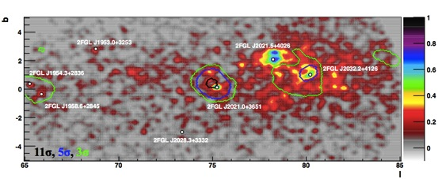
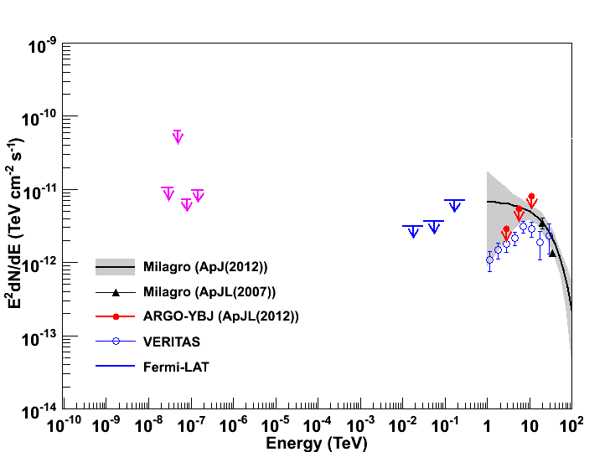
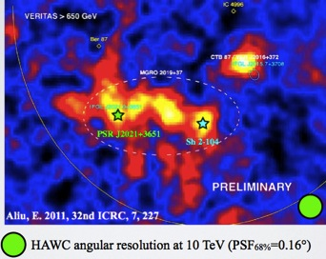
5. Summary of the status
The most fascinating discoveries in TeV gamma ray astronomy
  RXJ 1713: a possible hadronic source
  Fast transient AGNs: PKS 2155-304,Mrk501,…
  Very remote Quasar: 3C279 (z=0.5362)
  Very hard spectrum of very extended source in Cygnus region
  Cygnus Cocoon
  ………
3C279
Science 320, 1752 (2008); MAGIC

Slide 25
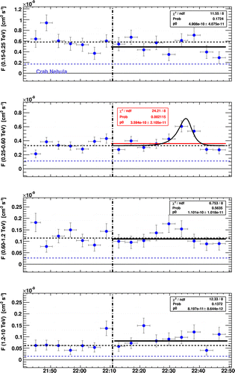
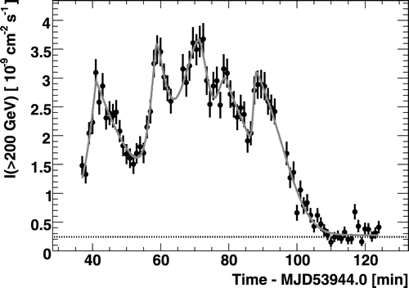
Mrk 501
PKS 2155-304
Aharonian et al. 2007 - H.E.S.S.
Albert et al. 2007 - MAGIC

Slide 26
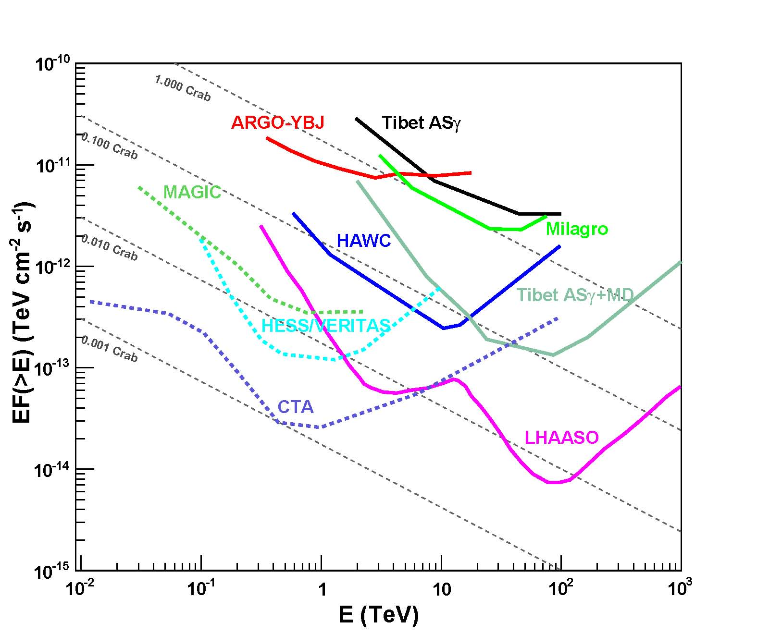
6. lookout
1 yr for Ω ~ 2 sr
Past EAS arrays (before 2014)
Tibet ASr: 1990-2008
Milagro: 1999-2008
ARGO-YBJ: 2006-2013
50~200% Icrab
Currrent EAS arrays (~2014)
Tibet ASr+MD,
HAWC
~10% Icrab
Future EAS arrays (~2018?)
LHAASO
~1% Icrab, 0.3~1000 TeV
50 hrs for single source
Past IACT arrays (before 2014)
few percent of Icrab
Current IACT arrays (~2014)
HEES (I + II)
MAGIC (I + II)
VERITAS (upgraded)
~1% Icrab
Future IACT arrays (~2018?)
CTA
~0.1% Icrab, 10GeV~10 TeV
~100% Icrab
~10% Icrab
~1% Icrab

Slide 27
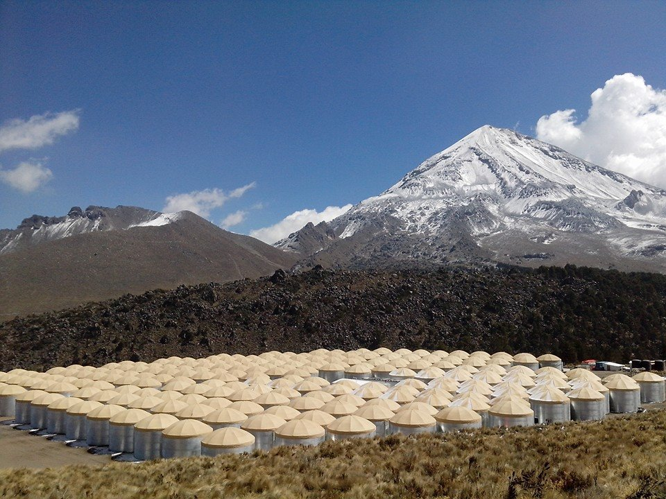
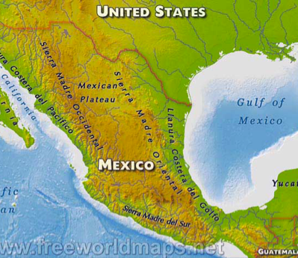
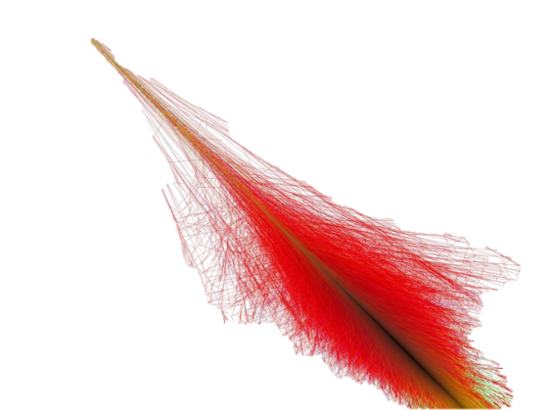
Some Numbers:
Location: 19º north, 97º west (Sierra Negra, Pico de Orizaba, Mexico)
4100 meters a.s.l.
300 detector stations (“tanks”, 7.3m x 4.5m)
Area: ~22,000 m^{2,}
Water volume: ~200,000 l /tank
3rd of the array online (data)
Array complete: 2014
15 x more sensitive than Milagro
petra@mtu.edu

Slide 28
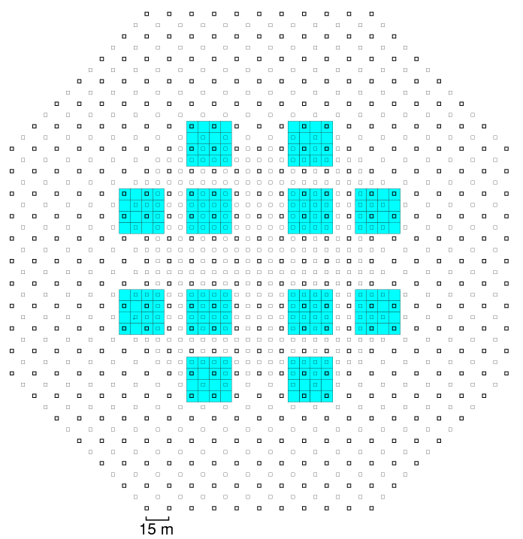
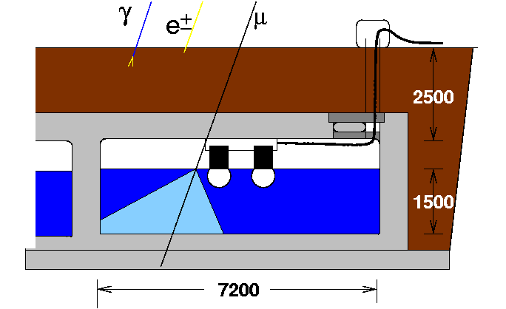
Major Upgrading of Tibet Array: MD
(1/4 century after the array built)
Water Cherenkov type detector
12 concrete pools (10,000 m² in Total)
A concrete pool = 16 water cells
Underground 2.5m (515 g/cm² = 19X₀)
A water cell = 7.2m x 7.2m x 1.5m depth
With two 20”φ PMTs
(HAMAMATSU R3600)
MD ~10,000m²
extends AS to
~83,000m²
Muon data is passively recorded
as an air shower trigger generated
28
Notes:
We are planning to build a water-Cherenkov-type muon detector array around the Tibet AS array as shown the right figure.
Each muon detector is a waterproof as shown in the left figure. The Tibet MD array consists of 240 muon detectors set up 2.5 m underground as shown in this figure. It’s total effective area amounts to be about 10,000 m^2.
We will also would like to extends AS array to 83,000 m^2.
Full Monte Carlo simulation includes all detector responses and data analysis have been done.

Slide 29
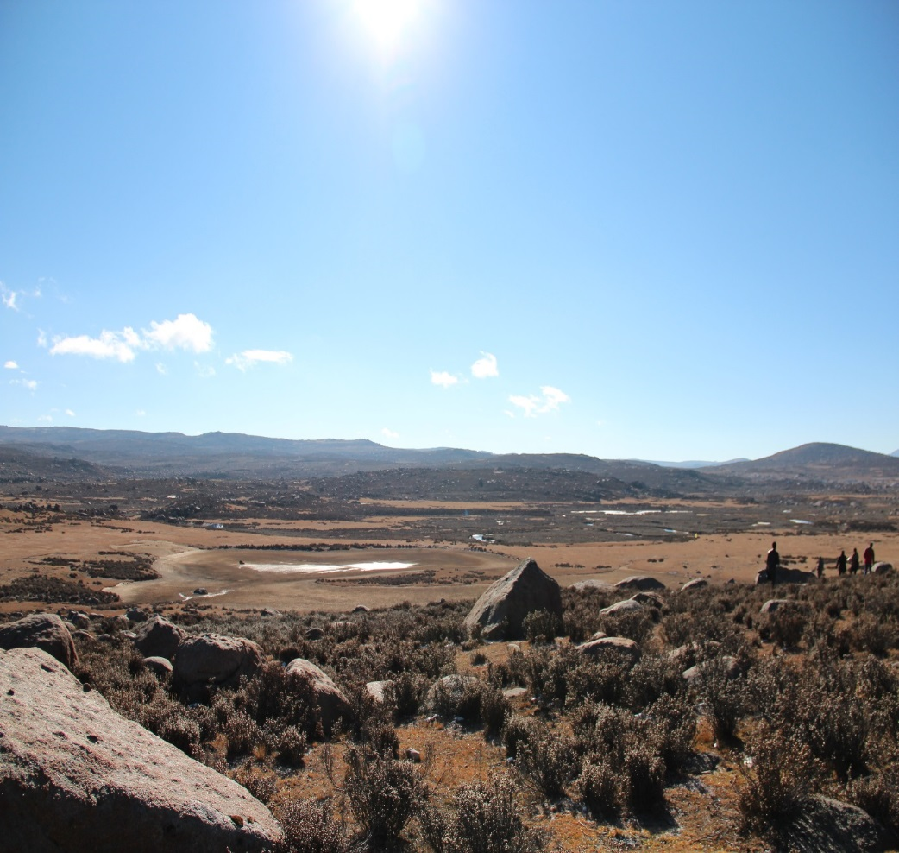
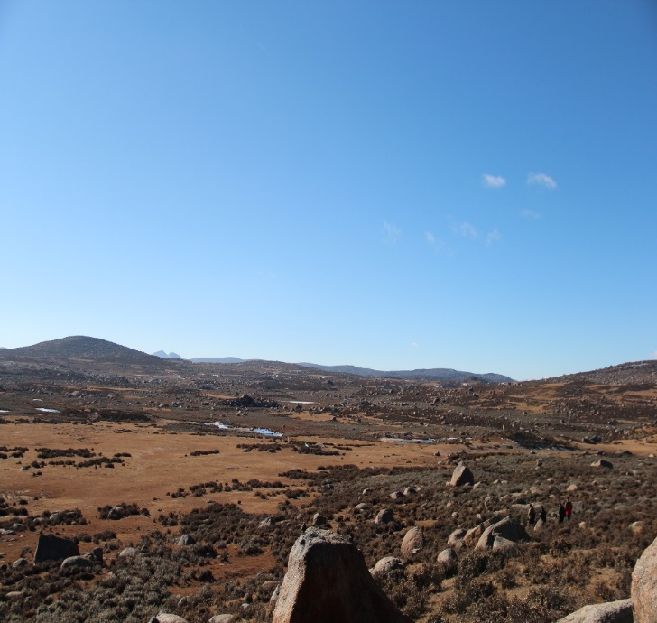
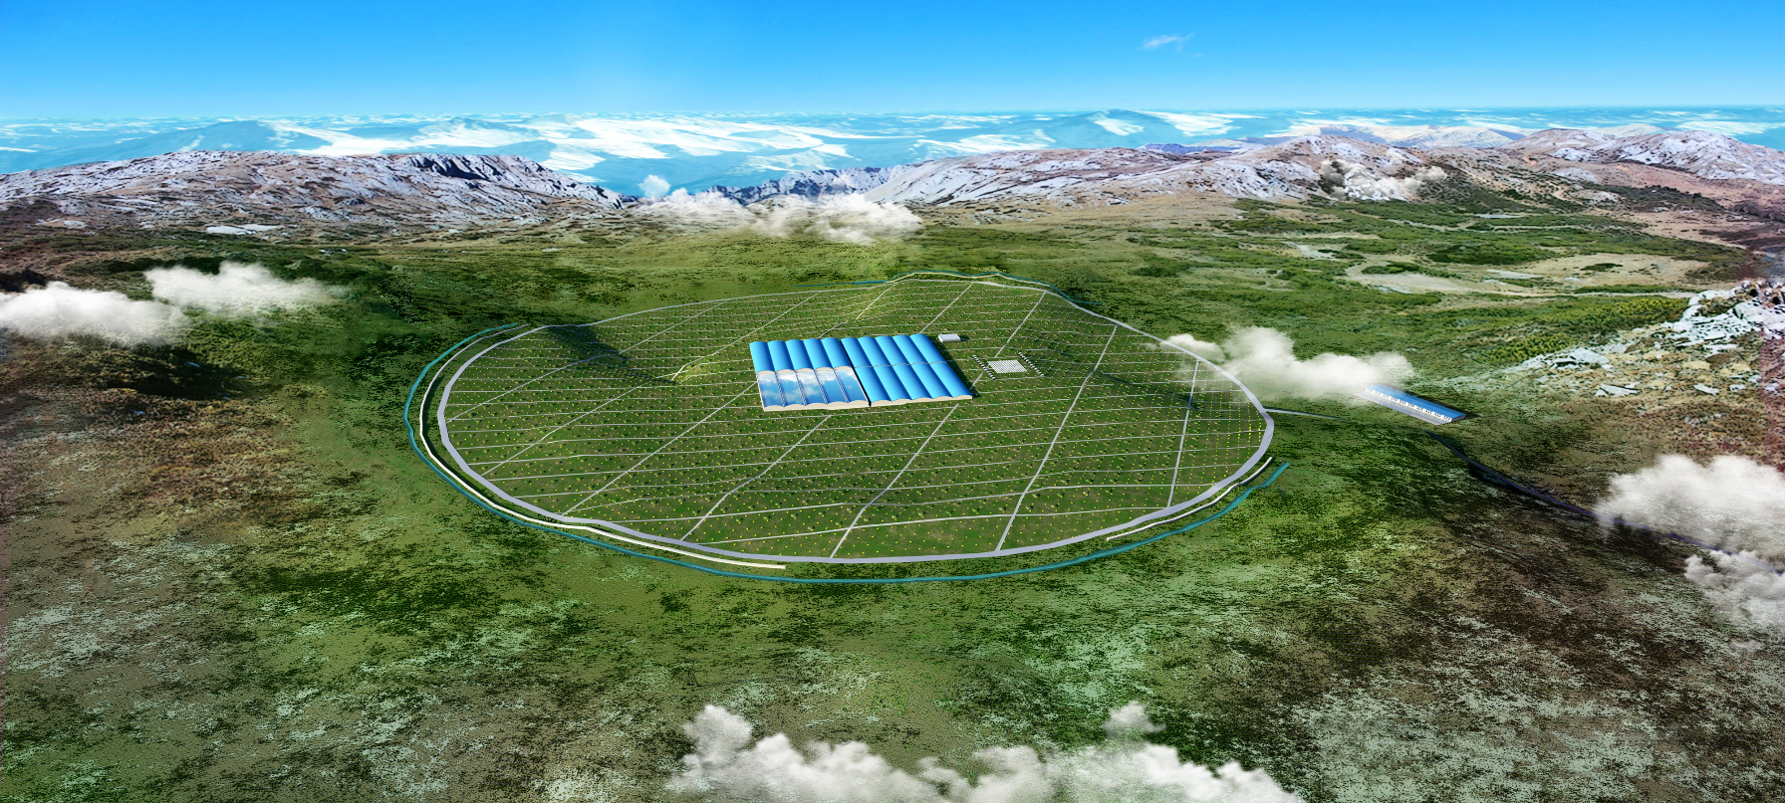
Future: LHAASO Project
LHAASO site

Slide 30
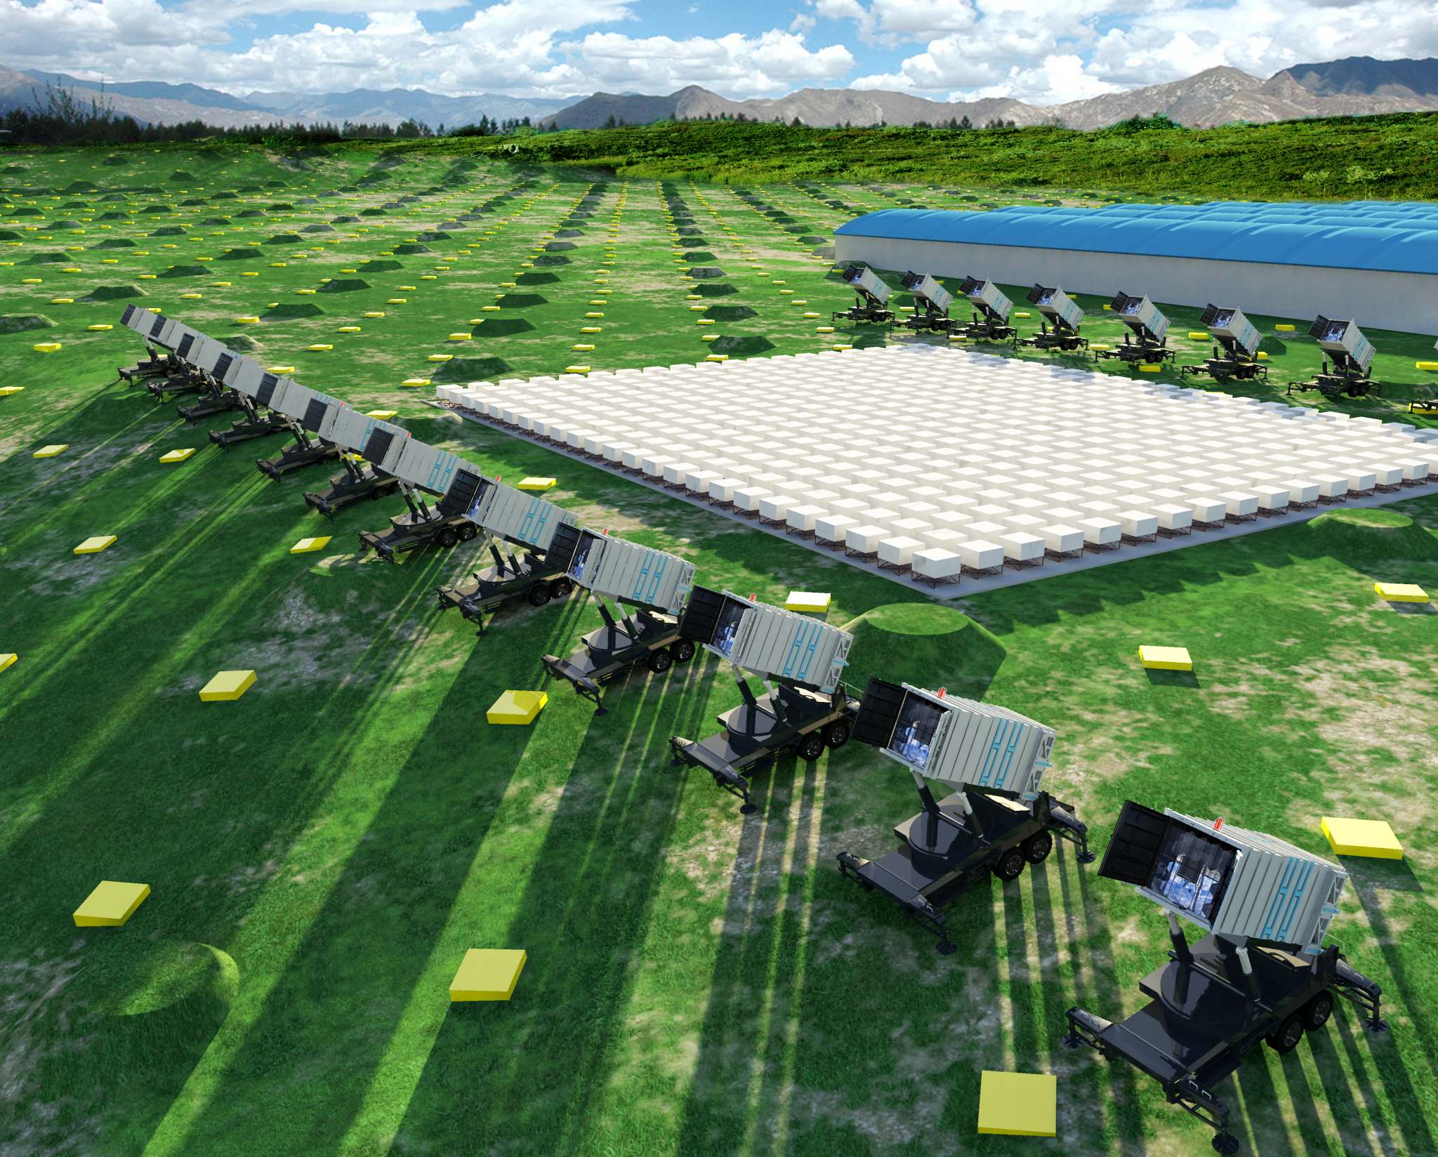
Water Cherenkov Detector
90,000 m²
Central Array：
24 Wide field View Cherenkov telescopes：precision measurement of CR pectrum
452 burst detectors：identification of primary CR species
Plus scintillator detectors every 15 m and μ–detectors every 30 m

Slide 32
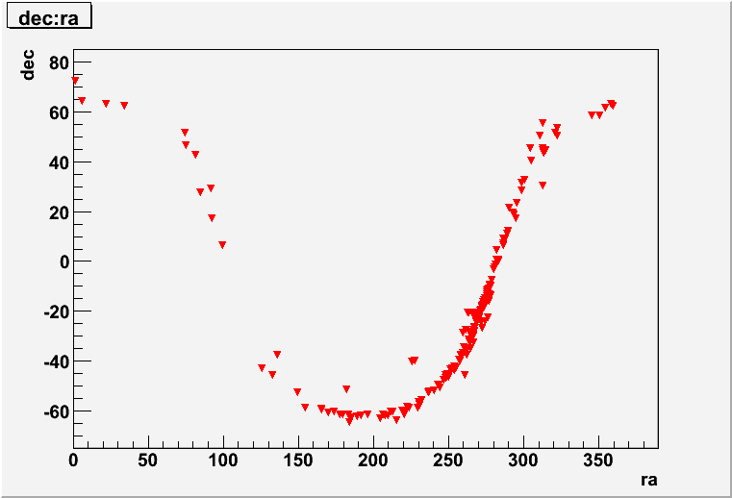

Flavor of future (Conclusion)
Crab Nebula
1000
200
10

