Slide 1
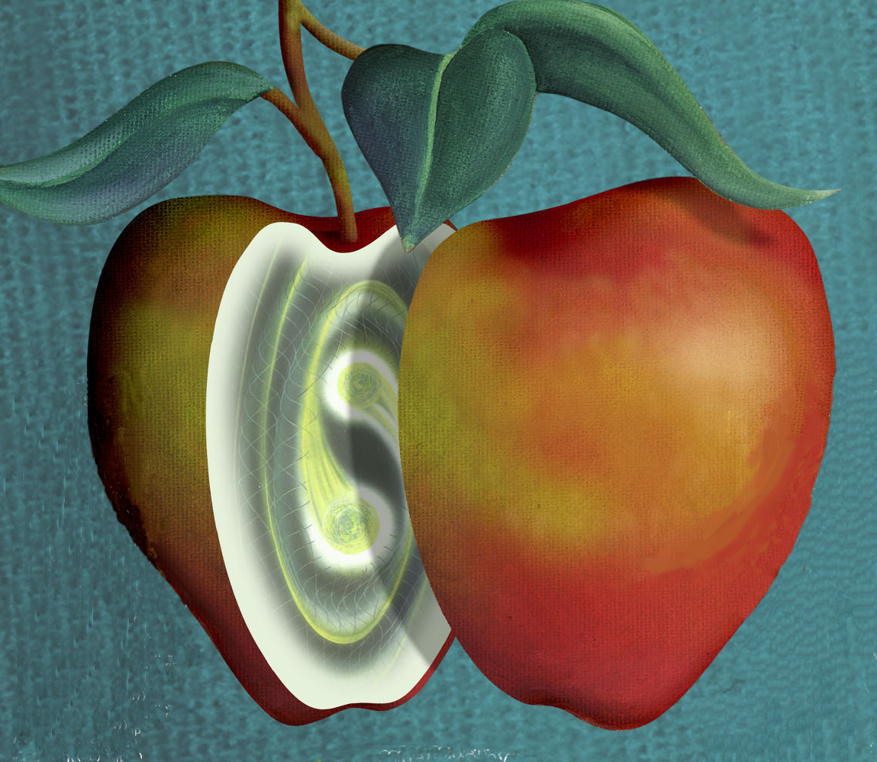
GW
APPIC meeting, Paris 9 May 2014
Eugenio Coccia
U. of Rome “Tor Vergata” and
INFN Gran Sasso Science Institute
Chair, Gravitational Wave International Committee

Slide 2
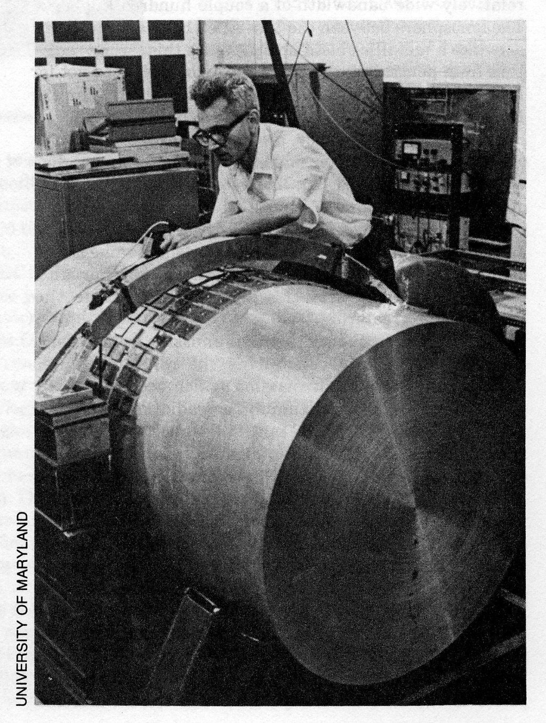
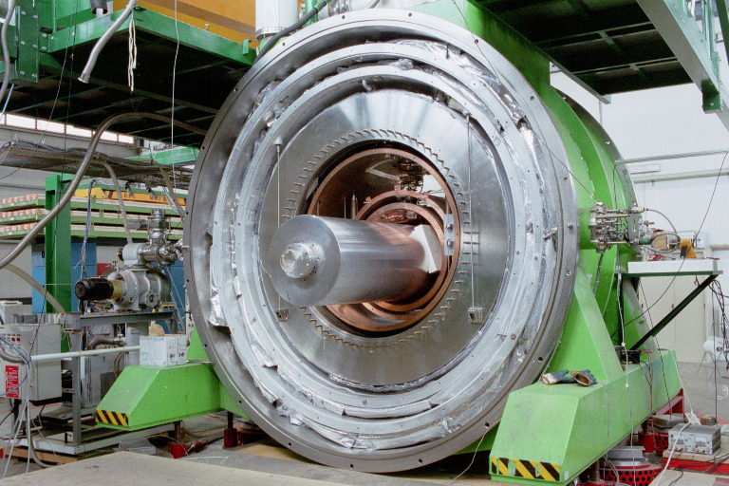
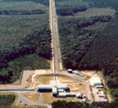
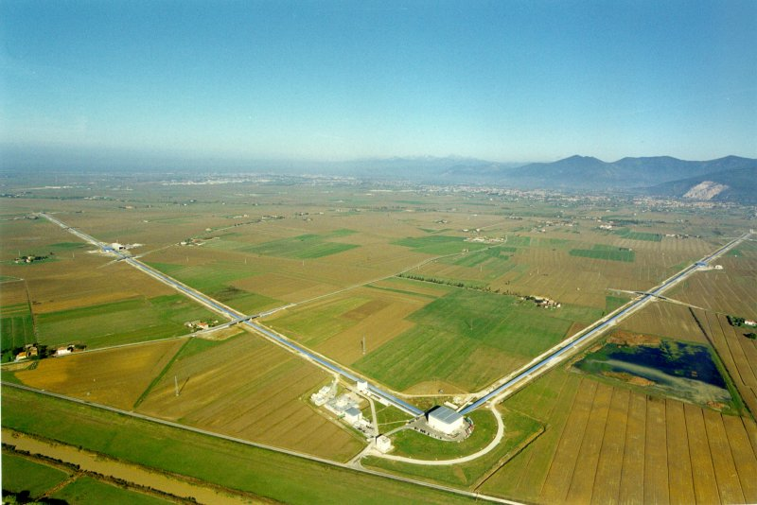
Some perspective: 50 years of attempts at detection:
Since the pioneering work of Joseph Weber in the ‘70, the search for Gravitational Waves has never stopped, with an increasing effort of manpower and ingenuity:
60’: Joe Weber
pioneering work
90’: Cryogenic Bars
1997: GWIC was formed
2000’ - : Large Interferometers
2

Slide 3
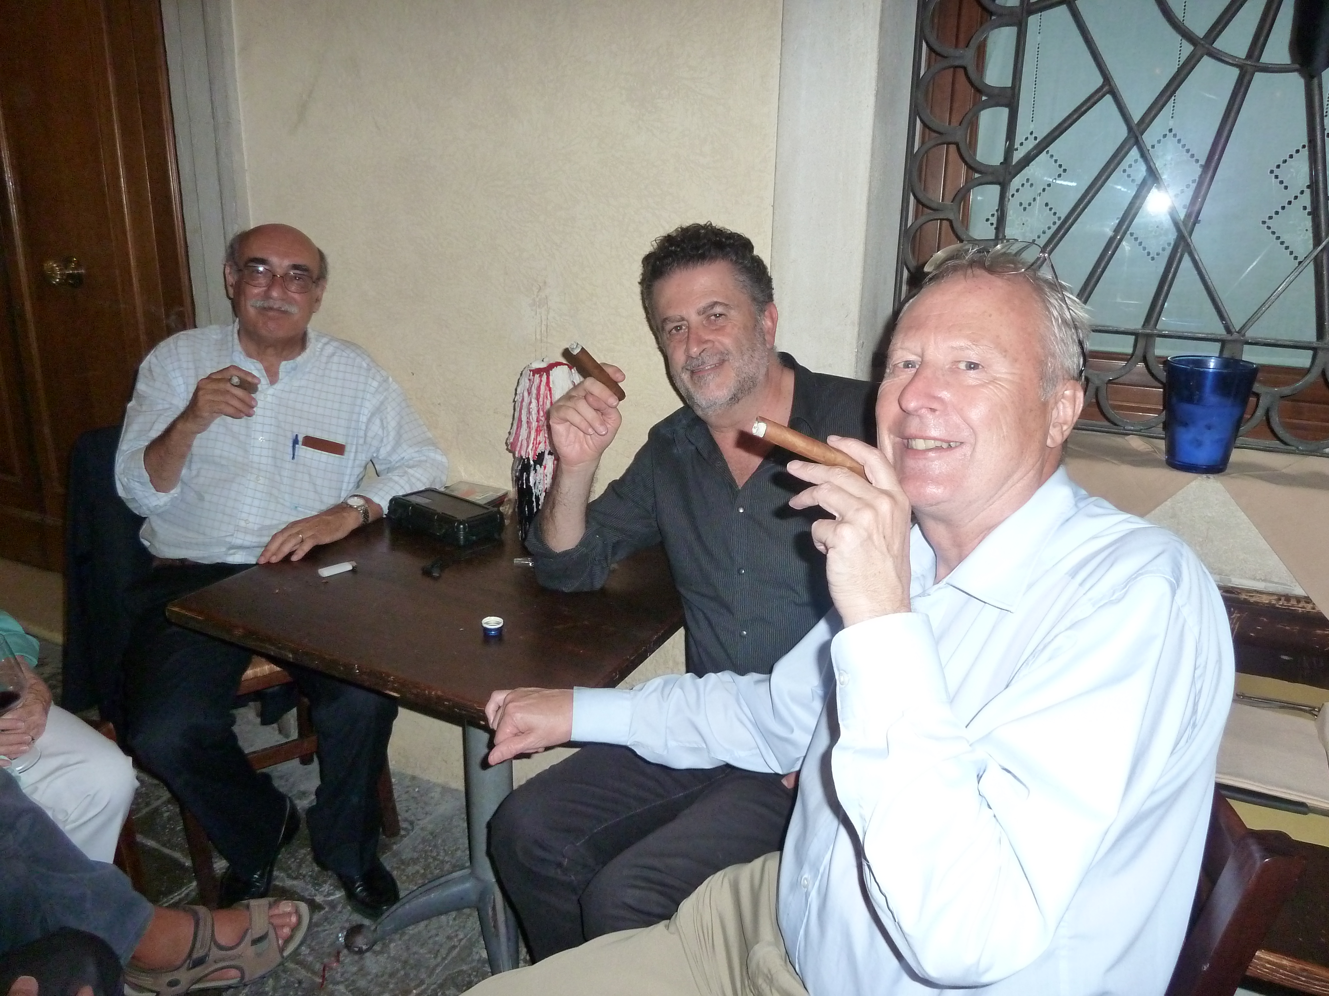
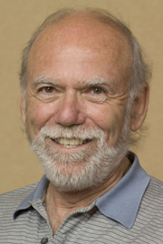
https://gwic.ligo.org/
GWIC is now an IUPAP Working group (WG11)

Slide 4
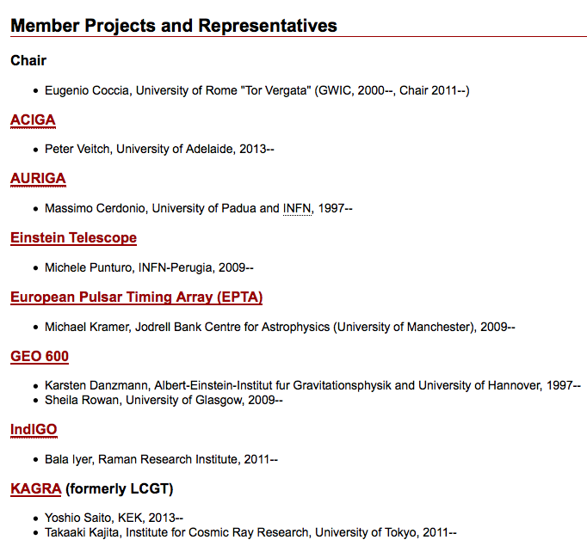
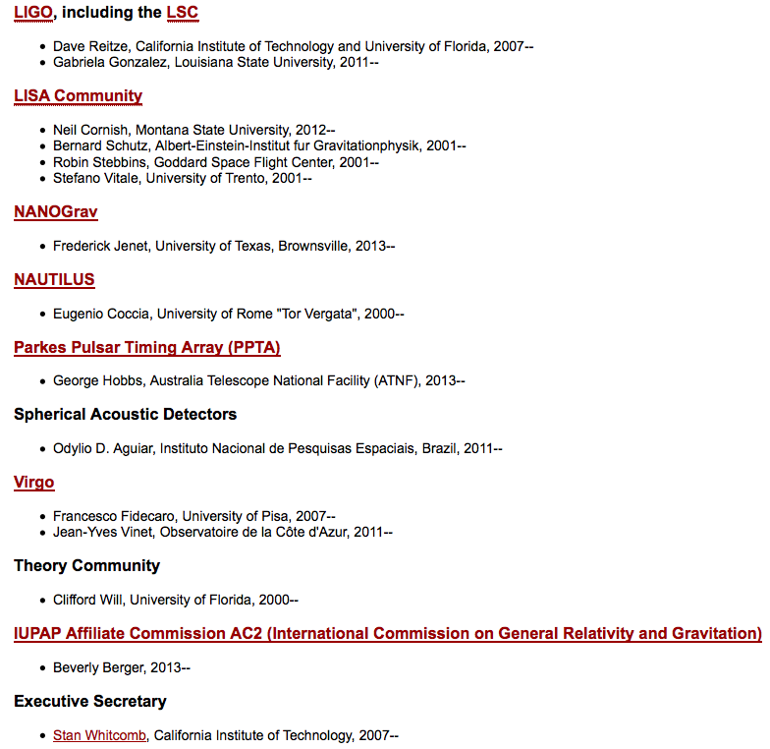

Slide 5
Bars

Slide 6
Results from Initial Detectors: Some highlights from LIGO and Virgo
Virgo
Several ~year long science data runs by LIGO and Virgo Since 2007 all data analyzed jointly
Limits on GW emission from known ms pulsars
Crab pulsar emitting less than 2% of available spin-down energy in gravitational waves
Limits on compact binary (NS-NS, NS-BH, BH-BH) coalescence rates in our local neighborhood (~20 Mpc)
Limits on stochastic background in 100 Hz range
Limit beats the limit derived from Big Bang nucleosynthesis

Slide 7
LIGO-VIRGO recent papers
All sky search for periodic gravitational waves in the full LIGO S5 science data.
Published in Phys.Rev. D85 022001, 2012.
Directional limits on persistent gravitational waves using LIGO S5 science data.
Phys. Rev. Lett. 107:271102, 2011.
Beating the spin-down limit on gravitational wave emission from the Vela pulsar.
Astrophys. J. 737, 93, 2011
Search for Gravitational Wave Bursts from Six Magnetars.
Astrophys. J. 734, L35, 2011.
Search for gravitational waves from binary black hole inspiral, merger and ringdown.
Phys. Rev. D83:122005, 2011.
Search for GW inspiral signals associated with Gamma-Ray bursts during LIGO's fifth and Virgo's first science run.
Astrophys. J. 715:1453-1461, 2010.
Searches for gravitational waves from known pulsars with S5 LIGO data.
Astrophys. J. 713:671-685, 2010.
Search for GW bursts associated with Gamma-Ray bursts using data from LIGO Science Run 5 and Virgo Science Run 1.
The LIGO and the Virgo Collaborations Astrophys. J. 715:1438-1452, 2010.
All-sky search for gravitational-wave bursts in the first joint LIGO-GEO-Virgo run.
Phys. Rev. D81, 102001, 2010
Search for Gravitational Waves from Compact Binary Coalescence in LIGO and Virgo Data from S5 and VSR1.
Phys. Rev. D82, 102001, 2010
An upper limit on the stochastic GW background of cosmological origin
Nature 460, 08278, 2009

Slide 8
Constraints on cosmic (super)strings from the LIGO-Virgo gravitational-wave detectors e-Print: arXiv:1310.2384 [gr-qc] |
First Searches for Optical Counterparts to Gravitational-wave Candidate Events e-Print: arXiv:1310.2314
A directed search for continuous Gravitational Waves from the Galactic Center e-Print: arXiv:1309.6221 [gr-qc] |
A search for long-lived gravitational-wave transients coincident with long gamma-ray bursts e-Print: arXiv:1309.6160 [astro-ph.HE]
Gravitational waves from known pulsars: results from the initial detector era e-Print: arXiv:1309.4027 [astro-ph.HE]
Prospects for Localization of GW Transients by the Advanced LIGO and Advanced Virgo Observatories e-Print: arXiv:1304.0670 [gr-qc]
Parameter estimation for compact binary coalescence signals with the first generation GW detector network LIGO and Virgo Collaborations (J. Aasi (Caltech) et al.). Apr 5, 2013. 23 pp. Phys.Rev. D88 (2013) 062001
Search for GW from Binary Black Hole Inspiral, Merger and Ringdown in LIGO-Virgo Data from 2009-2010 Phys.Rev. D87 (2013) 022002
Einstein@Home all-sky search for periodic gravitational waves in LIGO S5 data Phys.Rev. D87 (2013) 4, 042001

Slide 9
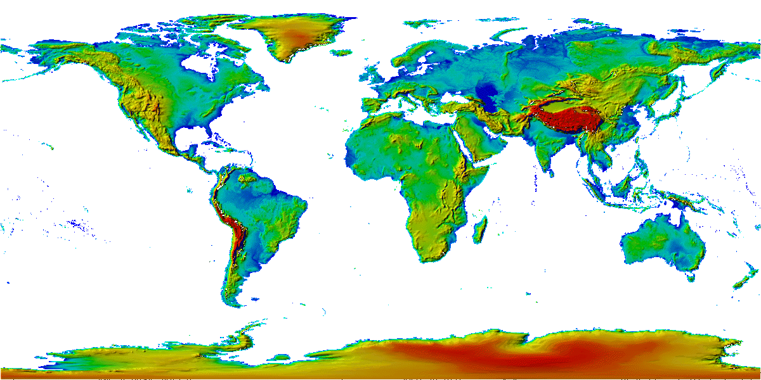
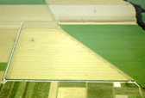
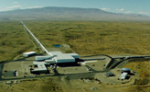
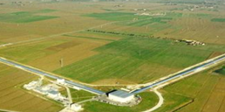
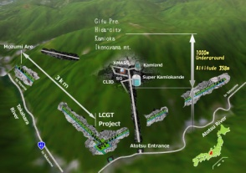
The Advanced GW Detector Network
GEO600 (HF)
Advanced LIGO
Hanford
KAGRA
Advanced LIGO
Livingston
Advanced
Virgo
LIGO-India
9
9

Slide 10
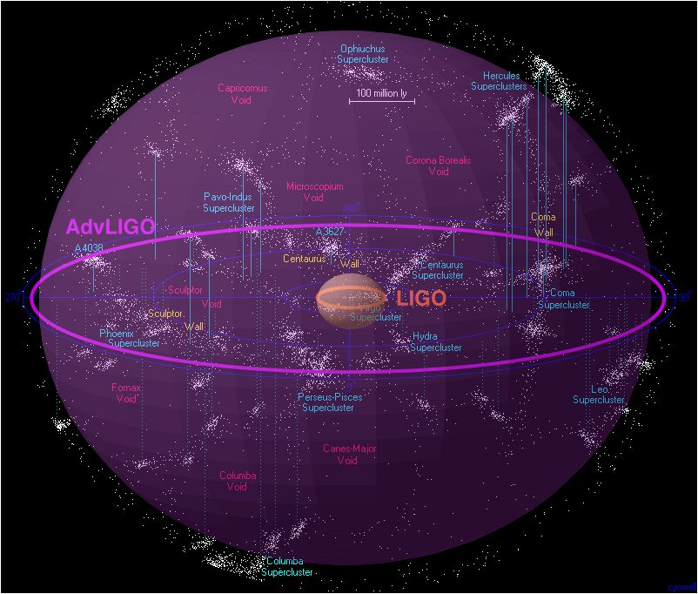
2nd GENERATION: DISCOVERY AND ASTRONOMY
2nd generation detectors:
Advanced Virgo, Advanced LIGO
Enhanced LIGO/Virgo+
2009
Virgo/LIGO
GOAL:
sensitivity 10x better →
look 10x further →
Detection rate 1000x larger
10⁸ ly
NS-NS detectable as far as 300 Mpc
BH-BH detectable at cosmological distances
10s to 100s of events/year expected!
Adv. Virgo/Adv. LIGO
2014
Credit: R.Powell, B.Berger

Slide 11
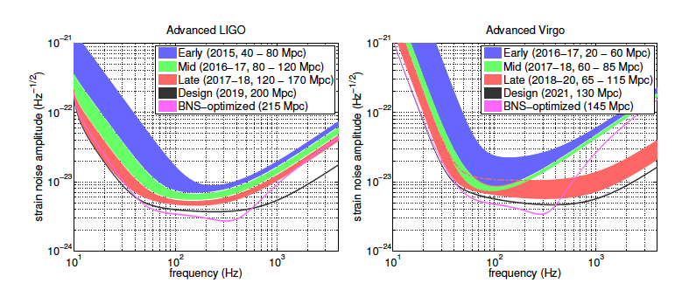
Plausible scenario
for the operation of the LIGO-Virgo network over the next decade

Slide 13
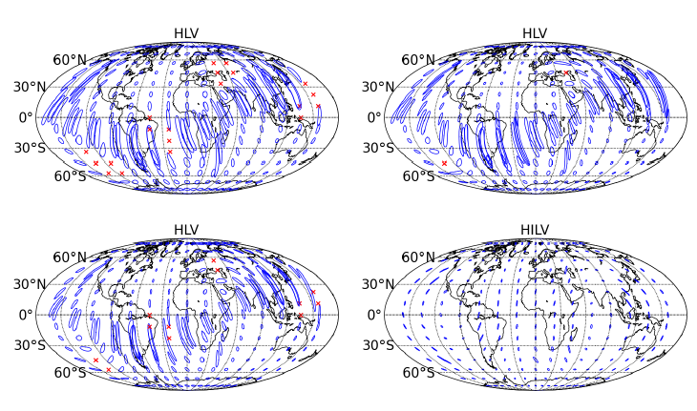
2016/17
2017/18
80 Mpc
2019+
160 Mpc
2022+
Localization expected for a BNS system
The ellipses show 90% confidence localization areas, and the red crosses show
regions of the sky where the signal would not be condently detected.

Slide 14
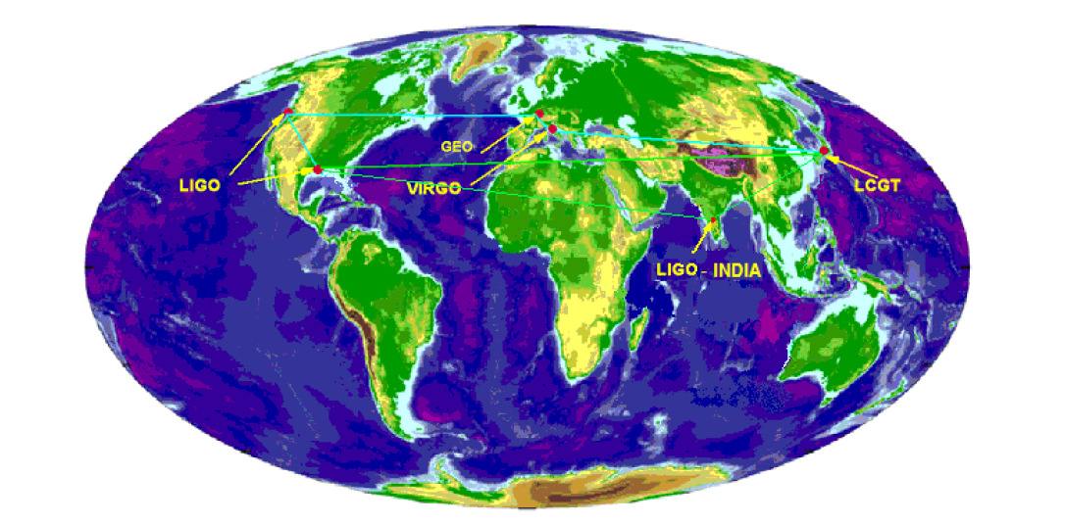
We are on the threshold of a new era of gravitational wave astrophysics
First generation detectors have broken new ground in optical sensitivity
Initial detectors have proven technique
Second generation detectors are starting installation
Will expand the “Science” (astrophysics) by factor of 1000
In the next decade, emphasis will be on the NETWORK

Slide 15
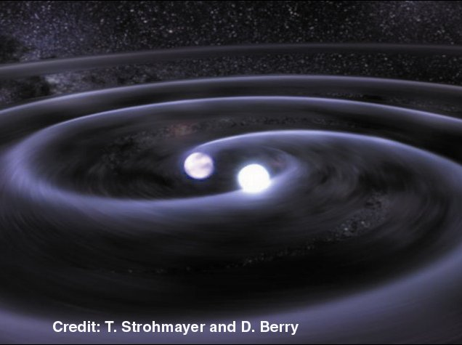
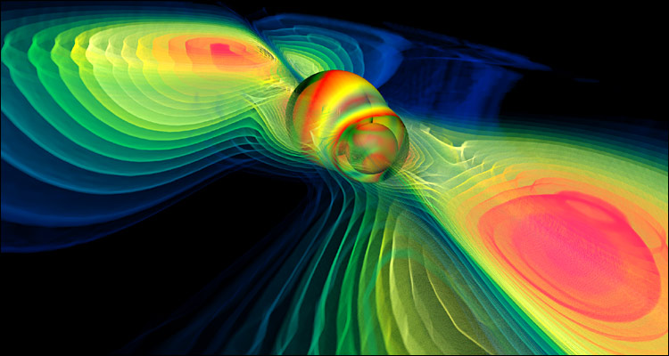
THE GLOBAL PLAN
Advanced Detectors (LIGO, VIRGO +) will initiate gravitational wave astronomy through the detection of the most luminous sources - compact binary mergers.
Third Generation Detectors (ET and others) will expand detection horizons and provide new tools for extending knowledge of fundamental physics, cosmology and relativistic astrophysics.
Observation of low frequency gravitational wave with LISA/NGO will probe the role of super-massive black holes in galaxy formation and evolution

Slide 16
MoU LSC-Virgo Purpose of agreement:
The purpose of this Memorandum of Understanding (MOU) is to establish and define a collaborative relationship between VIRGO on the one hand and the Laser Interferometer Gravitational Wave Observatory (LIGO) on the other hand in the use of the VIRGO, LIGO and GEO detectors based on laser interferometry to measure the distortions of the space between free masses induced by passing gravitational waves.
We enter into this agreement in order to lay the groundwork for decades of world-wide collaboration. We intend to carry out the search for gravitational waves in a spirit of teamwork, not competition. Furthermore, we remain open to participation of new partners, whenever additional data can add to the scientific value of the search for gravitational waves. All partners in the collaborative search should have a fair share in the scientific governance of the collaborative work.
Among the scientific benefits we hope to achieve from the collaborative search are: better confidence in detection of signals, better duty cycle and sky coverage for searches, and better source position localization and waveform reconstruction. In addition, we believe that the intensified sharing of ideas will also offer additional benefits.

Slide 17
3. This agreement governs cooperative scientific work between VIRGO and LIGO. The terms governing work on data analysis are exclusive; that is, the parties agree that all of the data analysis work that they do will be carried out under the framework of this agreement. The terms governing other forms of collaborative work are not exclusive; they may, in addition, make agreements with other parties that are not governed by this agreement, as long as such agreements do not involve sharing of data.
4. The agreement described herein represents a scientific collaboration between independent projects, not a merger. Each project will maintain its own separate governance. Decisions on issues that bear on collaborative work will be made in discussion among the leadership of the projects, each representing their Collaborations’ position as determined according to their own governing structures.
5. Goals for joint data analysis will be proposed by LSC/Virgo collaboration Joint Data Analysis Groups, will be discussed jointly by both Collaborations and will be approved by each Collaboration according to their own governing structures. The specific mechanisms for the coordination of the data analysis activities are described in an Attachment to this MOU.

Slide 18
6. After the data sharing provisions of this agreement go into effect, all subsequent observational data will be open to both collaborations, to be used in the framework of Joint Data Analysis Groups on all gravitational wave analysis topics. All gravitational wave data analysis will be carried out under the umbrella of this agreement between LIGO and VIRGO; there will be no LSC-only or Virgo-only gravitational wave data analyses while this agreement remains in force. (However, each collaboration may use its own environmental data freely, outside the framework of this agreement.)
Nevertheless, the LSC and the Virgo collaboration each reserve the right to maintain independent pipelines to carry out any data analysis problem.
After the data sharing provisions of this agreement go into effect, all subsequent collaborative data analysis work with projects other than LIGO or VIRGO will be negotiated by and carried out by the LSC and VIRGO together; prior agreements will remain in force automatically only for data collected earlier.

Slide 19
Organization of joint data analysis:
11. All data analysis activities will be open to all members of the LSC and Virgo Collaborations, in a spirit of cooperation, open access, full disclosure and full transparency with the goal of best exploiting the full scientific potential of the data.
Data analysis projects and activities will be organized in joint Analysis Groups, comprising members of the LSC and Virgo. Every data analysis project must be affiliated with at least one of the Analysis Groups.
Participation in the Analysis Groups will be open. Instrument experts will be active members of all Analysis Groups and Review Committees, to ensure appropriate use and interpretation of the data.
All data and their interpretation will be held strictly within the membership of the Collaborations until the review processes outlined below are complete and both Collaborations have given their permission for public release. This is to be interpreted that no discussion of results or pre-prints may take place with scientists who are not members of the Collaborations or with members of the media, until the leaderships of the Collaborations have approved the release of the information.

Slide 21
Open Questions for Multimessenger Observations
What is the speed of gravitational waves?
(subluminal or superluminal?)
Can gravitational wave detectors provide an early warning to electromagnetic observers?
(to allow the detection of early light curves?)
What is the precise origin of SGR flares?
(what is the mechanism for GW and EM emission and how are they correlated?)
What happens in a core collapse supernova before the light and neutrinos escape?
Are there electromagnetically hidden populations of GRBs?
What GRB progenitor models can we confirm or reject?
Is it possible to construct a competitive Hubble diagram based on gravitational wave standard sirens?
Nelson Christensen, Moriond – LIGO -G1100392

Slide 26
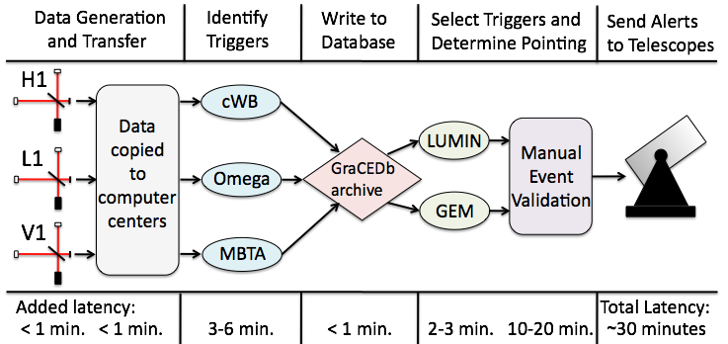
Low Latency EM Follow-Up Program
Subthreshold candidate GW events sent to partner ~meter class telescopes network
Target alert rate of 1 per week
Ran during parts of most recent science runs Dec 2009-Jan 2010 and Sep to Oct 2010
Images obtained for 8 different events
Astronomy & Astrophysics
539 (2012)A124
Astronomy & Astrophysics
541 (2012)A155

Slide 27
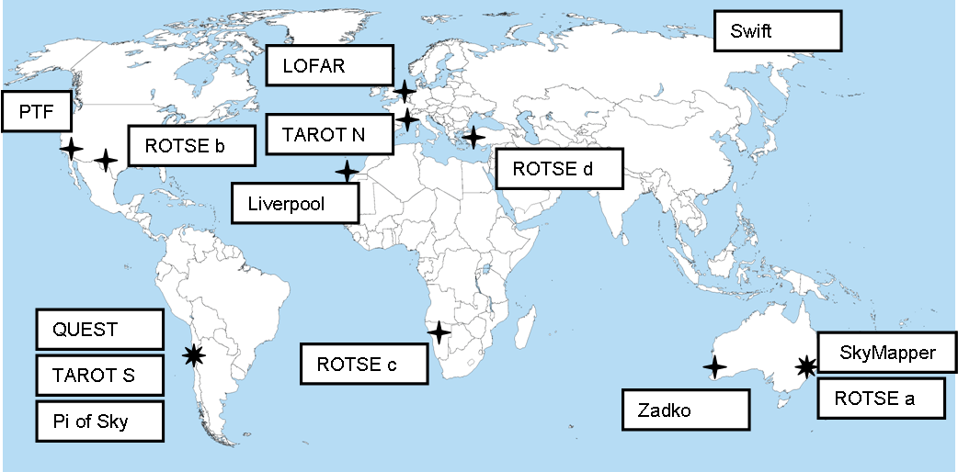
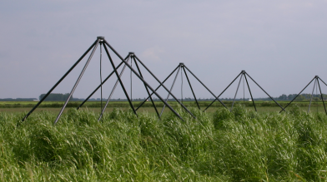
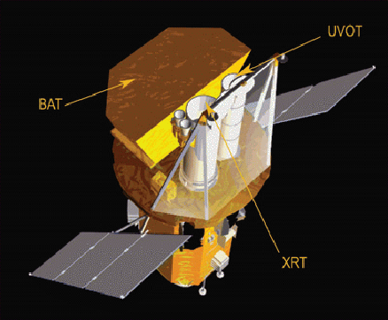
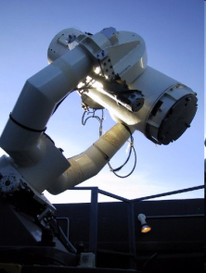
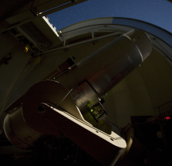
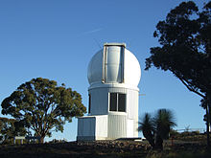
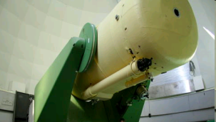
Telescope Network
Used in winter and autumn run
autumn run only

Slide 28
Nelson Christensen, Moriond – LIGO -G1100392

Slide 29
http://www.ligo.org/science/GWEMalerts.php.

Slide 30
LSC AND VIRGO POLICY ON RELEASING GRAVITATIONAL WAVE TRIGGERS TO THE PUBLIC IN THE ADVANCED DETECTORS ERA
The LSC and Virgo recognize the great potential benefits of multi-messenger observations, including rapid electromagnetic follow-up observations of GW triggers. Both Collaborations (the LSC and Virgo) will partner with astronomers to carry out an inclusive observing campaign for potentially interesting GW triggers, with MoUs to ensure coordination and confidentiality of the information. They are open to all requests from interested astronomers or astronomy projects which want to become partners through signing an MoU. They encourage colleagues to help set up and organize this effort in an efficient way to guarantee the best science can be done with gravitational wave triggers.
After the published discovery of gravitational waves with data from LSC and/or Virgo detectors, both the LSC and Virgo will begin releasing especially significant triggers promptly to the entire scientific community to enable a wider range of follow-up observations. This will take effect after the Collaborations have published papers (or a paper) about 4 GW events, at which time a detection rate can be reasonably estimated. The releases will be done as promptly as possible, within an hour of the detected transient if feasible. Initially, the released triggers will be those which have an estimated false alarm rate smaller than 1 per 100 years.

Slide 31
Partners who have signed an MoU with the LSC and Virgo will have access to GW triggers with a lower significance threshold and/or lower latency, according to the terms of the MoU, in order to carry out a more systematic joint observing campaign and combined interpretation of the results.
Throughout the Advanced Detectors era, the LSC and Virgo will release appropriate segments of data from operating detectors corresponding to detected gravitational waves presented in LSC/Virgo authored publications, at the time of the publication, including the first claimed detection of gravitational waves.

Slide 35
Neutrinos meet GravitationalWaves: Preparing for the Next Nearby Core-Collapse Supernova
Memorandum of Understanding among the Borexino Collaboration, the IceCube Collaboration, the LVD Collaboration and the LIGO Scientific and VIRGO Collaborations
In proceeding with this work, we propose two phases:
Phase 1 (lasting 1 year and requiring 2 FTE spread over multiple contributors) will focus on the preparation for the, near/sub-threshold scenario. As an exercise, we propose to re-analyze archival data of neutrino andGWdetectors from 2005 to 2010. We will aim for a conservative false alarm rate of 1/1000 years and consider two (or more) neutrino candidate events in 20-second temporal coincidence with significant GW triggers.
The results of this proof-of-principle joint analysis will be presented to the participating collaborations who will decide on the publication of a joint paper.

Slide 36
In Phase 2, (lasting 2 years and spreading 2 FTE spread over multiple contributors) based on the experience gained in Phase 1, we will prepare for joint
deep searches and integrate low-latency neutrino and GW triggering through the SuperNova EarlyWarning System (SNEWS) in the advanced GW detector era. We will also prepare for the nearby, high-statistics scenario (2) by developing integrated neutrino and GW parameter estimation approaches that will allow determination of core-collapse supernova physics by combining neutrino and GW information.
The details of data access, working group organization, membership and paper publication will be specified at a later time through a Memorandum of Understanding (MoU) among participants. In general, we expect any data exchanged as part of this effort to be analyzed only for the purpose of carrying out the joint scientific goals outlined in this proposal. No sharing of these data (in raw or derived form) outside the joint working group will be permitted.

Slide 37
http://www.ligo.caltech.edu/gwodw2011/

Slide 38
https://docs.google.com/spreadsheet/viewform?formkey=dFJuS1d4UlNiLW9Wdm5OQTJKWFE4ekE6MQ

