Slide 1
DAQ for SuperNEMO
1. DAQ-Middleware
2. CANDLES setup
3. Demonstration
4. SuperNEMO setup
21st, Feb, 2014
K. Suzuki

Slide 2
Review of DAQ-Middleware
DAQ-Middleware
Operator: organizer of DAQ
Component: source(out-port), sink(in-port), both type
We can develop Operator and Components.
Source: Reader of front end modules
Both: Event manager
Sink: Logger, Monitor
Operator: control state of each components, get error information
Operator
Source
both
Sink

Slide 3
Review of DAQ-Middleware
DAQ state
LOADED
CONFIGURED
RUNNING
PAUSED
DAQ command
0 LOADED->CONFIGURED
1 CONFIGURED->RUNNING
2 RUNNING->CONFIGURED
3 CONFIGURED->LOADED
4 RUNNING->PAUSED
5 PAUSED->RUNNING
DAQ Middleware state machine
Launch up DAQ
LOADED
daq_configure()
0
3
daq_unconfigure()
CONFIGURED
daq_start()
1
2
daq_stop()
daq_run()
RUNNING
Repeat
daq_pause()
4
5
daq_resume()
PAUSED

Slide 4
Review of DAQ-Middleware
DAQ-Middleware State Machine
daq_configured():
Configuration
daq_unconfigured():
daq_start():
Initialize
daq_stop():
Finalize
daq_paused():
daq_resume():
daq_run():
Data taking
DAQ Middleware state machine
Launch up DAQ
LOADED
daq_configure()
daq_unconfigure()
CONFIGURED
daq_start()
daq_stop()
daq_run()
RUNNING
Repeat
daq_pause()
daq_resume()
PAUSED

Slide 5
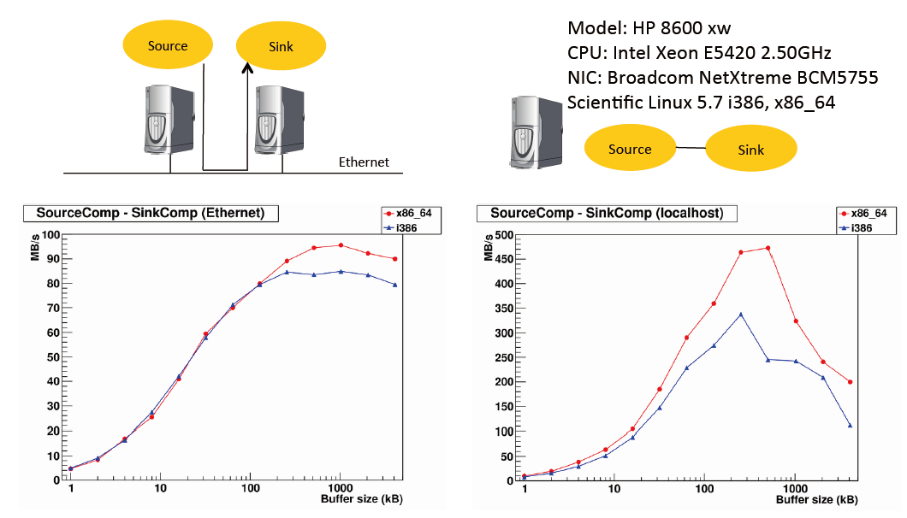
Review of DAQ-Middleware
DAQ-Middleware Speed
Reprinting form DAQ Middleware homepage

Slide 6
CANDLES setup
FastReader: read data from FADCs
SlowReader: read H.V. and Temperature data
EventManeger: order event sequentially, sneak slow data
Logger: record data to hard disk
EventServer: event service (use monitor system with EventClient)
Operator
FastReader
FastReader
Logger
FastReader
EventManeger
Dispatcher
SlowReader
EventServer
Socket connection
EventClient

Slide 7
Demonstration of DAQ-Middleware
Emulator: send data to EventServer
EventServer: send data to EventClient
EventClient: analyze and draw histograms
Commander: send command to Operator & receive data from Operator
Commander
Socket connection
Operator
Emulator
EventServer
Socket connection
EventClient

Slide 8
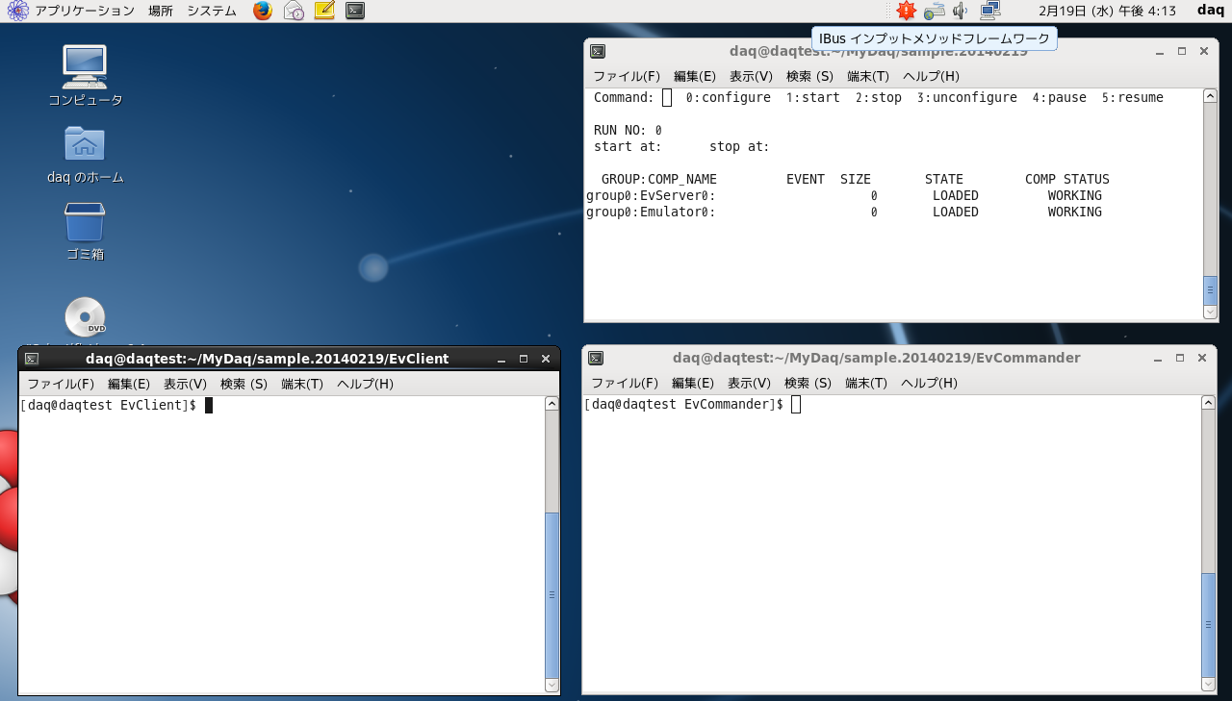
Demonstration of DAQ-Middleware
To start DAQ, execute run.py script ($> run.py –cl sample.xml)
Operator screen

Slide 9
Demonstration of DAQ-Middleware
To change DAQ state, input command 0-5 into terminal
Input 0-5 command
(Commander can connect
to Operator)
EventClient can connect
to EventServer anytime

Slide 10
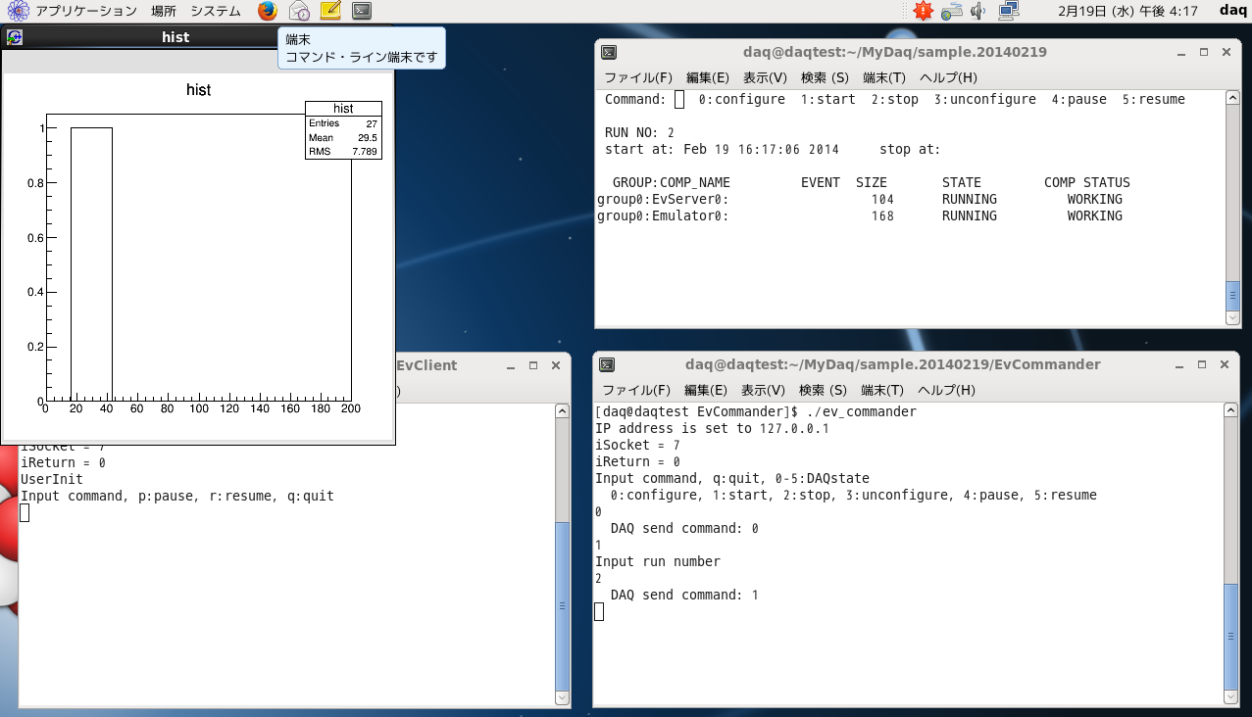
Demonstration of DAQ-Middleware
Connect Commander and EventClient

Slide 11
SuperNEMO setup
Control Operator (start, stop…)
DAQ information (state, errors)
How to launch DAQ-Middleware? (Python script launch DAQ-Middleware)
How to kill DAQ-Middleware? (it need to kill Operator job)
OnlineMonitor?
SlowControl
Operator
Source
both
Sink

Slide 12
SuperNEMO setup
daq_configure()
parameter setting
connect to front-end modules
daq_unconfigure()
disconnet
daq_start()
initialize
daq_stop()
finalize
daq_run()
data taking
daq_pause()
daq_resume()
DAQ Middleware state machine
LOADED
daq_configure()
daq_unconfigure()
CONFIGURED
daq_start()
daq_stop()
daq_run()
RUNNING
Repeat
daq_pause()
daq_resume()
PAUSED

