Slide 1
MAPS for ALICE Upgrade and Beyond
Frédéric Morel (on behalf of PICSEL and ALICE teams of IPHC Strasbourg)
Outline
Starting point: STAR-PXL
MISTRAL and ASTRAL: general description
MISTRAL upstream: description and test results
ASTRAL upstream: description and test results
MISTRAL and ASTRAL downstreams (SUZE): description and test results
Conclusions
Perspectives for MAPS

Slide 2
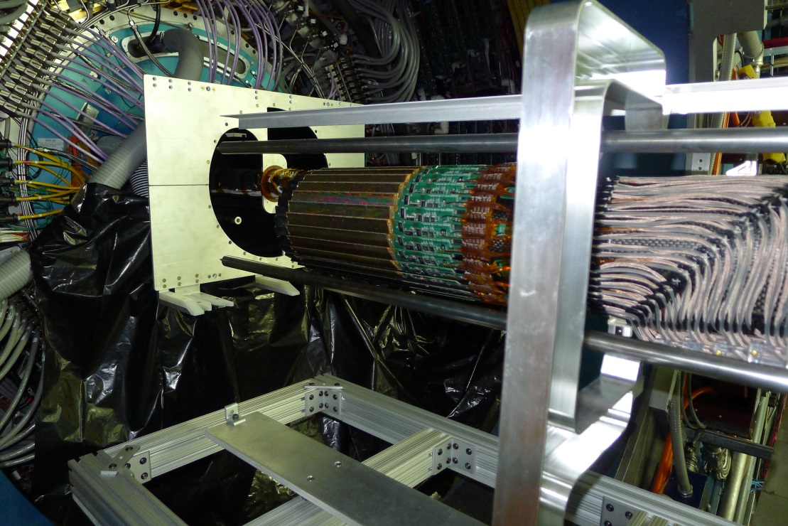
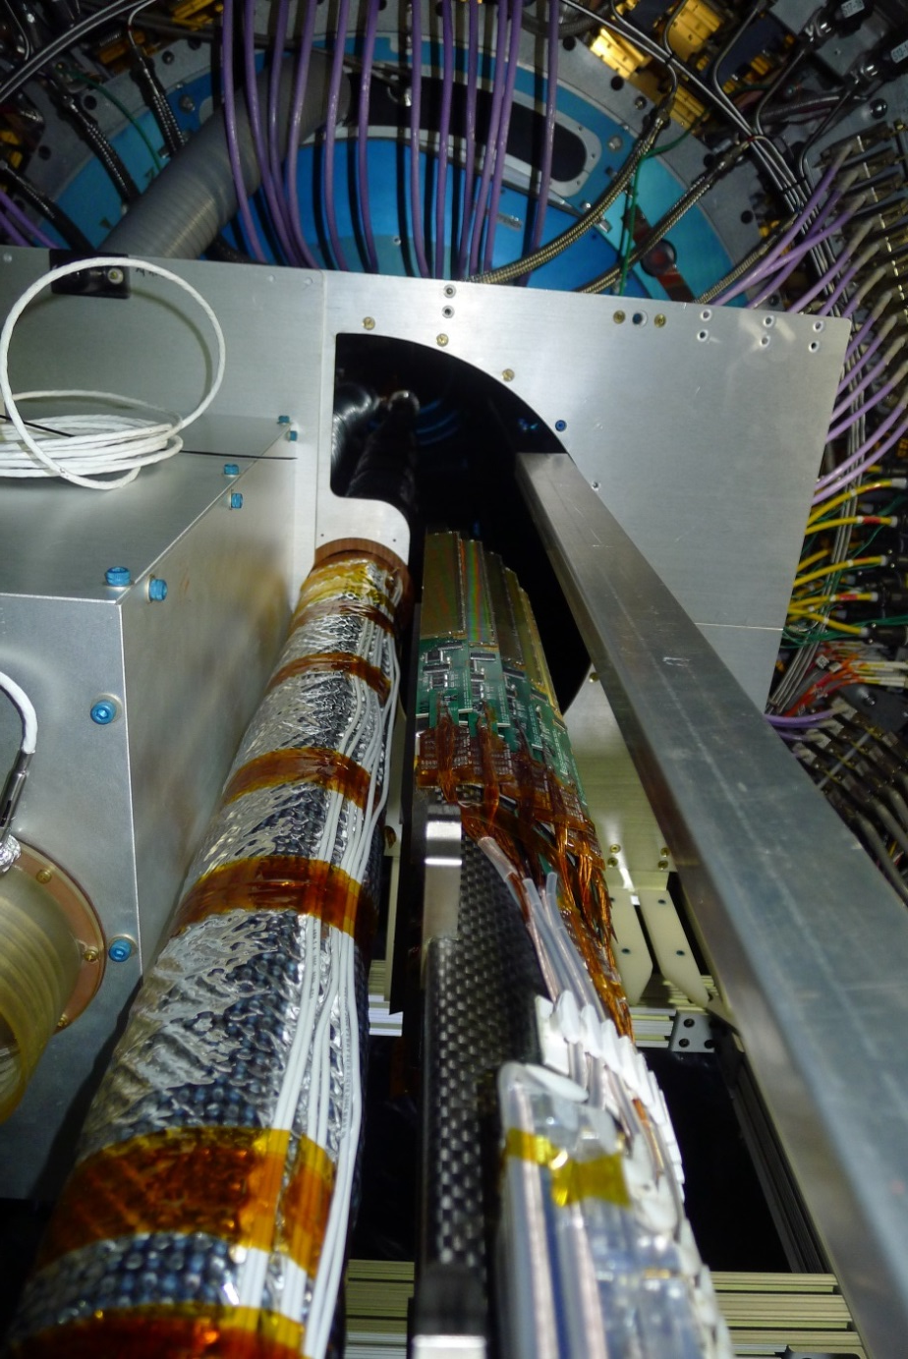
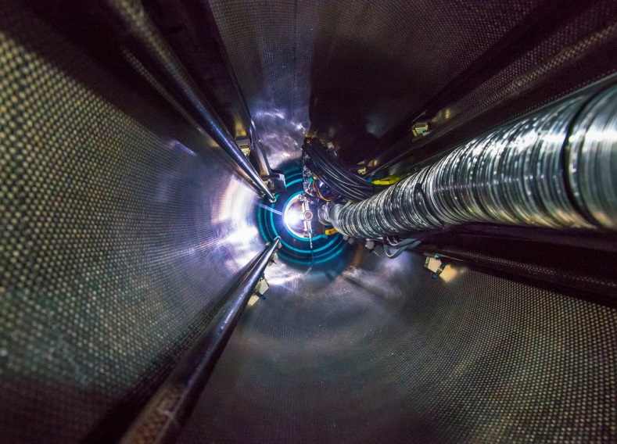
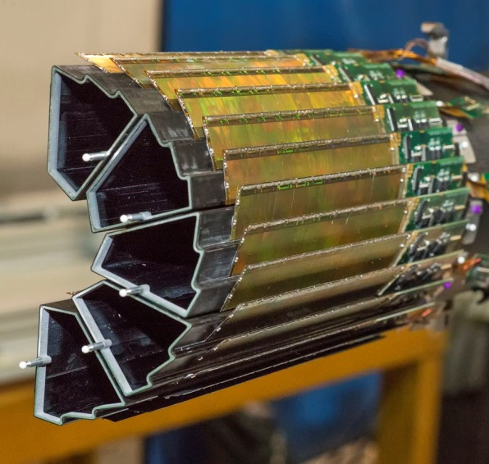
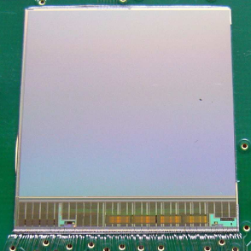
Starting point: Ultimate chip in STAR
Physics data taking since March 3rd, 2014
MIMOSA28
(ULTIMATE)
Pictures Credit: Berkley Lab and IPHC

Slide 3
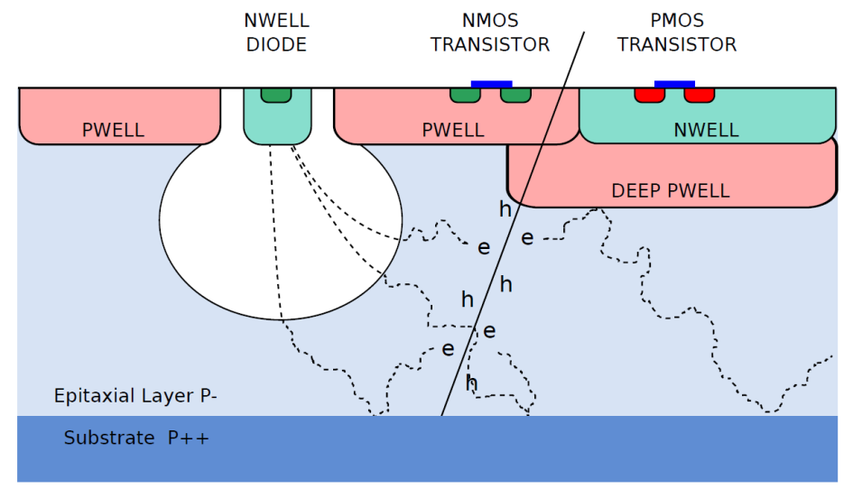
Towards Higher Read-Out Speed and Radiation Tolerance
Next generation of experiments calls for improved sensor performances:
Main improvements required while remaining inside the virtuous circle of spatial resolution, speed, material budget, radiation tolerance ➔ move to 0.18 µm process
  To enhance the radiation tolerance
    High resistivity epitaxial layer
    Smaller feature size process
  To accelerate the readout speed
    More parallelised read-out
    Optimised number of pixels per column
    New pixel array architectures
    Smaller feature size process
Expt-System | σ _{t} | σ _{sp} | TID | Fluence | T _{op}
STAR-PXL | <~ 200 µs | ~ 5 µm | 150 kRad | 3x10¹² n_{eq}/cm² | 30 °C
ALICE-ITS | 10-30 µs | ~ 5 µm | 700 kRad | 10¹³ n_{eq}/cm² | 30 °C
CBM-MVD | 10-30 µs | ~ 5 µm | <~10 MRad | <~ 10¹⁴ n_{eq}/cm² | <<0 °C
ILD-VXD | <~2 µs | <~ 3 µm | O(100) kRad | O(10¹¹ n_{eq}/cm²) | <~30 °C
Schematic cross section of MAPS in a CIS process with deep p-well feature

Slide 4
Sensors R&D for the upgrade of the ITS: Our Strategy
Upstream
Downstream
R&D of up- & down-stream of sensors performed in parallel at IPHC in order to match the ITS timescale
for 2 final sensors (~3x1.3 cm²)
  - Mature architecture: MISTRAL = MIMOSA Sensor for the inner TRacker of ALICE
    Relatively moderate readout speed (200 ns/ 2rows)
      ~ 200 mW/cm² , σ_{sp} ~ 5 µm for inner layers
      ~ 100 mW/cm² , σ_{sp} ~ 10 µm for outer layers
  - Improved architecture: ASTRAL = AROM Sensor for the inner TRacker of ALICE
    Higher speed (100 ns/ 2rows) + Lower power
      ~ 85 mW/cm², σ_{sp} ~ 5 µm for inner layers
      ~ 60 mW/cm², σ_{sp} ~ 10 µm for outer layers
Modular design + reused parts ➔ optimising R&D time
Several groups involved in the ITS design

Slide 5
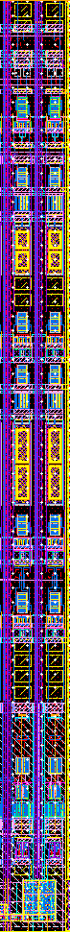
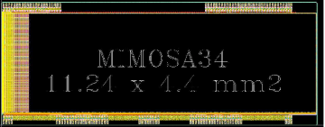
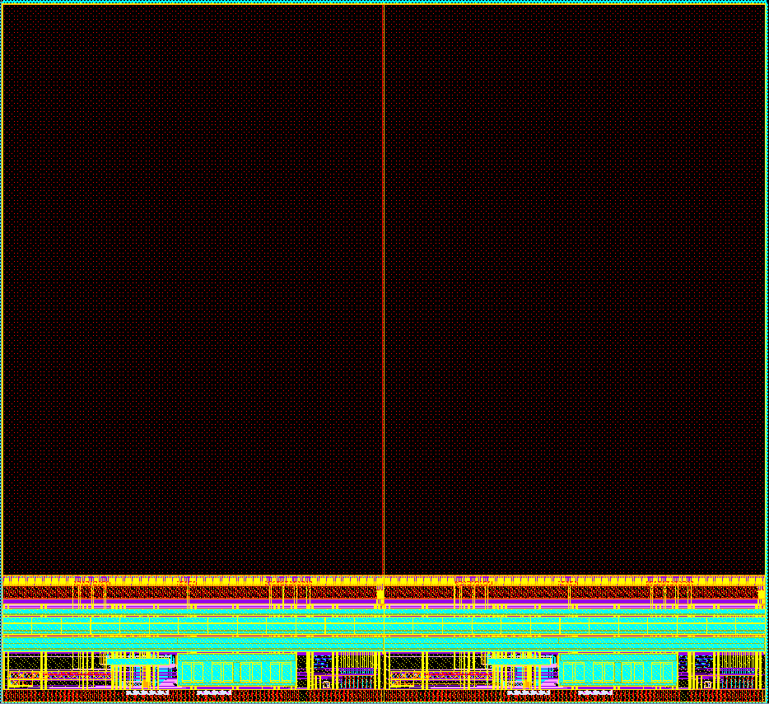

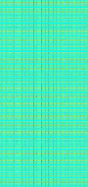

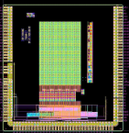
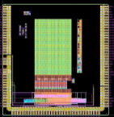
Upstream of MISTRAL Sensor
Pixel level
Column level
Designed by Y. Degerli (Irfu/AIDA)
Layout of 2 discri.
(1 columns)
~300 µm
1.8 cm
MIMOSA-34
Sensing node opt.
2 x FSBB_M0
Verify full chain and full functionalities
Pixel level:
  Sensing node: N_{well}-P_{EPI} diode
    Optimisation = f (diode size, shape, No. of diodes/pixel, pixel pitch, EPI)
  In-pixel amplification and cDS:
    Limited dynamic range (supply 1.8 V) compared to the previous process (3.3 V)
    Noise optimisation especially for random telegraph signal (RTS) noise
      Sensing diode: avoid STI around N-well diode
      RO circuit: avoid using minimum dimensions for key MOS & avoid STI interface
      Trade off between diode size, input MOS size w.r.t. S/N before and after irradiation
Column level:
  Discriminator: similar schematic as in MIMOSA26 & 28
    Offset compensated amplifier stage + DS (double sampling)
    200 ns per conversion
  Read out 2 rows simultaneously ➔ 2 discriminators per column (22 µm)
1.6 cm
MIMOSA-32FEE
Amp opt.
MIMOSA-32N
RTS opt.
MIMOSA-22THRb
Chain opt. => 2 D/col
MIMOSA-22THRa1&2
Chain opt. => 1 D/col

Slide 6
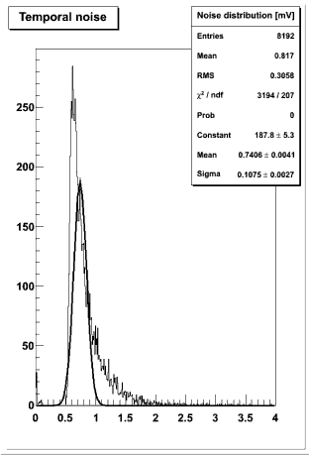
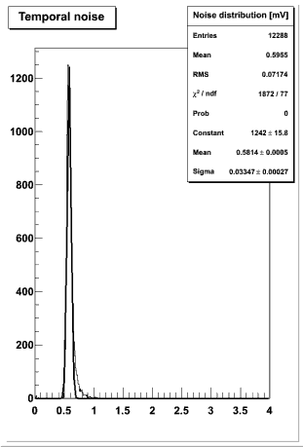
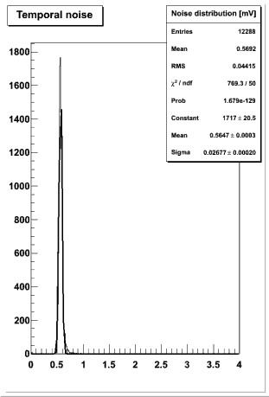
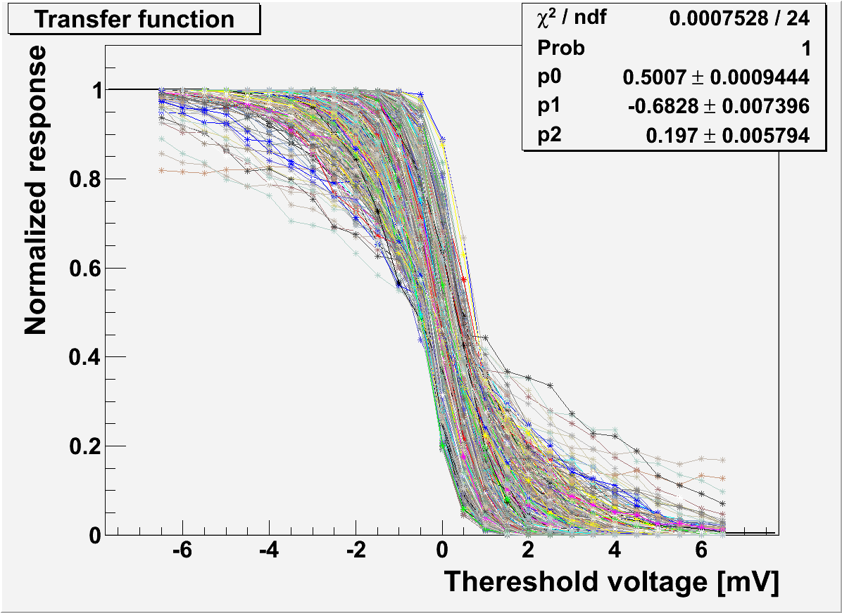
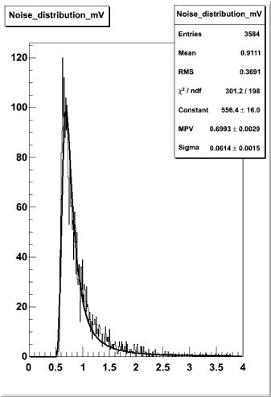
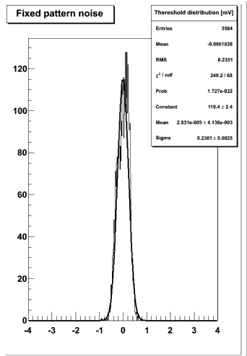
Test Results of the Upstream Part of MISTRAL Sensor
Lab test results @ 30 °C (MIMOSA22-THRa1 & 2, MIMOSA22-THRb) :
  Diode optimisation
    CCE optimisation: surface diode of 8-11 µm² (22x33 µm²)
  In-pixel amplification optimisation
    Reduction of RTS noise by a factor of 10 to 100
  MISTRAL RO Architecture: (single & double raw RO)
    2-row RO increases FPN by ~1 e⁻ ENC ➔ negligible impact on ENC_{total}
    ➔ Design of the upstream of MISTRAL validated
Beam test results (DESY):
  SNR for MIMOSA-22THRa close to MIMOSA 34 result
    8 μm² diode features nearly 20 % higher SNR (MPV)
  Detection efficiency ≥ 99.8% while Fake hit rate ≤ O(10⁻⁵)
  22×33 μm² binary pixel resolution: ~5 µm as expected from former studies
  Final ionisation radiation tolerance assessment under way
L_{in}xW_{in} = 0.18 µm²
L_{in}xW_{in} = 0.36 µm²
L_{in}xW_{in} = 0.72 µm²
Pixel not corrected for RTS noise
ENC ~ 17 e⁻
ENC ~ 4 e⁻

Slide 7
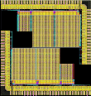
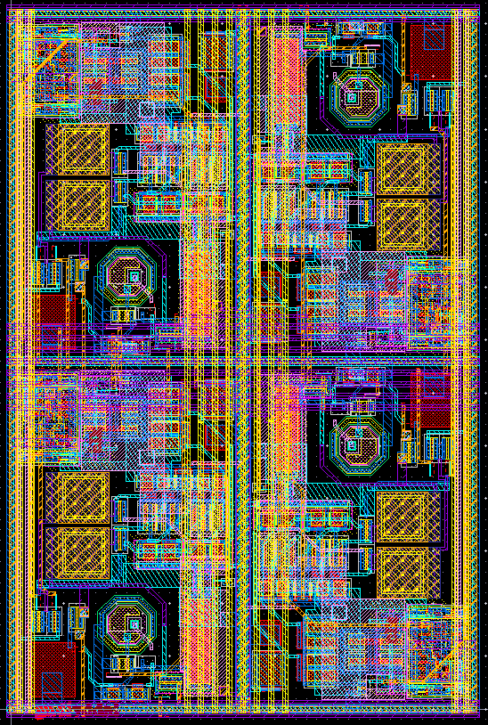
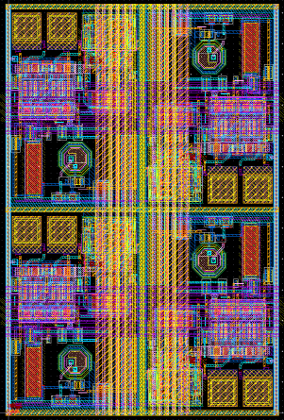
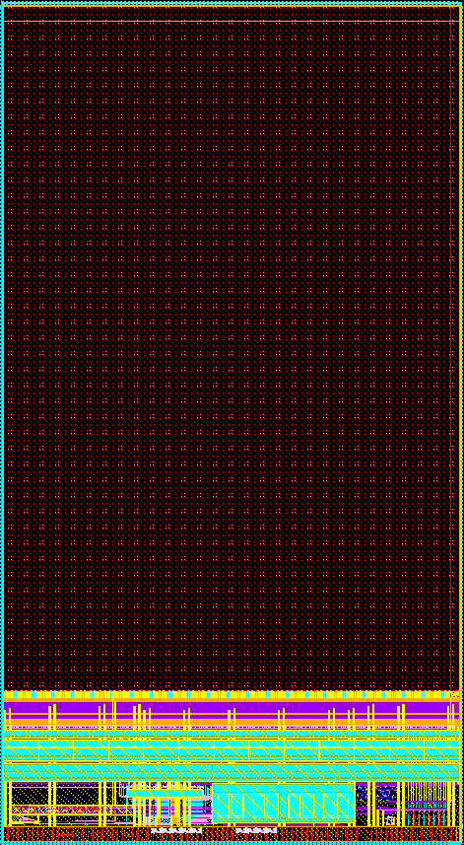
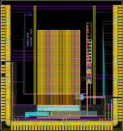
Upstream of ASTRAL sensor
Thanks to the quadruple-well technology, discriminator integrated inside each pixel
  Analogue buffer driving the long distance column line is no longer needed
    Static current consumption reduced from ~120 µA up to ~14 µA per pixel
  Readout time per row can be halved down to 100 ns (still with 2 rows at once) due to small local parasitics
Sensing node & in-pixel pre-amplification as in MISTRAL sensors
In-pixel discrimination
  Topology selected among 3 topologies implemented in the 1st prototype AROM-0
  Several optimisations on the 2 most promising topologies in AROM-1
  One third of final sensor (FSBB_A0 ) coming back this week from dicing/thinning
AROM-1a
2x2 pixels
AROM-1b
2x2 pixels
FSBB_A0
1/3 of final sensor
AROM-0
1.6 cm
AROM-1
Horizontal controls shared between 2 rows
Horizontal controls
in each row
0.9 cm

Slide 8
Summary of the AROM-1 development
AROM-0 submission Feb. 2013
Version 1
Version 2
32 x32 pixels (22x33 µm²) Single row readout
32 x32 pixels (22x33 µm²) Single row readout
16 x16 pixels (22x33 µm²) Double row readout
AROM-1_e/f
More stable
Less compact → more noise
AROM-1_a/b/c
More compact
Less stable → more noise
AROM-1 series
AROM-1e/f submission Nov. 2013
AROM-1a/b/c submission Aug. 2013
64 x64 pixels Double row readout
  a: 22x33 µm² (similar layout as AROM-0v2)
  b: 22x33 µm² (optimized layout)
  c: 24x33 µm² (study impact of pixel pitch)
RTS noise mitigated
Thermal noise from switches optimized
Optimized layout to minimize cross talk and asymmetry
Performance validated already in laboratory
64 x64 pixels Double row readout
  e: 22x33 µm²
  f: 27x27 µm²
Noise and power consumption optimized
Slightly different timing configuration
Tests in progress

Slide 9
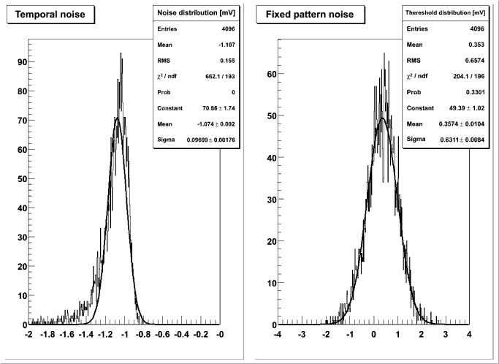
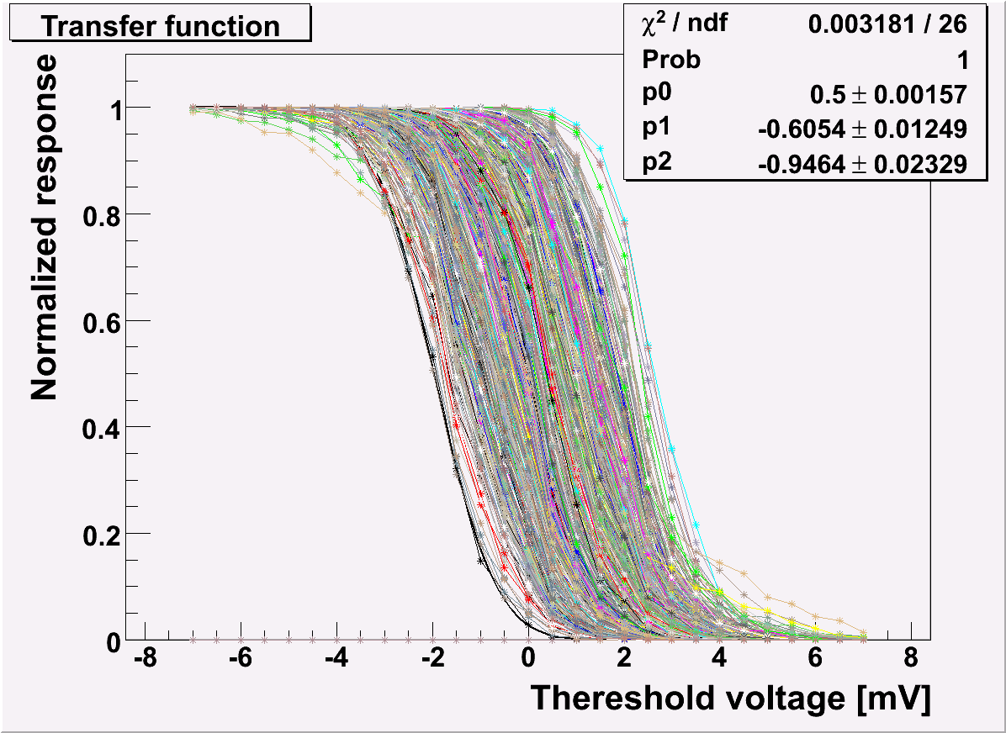
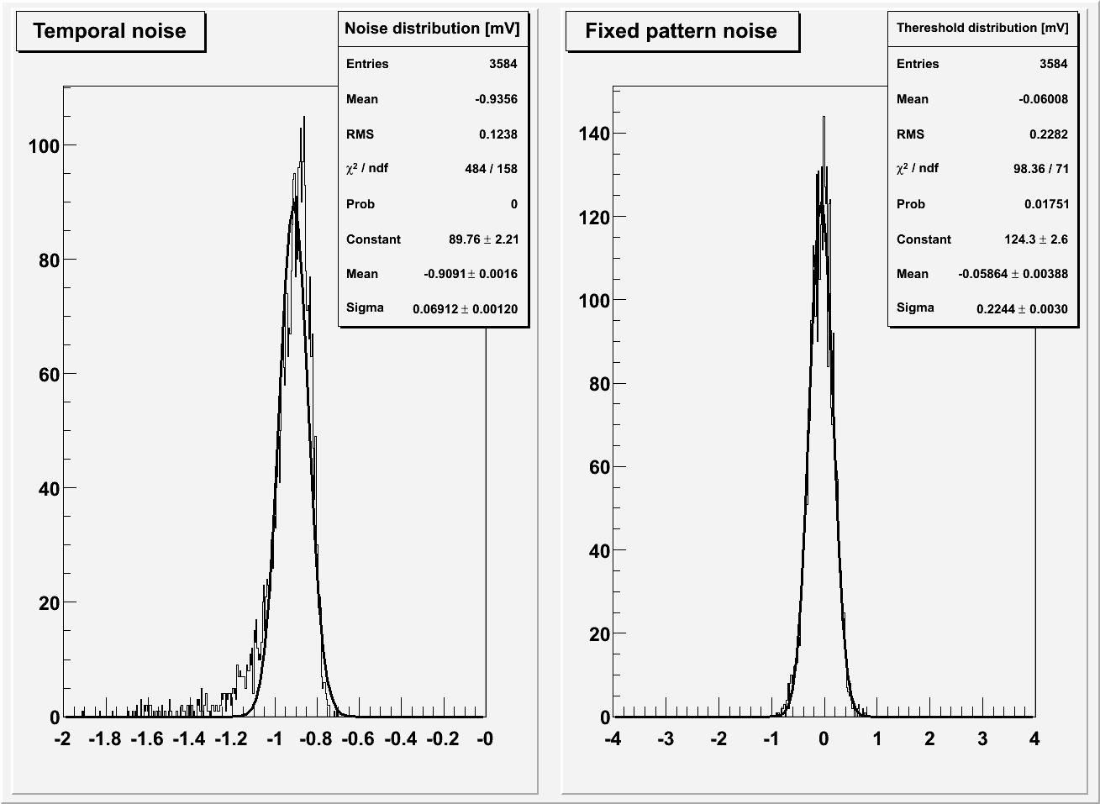
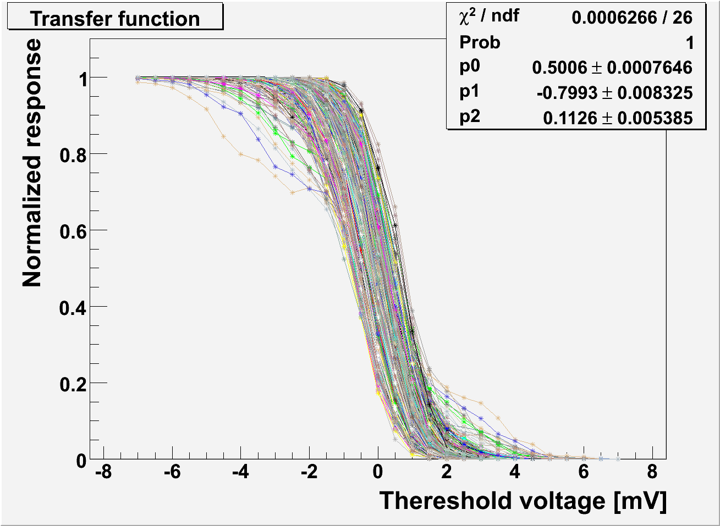
Test Results of the Upstream Part of ASTRAL Sensor
Preliminary lab test results @ 30 °C and @ 100 MHz (instead of 160 MHz)
  Current acquisition board limitation
AROM-1b/c
  Discri alone: TN ~ 0.75 mV, FPN ~ 0.63mV
  Discri+pixel: TN ~ 1.1 mV, FPN ~ 0.66mV
AROM-1e tests are ongoing
  Discri alone: TN ~ 0.29 mV, FPN ~ 0.19mV
  Discri+pixel: TN ~ 0.94 mV, FPN ~ 0.23mV
AROM-1e optimisation is validated
Some residual coupling effects are investigated

Slide 10
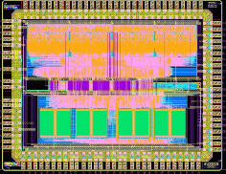
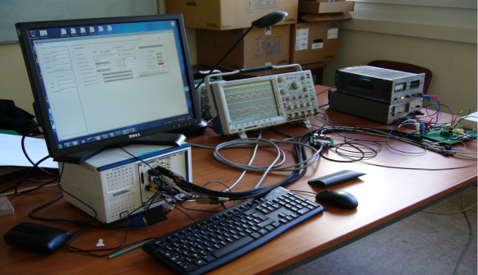
Downstream of Sensors: Zero Suppression Logic (SUZE02)
Identical for both MISTRAL & ASTRAL sensors
  AD conversion (pixel-level or column-level) outputs are connected to inputs of SUZE
Encoding: more efficient than SUZE01 implemented in MIMOSA28 sensor
  Sizable and suitable to process the binary information generated by a 1 cm long pixel array
    Hit density of ~100 hits/collision/cm² + safety factor of 3-4
    Compression factor: 1 to 4 order of magnitude
  Hit clusters identified in 4x5 pixels windows
  Results stored in 4 SRAM blocks allowing either continuous or triggered readout
  Sparsified data multiplexing onto a serial LVDS output
    Prototype data rate: 320 Mbit/s per channel (1 or 2 channels in SUZE02)
SUZE02 preliminary test results: functional and works well @ full speed
  Full sequence of signal processing steps validated using various types of patterns
  SEU sensitivity still to be evaluated
MISTRAL / ASTRAL: 1 Gbits/s data rate required
  One channel output per sensor
    INFN Torino is working on data transmission up to 2 Gbit/s
…….…
Row M-1
Row M
Row M+1
Window of 4x5 pixels
2965 µm
….….…
HIT
2162 µm

Slide 11
Conclusions
2 sensors being developed at IPHC for the ALICE ITS upgrade:
  MISTRAL: validation of the upstream and downstream architectures completed
    Spatial resolution (22x33 µm² pixel) ~5 µm for inner layers
    Detection efficiency > 99.8 % for fake hit rate ≤ O(10⁻⁵)
    Integration time: >~30 µs
    Power consumption ~200 mW/cm² for inner layers & ~100 mW/cm² for outer layers (large pixels)
  ASTRAL: architecture validation on going
    ASTRAL pixel front-end amplification (same as MISTRAL part) validation completed
    Downstream of ASTRAL (shares the same logic with MISTRAL) validation completed
    In-pixel discrimination validation completed
    ASTRAL exhibits 2 x faster readout and lower power consumption than MISTRAL
      Integration time: <~20 µs
      Power consumption ~85 mW/cm² for inner layers & ~30-60 mW/cm² for outer layers (large pixels)
    Beam tests foreseen in Q4/14 for final validation
Characterisation of first large scale prototype (1 cm² sensitive area = 1/3 final sensor), encompassing full signal sensing and processing chain, have been started
  Slow control, Digital test pattern are working

Slide 12
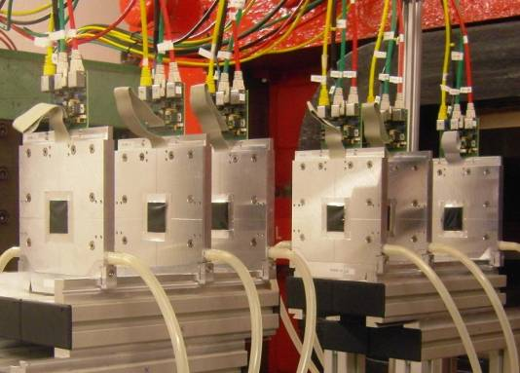
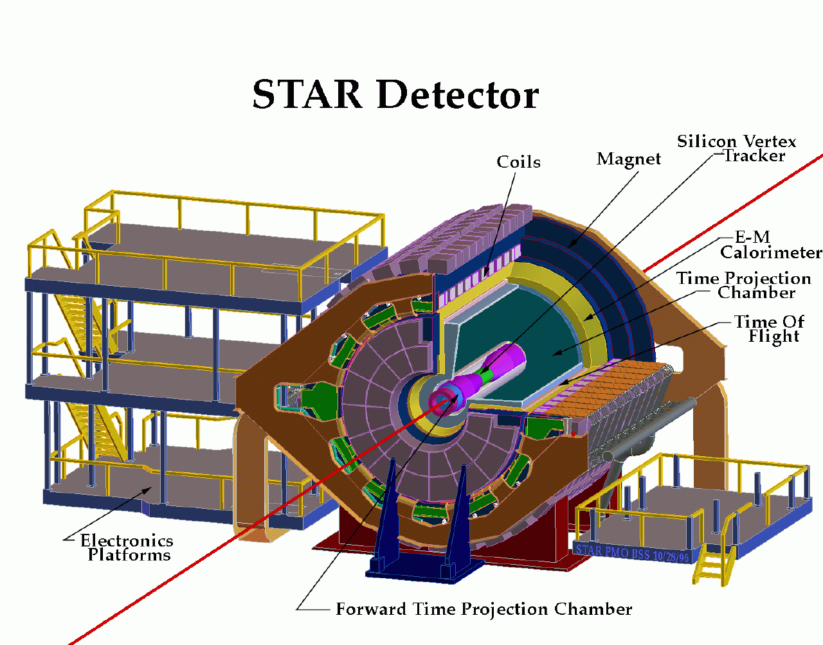
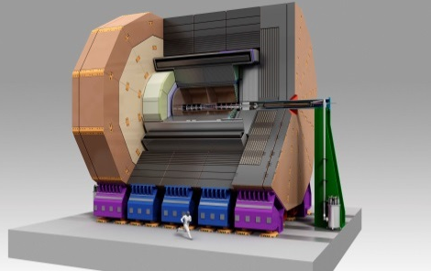

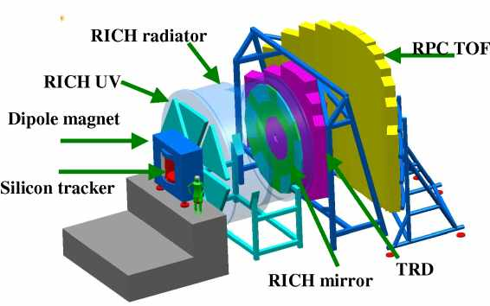
Perspectives for MAPS
Initial objective: ILC, with staged performances
  CPS applied to other experiments with intermediate requirements
EUDET 2006/2010
Beam Telescope
STAR 2013
Solenoidal Tracker at RHIC
EUDET (R&D for ILC, EU project)
STAR (Heavy Ion physics)
CBM (Heavy Ion physics)
ILC (Particle physics)
HadronPhysics2 (generic R&D, EU project)
AIDA (generic R&D, EU project)
FIRST (Hadron therapy)
ALICE/LHC (Heavy Ion physics)
EIC (Hadron physics)
CLIC (Particle physics)
BESIII (Particle physics)
…
ILC >2020
International Linear Collider
ALICE 2018
A Large Ion Collider Experiment
CBM >2018
Compressed Baryonic Matter

Slide 13
Outlook
Q2/2014: Submission of various Mimasa22-THRb prototypes to explore and optimise:
  Large pixel pitch optimised for tracker (σ_{sp} ~ 10 µm)
  Small diode with thicker hires epi starting material
  PADs on pixel array for laser soldering (4 metal layers used for pixels)
  MISTRAL upstream validation : a mature backup solution for the outer layers
Q3/2014: Submission of optimised versions of AROM-1
  Pixel optimisation
  Last improvement of pixels and sensors for ASTRAL for the inner layers
Q1/2015: Submission of final versions of the FSBBs
  FSBB-M1 which is 1/3 of MISTRAL for outer layers
  FSBB-A1 which is 1/3 of ASTRAL for inner layers

Slide 14
Thank You !

Slide 15
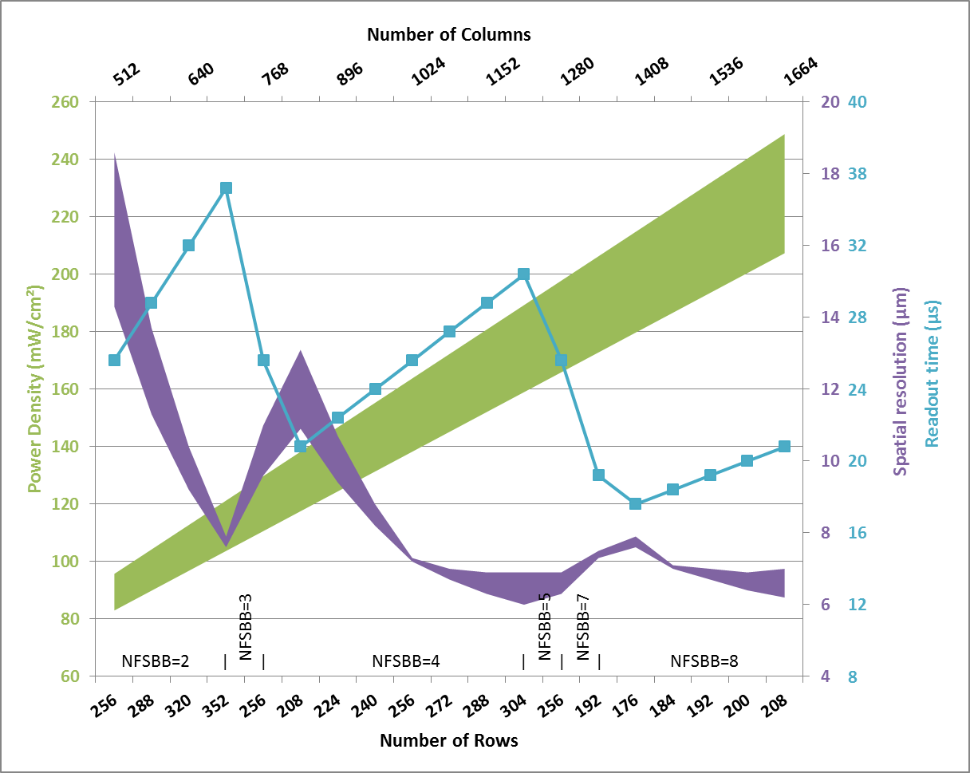
Power density, Integration time and Spatial resolution
Effect of pixel pitches on these 3 factors:
  Assumptions
    MISTRAL for outer layers
    Same sensitive area (1.3x3 cm²)
    1 SUZE per final sensor
    Constant power consumption for digital
    NC=Number of Columns (modulo 32)
    NFSBB= Number of FSBBs per final sensor
    NC/NFSBB = Number of rows
  Row pitch (RP) has an effect on Readout time (RT)
    RP = 30000 µm / NC
    RT = (NC / NFSBB ) / 2 x 200 ns
  Column pitch (CP) has an effect on Power density (PD)
    CP = 13000 µm / (NC / NFSBB)
    PD = (60 mA + 0,117 mA x NC x 2) x 1.8 V
    PDopt = (60 mA + 0,09 mA x NC x 2) x 1.8 V
  Both pitches have an effect on Spatial resolution (SR)
    SR = 7µm (RP x CP / (22 x 66 µm²) )^{1/2 or 1}
    Empirical formula for a specific technology and architecture based on the spatial resolution of tested chip with an area of 22 x 66 µm²

