Slide 1


Développements Microélectroniques Récents à l’IRFU
olivier.gevin@cea.fr
Planches d’E. Delagnes, D. Breton, H. Grabas,
A. Michalowska, S. Dubos, Y. Degerli.

Slide 2
PLAN
« Catalogue » printemps-été 2014.
SAMPIC: mesure du temps à la pico-seconde.
D²R₁: mesure de l’énergie à la limite de fano.

Slide 3
Introduction: chips en cours de design/prod à l’IRFU
Name | Description | Cible | Production foreseen | Status | IBM 0.13 | AMS 0.18 | XFAB 0.18 | TOWER 0.18 | AMS 0.35 | AMS SiGe 0.35
AGET | FE for Nuc. Phys. TPC | ACTAR, AT-TPC,Minos… | 2013 | Available |  |  |  |  | X
DREAM | FE for MM Tracker | CLAS12 MM | 2013 | Available |  |  |  |  | X
FPCSA | CSA for implant-decay | S3 | 2013 | Available |  |  |  |  | X
NECTAR0 | GSPS digitizer | HESS 1 upgrade | 2013 | Available |  |  |  |  | X
NECTAR1 | GSPS digitizer | CTA | 2016 ? | Under design |  |  |  |  | X
D2R1 | Ultra low noise FE | Spectro-Imageurs (CdTe,Si) Spatiaux | ? | Feas. Proto under test |  |  | X
OWB-1 | multi-channel ADC | Spectro-imageurs spatiaux/ATHENA | 2017 ? | Proto in fab |  |  |  |  | X
SAMPIC | GSPS sampler for ps timing. | ATLAS AFP | 2015 ? | Feas. Proto under test |  | X
PIXAM | MAPS tracker | MAPS pour Alice MFT | ? | Feas. Proto in fab |  |  |  | X
GDSP | FE // | AIDA/TPC ILC / Muon CMS | ? | Feas. Proto in fab | X
Bolochips | Ultracryo Mux ASIC for bolometers | ATHENA/IXO | ? | Proto under test |  |  |  |  |  | X
Trop de projets ?
Trop de technos.

Slide 4

  SAMPIC
E. Delagnes
H. Grabas
D. Breton
J. Maalmi

Slide 5
SAMpler for PICosecond time pick off
  Test chip = common prototype before designing specific chips for ATLAS AFP and SuperB TOF
  R&D funded by “P2IO” grant (not by experiments)
  Goals for the first prototype:
    Evaluation of AMS 0.18µm technology
    Evaluate new design options (DLL & SCA)
    Evaluate simultaneous R/W
    Multichannel Chip usable in a real environment (with detector and a real DAQ)
  Core of a future deadtime free chip

Slide 6
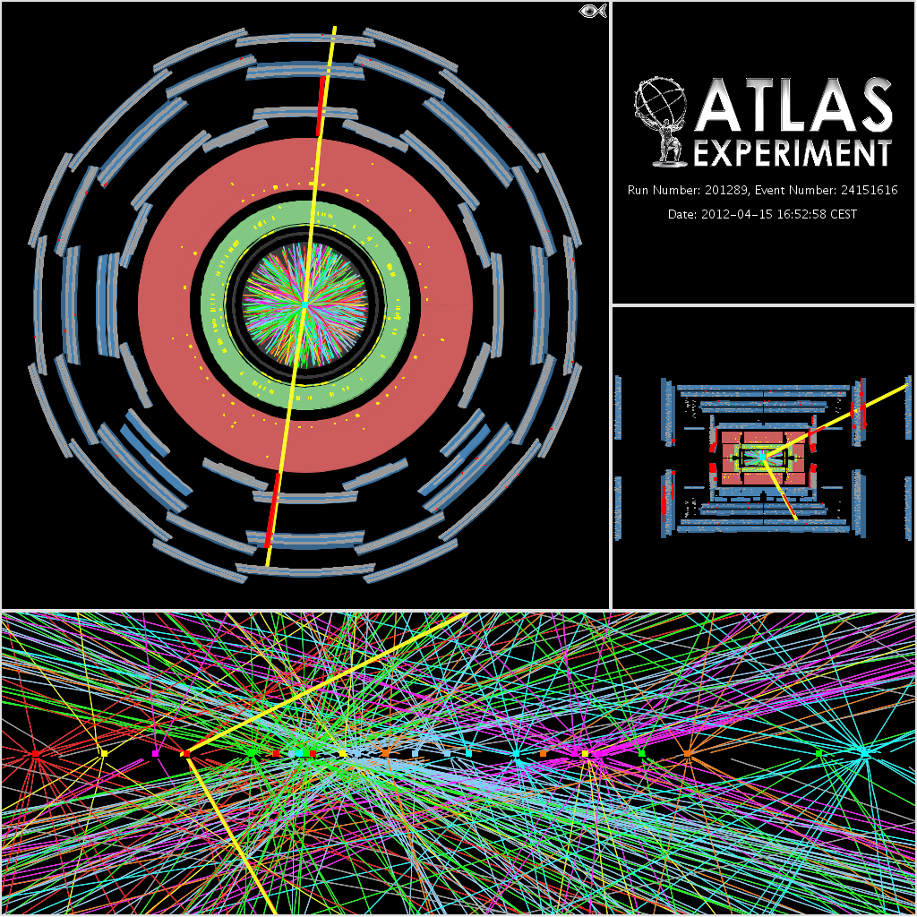
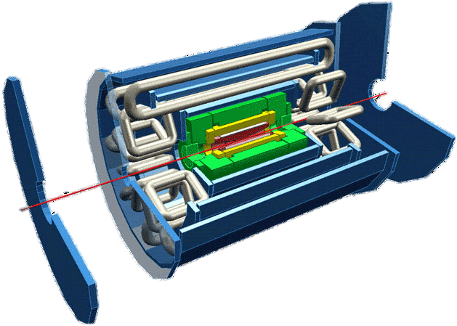
Mesure de temps dans ATLAS FORWARD PHYSICS
ATLAS
206&214m AFP detec.
Study of diffractive protons at very low angles
Few mm from the beam
2 x 2 detectors on each side of ATLAS
each made of:
  5 slices of Hybrid Si pixel detectors (FEI4)
  Timing detectors :
    Few ps timing resolution to:
      associate event to the correct vertex (3 mm precision => 10 ps)
      reject background due to the halo
    Careful segmentation to reduce pile-up
    High rate (HL-LHC):Typically: 1 event/bunch crossing / 16 ch
    3 Solutions in competitions 2 with (Quartz + MCP-PMT) one with diamond

Slide 7
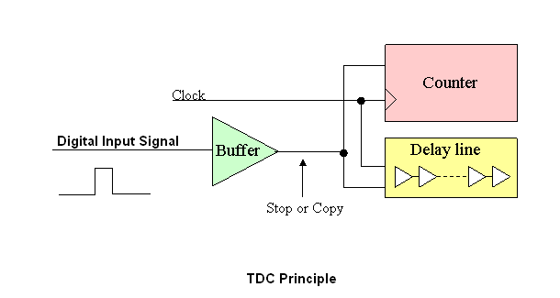
Quelques commentaires sur les TDCs
Current most performant TDCs use digital counters and Delay Line Loops (DLLs):
  advantage: they produce directly the encoded digital value
  but the resolution is at least limited by the DLL step (often by environmental factors)
  Actual time resolution of today’s available most advanced ASICs: ~ 20 ps
  New developments are ongoing (new HPTDC @ CERN, targetting 5 ps, 130 nm technology)
BUT a TDC needs a digital input signal
analog input signal has to be translated to digital with a discriminator
additional jitter and residues of time walk effect enter the game
overall timing resolution is given by the quadratic sum of the discriminator and TDC timing resolutions

Slide 8
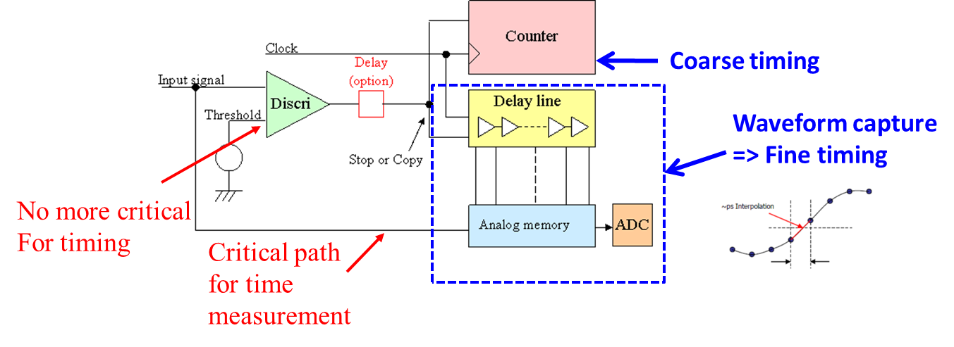
SAMPIC: The « WaveForm based TDC » structure
  The Waveform TDC : a new concept based on an original principle
  Association of : Analog Memory + Discriminator + Counter + DLL + ADC
  Time Given by :
  - Coarse = Timestamp Gray Counter ( ~6 ns step)
  - Middle = DLL locked on the clock to define Region of interest (150ps step)
  - Fine = few samples in the ZOI of the waveform (interpolation will give a precision of a few ps rms)
  Digitized Waveform Shape, Charge and Amplitude are available
  Discriminator used only for triggering, not for timing
12 bits in the chip
+ 20 bits in FPGA
Middle timing

Slide 9
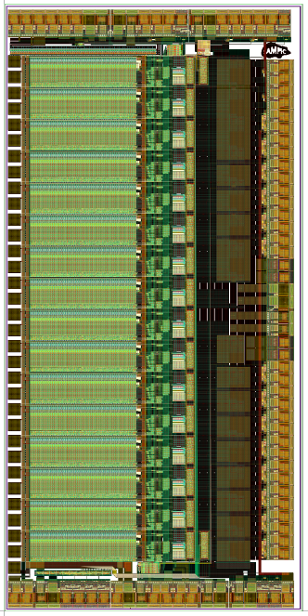
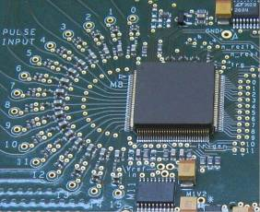
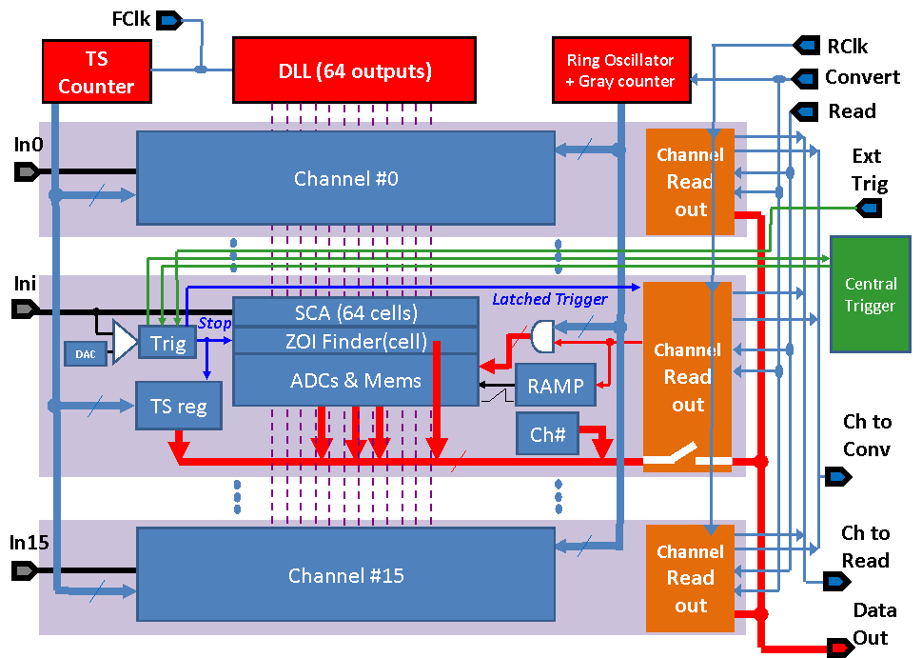
SAMPIC: Architecture globale
16 single-ended channels:
  Self triggerable (or Central OR Trigger, or External Trigger)
  Independent channels
  64 analog sampling cells/ch
  One 11-bit ADC/ cell (total : 64 x 16 = 1024 on-chip ADCs)
One common 12-bit Gray counter (@160MHz) for coarse timestamping.
One common servo-controlled DLL: (from 1 to 10 GS/s) used for medium precision timing & analog sampling
One common 11-bit Gray counter running @ 1.3GHz and used for the massively parallel Wilkinson analog to digital conversion.
12-bit LVDS readout bus (potentially running up to 400 MHz)
SPI Link for Slow Control configuration
Techno: AMS CMOS 0.18µm
Size: 7 mm2
Prototyping cost: only 10 k€
Package: 128-pin QFP, pitch of 0.4mm

Slide 10
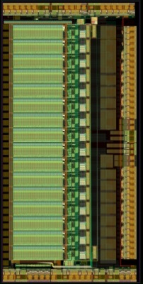
Caractérisation
Everything is working well excepted:
    ROI readout: fail in some cases => we read the whole depth
    Central trigger
    These 2 features are not absolutely necessary (and can be easily corrected)
    The chip is usable as it is
Sampling is ok :
    from 3 to 8.2 GSPS on all the channels
    up to 10 GSPS on 8 channels
    Not tested under 3 GSPS
Readout ok @ 80MHz. To be tested at higher frequency
No evidence of cell Leakage. Data not damaged for storage times of few tens µs
AMS0.18: 7mm²

Slide 11
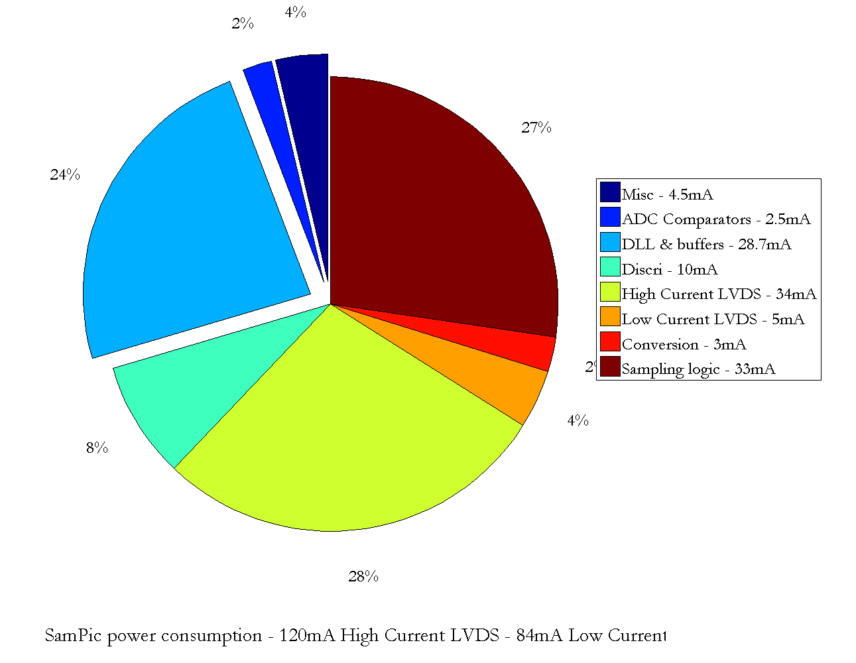
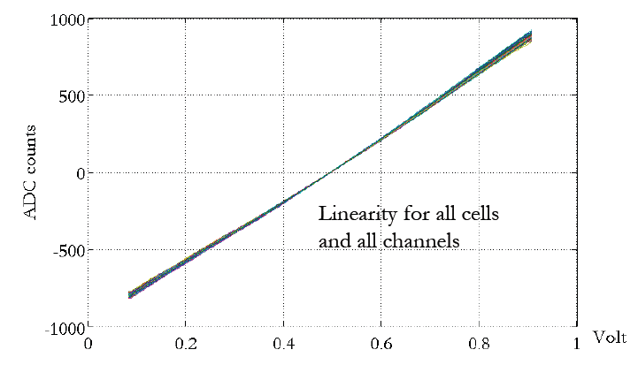
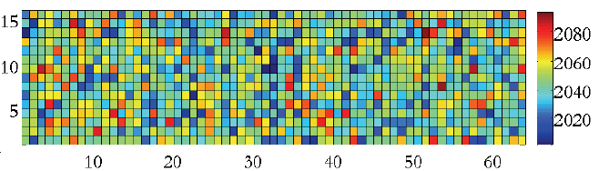
SAMPIC: quelques résultats de mesure
Bruit et puissance
1024 Fonctions de transfert ADC
10-15mW/ch
SAMPIC @ 6.4 GS/s.
Baseline ~ 1100 adcc, 11-bit mode, soft trigger
Noise map with FPN subtracted
Noise = sqrt(variance( Cell(i)) over all the acquisitions
Average noise = 1.9 ADC count
Dispersion de pente de cellule à cellule= 1% rms Distribution aléatoire (canal-indépendante)

Slide 12
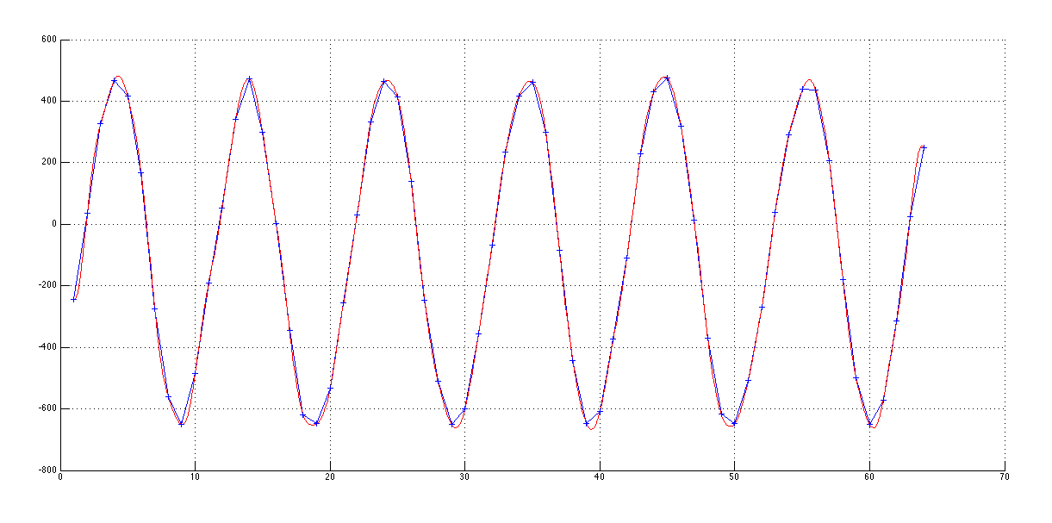
Réponse à une sinusoïde
1ns
1 GHz sinewave (0.5V peak-peak) 64 samples
‘out of the box’ (only pedestal correction) @ 10.2 GSPS
64 usable data points
Already looks good
-3 dB Bandwidth=1,6 GHz

Slide 13
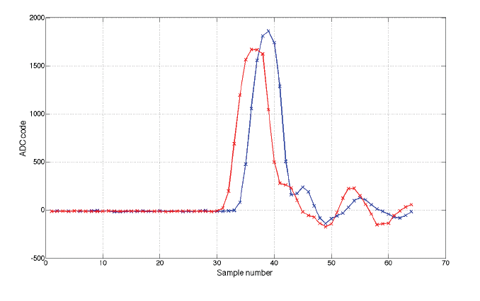
Réponse à un pulse
Further tests made with 1ns-FWHM pulse split in 2. 1 output delayed by cable => 0.9V amplitude
6.4 GSPS sampling
Self triggered

Slide 14
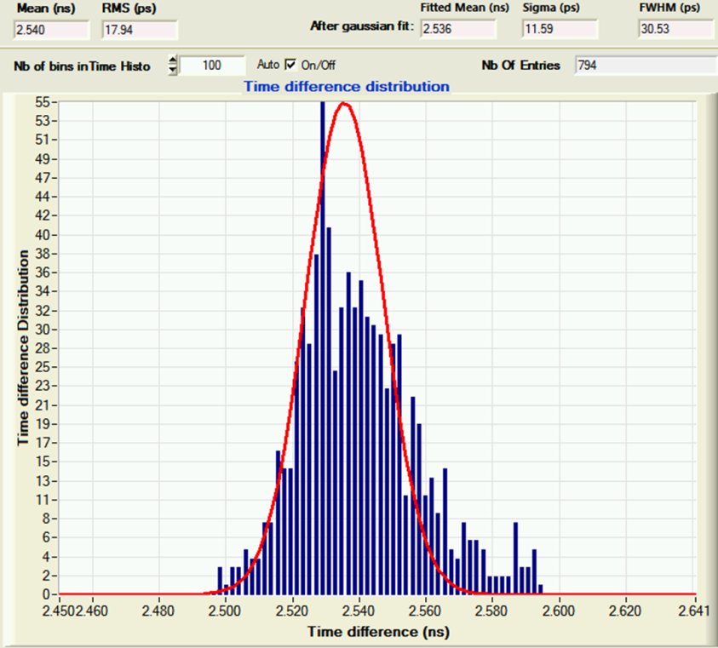
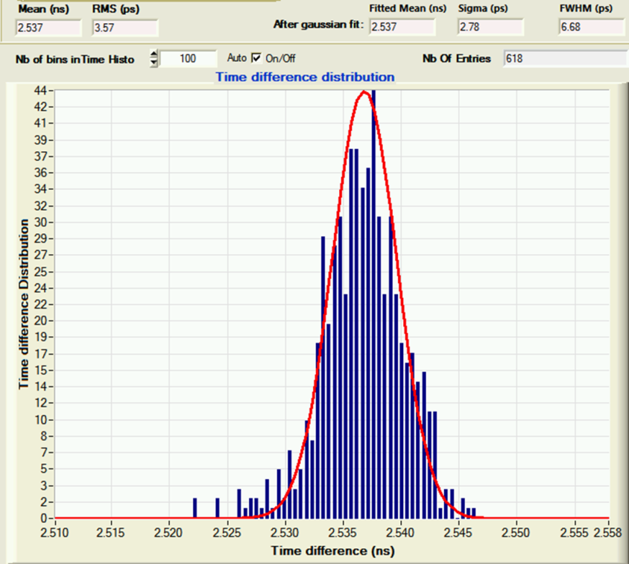
Résolution en temps (piédestaux corrigés)
First measurement: 2 pulses with 2.5ns distance. ,1ns FWHM, 800mV, 3 kHz rate
Measurement performed for 6.4 GSPS sampling
17 ps rms ΔT resolution before any correction => already not so bad.
3.6 ps rms ΔT resolution after INL timing correction
No tail in the distribution.
No hit “out of time” due to metastabilities, problem of boundaries between ranges, …
Before timing correction: 17-20 ps RMS
After timing correction:
3.6ps RMS

Slide 15
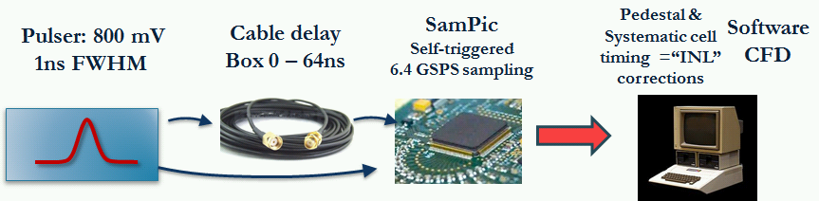
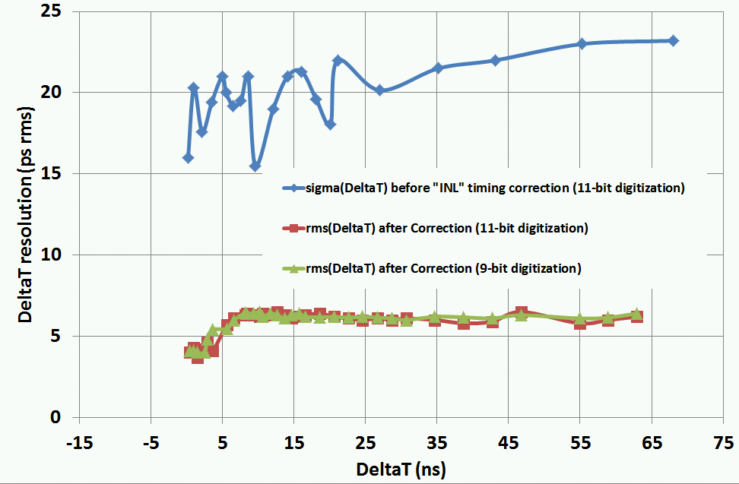
Δt: Résolution en temps (piédestaux corrigés)
Digital CFD
<15 ps RMS = (22/√2) single pulse timing resolution without any timing calibration (short DLLs)
<5 ps RMS timing resolution on single pulse after timing “INL” correction
Resolution vs ΔT is FLAT after 10ns
Same results in 9-bit/400ns mode
Correction of ADC gain spread and non-linearity not applied yet

Slide 16
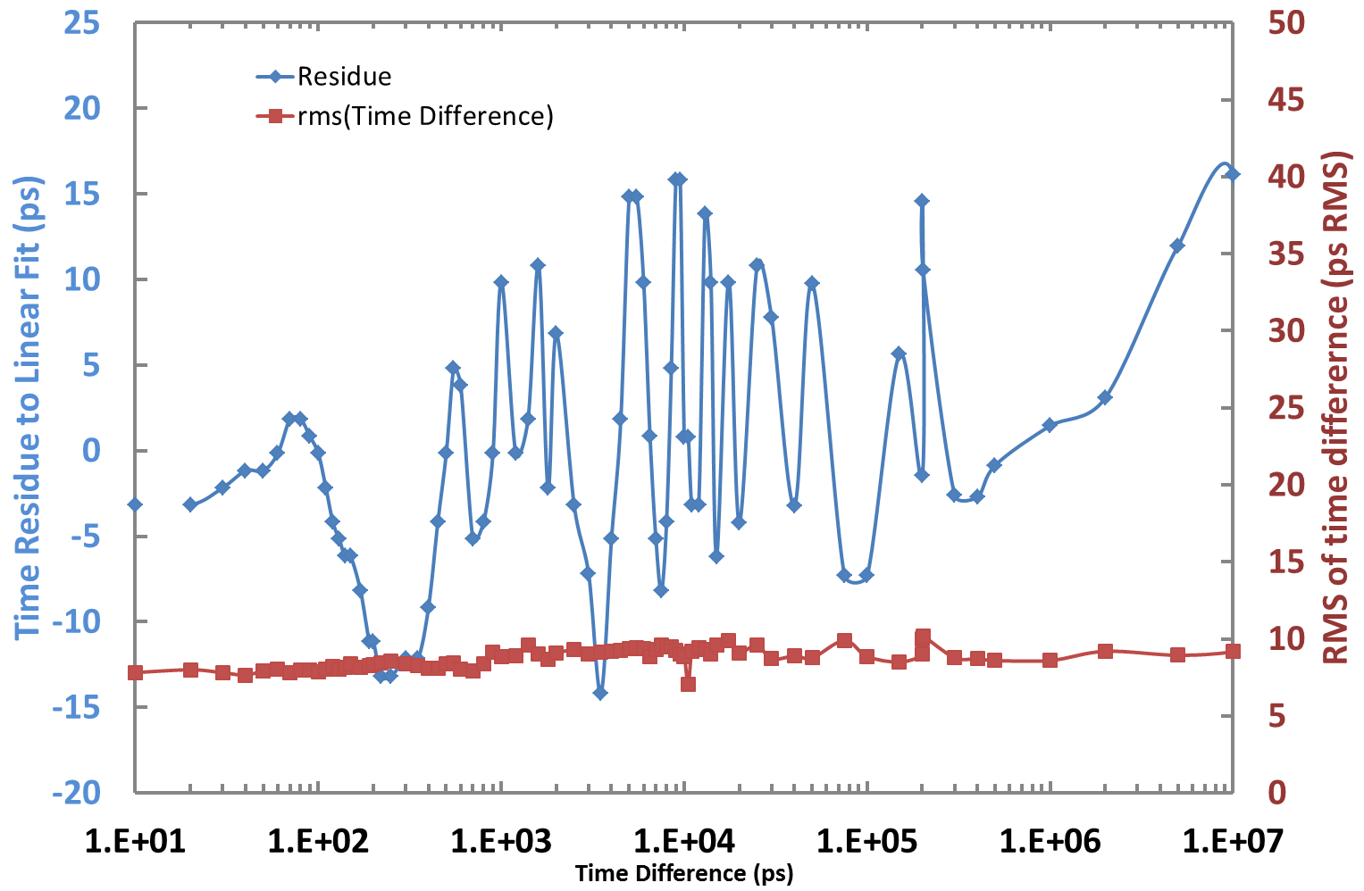
SAMPIC: mesure du temps « absolu »
Now we use a TEK 3052 arbitrary waveform generator
Slower than Lecroy one’s (2.5ns risetime)
We use the 2 channels of the pulser and program their delay (step of 10ps)
Generator specified for few 10 ps delay precision and 100ps jitter (clearly better)
Periodic pattern (~1ns)
DLL in the AWG ?
Resolution on time difference is < 10ps RMS, even for delays up to 10 µs = 1ppm resolution
Linear fit of the time difference vs delay programmed in the AWG:
Slope =1 +1.3E-6 => ~ppm relative precision of the oscillators od SAMPIC and of the AWG
Residue to the fit within +/-15ps up to 10µs delay

Slide 17
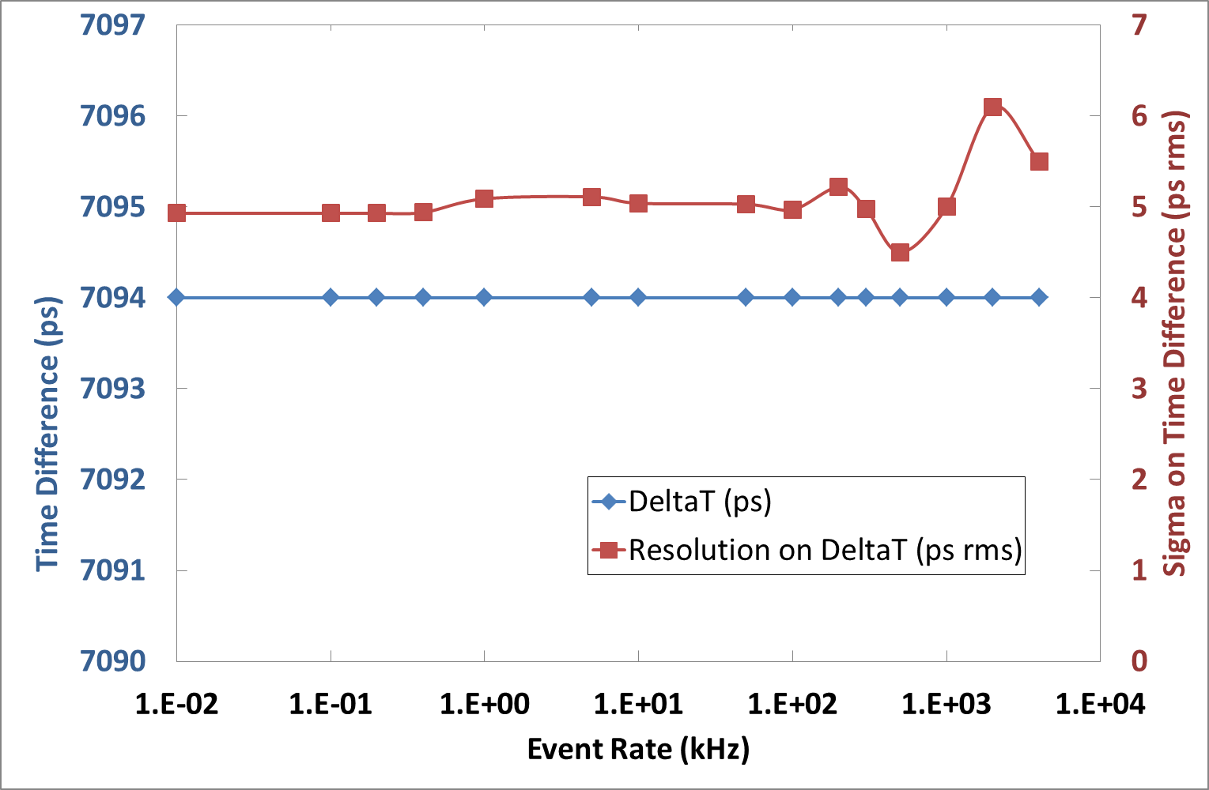
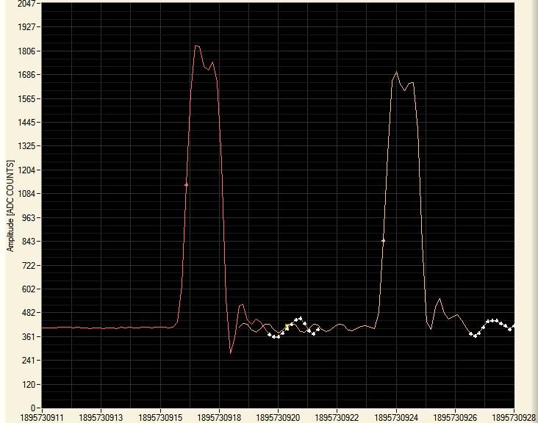
Résolution en temps et taux d’événement
1ns FWHM, 0.4ns risetime, 0.7V signals sent to 2 channels of SAMPIC (splitted)
7.1ns delay by cable, 6.4 GSPS. 11 bit mode, 64 samples, everything corrected
Rate is progressively increased.
No change of delay measured or of resolution up 2 MHz rate !!!
DAQ Rate limited by SAMPIC
DAQ Rate limited by soft +USB

Slide 18
SAMPIC: résumé
 |  | Unit
Technology | AMS CMOS 0.18µm
Number of channels | 16
Power consumption | 180 (1.8V supply) | mW
Discriminator noise | 2 | mV rms
SCA depth | 64 | Cells
Sampling Speed | <3-8.4 (10.2 for 8 channels only) | GSPS
Bandwidth | 1.6 | GHz
Range (Unipolar) | 1 | V
ADC resolution | 8 to 11 (trade-off time/resolution) | bit
SCA noise | <1 | mV rms
Dynamic range | >10 | Bit rms
Conversion time | 0.2-1.6 (8bit-11bit) | µs
Readout time (can be probably be /2 ) | 25 + 6.2/sample | ns
Time precision before correction | <20 | ps rms
Time precision after timing INL correction | < 5 | ps rms

Slide 19
SAMPIC: la suite…
Improvements of Firmware and DAQ software in progress (daily)
Characterization @ 8.2 and 10 GSPS => no drastic change on performance (with our test signals available)
Characterization @ low (3GSPS or less) sampling rate “PM mode”.
Timing characterization with detectors/ test beams.
  * 3 setups are already existing., one lent to TOTEM
  * We plan to produce 3 more ones => possible collaborations for measurements
Characterization in fastest conversion/less resolution mode
New submission planned for Mid 2014 :
            correction of the identified bugs
            Nb of bits for timestamp => 18 bits
            Improved “central trigger” (coincidence & or)
            channels could be merged by groups of 2 or 4 to be used as multiple buffers

Slide 20

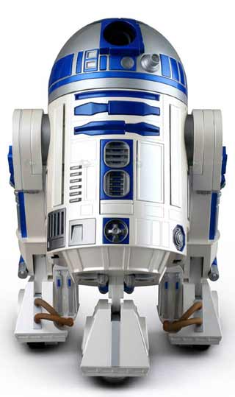
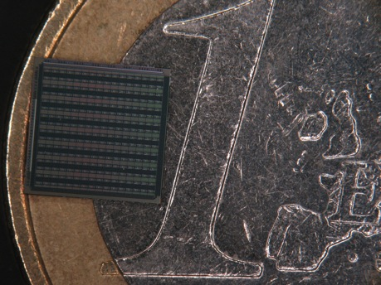
D²R₁

Slide 21
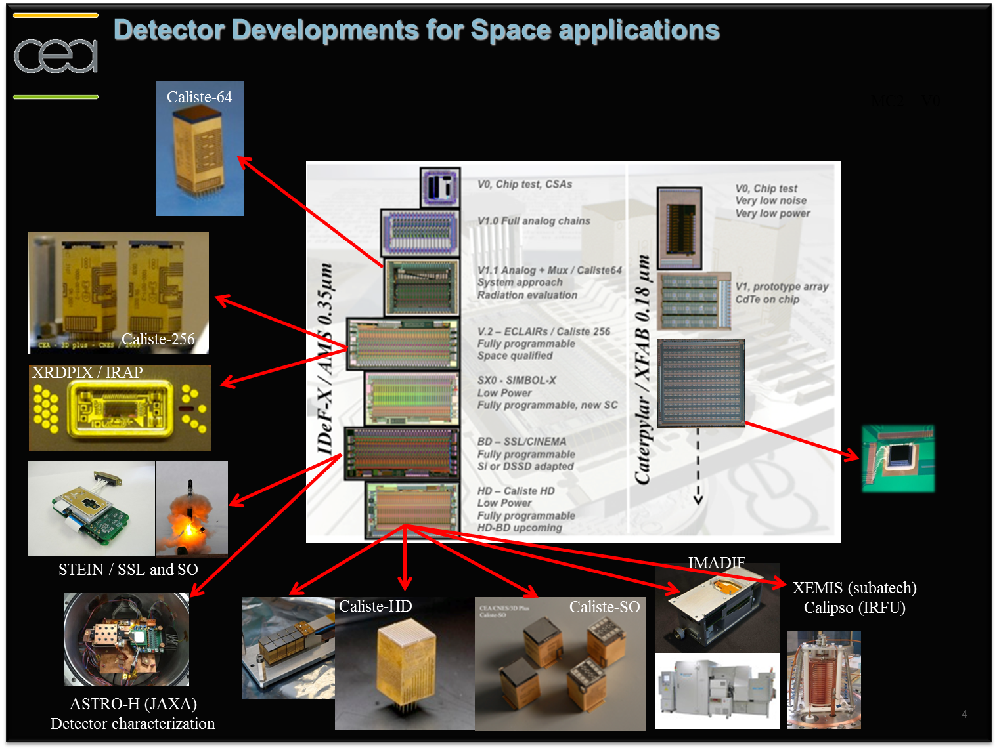
IDeF-X: FE pour application spatiales

Slide 22
  D²R₁
  Objectif: Front end bas bruit de lecture de CdTe matriciels, spectro-imagerie pour applications spatiales
  Détecteur CdTe matriciels (Cdet<1pF, ileak<1pA)
  Thèse CEA/CNES (Alicja Michalowska)
      Evaluation technologique: circuits Caterpylar XFAB et AMS (talk E.D. 2012)
      Prototype 256 pixels: D²R₁
  Perspectives: ASIC 1024 pixels (D²R₂) pour nouveaux modules Caliste 1024 aboutables sur 4 côtés.

Slide 23
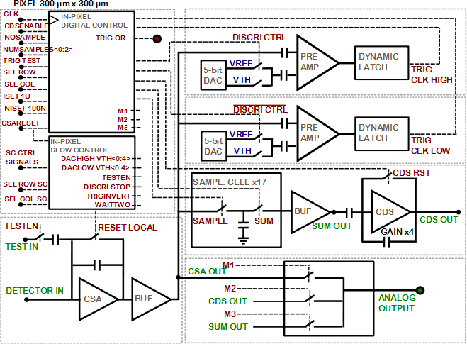
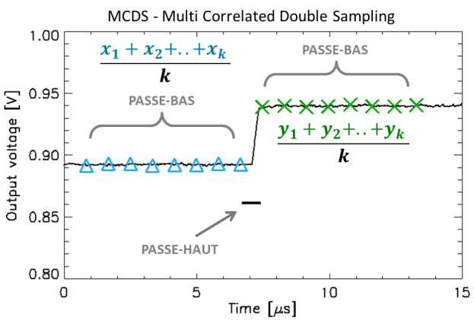
D²R₁ : pixel architecture
Submitted:december 2009
Come back from fondry: february 2010
Picture of the layout with the different stages, dimensions, ratio between analog and digital part, presentation of the main parts of the layout.
Channel, temperature sensor, digital part, buffer….
CSA optimized for 0.5 −> 2pF
  Folded cascode, 2-20 µW
  Pulsed reset
  Ileak<5pA
2 CDS discriminators (1/edge)
  Self triggered
  (DACs 5bits)X2
  Positive/negative threshold
Sampling Capacitor Array:
  k=1 to 16 depth
Average stage
CDS stage
Digital stage:
  In-pixel Slow Control (Threshold, Test_enable, pix_enable)
  Sampling and MCDS sequencement
3 readout modes:
  MCDS
  Stored Samples out
  CSA out (test)
Trapezoidal shaper

Slide 24
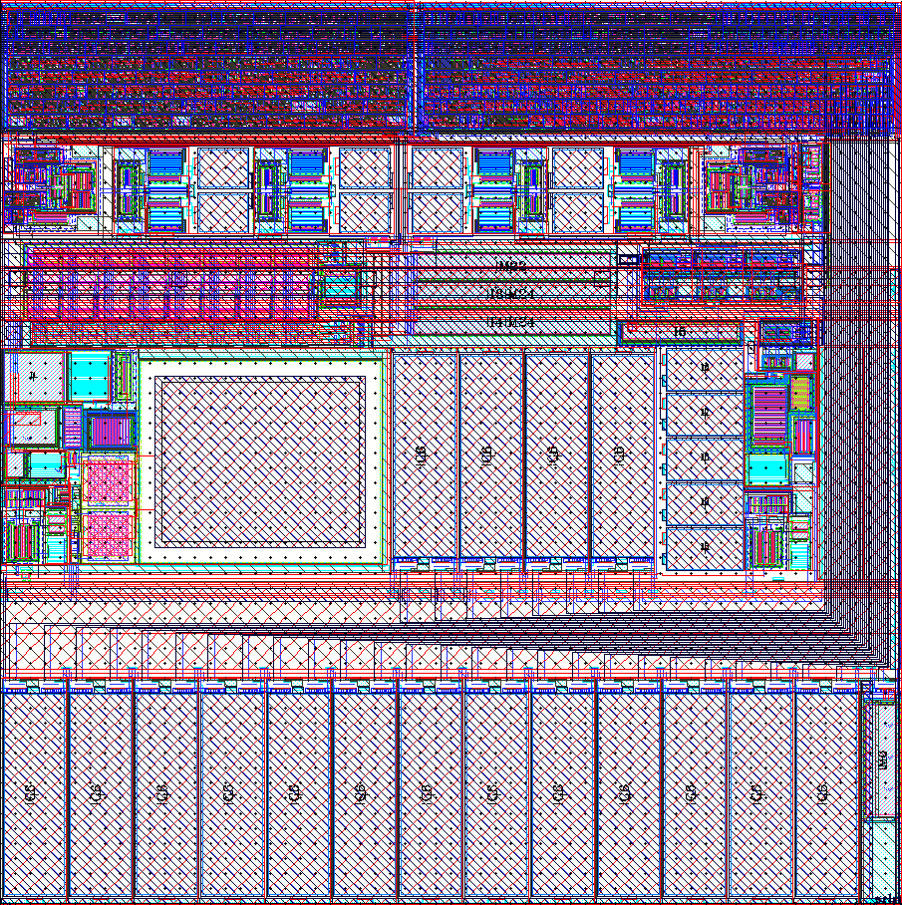
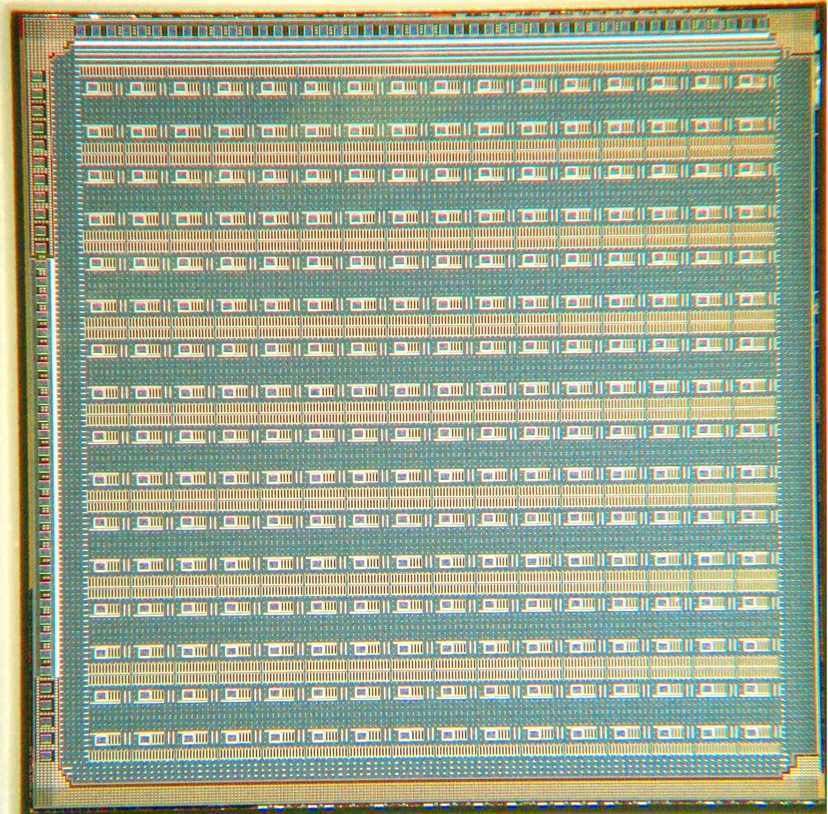
D²R₁: 16x16 matrix for CdTe detector
5.4 mm
EVENT
LOCALIZATION
GLOBAL OR
5.4 mm
Matrice
16 × 16
pixels
ENERGY
READOUT
300 µm × 300 µm

Slide 25
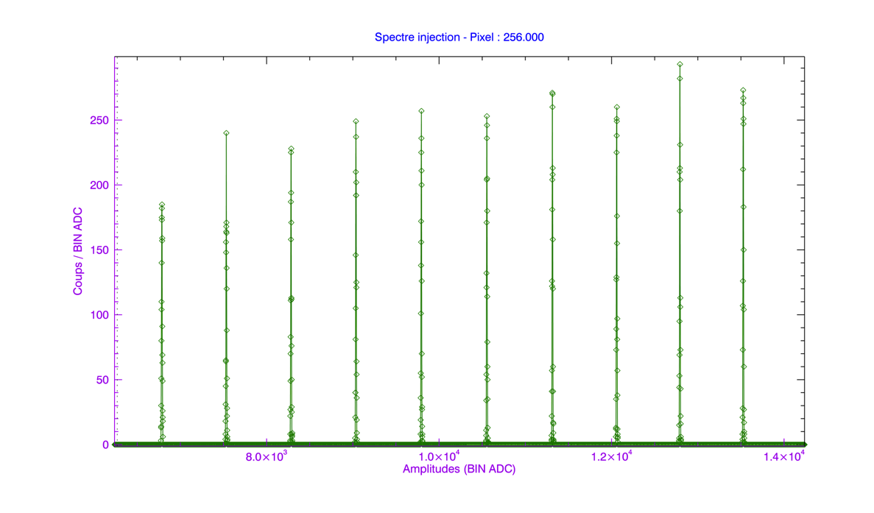
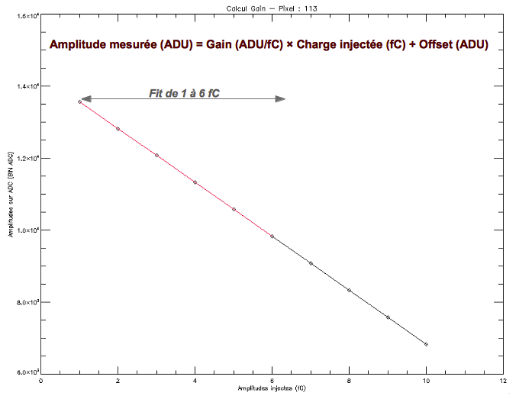
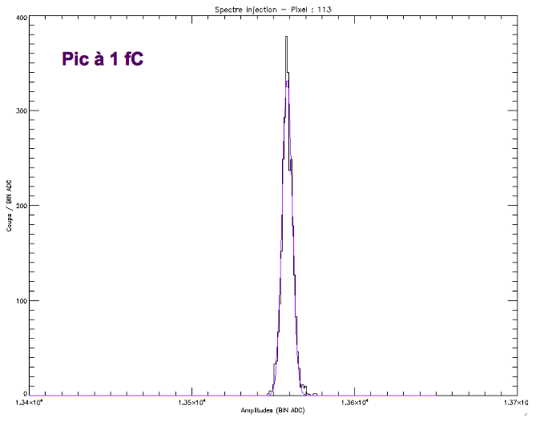
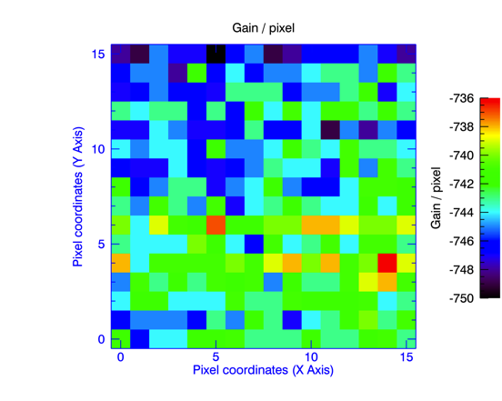
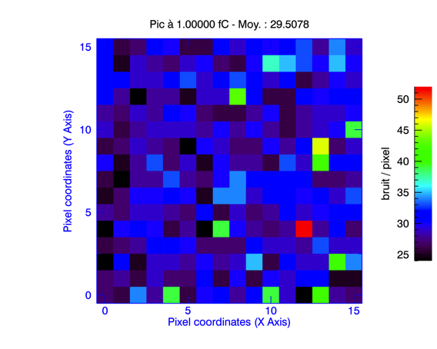
D²R₁ : caractérisation sans détecteur
Mode MCDS, F_{ech}=600kHz, N_{ech}=16, 300µW/canal.
Submitted:december 2009
Come back from fondry: february 2010
Picture of the layout with the different stages, dimensions, ratio between analog and digital part, presentation of the main parts of the layout.
Channel, temperature sensor, digital part, buffer….
Amplitude (ADU)
Coups
Coups
Amplitude (ADU)
Injection (fC)
Amplitude (ADC counts)
Gain moyen : -743 (ADU / fC), 150mV/fC
Bruit moyen : 29,51 e- RMS

Slide 26
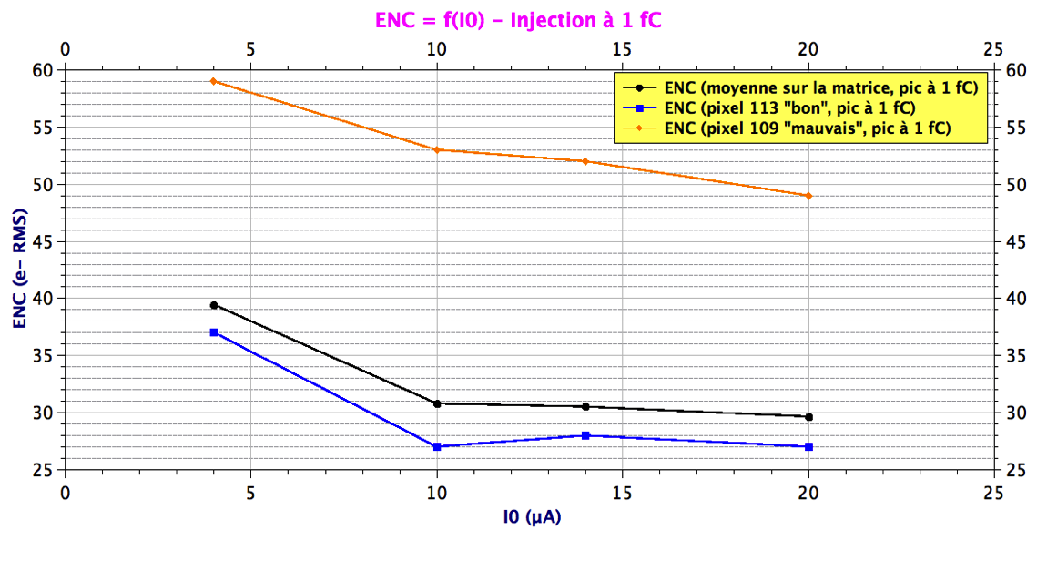
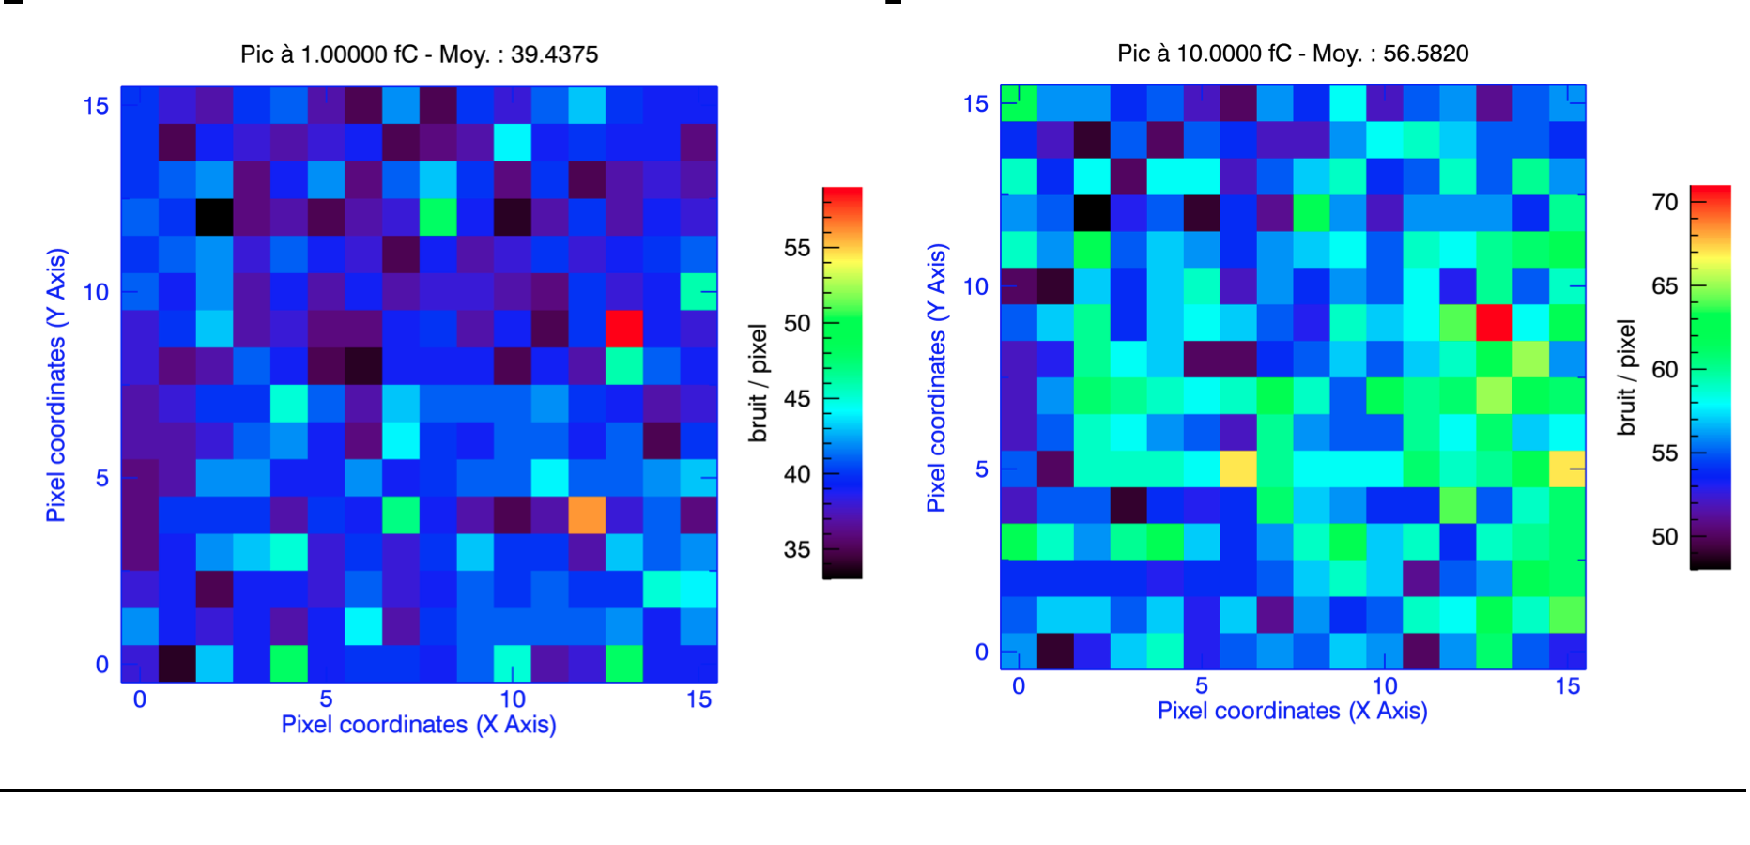
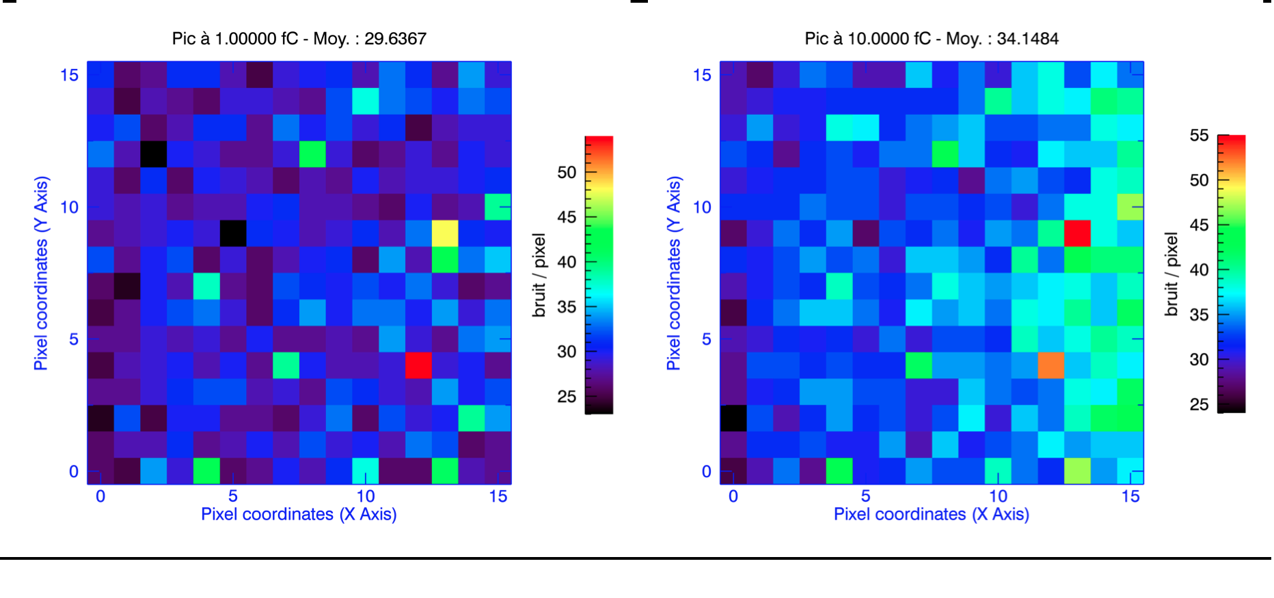
D²R₁ : Influence de courant de CSA
Mode MCDS, F_{ech}=600kHz, N_{ech}=16
4 μA
20 μA

Slide 27
D²R₁ : Influence du nombre d’échantillon
Mode MCDS, F_{ech}=600kHz, 300µW/canal,

Slide 28
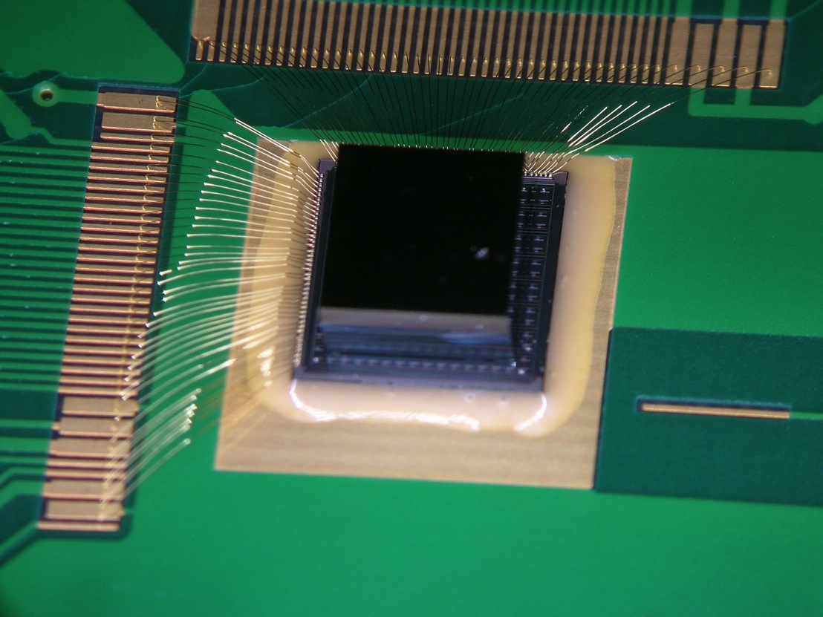
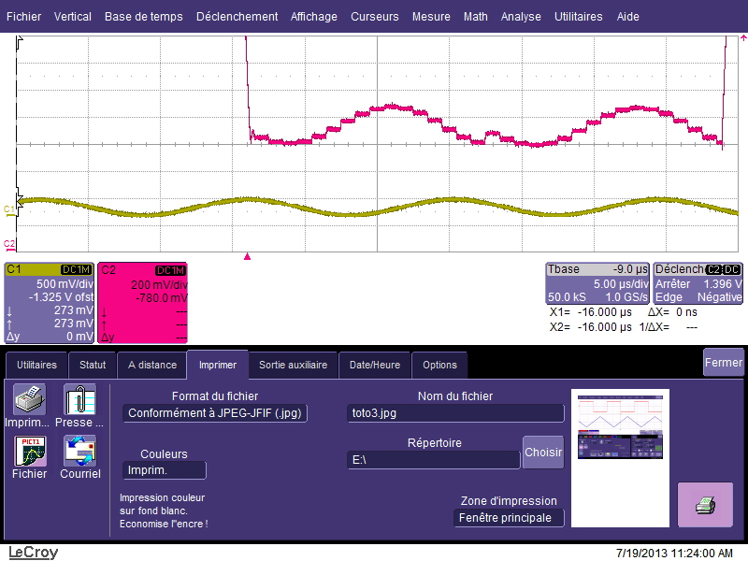
D²R₁ : et après?
Connexion à un détecteur matriciel
Mode « sample out » et filtrage numérique
Tenue aux radiations

Slide 29
Conclusions et Messages
  Vers la fin de la CMOS 0.35µm à Saclay => productions finales en 2012-2013. (Mais prévenez nous quand même si run engineering!)
  De nombreux chips en attente de retour de Fab => période creuse en conception?
  La phase de dispersion technologique continue.

Slide 30
BACKUP Slides

Slide 31
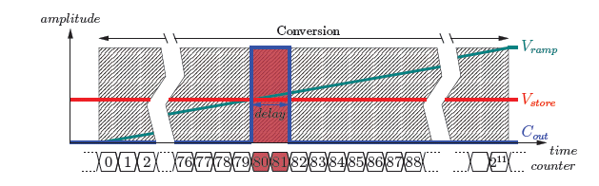
Wilkinson Digitization (1 per cell)
  Simultaneous conversion of all the cells of the triggered channels:
Ramp generator
comparator
×
64
comparator
Starts the on-chip 1.3 GHZ VCO
Starts the on-chip 1.3 GHz Gray counter and sends its outputs to the channels to convert
Starts the ramp generators of channels to convert: tunable slope: speed/precision tradeoff
    1.6µs/11bit, 400ns for 9 bit…
    Main contribution to the Dead Time
Enable the 64 comparators of the enabled channel
When Ramp crosses cell value => counter stored in a register
Once converted, a channel is immediately usable to record a new event
Start ramp
Convert ch(i)
cell
D
Q
cell
D
Q
11bit
× 16
11bit
Convert
Start count
11-bit Gray Counter
1.3 GHz
VCO
FEE 2014, Argonne NL.

Slide 32
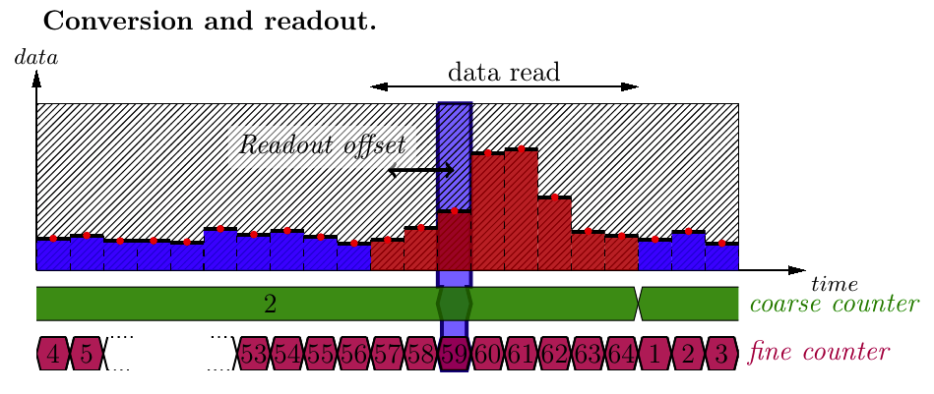

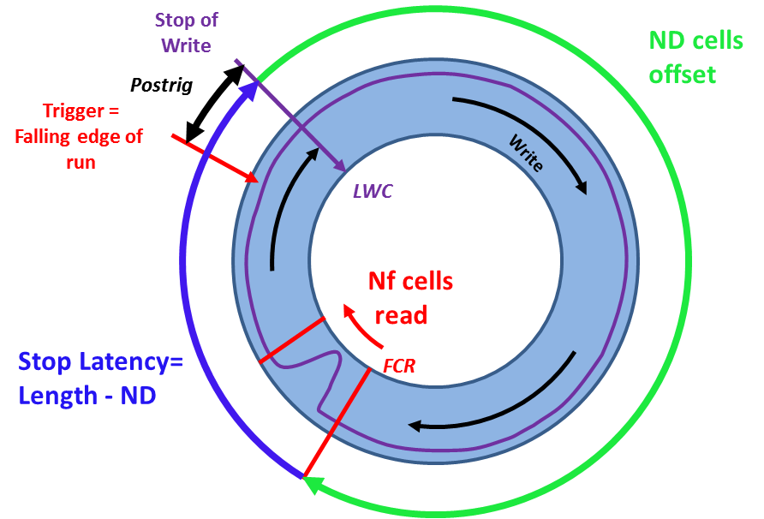
Analog memory (SCA)
No input buffer, Single ended
64 Cell-depth trade-off between:
    Time precision /stability (short)
    Input capacitor (short)
    Accommodation to trigger latency (long)
  >1 GHz BW
  1V usable range
  Cell structure with 3 switches to avoid leakages and ghosts. Switch 3 also isolate from coupling from input during conversion
  Continuously writing until triggering (circular buffer)
  « TDC » like trigger position marking
  Special design ensuring good quality (constant bandwidth and constant tracking duration) over all the 64 samples (even those after trigger)
  Optional Region of Interest Readout for deadtime minimization
~50fF

Slide 33
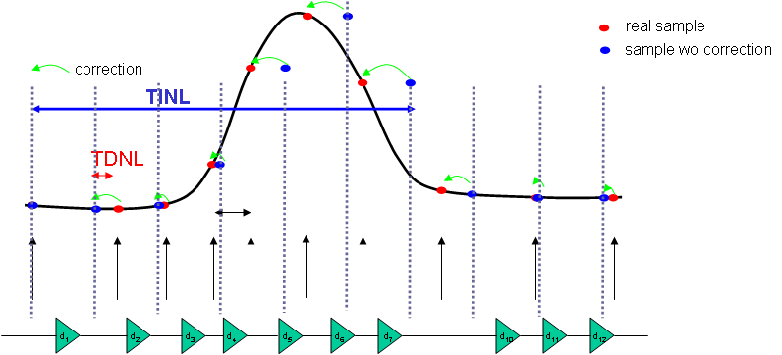
Timing Non_Linearities
Dispersion of single delays => time DNL
Cumulative effect => time INL. Gets worse with delay line length.
Systematic & fixed effect => non equidistant samples => Time Base Distortion
  If we can measure it => we can correct it !
  But calibration and even more correction have to remain “reasonable”.
Δt[cell]
Fake signal
Real signal
After interpolation
Remark:
same type of problem
occurs
with interleaved ADCs

Slide 34
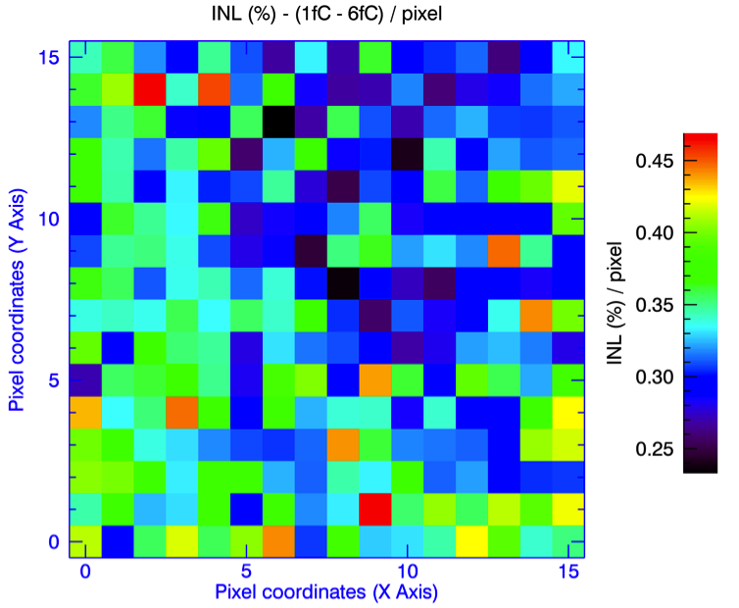
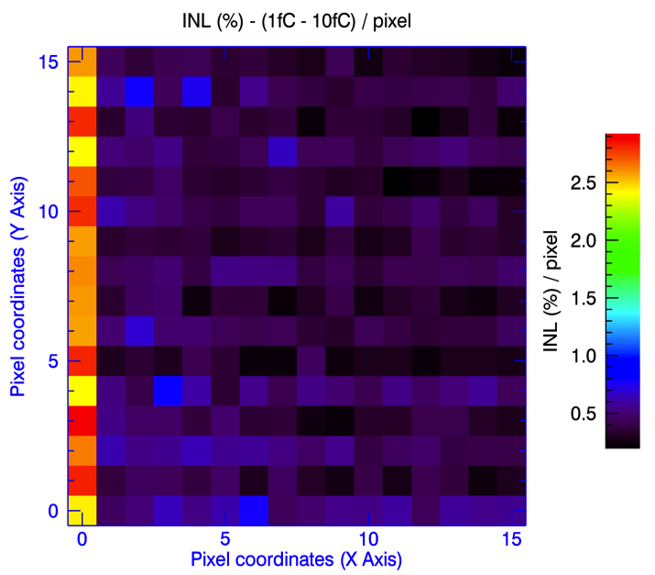
D²R₁ : caractérisation sans détecteur
Mode MCDS, F_{ech}=600kHz, N_{ech}=16, 300µW/canal.
Submitted:december 2009
Come back from fondry: february 2010
Picture of the layout with the different stages, dimensions, ratio between analog and digital part, presentation of the main parts of the layout.
Channel, temperature sensor, digital part, buffer….

Slide 35
PIXAM Chip
PIXAM (Pixel Sensor for ALICE Muon Forward Tracker-MFT)
1/3 of final chip
Tower-Jazz 0.18 µm CMOS 6M1L process
Rolling Shutter mode
In-pixel amplification, CDS and auto-zeroed discrimination
25 µm x 25 µm pixel pitch
Nominal readout: 15.36 µs (Possible readout: 10 µs)
Zero suppress
Estimated power dissipation: ~150 mW/cm²
Reuse of some existing blocs from IPHC
DACs with related bias circuitry
Bandgap, LVDS drivers
Testability
8 columns digital readout (16 outputs)
8 columns analog readout (16 outputs)
Test patterns input for Zero Suppress
32 CMOS outputs for Zero Suppress
Analog Outputs (16 PADs)
CMOS Dig. Test Outputs (16 PADs)
Output Mux
150 µm
Analog Pixels (8 col.)
Digital Pixel Array
(192x384)
4.8 mm
9.6 mm
References Buffers
100 µm
Sequencer
Writing of test patterns
6 row digital buffer
250 µm
Zero Suppress MFT
Bandgap + DACs
Bias
Slow Control
LVDS Drivers
32 CMOS Zero Suppress Outputs (32 PADs)
24 LVDS outputs, Serializer (48 PADs)

Slide 36
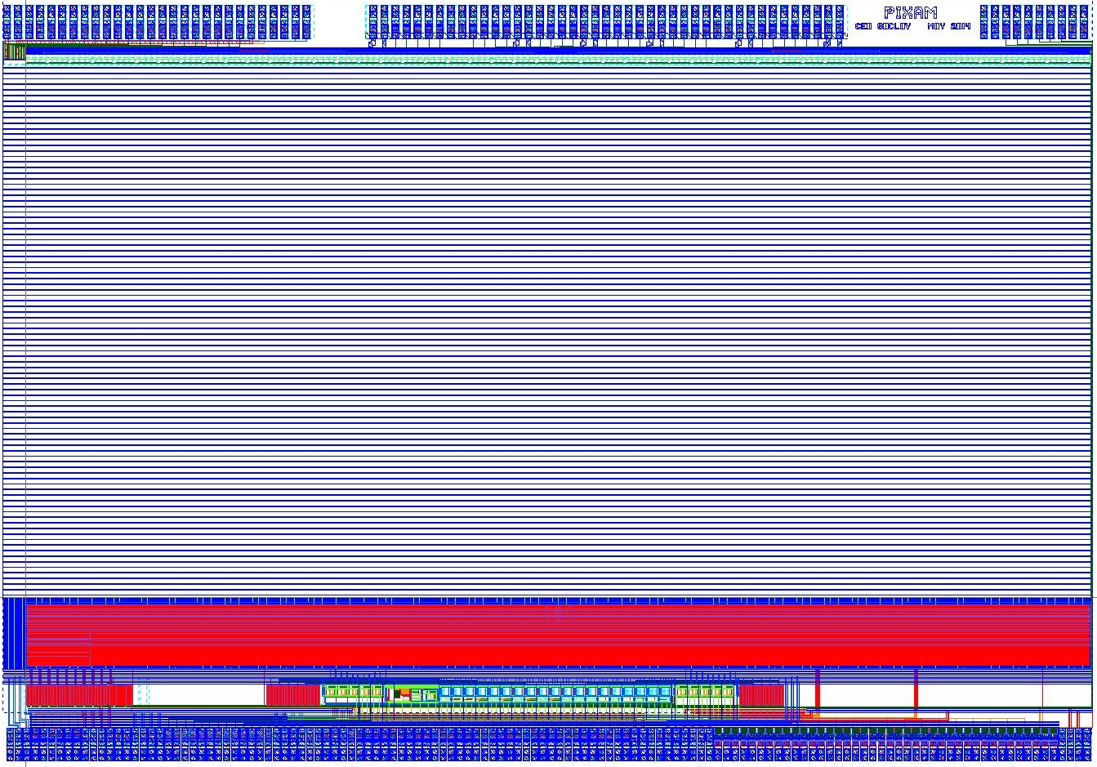
PIXAM Chip
Test Columns & Pads
Digital Pixel Array (192 x 384)
~ 9.6 mm x 6.2 mm
Zero Suppress MFT
Slow Control
DAC’s, buffers…
Submitted to fabrication
on May 12th 2014

