Slide 1
HODOPIC: a multi channel front-end ASIC for a beam tagging hodoscope
L. Caponetto, S. Deng, H. Mathez, W. Tromeur, Y. Zoccarato

Slide 2
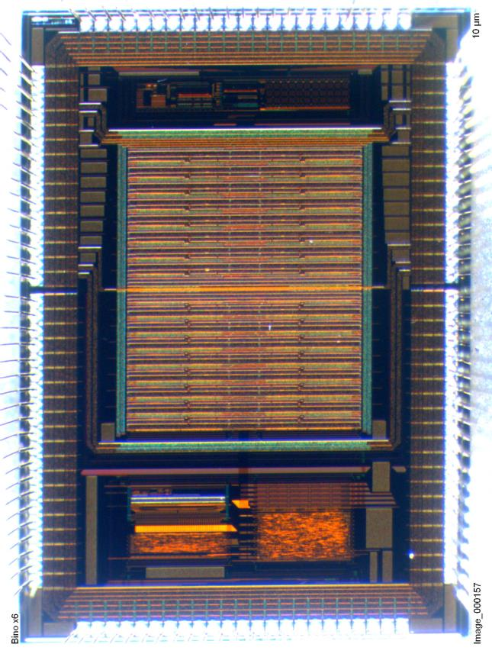
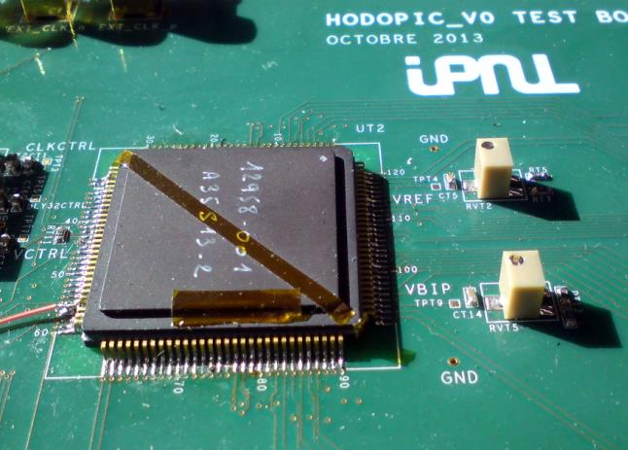
HODOPIC: hodoscope front-end
Context: ion-beam therapy (ANR GAMHADRON)
prototype of a Compton camera (see Y.Zoccarato presentation)
Readout of a beam hodoscope with time tagging feature
X,Y position + time on incident ions
particle fluencies up to 10⁸ ¹²C ions/s
Detector: optical fibers + multi-anode PMs
32+32 channels/PM: fibers read from both ends
Max expected trigger rate: 100 MHz
Max counting rate/channel: 10 MHz

Slide 3
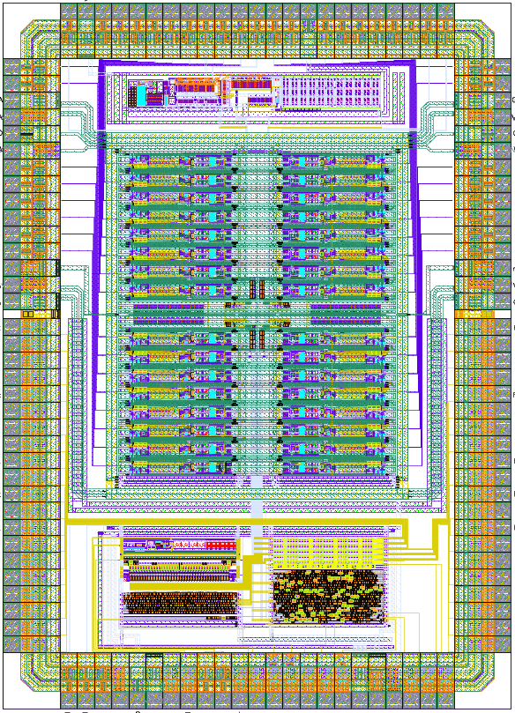
HODOPIC V0: first silicon
HODOPIC V0: first silicon after 2 evaluation chips
timeline:
first evaluation chip (S. Deng PhD Thesis): June 2010
HODOPIC design submission: June 2013
tests: ongoing
first die integrating front-end and Time Stamper
32 readout channels: <100 mA @ 3.3 V
asynchronous event-driven architecture
reference clock needed only for Time Stamper
typical signal (current): 10 ns
input dynamic range (charge): 2 pC – 10 pC
input dynamic range (current): 200 uA – 1 mA
adjustable threshold current
external resistor + 10b DAC (OMEGA group)
4b adjustable gain (per input channel)
1 muxed analogue output channel
(fiber ageing monitoring)
time reference input clock @160 MHz
time measurement resolution: 1 ns
time measurement dynamic range: 50 ns
40b digital output bus with 100 MHz readout
I²C interface for slow control parameters
technology AMS BiCMOS 0.35: about 13 mm²
25 packaged ASICs production (CQFP120)

Slide 4
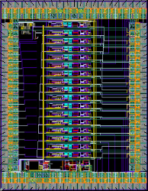
HODOPIC architecture: previous evaluation chips
first evaluation chip:
June 2010
8 + 8 channels front-end
8 + 8 binary outputs
two comparator architectures tested
front-end validated in test-beam
2207 x 2792
second evaluation chip:
December 2011
32b DLL @160 MHz
32-to-5 output Gray decoder
1870 x 1566

Slide 5
HODOPIC architecture: previous evaluation chips
first evaluation chip:
June 2010
8 + 8 channels front-end
8 + 8 binary outputs
two comparator architectures tested
front-end validated in test-beam
2207 x 2792
second evaluation chip:
December 2011
32b DLL @160 MHz
32-to-5 output Gray decoder
1870 x 1566

Slide 6
HODOPIC architecture: previous evaluation chips
first evaluation chip:
June 2010
8 + 8 channels front-end
8 + 8 binary outputs
two comparator architectures tested
front-end validated in test-beam
2207 x 2792
second evaluation chip:
December 2011
32b DLL @160 MHz
32-to-5 output Gray decoder
1870 x 1566

Slide 7
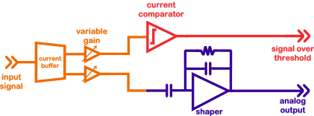
Front-end evaluation chip: readout channel
684

Slide 8
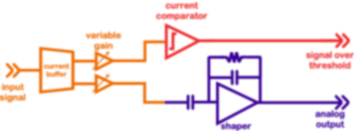
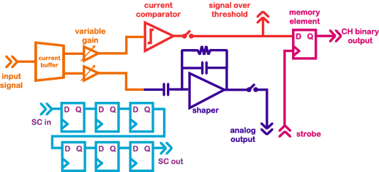
HODOPIC: modified readout channel (1)
HODOPIC integrates 32 front-end channels
added features:
memory bit for binary output
event triggering
channel mask
mux on analogue output
6b slow control register:
input gain + mask + analogue out mux

Slide 9
HODOPIC: modified readout channel (2)
HODOPIC
front-end evaluation chip
684

Slide 10
HODOPIC: modified readout channel (3)

Slide 11
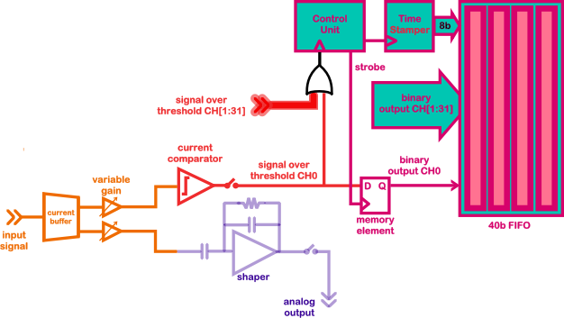
HODOPIC: event driven architecture

Slide 12
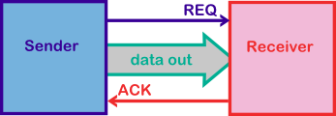
Asynchronous design style
sender/receiver communication protocol
two signaling wires with arbitrary number of data bits
2-phase philosophy:
rising and falling transitions on signaling wires have the same meaning
data are consumed only after having been validated by a request event
new data are produced only after an acknowledge event has been received
MICROPIPELINES:
easy implementation of asynchronous data-driven architectures

Slide 13
Asynchronous design style (2)
sender/receiver communication protocol
two signaling wires with arbitrary number of data bits
2-phase philosophy:
rising and falling transitions on signaling wires have the same meaning
data are consumed only after having been validated by a request event
new data are produced only after an acknowledge event has been received
MICROPIPELINES (*):
easy implementation of asynchronous data-driven architectures
(*) see amongst others I. Sutherland and S. Furber works

Slide 14
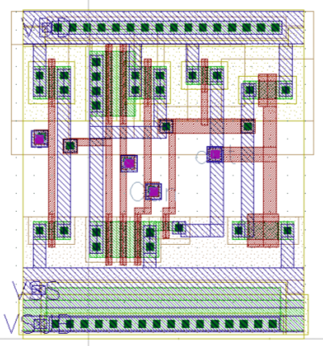
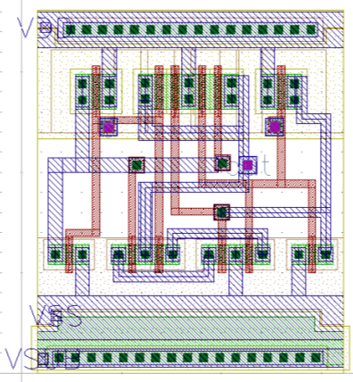
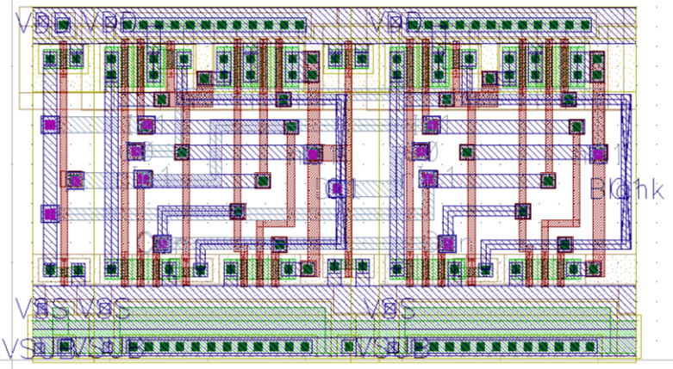
Event control modules
Basic building blocks to easily implement transition signaling circuits contains:
(Muller) C-gate: AND function for transition events
it enables events to propagate only when there has been an event on both outputs
XOR gate: OR function for transition events
it merges two event streams into one: care must be paid in not having two simultaneous events on both inputs
Toggle gate: steers incoming events to one of two outputs
used to split an incoming event stream

Slide 15
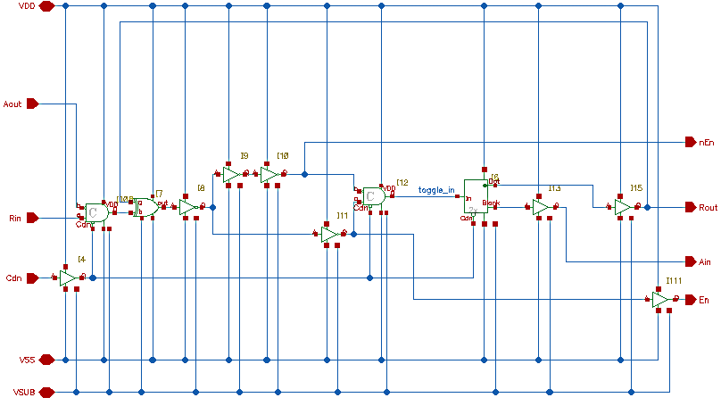
Asynchronous event FIFO
HODOPIC FIFO is a 4 level 40b event asynchronous (clockless) FIFO
based on transparent latches and blocking Micropipeline with fast forward control units

Slide 16
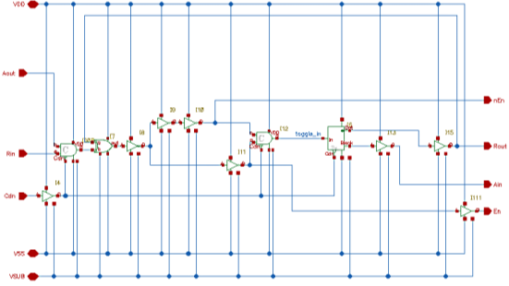
Asynchronous event FIFO (2)
HODOPIC FIFO is a 4 level 40b event asynchronous (clockless) FIFO
based on transparent latches and blocking Micropipeline with fast forward control units
195
729

Slide 17
HODOPIC architecture: floorplan

Slide 18
HODOPIC architecture: floorplan
Reference currents
4 mirrored currents generated from external resistor and bandgap
I_{ref} = I_{baseline} + 2 x I_{dac}
3b programmable current mirror provides baseline adjustment : [0uA : 350uA] typical
10b current DAC (courtesy of OMEGA group) provides fine adjustment: LSB is 21,7 nA typical

Slide 19
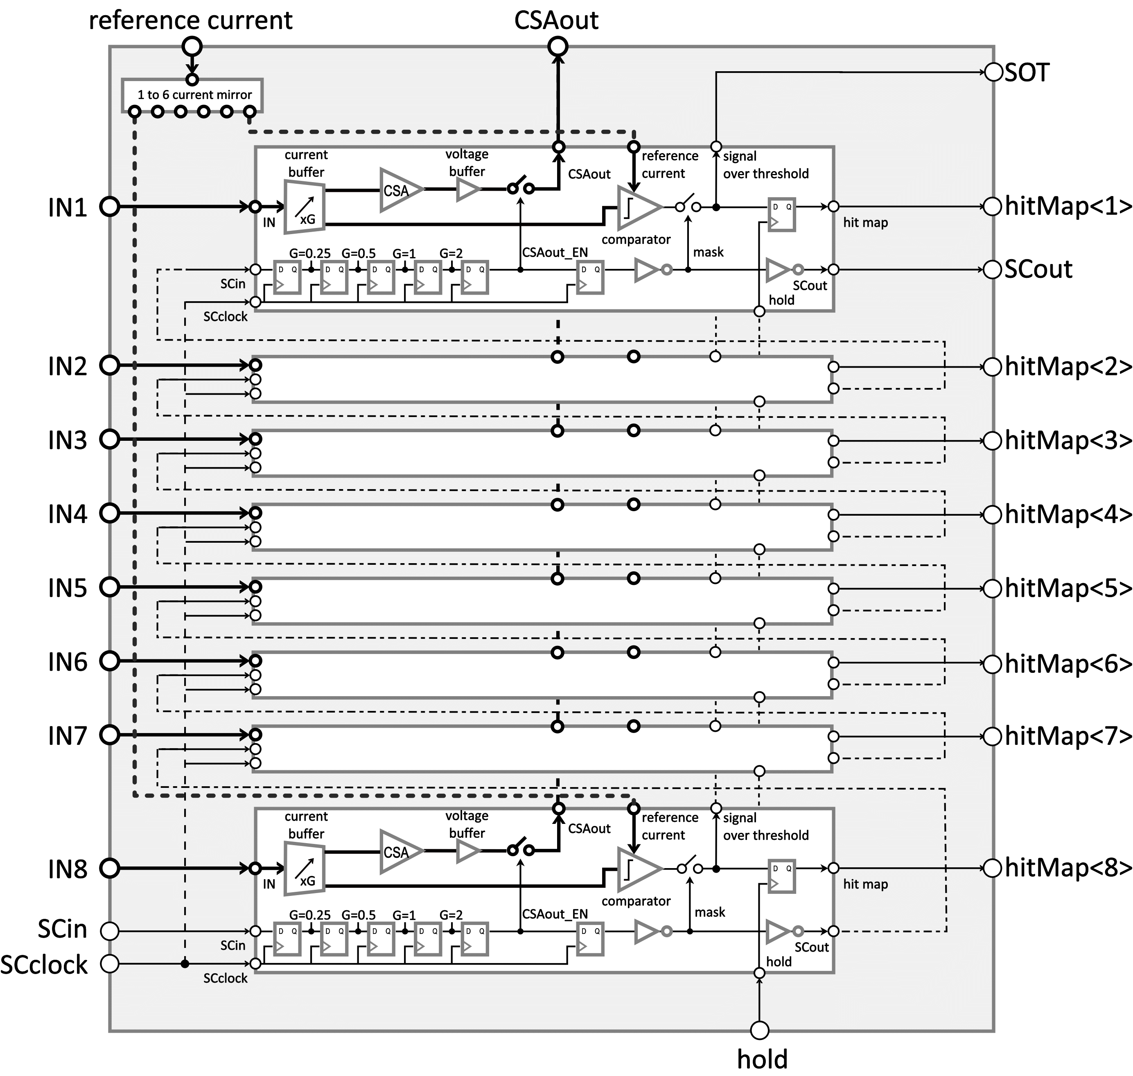
HODOPIC architecture: floorplan
Front-end block
8 front-end channels in each block
4 identical front-end blocks
a 1:8 local current mirror copies reference currents for 8 channels
on each block:
one Signal Over Threshold digital output
8b latched comparators output memory
8x 8b slow control registers

Slide 20
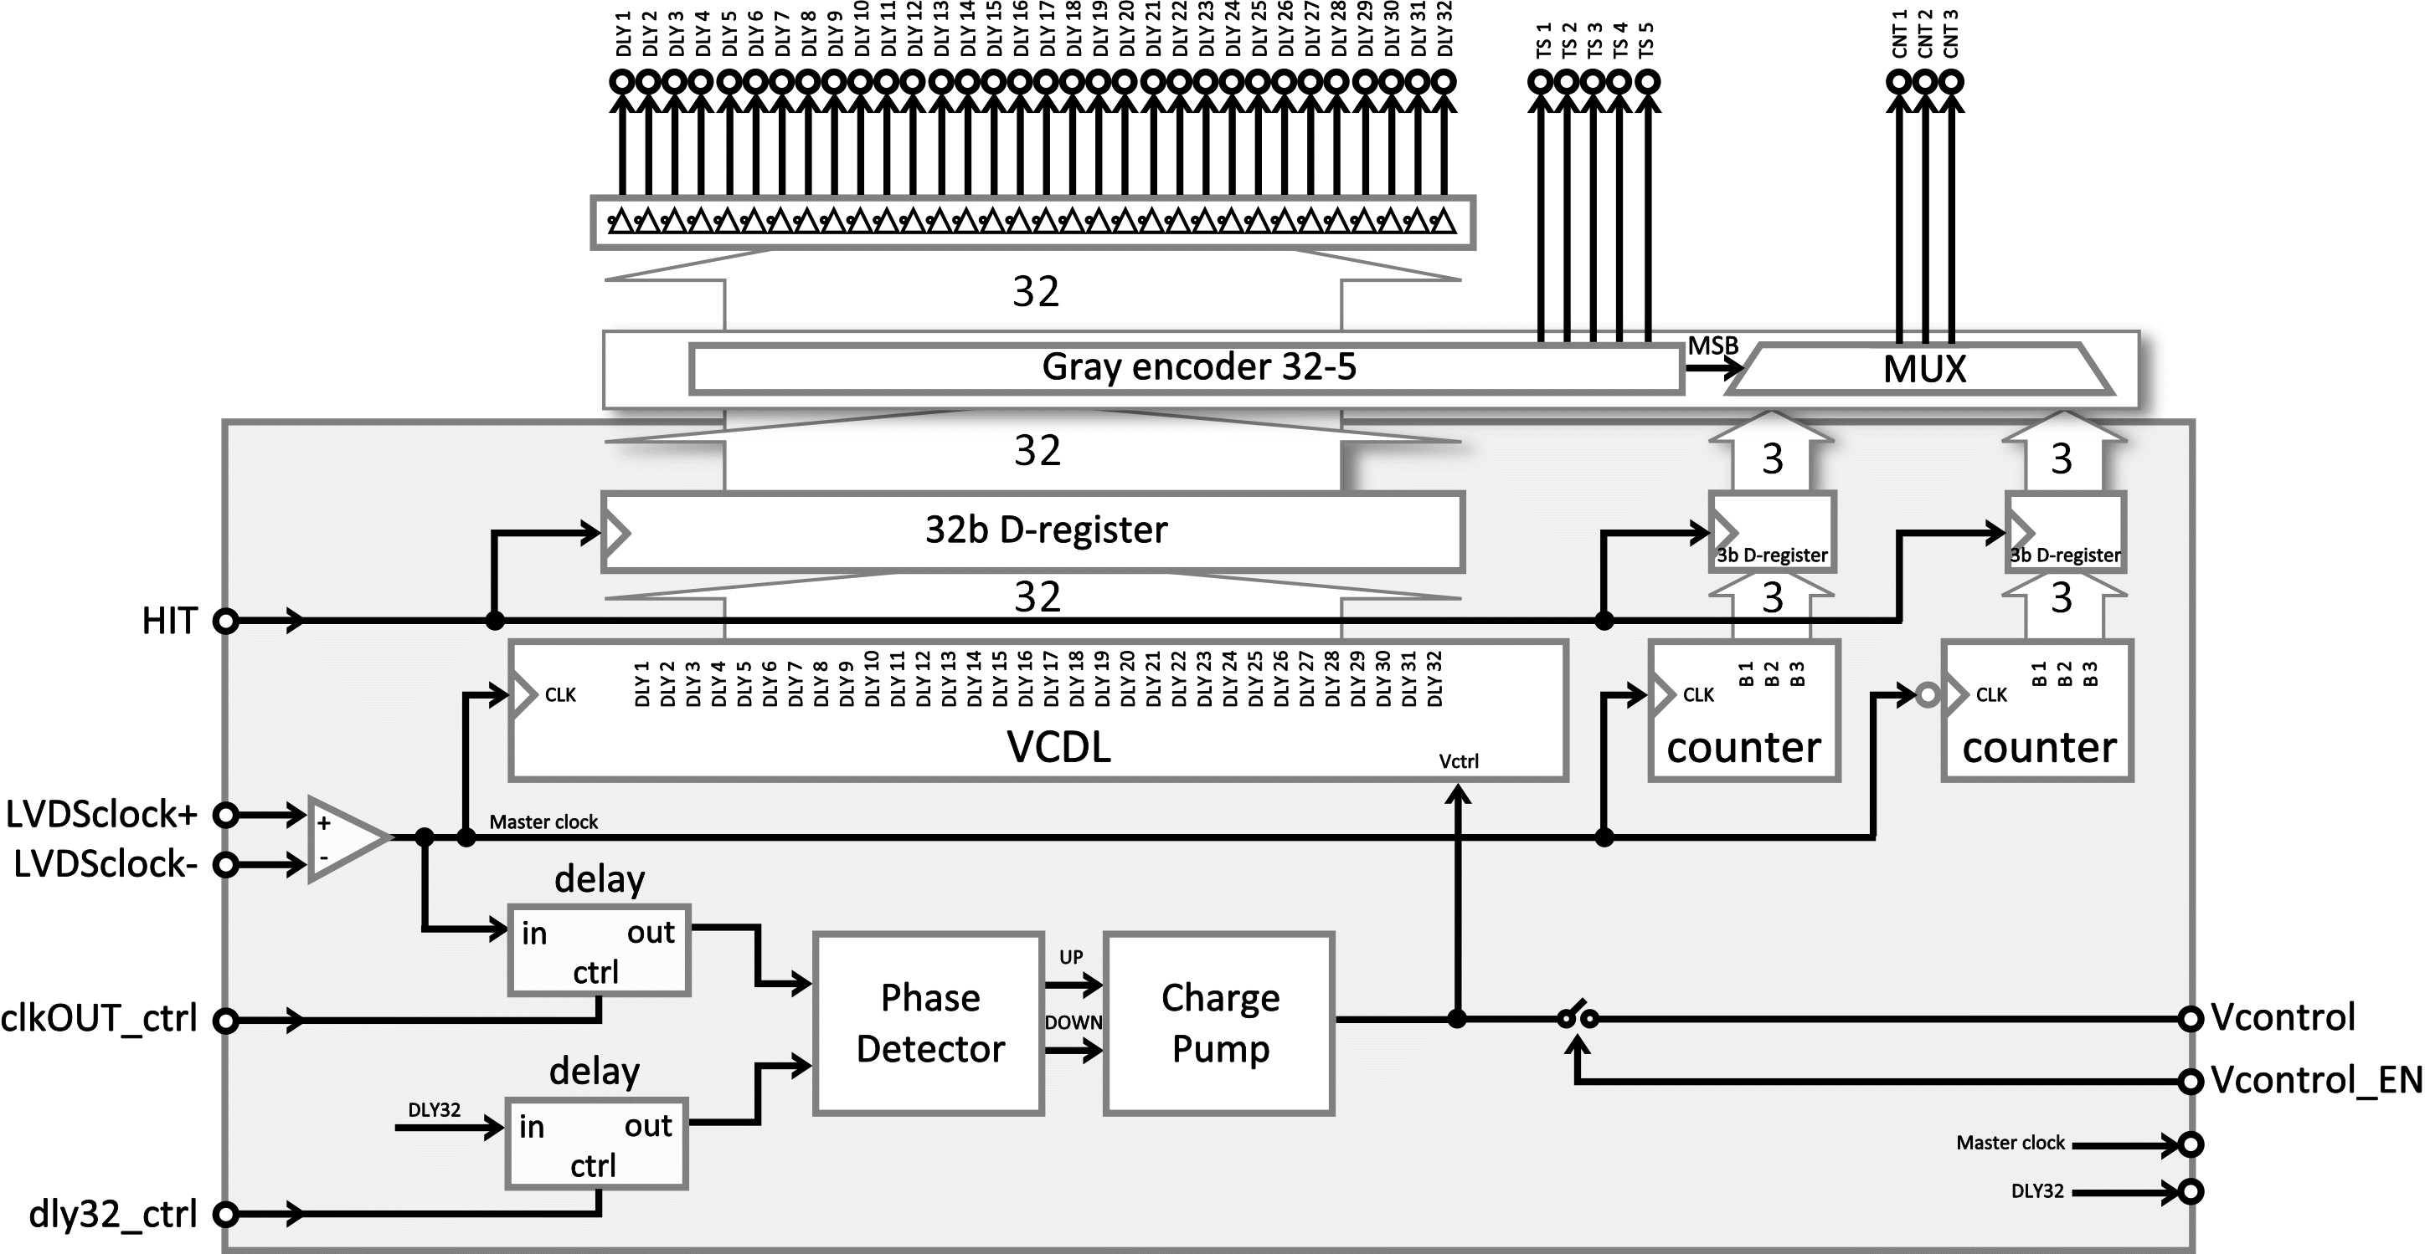
HODOPIC architecture: floorplan
Time Stamper block
32 elements DLL @160MHz external clock (as in SCATS chip)
2x 3b counter provides 50ns time dynamic (as in IMOTEPAD chip)
5b Gray decoding of the 32b Voltage Controlled Delay Line
DLL architecture described in S.Deng PhD thesis

Slide 21
HODOPIC architecture: floorplan
Three-state bus
Time Stamper test feature:
content of the 32b VCDL register can be directly written into the FIFO
40b bus three state bus shared between front-end memory and VCDL memory

Slide 22
HODOPIC architecture: floorplan
Async FIFO

Slide 23
HODOPIC architecture: floorplan
I²C slave interface
3x32 (front-end) + 2 (reference current) controls
organised in 27 8b I²C registers

Slide 24
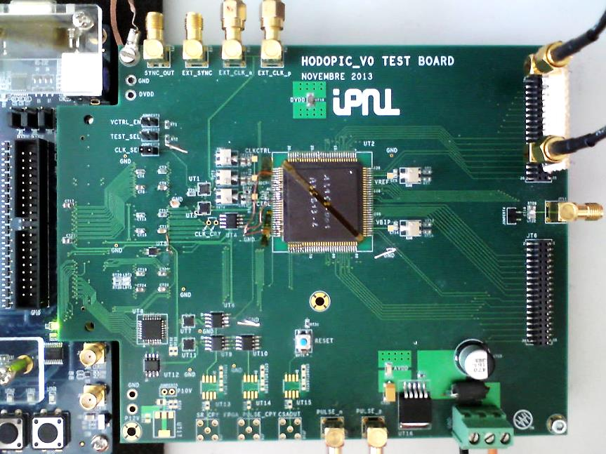
Functionality tests on HODOPIC
daughter board + DE2-115 Terasic board
NIOS processor on a Cyclone IV
embedded C code for DAQ
Labview data analysis on a host PC
I²C interface with Labview GUI
32/32 input channels available for test
analogue output channel available for test
automatic measurements not (yet) available:
this TB was built to validate the design functionality
still usable for a complete characterization with:
new firmware (readout limited at 40 MHz)
development of a new Labview interface

Slide 25
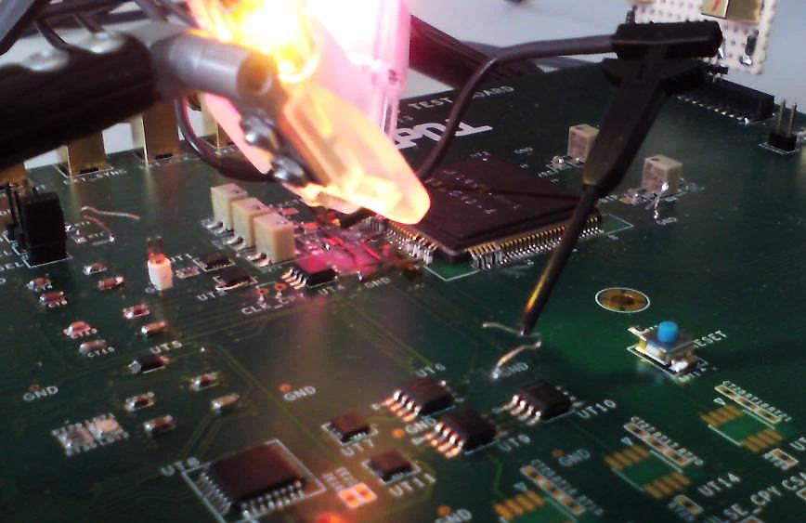
Slow control: I²C interface
27 8b registers set by slow control through a I²C interface
every single channel:
4 gain bits
channel mask bit
analogue output switch
reference current (all channels):
10b fine adjustment
3b baseline (coarse) adjustment

Slide 26
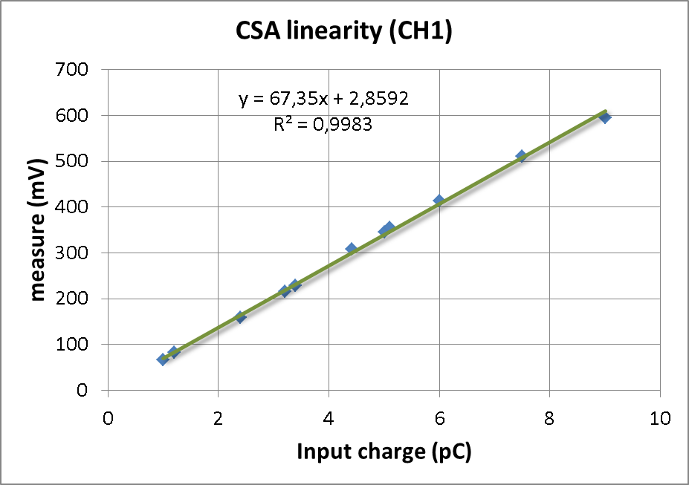
Analogue channel: input buffer + CSA linearity (preliminary)
Test conditions:
input charge injected through a 10 ns voltage ramp on a 3 pF capacitor
Input DeltaV = [0,33 0,4 0,8 1,07 1,13 1,47 1,67 1,7 2 2,5 3]
50 samples/measure
CH1 set at unitary gain
CH1 analogue output selected through its slow-control register

Slide 27
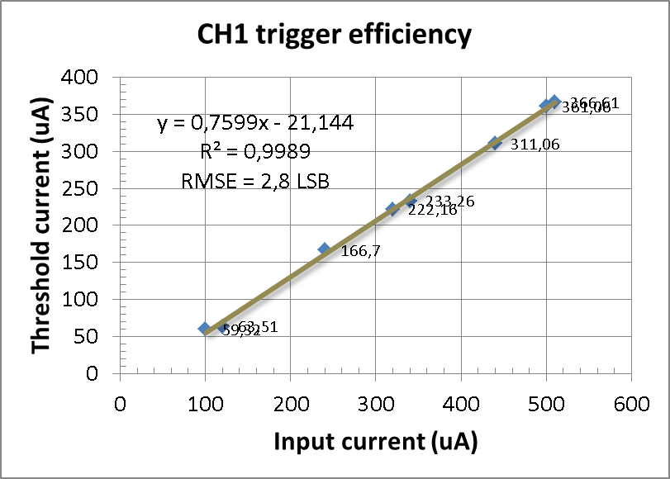
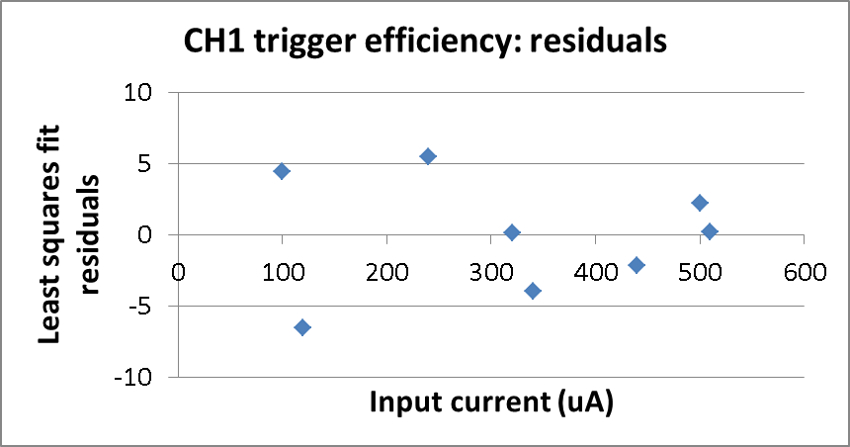
Trigger efficiency: S-curves (preliminary)
Test conditions:
input charge injected through a 10 ns voltage ramp on a 3 pF capacitor
Input DeltaV = [0,33 0,4 0,8 1,07 1,13 1,47 1,67 1,7]
input test pulse at fixed rate (22 MHz)
current threshold is scanned while measuring detection rate
Pedestal is at 61,06 uA (digital noise)
CH1 set at unitary gain

Slide 28
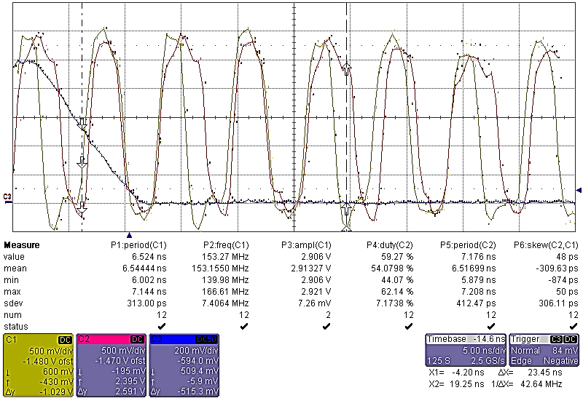
Time Stamper: stability problems
CH1: DLY1
CH2: DLY32
CH3: input voltage step
DLL clock duty cycle deformation (period to period)
Simultaneous Switching Noise: delay line affected by readout digital noise
core and periphery digital supply power rings are not separated
lenght of bonding wires

Slide 29
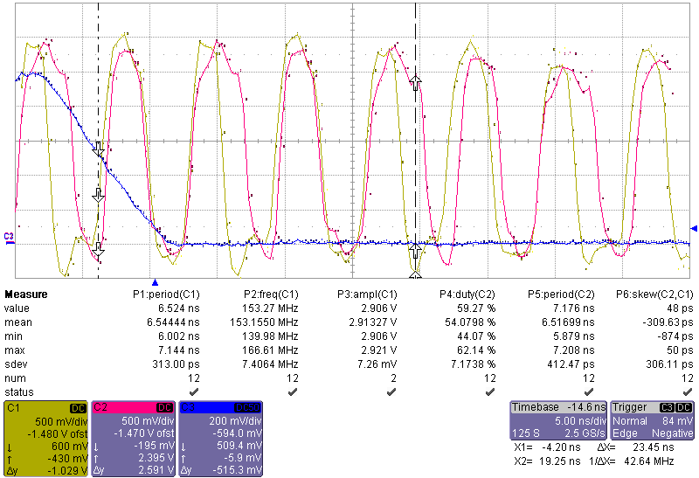
Time Stamper: stability problems
DLL clock duty cycle deformation (period to period)
Simultaneous Switching Noise: delay line affected by readout digital noise
core and periphery digital supply power rings are not separated
lenght of bonding wires ( > 6mm )

Slide 30
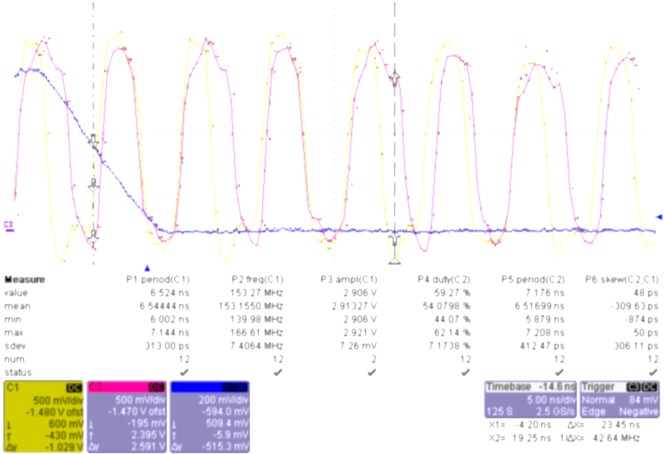
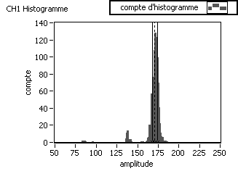
Time Stamper: stability problems
DLL clock duty cycle deformation (period to period)
Simultaneous Switching Noise: delay line affected by readout digital noise
core and periphery digital supply power rings are not separated
lenght of bonding wires ( > 6mm )

Slide 31
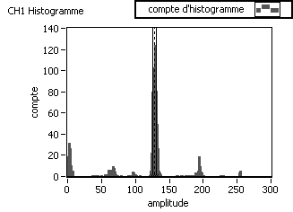
Time Stamper: stability problems
DLL clock duty cycle deformation (period to period)
Simultaneous Switching Noise: delay line affected by readout digital noise
core and periphery digital supply power rings are not separated
lenght of bonding wires ( > 6mm )

Slide 32
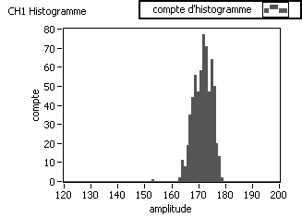
Time Stamper: stability problems
DLL clock duty cycle deformation (period to period)
Simultaneous Switching Noise: delay line affected by readout digital noise
core and periphery digital supply power rings are not separated
lenght of bonding wires ( > 6mm )

Slide 33
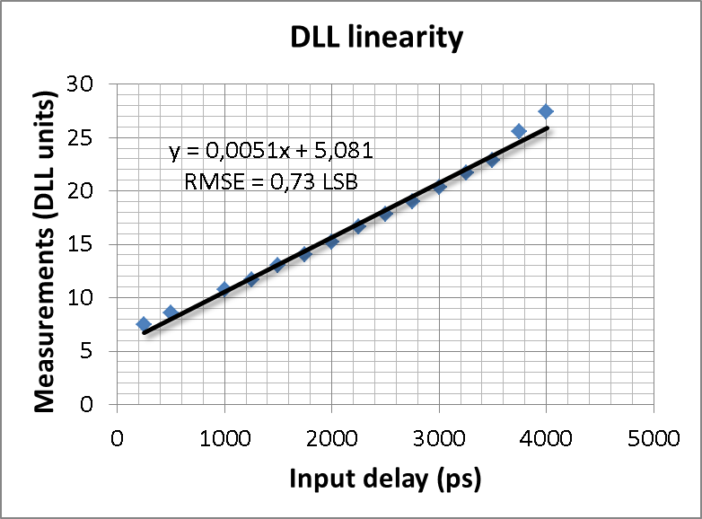
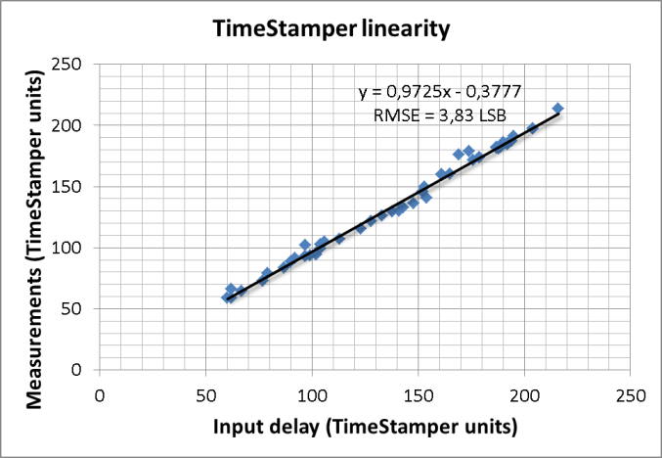
DLL and Time Stamper linearity (preliminary)
DLL linearity test conditions:
input charge is 340 pC
delay of the input pulse wrt reference clock is scanned (full range NOT scanned)
reference (generator) clock jitter measured at 25,6 ps
DLL first and last delay elements jitter measured at 79 ps and 69,4 ps
first delay element output duty cycle is 48% (5,7% sigma)
last delay element output duty cycle is 55% (6,4% sigma)
RMS resolution is 142,4 ps (worst than in DLL evaluation chip: 58,8 ps)
Time Stamper linearity test conditions:
input charge is 340 pC: two channels are used (CH1 and CH10)
delay of the two pulses is changed in the range [11,7 ns : 42,12 ns]
measurements are fitted with a least square method and shows a bad linearity
RMS resolution is less than 4 LSB (746,8 ps)

Slide 34
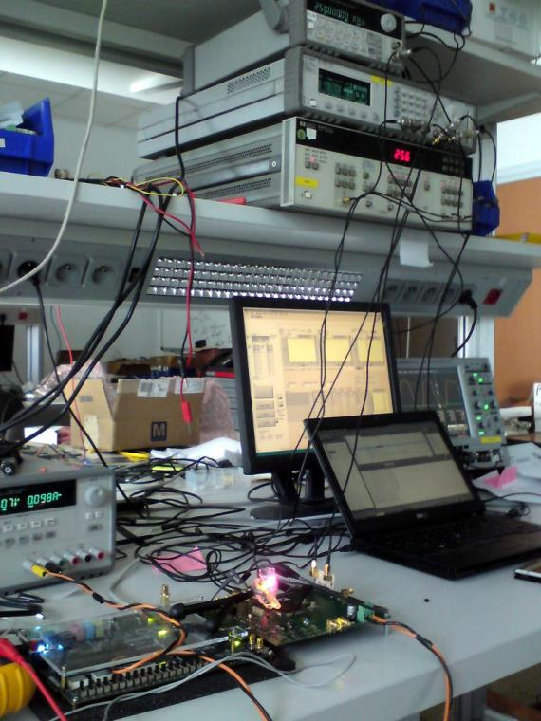
Conclusion
HODOPIC: a multi channel architecture with a binary current readout front-end with single threshold and time-tagging feature
the architecture integrates blocks from two previous evaluation chips
althought all functionalities are achieved the preliminary tests show bad performances of the time stamper unity
observed problems concern new functionality added in HODOPIC (time range extension) as well as the original DLL
could be partly justified by:
poor PSRR , SSN, length of bonding wires
CMP will provide two chips packaged in a smaller cavity package (shorter bonding length)
more tests needed and a full characterisation of the circuit
architectural faults:
DLL power supply not decoupled from output buffers
DLL lock status could not be checked
GAMHADRON ANR funding ended in fev/2014: no second silicon foreseen
a front-end board integrating two HODOPICs already designed: more tests foreseen with a PM

Slide 35
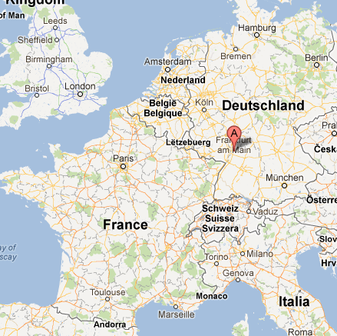
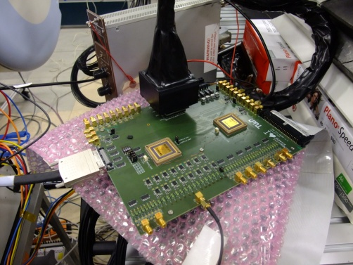
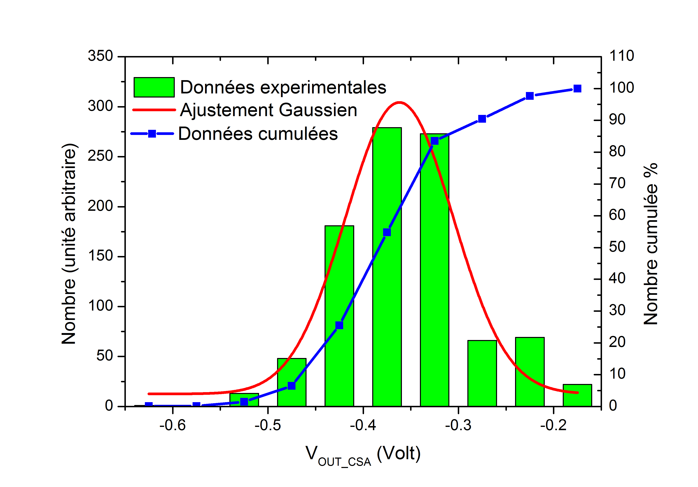
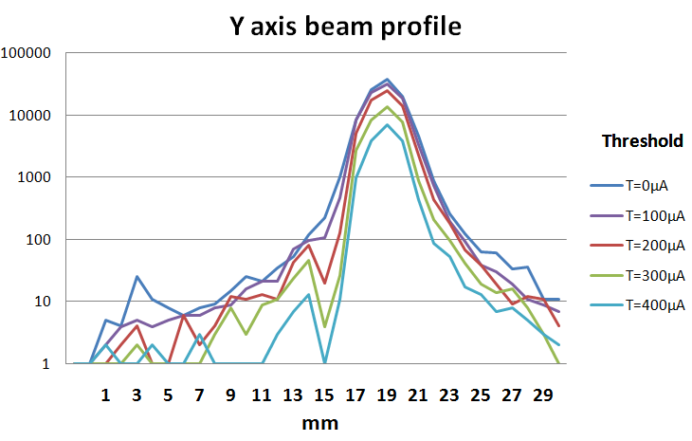
Front-end evaluation chip: test beam results
Ma-PMT (Hamastu H8500)
2 evaluation ASICs
2x 8+8 channels
ASIC associé aux PMTs
Heidelberg Ion-Beam Therapy Center (HIT)
Sorite de CSA d’une voie
32 voies:
Convoyeur + Comparateur
Nombre d’événements incidents
Voie
Beam: d=3.8mm
Analyis :d=3.64mm
σ =0.056 Mean=-0.362
charge (3σ):[-0.192(2.1pC),-0.53(5.9pC)]

Slide 36
Voie
σ =0.056 Mean=-0.362
charge (3σ):[-0.192(2.1pC),-0.53(5.9pC)]

