Slide 1
La technologie HVCMOS pour les upgrades de LHC
Patrick Pangaud
12 juin 2014
Journées VLSI - FPGA - PCB de l'IN2P3 2014

Slide 2
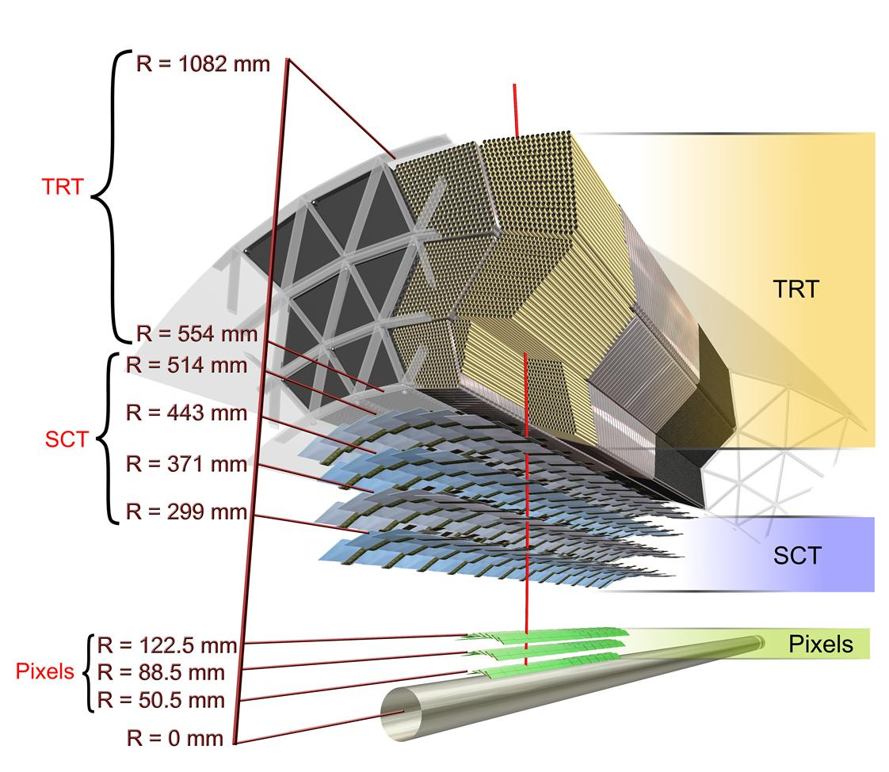
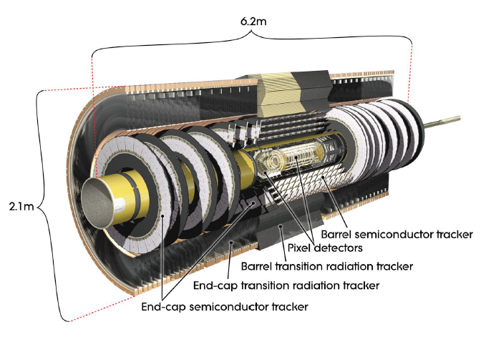
Inner Tracking ATLAS detector
Straw tubes
Silicon strip
Silicon pixel
Pixels area ~1.5m²
Strip area ~100m²

Slide 3
LHC and ATLAS upgrade
Possible upgrade timeline
7 TeV
→14 TeV
→ 5x10³⁴cm⁻²s⁻¹
luminosity leveling
∫ L dt
1x10³⁴ →
~2x10³⁴cm⁻²s⁻¹
3000 fb⁻¹
phase-2
→ 1x10³⁴cm⁻²s⁻¹
~300 fb⁻¹
10²⁷ →
2x10³³cm⁻²s⁻¹
phase-1
~50 fb⁻¹
phase-0
~10 fb⁻¹
2013/14
2018
~2022
Year
Now
T. Kawamoto, TIPP2011, Chicago, USA

Slide 4
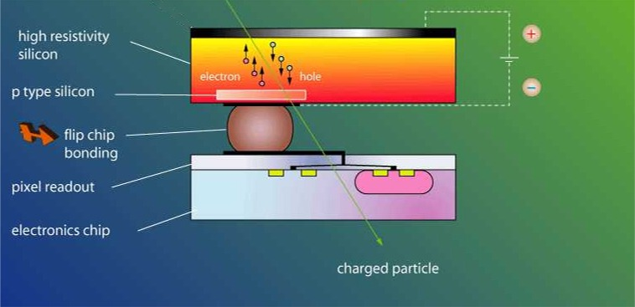
Hybrid Pixels Detector
for particles trackers
An early 3-D approach!!
  Sensor for particles detection
  Dedicated electronic chip
  AND
  A fine pitch bump-bonding solder for interconnection
Sensors (Si, CdTe, GaAs, Diamond…) for ionizing particles
Electronic pixel readout
  Monolithic device
  Analog detection (low noise, low power)
  Discriminator
  Digital readout

Slide 5
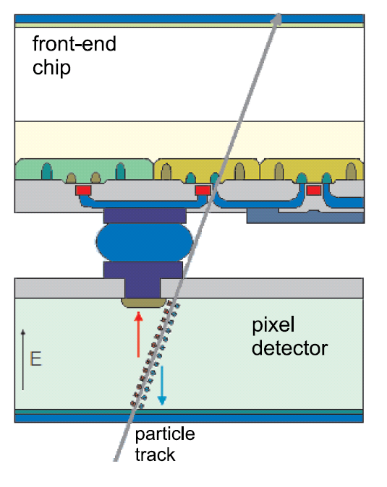
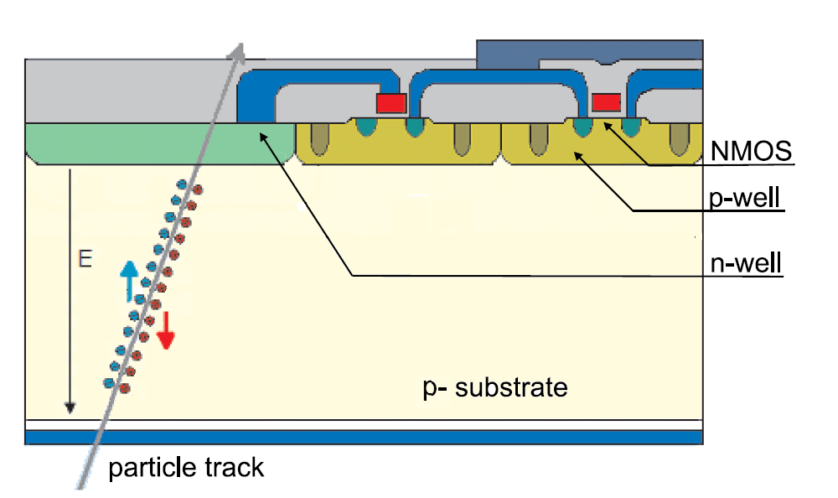
From Hybrid to Monolithic pixel sensor
Hybrid Pixel Detectors
Depleted MAPS
Properties
for HL-LHC need
Charge collection by drift in depleted bulk -> High signal and radiation hardness
d ~(ρV)^{1/2}
Full CMOS technology
- high material budget
- high cost (chip + sensor + hybridization)
Charge collection by drift in depleted bulk -> High signal and radiation hardness
d ~(ρV)^{1/2}
Usually not full CMOS
AND material budget
AND low cost

Slide 6
Smart pixel Project
P-substrate
Pixel electronics in the deep n-well
Deep n-well
NMOS transistor
in its p-well
PMOS transistor
in its n-well
The sensor is based on the “deep” n-well in a p-substrate
E-field
Particle
From the Hybrid Pixel, the outer sensor is placed now into the substrate. The CMOS signal processing electronics are placed inside the deep-n-well. PMOS are placed directly inside n-well, NMOS transistors are situated in their p-wells that are embedded in the Deep-well as well.
The best results are achieved when a standard high voltage CMOS technology is used.
A lowly-doped deep n-well can be then used. Such an n-well can be reversely biased with a high voltage.
We expect a large depleted area thickness
The charge generated by ionizing particles in the depleted area is collected by drift. Due to high electric field and small drift path, charge collection is very fast
Due to drift based charge collection we expect to get an high radiation tolerance

Slide 7
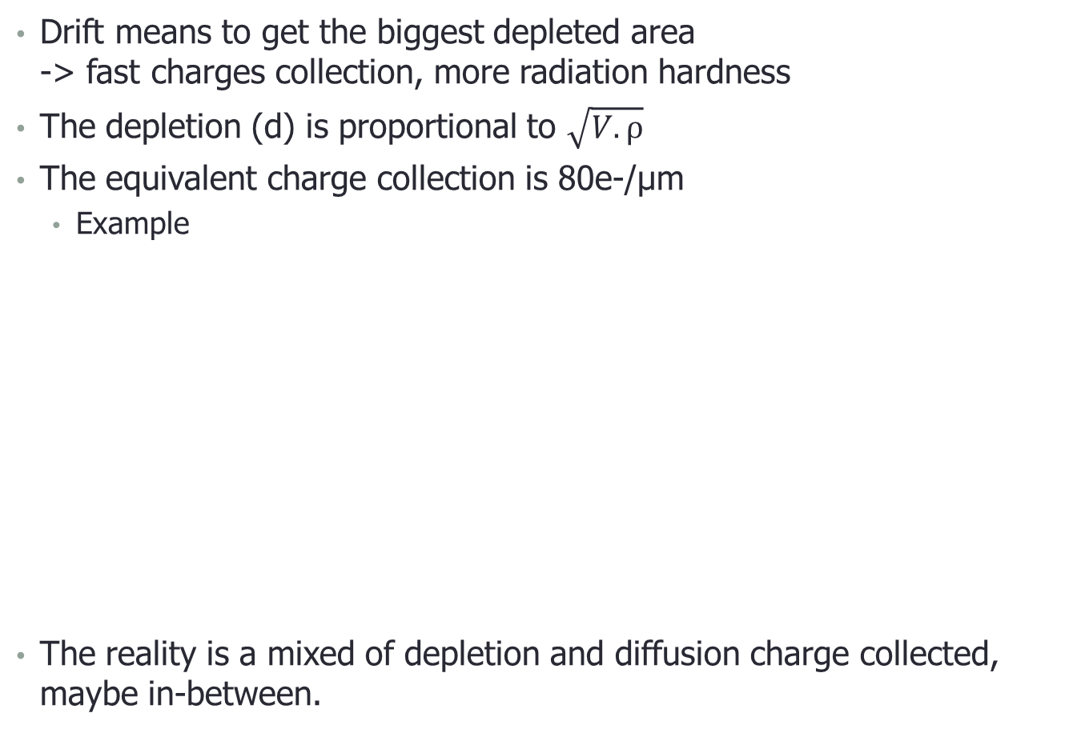
Charge collection by drift (HV vs HR)
Drift means to get the biggest depleted area
-> fast charges collection, more radiation hardness
The depletion (d) is proportional to $\sqrt{V.ρ}$
The equivalent charge collection is 80e-/µm
  Example
The reality is a mixed of depletion and diffusion charge collected, maybe in-between.
charges sharing Psub
DNWELL
NWELL
PWELL
DNWELL
NWELL
PWELL
    200Ω.cm gives d=15µm@100V (1200 e-)
reduced charges sharing Psub
DNWELL
NWELL
PWELL
DNWELL
NWELL
PWELL
    2kΩ.cm gives d=50µm@10V (3500 e-)

Slide 8
Using Hybrid or Monolithic Detectors
Hybrid detector characteristics:
  n-in-n or n-in-p silicon sensor with reduced drift distance
  DSM rad-hard IC (-130nm- or reduced feature size 65nm?).
  Valid option: should work (after development).
  Drawback: 1- Price of hybridization / of non-standard sensors (yield?) and for a large area.
  2- Will stay rather thick.
  3- High bias voltage.
  4- Deep charge collection leads to difficult 2-track separation in boosted jets.
Monolithic detectors characteristics :
  -> Next slide

Slide 9
Monolithic Detectors Main Characteristics
CMOS electronics inside deep n-well.
Negatively biased substrate leads to ~10-15μm depletion zone
 charge collection by drift.
Small feature size + relatively low complexity of in-pixel logic
 small pixel size.
1st stage signal amplification on-sensor (low capacitance  good SNR).
Featuring: 1- electronics rad-hard (DSM technology).
2- sensor rad-hard (small depletion depth, small ΔNeff).
3- low price (standard CMOS process).
4- low material budget (can be thinned down).
5- low maximum bias voltage (moderate substrate resistivity).
6- fast (electronics on sensor).
7- great granularity (1st prototype 33×125μm , can go down).

Slide 10
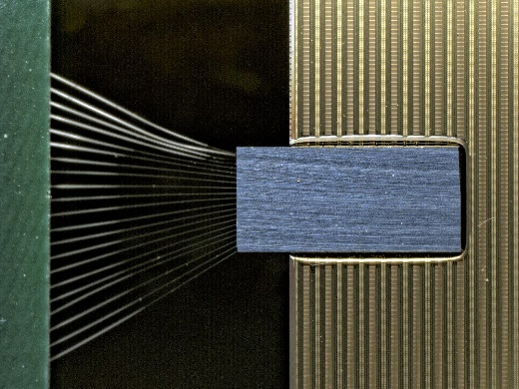
Technologie HVCMOS : Echéances
Période 2014-2015 : Capteur HVCMOS couplé capacitivement au circuit FE-I4-B (pour ATLAS)
Objectif : atteindre 99 % d'efficacité (moins de 1 % masqué pixels) avec un « time-walk » de 25ns, un décodage d'adresse des sous-pixel sur toute la surface de 2cm x 2 cm, avec une tolérance de au moins 300 MRads. Doit servir de démonstrateur in-situ. Pour cela, recherche de la meilleur technologie(HT ou HR), avec contact par colle mais aussi par bump-bonding (coûts plus élevés).
Période 2015-2019 : Capteur HVCMOS couplé au nouveau circuit numérique (FE65 ou FEI4-C) (couplé capacitivement ou par liaison 3D avec TSVs) ou bien directement intégré dans le prochain circuit (FE65 ou autre). Tolérance au radiations jusqu'à 1000 MRad. La technologie HVCMOS devra être fiable, de faible coût avec un fondeur acceptant une grosse production pour fournir les expériences ATLAS et CMS.

Slide 11
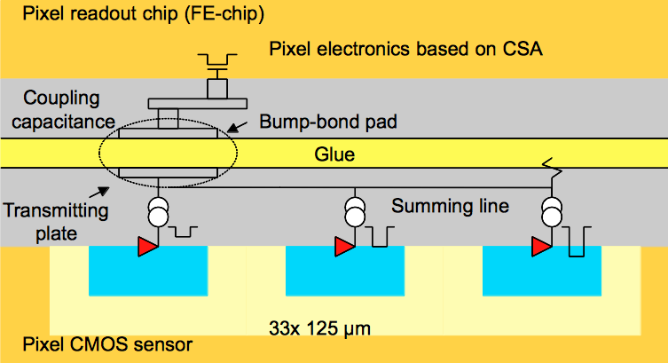
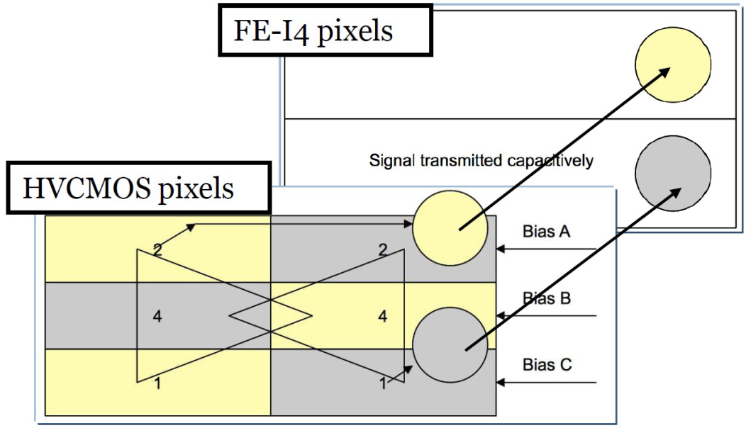
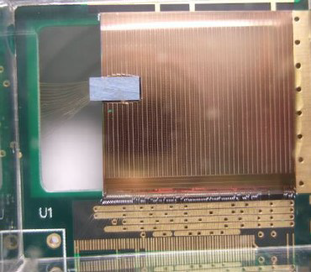
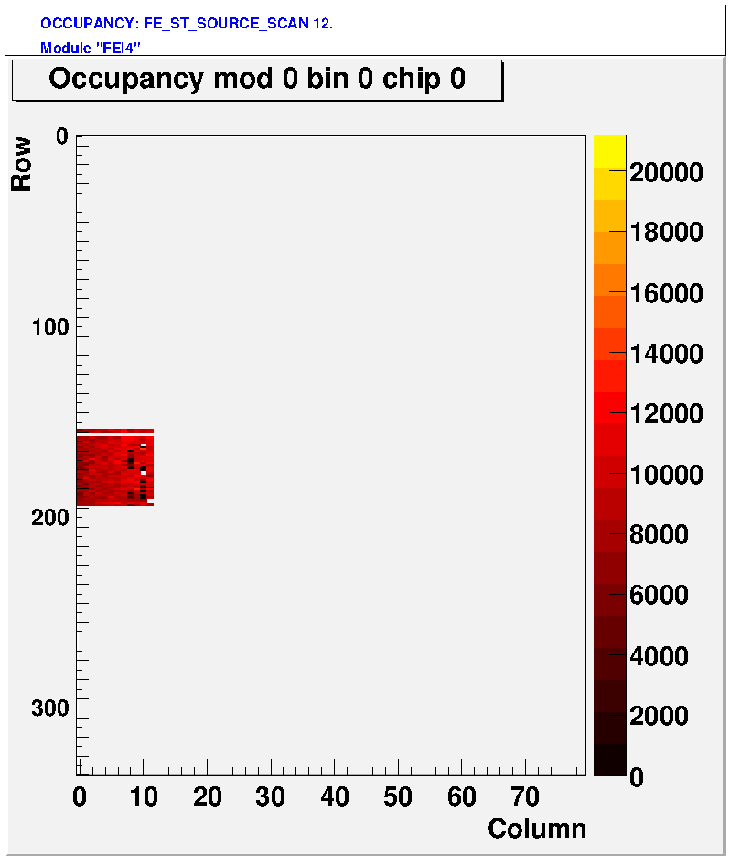
ATLAS Readout -with larger pixels-
Combine 3 pixels together to fit one FE-I4 (50×125μm² pixels), with HVCMOS pixels encoded by pulse height.
The tiny HV2FEI4p2 prototype glued on the large FE-I4

Slide 12
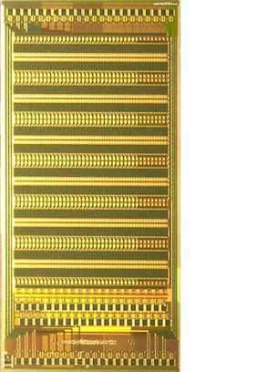
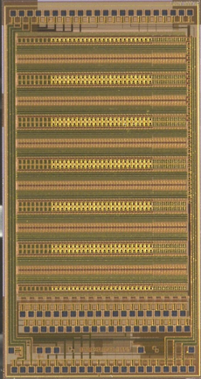
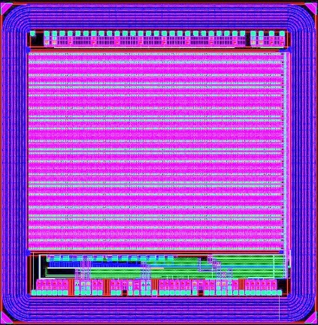
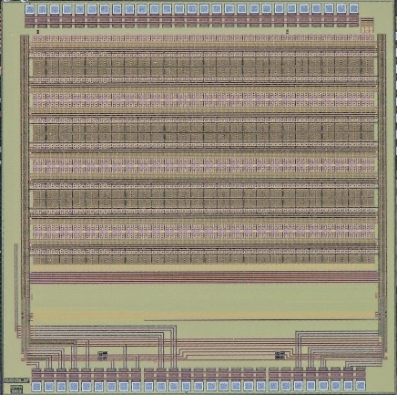
HV2FEI4 chips
2011
AMS 0.18µ HV
3mm x 4mm
CCPD_AMS V1
ρ : 10 Ω.cm
HV : 60V
Few MRads
2012
AMS 0.18µ HV
3mm x 4mm
CCPD_AMS V2
ρ : 10 Ω.cm
HV : 60V
860 MRads
RAD-HARD
RAD-HARD
2014
LF 0.15µ
3mm x 3mm
CCPD_LF V1
1k-3k Ω.cm
10V
? GRads
RAD-HARD & EFFICACITE
2013
GF 0.13µ BCDLite
3mm x 3mm
CCPD_GF V1
10 Ω.cm
HV : 30V
1 GRads
2014
GF 0.13µ LP
3mm x 3mm
CCPD_GF V2
1K- 3k Ω.cm
HV : 30V
1 GRads
RAD-HARD & EFFICACITE

Slide 13
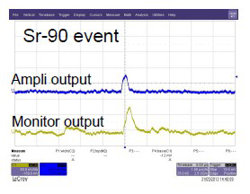
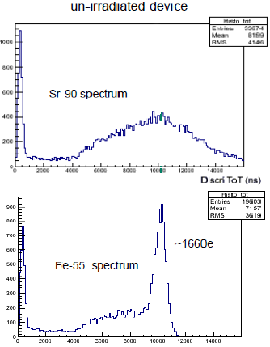
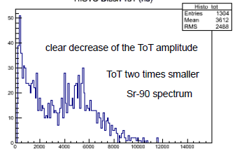
AMS 1nd prototype : unglued
Recorded routinely ⁹⁰Sr and ⁵⁵Fe spectra.
Degradation at 80MRad proton irradiation (dead at 200MRad!)

Slide 14
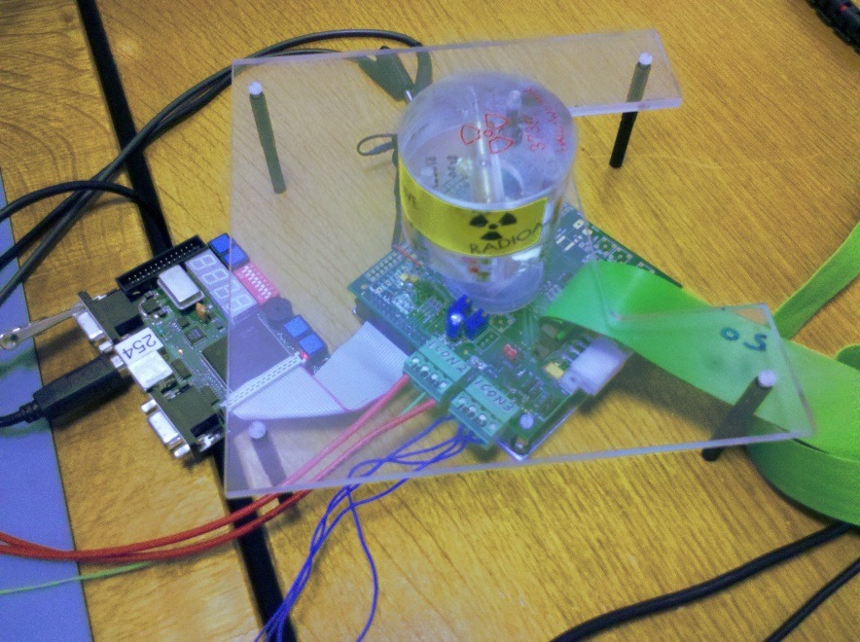
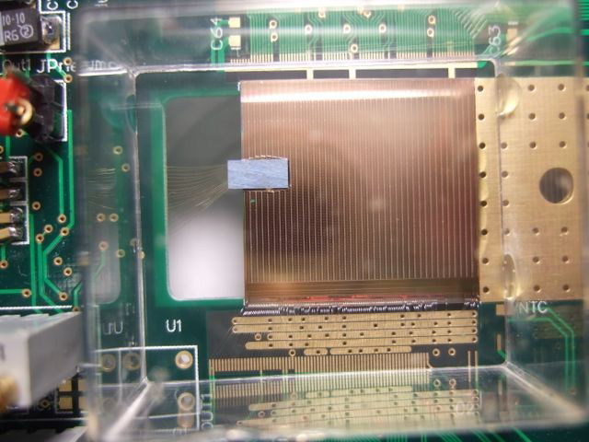
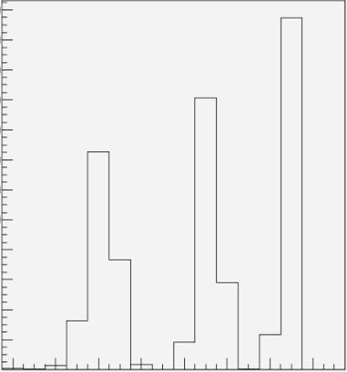
AMS 1nd prototype on FEI4
⁹⁰Sr-source.
Readout through FE-I4.
kHz rate recorded!
Figure 1: the sub-addresses of the CCPD pixels as reconstructed in units of Time-Over-Threshold (ToT, 25 ns) by the FE-I4 chip.
The sub-addresses of the CCPD pixels as reconstructed in units of Time-Over-Threshold (ToT, 25 ns) by the FE-I4 chip.

Slide 15
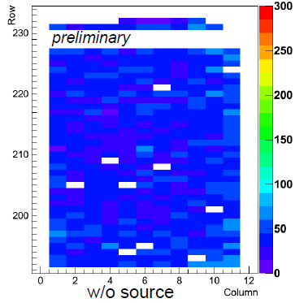
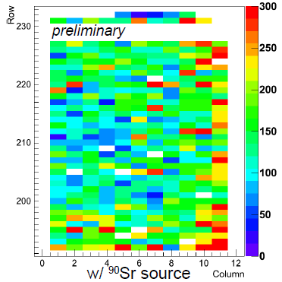
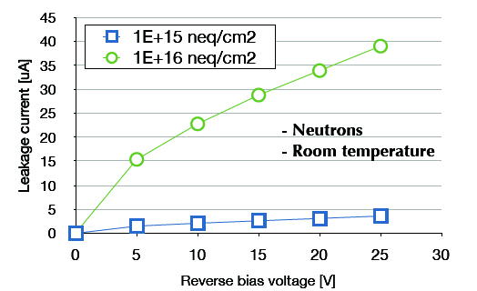
AMS 1nd prototype : Bulk damage
Small depletion depth  bulk enough rad-hard?
Non-ionizing radiation at neutron source (Ljubljana) to 1.10¹⁶ n_{eq}.cm⁻².
No source
With ⁹⁰Sr
sensor works at room T!
Note: 30 days annealing at room temp
leakage current increase
(as expected)

Slide 16
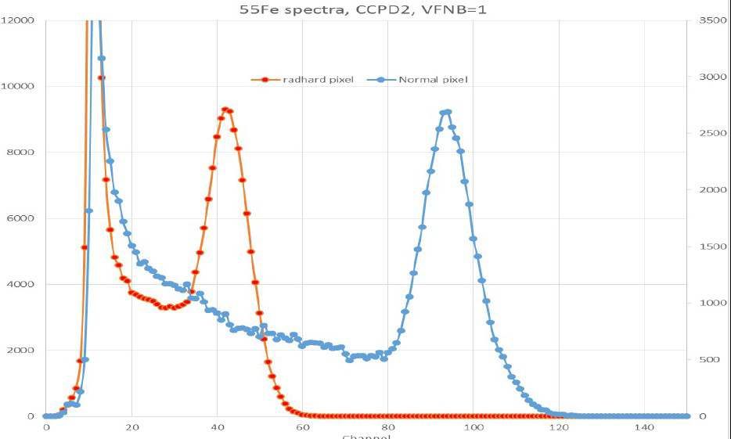
AMS 2nd prototype : TID issue
Few pixel flavors with enhanced rad-hardness: guard rings, circular transistors… (different pixel types lead to different gains -expected-).
⁵⁵Fe spectra, unirradiated
“rad-hard”
“normal”
different gains

Slide 17
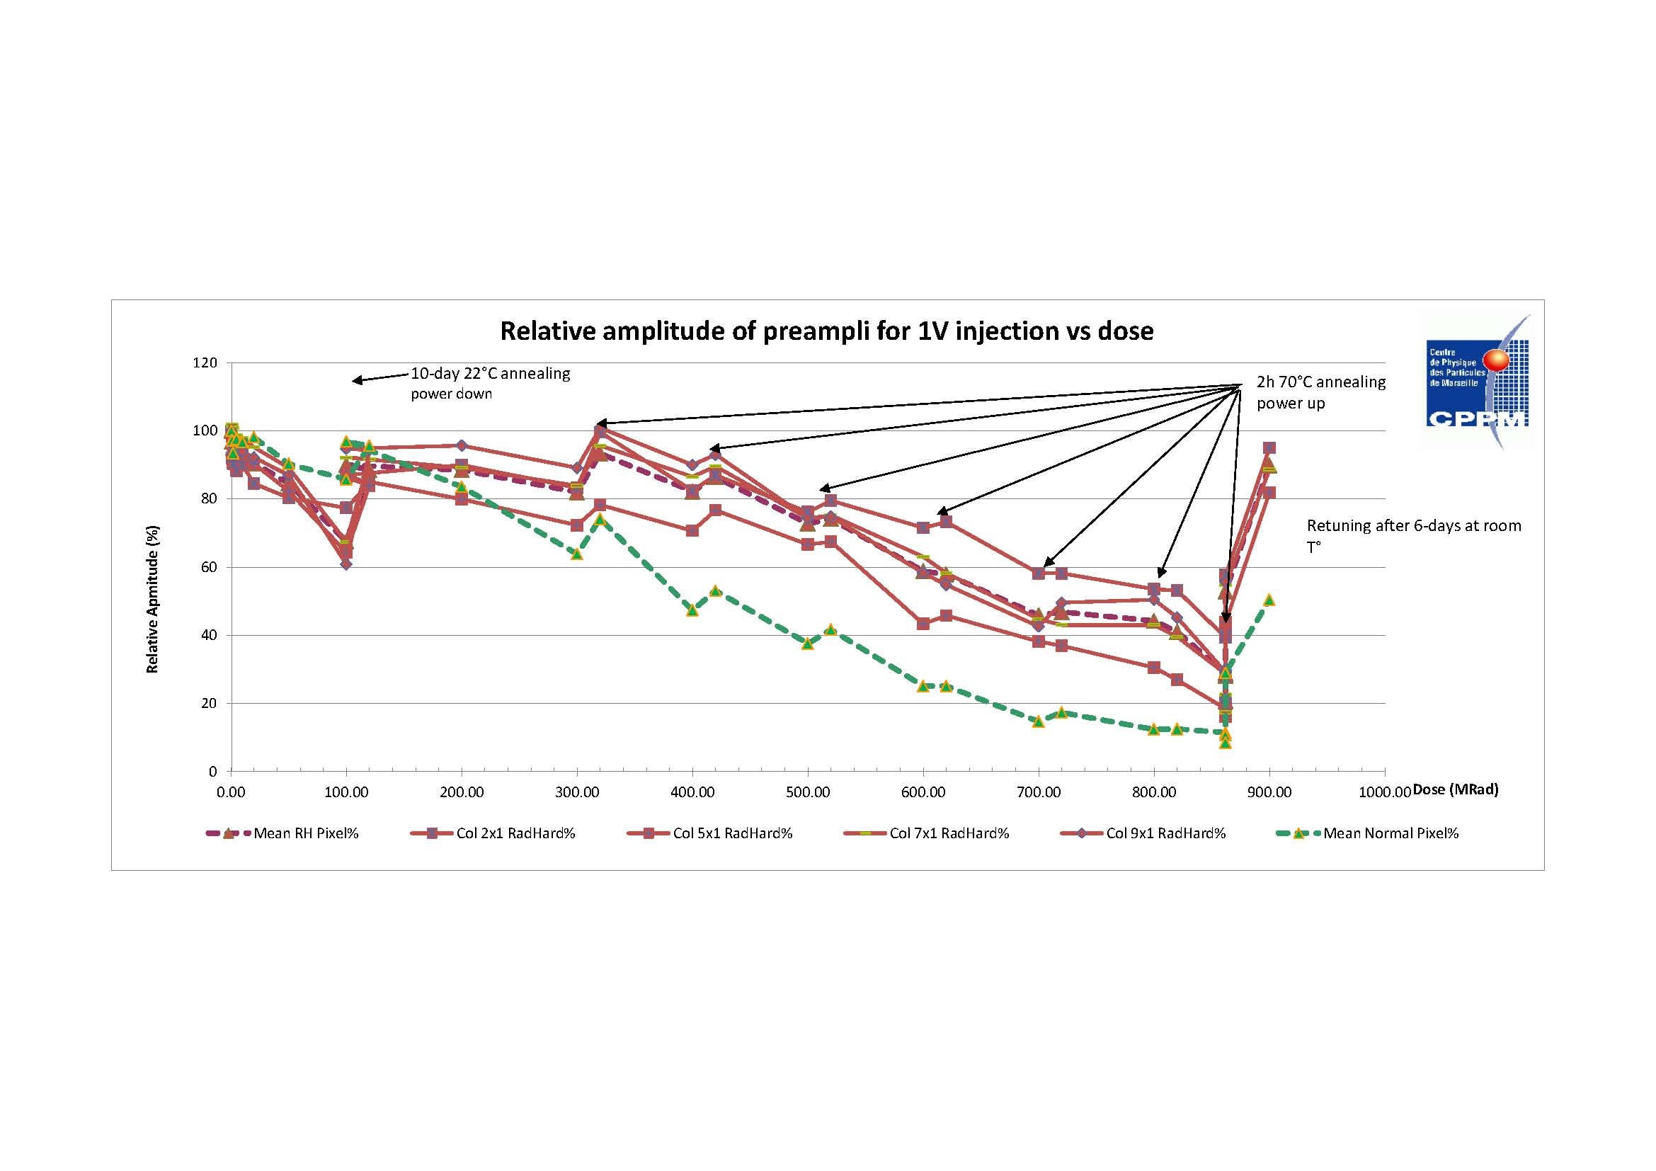
AMS 2nd prototype : TID issue
After 862 MRad (annealing included 2h at 70°C each 100MRad), after parameter retuning, amplifier gain loss recovered to 90% of initial value
Relative preampli amplitude variation as function of dose
Recovery at 862 MRad (NOT 900MRad)

Slide 18
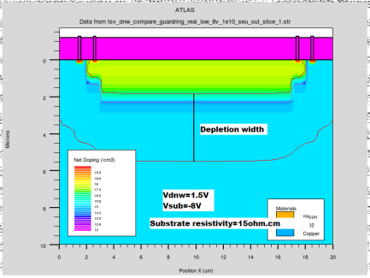
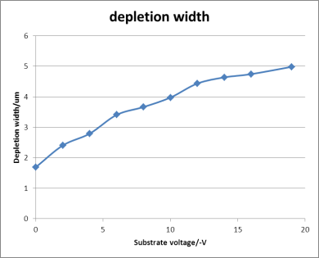
GF BCDLite technology
ATLAS Upgrade Week - P. Pangaud
Why GlobalFoundries BCDLite
  It’s a new and low cost commercial available solution, with a growth has being driven by the smartphones and tablets, in the last years.
  The 0.13µm BCDlite is based on 0.13µm LP baseline, incorporating Bipolar, CMOS and HV transistors.
  GF 0.13µm BCDLite Characteristics
    8 metals (2 Thick) and 1 poly level
    Psub 10 ohms.cm,
    8 inches wafer,
    Reticle size : 26 x 30 mm.
    Low Voltage devices into Low Voltage DeepNwell.
    High voltage devices into High voltage DeepNwell
  By tweaking the Design Rules, it’s possible to put low voltages devices into low Voltage DeepNwell, and to apply High Voltage into the substrate (30V and more), by increasing the breakdown voltage between the N (DeepNwell ) and P (Pwell into the subtrate) junction.

Slide 19
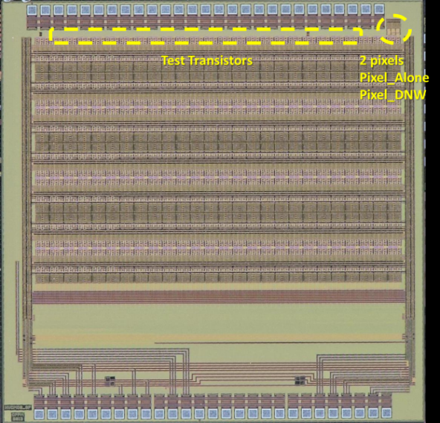
The HV2FEI4_GF Chip
The CPPM has submitted (June 2013) a new HV2FEI4 version in GlobalFoundries 0.13µm BCDLite technology. The HV2FEI4 GF version is a 26 columns and 14 rows matrix pixels.
The HV CMOS sensor pixels are smaller than the standard ATLAS pixels, in our case 33μm x 125μm - so that three such pixels cover the area of the original pixel.
The HV2FEI4_GF chip contains additional test structures
Test Transistors :
3 NMOS ; 3 PMOS
Mini size :150n/130n
Narrow channel size : 200n/15µ
ELT size : 2,639µ/1.302µ
Pixels simple (outside of the matrix)
1 pixel chain without discriminator (Pixel_Alone)
1 pixel without analog Front-End chain (Pixel_DNW)
Additional Test
1 inner Current reference readout
1 DAC for test purpose
FEI4 Pixels
Signal transmitted capacitively
CCPD Pixels
2
2
Bias A
3
3
Bias B
1
1
Bias C
The pixel chain contains charge sensitive amplifier, comparator and tune DAC.

Slide 20
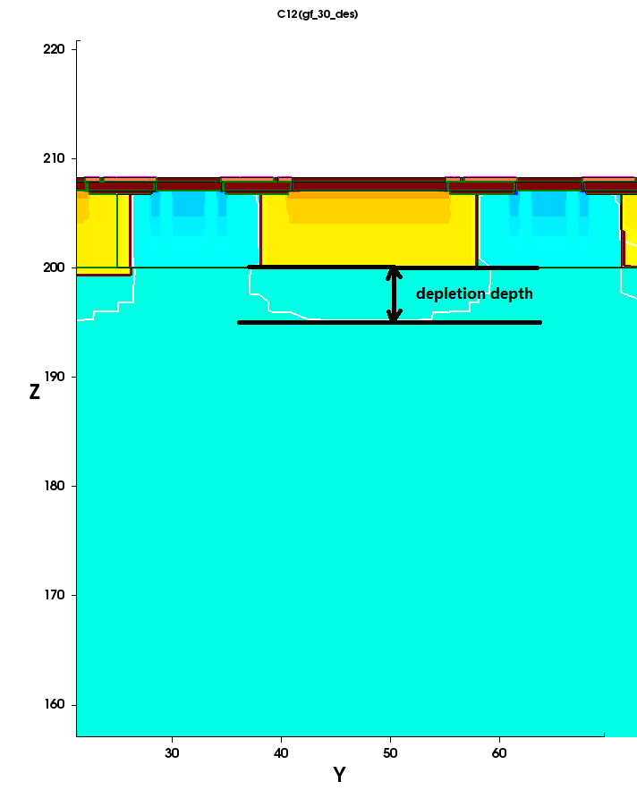
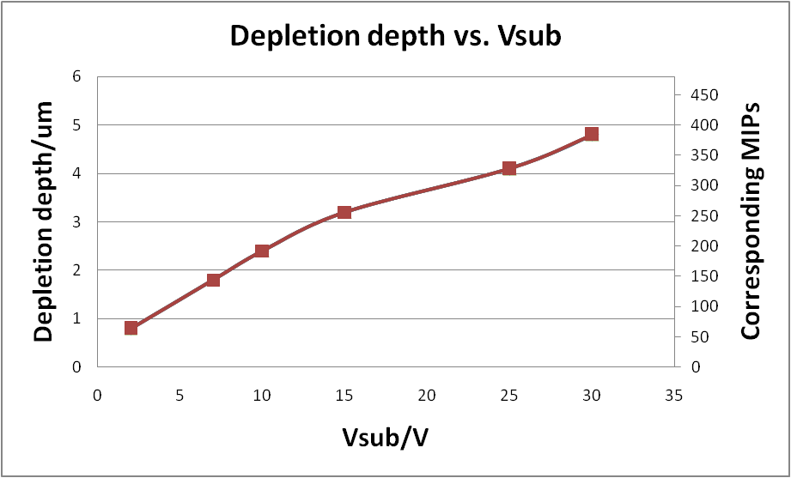
TCAD Simulation- a precious help
~4.8um depletion depth is obtained @Vsub= -30V → 384e (MIPs)
    Psub 10 ohms.cm
Depletion width is ~1.5um @ Vsub= -30V.
Due to the relative heavy doping in the p-region, large dead region exits between pixels.
More detail of TCAD Simulation please see Jian Liu’s talk

Slide 21
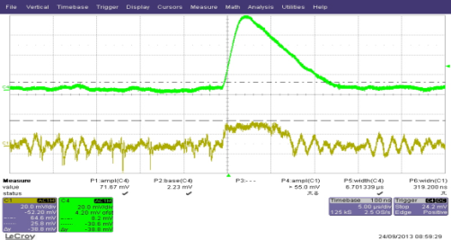
HV2FEI4_GF Chip: Test results and General Functioning
The chip works well with a HV of -30V.
BUT it has minor defective functions:
Sr90
The test analog buffer has not been optimized : The observed analog output via this buffer is ten times smaller than expected.
The problem is identified: need to optimize the size of 1 transistor.
The loading of data works only if the power values are changed.
The problem is identified : need to add a digital input buffer.

Slide 22
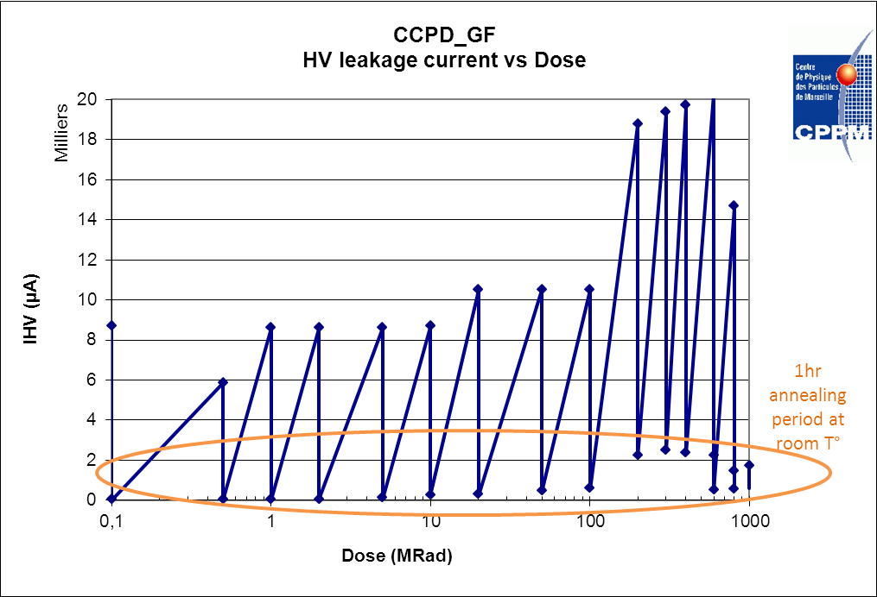
GF : High voltage Power consomptions
Annealing period helped to recover few µA leakage current up to 600MRads.
After 600MRads, annealing period at 70°C is a mandatory, to recover few µA leakage current

Slide 23
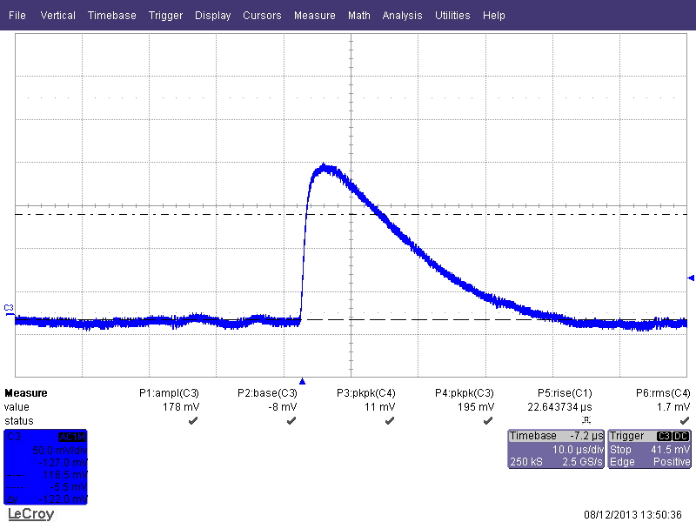
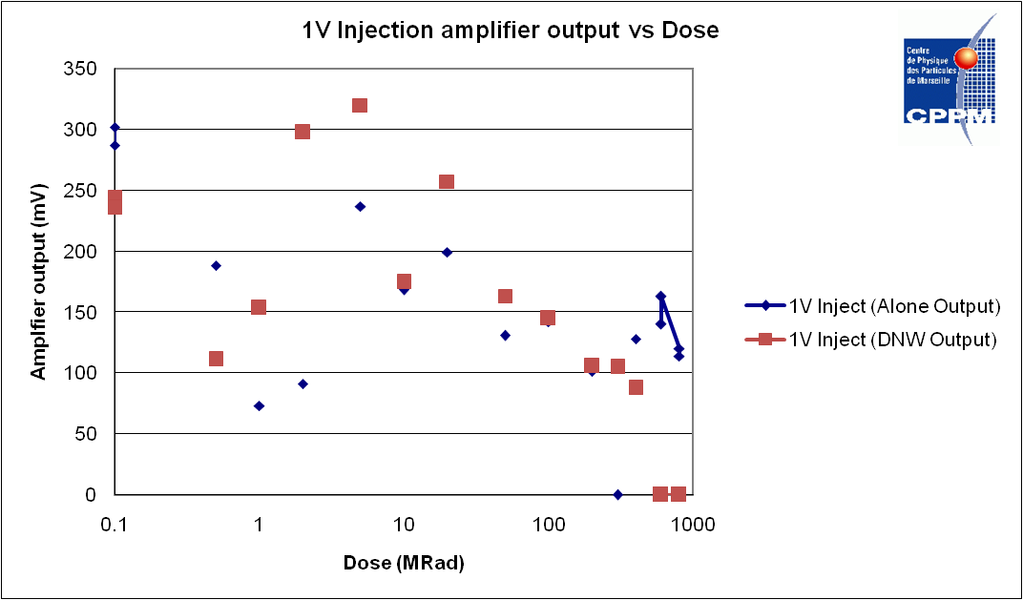
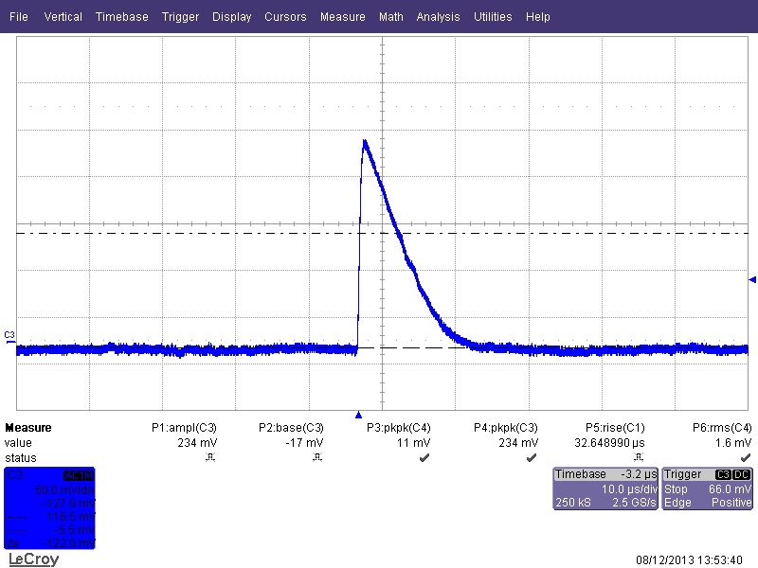
GF : Pixels behavior at 1GRads (outside of matrix)
SR90
Pixel Alone
After 2hrs at 70°C
After 200MRads, the both signals were to weak to be check by spectrum analysis.
The preamplifier has a defect cascode transistor ( bad size) from the design. This cascode transistor, is not enough hardness for this High Level dose.
At 1GRads, the chip is still alive.
SR90
Pixel DNW
After 2hrs at 70°C
Amplifier output vs. Dose

Slide 24
A new 3D approach for HEP community
Can we mix the smart diode and the 3D Integrated technology?
particle
Wire-Bond PAD
BackSide Metal (electrical connected)
Smart Sensor
Electrical field
TSV
TSV technologies
(Via last or middle or first)
HV process
Bond Interface
Backside Metallization
Tier 1
(thinned wafer)
M1
M2
M3
M4
M5
M6
M1
M2
M3
M4
M5
M6
Bond Interface
M6
M5
M4
M3
M2
M1
M6
M5
M4
M3
M2
M1
Tier 2

Slide 25
Smart sensor : Qualification Program
HV and HR CMOS technologies evaluation
(ATLAS Phase 1 and 2)
  Contact various vendors, offering HV CMOS and/or HR technology
  Qualification program
    Detection efficiency
    Radiation Hardness
    Cost and production
    Reliability
Fonderies | Node size | Prototypes | Triple Well (shallow NWELL) | HV option | HR option | Rad Hard
A | 180nm | 3 | no | 60V | 2015 | 862MRads
B | 150nm | 1 | Shallow NWELL | no | 3kΩ.cm | 50MRads
C | 130nm | 1 | Triple Well | 30V | 3kΩ.cm | 1GRads
D | 130nm | 1 | Triple Well | no | no | 400MRads

Slide 26
Technology requirements
Capacitive Coupling and Monolithic Pixels
  To increase the depleted zone , we need HV technology and High Resistivity wafer
  To increase the matrix surface, we need to increase the reticle size, by using stitching solution.
  To increase the detection efficiently (smaller pixel and higher S/N ratio), we need to understand the process generation. (profile, process generation, etc..)
  To enhanced the pixel architecture, by applying if possible an Triple-Well into the DNWELL
  To increase the reliability, we need to design a radiation hardness pixel structure.
  Back-Metallization and TSV approach
Business and sales approach
  Which scheme to do prototyping
  Access to MPW
  Partnership
  Production time frame and large scale production

Slide 27
Conclusions
  Les technologies pouvant être utilisées dans des applications HVCMOS sont de plus en plus nombreuses.
  ( IBM 0.13µm, AMS 0.35µm HV, AMS, 0.18µ HV, GF 0.13µm, Lfoundry 0.15µm, TowerJazz 0.18µm, XFAB 0.18µm SOI………………………).
  A fortiori, de plus en plus d’applications sont intéressées par le HVCMOS.
  Par contre, elles demandent une connaissance très pointue du process de fabrication, ainsi que de la technologie (profile de dopage, etc…).
  ATLAS et CMS (trackers) sont très demandeurs de cette nouvelle approche ( faible coût, faible bilan matière, meilleure granularité…), pour les upgrades de LHC, mais….
  Rien n’est encore démontré/validé à ce jour ( quelques proto… très prometteurs)
  Par contre, l’arrivée de Wafers High Res (qques KΩ) devrait grandement aider la validation.

