Slide 1
Exemples d'utilisation des outils TCAD pour la technologie HVCMOS
Journées VLSI - FPGA - PCB de l'IN2P3, Marseille
Jian LIU — SDU/CPPM (PhD Student)
12 June 2014
On behalf of the HV CMOS ATLAS Collaboration

Slide 2
Outline
ATLAS Phase II Upgrade and HV CMOS Introduction
Sentaurus TCAD Introduction and Simulation Procedure
GF BCDlite Technology TCAD Simulation
Conclusion and Perspective

Slide 3
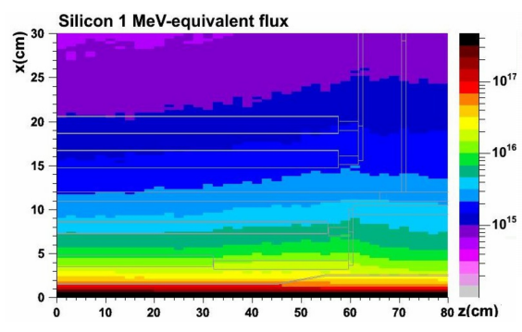
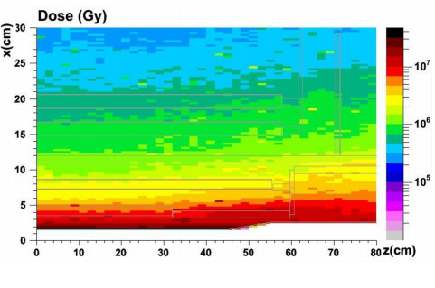
HL-LHC Environment
After the Phase II upgrade ~2025,
The HL-LHC will operate at a nominal instantaneous luminosity of 5×10³⁴cm⁻²s⁻¹ .
Total pixel silicon area of ATLAS Inner Tracker (ITk) is 8.2m².
Fluence at 5 cm radius:
NIEL: ~1-2•10¹⁶ neq cm⁻²
TID: ~1 GRad
The new Inner Tracker should be rad-hard, cope with high occupancy and lower material budget.
More detail of ATLAS Upgrade please see Patrick Pangaud’s talk: La technologie HVCMOS pour les upgrades de LHC

Slide 4
HV CMOS for Phase II Upgrade
Main advantages:
Commercial CMOS technology→ lower price per unit area.
Can be thinned to tens of um → material budget reduced.
Pixel size can be reduced.
1st amplifier in-sensor → capacitive coupling to a specific digital part by gluing (compatible with ATLAS FE-I4).
Explore industry standard CMOS processes as sensors:
Basic requirement is Deep N Well(DNW)=>high substrate bias voltage=>drift=>rad-hard
Existing in many processes, especially in HV CMOS technologies, such as AMS 0.18um HV CMOS, GF 0.13um BCDlite and LF 150nm technology…
In order to verify the feasibility of specific HV CMOS technologies, we need to understand the DNW electrical behavior carefully → 3D TCAD simulations were and are being performed using Sentaurus.
Questions:
Radiation hardness (sensor / transistors).
Signal to Noise Ratio / Efficiency.
More detail of HV CMOS project please see Patrick Pangaud’s talk: La technologie HVCMOS pour les upgrades de LHC

Slide 5
Sentaurus Framework and Tools
Sentaurus is a suite of TCAD tools which simulates the fabrication, operation and reliability of semiconductor devices.
Green items : we are using at this moment.

Slide 6
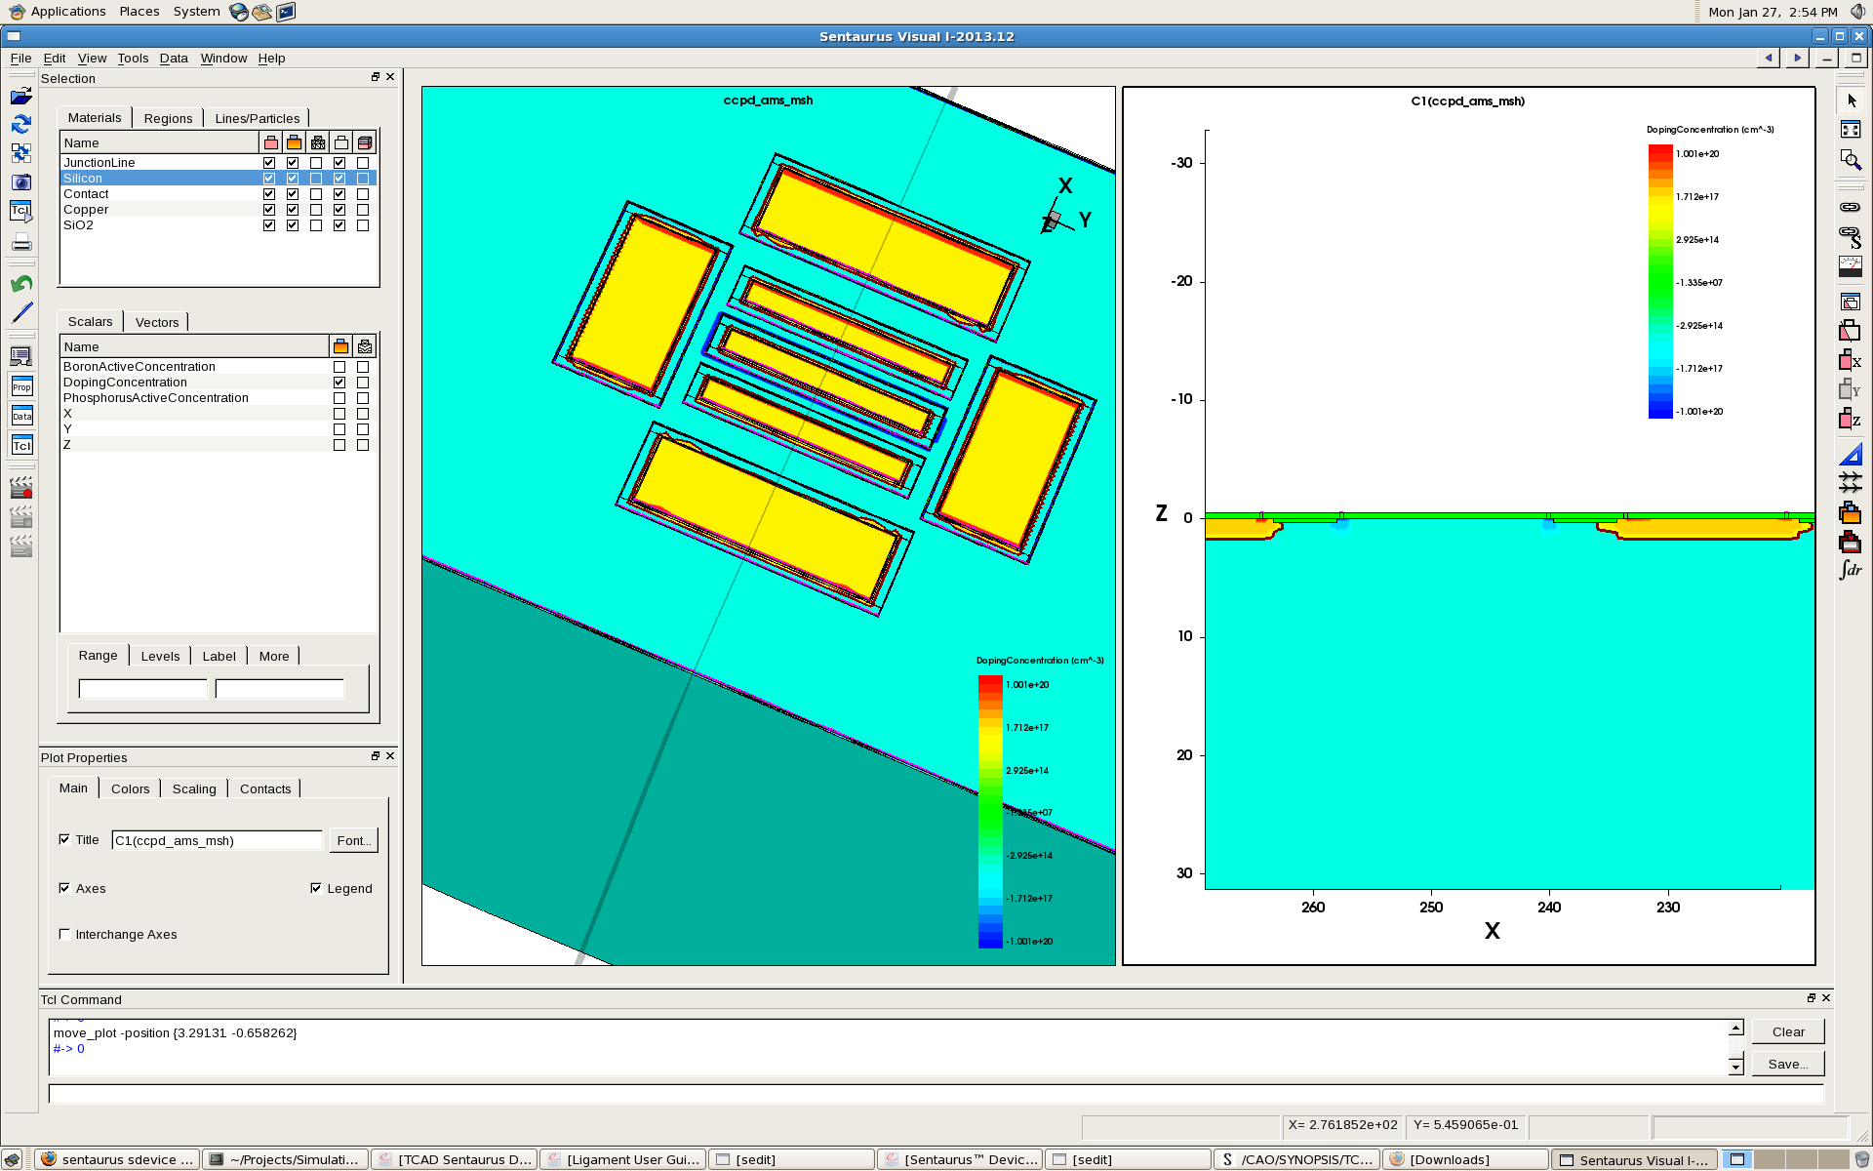
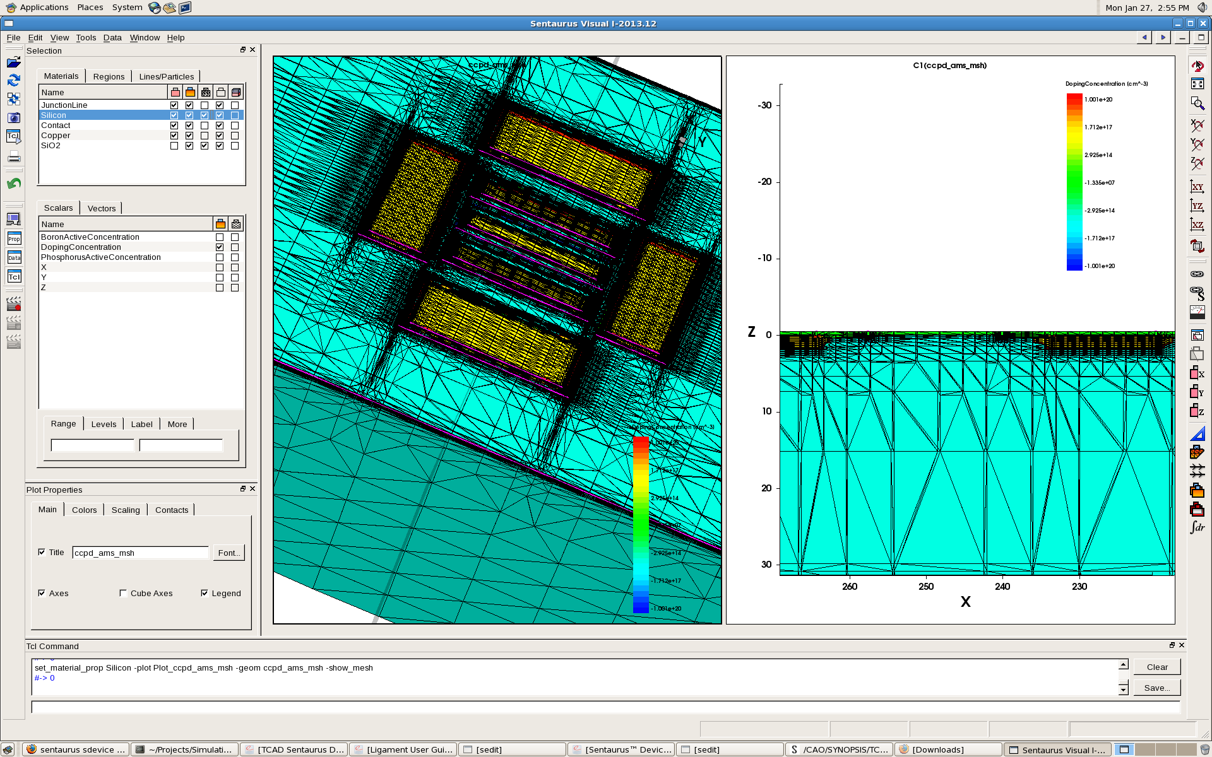
Device Simulation Flow
File {
*input files:
Grid= "n3_ccpd_ams_msh.tdr“
*output files:
Plot= "n1_des.tdr“
Current = "n1_des.plt“
Output = "n1_des.log“
}
Electrode {
{ Name="dnw1" Voltage=1.8 }
{ Name="p+2" Voltage=0 }
}
Physics{
Mobility( PhuMob HighFieldSaturation Enormal )
Recombination( SRH( DopingDependence ) )
}
Plot {eDensity hDensity eCurrent hCurrentPotential SpaceCharge ElectricFieldeMobility hMobility eVelocity hVelocityDoping DonorConcentration AcceptorConcentration}
Math {
Wallclock ParallelLicense (Wait) Number_of_Threads = 4 Extrapolate RelErrControl NotDamped=50 Iterations=20
}
Solve {
PoissonCoupled {Poisson Electron}Coupled {Poisson Hole Electron }
Quasistationary (Goal { Name="p+1" Voltage=-60 }InitialStep=-0.1 Maxstep=-5 MinStep=-0.01){Coupled {Poisson Electron Hole }}
}
Substrate boundary and doping:
(sdegeo:create-cuboid (position 0 0 0) (position 387.47 878.28 250) "Silicon" "bulk" )
(sdedr:define-refinement-size "bulk" 30 80 50 2 2 2 )
(sdedr:define-refinement-placement "bulk" "bulk" (list "material" "Silicon" ) )
(sdedr:define-refinement-function "bulk" "BoronActiveConcentration" "MaxTransDiff" 1e10)
(sdedr:define-constant-profile "bulk" "BoronActiveConcentration" 1.34e15)
(sdedr:define-constant-profile-material "bulk" "bulk" "Silicon")
Sde
Input: xx_sde.cmd
xx_sde.sat
Output: xx_bnd.tdr
Snmesh
Input: xx_bnd.tdr
Output: xx_msh.tdr
Sdevice
Input: xx_des.tdr xx_des.plt xx_des.log
Svisual
Output: xx_des.tdr
xx_des.plt
xx_des.log …
Input: xx_msh.tdr xx_sdevice_des.cmd
Sentaurus Structure Editor can be used as a two-dimensional (2D) or three-dimensional (3D)
structure editor, and a 3D process emulator to create TCAD devices.
Define input and output file
Declare electrodes
Mesh Generation Tools is a suite of tools that produce finite-element meshes for use in
applications such as semiconductor device simulation, process simulation.
Declare physics models
Declare parameters which will be saved to .tdr file
Sentaurus Device simulates numerically the electrical behavior of a single semiconductor
device in isolation or several physical devices combined in a circuit.
Declare math method and settings
3D Structure
Sentaurus Visual allows you to visualize complex simulation results generated by physical
simulation tools in one, two and three dimensions.
Declare solve method and steps

Slide 7
Sdevice Physics
Physics | Models
Mobility | Concentration-dependent mobility , High-Field saturation, Mobility degradation at interfaces, Philips Unified mobility(temperature dependence)
Generation recombination | Concentration dependent Shockley-Read-Hall(SRH), Avalanche generation
Traps and Fixed Charges | Bulk traps, interface traps, charges
Tunneling | Band-to-band tunneling, Trap-Assisted tunneling, Fowler-Nordheim tunneling
Radiation | Heavy Ion Model,
Hot carrier | Classical lucky electron injection, Fiegna Hot-Carrier Injection

Slide 8
Bulk Damage Model
Bulk damage is induced by interaction of the incident particles with the nuclei of the silicon lattice atoms.
Implement radiation damage effects via traps in the forbidden gap.
V. Eremin, E. Verbitskaya, Z. Li, Nucl. Instr. and Meth. A 476 (3) (2002) 537.
Notice: this model is valid for Non Ionizing Energy Loss (NIEL) and equivalent fluence up to 1e16neq/cm2

Slide 9
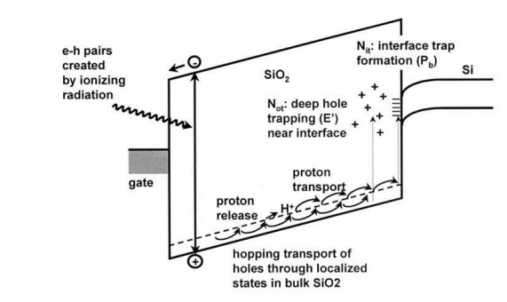
TID Effect Simulation (X-ray)
Fix charge
Bias conditions
Pre-irradiation TCAD device simulation
Irradiation condition (D)
Eox extraction
For Total Ionization Dose effects,
Calculate N_{ot} and N_{it} density from analytical models;
N_{ot} is simulated as a fixed charge sheet in the oxide;
N_{it} is simulated with a TCAD interface trap model.
Nit calculation
Not calculation
Interface trap
Post-irradiation TCAD device simulation
Two discrete levels at 0.3 and 0.8 eV from Valence band

Slide 10
Goals of Simulation
1) Depletion → signal amplitude, charge sharing
2) Electrical Field & Weighting Potential → signal formation, breakdown voltage
3) Leakage Current → SNR
4) Breakdown & Punch Through
5) Capacitance → SNR
6) Noise → SNR
7) MIPs Response and Efficiency → signal formation
8) Spice Parameter Extraction
Above items will be simulated with both NIEL and TID effects.

Slide 11
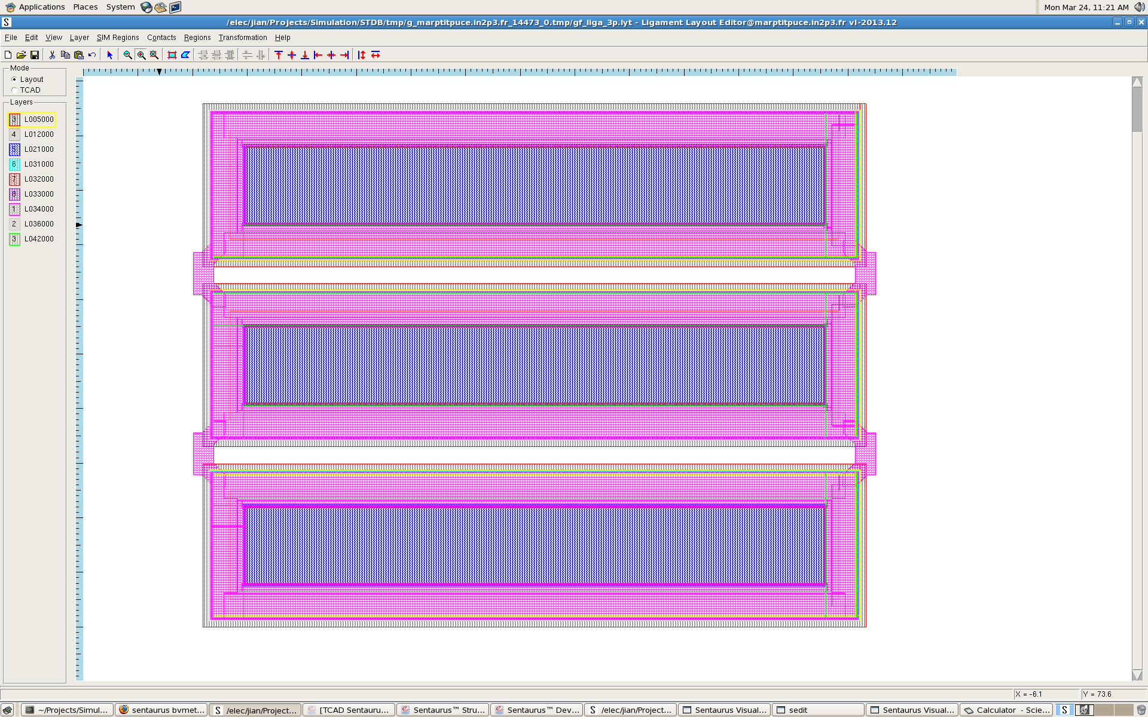
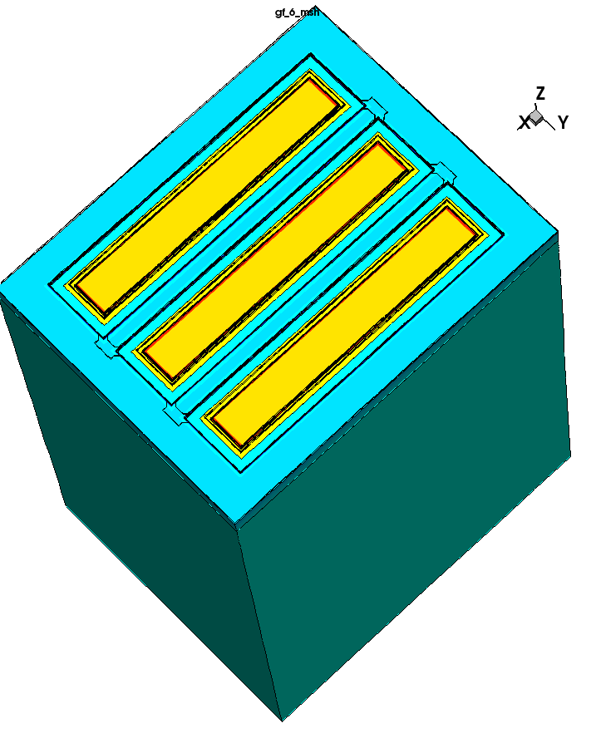
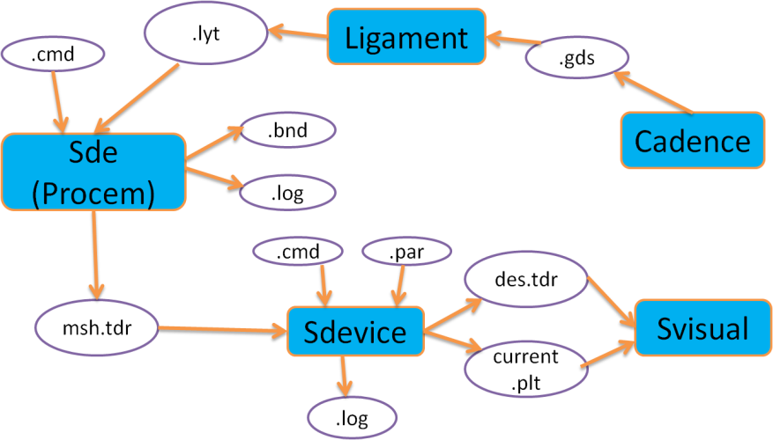
GF BCDlite TCAD Simulation Geometry
Layout in Cadence
Transport to Sentaurus Ligament
Pixel size: 33*125um²
Substrate thickness:
200um
Substrate resistivity: p-type 10 ohm.cm
3-pixel device generated by Procem

Slide 12
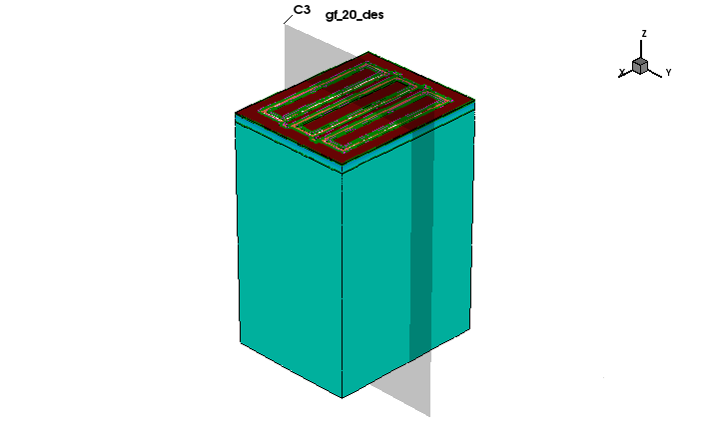
GF Doping Profile
NAT
PF1VA
DNW (N-epi)
DW
P-SUB
GF BCDlite doping schematic
By checking design rules, mask generation and doping schematic, try to use an uniform p-type doping in regions 1-6 (P-region).
Note: the p-region is the most crucial area, which will determine the breakdown and lateral capacitance.
Architecture in simulation

Slide 13
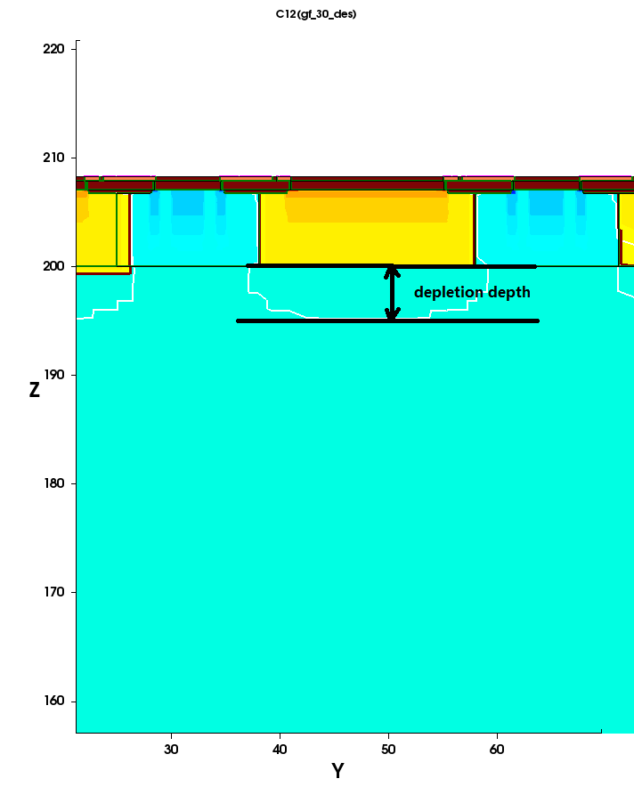
GF Simulation — Depletion
~4.8um depletion depth is obtained @Vsub= -30V → 384e (MIPs)
Depletion width is ~1.5um @ Vsub= -30V.
Due to the relative heavy doping in the p-region, large dead region exits between pixels.
@Vsub=-30V: the simulation junction capacitance is ~80fF, which is agree with the calculated value ~60fF(using SPICE model parameters)

Slide 14
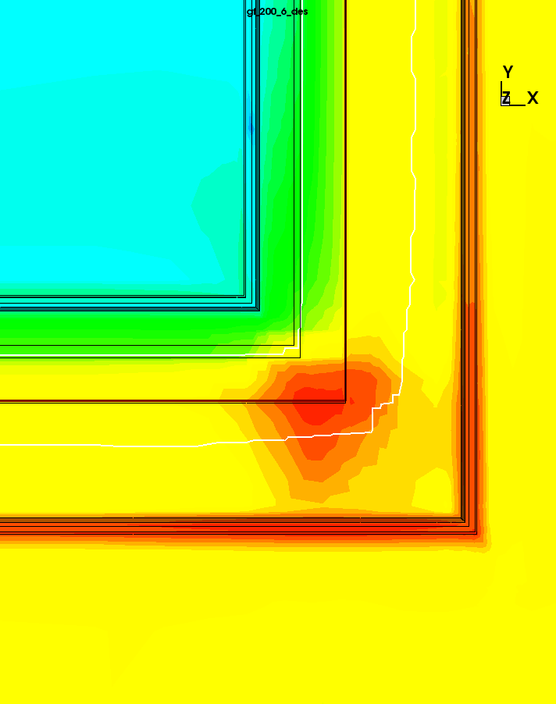
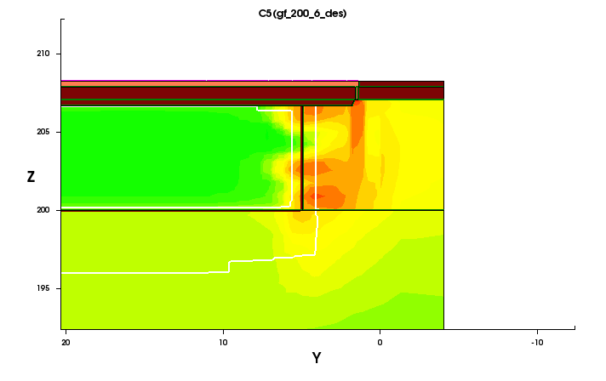
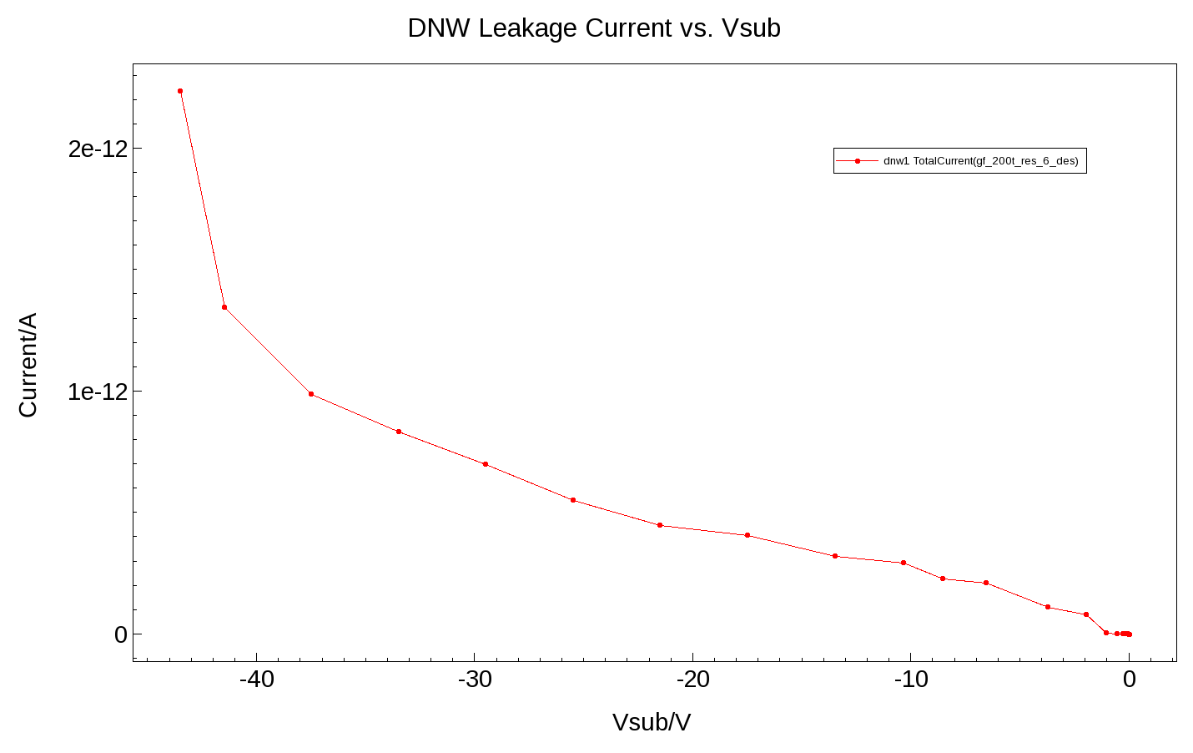
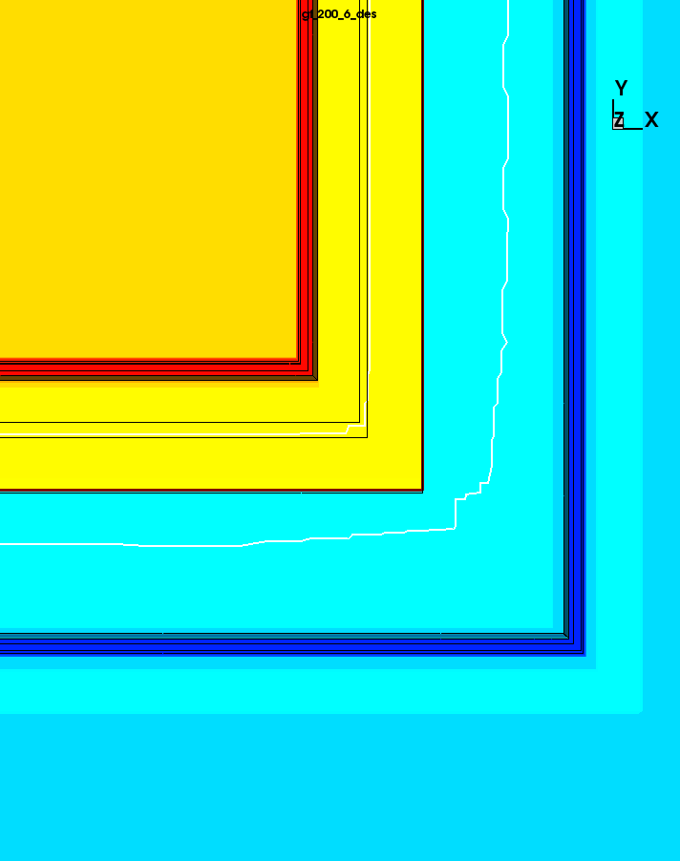
GF Simulation — Breakdown
Breakdown occurs at metallurgy junction and beneath the STI.
If reduce p-region doping, increasing breakdown is obtained.
Hole current density
Breakdown ~-40V
Measured value ~-33V
doping

Slide 15
GF Simulation — Leakage Current with NIEL Effect
To simulate non-ionizing energy loss (NIEL) effect, we can implement discrete traps into the forbidden gap.
Fluence( )/neq.cm⁻² | Current/A @ -30V
0 | 6.5e-13
1e14 | 7.8e-11
1e15 | 7.9e-10
1e16 | 8.2e-9
Measured value is ~9e-13A (matrix ~1nA)
(source meter has a large fluctuation +-1nA)

Slide 16
Conclusion and Perspective
What we can do using Sentaurus:
2D/3D Process/Device simulations
DC/AC parameters extraction
Transient response(MIPs)
Irradiation effects
Multi projects manipulation
Define parameters and variables for a specific technology in Workbench
By TCAD simulation (GF BCDlite), ~77% p-region between pixels is un-depleted, which will reduce the efficiency!! Alternative approach→ Normal 130nm LP Process with HR substrate.
Will continue to perform simulations of NIEL, TID effects and transient response.

Slide 17
Thanks for your attention!!

