Slide 1
Simulation of Radiation Effects
on Semiconductors
Design of Low Gain Avalanche Detectors
Dr. David Flores
Instituto de Microelectrónica de Barcelona (IMB-CNM-CSIC)
Barcelona, Spain
david.flores@imb-cnm.csic.es

Slide 2
Outline
General Considerations
Background
Basic principles
Ionization Damage Simulation
Silicon
Silicon oxide
Displacement Damage Simulation
Semiconductor
Case Study: Design of Low Gain Avalanche Photodetectors
LGAD structure and application
Gain simulation
Design of active region
Design of periphery and edge termination region
Fabrication and Experimental results

Slide 3
General Considerations

Slide 4
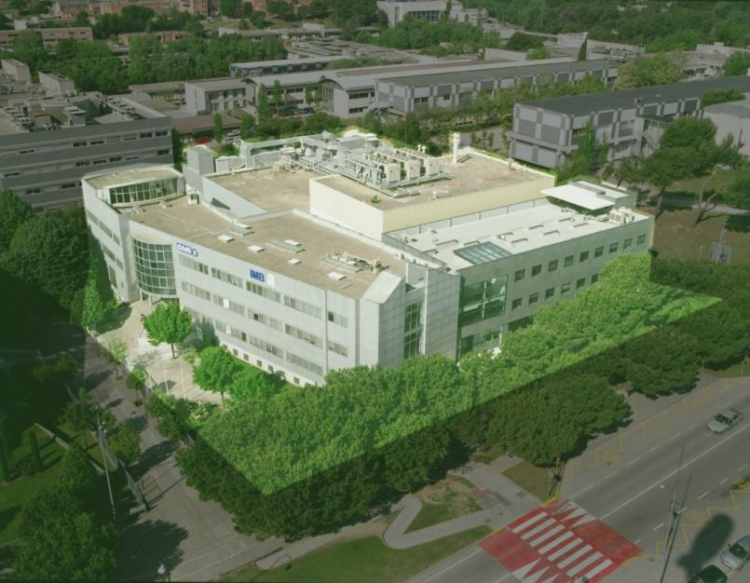
Centro Nacional de Microelectrónica

Slide 5
Centro Nacional de Microelectrónica
IMB-CNM Main Pillars & R&D Activity
R&D
Training
Technology Transfer
Semiconductor Devices
Power Devices
Integrated Circuits and Systems
Sensors, Actuators and MEMS
Nanoscale Devices and Actuators
Lab-on a chip, Polymer devices

Slide 6
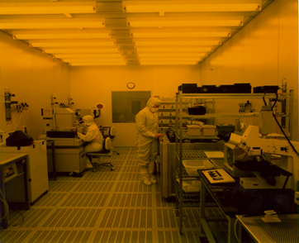
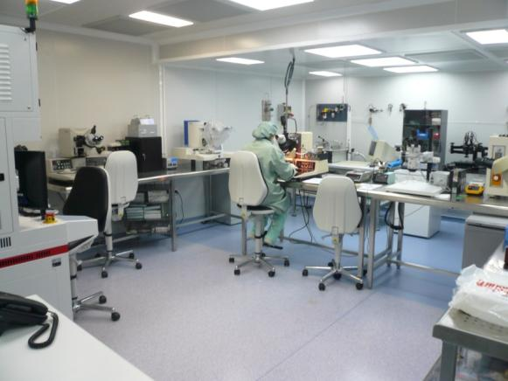
Centro Nacional de Microelectrónica
Integrated Micro and Nano Fabrication Clean Room
Main CR
1,500 m²
Class 100-10,000
CMOS integrated circuits
Microsystems processes
Nanolithography and nanofabrication
Back-end CR
40 m²
Class 1000-10,000
Chip packaging
Hybrid circuit assembly

Slide 7
General Considerations
TCAD Software for (Power) semiconductors
Silvaco
Sentaurus
SRIM (TRIM Monte Carlo simulation)
Previous knowledge:
Power semiconductor devices: Design, optimisation and fabrication
Silvaco tools for process technology simulation and Clean Room control
Sentaurus tools for structure optimisation (selection of optimum geometrical and technological parameters)
Advanced simulation of device degradation (hot carriers, hot spots, etc.)
Performance degradation after irradiation of commercial power lateral MOSFETs
Design and application of Silicon tracking detectors (ATLAS)

Slide 8
General Considerations
What do we need to simulate / emulate ?
Radiation hardness of (power) semiconductor devices
Post-irradiation damage
Technological modifications to enhance robustness
Single Event Effects (logic circuits and memories)
Generated charge profiles
Transient simulations of complex 3D structures
Charge generation and evolution in Silicon detectors
Transient or quasi-static simulation?
Strategies
Gain simulation in Silicon detectors

Slide 9
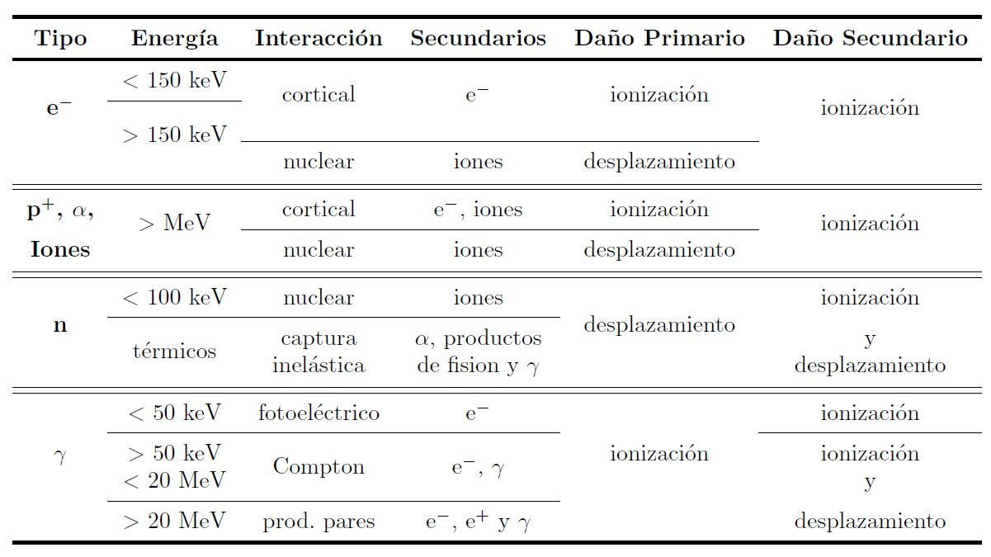
General Considerations
The interaction between radiation and materials (of a semiconductor device) is based on the moment and energy transfer
Ionisation damage
Displacement damage

Slide 10
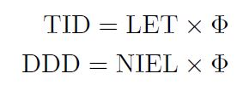
General Considerations
Relation between absorbed dose and energy transfer
Flux (Φ): Number of incident particles (cm⁻²·s⁻¹)
Integrated Flux or Fluence (Φ): Total number of incident particles (cm⁻²)
Dose (D): Absorbed energy per unit mass (Gray: 1 Gy = 100 J·Kg⁻¹)
(rad; 1 rad = 100 erg·s⁻¹)
Stopping Power (S): Energy transfer, normalised to the material density (MeV·cm²·Kg⁻¹)
Ionising Energy Loss (IEL)
Linear Energy Transfer (LET)
Non-Ionising Energy Loss (NIEL)
Total Ionising Dose (TID)
Displacement Damage Dose (DDD)

Slide 11
Ionisation Damage Simulation

Slide 12
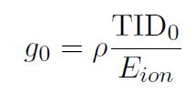
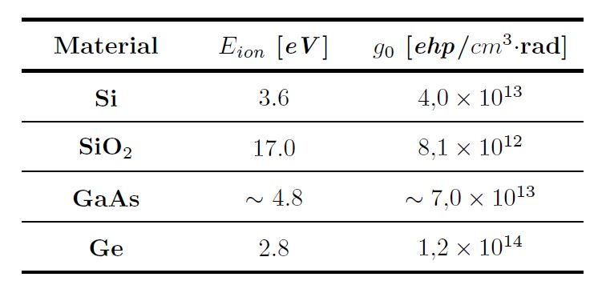
Ionisation Damage Simulation
The incident particle transfer its energy to a cortical electron, creating an electron-hole pair
The minimum energy to create an electron-hole pair (Shockley theory) is:
The generation rate accounts for the electron-hole pairs created by a TID₀ = 1 Rad in 1 cm³
E_{G} (gap), E_{R} (Raman), E_{f}(Fonons)

Slide 13
Ionisation Damage Simulation
The damage introduced by the generation of a great amount of electron-hole pairs depends on the transient evolution of the charge and also on the bias and ambient conditions
Semiconductors:
If no bias is applied, charge disappears due to recombination. The process is ruled by the carrier lifetimes and does not degrade the material. No simulation interest
If bias is applied, mobile charge is accelerated by the electric field in the depletion region and a transient current is observed. Single Event Effects
Transient simulation.
Dielectrics:
The number of generated electron-hole pairs is much lower than in semiconductors
The charge mobility is also much lower than in semiconductors
As a consequence, carrier are trapped and a certain density of fixed charge is created. Critical in active devices
Quasi stationary simulation

Slide 14
Ionisation Damage in Semiconductors

Slide 15
Ionisation Damage Simulation in Semiconductors
The simulation of ionising particles is only relevant when the density of generated electron-hole pairs is really high (electron-hole plasma)
Heavy ions typically create an electron-hole plasma
Transport equation in a non-linear regime have to be solved
Strong injection conditions are easily reached
The Sentaurus Heavy Ion model works properly to emulate the transient evolution of the generated charge (Single Event Effects)
Simulation of particles with Minimum Ionizing Energy is of great interest since the number of generated electron-hole pairs is perfectly known.
Transient simulations are time costly if accuracy is expected.
The distribution of the generated electron-hole pairs in the semiconductor has to be previously determined by using a SRIM/TRIM simulator (Stopping and Range of Ions in Matter)

Slide 16
Single Event Effects: Experimental Study and Simulation
Single Event Effects (SEE):
Produced by high energy particle hits on sensitive circuit regions
Main topic in reliability and device performance in space applications
Study and prediction of SEE require test in particle accelerator facilities
Heavy Ion accelerator provide high energy capabilities
High cost and limited availability impose alternative methodologies
Numerical simulation techniques are able to predict device and circuit behaviour after an ion hit

Slide 17
Single Event Effects: Experimental Study and Simulation
Simulation Techniques: Different Approaches.
Physics of the incident particle and its interaction with matter (SRIM-Stopping and Rang of Ions in Matter):
Calculations on the energy deposition of ions passing through matter
Linear Energy Transfer (LET) profile along the particle track can be obtained
Electric performance of the circuit after the perturbation (CADENCE-SPECTRE):
Perturbation is replaced by a pulsed current in the affected node
Single Event evolution can be followed
Semiconductor solid state physics (Synopsys Sentaurus TCAD):
Exact reproduction of the charge collection phenomenology
Accurate consequences over the electrical characteristics can be evaluated

Slide 18
Ionisation Damage in Oxides
Case Study: Power LDMOS Transistor

Slide 19
Ionisation Damage Simulation in Oxides
Two approaches can be contemplated:
Simulation of the defect evolution
Transport, anneal and recombination models
Transient simulation (time costly)
Continuity equations are not solved in oxides
“Oxide as semiconductor” option has to be selected and a correct set of parameters have to be introduced (good knowledge of the dielectric)
Simulation of the permanent damage using Sentaurus Fixed Charge and Traps models
Quasi-static simulation
Average final values necessary
A relation between defects and Dose (TID) is needed
Generation of fixed charge (N_{ot}) and interface traps (N_{it})
Energy distribution of traps (D_{it})
Strong electric field dependence (irradiation bias conditions to be emulated)

Slide 20
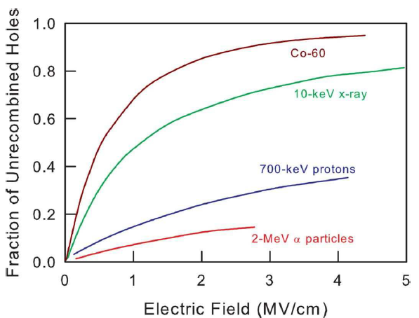
Ionisation Damage Simulation in Oxides
Calculation of the recombination efficiency (f_{y})
Efficiency of the recombination process (f_{y}) is the ratio between surviving holes and total generated holes
Recombination strongly depends on the ionising particle
X or γ rays (⁶⁰Co) generate charges in almost all the dielectric volume (Slow recombination)
α particles generate charges in the neighbourhood of their trajectory (Fast recombination)
The efficiency of the recombination also depends on the electric field
For ⁶⁰Co: m=0.7 and E₁=0.55 MV/cm

Slide 21
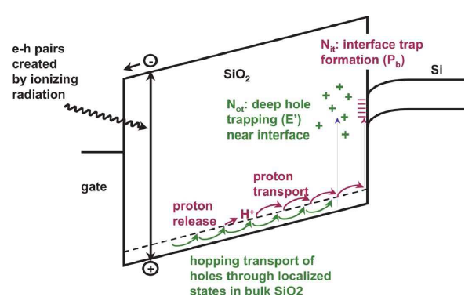
Ionisation Damage Simulation in Oxides
Charge generation and evolution in a MOS structure
Electron-hole pairs suffer an initial recombination (low electric field)
Under high electric field electrons are immediately removed through the gate electrode
Holes are also drift by the high electric field, but their mobility is low and take time to reach the Si/SiO₂ interface (hopping transport)
Some holes are trapped in the deep levels at the region close to the Si/SiO₂ interface creating fixed charges and interface traps

Slide 22
Ionisation Damage Simulation in Oxides
Calculation of the trapping efficiency (f_{ot}) and fixed charges (N_{ot})
Survivor holes (to the eventual initial recombination) travel through the oxide
Holes can be trapped in their way to the oxide interface
The efficiency of the trapping process (f_{ot}) is the ratio between trapped holes and surviving holes
The trapping efficiency depends on the electric field and on the oxide quality
If the oxide thickness is lower than 15 nm, holes are completely removed by tunneling effect (f_{ot}=0)
Finally:
The fixed charges are described by
Initially generated

Slide 23
Ionisation Damage Simulation in Oxides
Calculation of the Interface traps
Traps in the Si/SiO₂ interface are related with the H⁺ density in the oxide (depends on the growth process) and are identified as P_{b}
Incident particles release H⁺ which are drift to the Si/SiO₂ interface where they create dangling bonds (traps)
Finally:
The interface traps (N_{it}) are described by
(where a_{it} is the kinetic constant and p is the H⁺ concentration)
N_{it} can also be expressed as a function of the ionising dose (TID) as
(where b_{it} depends on the process technology and is determined by
performing tests on capacitors. Typically b_{it}~1)
Only two energy levels are considered: E_{V}+0.3 eV (acceptor) and E_{v}+0.8 eV (donor)

Slide 24
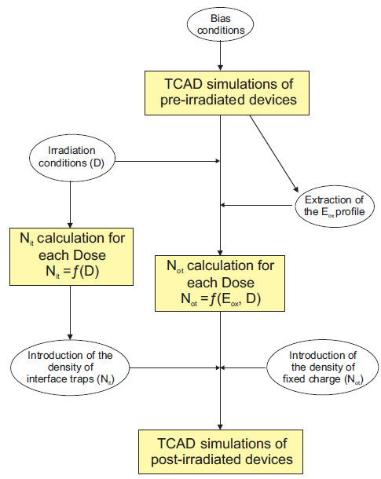
Ionisation Damage Simulation Procedure in Oxides
Fixed charge (N_{ot}) is introduced in Sentaurus by setting the charge parameter
Traps in the Si/SiO₂ interface are set by:
The two energy levels (E_{V}+0.3 eV and E_{v}+0.8 eV)
The superficial trap concentration (N_{it})
Capture cross-section of electrons and holes

Slide 25
Ionisation Damage in LDMOS Transistors
LDMOS transistors will be used in DC-DC converters for the HL-LHC upgrade
Transistors from IHP Microelectronics (DE) (0.25 µm SGB25V GOD SiGe BiCMOS)
Submitted to neutron irradiation (0.5, 5 and 10 Mrad)
First step: Technological and electrical simulation of basic cell and fitting with experimental data
Second step: Electric field distribution (oxides and semiconductors)
V_{BD} = 22 V, f_{T} = 20 GHz
V_{BD} = -16 V, f_{T} = 10 GHz

Slide 26
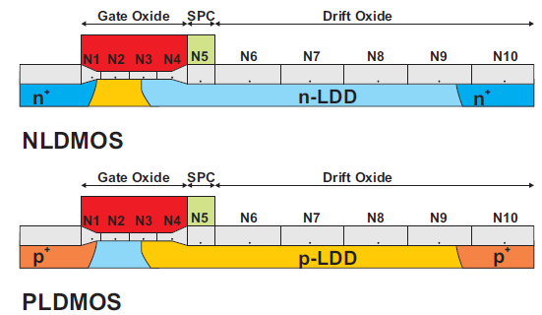
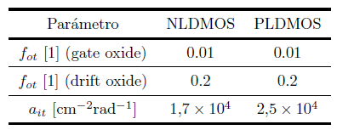
Ionisation Damage in LDMOS Transistors
Third step: Definition of oxide blocks for fixed charge and interface traps
Fourth step: Calculation of recombination efficiency f_{y}(E_{ox}) and fixed charges N_{ot} (f_{ot} has to be tuned with available irradiation data)
N_{ot} values are introduced in Sentaurus as fixed charges in each oxide block
Fifth step: Calculation of interface traps N_{it} according to:
(a_{it} has to be tuned with available irradiation data)
f_{ot} and a_{it} values according to available irradiation data

Slide 27
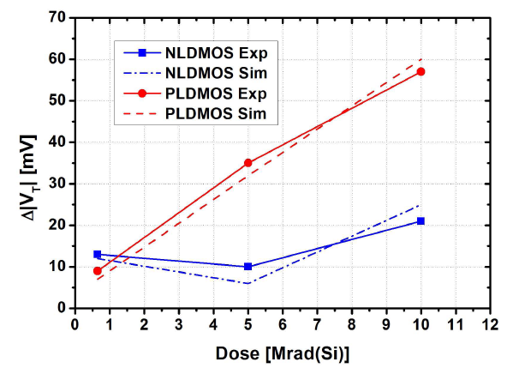
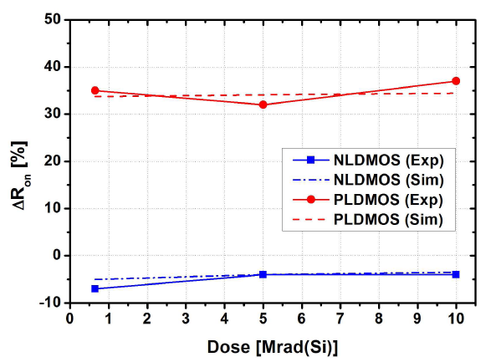
Ionisation Damage in LDMOS Transistors
N_{ot} effect
N_{it} effect

Slide 28
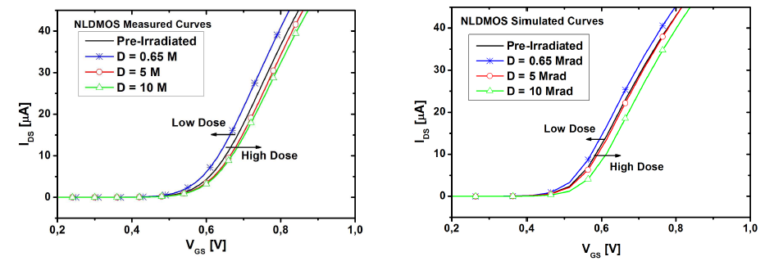
Ionisation Damage in LDMOS Transistors
Accurate fitting between simulated and measured I_{DS} versus V_{DS} curves

Slide 29
Displacement Damage

Slide 30
Displacement Damage Simulation
Displacement damage in oxides is not relevant (only optical effects)
Displacement damage in semiconductors creates energy levels in the gap
Minority carrier lifetime reduction
Reduction of carriers (n or p)
Mobility degradation
E_{displ} = Minimum energy for atomic dislocation
E_{displ-th} = Minimum energy for relevant displacement damage

Slide 31
Displacement Damage Simulation Procedure
Sentaurus includes a model for Semiconductor Traps
Typical traps in Float Zone substrates for Silicon detectors are perfectly determined
The total trap concentration (N_{t}) is the added contribution of filled (n_{t}) and empty (p_{t})
(where η is the introduction rate, determined by DLTS measures)
The effective doping concentration in the P-type substrate is finally given by:
University of Peruggia model, including Pennicard corrections

Slide 32
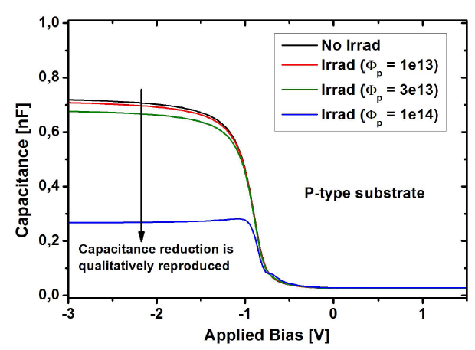
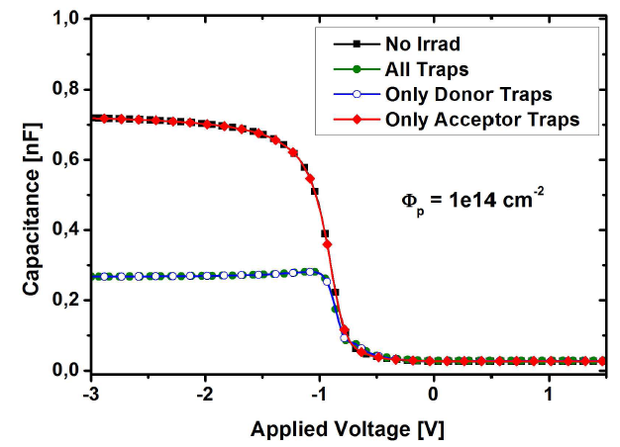
Displacement Damage in MOS Capacitors
Simulation of displacement damage in MOS capacitors under 24 GeV proton irradiation conditions
The introduction rate (η) is calculated for the equivalent 1 MeV neutrons. Hence, the fluence has to be corrected according to the 24 GeV protons
Boron concentration = 8e14 cm⁻³
Oxide thickness = 10 nm

Slide 33
Case Study: Design of
Low Gain Avalanche Photodetectors

Slide 34
Silicon Detectors with Internal Gain and Proportional Response
Tracking Detectors
Low Gain Avalanche Detectors (LGAD)
Proportional response (linear mode operation)
Good efficiency
Good spectral range
Better sensibility (Gain)
Thin detector integration with the same signal and higher collection efficiency
Better signal/noise ratio
After Irradiation
Similar pre & post irradiation signal (higher quality signal + lower noise increase)
Power consumption slightly increased
Ionisation damage in oxides (relevant on n-on-p structures)
Internal Gain
PiN Diodes
Proportional response
Good efficiency
Good spectral range
Segmentation is technologically available (strip and pixel detectors).
After Irradiation
Worse signal to noise ratio (lower quality signal + noise increment)
Increment of the power consumption (leakage current increase)
Ionisation damage (relevant on n-on-p structures)
Notes:
The aim of this work is to improve the performance and stability against radiation of PiN diode detectors for tracking applications.
In this sense, the controlled use of avalanche phenomenon, characteristic of a PN junction polarized in reverse mode, allow us to improve some characteristics of the PiN diodes used in such applications.
Thus, we will be able to get more stable detectors, reducing degradation due to radiation, and achieving a higher signal to noise ratio. This will allow more accurate detection of the particles and the fabrication of thinner detectors with the same signal and greater collection efficiency.

Slide 35
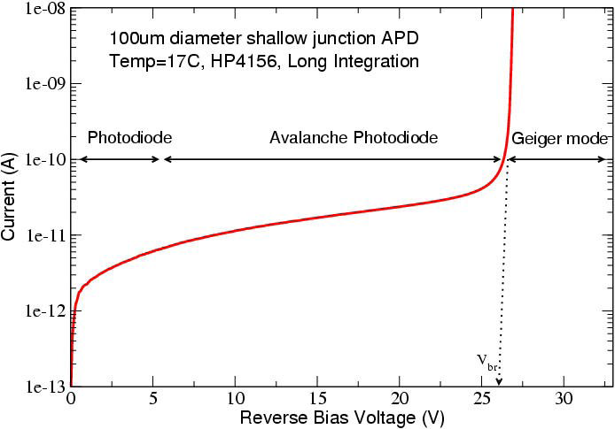
Linear Mode Operation. Gain Definition
Diodes with multiplication can operate in Linear or Geiger mode
Linear mode: Moderate gain: Proportional response to the deposited energy
Geiger mode: Very high gain: Digital response (detection or not detection)
Linear mode
No Gain
Gain > 10⁴
Digital response
Moderate Gain
&
Proportional response
[1] A.G. Stewart et al. in Proc. of SPIE, Vol. 6119, 2006
Notes:
Since we are interested in a detector with a moderate gain and a proportional response, we fix its operating point in the linear region with a voltage below its breakdown voltage.
In this situation, we consider the Gain as the ratio between the signal at this point and the constant signal at low voltage, taking into account the procedure fixed by Tapan in 1997.

Slide 36
PiN Diode (No Gain)
N⁺ cathode
P-type (π)substrate
P⁺ anode
Abrupt N⁺P junction with trapezoidal electric field profile (linearly decreasing in the P substrate)
Electrons are accelerated towards the N⁺ region until they reach the saturation velocity
Since the electric field is much lower than E_{crit}, electrons can not generate new carriers
(no impact ionisation and no gain)
Notes:
The structure on which we have worked is based on a PiN-PAD diode with an area of 25 square millimeters.

Slide 37
Pad Diode with internal Gain
N⁺ cathode
P-type multiplication layer
P-type (π)substrate
P⁺ anode
Gaussian N⁺P junction where the P-multiplication layer becomes completely depleted at a very low reverse voltage
Electrons are accelerated towards the N⁺ region until they reach the saturation velocity
The electric field in the P layer is close to the E_{crit}, value (impact ionisation and gain)
Notes:
On a highly resistive P-type substrate, prior to N-plus well to form the diffusion cathode, we have defined a P well to be the multiplication layer. The objective of this layer is to enhance the value of the electric field in that region, and its impurity profile will be the main technological parameter to define in order to adjust the gain value.

Slide 38
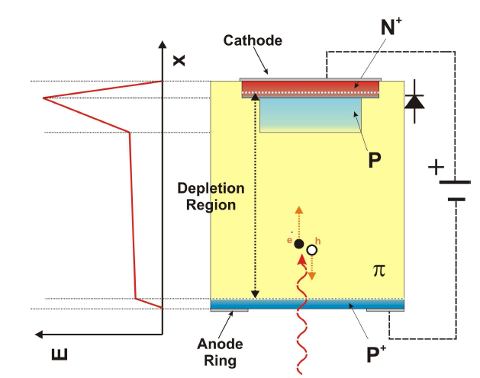
Conditions for Gain
Impact ionisation requires a minimum electric field of 1e5 V/cm in the P layer
Full depletion of the P-type substrate is needed to avoid recombination
The E_{crit} value (~3e5 V/cm) can not be reached in the N⁺P junction (reverse breakdown)
Impact ionisation region
Electrons traveling at their saturation velocity (good for signal uniformity)

Slide 39
Gain Definition and Usage
The Gain can be defined in two equivalent ways and is identical whatever the incident particle is
A known radiation source has to be used to calibrate the gain
Collected charge is determined by integrating the current waveform
The total number of generated electron-hole pairs in Silicon is determined by the type of radiation source
If no impact ionisation is contemplated (Equivalent PiN diode.)
Once the Gain is calibrated, the detector can be used to identify the incident radiation by simply measuring the collected charge

Slide 40
Gain Simulation
Gain simulation considering generated and collected charge
An initial charge distribution has to be introduced in the Sentaurus Heavy Ion model
The evolution of the generated charge is calculated by transient simulations
We have not been able to observe any transient current increase
Impact ionisation is an statistic concept while transient simulation considers the evolution of each single electron…
Gain simulation considering multiplied and non-multiplied current (alternative method)
Ionisation coefficients are modified in a very small volume of the P-type substrate (3 orders of magnitude greater) to create a know number of electron-hole pairs (3000)
Quasi static simulations are performed with and without the generated charge
The PiN diode is simulated to determine current increase due to the generated charge (no impact ionisation is present)
Then, the LGAD counterpart is simulated with and without charge (impact ionisation is present)
Finally, the simulated Gain corresponds to the ratio between PiN and LGAD currents when charge is generated

Slide 41
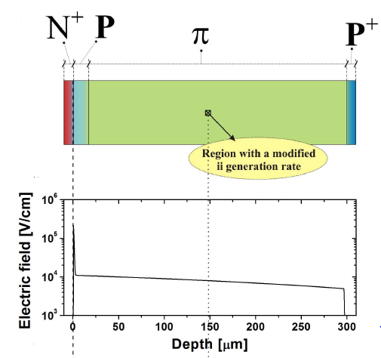
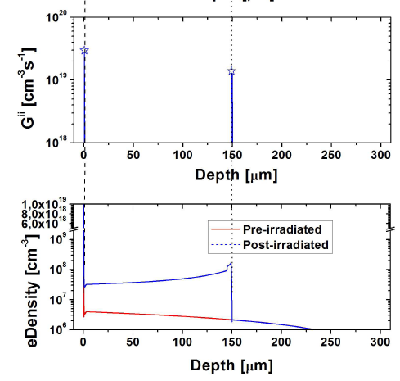
Gain Simulation

Slide 42
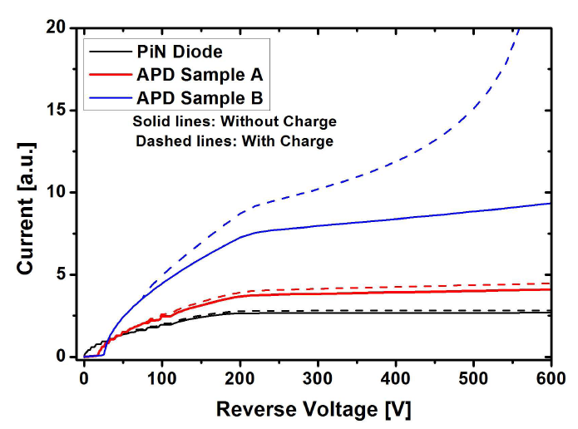
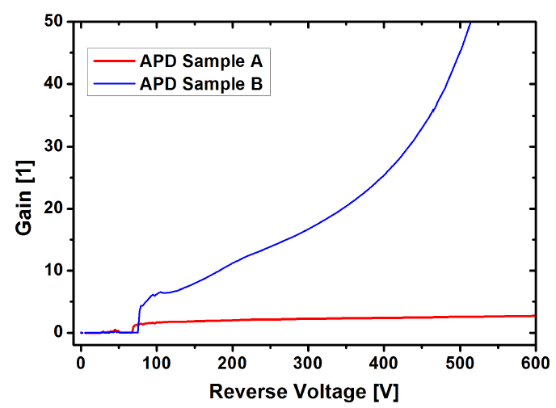
Gain Simulation
Local charge generation equivalent to the absorption of a 30 KeV X-ray
The doping of the sample B P-multiplication layer is higher than the A sample (high Gain)

Slide 43
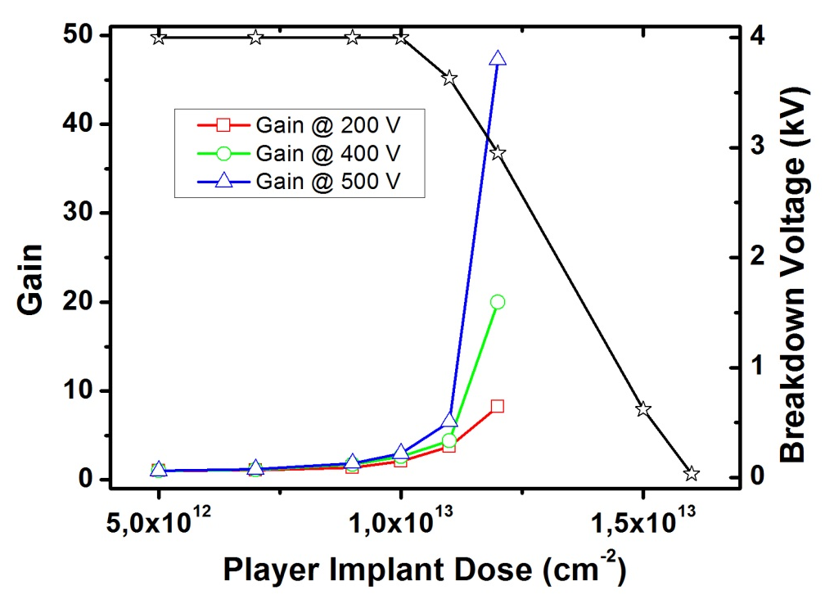
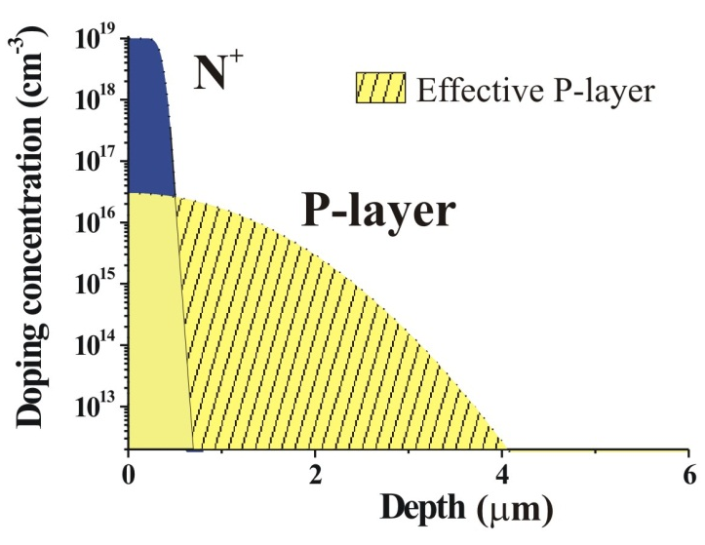
Design of the P-Multiplication Region
Doping profile of the P-multiplication layer is critical
1D Simulation @ Pad Centre
Gain/V_{BD} trade-off
If implant dose increases:
Gain increases
V_{BD} decreases
Small modifications in the Boron implant dose (~ 2 × 10¹² cm⁻²) induce great changes in Gain and V_{BD}
Notes:
The simulations show that the adjustment of the impurity profile in this region is critical, due to its effect on the gain and on the voltage capability for the analyzed detector. The P well dose must be enough to obtain a determined gain without a high reduction on its breakdown voltage.
Thus, small modifications in the Boron implant dose, in the order of ten to twelve atoms per square centimeter, can induce great changes on the gain and breakdown voltage values.
Therefore, the accurate control of the doping profile in the multiplication area, is the most important technological condition for its fabrication.

Slide 44
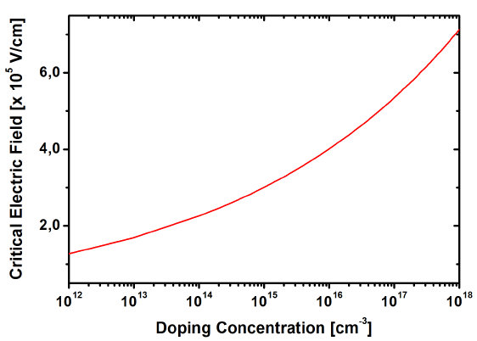
Design of the Edge Termination
The optimisation of the edge termination is ruled by the electric field at the multiplication layer (not by the maximum voltage capability, as in the case of power devices)
P-Multiplication layer
Correlated values
P-Substrate

Slide 45
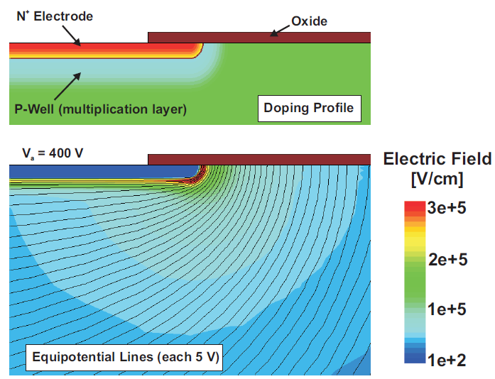
Edge Termination: Why is needed?
The N⁺ shallow contact and the P-multiplication layers have to be locally created with a lithography mask
The electric field at the curvature of the N⁺/P junction is much higher than that of the plane junction (where Gain is needed)
Avalanche at the N⁺/P curvature at a very low reverse voltage (premature breakdown)
Shallow N⁺ and P-multiplication layers self aligned
High electric field peak at the curvature

Slide 46
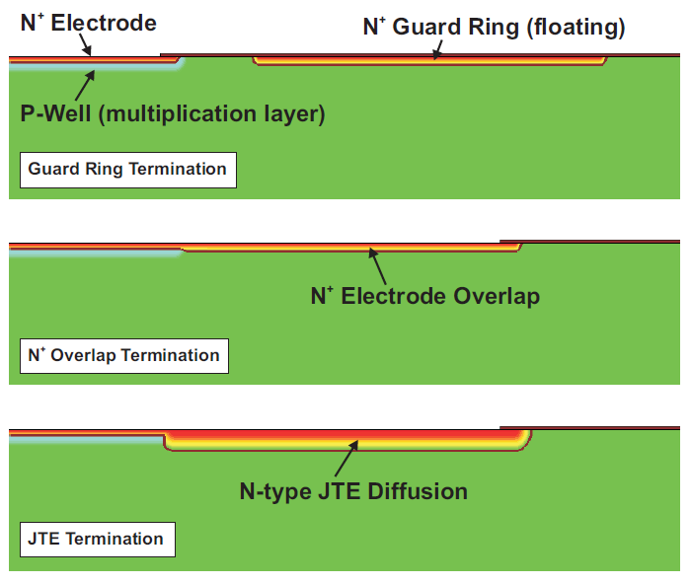
Compatible Edge Termination Techniques
Maximum efficiency of 80%
Maximum efficiency of 60%
Maximum efficiency of 90%

Slide 47
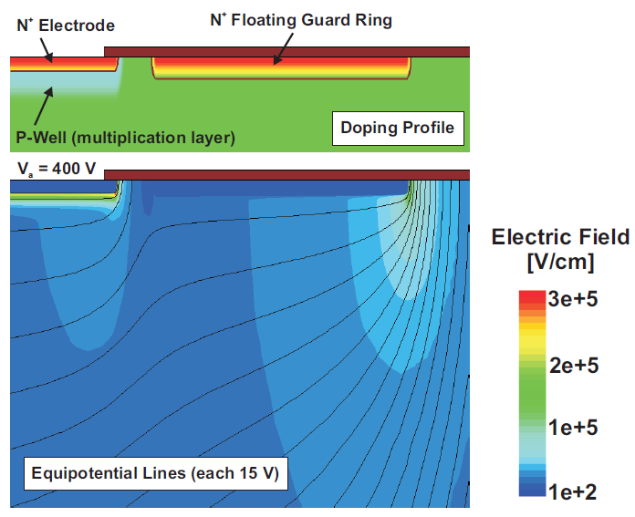
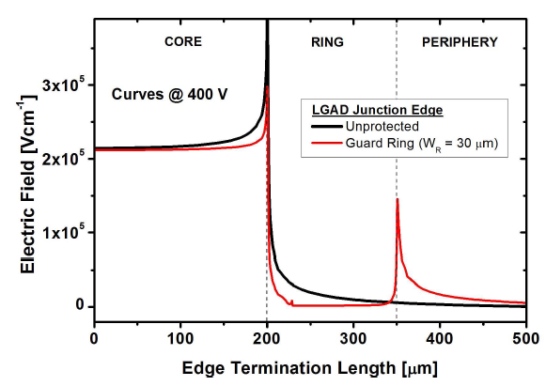
Edge Termination with Guard Ring
The N⁺ shallow diffusion is used to implement a floating guard ring
The lateral electric field distribution is smoothed leading to two peaks (main junction and floating guard ring)
The electric field peak and the risk of avalanche breakdown at the curvature of the main junction is reduced. Optimisation of the guard ring location is needed

Slide 48
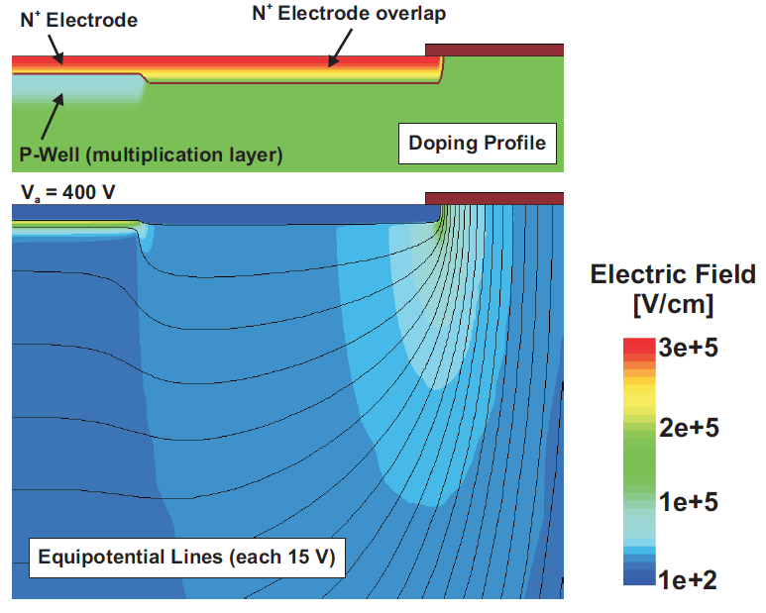
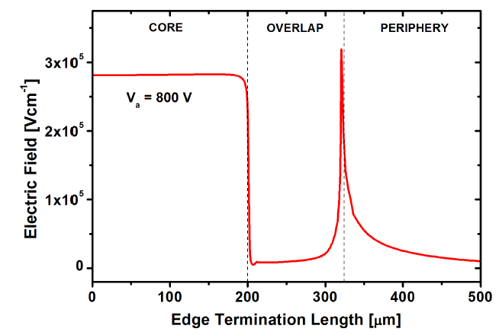
Edge Termination with N⁺ Extension
The N⁺ shallow diffusion is used to extend the N⁺ beyond the edge of the multiplication layer
Phosphorous diffuses more in the very low doped substrate (higher curvature radius and voltage capability)
The electric field rapidly increases at the plain junction (multiplication)
At high reverse voltage the electric peak at the extended N⁺ diffusion leads to avalanche breakdown
Avalanche
Multiplication

Slide 49
Edge Termination with Junction Termination Extension
Junction Termination Extension (JTE) with an additional deep N diffusion
Additional photolithographic step with high energy Phosphorous implantation
A field plate can also be implemented for additional electric field smoothing
Field Plate
N⁺ cathode
P-type multiplication layer
JTE diffusion
P-type substrate
P⁺ anode
Notes:
To achieve this condition, we define a low doping N-well in the periphery of the cathode diffusion, deeper than this, and with the aim to increase the voltage cability of the peripheral zone. This low doping N-well is known as Junction Termination Extension (JTE).

Slide 50
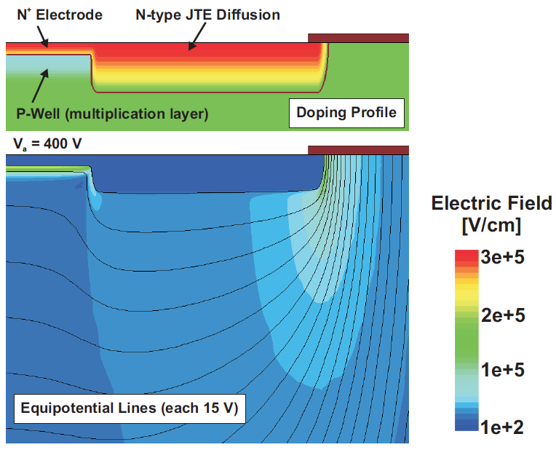
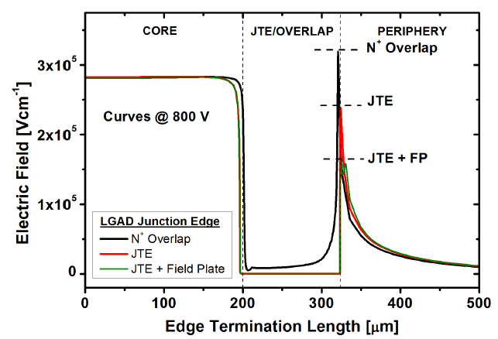
Edge Termination with Junction Termination Extension
Deep N diffusion with high curvature radius (long anneal process)
Reduced electric field peak at the JTE diffusion
Highest electric field at the plane junction (gain control) V_{BD plane} < V_{BD JTE} (Gain control)
Multiplication and avalanche control

Slide 51
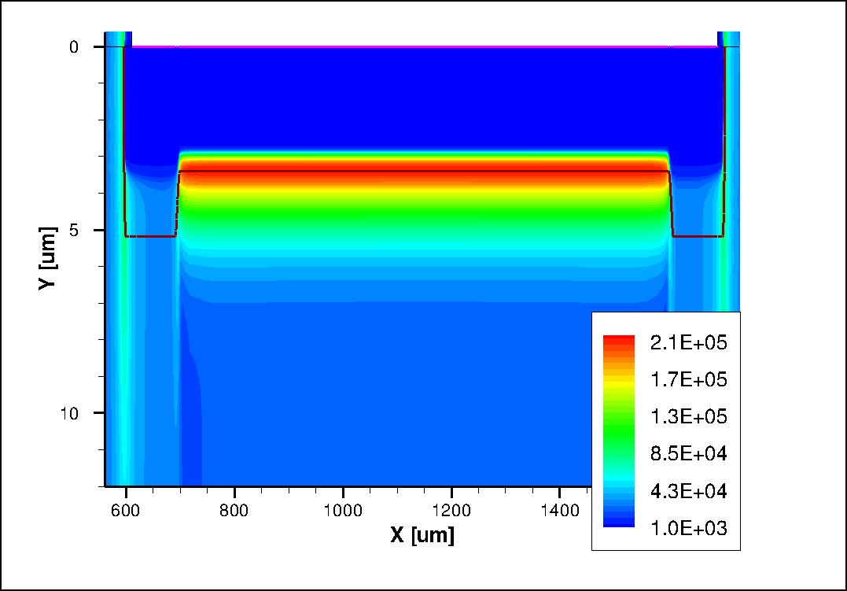
Edge Termination with Junction Termination Extension
Electric Field @ 400 V
Planar and uniform electric field distribution, high enough to activate charge multiplication
N⁺
N
P
π
Notes:
The reduction in the peripheral electric field, allows that the maximum Electric Field is reached in the multiplication area. We can also see how, if we add a field plate on the end of the JTE, we can increase the reduction of the electric field, increasing the breakdown voltage in that area.

Slide 52
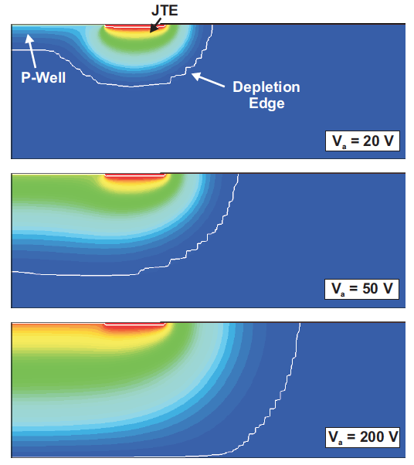
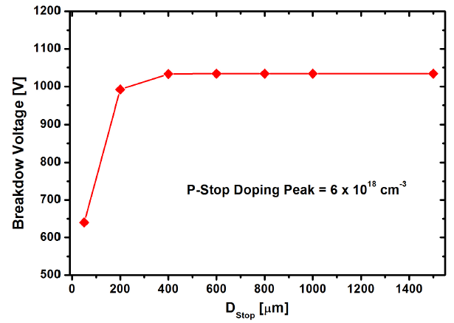
Design of the Device Periphery
Full depletion below 100 V reverse bias
Fast lateral depletion of the low doped substrate (A deep P⁺ diffusion –P stop- is needed in the die periphery to avoid the depletion region reaching the unprotected edge

Slide 53
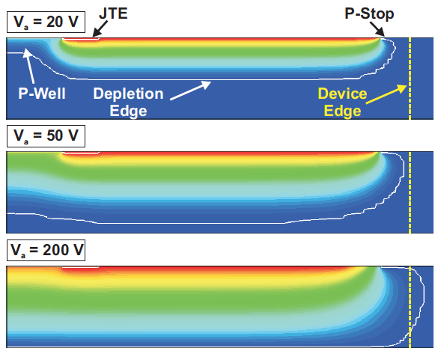
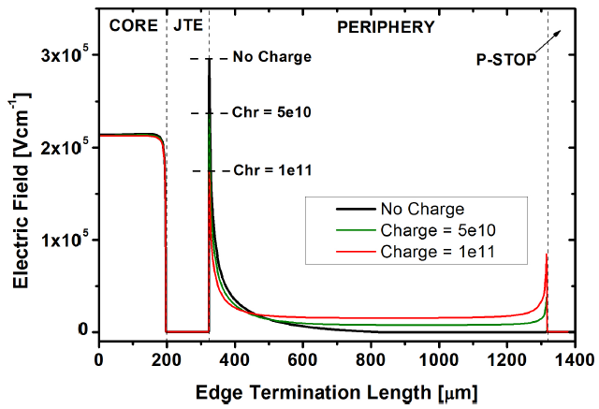
What about the Inherent Positive Oxide Charges?
Field oxides grown in wet conditions (H₂+O₂) typically have a positive charge density in the range of 5e10 cm⁻²
Surface inversion and modification of the depletion region, reaching the deep P-Stop peripheral diffusion
Surface inversion + fast depletion + electric field peak at deep P-stop+ SURFACE LEAKAGE CURRENTS

Slide 54
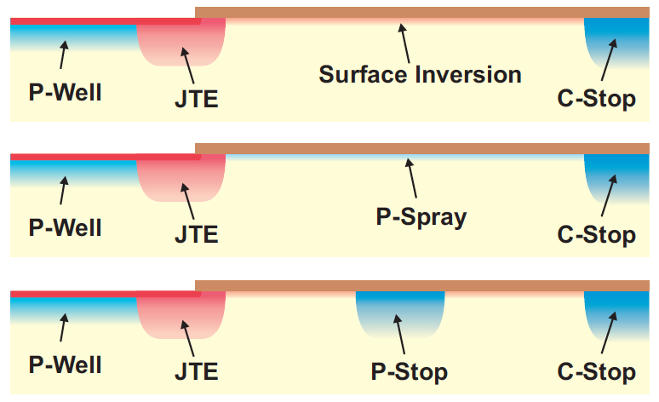
How to Protect the Surface, Limiting the Current Leakage?
Oxide positive charges create a surface inversion layer (electron path towards the cathode electrode, masking the charge collection when used as a detector)
A shallow P-type diffusion (P-Spray) can be used to compensate the surface inversion
A deep P⁺ diffusion can be placed close to the JTE to eliminate the electron surface current
Blanket Boron implantation
Same Boron implantation

Slide 55
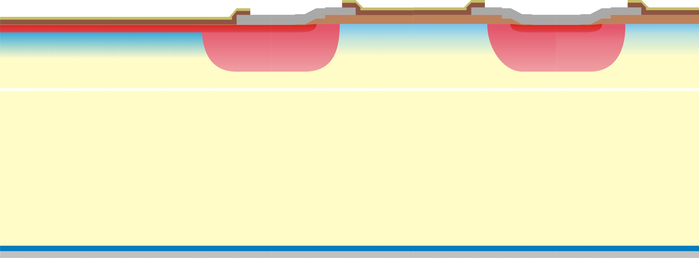
How to Protect the Surface, Limiting the Current Leakage?
An additional N-type ring is implemented by using the deep JTE diffusion
The N ring has to be placed close to the JTE to avoid a premature breakdown at the JTE
The P-spray diffusion has to be efficient (to avoid short circuit through the inversion layer)
The voltage capability is not degraded since the junction to be protected is now the right edge of the added ring (identical than the JTE)
P
N⁺
N
N
P⁻
N⁺
Multiplier Junction
Overlap
Collector Ring
P⁺

Slide 56
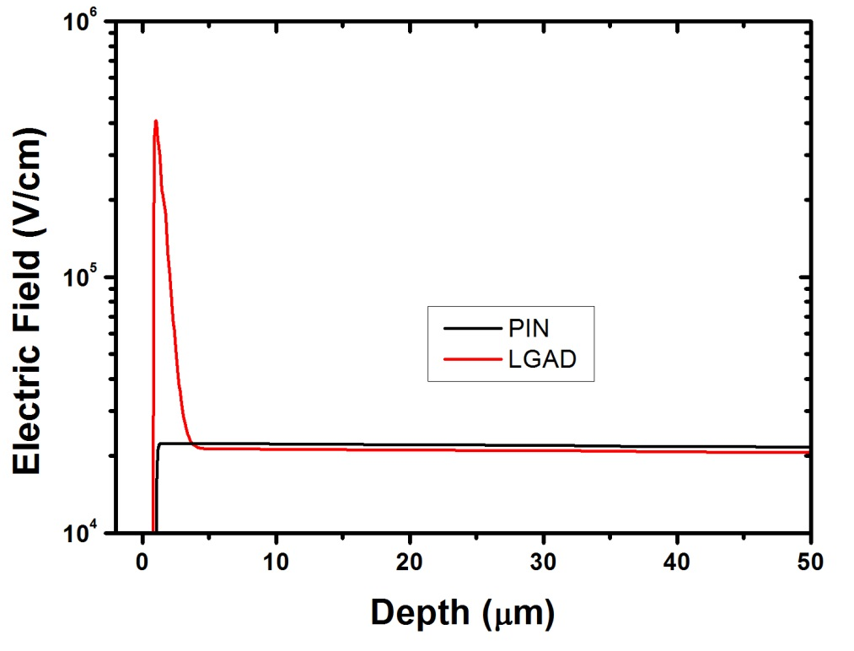
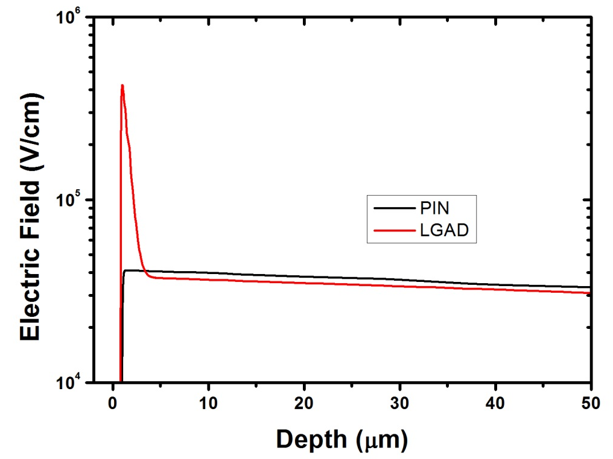
Simulation of the Irradiated Devices
Curves @ 600 V
No Irradiated
Irradiated. Φ_{eq} = 1 x 10¹⁵
High Electric Field peak at the junction
PiN: electric field strength at the junction increases after irradiation
LGAD: electric field strength at the junction is almost equal after irradiation
Irradiation Trap Model (Perugia Model)
Acceptor; E= E_{c} + 0.46 eV; η=0.9 σ_{e} = 5 x 10⁻¹⁵ σ_{h} = 5 x 10⁻¹⁴
Acceptor; E= E_{c} + 0.42 eV; η=1.613 σ_{e} = 2 x 10⁻¹⁵ σ_{h} = 2 x 10⁻¹⁴
Acceptor; E= E_{c} + 0.10 eV; η=100 σ_{e} = 2 x 10⁻¹⁵ σ_{h} = 2.5 x 10⁻¹⁵
Donor; E= E_{v} - 0.36 eV; η=0.9 σ_{e} = 2.5 x 10⁻¹⁴ σ_{h} = 2.5 x 10⁻¹⁵
Impact Ionization Model (Univ. of Bolonia)
Notes:
Taking into account that the value of the electric field in the junction, causes the appearance of the charge multiplication, using numerical simulations we can compare the electric field profile of an irradiated detector with an un-irradiated one.
Thus, simulations show that the electric field at the junction of a PiN diode increases by the action of radiation, while maintaining substantially equal in the low gain avalanche diode (LGAD).

Slide 57
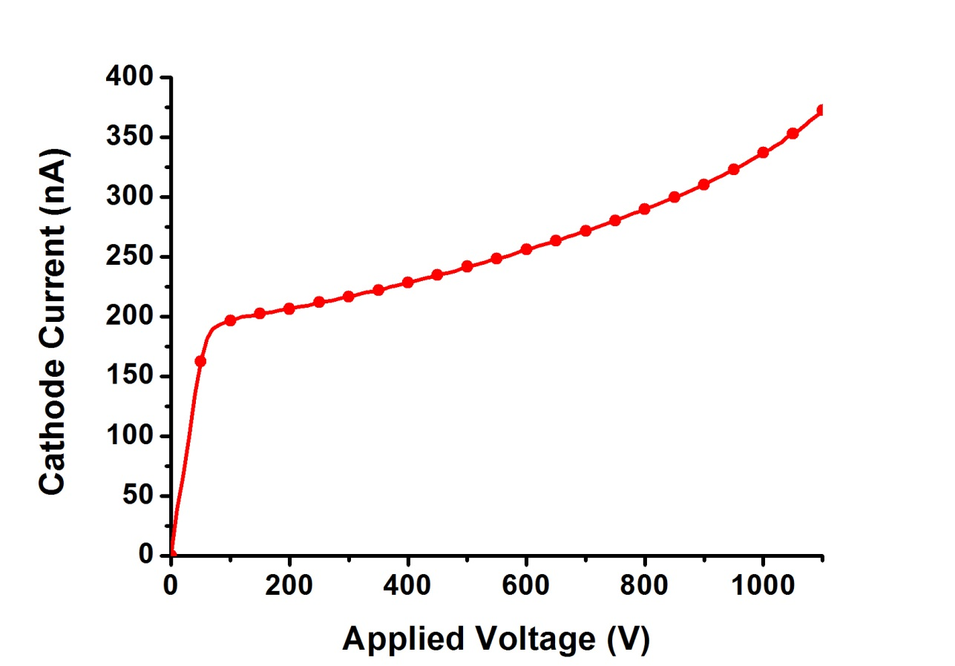
Experimental Results
Static Performance
Current levels below 1 µA thorough the whole voltage range
Junction breakdown above 1100 V
W5_F11
Junction breakdown above 1100 V
Current level
(~ few hundreds of nA)
Wafer 5 (1.4 × 10¹³ cm⁻²)
Notes:
In all cases identified as "good devices", the reverse leakage current is less than one micro ampere for voltages lower than the breakdown voltage. This voltage reaches a value of eleven hundred volts for all wafers (1100 V), except the eighth wafer that reaches eight hundred volts, as planned.

Slide 58
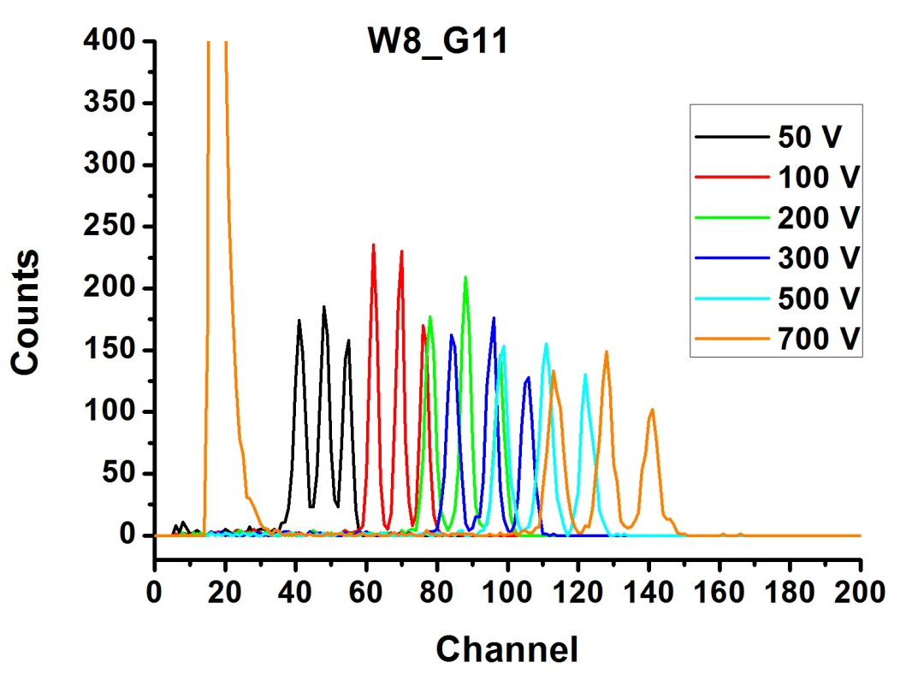
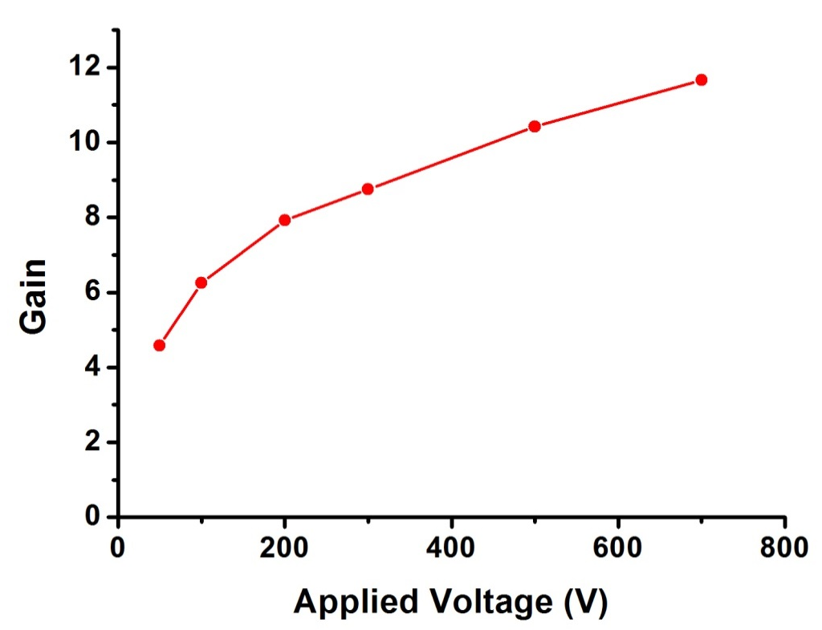
Experimental Results
Multiplication factor has been tested with tri-alpha (²³⁹Pu/²⁴¹Am/²⁴⁴Cm) source.
Irradiation through the anode (back side, 1 µm Aluminum):
Back Side Irradiation
Notes:
The Detectors characterization using a tri-alpha source, shows how the gain increases with voltage, which is in the range of 10.
Irradiation measures through the back of the detector, provide better results than the measurements performed irradiating through the cathode.

Slide 59
Notes:
That's all. Thank you very much for your attention.

