Slide 1

SRF2013 TUTORIAL
BASIC PRINCIPLES OF RF SUPERCONDUCTIVITY
Enzo Palmieri
ISTITUTO NAZIONALE DI FISICA NUCLEARE
Legnaro National Laboratories
and
University of Padua
ITALY

Slide 2
Let us build a resonant cavity

Slide 3
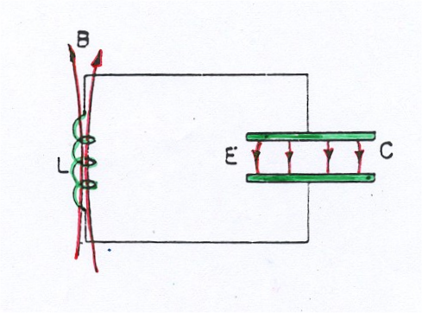
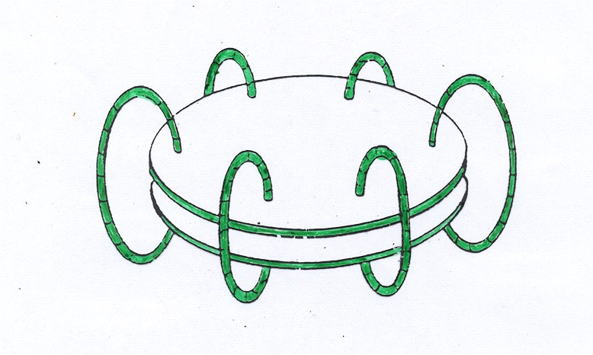

Slide 4
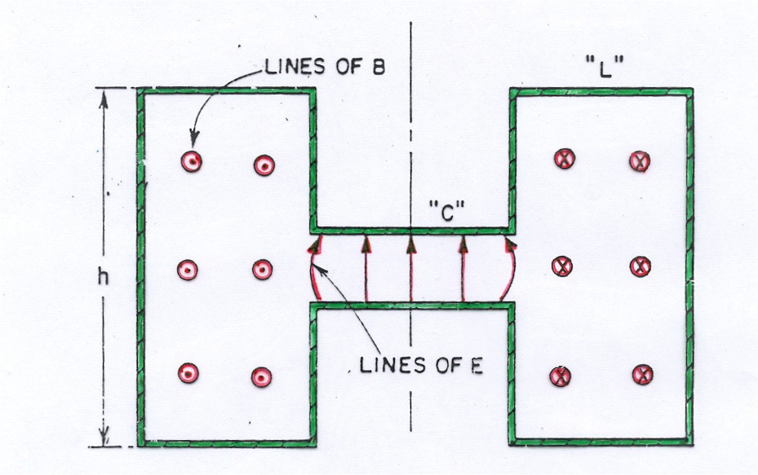

Slide 5
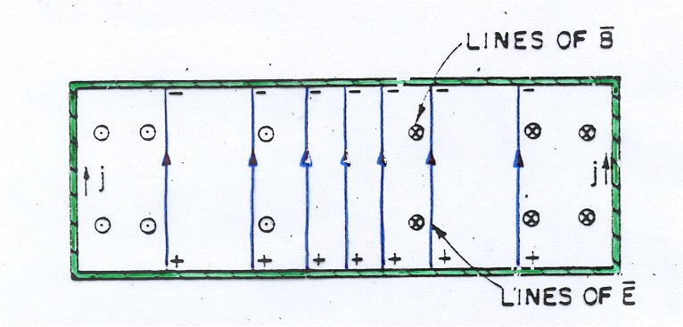

Slide 6
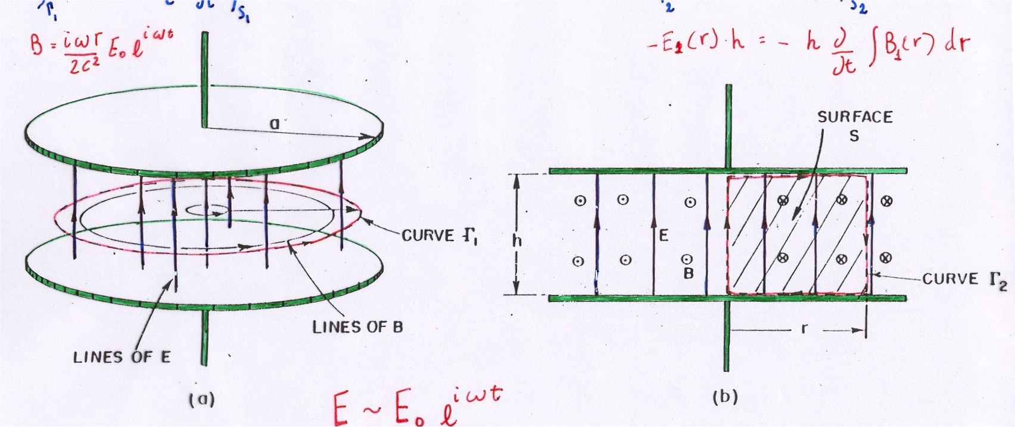
E ~ E₀ e^{iωt}
E0 → B0 → E0 + E1 → B0 + B1 → E0 + E1 +E2 →

Slide 7
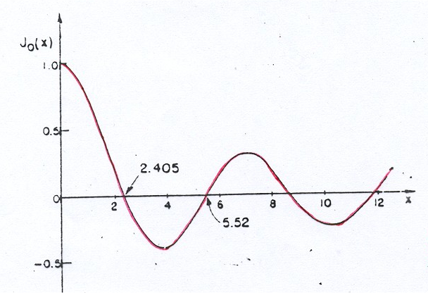

Slide 8
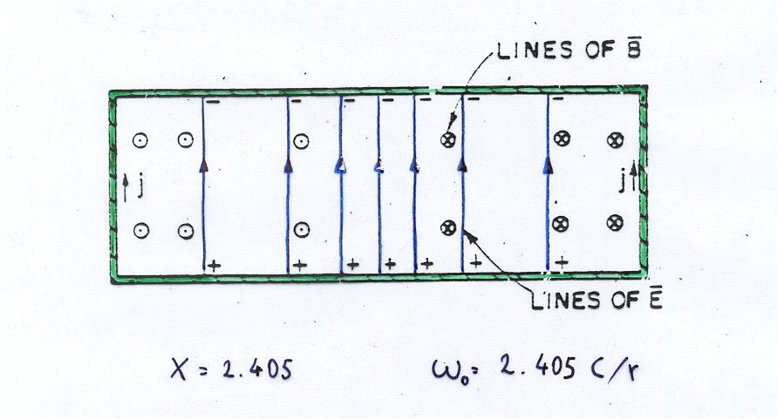
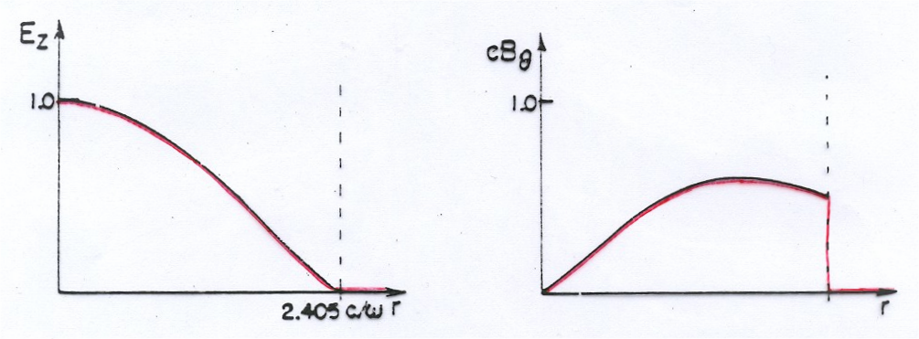

Slide 9
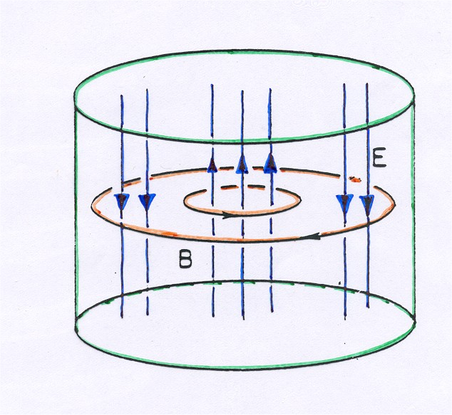
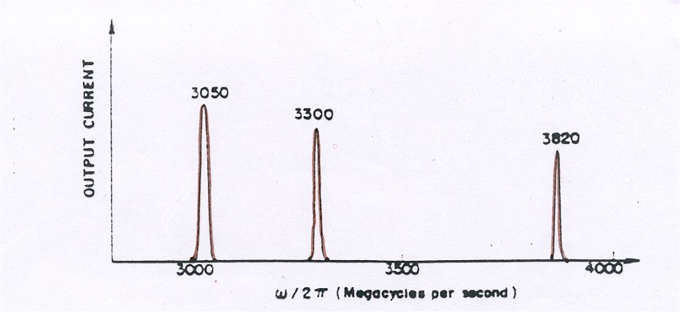
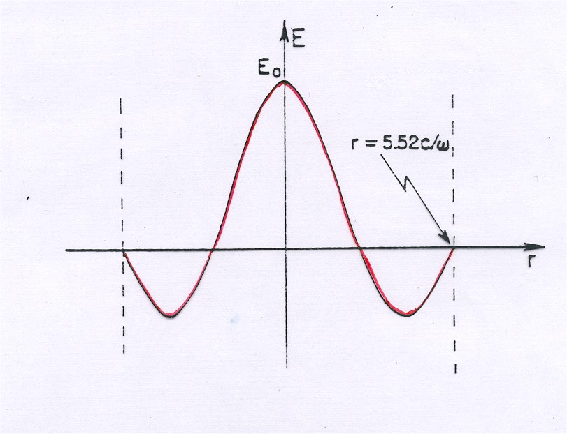

Slide 10
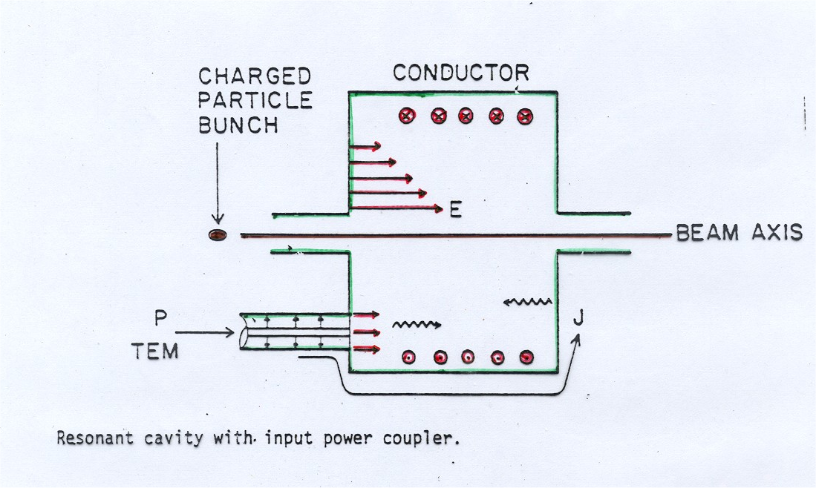
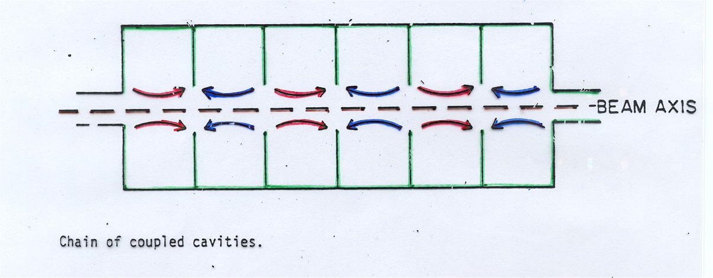
By Radiofrequency one can accelerate particles to high energy without the need of the equivalent high static fields

Slide 11
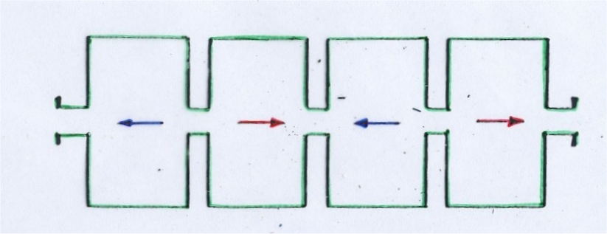
Chain of weakly coupled pill-box cavities representing an accelerator module

Slide 12
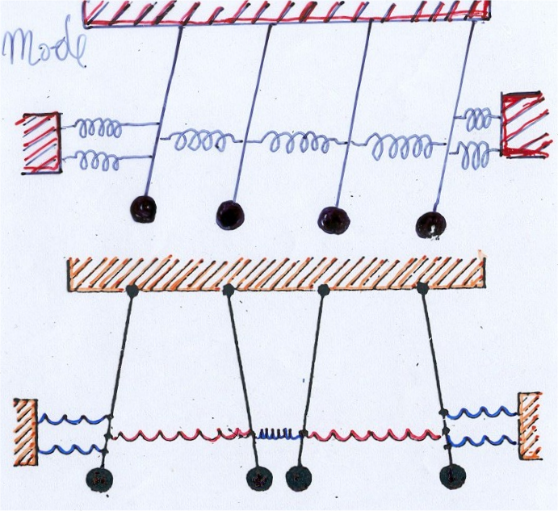
Zero mode
Coupled pendula for a mechanical analogous
π−mode
There are N eigen-modes for such an oscillating system
The smallest RF losses

Slide 13
  A normal metal exposed to RF fields

Slide 14
Normal metals in RadioFrequency and the normal skin effect
Normal metal
Vacuum
E_{y}(0)
δ
k = k₁ + i k₂

Slide 15
THE ELECTROMAGNETIC RESPONSE OF A METAL
For a semi-infinite conductor filling the +x half-space and has a plane surface at x = 0
x
H
metal
E
z
Vacuum
y

Slide 16


THE ELECTROMAGNETIC RESPONSE OF A METAL

Slide 17
x
metal
H
z
E
Vacuum
y

Slide 18
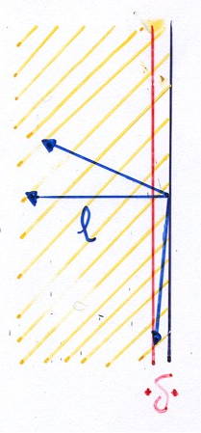
ω ; T
δ
J(r) = σ E(r)

Slide 19
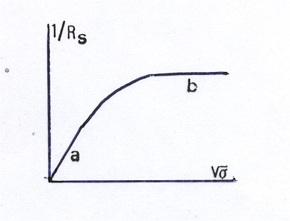
:
The Anomalous Skin Effect

Slide 20
The Two fluid Approach for describing the phenomenology of a Superconductor

Slide 21
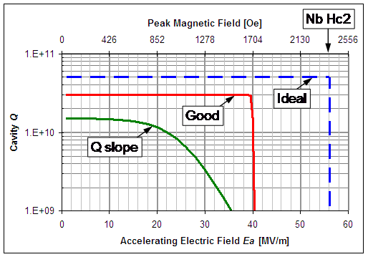

Slide 22
Two Fluid model for a superconductor
Electrical Conduction mechanism due to 2 different components
J = J_{n} + J_{S}
Normal
Superfluid
1
n_{S}/n
n_{n}/n
T_{C} T

Slide 23
J = J_{n} + J_{S}
J_{n} = σ E
J_{S} = n_{s} e v_{s}
m v_{s =} -e E
London equation
Is the Analogous of the
“Ohm Law” for Superconductors

Slide 24
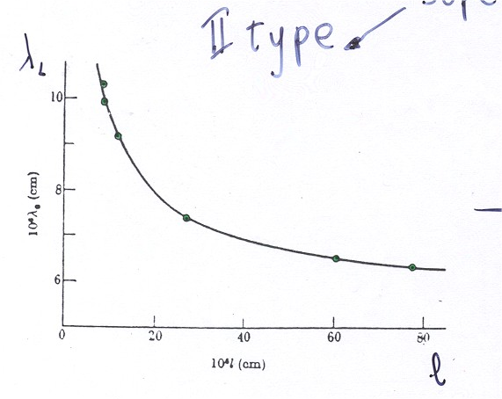
I type
Pippard
Superconductors
II type
London
The λ dependence vs mfp induced Pippard to modify London’s model
He borrowed from Chambers the non local approach that relates Current and Electric field

Slide 25
Strong Correlations among Superelectrons
within a coherence length ξ₀
instead of
λ
λ
ξ_{o}
ξ_{o}
Pippard
London

Slide 26
ξ = ξ₀ if l→∞
otherwise
Pippard ξ > λ
London ξ < λ
λ
λ
ξ_{o}
ξ_{o}
Pippard
London
ξ
If l then
λ

Slide 27
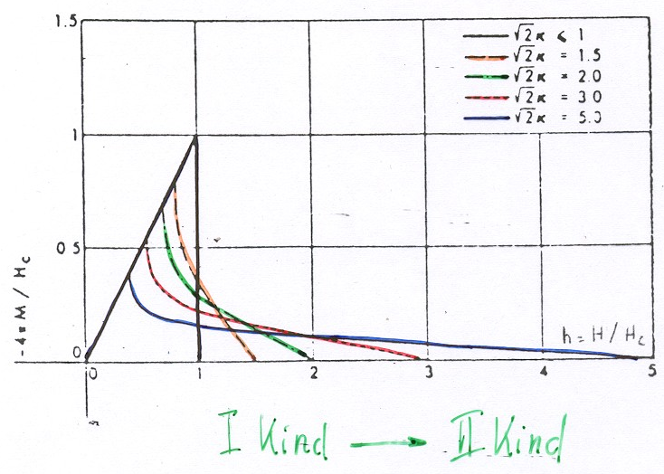

Slide 28
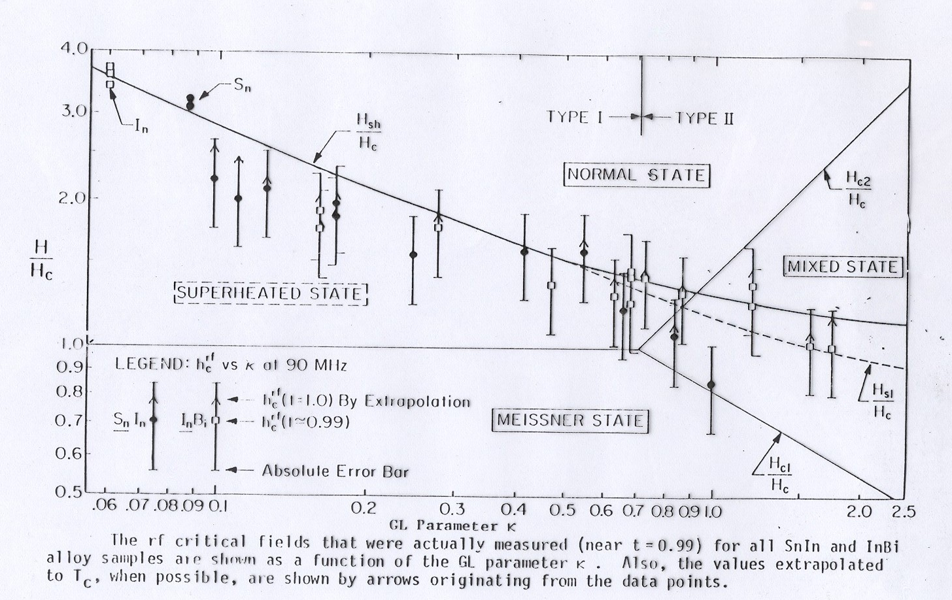

Slide 29
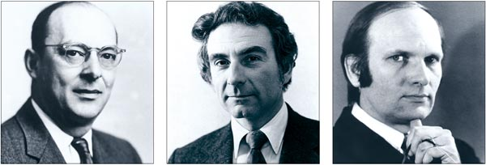
J. Bardeen L. Cooper R.Schrieffer
Cooper Principle:
Between 2 electrons excited above Fermi Energy, it exists a pair bound state separated by Δ from E_{F}, however weak an attractive interaction is supposed

Slide 30
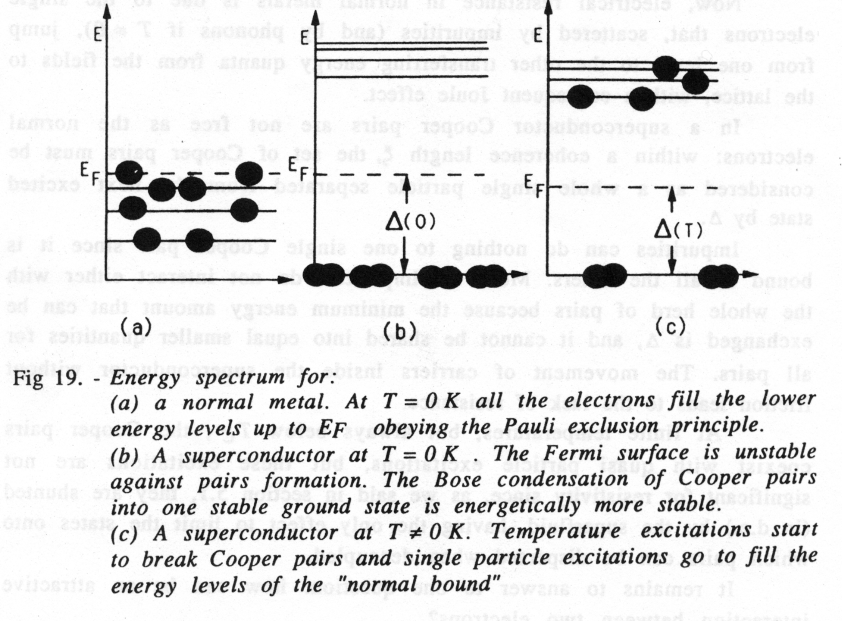

Slide 31
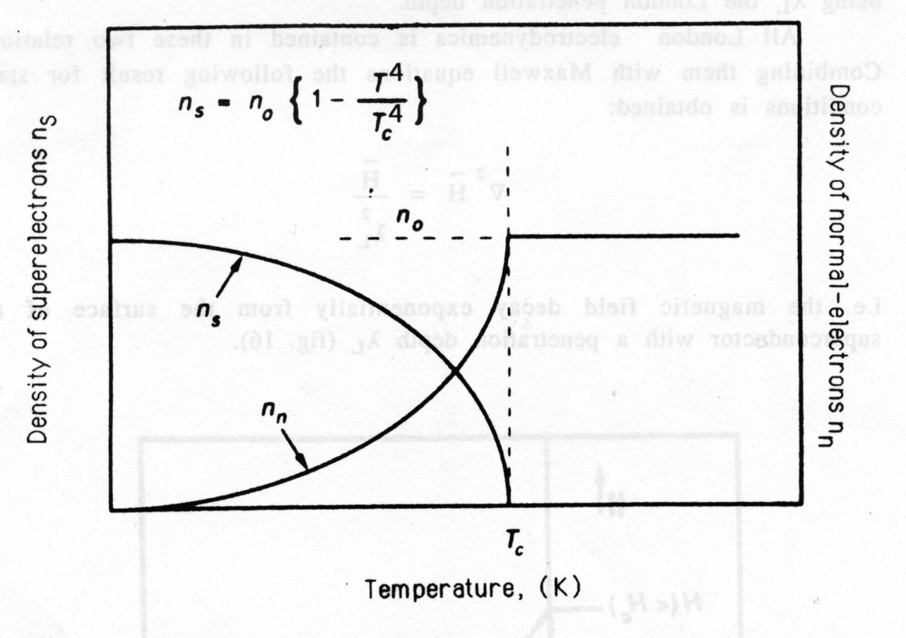
c

Slide 32
The Surface Resistance for a Superconductor: BCS contribution

Slide 33
The power losses through the walls of a resonator
may be described by the quality factor Q
V is the volume enclosed by the resonator,
A is the resonator surface and w is the resonance frequency
In the approximation of an uniform magnetic field on the surface
where G is a geometrical factor equal to 254 Ω for the TESLA type shape.

Slide 34
R is the real part of a complex quantity, the surface impedance
Z = R + i X
the surface resistance R measures dissipation processes of rf fields into the medium surface,
the surface reactance X measures the phase shift of a wave upon reflection from the surface.

Slide 35
The results for normal metals can be easily extended to superconductors, when a complex conductivity σ1 − i σ2 is introduced in place of the normal state conductivity σn.
Hence, as derived by Nam
where m = - 1/3 for the Pippard limit,
and m = - 1/2 for the London limit
Rs can be so written as

Slide 36
in the London limit to
However when σ1 << σ2, (T < Tc / 2), this relation simplifies to

Slide 37
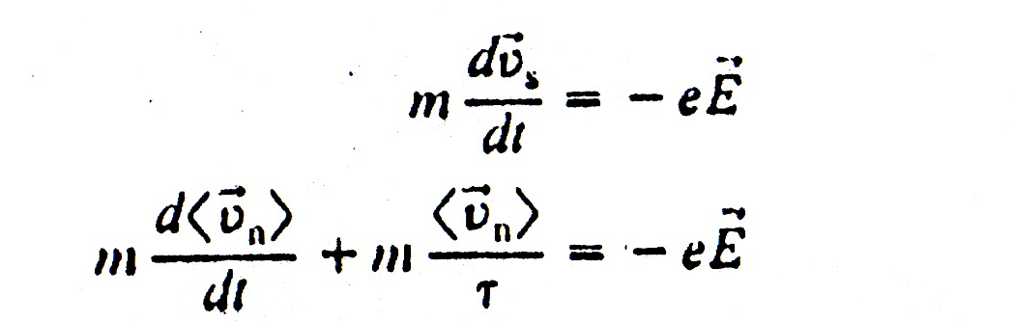
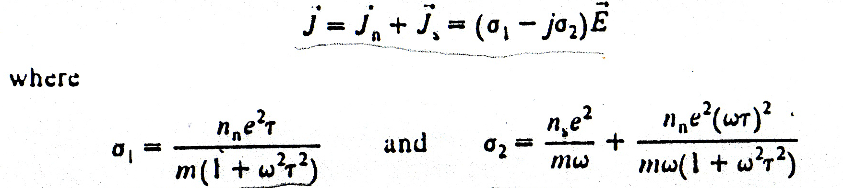
In the two fluid approximation
where

Slide 38
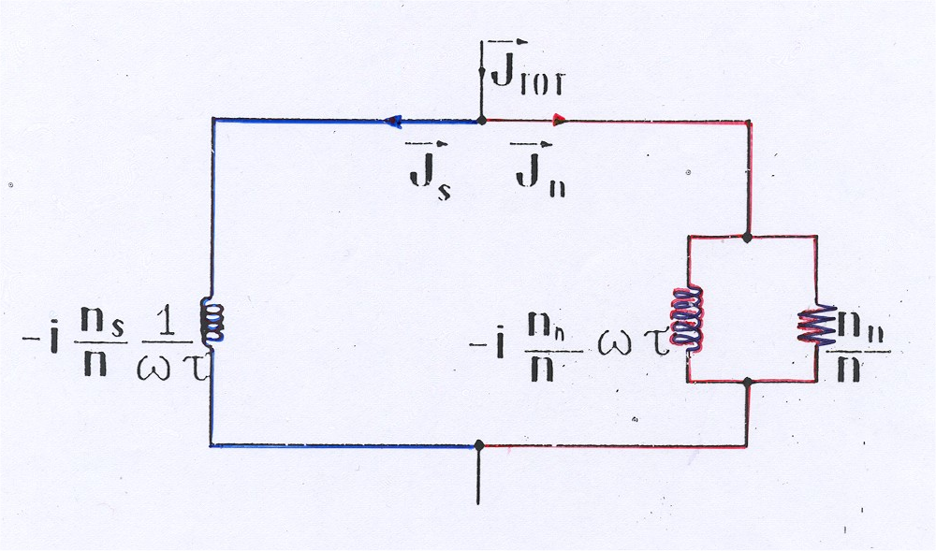
T =T_{C}; ω ≠ 0 → R_{S} ≠ 0
J = J_{n} + J_{S}

Slide 39
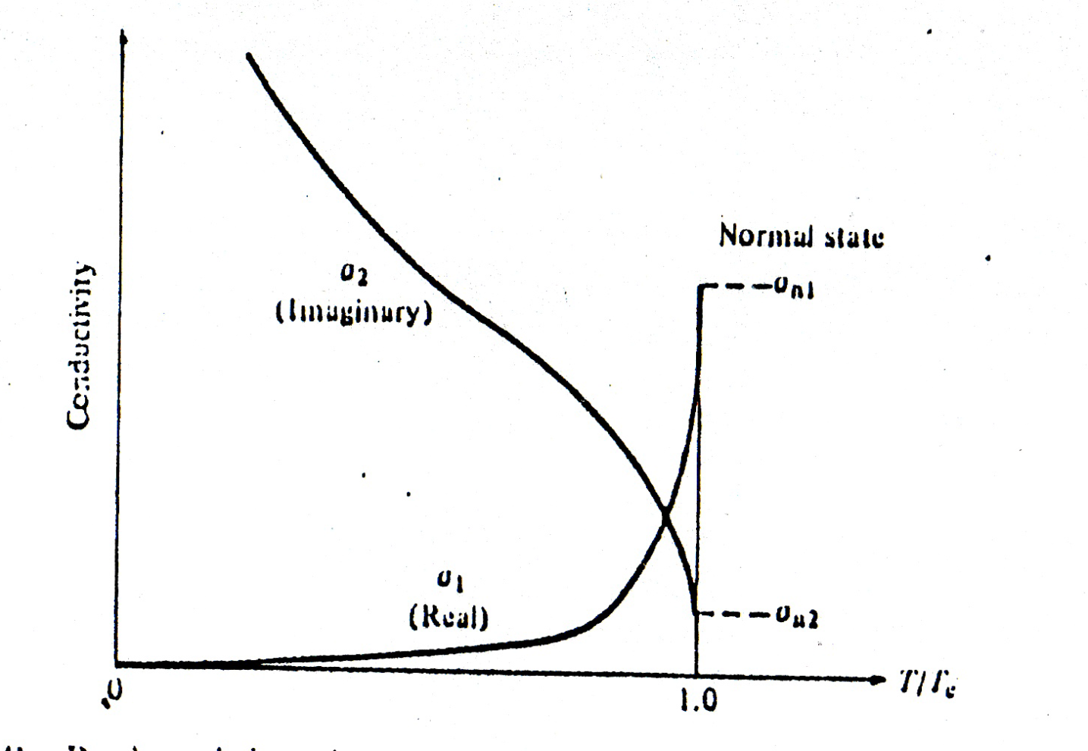
σ_{eff} = σ₁ – jσ₂ ≈ σ_{n} (n_{n}/n) – j (1/ωμ₀λ²)

Slide 40
The MB expressions were found also valid in the limit of impure superconductors by Nam.
The two integrals σ₁/σ_{n} and σ2/σn are easily numerically calculated. In particular they can be approximated in the normal skin effect regime for h'ω << 2 Δ and ω2 τ << 1 (τ is the momentum relaxation time) by:

Slide 41
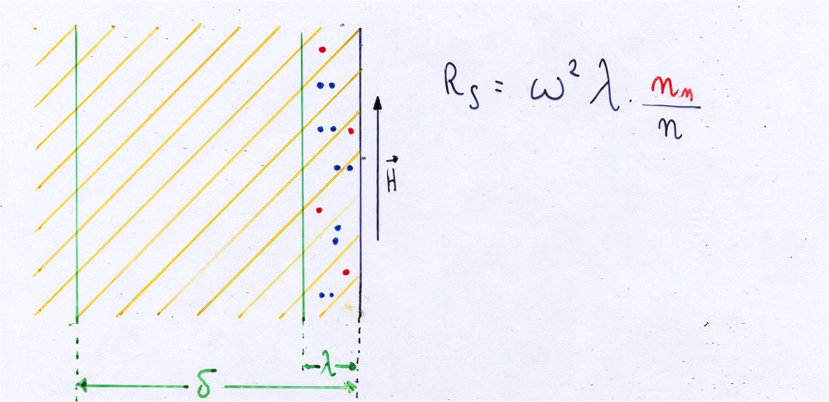

Slide 42
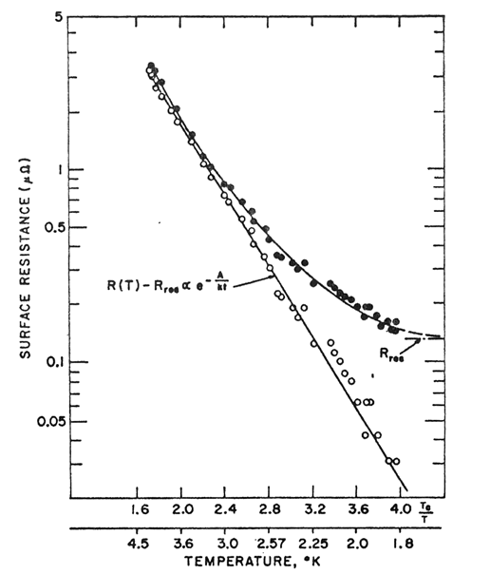

Slide 43
Surface Impedance and Surface Resistance
For a normal metal in the normal regime:
σ_{n} = 1 / ρ_{n} = dc conductivity at T
δ = skin depth
Extension to Superconductors:
σ₁-iσ₂ in place of σ_{n}
As derived by Nam, for T < T_{c} / 2, R_{s} can be approximated by:

Slide 44
Mattis and Bardeen Integrals
In the framework of the BCS theory, for ω < 2 Δ, the complex conductivity of a superconductor is:
in the extremely anomalous
The second integral in σ1 / σn does not appear unless ω > 2 Δ.
In such a case the lower limit of the integral in σ2 / σn is - Δ instead of Δ - h'ω.

Slide 45
and
Δ ( T ) = Δ (0) . { cos [ π ( T / Tc )² / 2 ] }^{1/2}

Slide 46
Mattis and Bardeen Integrals
The two integrals σ₁/σ_{n} and σ₂/σ_{n} are easily numerically calculated.
In the normal skin effect regime, for ħω << 2 Δ

Slide 47
since the effective penetration depth λ,
related in the London limit (ξ3 << ξ0 λL 2),
to the classical London penetration depth λL by
or

Slide 48
R_{BCS}
Then, if T < T_{c} / 2
where A = 6.0 E⁻²¹

Slide 49
R_{BCS}
Then,
(Empirically, R_{res} is found to be dependent on ρ_{n} too)

Slide 50
Essence of the previous calculations
For low rf losses,
a high T_{C} value is not sufficient
A metallic behaviour
in the normal state is mandatory

Slide 51
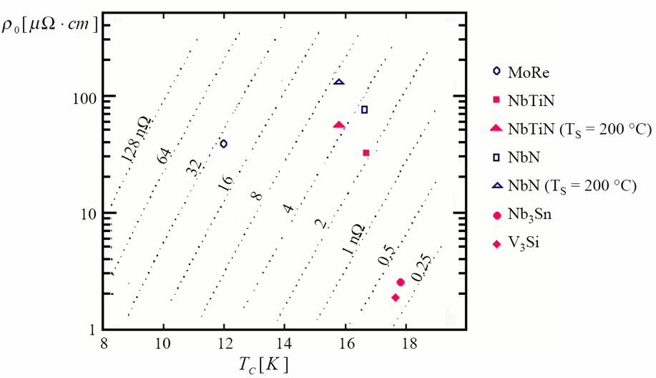
T= 4.2K, f = 500MHz, S=4
After C. Benvenuti, V. Palmieri, R. Vaglio, "Construction Materials for Superconducting RF accelerating cavities", P. Vincenzini ed., Advances in Science and technology 8, Superconductivity and Superconducting Materials Technologies, Techna publ. Faenza (1995), pp. 637-648.

Slide 52
Or equivalently
c

Slide 53
The validity of previus formulas is however limited to the dirty limit superconductors, but Niobium fails out of this limit, when l becomes comparable with ξ₀ : in such a case RBCS even increases when the Niobium purity is enhanced.
Although our approximation is valid only in the dirty limit, we asssume to not committ a large error if such relation is analitically prolongated in the London limit.

Slide 54
In this case the penetration depth λ becomes

Slide 55
B is the Nb RRR values one obtains

Slide 57
the formula has a minimum for values of β around 10

Slide 58
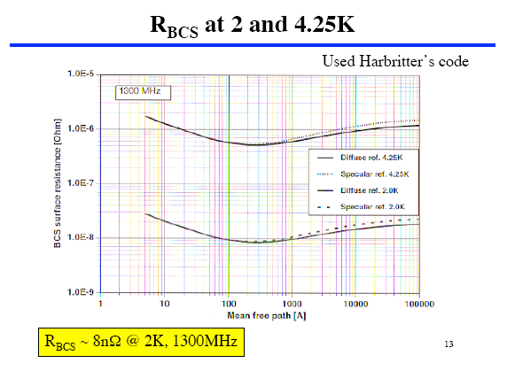

Slide 59
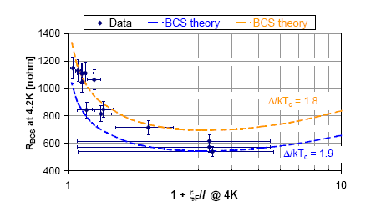
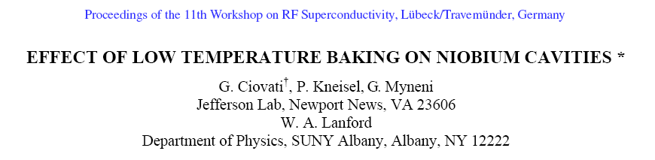

Slide 60
The field dependence
of BCS contribution

Slide 61
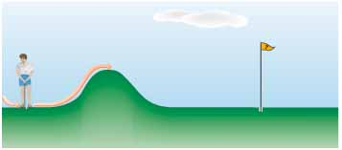

$$R_{BCS}= \frac{A}{T^{n}} e^{−\frac{∆}{K_{B}T}}$$
Modified Arrhenius Equation
For any chemical reaction, there must be a minimum amount of energy between reactant molecules for effective collisions between them. This is termed as activation energy.

Slide 63

$$R_{BCS}= \frac{A}{T^{n}} e^{−\frac{∆}{K_{B}T}}$$
Modified Arrhenius Equation
At room temperature, most of the molecules have less than the threshold value. Hence, if energy is supplied to the reactant molecules in the form of light or heat, they absorb that energy and reach a higher energy level which is equal to or greater than the threshold energy level.

Slide 64

$$R_{BCS}= \frac{A}{T^{n}} e^{−\frac{∆}{K_{B}T}}$$
Modified Arrhenius Equation
Activation energy (E_{a}) = Threshold energy - Average kinetic energy of molecules
Those reactions which have less magnitude of activation energy (E_{a}) are completed fast while some reactions appear to be slow due to higher activation energy

Slide 65
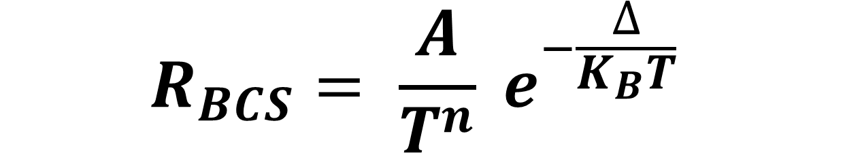
$$R_{BCS}= \frac{A}{T^{n}} e^{−\frac{∆}{K_{B}T}}$$
Activation energy (E_{a}) = Threshold energy - - Average kinetic energy
Δ = Δ₀ - K_{s}

Slide 66
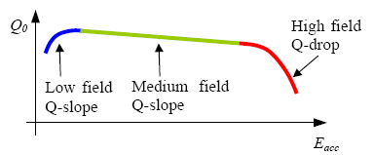

Slide 67
?
Δ = Δ₀ - p_{f}v_{s}
I.I. Kulik, V. Palmieri, "THEORY OF DEGRADATION AND NON LINEAR EFFECTS IN Nb-COATED SUPERCONDUCTING CAVITIES",
Proceedings of the Eight Workshop on RF Supercoductivity, Abano, Italy, October 1997, V. Palmieri, A. Lombardi eds.
Special Issue of Particle Accelerators, Vol. 60,(1998)p.257-264
The Ginzburg-Landau result
Δ= Δ₀ (1 – H²/H_{C}²)
does not apply!!!

Slide 68
Δ= Δ₀ (1 – H²/H_{C}²)
This formula has done a lot of damage to our community for the understanding of the Q-Slope
R.H. White and M. Tinkham, Magnetic-Field Dependence of Microwave Absorbtion and Energy gap in Superconducting Films, Phys Rev, vol 136, 1A, (1964), p. A203
“…..The qualitative features of Δ/Δ₀ dependences like (1 – h²) and (1-h²)^{1/2} arevery different from those of the experimental absorption curves reported here …. due to the disagreement between these results and previous theory and experiment, it must be concluded that the above procedure for determining an effective energy gap parameter as a function of H is too naive.”
Y. Nambu, S.F. Tuan, Phys, Rev. Lett. 11, 119 (1963); Phys.Rev.133, A1, (1964)
“…Electrons moving parallel to the surface play a special role: since the magnetic filed will confine such an electron and the one with which it is paired to opposite surfaces of the film, they contribute little to the superconductivity pairing energy…”

Slide 69
This relation goes back to first principles
Δ = Δ₀ - p_{f}v_{s}
It means to take into account the supercurrent!
If for Superconducting Magnets the fundamental and indipendent parameters are 3: T_{C}, H_{C} and J_{C}, …..

Slide 70
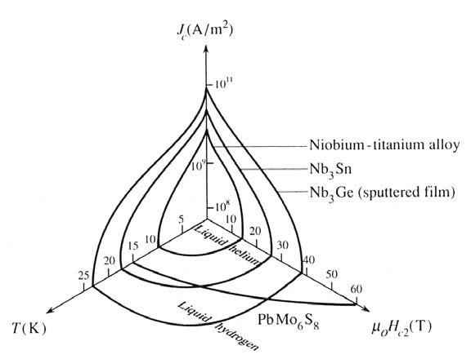
Why for Superconducting cavities, JC disappeared?
Is 40 MV/m (1600 G) a field not strong enough?

Slide 71

REVIEWS OF MODERN PHYSICS VOLUME 34, NUMBER 4 OCTOBER 1962
Critical Fields and Currents in Superconductors*
JOHN BARDEEN
UNIVERSITY OF ILLINOIS, Urbana, Illinois
… II.THERMODYNAMIC RELATIONS
To discuss the thermodynamics of a superconductor in a magnetic field or with current flow, it is most convenient to take the external field H and the superfluid velocity v_{s} as independent variables. ……
The displacement of the pairs causes an increase in free energy of the system which may be expressed simply in terms of J_{s}……
APPENDIX B. DIRECT CALCULATION OF CHANGE OF GAP WITH CURRENT
... In the low temperature limit, there are no excitations formed and thus no change in D until the velocity vs reaches the value for which it is favorable to form pairs of excitations, corresponding to transfer of an electron from one side of the Fermi sea to the other.This criterion is (depairing condition)
or

Slide 72
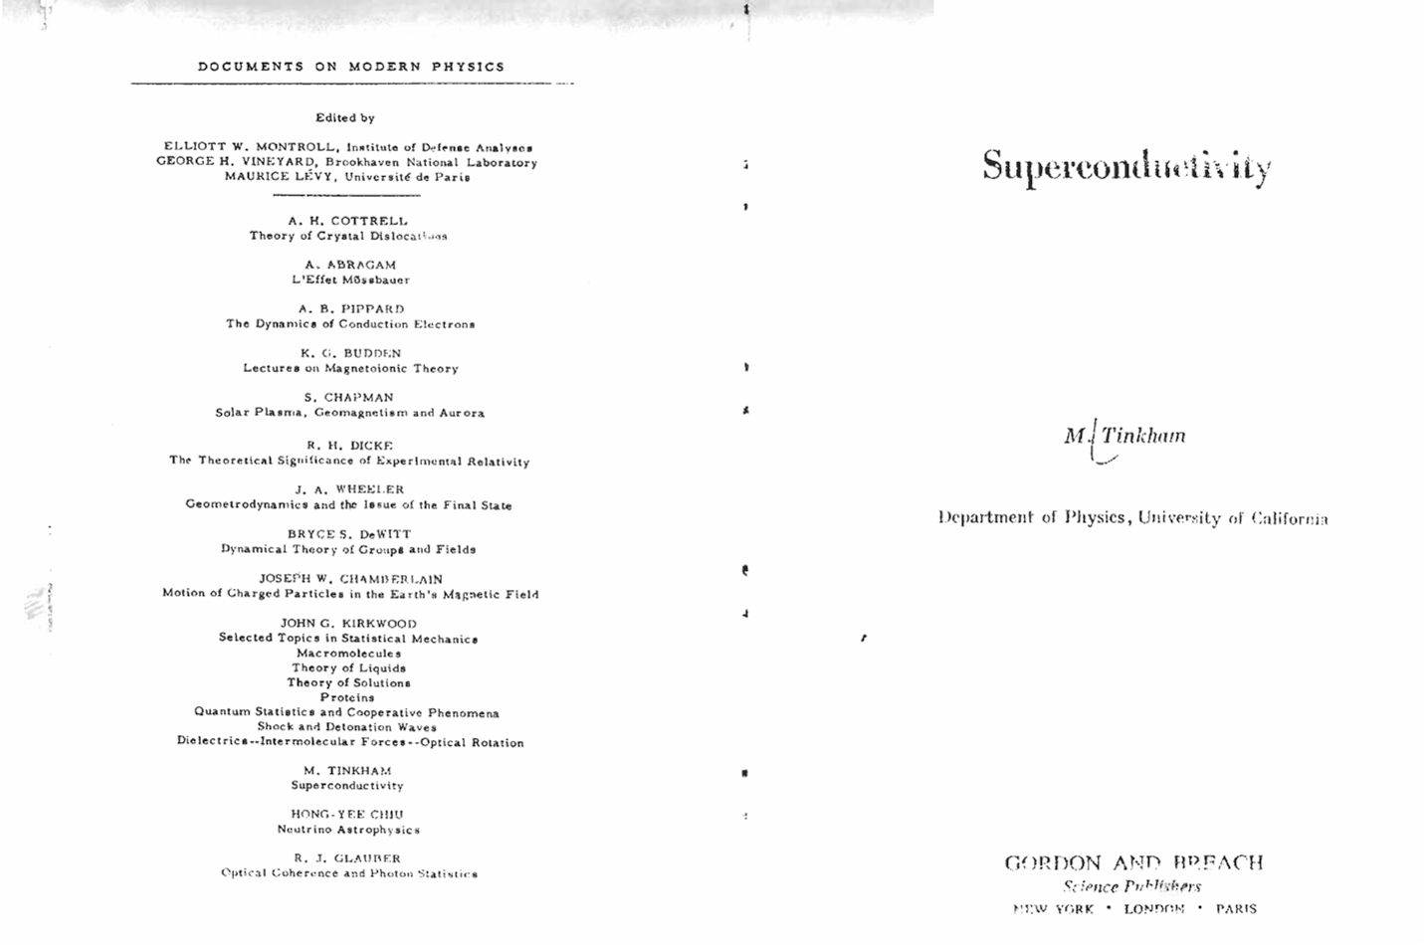

Slide 73
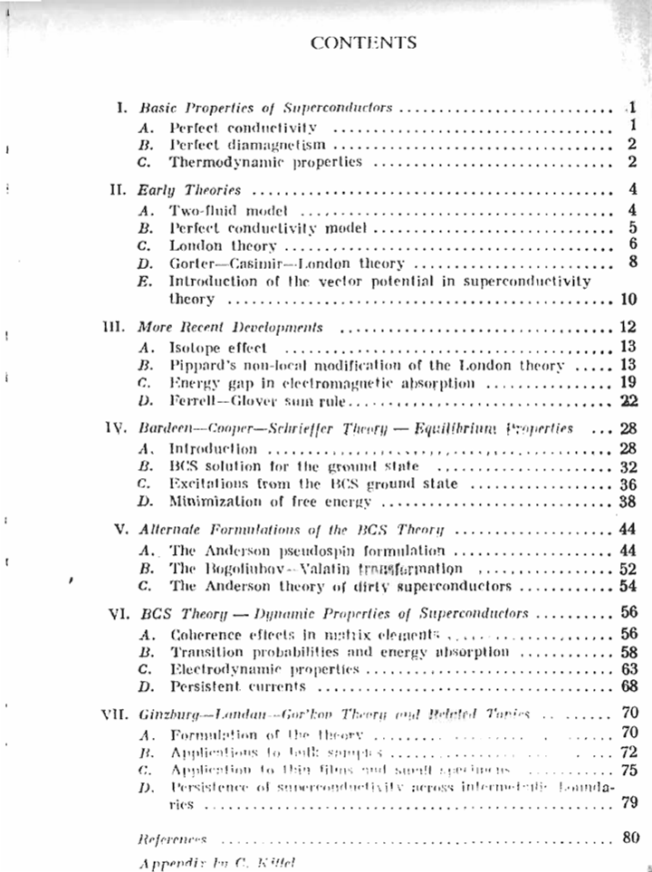

Slide 74
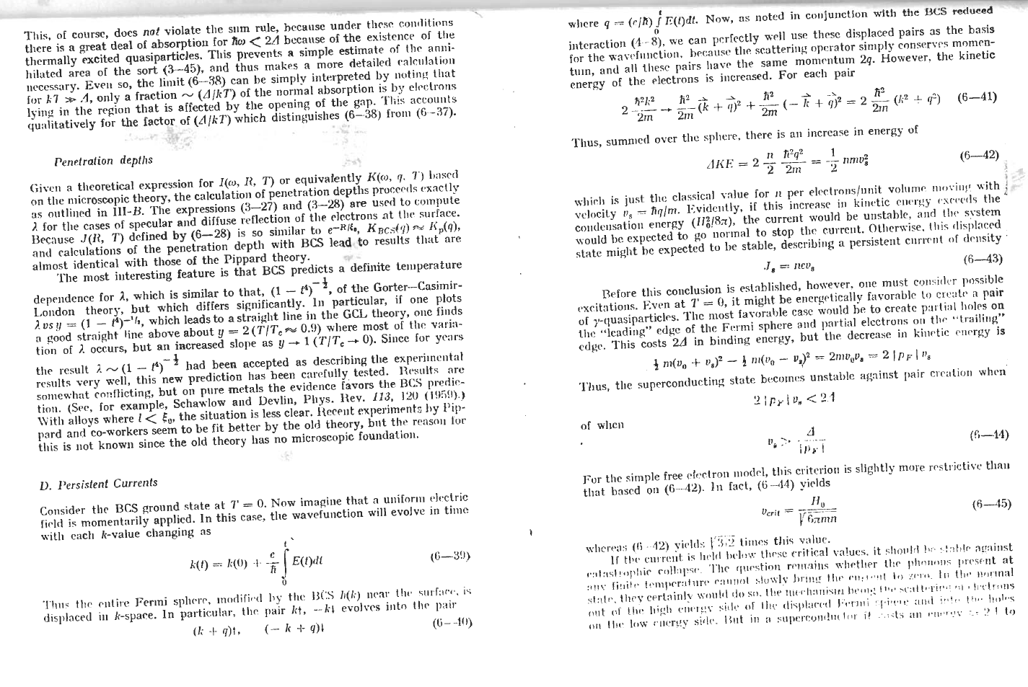

Slide 75
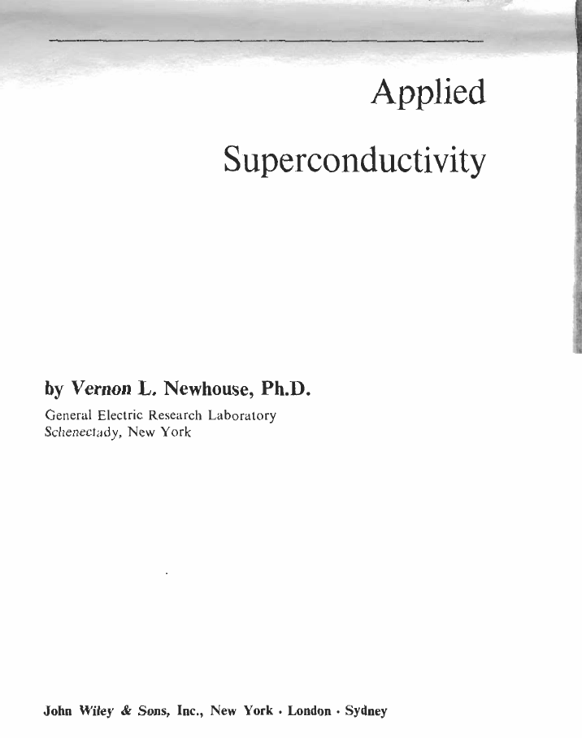

Slide 76
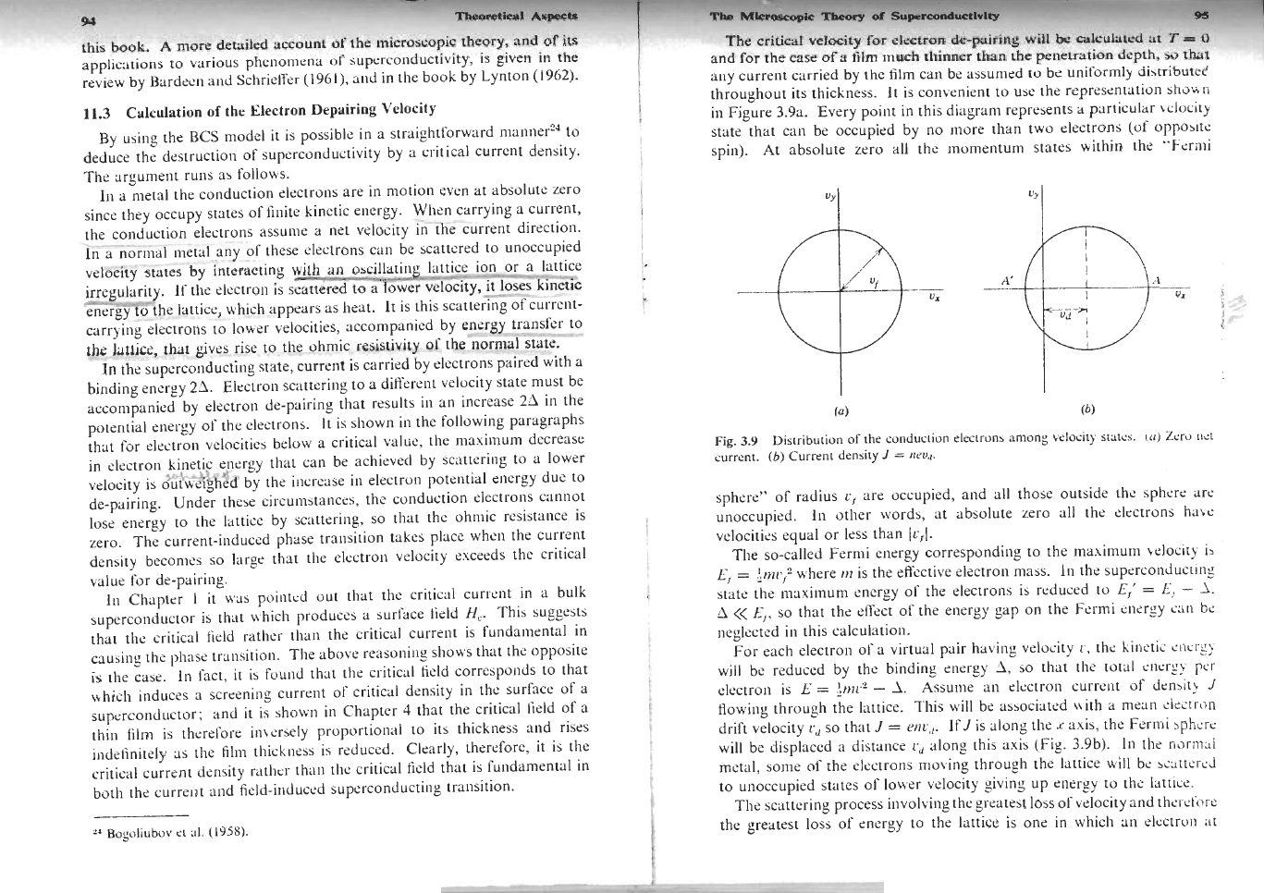

Slide 77
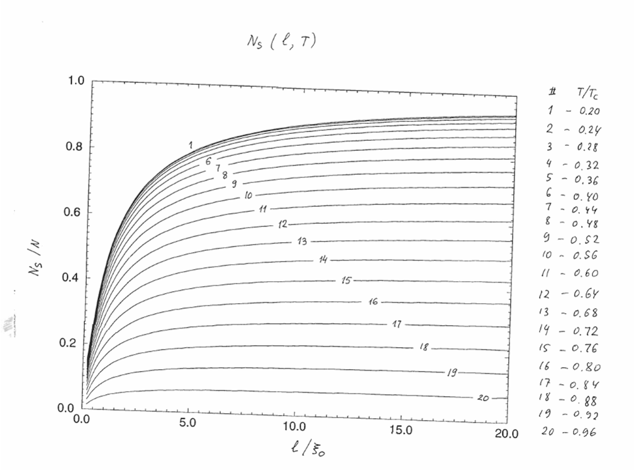

Slide 78
The parasitic term P_{f}V_{s} is neglectable at high value of the pure bulk Nb case
It becomes important at low
- thin film case
- contaminated surface after low temp baking

Slide 79
Δ = Δ₀ - p_{f}v_{s}
This will affect λ₀ and B_{c}

Slide 80
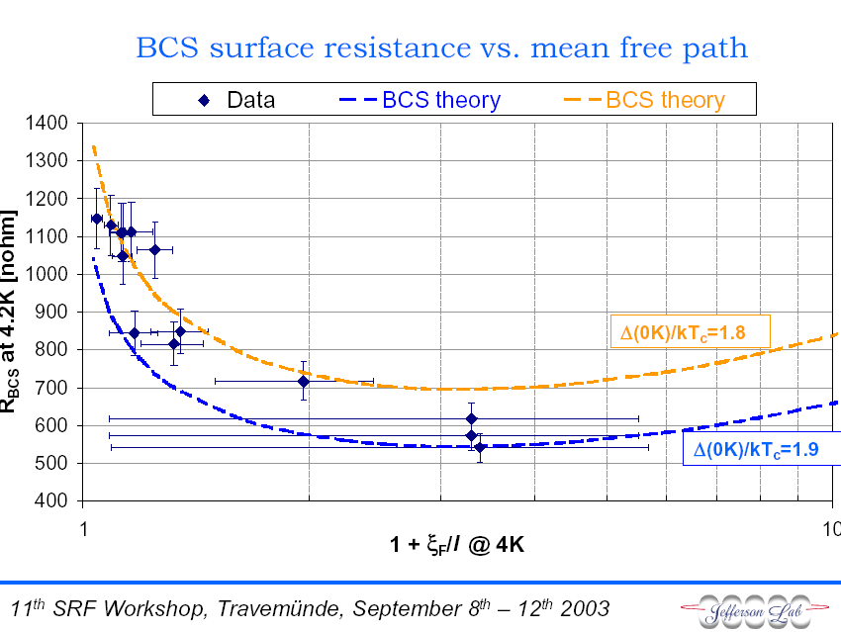
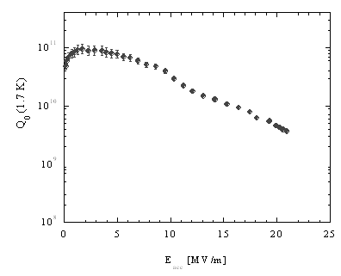
Courtesy C. Benvenuti et al
Is a key parameter; low values give:
- high Q
- higher slope
For film coated cavities there is no hope to get rid of the slope, unless RRR is increased, but in this case Q values will be lower than the actual

Slide 81
High field Q-drop
10
11
0
Q
10
10
2 K
1,8 K
1,6 K
10
9
0
10
20
30
40
E
acc
[MV/m]

Slide 82
In local electrodynamics of superconductivity, j = j₁+j₂
Where J₁ is the Meissner current
At small supercurrent
but at larger V_{s}, GL theory foresees a deparing effect by the current
Δ
n_{s}
J_{s}
V_{m}
V_{s}
V_{s}
V_{s}
Over V_{m} the superconducting state become unstable

Slide 83
The low field Q slope

Slide 84
Questions:
Is the low-field Q-slope a calibration problem?
If not, which is its physical reason?
and in such a case…..
Is something pulling up the Q ?
The Q is originally higher, but for some reason at low field, it decays?
(if understood, it could be beneficial)
10
11
0
Q
10
10
1,6 K
10
9
0
10
20
30
40
E
acc
[MV/m]

Slide 85
Before Abano/Santa fè Workshops (1997/1999):
the low field Q-slope was reported only for Nb/Cu cavities
Nb/Cu sputtered cavity at CERN
Courtesy C. Benvenuti et al
Since first cavities were baked in the cryostat at ~150°C for ~48 hours
the low field Q-slope was also reported for bulk Nb cavities

Slide 86
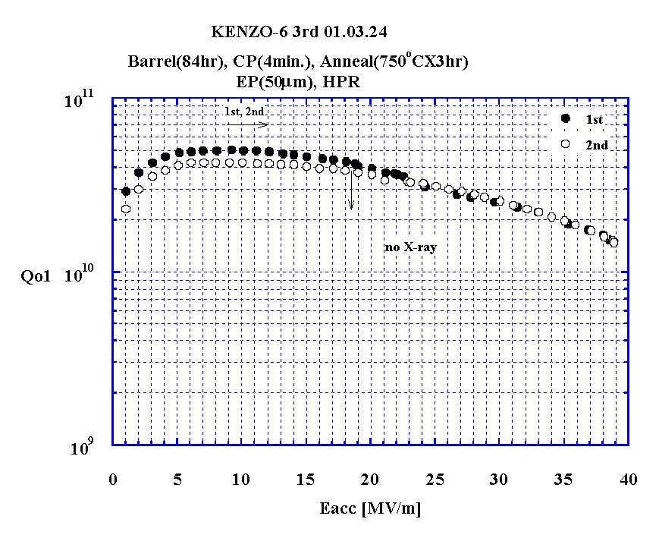
Cavity spun at LNL and treated/measured at KEK

Slide 87
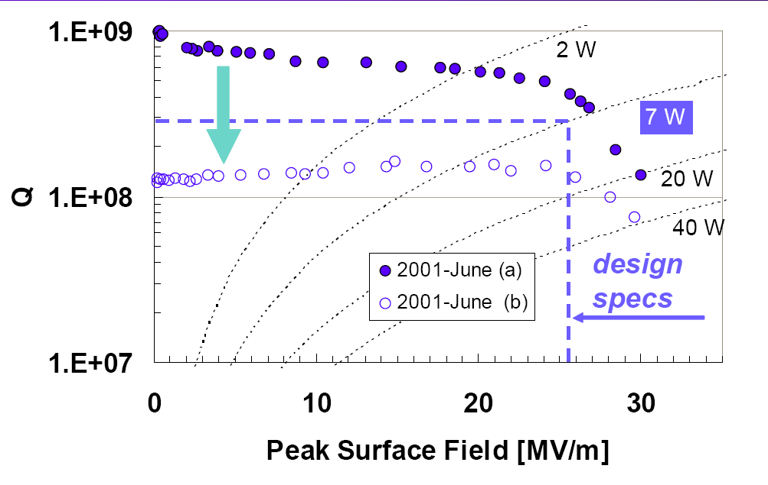
(Courtesy G. Bisoffi)

Slide 88
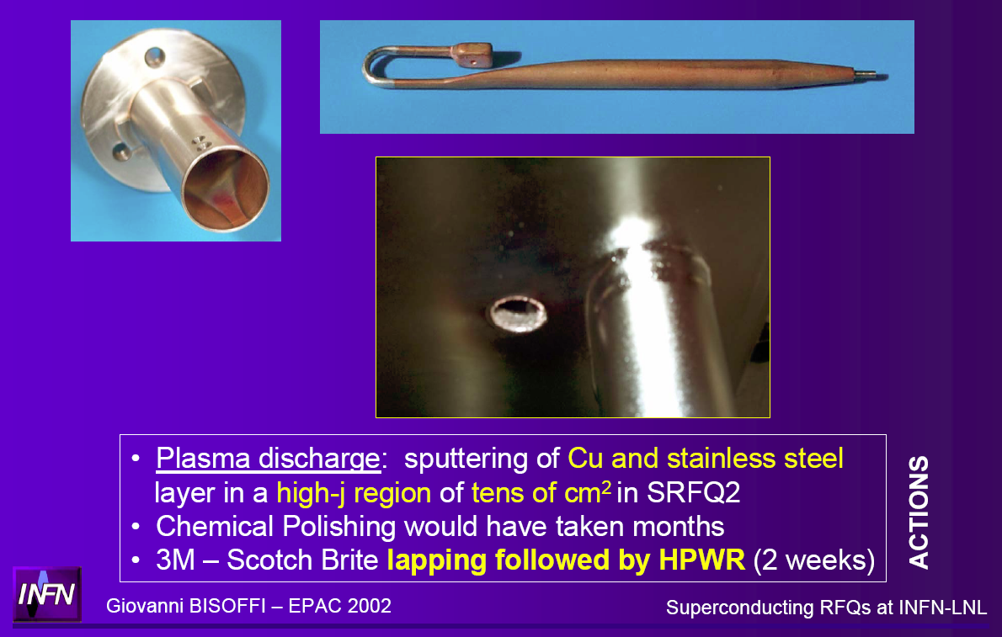

Slide 89
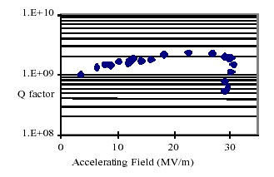
Presented at the 9-th RF Superconductivity Workshop, Santa Fè, NM, 1999
Renzo Parodi - RF SUPERCONDUCTIVITY AT INFN_GENOA
Typical plot of Q_{o} vs E_{acc} for cavities treated by Dry Oxidation of the surface after a medium temperature annealing

Slide 90
Let us suppose that:
on bulk niobium (SC 2 ) we put an overlayer of a different superconductor (SC 1)
SC 2
SC 1
Vacuum
λ₁
H_{z}
a
λ₂
λ₂ is the penetration depth of the SC 2
a is the tickness of the SC 1
λ₁ is the penetration depth of the SC 1

Slide 91
SC 2
SC 1
Vacuum
Two Superconductors:
SC 2 + SC 1
λ₁
H_{z}
a
λ₂

Slide 92
SC 2
SC 1
Vacuum
λ₁
H_{z}
a
λ₂

Slide 93
SC 2
SC 1
Vacuum
For a “2 Superconductor system”
λ₁
H_{z}
a
Q₂
λ₂
ΔQ
Q₁
λ₁/a

Slide 94
Medium field Q-Slope
10
11
Q
0
10
10
2 K
1,8 K
1,6 K
10
9
0
10
20
30
40
E
acc
[MV/m]

Slide 95
SC 2
SC 1
Vacuum
λ₁
H_{z}
Q₂
a
λ₂
Q₁
λ₁/a
An hypotesis:
Gap and Penetration depth depends on magnetic field

Slide 96
SC 2
SC 1
Vacuum
λ₁
H_{z}
a
λ₂
Q₂
Q₂
Q₁
Q₁
λ₁/a
λ₁/a

