Slide 1
Toward the final design of a TPC for the ILD detector
D-RD9
P. Colas, K. Fujii et al.

Slide 2
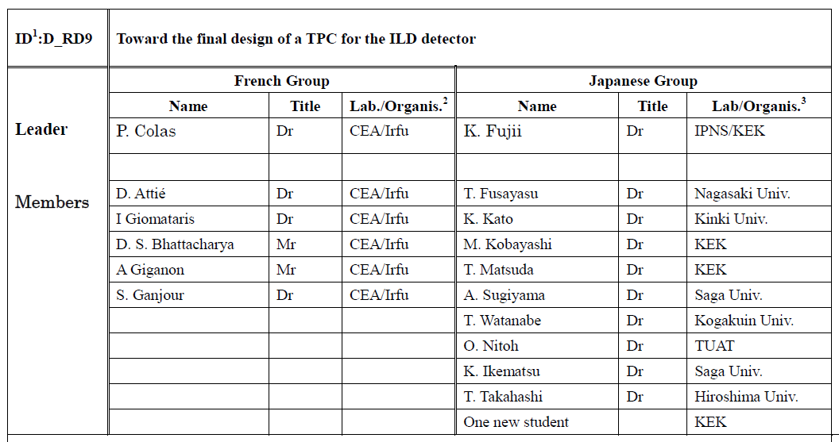

Slide 3
D_RD9 Toward the final design of a TPC for the ILD detector
From 2007 to March 2013, the feasability of a MPGD TPC for the LC was demonstrated in D_RD2 (Construction and tests of a MPGD TPC endplate prototype for the Linear Collider)
ILD Detailed Baseline Document completed in March 2013
Started in April 2013 : New project D_RD9
In the new context (Higgs 125 GeV, realism of a ‘fast track’ scenario in Japan for the LC, gain also in realism in our TPC study
Tackle engineering issues: electronics, cooling, software
List remaining issues

Slide 4
A Possible Schedule of ILC in Japan As presented in the 2013 ILD meeting in Cracow

Slide 5
Events in the Large Prototype

Slide 6
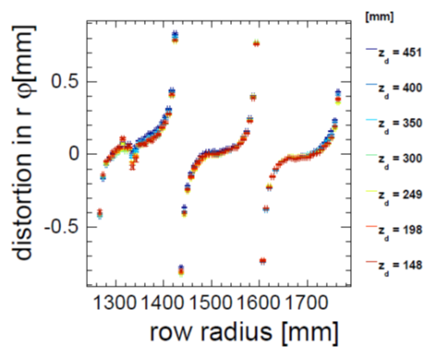
Distortions from the Large Prototype

Slide 7
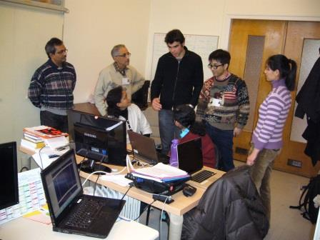

Slide 8
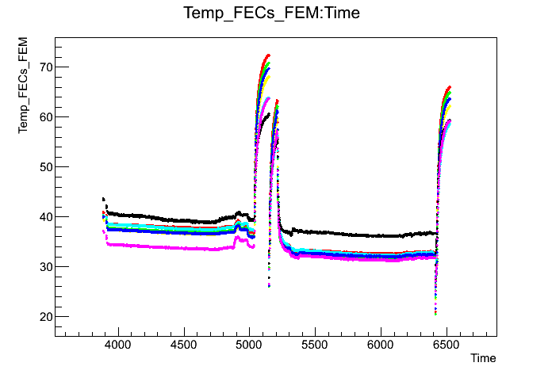
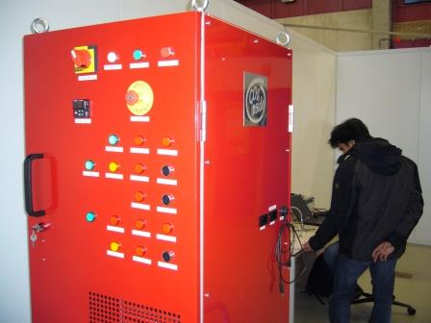
2-phase CO₂ cooling
Principle : CO₂ has a much lower viscosity and a much larger latent heat than all usual refrigerants. The two phases (liquid and gas) can co-exist a room temperature (10-20°C at P=45-57 bar).
Very small pipes suffice and hold high pressure with low charge loss.
Results from a test at Nikhef
300 W compressor purchased by KEK at Nikhef

Slide 9
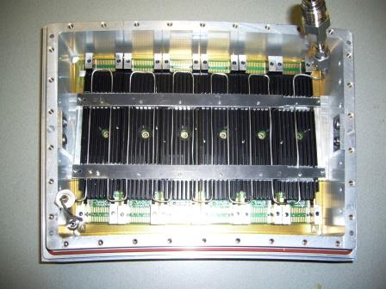

Slide 10
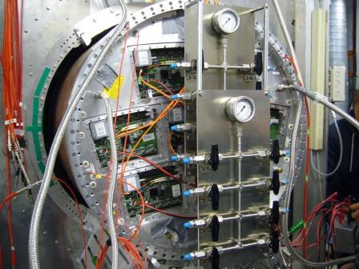
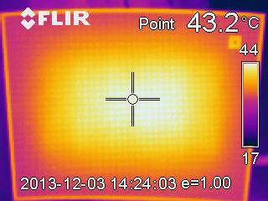
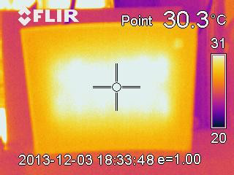
2-phase CO₂ cooling
Tests with 1 module were performed at Nikhef in December 2013, and tests with 7 modules at DESY in February 2014

Slide 11
Electronics
The test electronics are not those to be used in the final ILD detector, for the following reasons:
AFTER (T2K chip) not extrapolable to Switched Capacitor Array depths of 1 bunch train
S-Altro 16 (ALICE-based) has to evolve : improve packing factor, lower power consumption, power pulsing from the beginning (probably 65nm)
Present work within AIDA : Common Front End for Gas Detector Signal processor, 130 nm

Slide 12
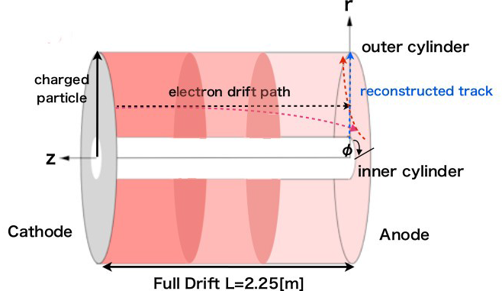
Ion space charge
Primary ions create distortions in the Electric field which result to O(<1µm) track distortions. 1 to 2 orders of magnitude safety margin with estimated BG.
However ions flowing back from the amplification region produce a high density ion disk for each train crossing. This disk drifts slowly (1m/s) to the cathode, influencing electron drift of subsequent train crossings

Slide 13
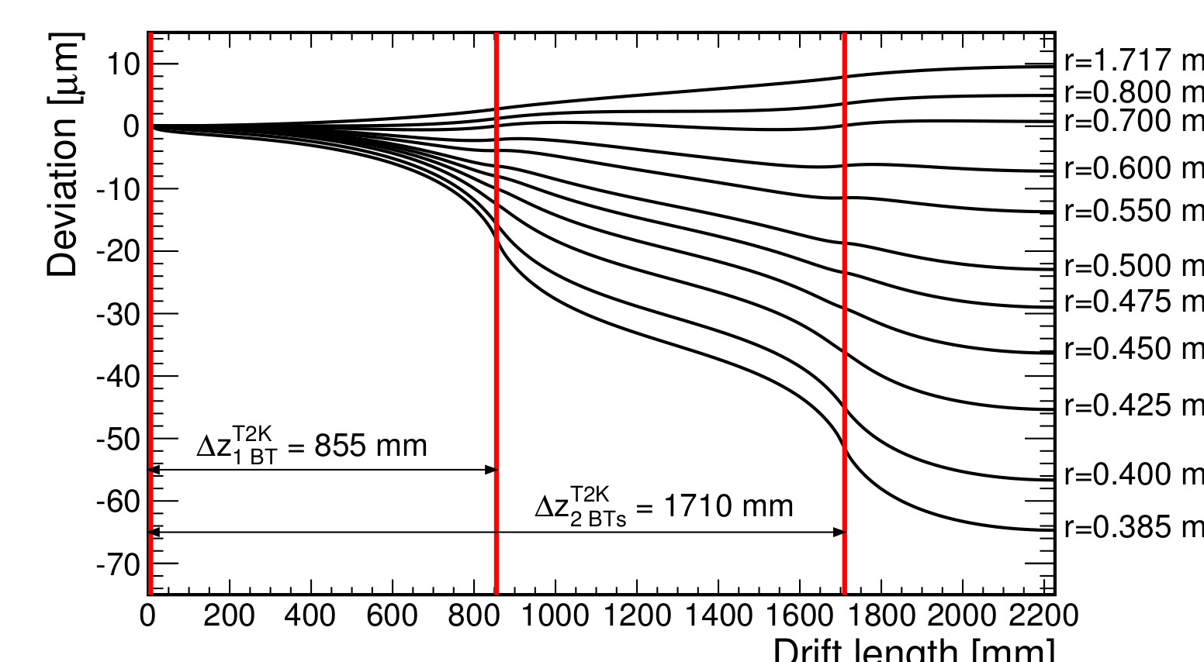
Distortions from backflowing ions
Example for the case of 2 ion disks :
60 µm distortion for
‘feed-back fraction’ x ‘gain’ = 1
GATE NEEDED

Slide 14
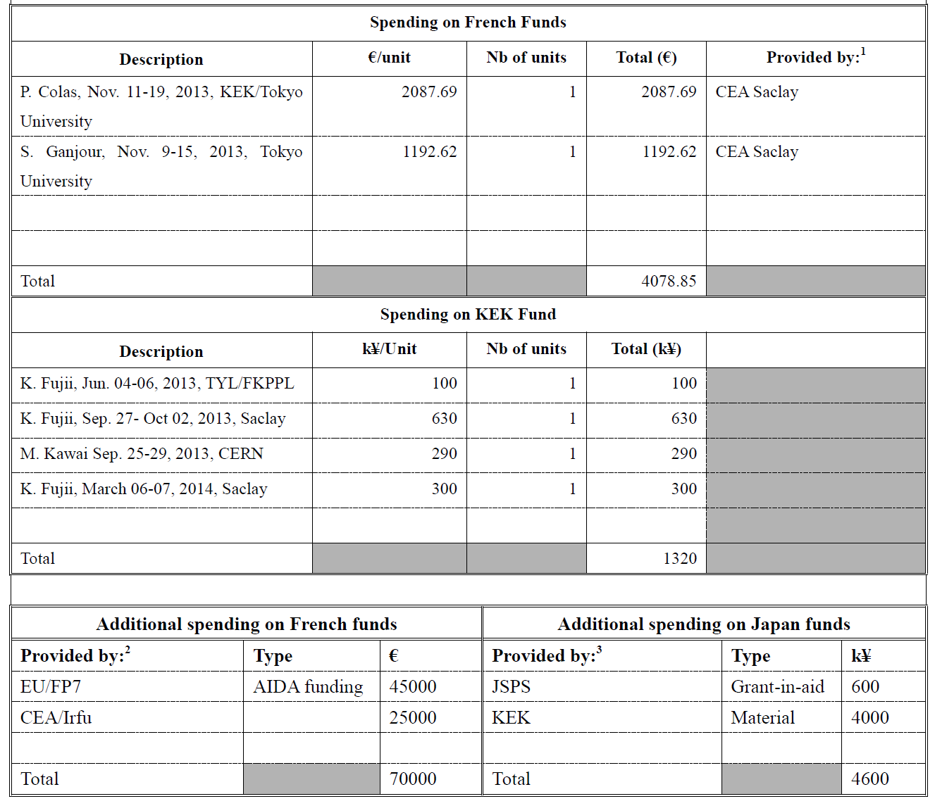

Slide 15
Remaining R&D issues
Ion backflow and ion gating
Fully understand, mitigate and correct distortions
Design a new electronics, at a pace adapted to the progress of the technology. Optimization of power consumption and power pulsing must be included in the design from the beginning.
Carry out technical research for connections to many channels, precision mechanics for large devices, cooling, etc…

Slide 16
Toward the Final Design of ILD TPC
The earliest timeline?
2014-15 R&D on ion gates and a decision on the ion gate:
2015-17 Beam tests of new LP modules with the gate
2017 Prioritization of the MPGD technology and module
ILC LAB & ILD detector proposal
2017-19 Final design of the readout electronics for ILD TPC and its tests
Design of ILD TPC
2018-19 TDR for the ILD tracking system:
2019-23 Prototyping and production: Electronics (chips→boards)
Prototyping and production: Modules
Production: Field cage/endplate and all others
2024-25 TPC integration and test
2026 TPC Installation into the ILD detector
ILC commissioning

Slide 17
Conclusion
The French-Japan R&D work within the LCTPC collaboration entered a new phase, more engineered and realist.
It also allowed to identify a few points requiring active R&D to be pursued in the next few years

