Slide 1


Nanometer stabilisation at ATF2 within FJPPL and FKPPL
A.Jeremie
For FJPPL A-RD-10: Nanometer stabilisation at ATF2
For FKPPL A-RD-: ATF2
Joint France-Japan-Korea Project!

Slide 2
Outline
Participants
KEK*: host, organisation, installation, ATF2
KNU*: IP-BPMs and associated electronics
LAL*: IP-chamber, in-vacuum diamond sensor
LAPP*: GM sensors, QF1 relative displacement
Application for 2014
*principal contributor although collaborative work

Slide 3
Participants

Slide 4
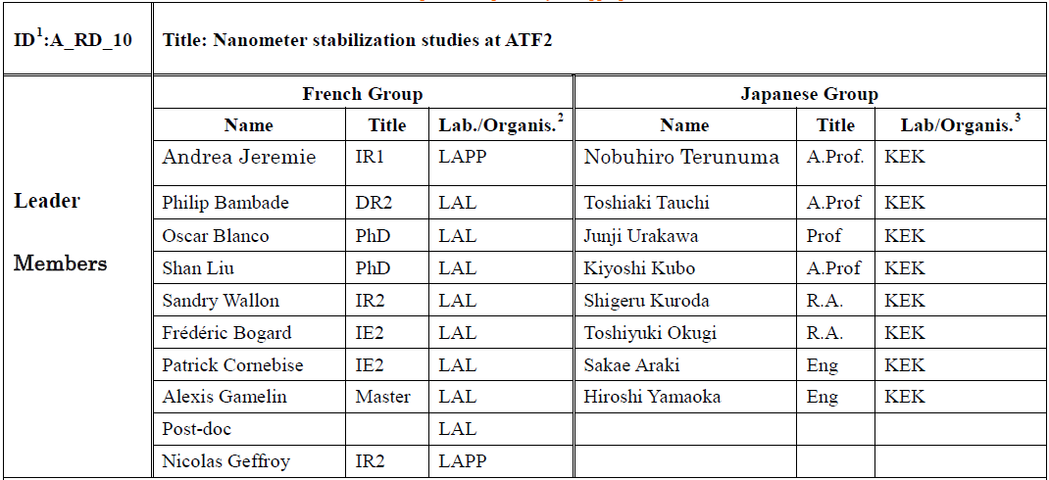
FJPPL

Slide 5
FKPPL

Slide 6
ATF2

Slide 7
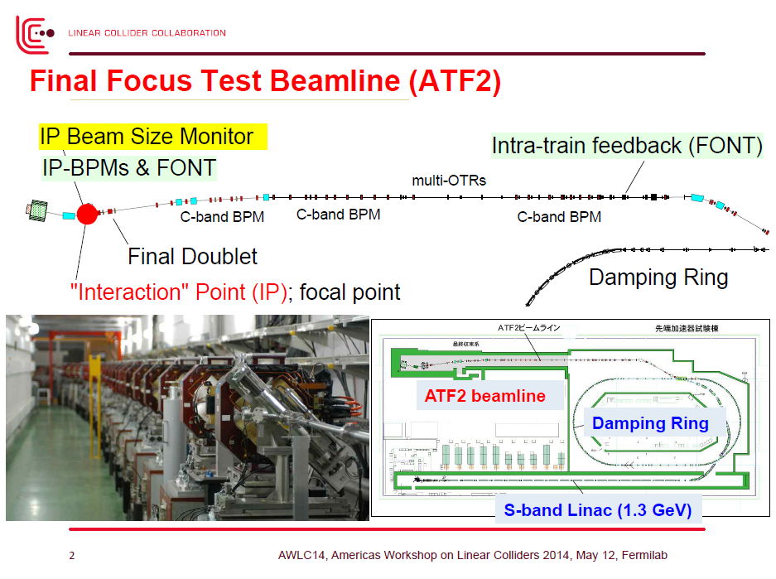
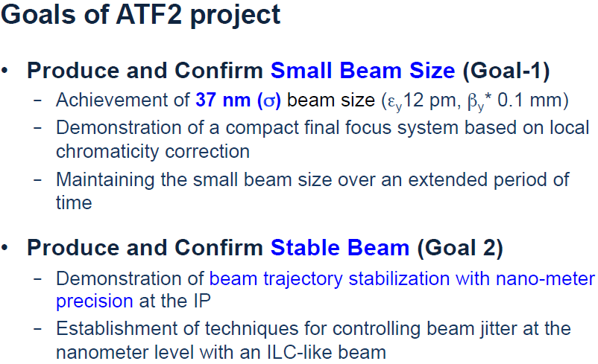

Slide 8
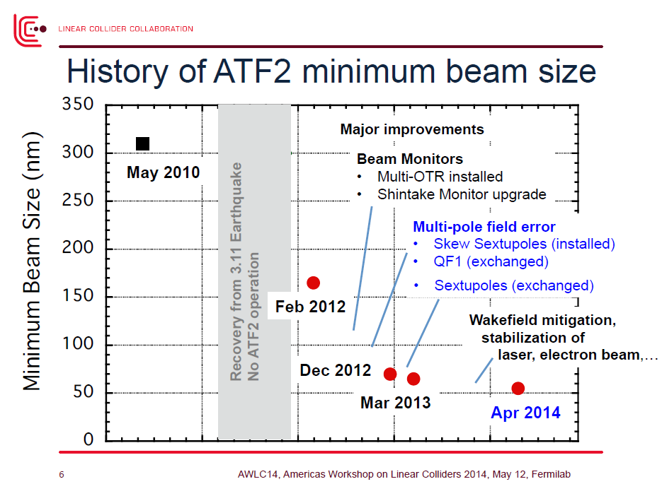

Slide 9
IP-BPMs, associated electronics IP-BPM chamber

Slide 10
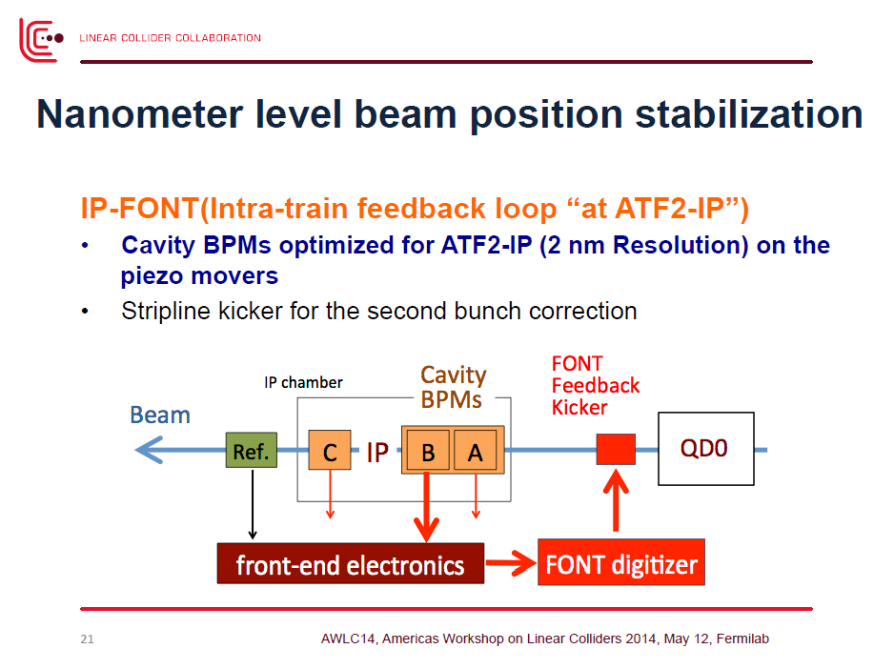

Slide 11
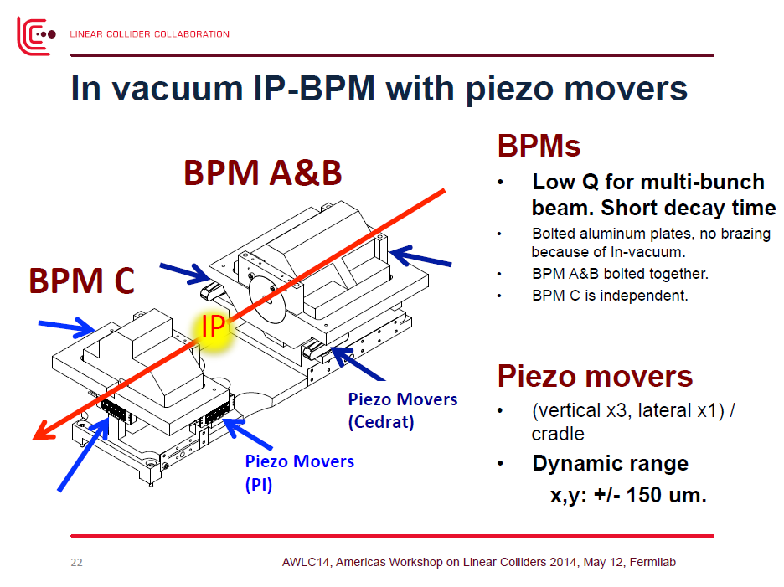

Slide 12
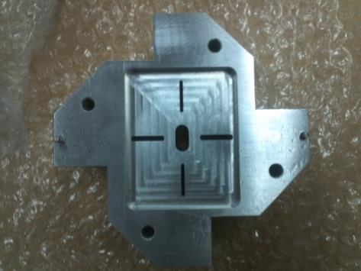
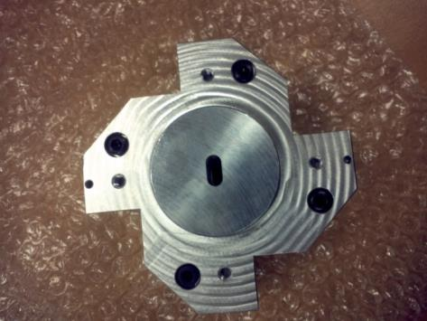
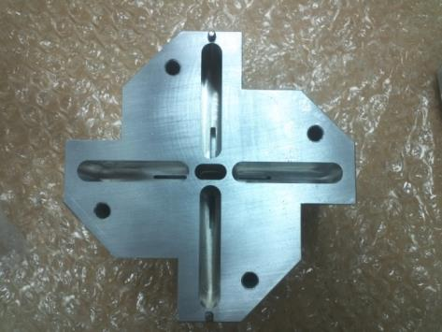
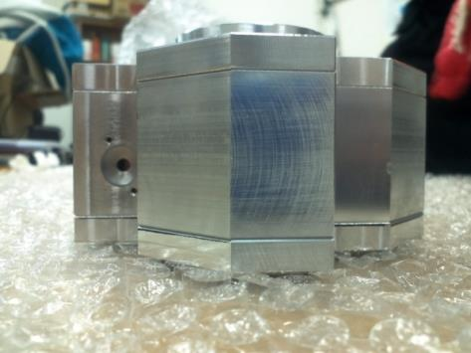
Tested Double block IP-BPM
Made by Aluminum (2kg for double block)

Slide 13
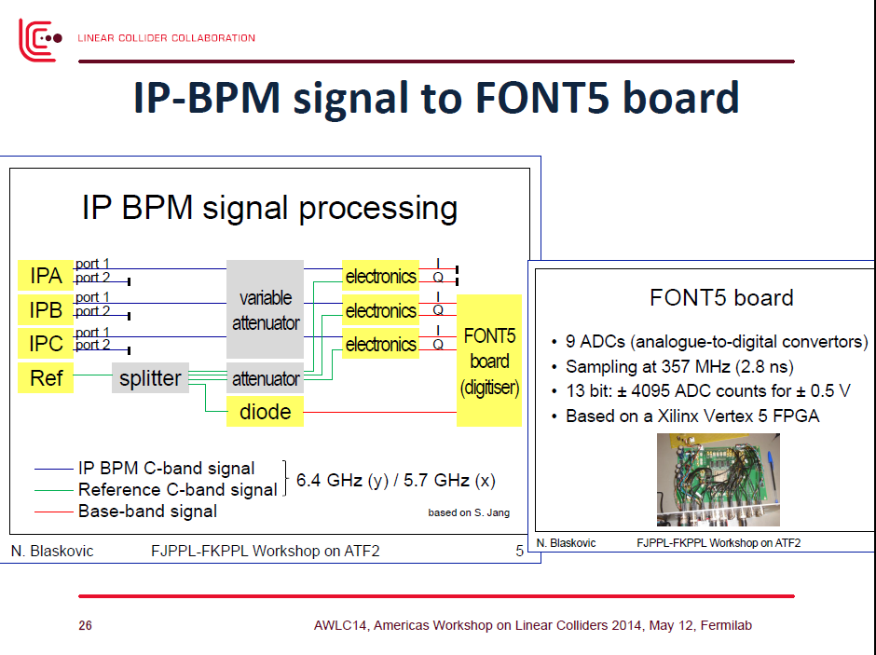

Slide 14
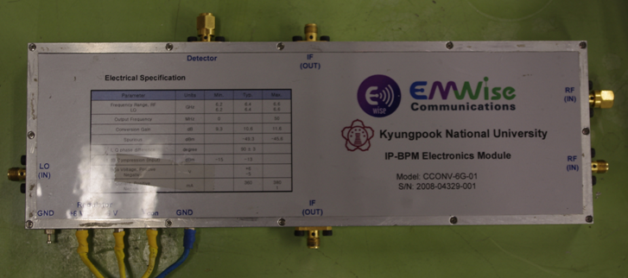
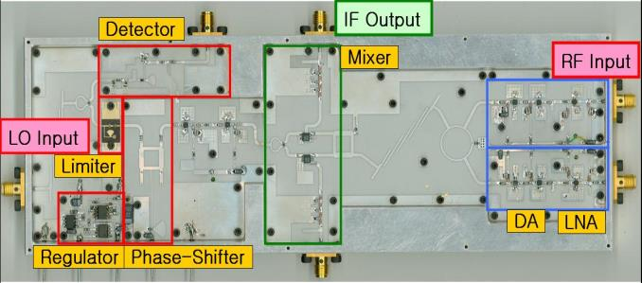
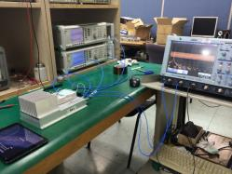
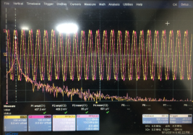
Electronics for Y-ports
Y-port Electronics
I-Q signal with 90º difference
I-Q tuning by phase shifter
20ns decay time for feedback System.
Design Frequency
LO: 6426 MHz
RF: 6426 MHz
Some upgrade was necessary:
12 mixer parts were replaced
The resistors were back to original values.
The total conversion gain of electronics was set to 54dB.
The IF offset voltage was set to 0mV (±700uV).
After repair, the electronics was tested and commissioning ongoing at ATF2.

Slide 15
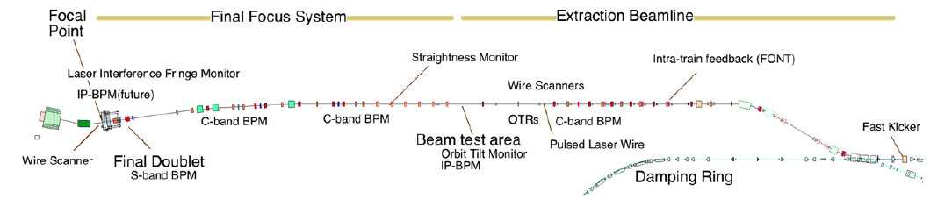
Methodology for stabilization
Goal 1 (beam size ∼ 37 nm) beam jitter < 10 nm
Goal 2 (nm-scale stability with feedback) beam jitter ∼ 2 nm
Measure stability at one of IP-BPMs after shifting the beam waists there
Infer position from measurements at the two other IP-BPMs
Use fast kicker just upstream to correct second bunch within ATF2 train
in all cases ➔ must first calibrate scale factors and study system resolution
1
2
IP
3
beam kicker
•

Slide 16
Required precision on relative IP-BPM scale factors depends on beam parameters
1
2
IP
3
d ∼ 0.1 m
ε_{y} ∼ 12 pm
σ_{jitter} / σ ∼ 10%
•
d
_{IP} = (y₂ – y₁) / d
y_{IP} = 2 y₂ – y₁
ξ = calibration error of 1 relative to 2
→ 2 y₂ – y₁ ∼ y_{IP} + 2 ξ θ d
Determination of resolution
Feedback to IP or to 3rd IP-BPM
β ~ 1 m (e.g. diagnostic section)
Residual ∼ 2 (ε / β)^{0.5} d (σ_{jitter} / σ) ξ ∼ 10⁻⁷ ξ ➔ ξ ∼ 10⁻² for 1 nm error
β ~ 10⁻⁴ m (interaction point : nominal optics)
Residual ∼ 2 (ε / β)^{0.5} d (σ_{jitter} / σ) ξ ∼ 10⁻⁵ ξ ➔ ξ ∼ 10^{-4 / -3} for 1 / 10 nm error

Slide 17
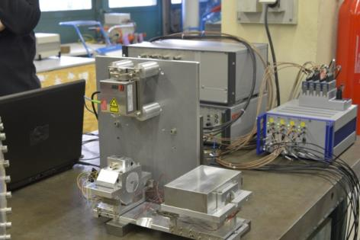
New IP-BPMs and IP-chamber
A precise mover system (piezo movers PI and Cedrat) has been designed
→ precise remote internal mechanical alignment of IP-BPMs with respect to beam line components and IP-BSM
→ mechanical calibrations of IP-BPM scale factors with required precision (instead of moving the beam as before); their calibration, reproducibility and linearity below 10⁻⁴
Piezo-mover performance was checked at LAL before installation at ATF2 IP using a Sios interferometer, with a weight representing IP-BPM block 1&2 and identical cabling
Each block can be moved independantly
- Closed-loop stability
- Open-loop stability
- Setting accuracy
- Calibration
- Thermal effects
- Vibration mitigation
Piezo movers (PI) showed linearity at least to 10⁻⁴ as needed

Slide 18
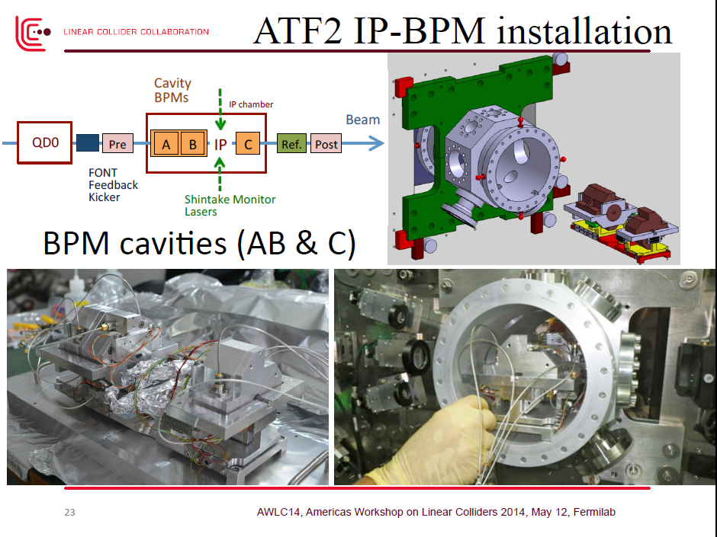

Slide 19
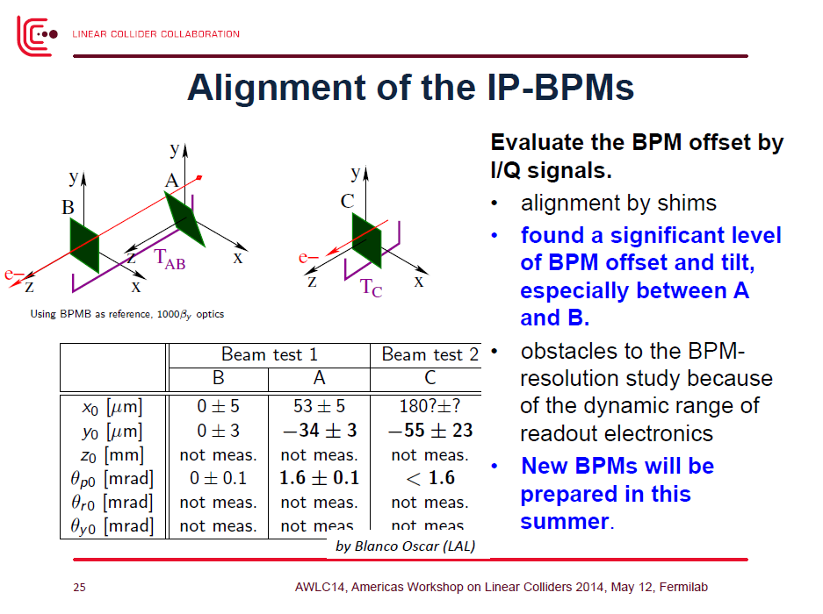

Slide 20
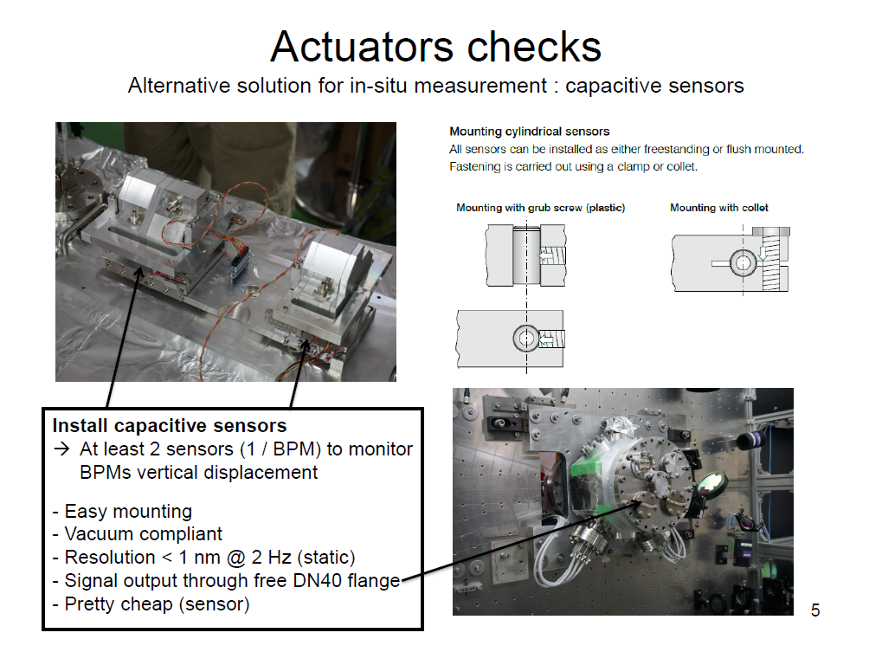

Slide 21
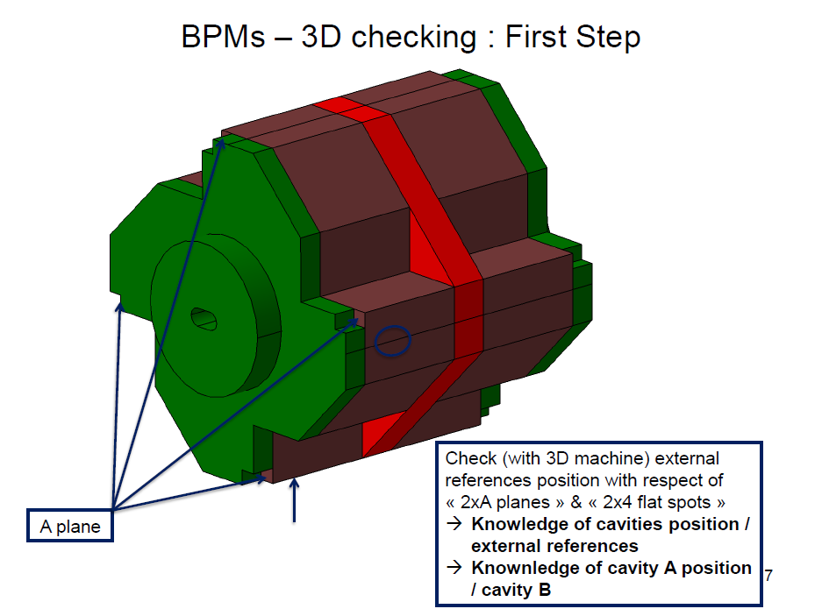
S.Wallon from LAL will visit KNU this week to discuss BPM fabrication and make sure pertinent alignment references are included

Slide 22
Diamond sensor

Slide 23
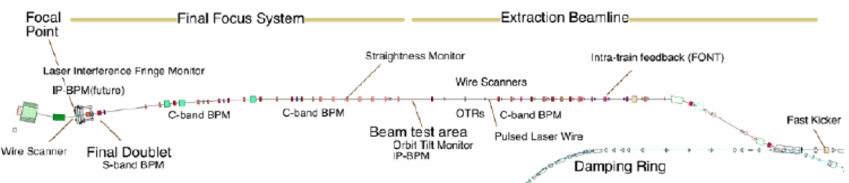
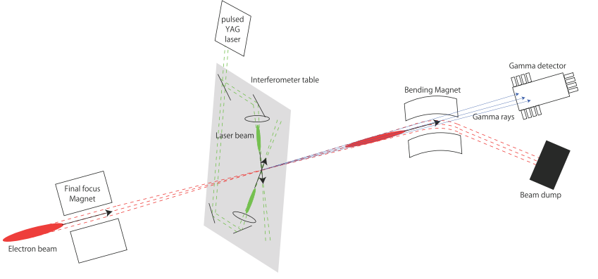
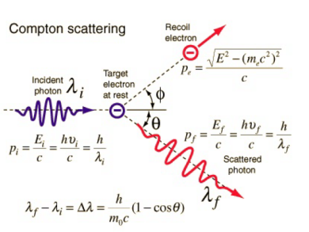
Introduction
ATF2
Shintake Monitor
Compton
Diamond Sensor
Motivations:
Beam halo transverse distribution unknown → investigate halo model & propagation
Monitor beam halo to control backgrounds by means of collimation and tuning
Probe Compton recoil electron→ (possibly, in future, higher order contributions)

Slide 24
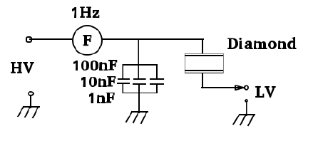
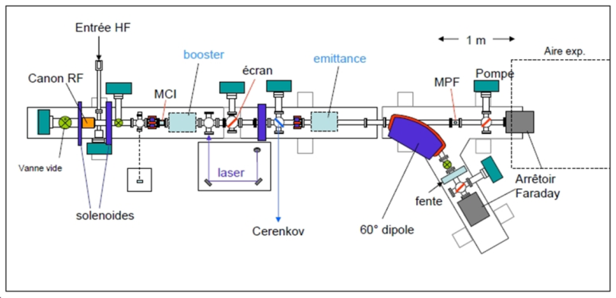
Diamond Detector Features
ADVANTAGES
Property Diamond Silicon
Density (g m⁻³) Band gap (eV) Resistivity (Ω cm) Breakdown voltage (V cm ⁻¹) Electron mobility (cm² V⁻¹ s⁻¹) Hole mobility (cm² V⁻¹ s⁻¹) Saturation velocity (μm ns⁻¹) Dielectric constant Neutron transmutation cross-section(mb) Energy per e-h pair (eV) Atomic number Av.min.ionizing signal per 100 μm (e) | 3.5 5.5 >10¹² 10⁷ 1700 2100 141 (e⁻) 96 (hole) 5.6 3.2 13 6 3600 | 2.32 1.1 10⁵ 10³ 1500 500 100 11.7 80 3.6 14 8000
• Large band-gap⇒ low leakage current
• High breakdown field
• High mobility⇒ fast charge collection
• Large thermal conductivity
• High binding energy⇒ Radiation hardness
Fast pulse ⇒ several ns
Test of fast remote readout (fast heliax coax cable + high BW scope) with particles at end of beam line, using existing single crystal 4.5x4.5mm CVD diamond pad sensor
In-vacuum single crystal CVD diamond sensor profile scanner -> for PHIL and ATF2 diagnostic (“plug compatible” design)
Diamond detector test at PHIL

Slide 25

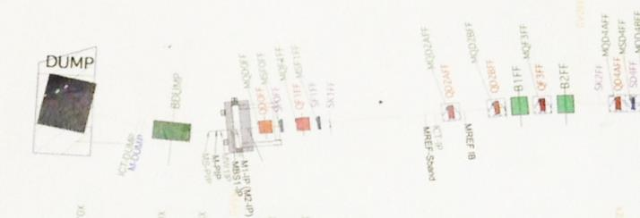
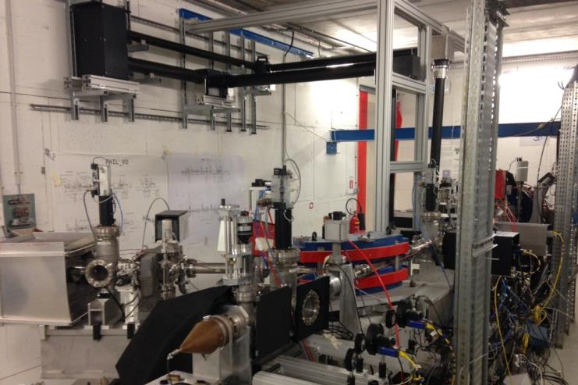
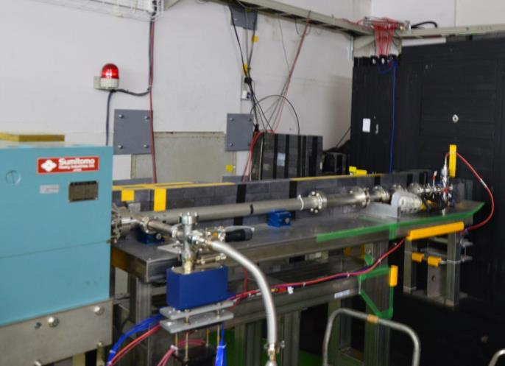
PHIL @ LAL
ATF2 @ KEK
Diamond Detector
Same "plug compatible" design for PHIL and ATF2: fabrication will be completed in April 2014 before testing in May-June at PHIL.

Slide 26
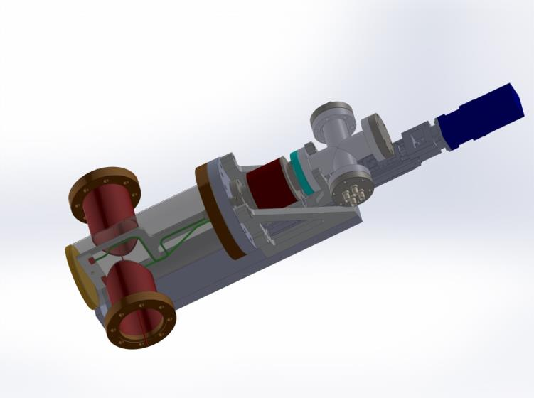
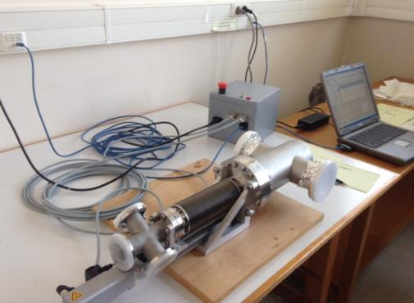
In-vacuum diamond halo sensor
Several tests of diamond detector done in air at PHIL
S/N ratio of these measurements needs to be studied
Two sets (diamond sensor + mechanics) is ordered for application in vacuum → one for PHIL, another for ATF2. Plan test at PHIL June 2014 and install at ATF2 in September
Proposal for horizontal & vertical moveable halo collimators being prepared with IFIC group
Simulation (BDSIM, CMAD) and analytical work for halo modeling

Slide 27
GM sensors

Slide 28

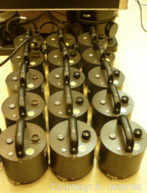
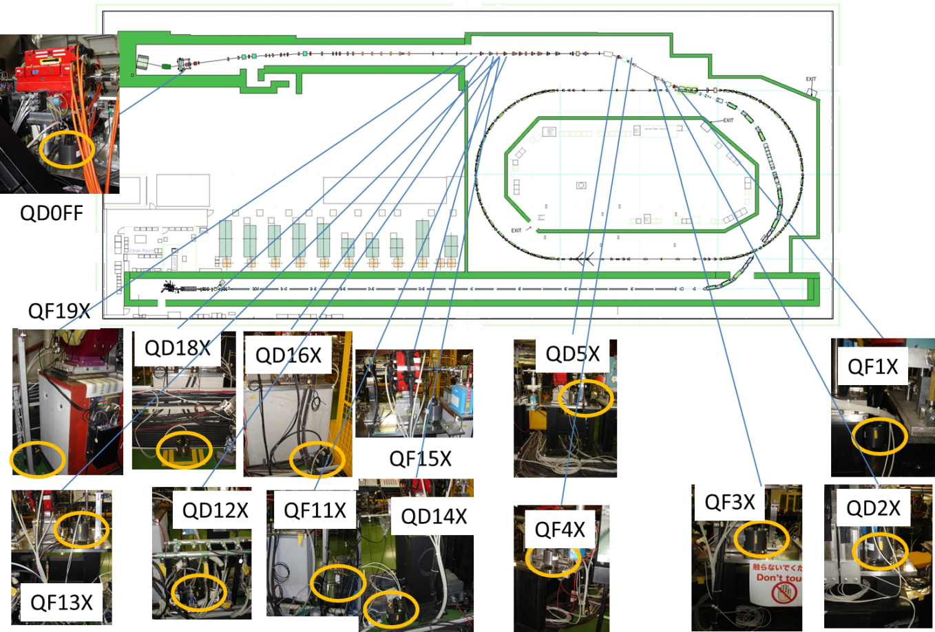
14 GM sensors have been installed in EXT and FD
-Measurements are available
-BPM and ground motion data have been taken in parallel.
-Setup works very well.

Slide 29
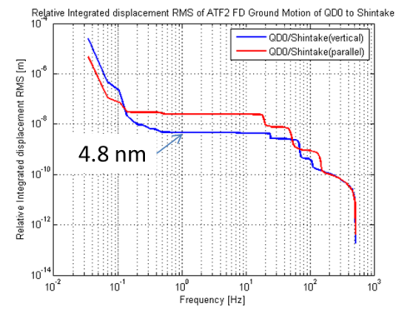
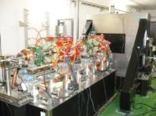
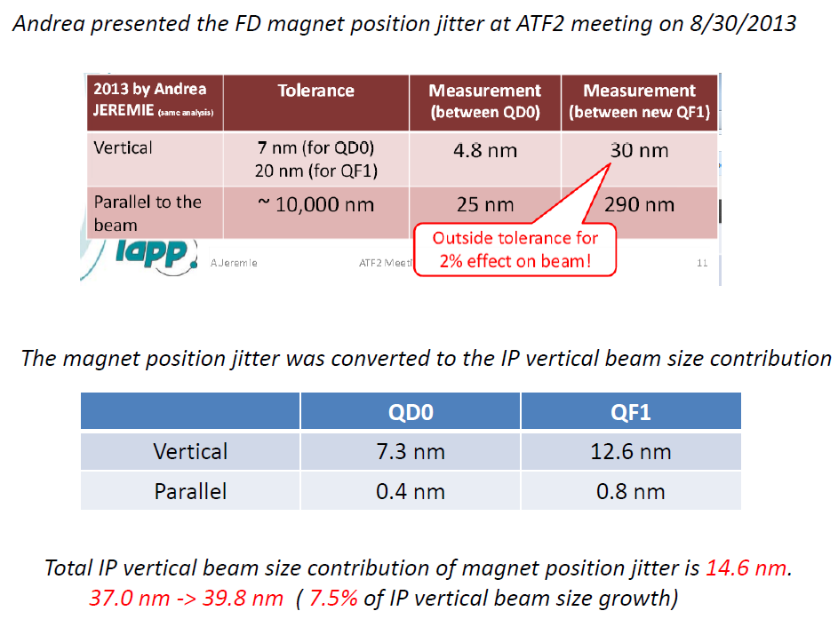
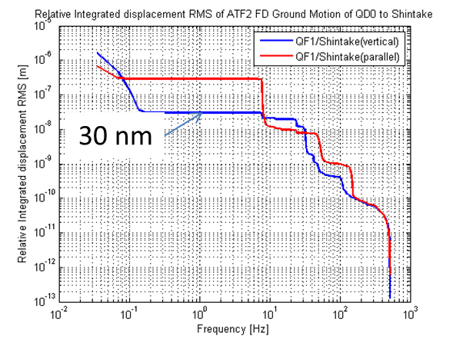
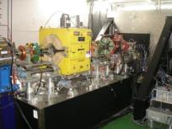
System has also been used for Relative Displacement studies at FD
Presented by Okugi-san (Sept 27, 2013)
QD0FF
QF1 replaced
QF1FF
=> Vibration mitigation under study

Slide 30
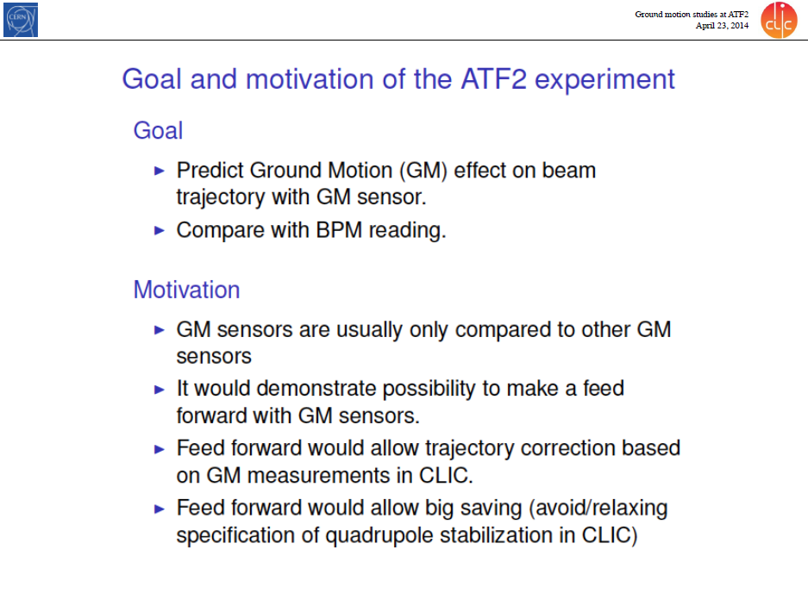

Slide 31
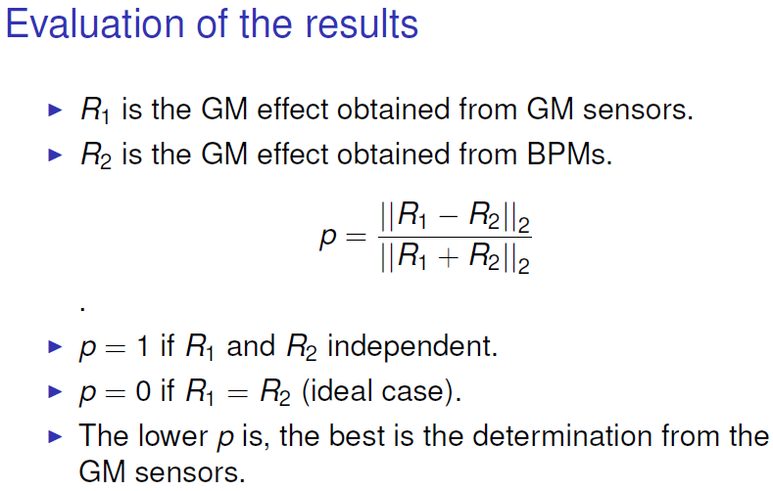
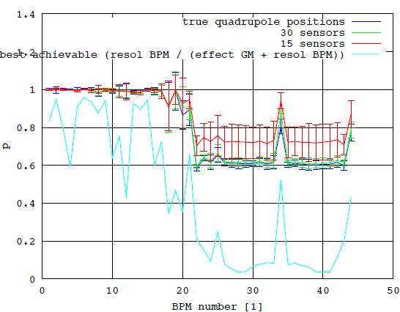
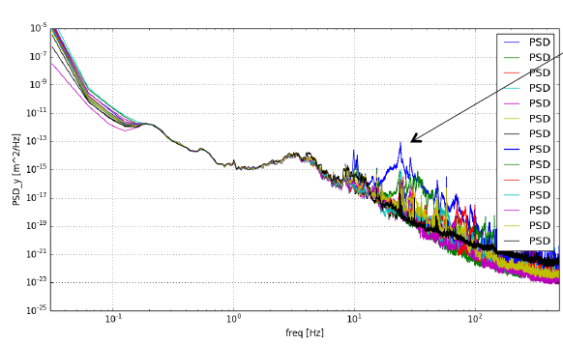
Expected
Identified spot in ATF2 where GM signal higher, thus better suited for correlation studies

Slide 32
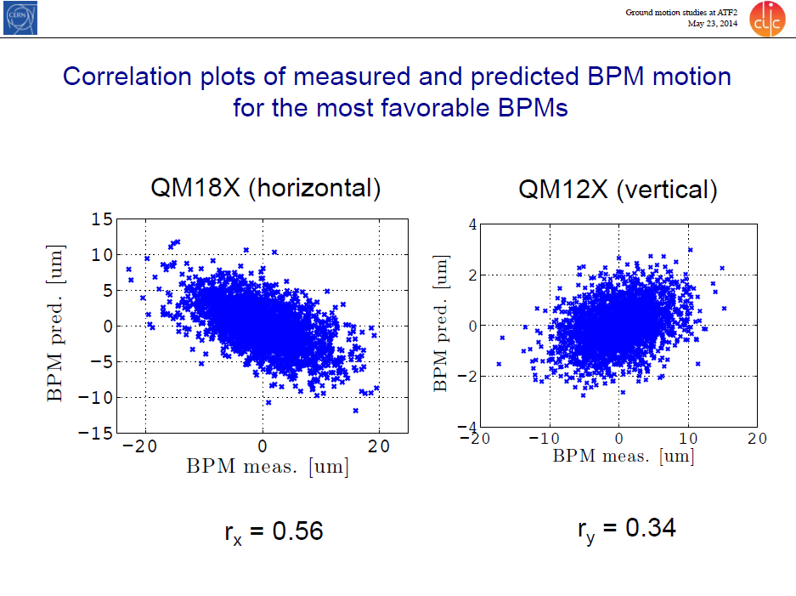
Made possible thanks to work with KEK on improved synchronisation signal

Slide 33
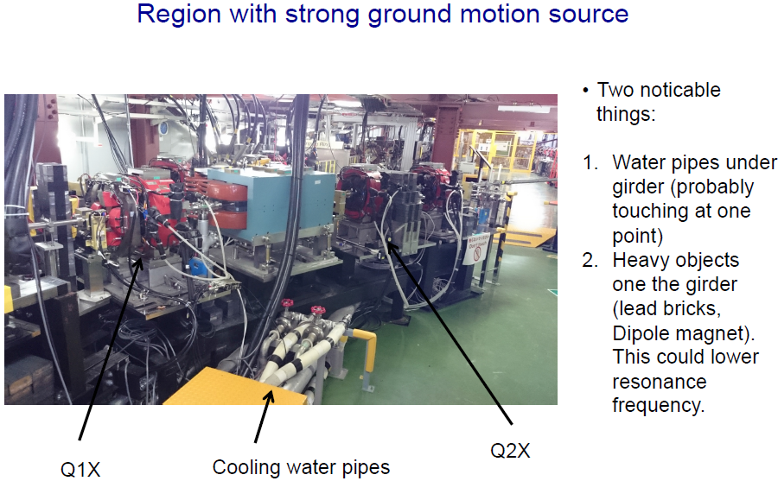
Plans:
new instrumentation will help determine a better “machine” model
Identify higher vibration source
  Move sensor from girder to top of quadrupole
  Turn off cooling water

Slide 34
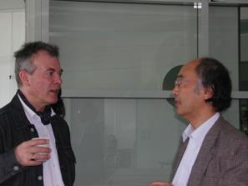
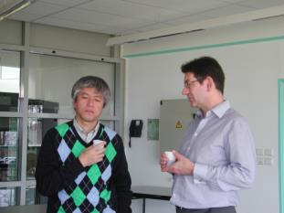


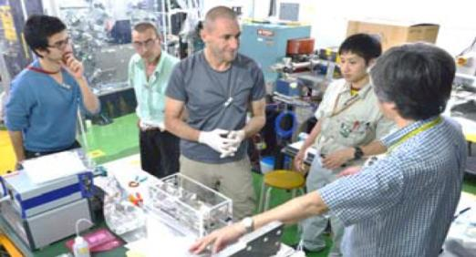
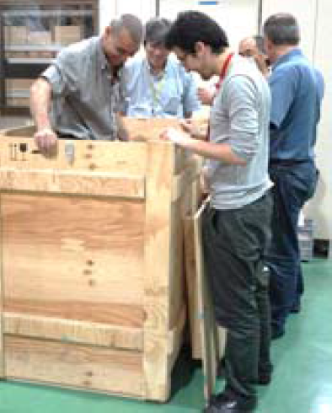
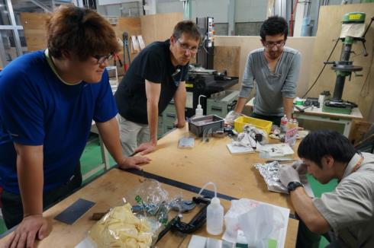
Joint France-Japan-Korea project!
FJPPL-FKPPL ATF2 Workshop in Annecy March 2014
Common integration work at KEK

Slide 35
2013 Report
KEK/ATF2: Routine vertical beam size at low intensity of 55nm
KNU: IP-BPMs and associated electronics tested, updated and currently under evaluation
LAL: IP-chamber installed at ATF2 IP, piezo movers operational; diamond sensor development and testing
LAPP: GM sensors installed, first results under study; QF1 relative displacement measured
Publications

Slide 36
Application

Slide 37
Plans for 2014
KEK/ATF2: Concentrate on ATF2 Goal 2 for Nanometer beam stabilisation
KNU: New BPM fabrication, electronics evaluation
LAL: improve IP-BPM alignment strategy; in-vacuum diamond sensor testing at ATF2
LAPP: Identify vibration sources and enhance correlation capabilities; QF1 vibration mitigation study

Slide 38
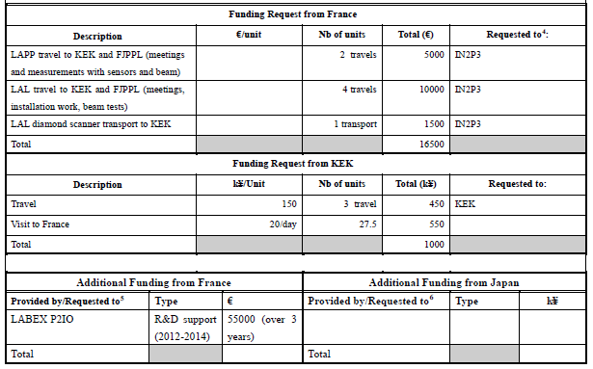
FJPPL application for 2014

Slide 39
FKPPL application for 2014
Requested LIA specific funding from France
Description |  | Euro/unit | Nb of units | Total (euros) | Requested to: *
Travel to Daegu (KNU) |  | 1000 | 2 | 2000 | IN2P3
Local expenses in Daegu (5 days) |  | 750 | 2 | 1500 | IN2P3
Total |  |  |  | 3500 | IN2P3
Requested funding from Korea
Description | Won/Unit |  | Nb of units | Total (kWon) | Requested to: **
Travel to LAL for meeting | 1000 |  | 1 | 1000 | KNU
Local expenses in LAL (5days) | 750 |  | 1 | 750 | KNU
Total |  |  |  | 1750

Slide 40
backup

Slide 41




“Routinely” produce 65 nm beams at ATF2!
Shintake Monitor: essential for beam tuning
Focused beam
Less focused
Modulation of photon rate by Compton diffusion on interference fringes
M 〜 0.306 ± 0.043 (RMS)
correspond to σy 〜 65 nm

Slide 42


Slide 43

ATF2 – Strategy of stabilization
Shintake monitor
Interference
fringes
Last focusing magnets
Previous magnets
Beam
➔Very rigid and independent supports
Ground
4m
Efficient coherence of ground motion: measured on site
ATF2 Proposal vol 1
QF1
For QD0 at ATF2: 7 nm tolerance
For QF1 at ATF2: 20 nm tolerance
Measurements by B.Bolzon in 2008: better than tolerances
QD0 to IP relative displacement of 4.8 nm and QF1 of 6.3 nm

Slide 44


