Slide 1
A Proposal for FJPPL (TYL) Development of Frequency Tuners Optimization and Cryomodule Integration for 1.3 GHz SRF Cavities
G. Devanz, F. Nunio, O. Napoly (CEA/Irfu)
K. Artoos (CERN)
A. Yamamoto, H. Hayano, and M. Yamanaka (KEK)
to be presented at FJPPL meeting, Bordeaux, 26-27 May, 2014

Slide 2
Outline
Introduction
Proposal
Future Scope
Summary

Slide 3
Introduction
The frequency tuners play an important role in the efficient operation of a superconducting RF cavity : the fundamental frequency of the cavity can be adjusted, and the detuning of the cavity under the Lorentz force (LFD) in a long RF pulse can be counteracted.
The tuners apply a longitudinal force to change the length of the cavity. Typically a motor-driven adjustment applies the force to adjust the length of the cavity to the fundamental mode, in order to mainly compensate the thermal contraction effect.
A piezo-driven fine-adjustment applies a force to counteract the effect of the Lorentz force during the RF pulse. Sophisticated feed-forward (feedback) systems are required to control the action of the tuners during pulsed (CW) operation.
Achieving high reliability of the tuners (both mechanical and piezo) is a key requirement, and careful design of the stepper-motor drivers and associated gearing box is crucial in this respect.

Slide 4
E-XFEL Cavity, Tuner and He Tank

Slide 5
E-XFEL Tuner drawing courtesy: Lars Hagge and Lutz Lilje, 2013-11-1

Slide 6
Introduction (2)
The so-called Saclay/DESY tuner is the version of the tuner in operation at the TTF/FLASH facility, where more than 50 such tuners are routinely operated in the 7 installed cryomodules.
The same tuner will be used for the 800 cavities in the European XFEL.
However, the Saclay/DESY tuner could not be considered as a baseline tuner in the Technical Design Report, published in 2013, for the International Linear Collider (ILC), because of the longitudinal envelope at the end of the cavity exceeding the beam pipe length limit on that end by 35 mm more than that required to increase a filling factor of active gradient components.

Slide 7
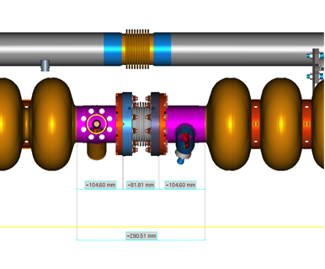
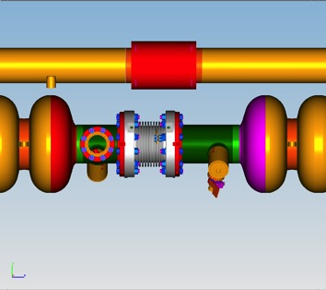
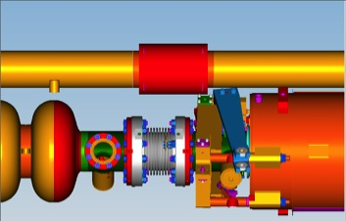
Inter-Cavity Spacing Issue
ILC Type-IV
XFEL
105
82
105
105
108
140
292
353
Reduction in inter-cavity spacing = 61 mm
Bellows: = 108→82 = 26 mm
“Long” cavity end = 140→105 = 35 mm

Slide 8
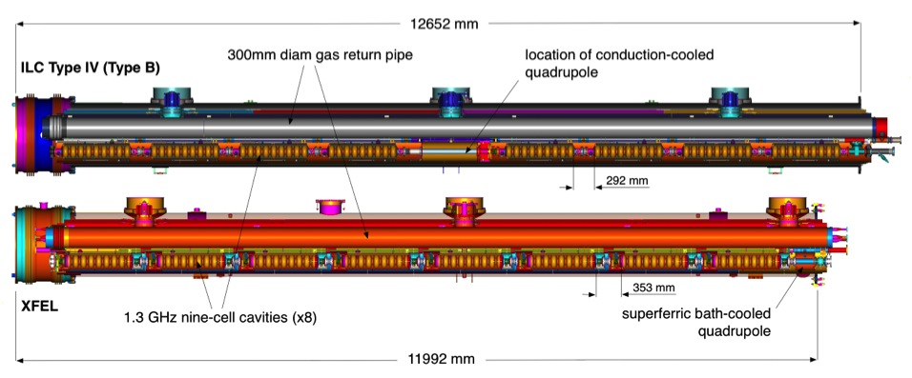
E-XFEL vs ILC Cryomodule

Slide 9
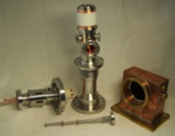
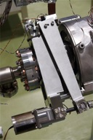
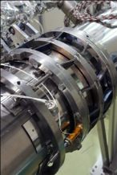
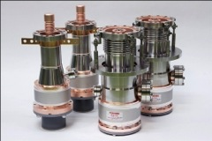
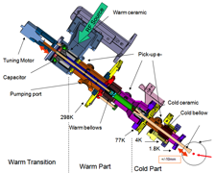
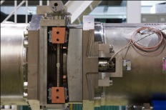
Demonstration and Evaluation of Various Couplers and Tuners in S1-Global (KEK)
Every coupler and tuner demonstrated, as expected, and be applicable for ILC cavities
Various subjects to be further investigated and settled: cost and reliability

Slide 10
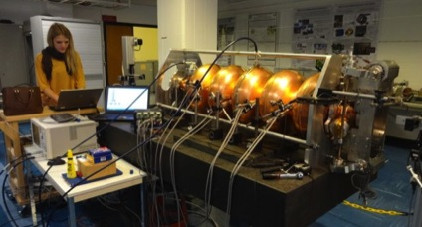
Proposal
An important objective of this proposal is to seek for a novel design to accommodate the frequency tuner within the ILC constraint of reducing the physical length of the beam pipe of 35 mm (see Fig. 1 for the space constraint). We may find two possibilities as follows:
to seek for a shorter mechanical design with the same Saclay/DESY tuner being applied for the FLASH and E-XFEL tuners (see Fig. 2) , or
to seek for a new design based on the tuner design for the CERN-SPL (Superconducting Proton Linac) cavity (Fig. 3).
Both designs are originating from CEA/Saclay. There is an advantage with the CERN-SPL tuner : the motor location can be outside of vacuum vessel allowing for easier accessibility and maintainability.
European XFEL Tuner
CERN SPL Cavity and Tuner

Slide 11
He Tank Design Comparison
E-XFEL/FLASH/TESLA LHe tank with Saclay/Desy tuner at the axial end
ILC LHe tank design with ‘Blade Tuner’ at the axial center
Note:
Re-visiting overall design of tuner and LHe tank may be required

Slide 12
A possible Extended Collaboration with LCLS-II Project and Fermilab
LCLS-II Cavity: a Tuner Design Option to be investigated
LCLS-II Tuner design covering the beam
Pipe flanges, overcoming a constraint
with a shorter beam pipe
T. Peterson, C. Grimm, et al.,
Tesla type tuner assembly
(photo at Fermilab)

Slide 13
A possible Extended Collaboration with LCLS-II Project and Fermilab
R&D work to be shared by CEA, CERN, Fermilab, and KEK as follows:
Engineering design: by Fermilab
Evaluation of design by CEA
Fabrication of a prototype: by Fermilab
Evaluation of module integration by CEA
Test and feedback: by CERN and KEK
Activities
A satellite workshop after LINAC 14 (CERN, Sept. 2014)
The second workshop to be held in autumn, 2014 after a prototype work progressed at Fermilab

Slide 14
Summary
A cooperative development work is proposed for a compact Frequency Tuner for various SRF elliptical cavity projects.
CEA, KEK and CERN will cooperate with SLAC/Fermilab to develop a common and the best cost-effective tuner for future SRF accelerators.
Two workshops are to be held based on the project proposed here.

