Slide 1

A_RD_9
Effort Torwards Improving Large Scale Production for SC Cavities
T. Saeki, F. Eozénou
France-Japan-Korea
Associated Laboratories
2014 International Annual Workshop
May 26th 2014, Bordeaux

Slide 2
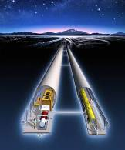
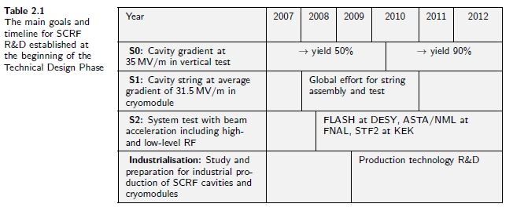
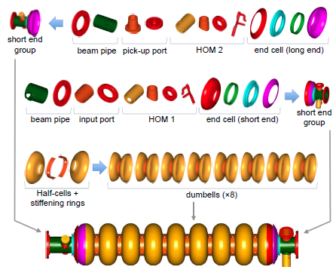
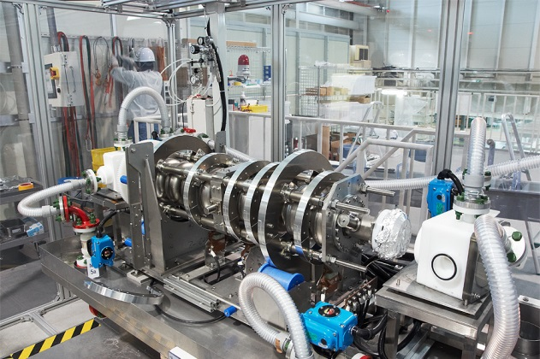
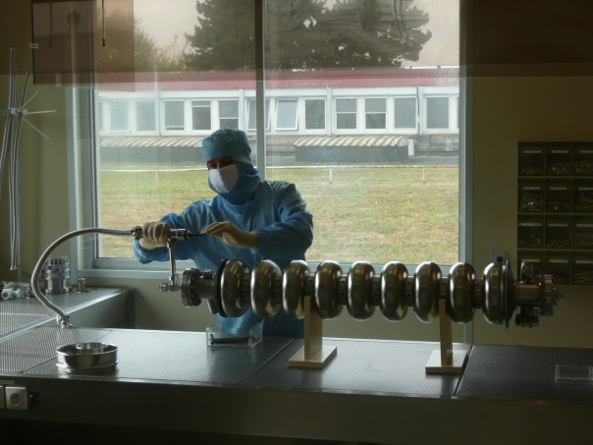
CONTEXT
  ILC: ~16000 Superconductive Niobium cavities > 31.5 MV/m
  = cost driver
  Challenging performance
  Requires a worldwide effort
Horizontal EP set-up at KEK
Cleanroom Assembly at CEA/IRFU
Requires perfect knowledge of SRF technology from cavity fabrication
to cleanroom assembly

Slide 3
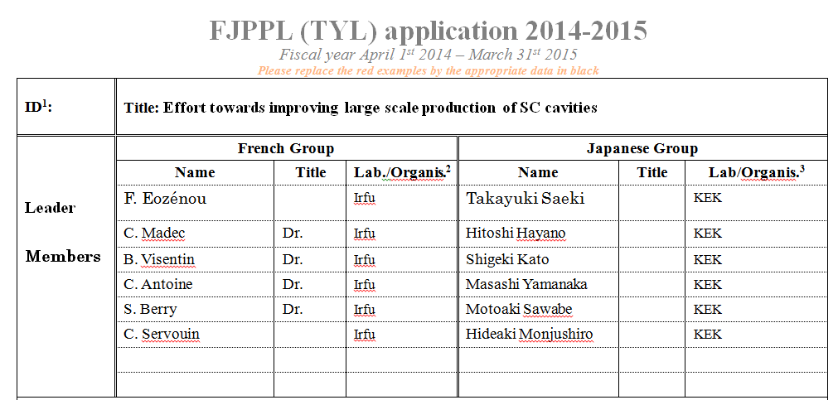
GOAL of A_RD_09
Develop process dedicated to the large scale cavity production
From Cavity Fabrication to VT
Thanks to advanced facilities: CFF/STF/COI at KEK, Supratech at CEA Saclay
Thanks to motivated teams:

Slide 4
OUTLINE
INFRASTRUCTURE
RECENT ACHIEVEMENTS
PROPOSAL FOR 2014-2015

Slide 5
INFRASTRUCTURE

Slide 6
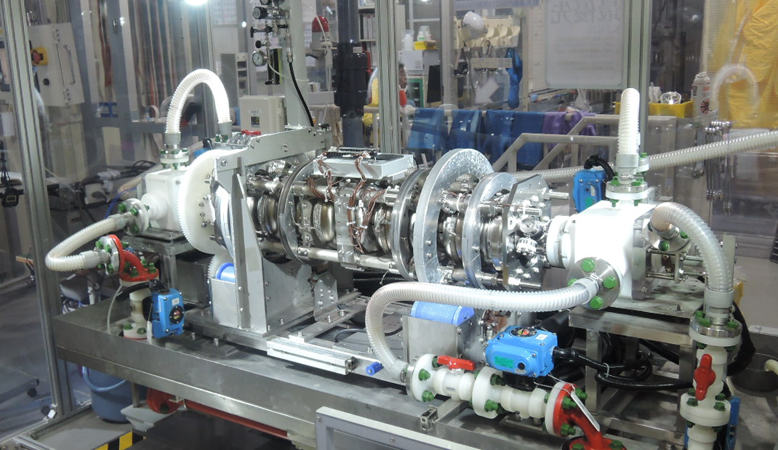
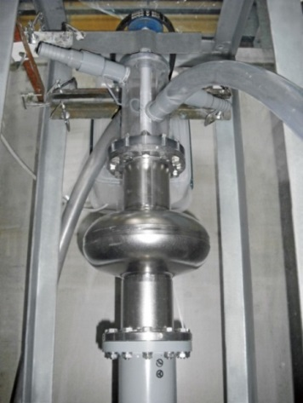
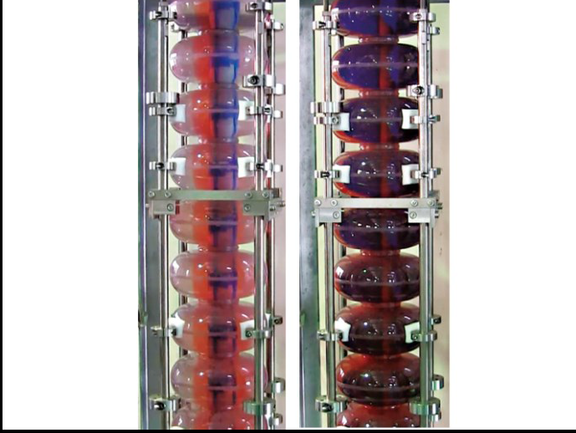
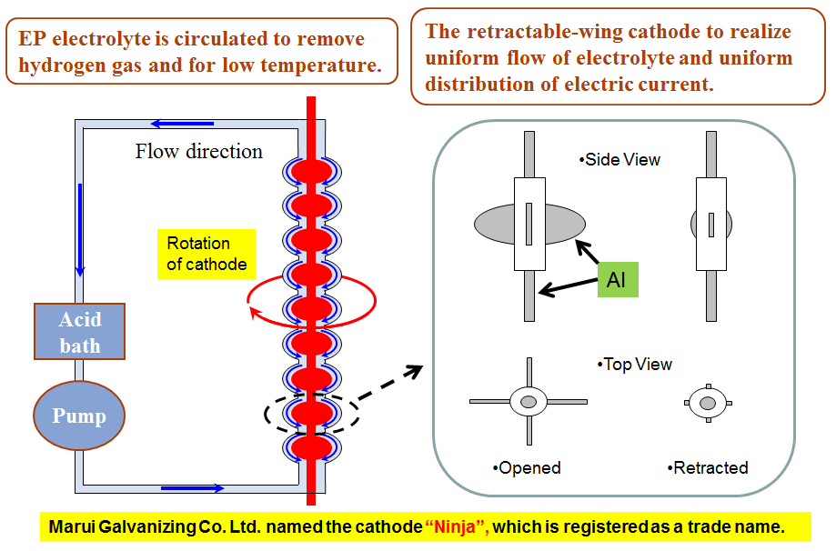
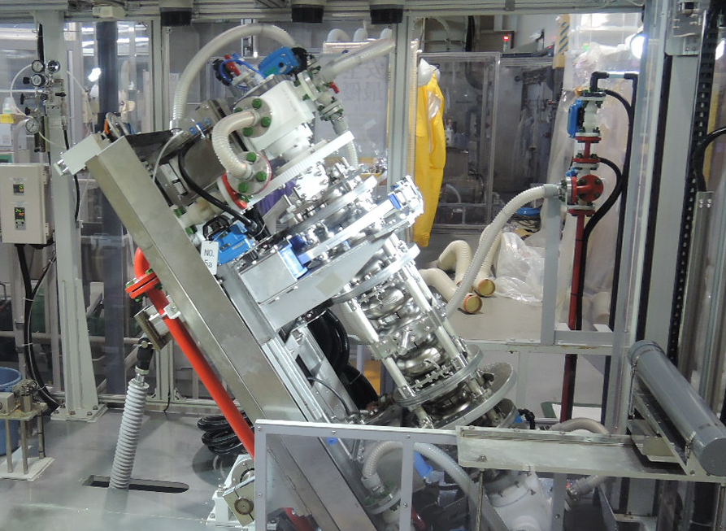
ELECTROPOLISHING AT KEK & MARUI
Rotation of cavity in HEP process.
(HEP setup at KEK-STF)
EP at Marui Galvanizing Co. Ltd.
EP electrolyte is half filled.
Turning the EP-bed for draining

Slide 7
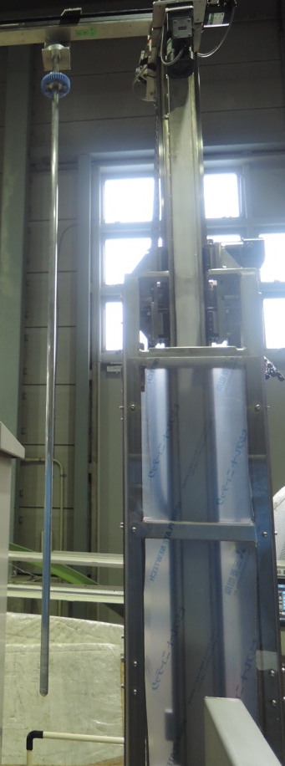
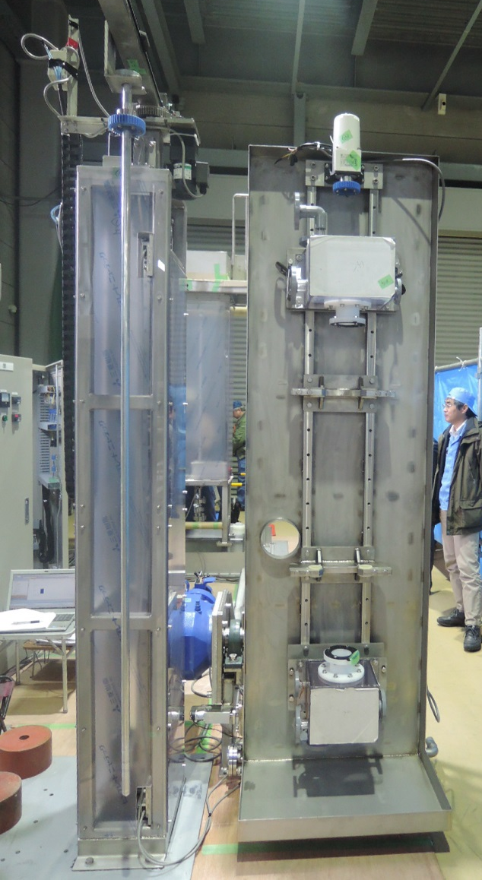
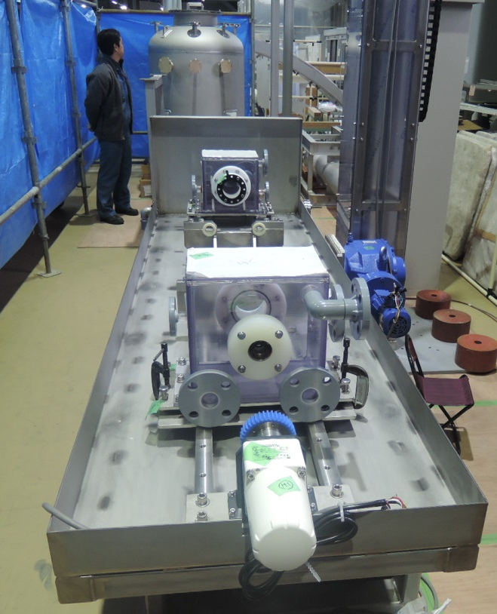
NEW EP SET-UP FOR COI BUILDING AT KEK
(CENTER-OF-INNOVATION)
Cathode motor
EP bed is used both for HEP and VEP (2 ways). This enables the direct comparison of HEP and VEP processes.
Cathode insertion tool.
EP bed
Manufacturer is MHI

Slide 8
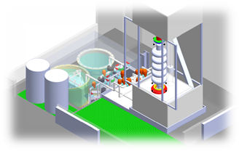
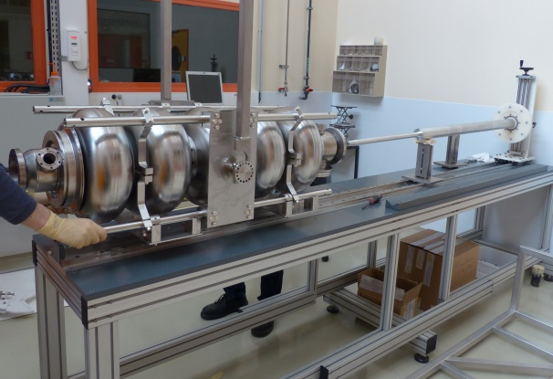
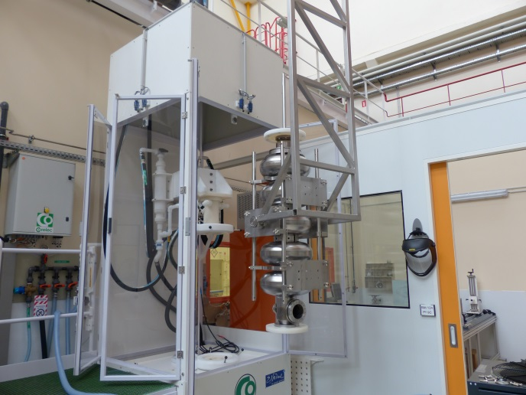
VEP SET-UP AT CEA SACLAY
Designed for large cavities
Circulating acid
Injected from bottom
300L acid capacity
Cooling system (heat exchanger in acid tank)
Emptying by gravity
Nitrogen blowing in top of cavity/acid tank
Cathode inserted in horizontal position
Cathode’s insertion in horizontal position
SPL Cavity insertion in the cabinet

Slide 9
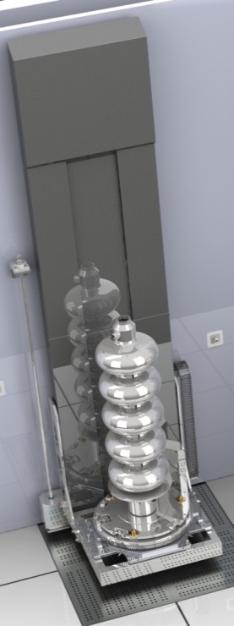
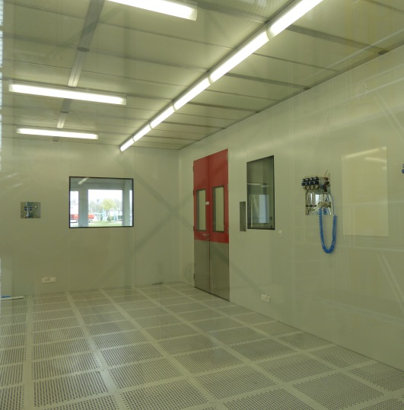
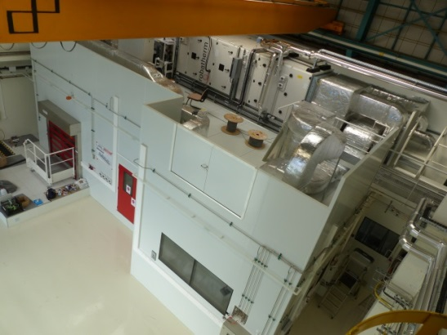
NEW CLEANROOM /
High Pressure RINSING AT IRFU
ISO5 Clean Room (53m²) + 27m² ISO7
Cavity Assembly for R&D activities will be located there
New HPR system available in november

Slide 10
RECENT ACHIEVEMENTS

Slide 11
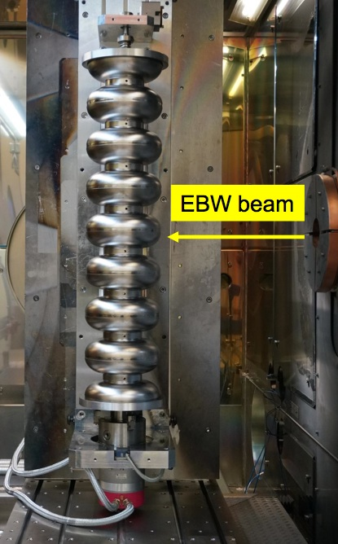
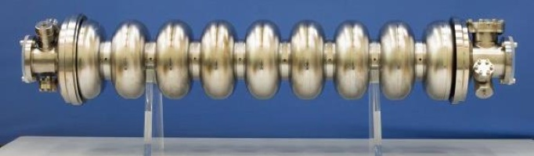

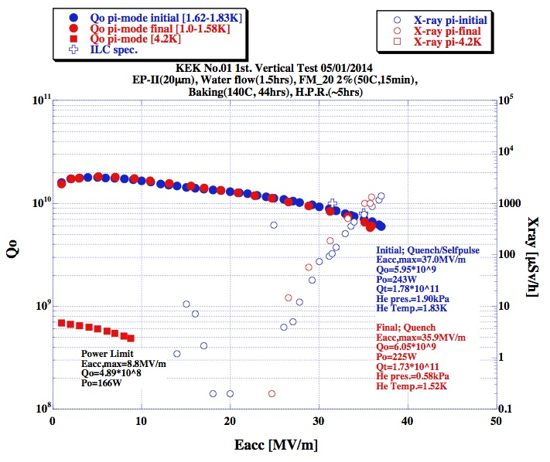
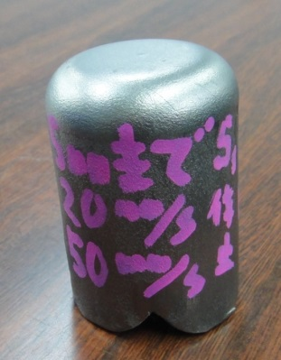
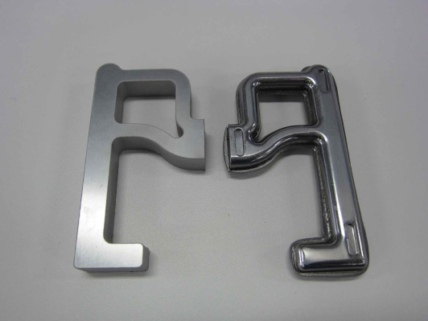
KEK in-house 9-cell cavity;
KEK-01
Trials of industrial fabrication
37 MV/m
Deep-drawing HOM-cup
Press form HOM-antenna
11

Slide 12
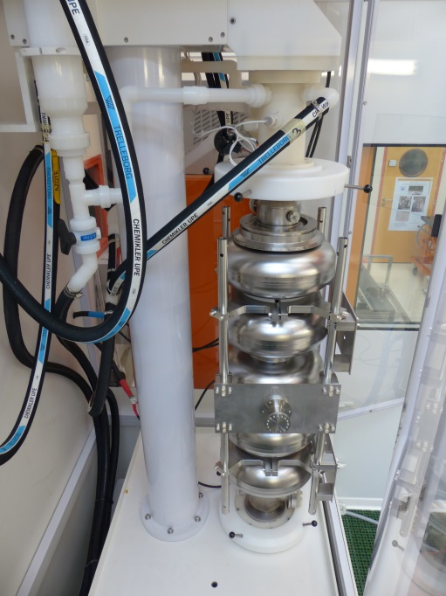
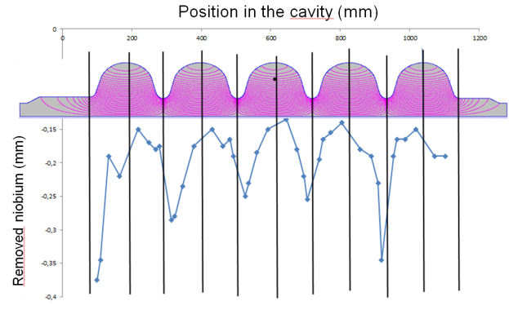
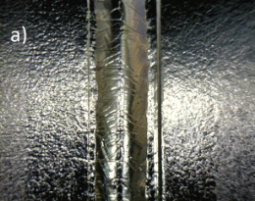
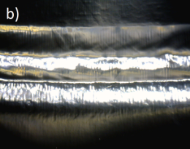
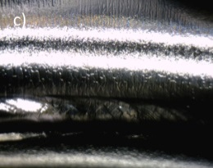
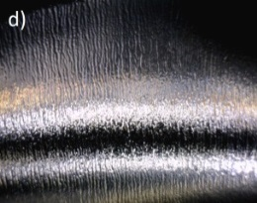
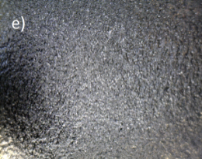
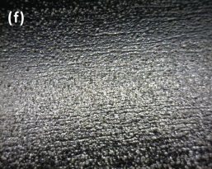
VERTICAL EP OF 704-MHz SPL CAVITY
AT IRFU
4 sequences with turning of the cavity in between
200 µm average removal
Symmetric removal in the cavity
Ratio iris/equator: 2/1 = similar compared to ILC shape
20mm
Strong local attack due to acid condensation in exhaust pipe
Typical surface morphologies after >100µm VEP at different locations. The weldings at a) equators, and b) irises are smooth. Bubbles stripes are observed at the proximity of irises c) and d). In the areas between equators and irises e) and f), the surface is rougher. Some pitting due to the uncontrolled EP sequence

Slide 13
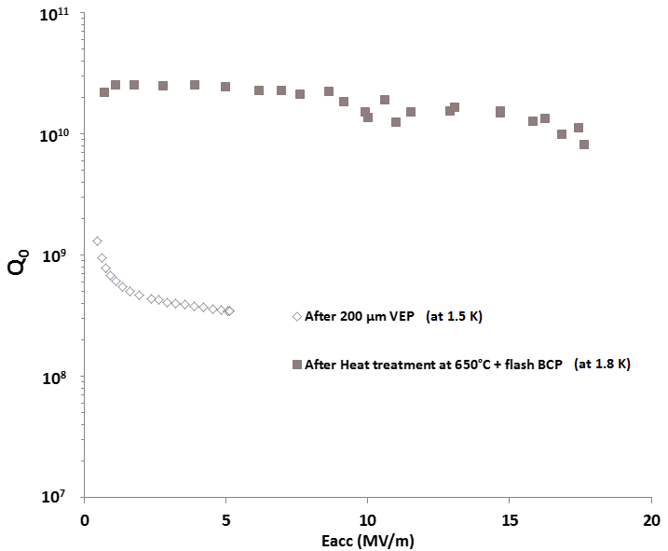

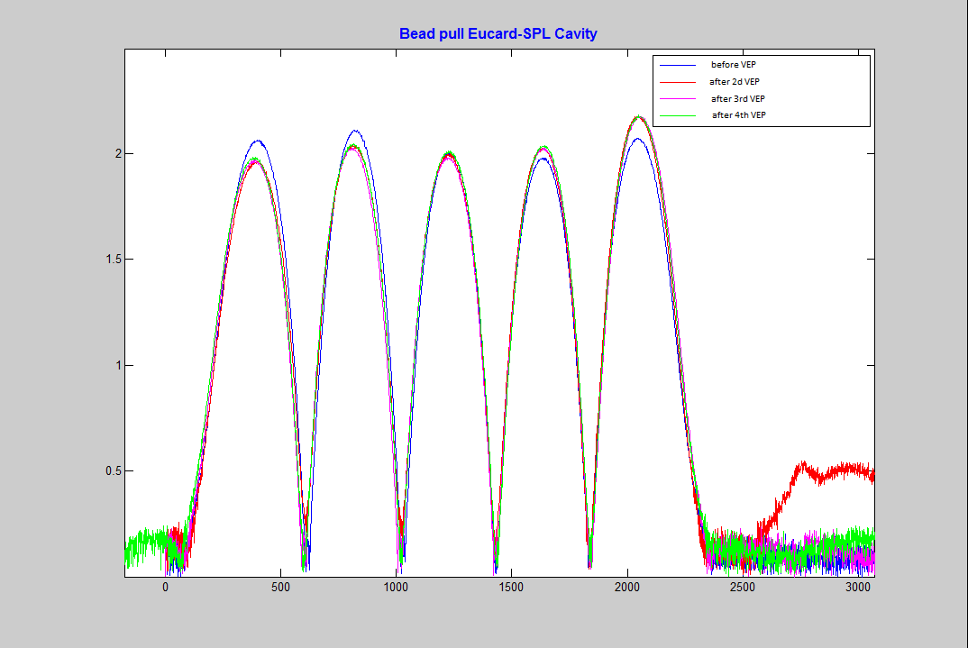
VT RESULT FOR THE SPL CAVITY
Strong Q-disease after 200 um removal by VEP
Q improved after heat treatment at 650°C x 24hours
Eacc reached 18 MV/m but high radiation in the testing hall
New test planned at higher gradient after increased protection
Heat tratment 650°Cx24h at CERN
(A. Mongelluzzo, S. Calatroni)
Shift in Field Flatness when hydrogen release not controlled
No change once the problem solved

Slide 14
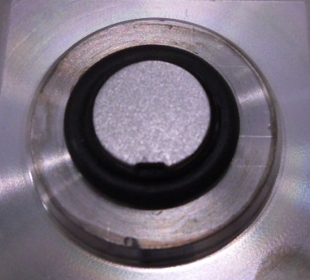
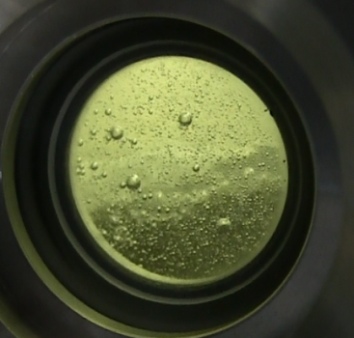
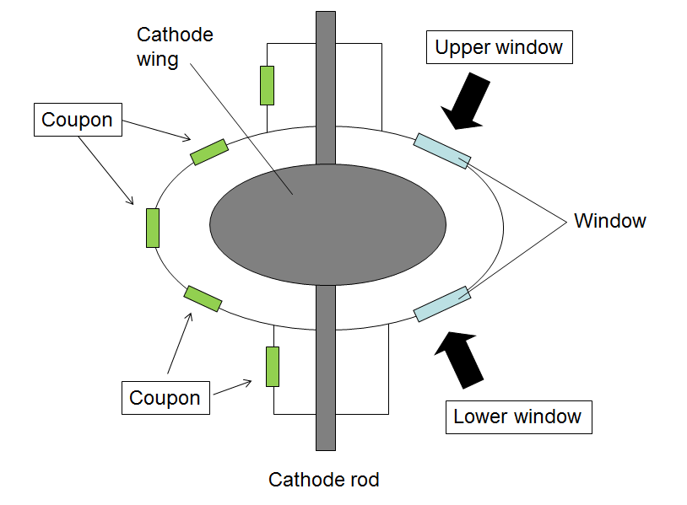
9-CELL VEP STUDIES AT KEK/MARUI
Nb coupons (6 points)
・EP current
・Temperature
・Surface roughness
・Removal thickness
・Impurities
can be investigated.
Transparent window
(4 points)
・State of bubbles
・State of cathode
can be seen
during VEP process.
Coupon cavity
(with 6 Nb coupons and
transparent windows)
VEP condition (an example)
EP solution: H₂SO₄(98%):HF(55%)=9:1
Voltage: 9–11V
Flow rate: 5L/min
Rotation speed: 1rpm
EP time: 150min
Flow direction: Bottom to top

Slide 15
9-Cell VEP STUDIES AT KEK/MARUI
Upper
Upper
Logged data (Temperature-time)
Lower
Lower
Temperature in EP tank
Total average
18.2μm
Average temperature
of each cell (After 60min)
Average removal thickness
of each cell
Logged data
(Voltage, Current density-time)

Slide 16
PROPOSAL FOR FY 2014-2015

Slide 17
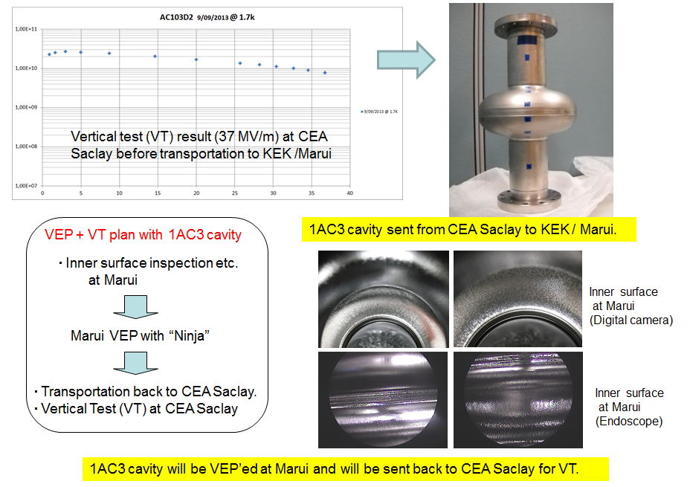
CAVITY EXCHANGE PROGRAM
1AC3 / VEP

Slide 18
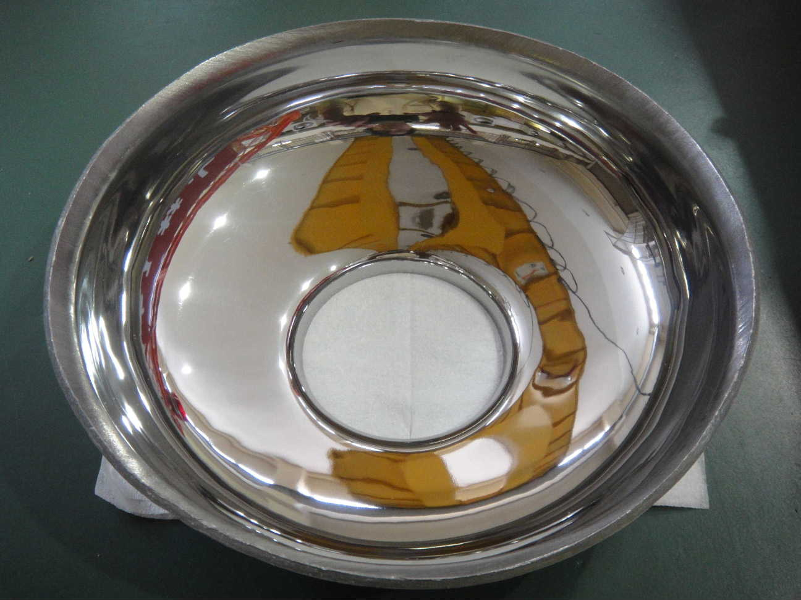
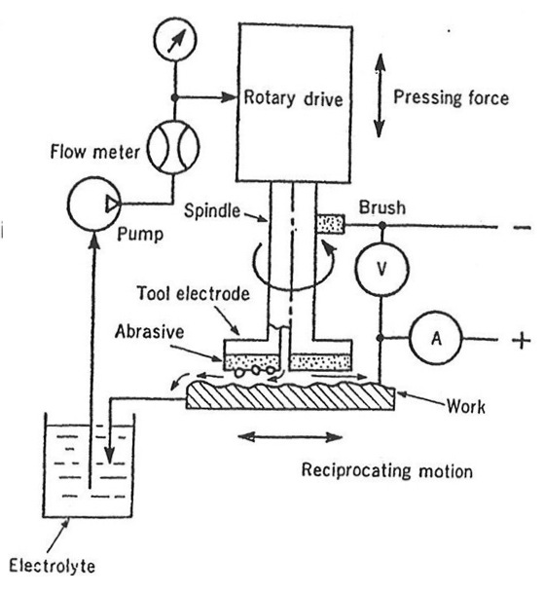
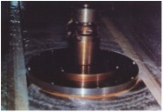
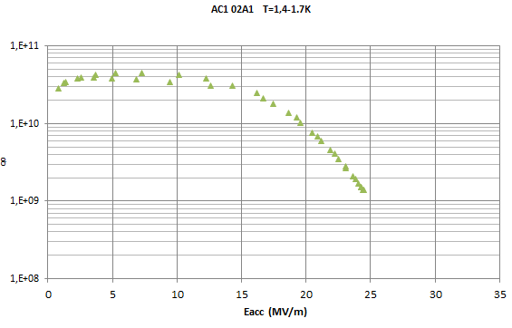
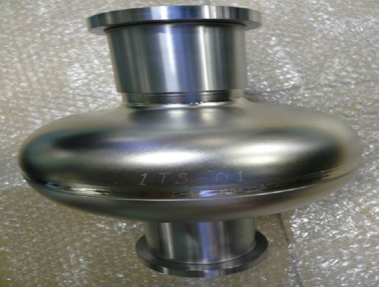
CAVITY EXCHANGE PROGRAM
1AC2 / Electro-CHEMICAL BUFFING (ECB)
ECB makes it possible to reach smooth Nb surface
Has to be tested on 1Cell cavity
ECB process
Cavity exchange program with 1AC2
Performance of 1AC2 limited by Q-Slope after VEP
Insufficient material removal?
Pitting due to uncontrolled VEP
ECB in June 2014 at KEK
VT at Saclay
1-TS-01 Cavity
Delay due to mistakes during fabrication (thin wall)
Cavity repaired
Shipping to Saclay after ECB
VT at Saclay

Slide 19
CAVITY EXCHANGE PROGRAM
9-CELL / VEP
Four 9-Cell ILC cavities will be delivered to KEK (2 x MHI, 2 x Toshiba)
One cavity will be studied within FJPPL Program
VEP at KEK
Shipping to Irfu
VT at Irfu
VEP at Irfu
VT at Irfu
Comparison of the VEP processes

Slide 20
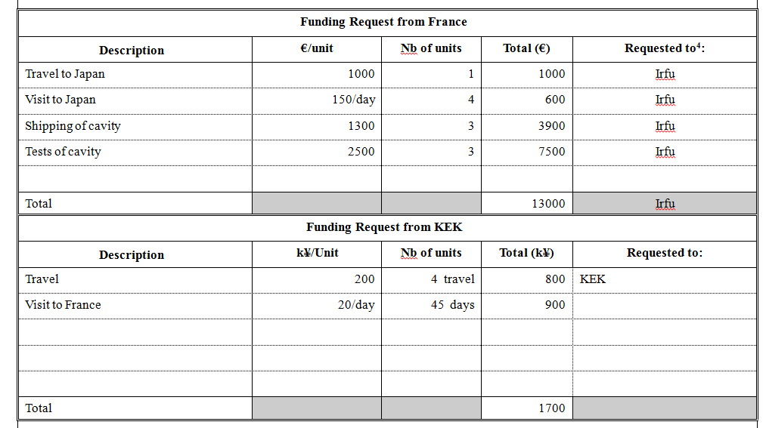
THANK YOU FOR YOUR ATTENTION
SUMMARY

