Slide 1
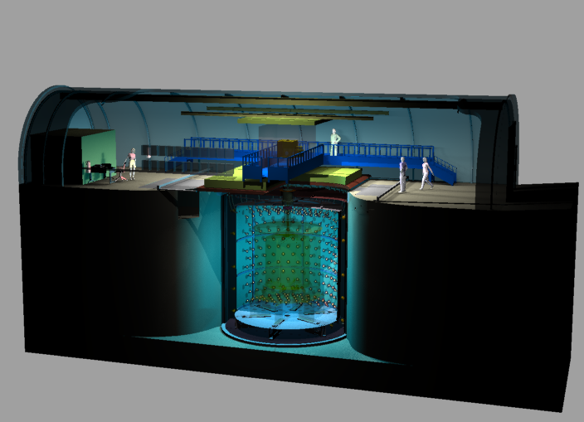
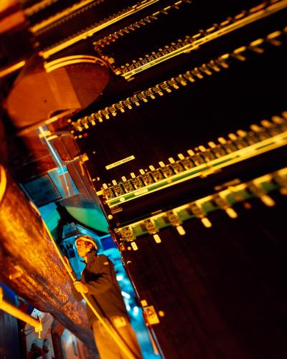
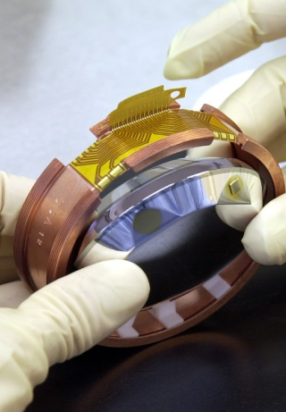
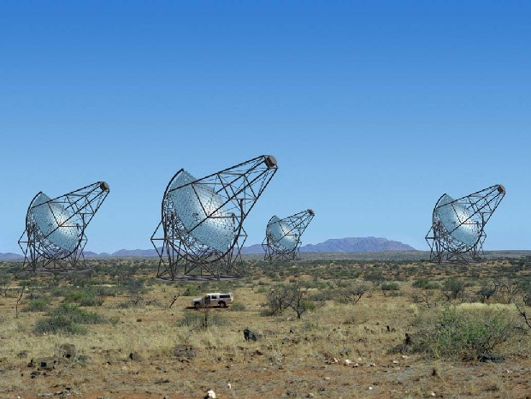
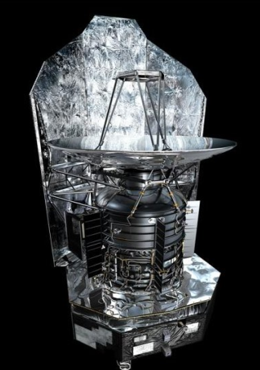
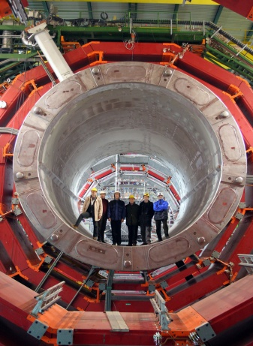
IRFU
Strategy 2020
Double Chooz
ALICE
Edelweiss
HESS
Herschel
CMS
Philippe CHOMAZ
Déchiffrer les rayons de l’Univers
Irfu Director

Slide 2
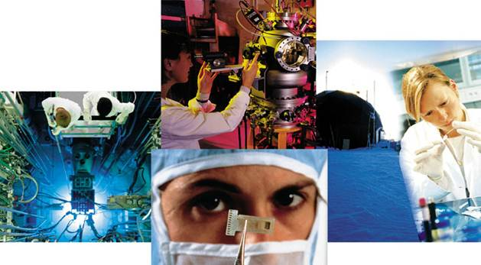
Irfu: Large CEA Institute created in 1993
Research and Technology
CEA
Alternative Energies & Atomic Energy Commission
Energies
Technologies
Defense
Basic Research
16 000 Employees, 3 900 M€

Slide 3
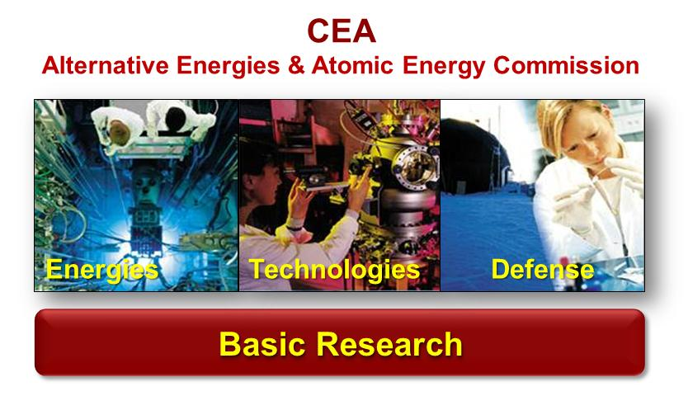
Irfu: Large CEA Institute created in 1993
Research and Technology

Slide 4
Irfu: Large CEA Institute created in 1993
Research and Technology
  Fusion in 1993 (DAPNIA)
      Physics: Infinitely large & small
      Technology: Radiations
  Institute in 2008
Irfu
814 Employees, 84 M€

Slide 5
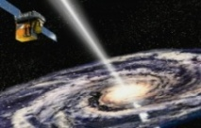

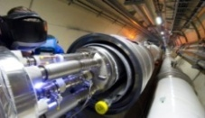
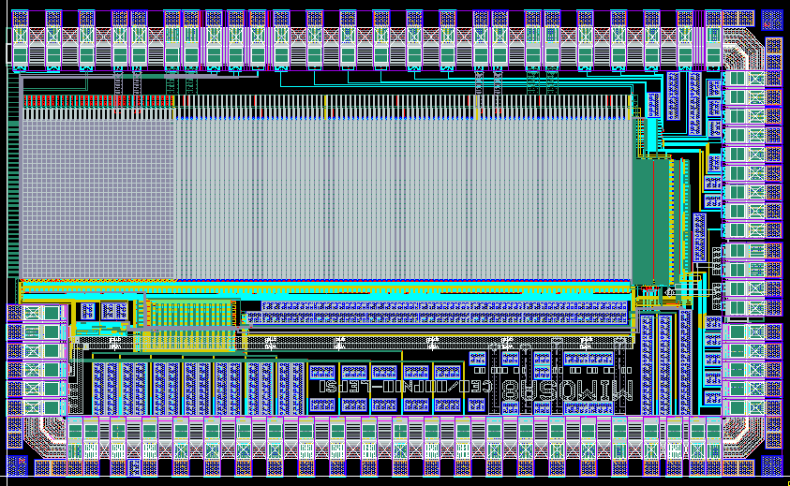
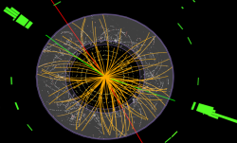
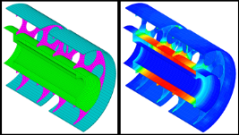
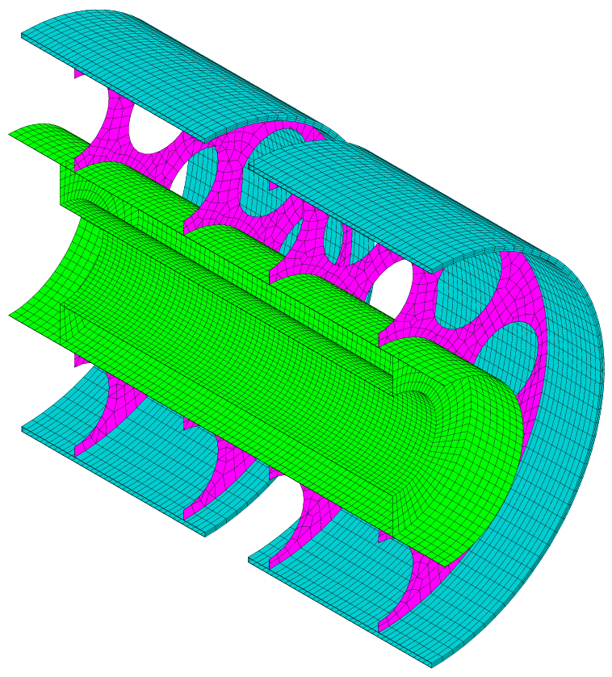
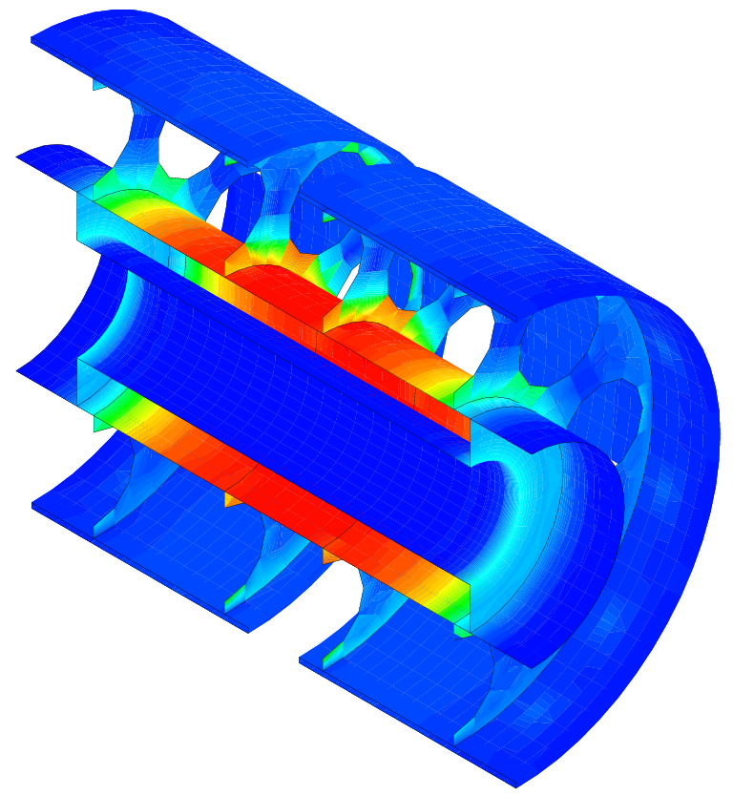
Irfu: Large CEA Institute created in 1993
Research and Technology
  Research & Technology
      Physics: Infinitely large & small
      Technology: Radiations
Irfu
Institute of Research into the Fundamental laws of Universe
Institute of Research into the Fundamental laws of Universe
Astrophysics
Space technologies
Astrophysics
Space technologies
SAp: Astrophysics
Space technologies
Accelerators,
Supra. Magnets
Accelerators,
Supra. Magnets
SACM: Accelerators,
Supra. Magnets
Nuclear Physics
Nuclear Physics
Detectors, electronic,
computing
SPhN: Nuclear Physics
Detectors, electronic,
computing
SEDI: Detectors,
electronic, computing
Particle Physics
Particle Physics
SPP: Particle Physics
Systems engineering
Systems engineering
SIS: Systems engineering

Slide 6
Irfu: Large CEA Institute created in 1993
Research and Technology
  Research & Technology
      Physics: Infinitely large & small
      Technology: Radiations
814 FTE
632/615 CDI/CDI-CEA
814
FTE
Institute of Research into the Fundamental laws of Universe
Institute of Research into the Fundamental laws of Universe
Astrophysics
Space technologies
116 CDI
94 CDD
Astrophysics
Space technologies
SAp: Astrophysics
Space technologies
Accelerators,
Supra. Magnets
Accelerators,
Supra. Magnets
SACM: Accelerators,
Supra. Magnets
121 CDI
10 CDD
Nuclear Physics
Nuclear Physics
Detectors, electronic,
computing
SPhN: Nuclear Physics
Detectors, electronic,
computing
56 CDI
29 CDD
SEDI: Detectors,
electronic, computing
125 CDI
11 CDD
Particle Physics
Particle Physics
SPP: Particle Physics
Systems engineering
72 CDI
45 CDD
Systems engineering
SIS: Systems engineering
97 CDI
8 CDD

Slide 7
Irfu: Large CEA Institute created in 1993
Research and Technology
814 FTE
632/615 CDI/CDI-CEA
84 M€ (2012)
54 M€ Gov. Subsidies
814
FTE
84
M€
Institute of Research into the Fundamental laws of Universe
Institute of Research into the Fundamental laws of Universe
Astrophysics
Space technologies
116 CDI
94 CDD
Astrophysics
Space technologies
SAp: Astrophysics
Space technologies
Accelerators,
Supra. Magnets
Accelerators,
Supra. Magnets
SACM: Accelerators,
Supra. Magnets
121 CDI
10 CDD
Nuclear Physics
Nuclear Physics
Detectors, electronic,
computing
SPhN: Nuclear Physics
Detectors, electronic,
computing
56 CDI
29 CDD
SEDI: Detectors,
electronic, computing
125 CDI
11 CDD
Particle Physics
Particle Physics
SPP: Particle Physics
Systems engineering
72 CDI
45 CDD
Systems engineering
SIS: Systems engineering
97 CDI
8 CDD

Slide 8
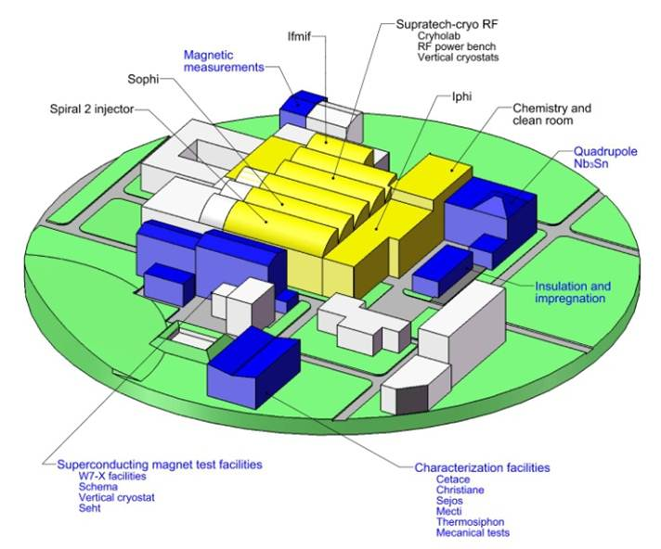
Irfu: Large CEA Institute created in 1993
Research and Technology
814 FTE
632/615 CDI/CDI-CEA
84 M€ (2012)
54 M€ Gov. Subsidies
814
FTE
84
M€
  Platforms Saclay & Orme
      50 000 m², 130 M€
      Radiations Techno: Accelerators, Magnets, Space, Detection, computing

Slide 9

IRFU: Organized for large projects
Concentration of human Resources
Heavy equipment
Advanced technologies
Project oriented organization,
inside CEA, a technology
dominated institution
ATLAS Toroïdal Magnet

Slide 10




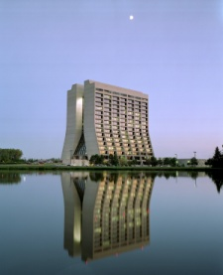
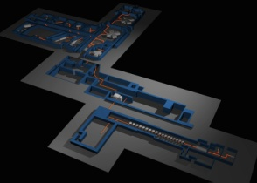
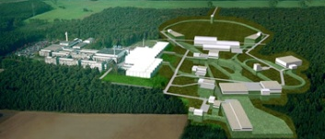

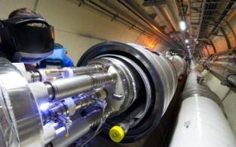
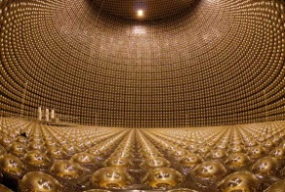
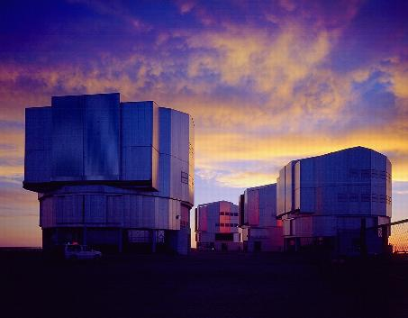
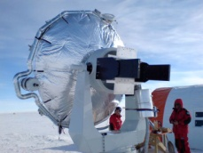
Think global …
Research projects inside large international programs
implying a collaboration with other French and foreign institutions
US-DOE
CNRS/In2p3
GANIL
GSI-FAIR
DESY
CERN
KeK
JAEA
ESO

Slide 11
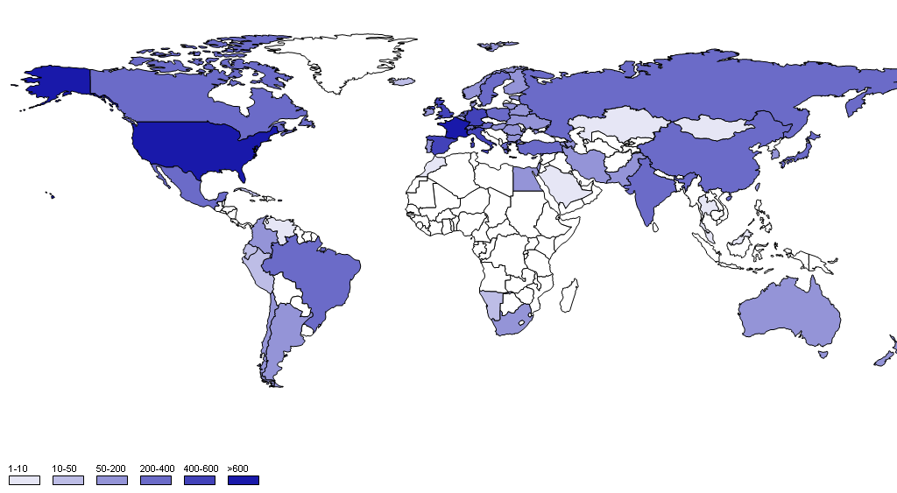
Scientific Production
Number of International co-publications with Irfu in2012

Slide 12
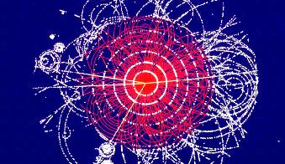
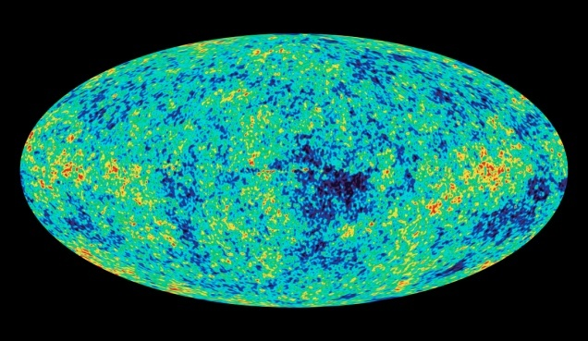
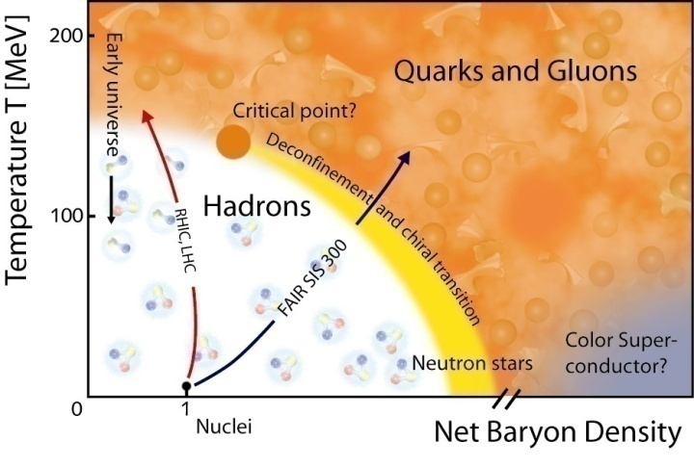
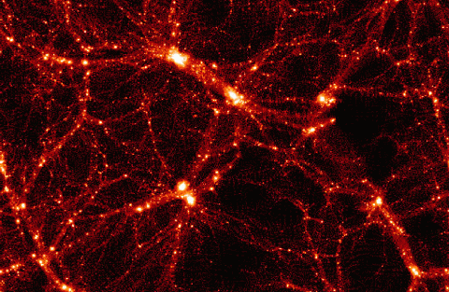
Exploring the fundamental laws of Universe
What are the ultimate constituents of matter ?
What is the energy content of the Universe ?
Infinitely small
Infinitely large
Elementary
Complexe
What are the origins of particles and nuclei ?
What are the origin and structure of Universe ?

Slide 13
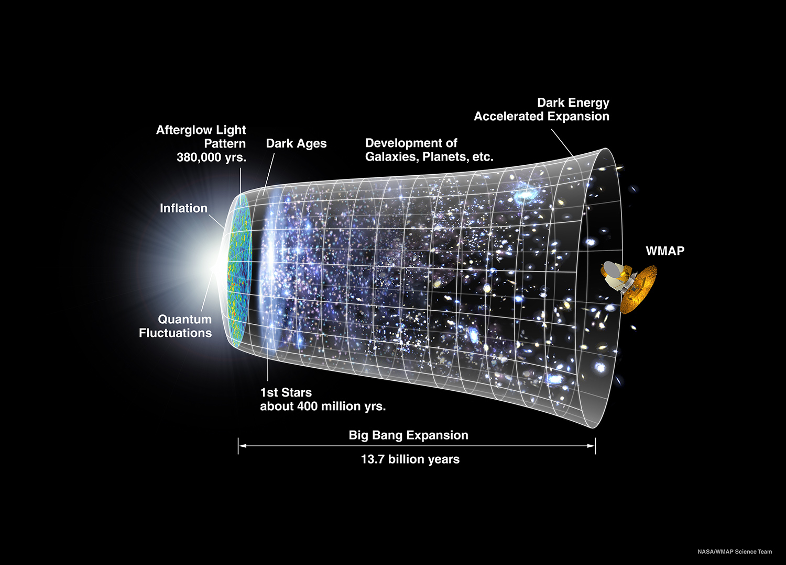
3) Comment l’Univers est-il structuré ?
Exploring Universe history
  Etoiles et galaxies
  Univers violent et trous noirs
  Rayons cosmiques

Slide 14
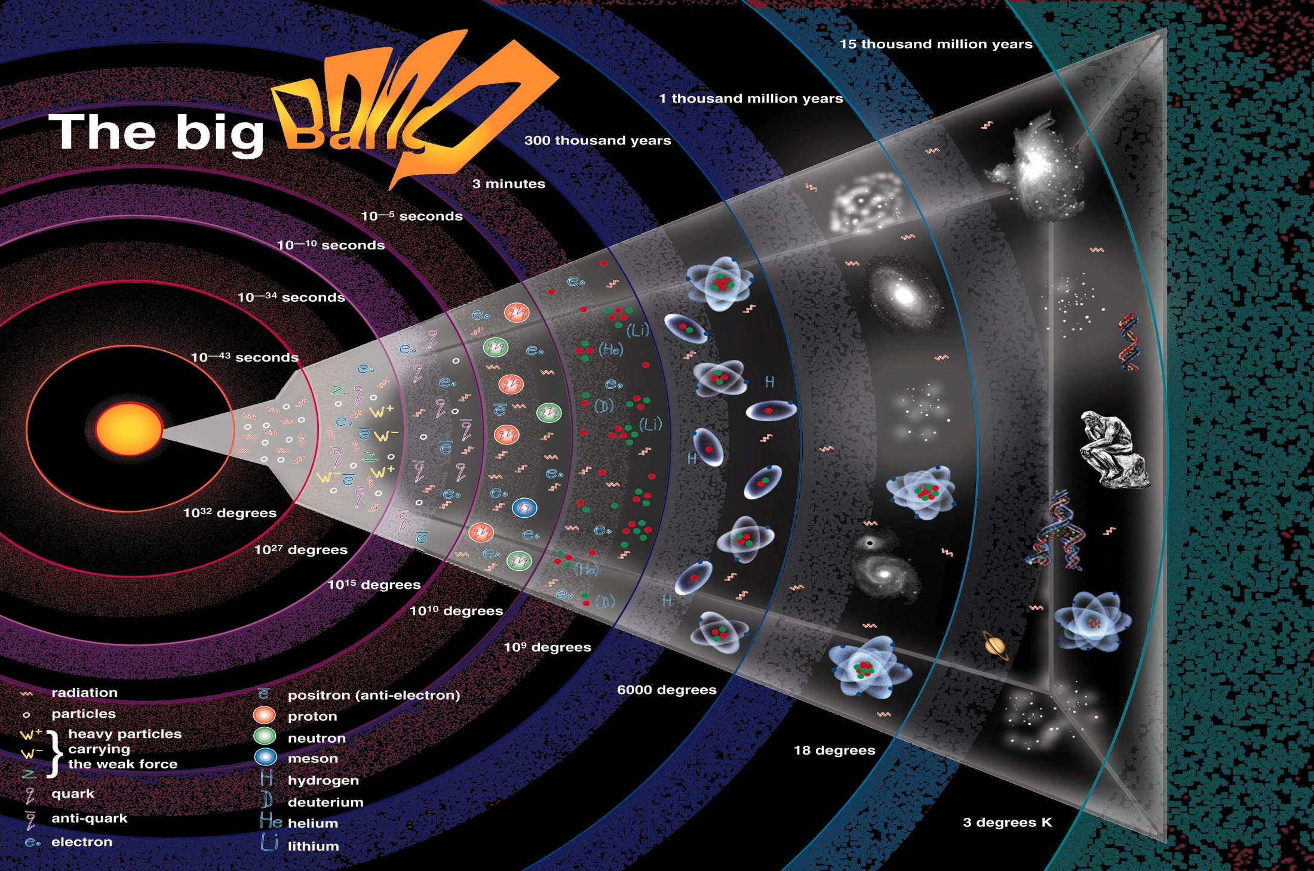
4) Comment les noyaux et particules sont-ils créés ?
Exploring Universe history
  Plasma de quarks et de gluons
  Noyaux exotiques

Slide 15
4) Comment les noyaux et particules sont-ils créés ?
Exploring Universe history
  Plasma de quarks et de gluons
  Noyaux exotiques

Slide 16
Positionnement par segment lois fondamentales de l’Univers
Explorer l’ histoire de l’ Univers
4) Comment les noyaux et particules sont-ils créés ?
Quels sont les constituants ultime de la matière ?
Quel est le contenu énergétique de l’Univers ?
Infiniment petit
Infiniment grand
élémentaire
Complexe
  Plasma de quarks et de gluons
  Noyaux exotiques
Comment s’organise la matière nucléaire ?
Comment l’Univers s’est-il structuré ?

Slide 17
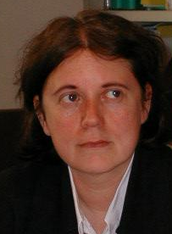
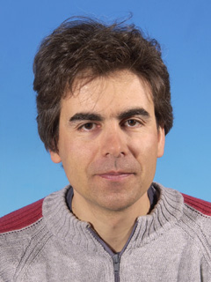
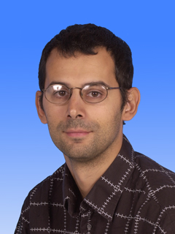
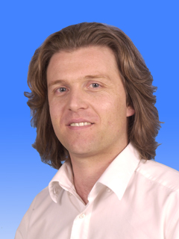
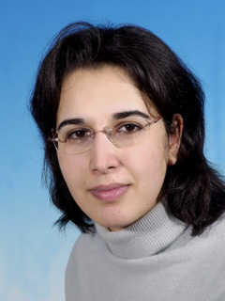
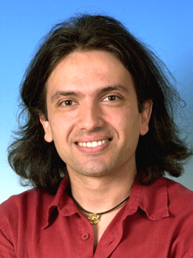
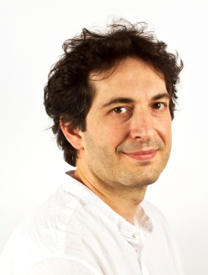
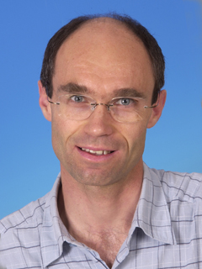
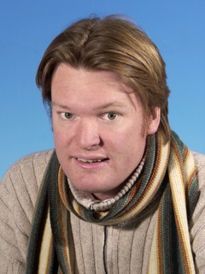
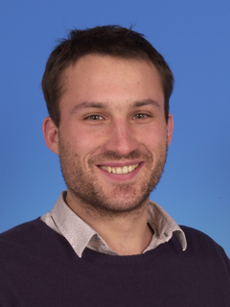
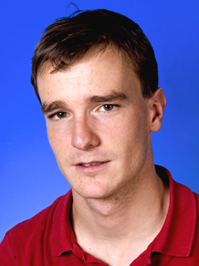
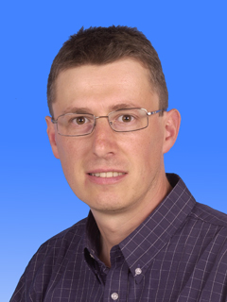
4) Comment les noyaux et particules sont-ils créés ?
12 ERC Grants
  Plasma de quarks et de gluons
  Noyaux exotiques

Slide 18
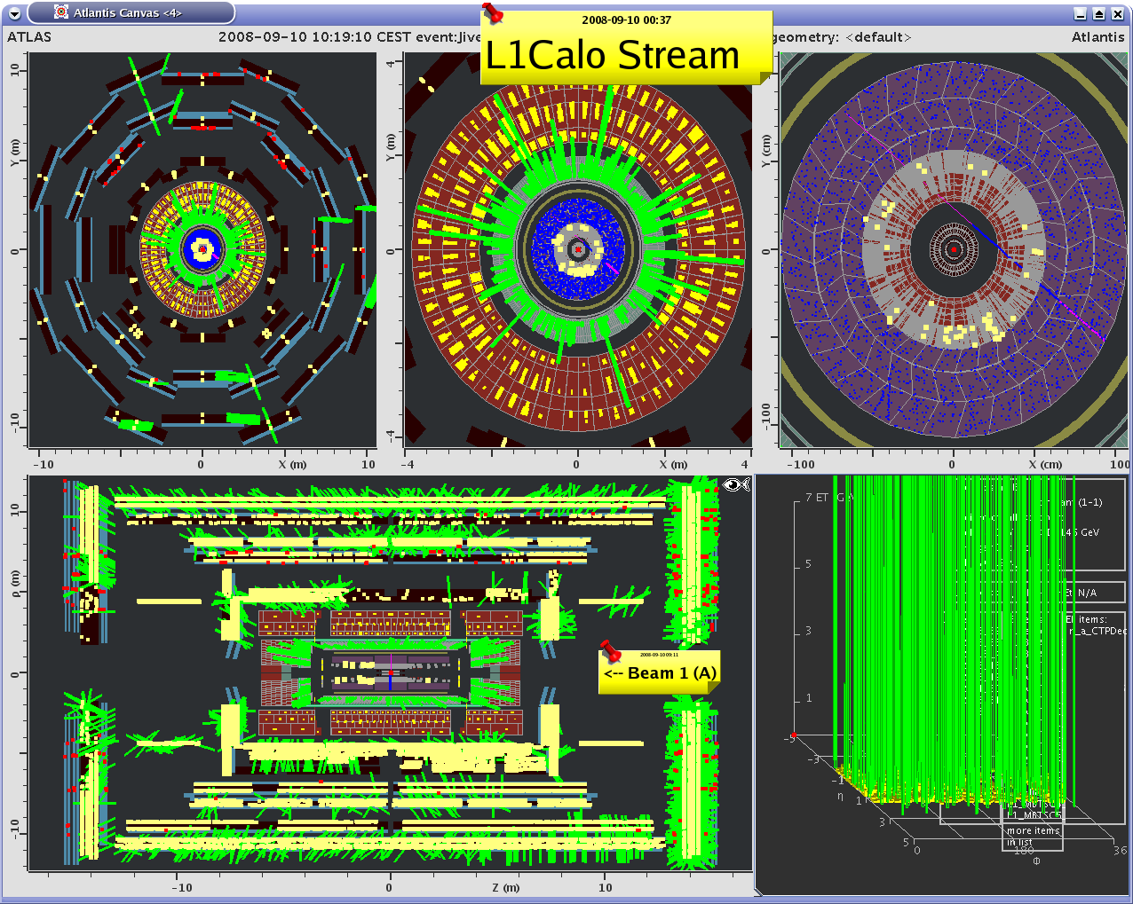
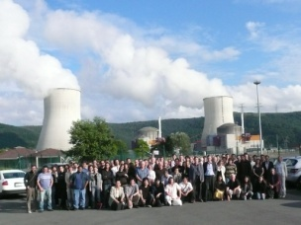

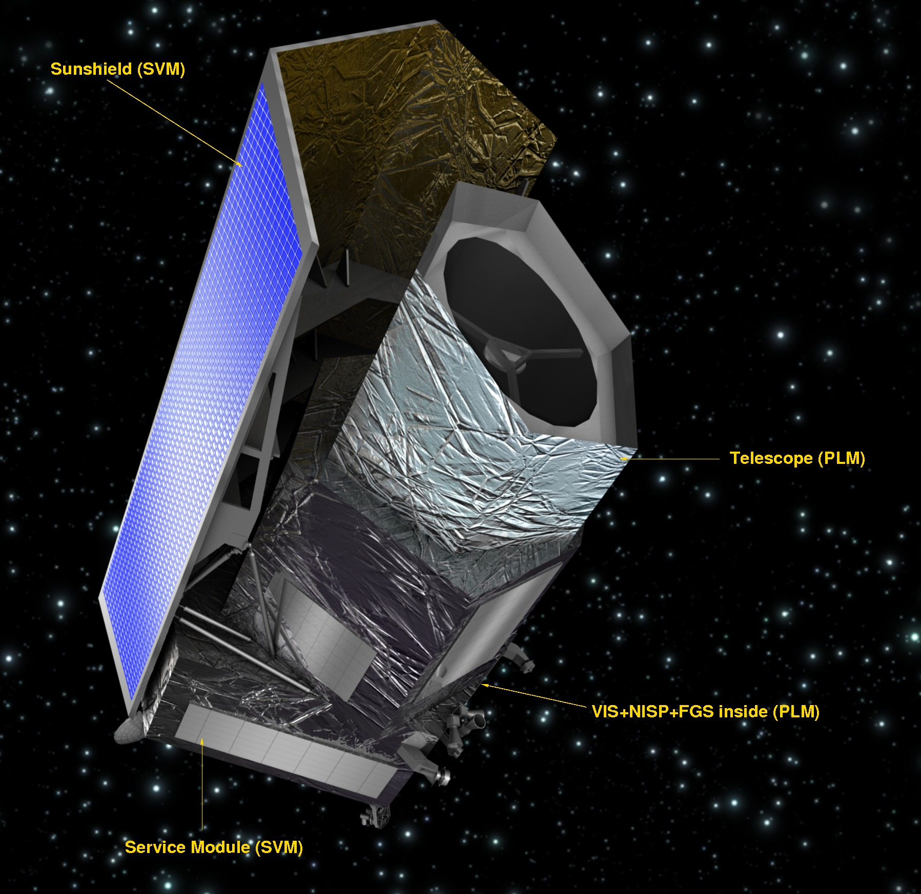
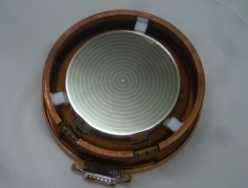


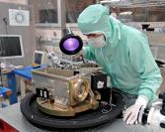
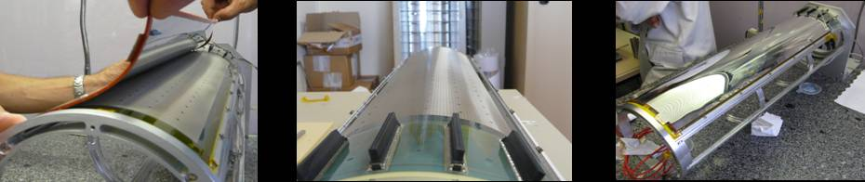
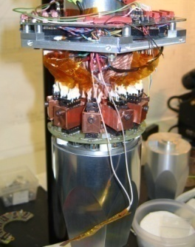

Exploring the fundamental laws of Universe
Elementary constituents?
  Standard Model, Higgs boson (D0,ATLAS,CMS)
  Neutrinos oscillations (T2K, D-Chooz, Cesox, Stereo)
Energy content?
  Dark Universe (Edelweiss, Boss/Desi, Euclid …)
  Antimatter (Gbar)
Structures in the Universe?
  Cosmology (Planck)
  Formation of galaxies & stars (Hershel, JWST, ELT)
  Cosmic radiations (Fermi, Svom, Hess/CTA, Antares)
Origin of particles and nuclei?
  Plasma of quarks and gluons (ALICE)
  Structure of Hadrons (COMPASS, JLAB)
  Exotic nuclei (GANIL/SPIRAL2, FAIR)

Slide 19




Exploring the fundamental laws of Universe
  Irfu roadmap
Important milestones
2011
2012
2013
2014
2015
2016
2017
2018
2019
2020
Decision
Closing
Ultimate constituents of the universe
Update of
EU strategy
Decision for next generation
Accelerator (ILC, 80KM)
Higgs Discovery
MOU for Upgrades
Upgrades phase 1 operational
Standard model
Atlas - CMS
14 TeV
Atlas – CMS Upgrade
HL - LHC
Measurement of mixing angle
D-Chooz near laboratory
D-Chooz near detector
End of D-Chooz
Decision for Long Baseline
Neutrino physics
T2K
D-Chooz
Long Baseline
Energy content of the universe
Euclid final selection as M2
Planck results on CMB
BAO
Euclid launch 2020
Dark energy
Planck
Update of Direct
DM Detection Strategy
Euclid
Dark matter
Edelweiss
End of Edelweiss measurement at maximum sensitivity
Formation of structures in the universe
Stars and galaxies
Herschel
ArTeMiS
E-ELT Funfing
JWST - MIRI
E-ELT - METIS
JWST Launch
E-ELT First Light → 2024
HE γ astronomy
Hess2
CTA-PP
CTA
CTA First light
SVOM Mission cancelled
SVOM Mission restarted by CNES
Athena+
Violent universe
SVOM
SVOM
ν Astronomy
KM3
Withdrawal of KM3 Collaboration
Structures of nuclear matter
Exotic nuclei
Funding of S³ Equipex
SPII – Phase 1 First beam
SPII – Phase 2 First beam
Agata - demo
S³ Experiment
Agata-1Π Spiral2
Spiral2 Phase 2
Heavy ions physics run
MOU for Detectors Upgrades
Upgrades operational
Quarks Gluons Plasma
Alice
Alice Upgrade
Quark Gluon Structure
SPSC Compass II Selection
Compass II
Start of Compass physics run
CLAS12 physics run
CLAS 12GeV
End of Compas II measurement of GPD
Electron-Ion

Slide 20

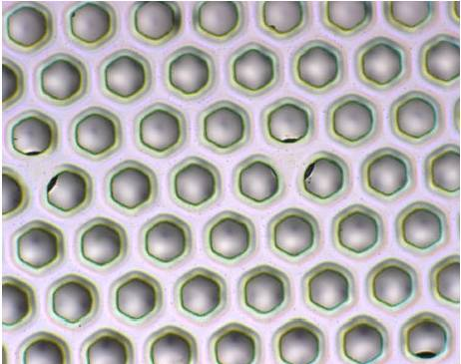



Inventing and constructing new devices
What are the ultimate constituents of matter ?
What is the energy content of the Universe ?
Manipulating
Detecting
What are the properties of matter under extreme conditions ?
What are the origin and structure of Universe ?
Observing
Simulating

Slide 21







Inventing and constructing new devices
Production and manipulation of radiations
  Accelerators (Spiral2, XFeL, FAIR, CERN, IFMIF, ESS)
  Magnets & Superconductivity (R3B, ISEULT, JT60SA)
Detecting radiation
  Microstructured detectors (RD51, CLAS12)
  Imaging device (ELT-METIS, APEX, CALIST)
  ASIC
Space technology
  Camera (PACS, MIRI, Éclair)
  Data center (Fermi, SWOM)
Simulation and data treatment
  Massively parallel calculations
  Grid
  Data processing

Slide 22


Inventing and constructing new devices
Cryotechnologies
  Irfu roadmap in Cryotechnologies
Important milestones
2011
2012
2013
2014
2015
2016
2017
2018
2019
2020
Expected decision
Superconducting Magnets
ISEULT Magnet
Start of magnet production
ISEULT
Start of commissioning at Neurospin
Gradiens Coils
R3B Glad
Test in W7X cryostat
MOU CEA-FAIR
Installation of R3B magnet at GSI
Delivery of Super FRS dipoles at GSI
GSI - Fair Magnets
Super FRS dipoles
LHC Insert Magnets
Eucard 2 FP7 and CEF
LHC Upgrade
HL - LHC
HE - LHC
Cryogenic Tests Facilities
Coil Test Facilities
JT60 SA
End of CTF construction
End of JT60 Coil Tests
ITER - Activities
Sources and Injectors
Installation RFQ at CERN
MOU CEA-FAIR
Delivery at GSI
Protons Injectors
LINAC4
FAIR p-Linac
Deuterons Sources
& Injectors
1st beam at Saclay
First beam at Ganil
Decision on SARAF
End of Saraf study
1st beam at Rokkasho
Installation at Soreq
Decision
SPIRAL2
IFMIF-EVEDA
SARAF
IFMIF
End of RFQ reception
ESS TDR
Decision on ESS
End of IPHI Tests
ESS RFQ
High intensity Injectors
IPHI
Superconducting LINACS
Protons-Deuterons
SC Linacs
Validation of SRF-Linac concept
Decision on SARAF
Start SRF-Linac integration
Start of commissioning at Rokkasho
Start delivery at Lund
IFMIF-EVEDA SRF-Linac
ESS / SARAF Cryomodule
XFEL Convention signed
Start of industrial production
End of industrial production
Electrons Cryomodules
E-XFEL
ILC

Slide 23






Applying research and technologies
What are the ultimate constituents of matter ?
What is the energy content of the Universe ?
knowledge
Know-How
Energy
TGIR
Large Research infrastructures

Slide 24




Irfu

Slide 25
Direction des Sciences de la matière
Institut de Recherche sur les lois Fondamentales de l’Univers
Direction
Double Chooz
ALICE
Edelweiss
HESS
Herschel
CMS
Interpreting radiations from the Universe.
Commissariat à l’énergie atomique et aux énergies alternatives
Centre de Saclay | 91191 Gif-sur-Yvette Cedex
  Etablissement public à caractère industriel et commercial | RCS Paris B 775 685 019

