Slide 1
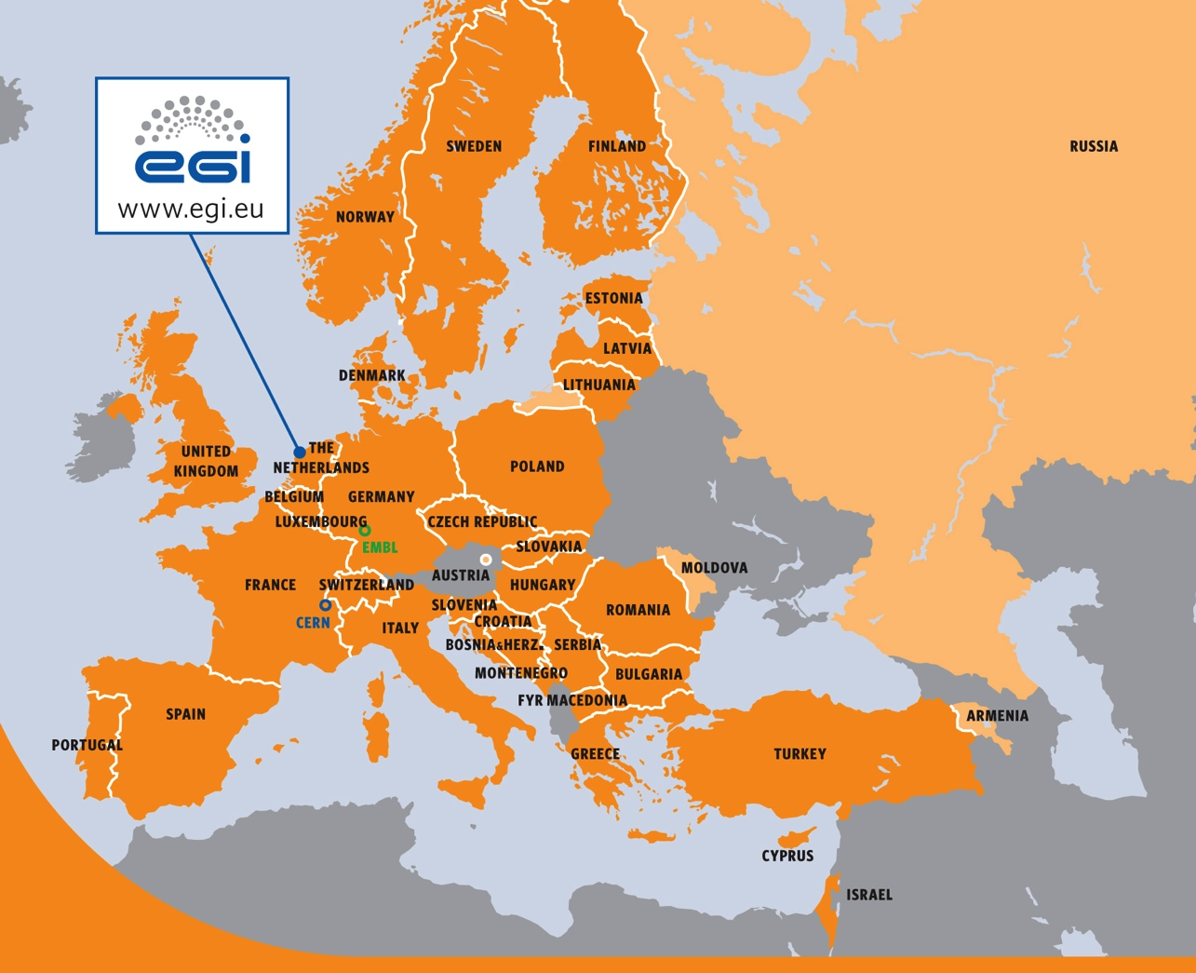
EGI.eu
EGI.eu coordinates and manages the European Grid Infrastructure federation on behalf
of its participants, the National Grid Initiatives and the European International Research Organisations
Notes:
Currently: 1 Manager 2 Full time 1 Part time
From 1st August: 3 Full time (including manager)

Slide 2
EGI.eu
Provides expertise and services to EGI.eu participants, resource providers and researchers across four broad areas:
Software Services and Platforms
Coordination
Consulting and Support
Marketing and Outreach
Notes:
Currently: 1 Manager 2 Full time 1 Part time
From 1st August: 3 Full time (including manager)

Slide 3
EGI.eu
A not-for-profit foundation (stichting) established under Dutch law in February 2010
Based in the Amsterdam Science Park to the east of the city centre
Around 20 members of staff
Notes:
Currently: 1 Manager 2 Full time 1 Part time
From 1st August: 3 Full time (including manager)

Slide 4
EGI.eu
Governed by a 39 member council
33 full members
6 associate members
Oversight of the day to day activities is by a 7 member executive board
Financial and organisational responsibility devolved to the EGI.eu Director
Notes:
Currently: 1 Manager 2 Full time 1 Part time
From 1st August: 3 Full time (including manager)

Slide 5
EGI.eu
Sources of income:
EGI InSPIRE project
€25 Million From the European Commission over 55 months RI-261323
EGI.eu participants contributions
Subscription fees paid by NGIs (based on GDP)
Other projects
EGI receives funding to provide effort in other projects
Notes:
Currently: 1 Manager 2 Full time 1 Part time
From 1st August: 3 Full time (including manager)

