Slide 1

The Alpha Magnetic Spectrometer on the International Space Station
S.Rosier-Lees
LAPP-CNRS-IN2P3-Université de Savoie
Grands Instruments - IAP 2nd April 2014

Slide 2
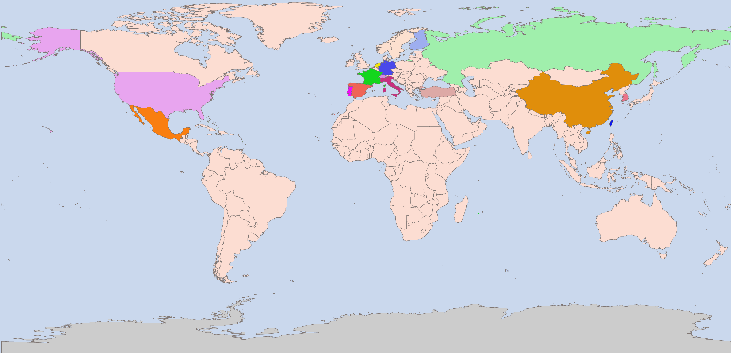
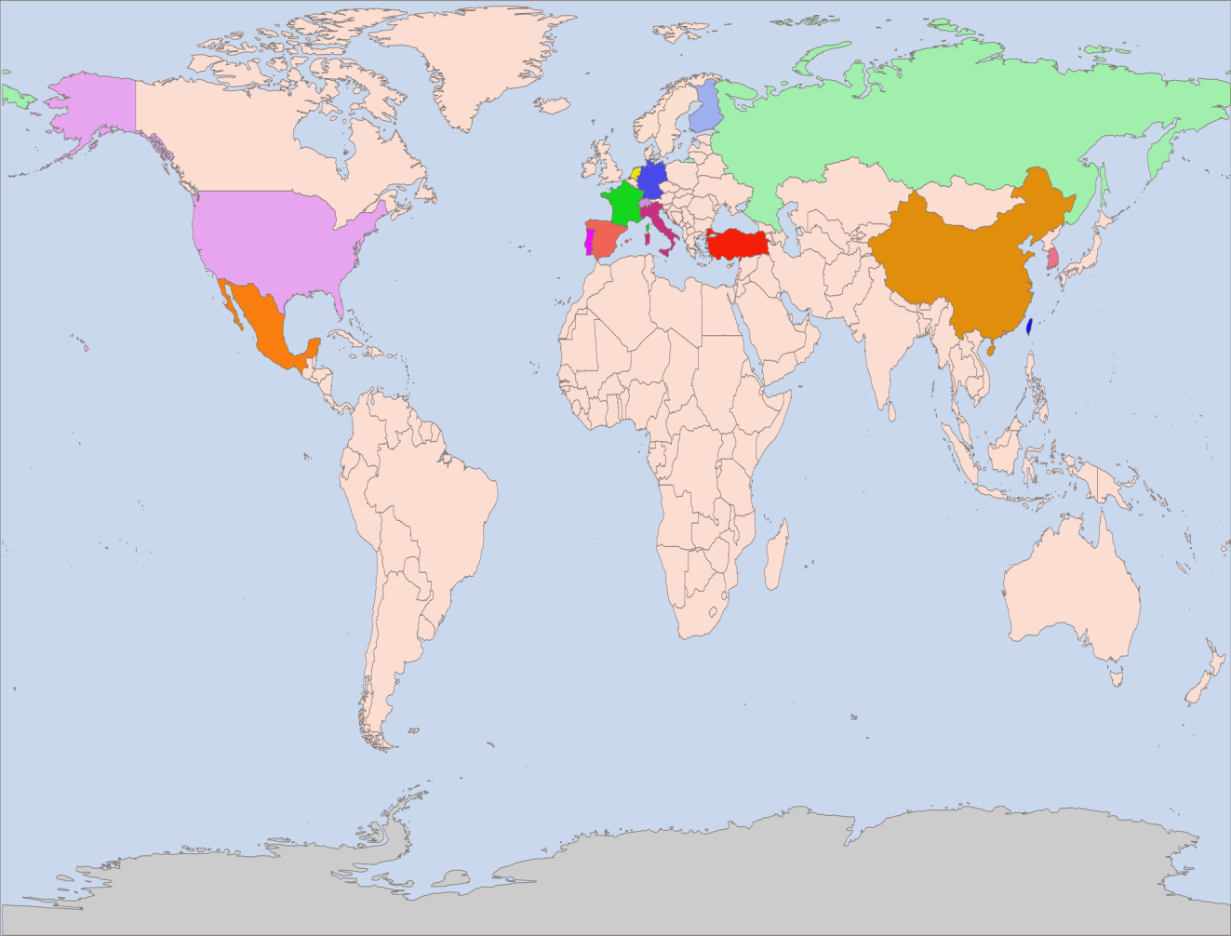
AMS : an International Collaboration
15 Countries, 44 Institutes and 600 Physicists
FINLAND
UNIV. OF TURKU
RUSSIA
NETHERLANDS
ITEP
KURCHATOV INST.
ESA-ESTEC
NIKHEF
GERMANY
RWTH-I.
KIT - KARLSRUHE
USA
KOREA
MIT - CAMBRIDGE
NASA GODDARD SPACE FLIGHT CENTER
NASA JOHNSON SPACE CENTER
UNIV. OF HAWAII
UNIV. OF MARYLAND - DEPT OF PHYSICS
YALE UNIVERSITY - NEW HAVEN
FRANCE
EWHA
KYUNGPOOK NAT.UNIV.
LUPM MONTPELLIER
LAPP ANNECY
LPSC GRENOBLE
TURKEY
CALT (Beijing)
IEE (Beijing)
IHEP (Beijing)
NLAA (Beijing)
SJTU (Shanghai)
SEU (Nanjing)
SYSU (Guangzhou)
SDU (Jinan)
METU, ANKARA
PORTUGAL
SWITZERLAND
LAB. OF INSTRUM. LISBON
ETH-ZURICH
UNIV. OF GENEVA
SPAIN
CIEMAT - MADRID
I.A.C. CANARIAS.
ITALY
TAIWAN
ASI
IROE FLORENCE
INFN & UNIV. OF BOLOGNA
INFN & UNIV. OF MILANO-BICOCCA
INFN & UNIV. OF PERUGIA
INFN & UNIV. OF PISA
INFN & UNIV. OF ROMA
INFN & UNIV. OF TRENTO
ACAD. SINICA (Taipei)
CSIST (Taipei)
NCU (Chung Li)
MEXICO
UNAM
Notes:
2
2

Slide 3
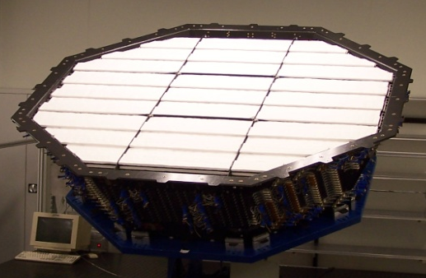
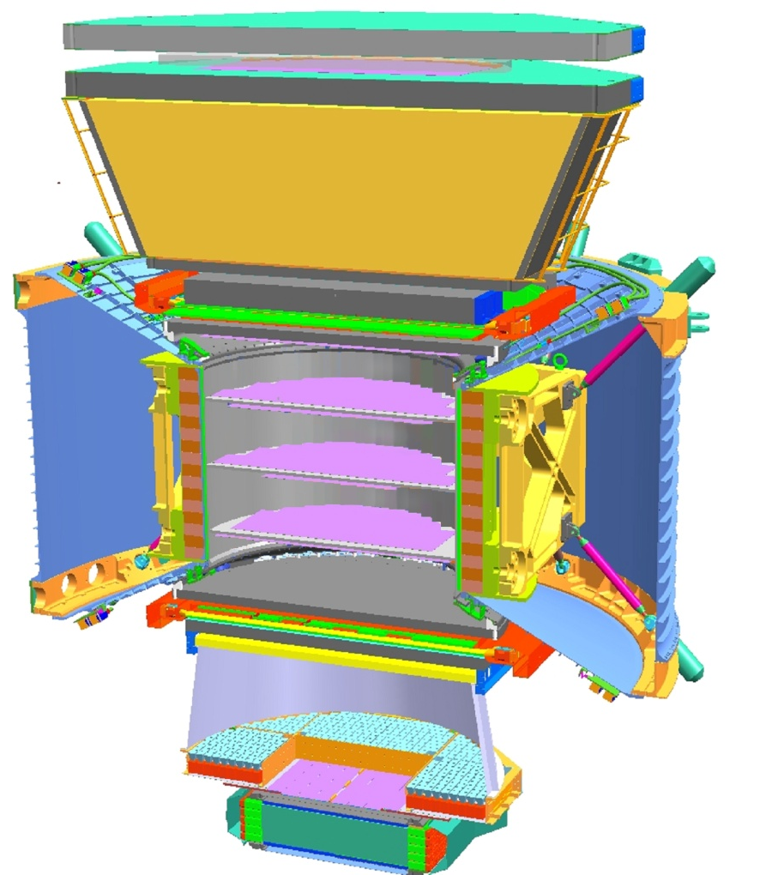
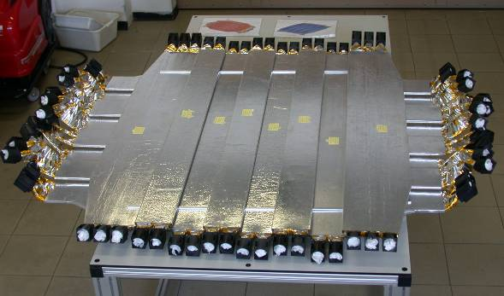
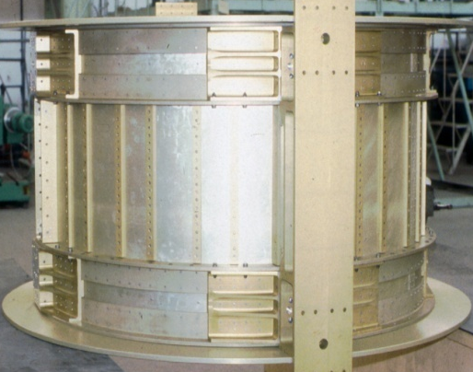
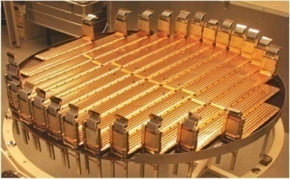
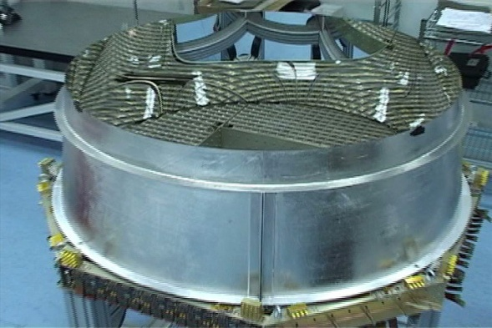
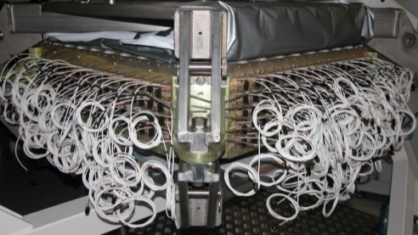
AMS: A TeV precision, multipurpose spectrometer in space
TRD
Identify e+, e-
Particles and nuclei are identified by their
charge (Z) and energy (E ~ P)
TOF
Z, E
1
TRD
Magnet
±Z
Silicon Tracker
Z, P
TOF
2
3-4
5-6
Tracker
7-8
TOF
RICH
Z, E
RICH
3D imaging ECAL
E of e+, e-, γ
9
ECAL
5m x 4m x 3m 7.5 tons
Z, P are measured independently from Tracker, RICH, TOF and ECAL
6
Notes:
3
3
3

Slide 4
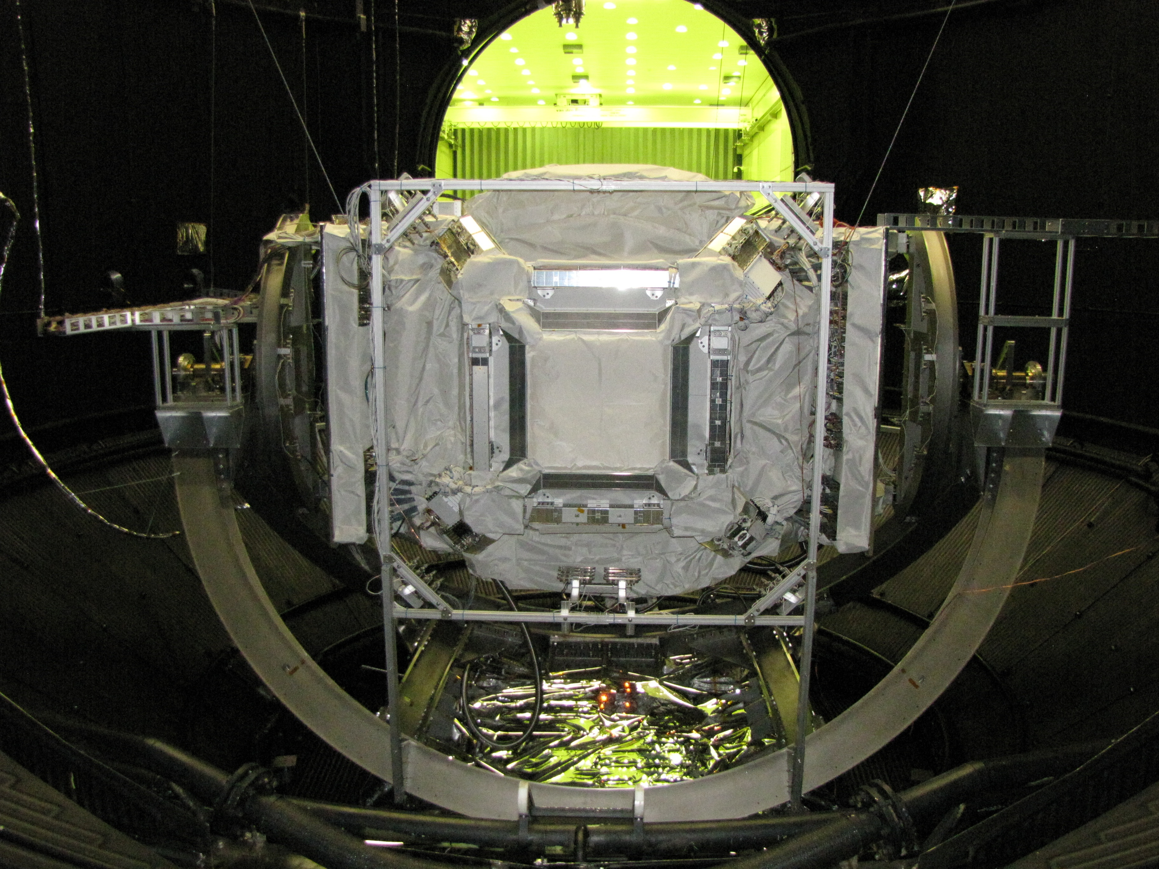
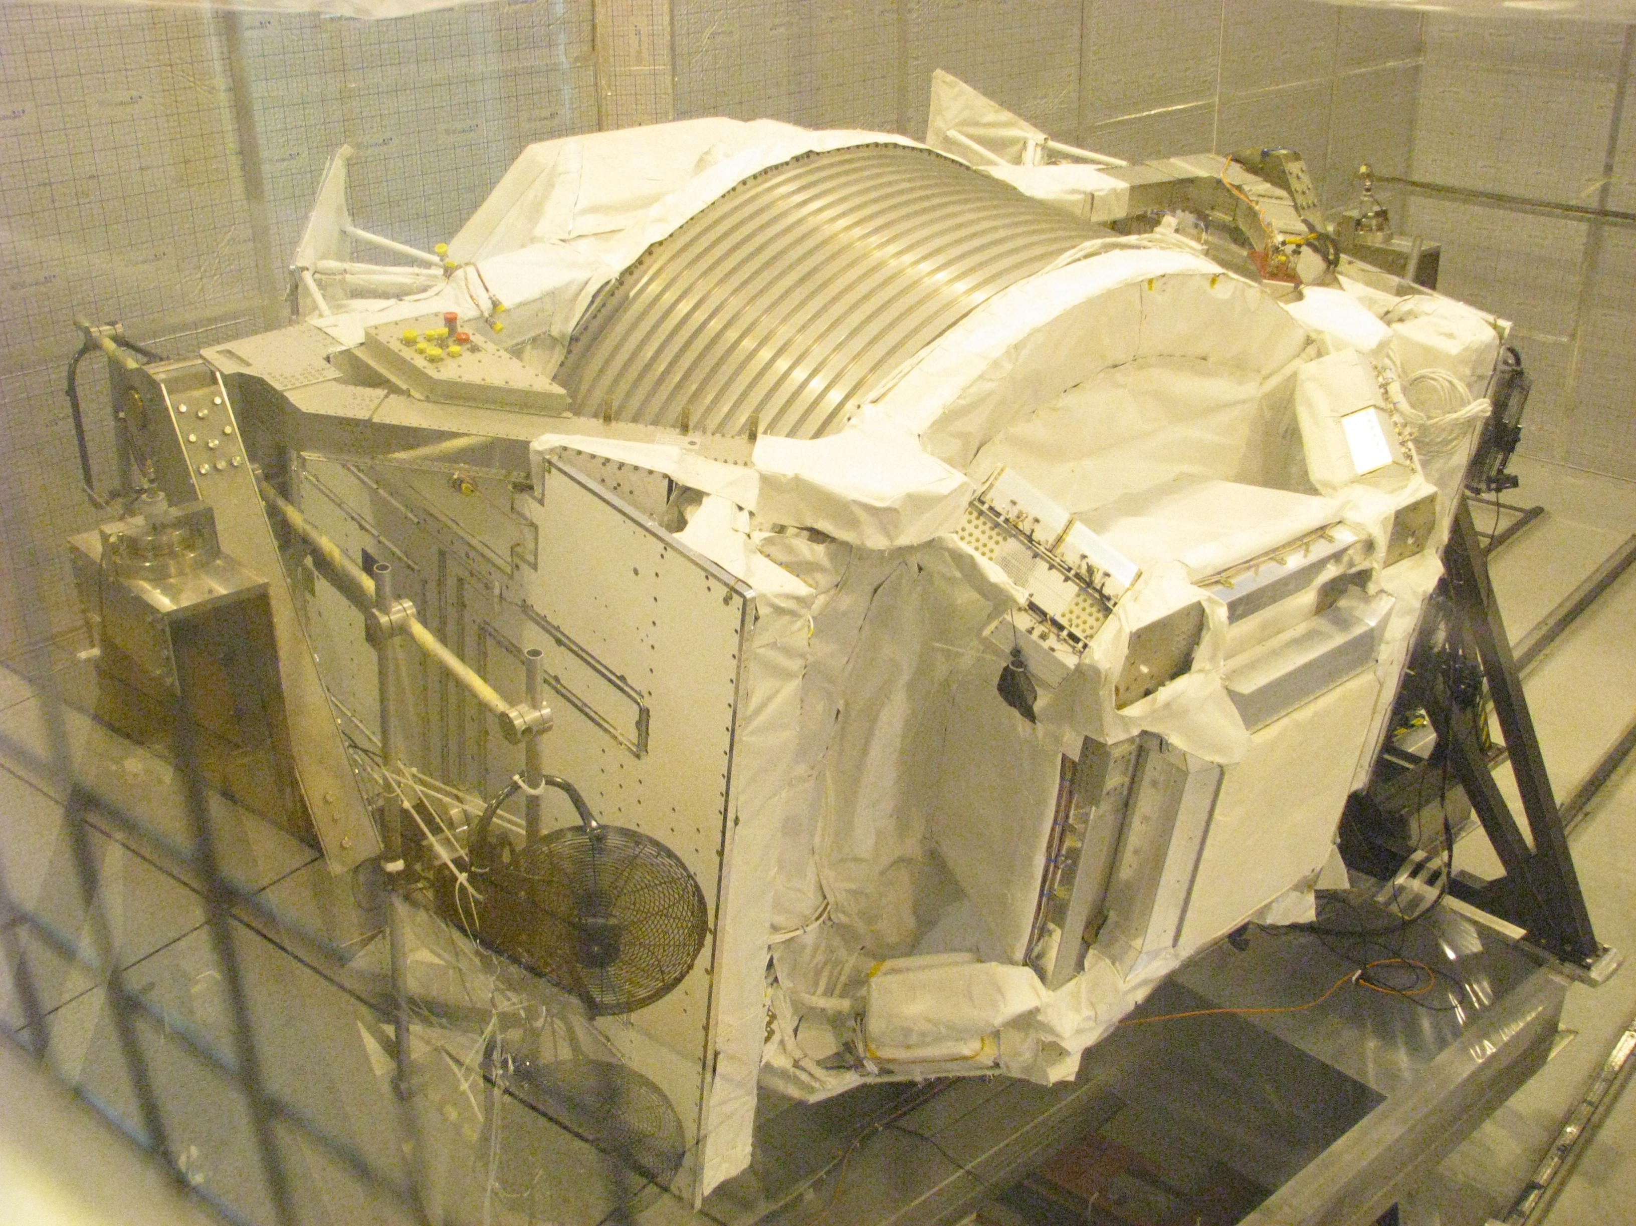
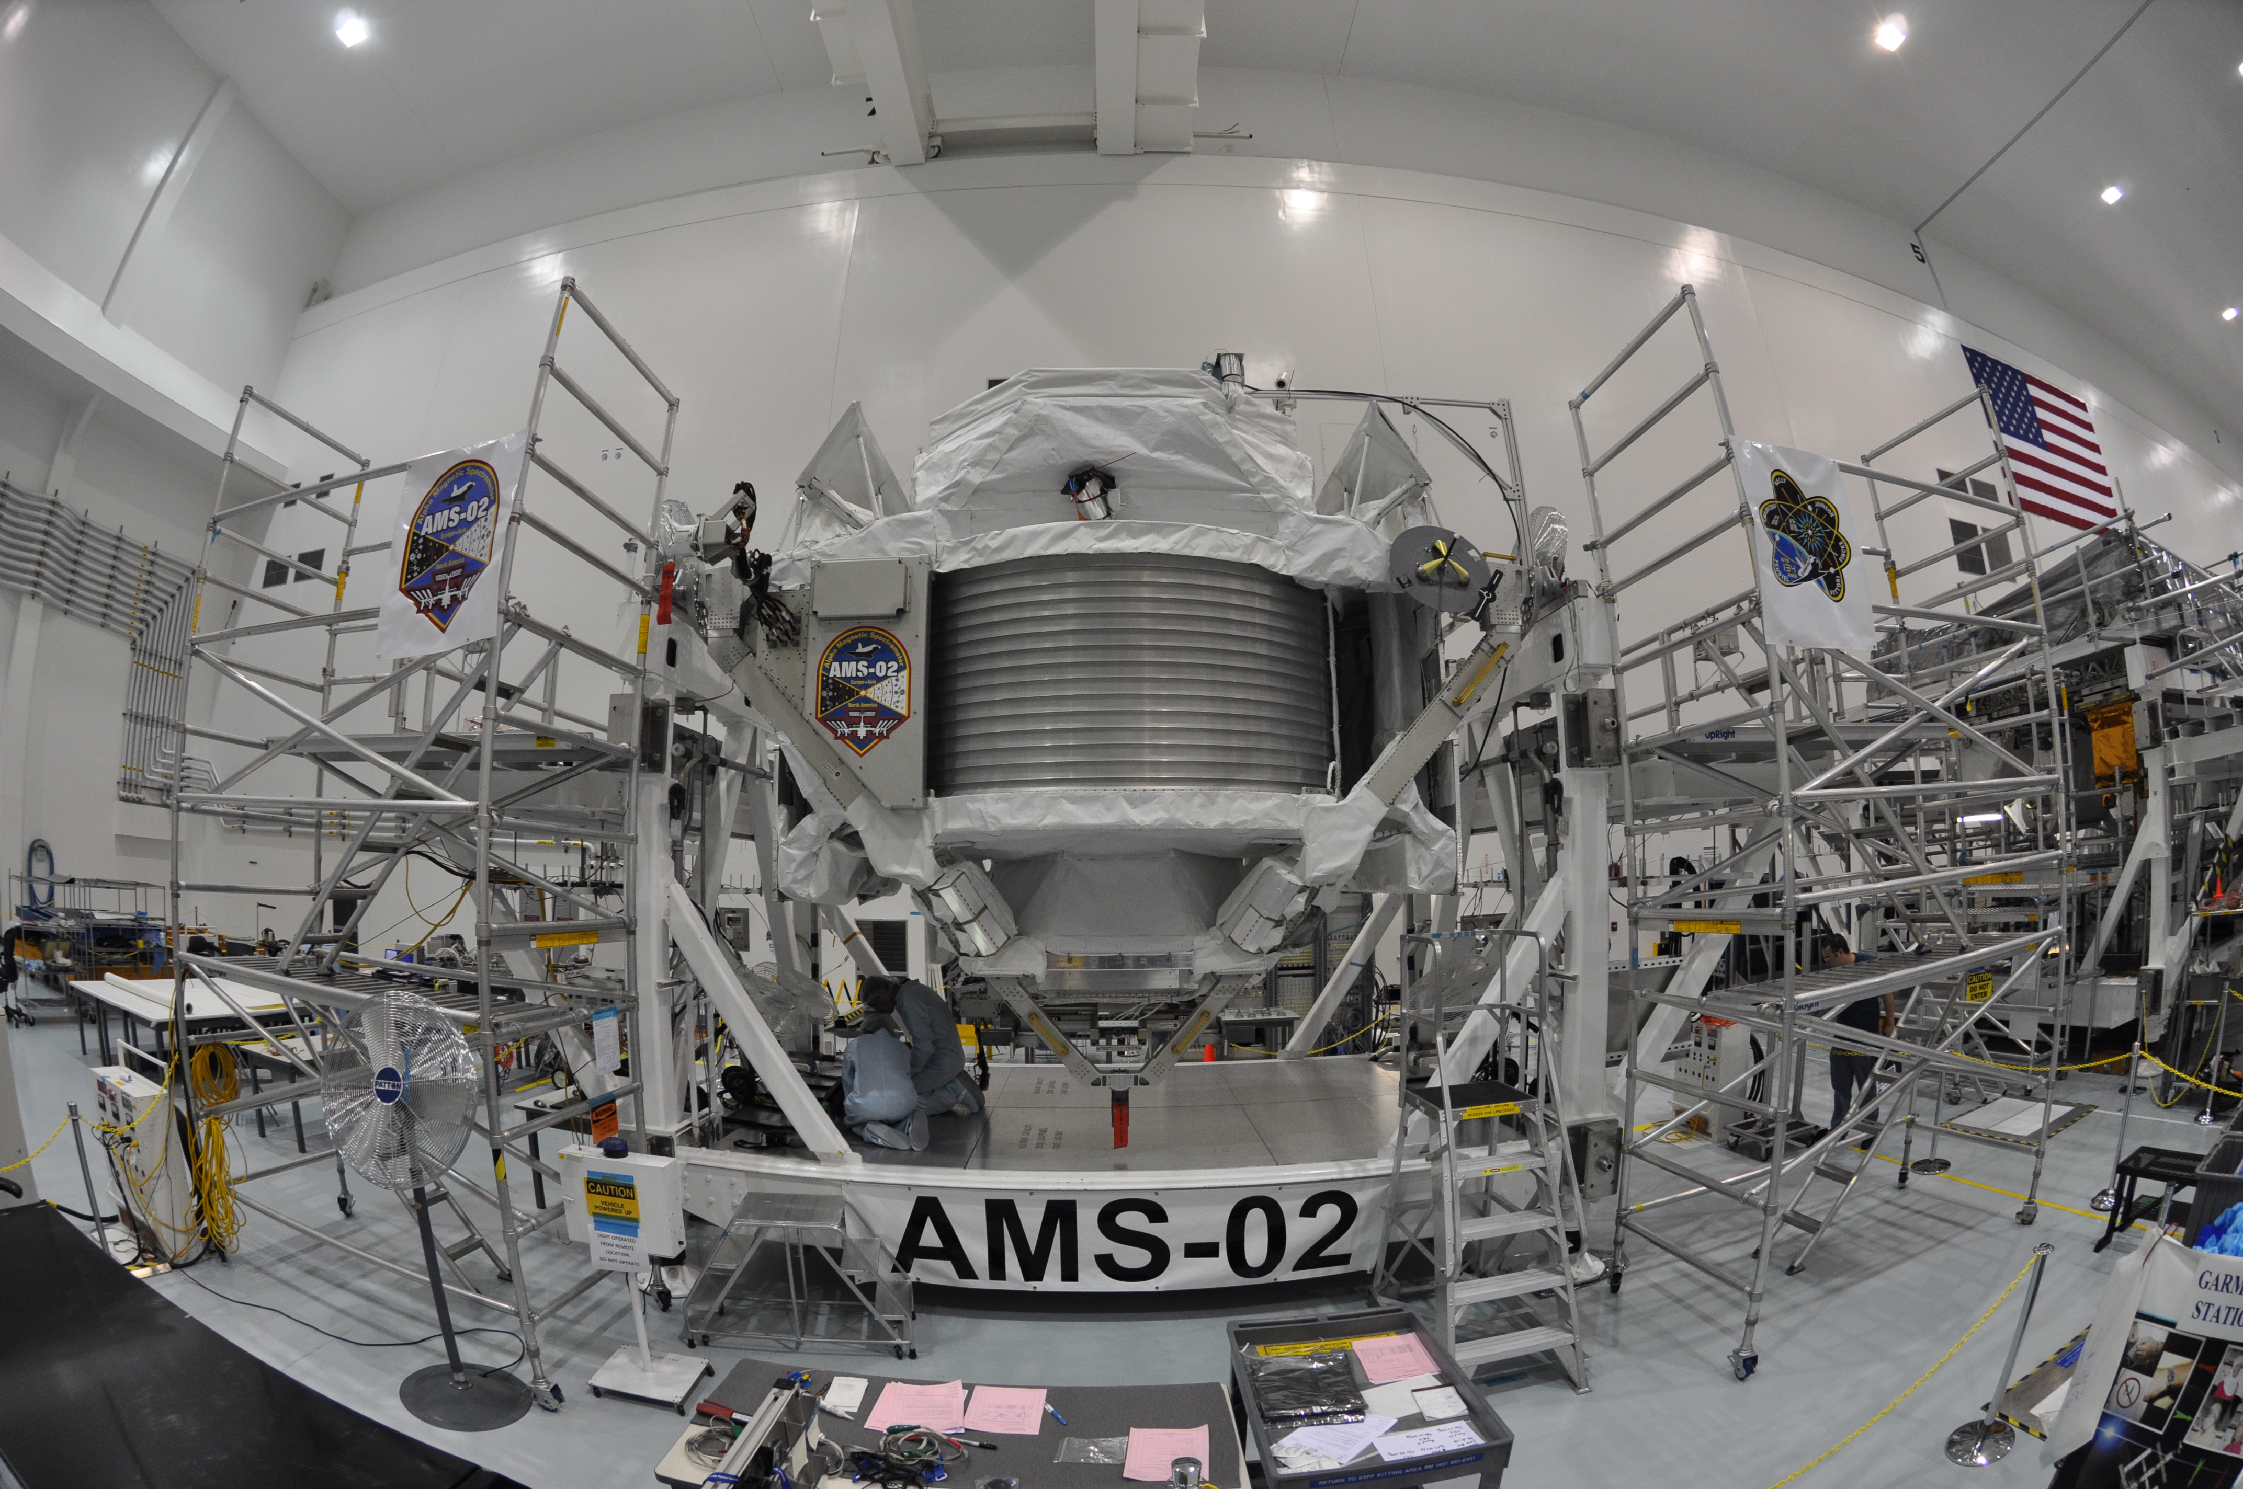
Extensively tested before the launch
For each subdetector : Engineering Model (EM) and the Flight Model(FM)
EM : 2001-2005
  (qualification tests and Test beam 2002-2004)
FM :
  2006->2008 Ecal Standalone (Test beam 2007 => Calor 2008)
  2008-2009 :AMS Assembly
Thermal Vacuum Tests,330 hours
Test Beam(e+,e--,Protons@400 GeV, pions)
KSC , cosmic rays
ESA, April, 2010, ESTEC, Noordwijk
NASA, Cape Canaveral,
30 August 2010 – March 2011
CERN, 8-20 August 2010,

Slide 5
Outline
Introduction
Nuclei flux measurements (LPSC et al, 2 postdoc: CNRS,Enigmass, 2 Phd Université Grenoble-Alpes)
  Hydrogen, Helium nuclei
  Boron/carbon
Positron fraction, positron and electron fluxes (LAPP et al, 3 postdocs: CNRS, CNES, ANR, 3 PhD Université Grenoble-Alpes)
Summary
References: Phys.Rev.Lett. 110 (2013) 14, ICRC2013, EPS2013
1

Slide 6
AMS Physics Potential
Searches for primordial antimatter:
  Anti-nuclei: anti He, …
Dark Matter searches:
  e⁺ , e± , anti p , γ…
  simultaneous observation of several signal channels.
Searches for new forms of matter:
  strangelets, …
Measuring CR spectra – refining propagation models;
Study effects of solar modulation on CR spectra over 11 year solar cycle
…
2

Slide 7
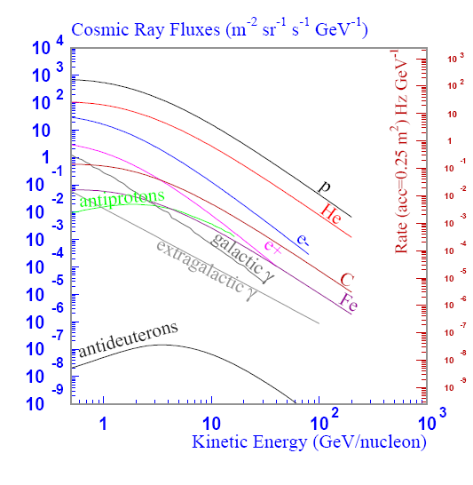
Cosmic Ray Flavors (balloons, PAMELA,..)
Power law E^{-γ} γ [2-3.5]
Protons : 88 %
Proton ~ 1
Helium ~ 10 ⁻⁻¹
Electron ~ 10 ⁻⁻²
Positron ~ 10 ⁻⁻³
Carbon ~ 10 ⁻⁻⁴
Antiproton ~ 10 ⁻⁻⁴
Iron ~ 10 ⁻⁻⁵
3

Slide 8
Cosmic Ray Issues
Production = Primaries (protons, Nuclei, e-, …) from the sources (Super Novae Remnant, Pulsar Nebula, ..)
  E ^{-α} α~2
Propagation and diffusion
  E ^{–δ} δ~ [0.3-0.8]
Secondaries
  C, O spallation within the Interstellar Medium
    C + (p,He)_{IM} → B + ... Boron, Be, Li,
  He and H nuclei interacting with the Interstellar Medium
    p + (p,He)_{IM} → e+ + Positrons, Anti protons , …..
20 kpc
2-6 kpc
Diffusive galactic halo
4

Slide 9
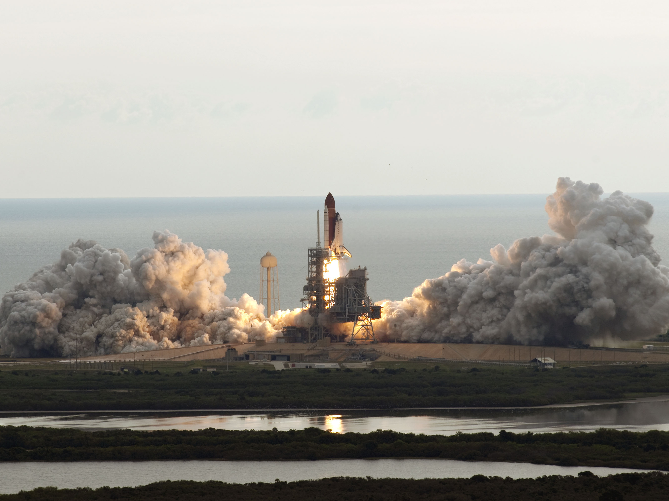
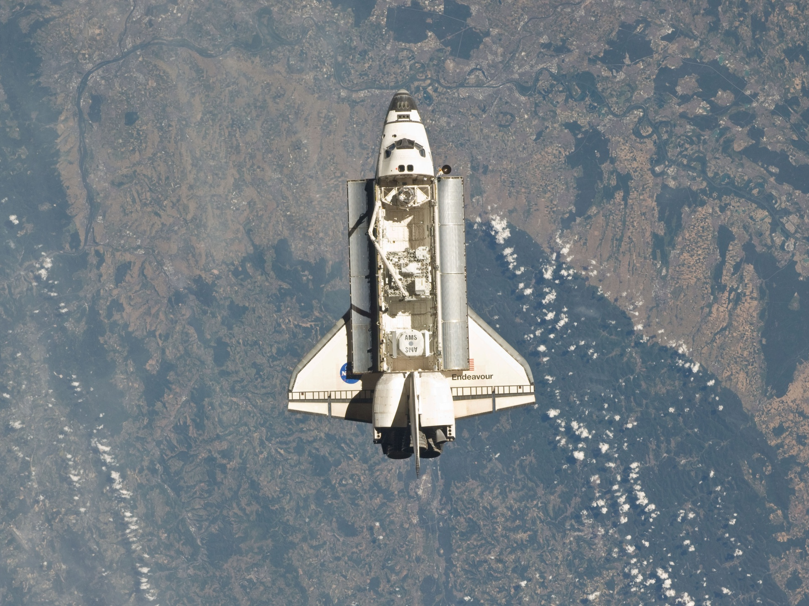
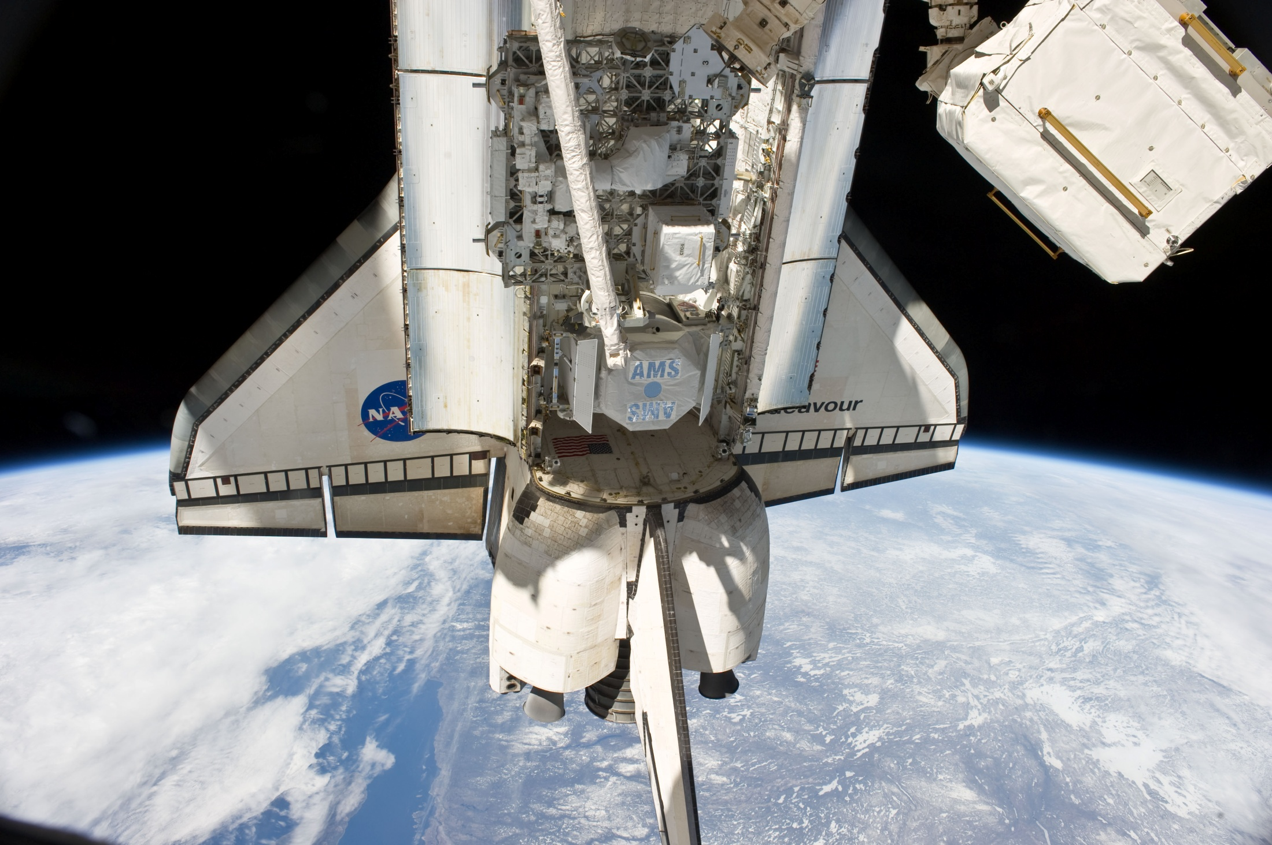
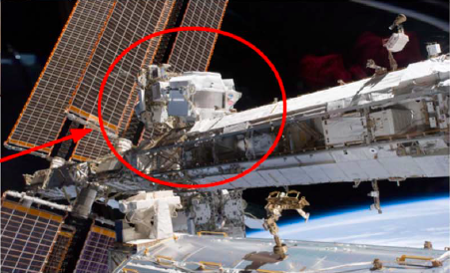
AMS02 – May 2011
              Endeavour approaches the International Space Station
Cape Canaveral, May 16 2011.
STS 134 Mission, Launch of Endeavour Shuttle
Endeavour approaching the
International Space Station (ISS ~300 km)
Cape Canaveral,STS-134 launch
May 16, 2011
May 19 2011
AMS installation completed on ISS at 5:15 CDT,
start taking data 9:35 CDT Until …. 2020
(CDT Central Daylight Time)
AMS02 is grappled by the Shuttle
Remote Manipulator System (SRMS)
May 19, 2011
7

Slide 10
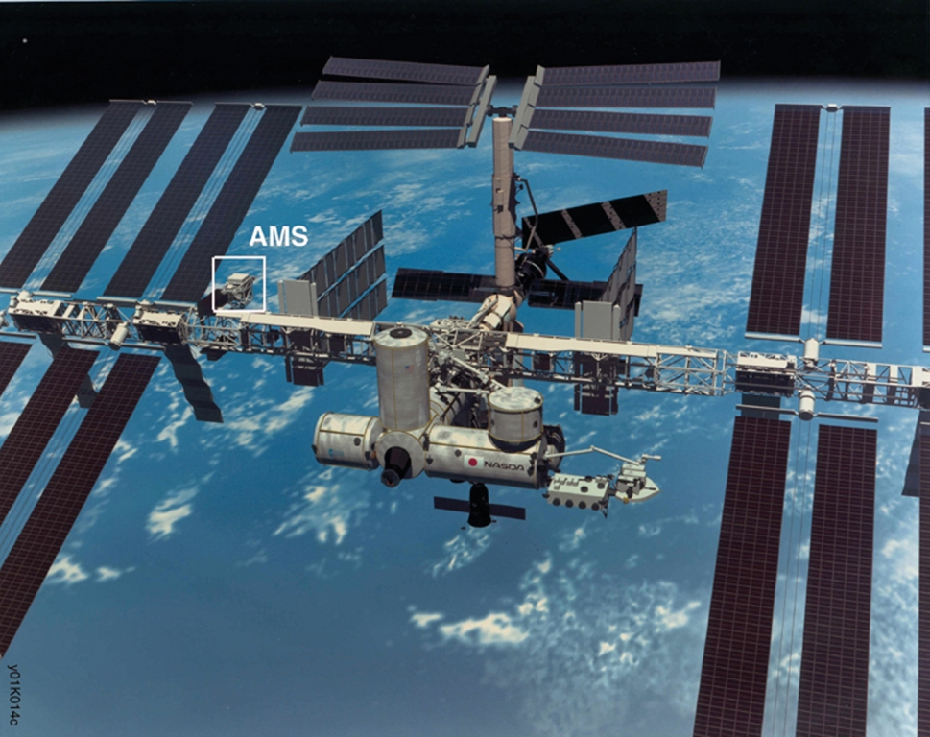
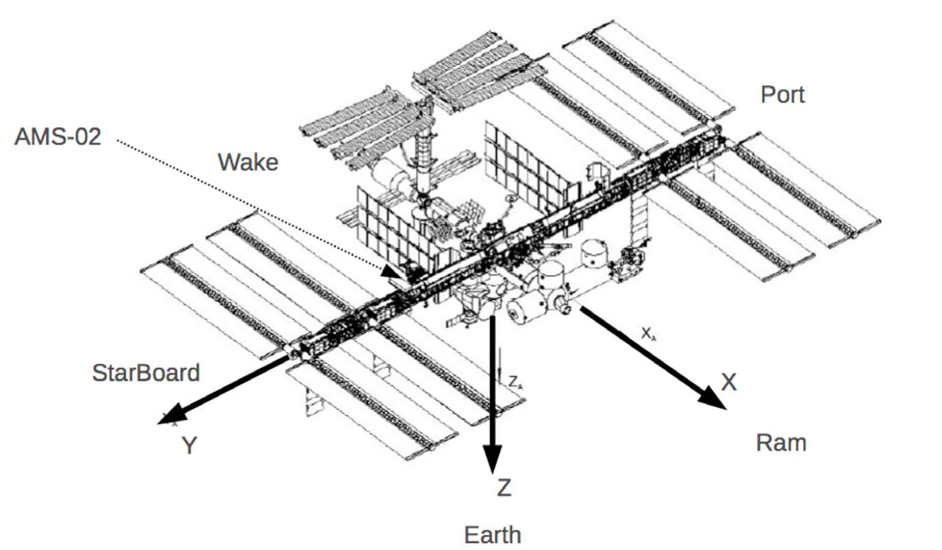
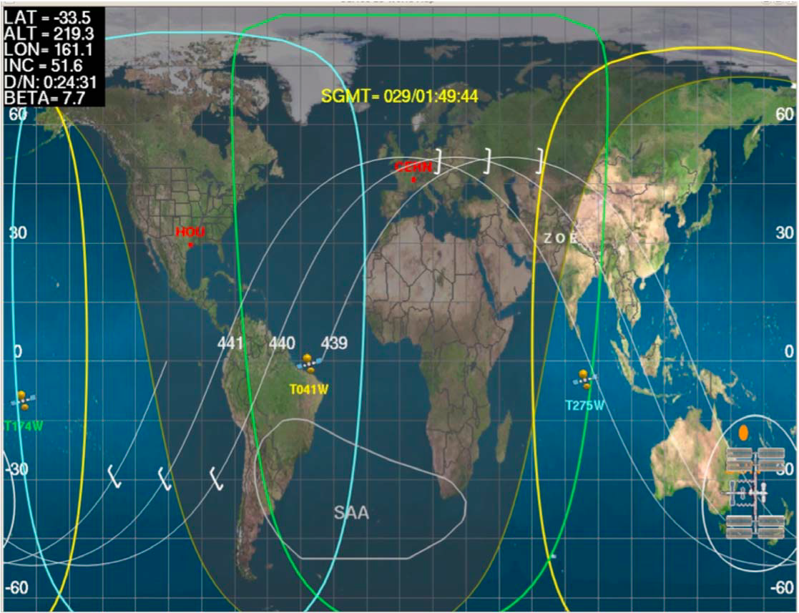
ISS orbit
Movement direction from wake to ram
ISS velocity: 8km/s, one orbit every 90 mn
Altitude 340-400 km
ISS orbits
8

Slide 11
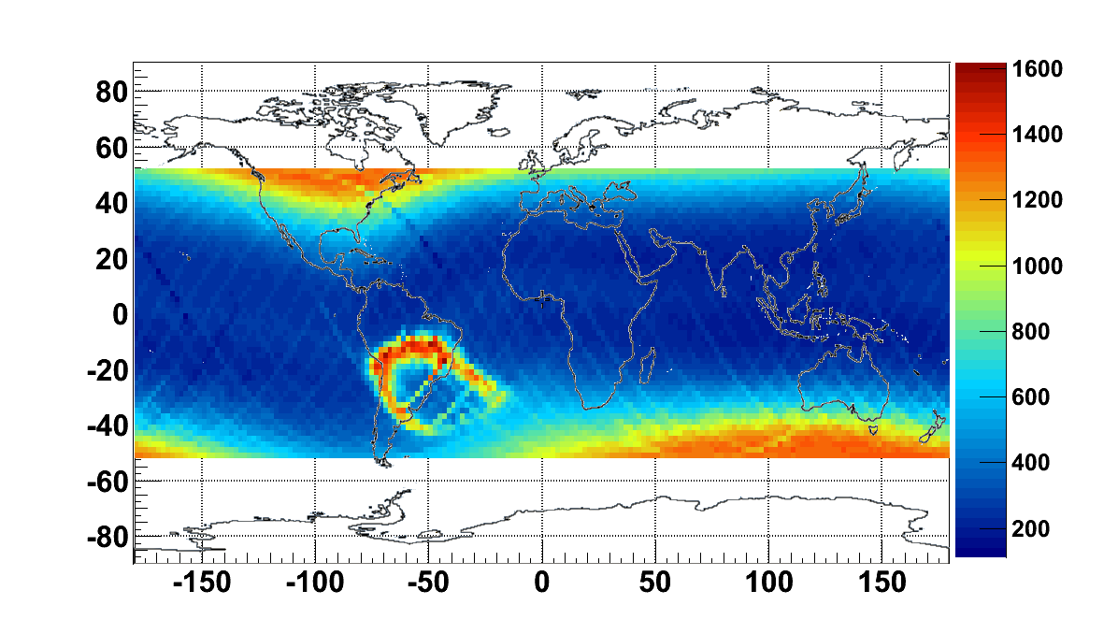
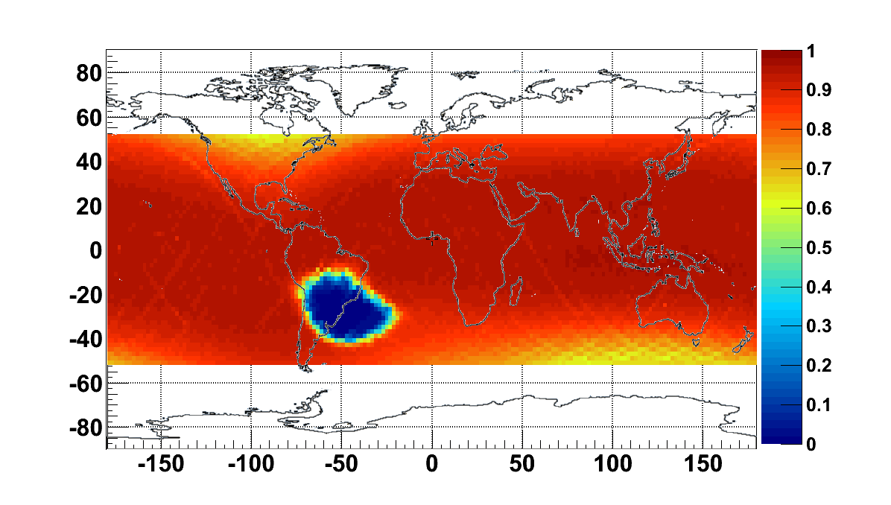
Orbital DAQ parameters
Latitude (⁰)
Acquisition rate [Hz]
Particle rates vary from
200 to 2000 Hz per orbit
On average:
DAQ efficiency 85%
DAQ rate ~700Hz
Longitude (⁰)
Latitude (⁰)
DAQ efficiency
Longitude (⁰)
9

Slide 12
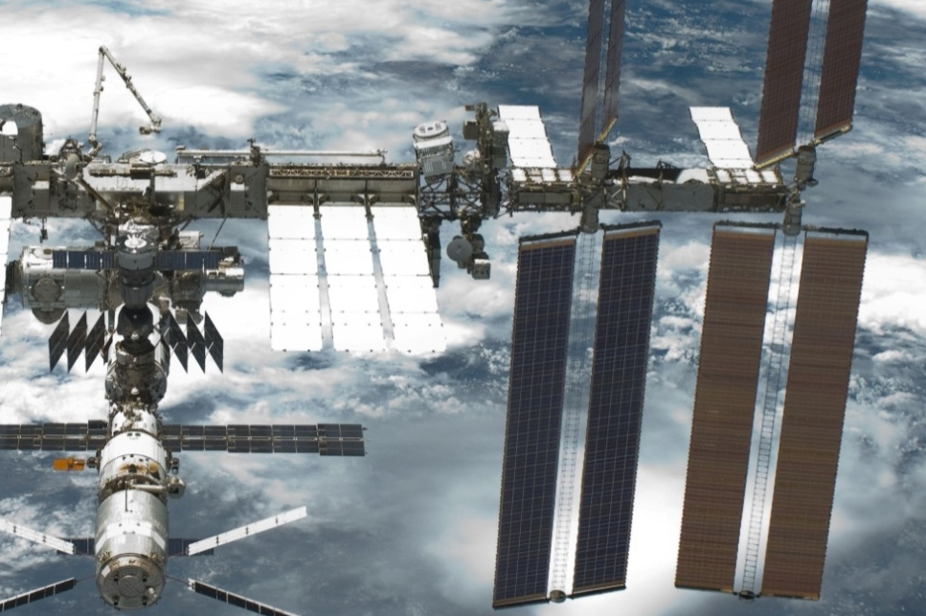
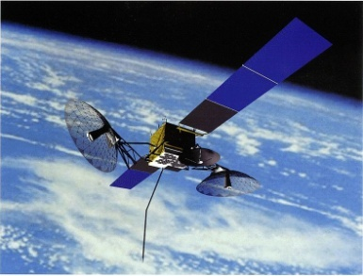
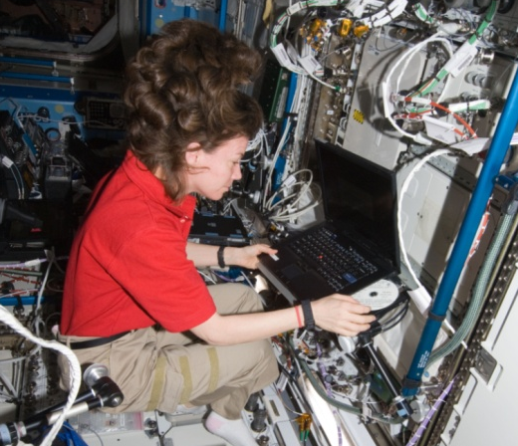
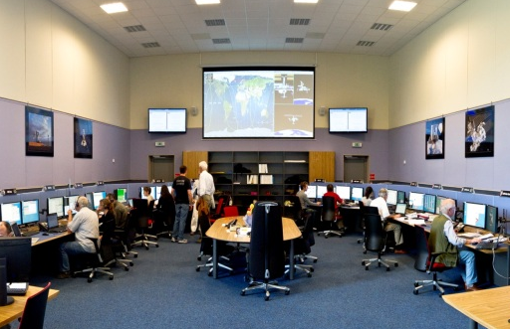
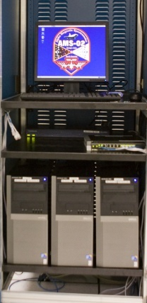
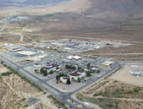
AMS Data Flow
AMS
TDRS Satellites
Ku-Band
High Rate (down):
Events <10Mbit/s>
S-Band
Low Rate (up & down):
Commanding: 1 Kbit/s
Monitoring: 30 Kbit/s
Astronaut at ISS AMS Laptop
White Sands Ground Terminal, NM
AMS Payload Operations Control and Science Operations Centers
(POCC, SOC) at CERN since June 2011
AMS Computers
at MSFC, AL
10

Slide 13
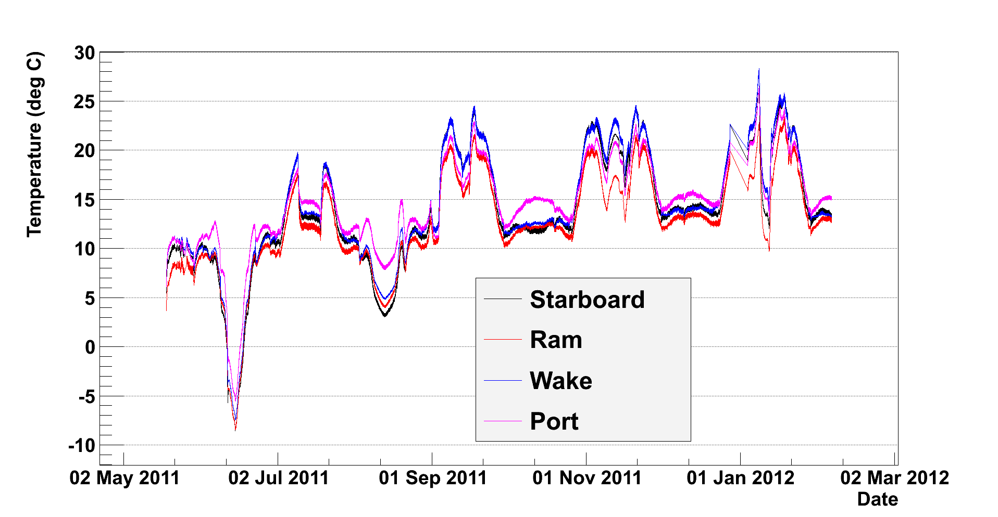
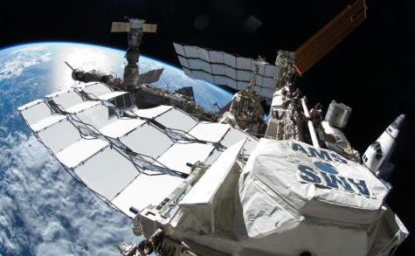
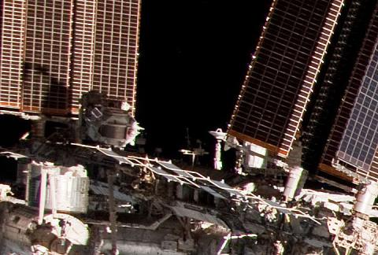
The thermal environment on the ISS is constantly changing due to:
Ecal – Temperature variation :-10⁰C-28⁰C
A) The position of the Sun
A
SUN
B
Port
orbit plane
AMS
Starboard
C
B)
Visiting Vehicles
Soyuz or Progress
C) Solar Array Positions
Main Radiator
13
11
13

Slide 14
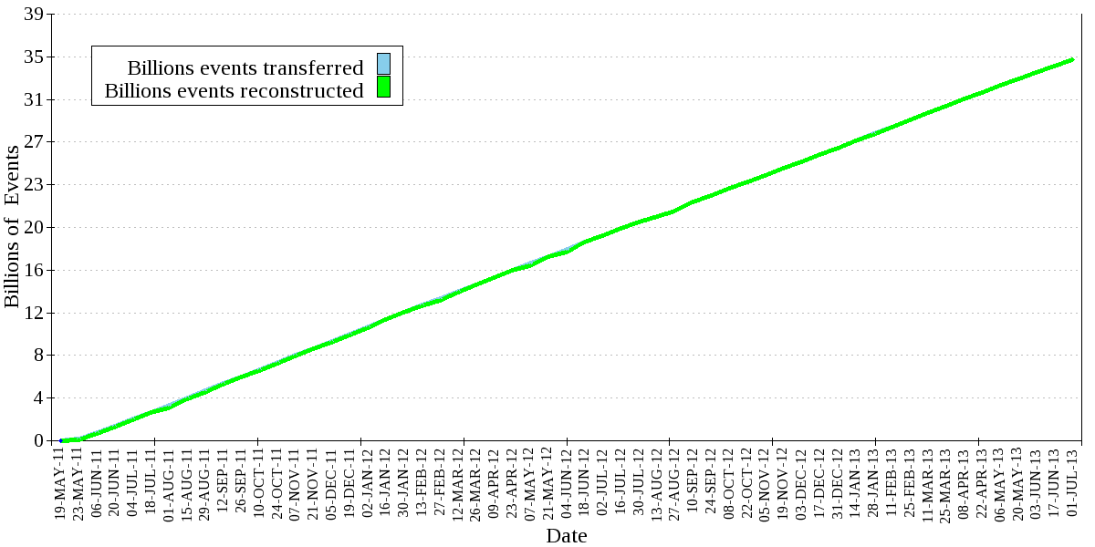
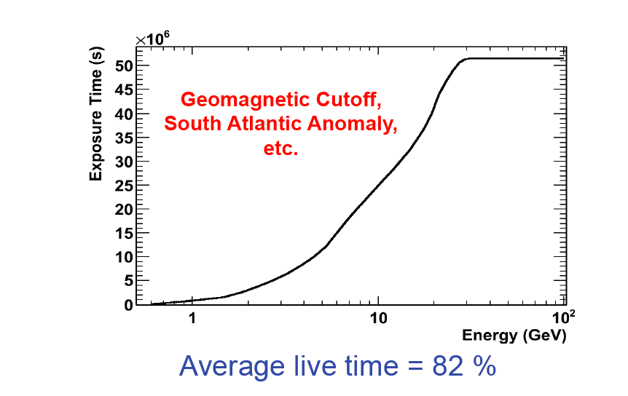
Data sample and data taking time
Data take from : 19 May 2011 to : 19 May 2013 (1.5 or 2 years)
Total exposure time : T_{exp.} (Rigidity > 25 GV) = 51.2 ✕ 10⁶ s
25 billion events are used
in the present analysis
~up to now: 48 billions of data
20 years of operation foreseen
12

Slide 15
AMS-02 Trigger
Trigger efficiency is estimated with an unbiased trigger sample.
.
ACC
UToF
MAGNET
LToF
ECAL
Horizontal Particle
Rejected
High-Z particle
Accepted
TOF + ECAL Trigger
Accepted
13

Slide 16
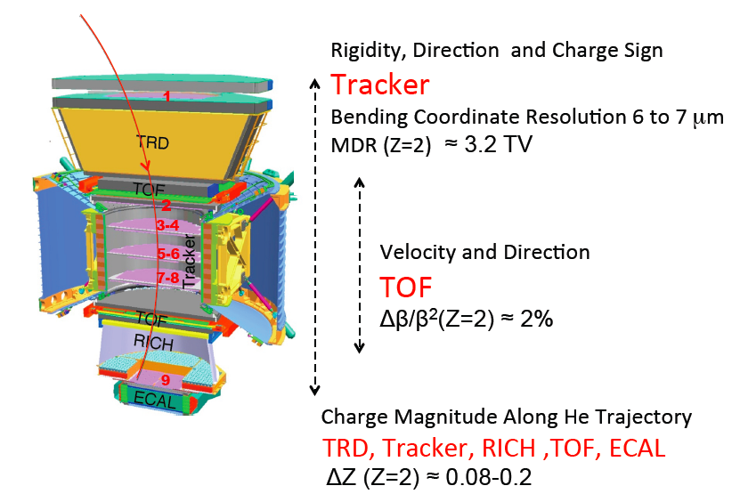
AMS-02 Nuclei Properties Measurement
14

Slide 17
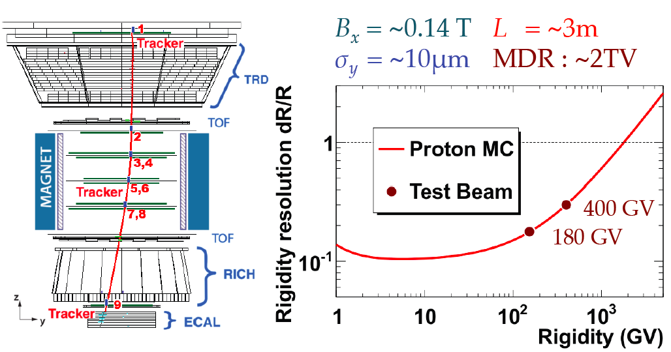
Rigidity measurement
100% relative error for the rigidity
So called Maximum Detectable Rigidity(MDR)
15

Slide 18
Charge Measurement
16

Slide 19

Charge measurement (|Z|)
Carbon (Z=6)
ΔZ (cu)
1
Tracker Plane 1 (L1)
0.30
TRD
TRD
0.33
TOF
Upper TOF (1 counter)
0.16
2
3-4
5-6
Inner Tracker (L2-L8)
0.12
Tracker
7-8
TOF
Lower TOF (1 counter)
0.16
RICH
RICH
0.32
9
ECAL
Tracker Plane 9 (L9)
0.30
17

Slide 20
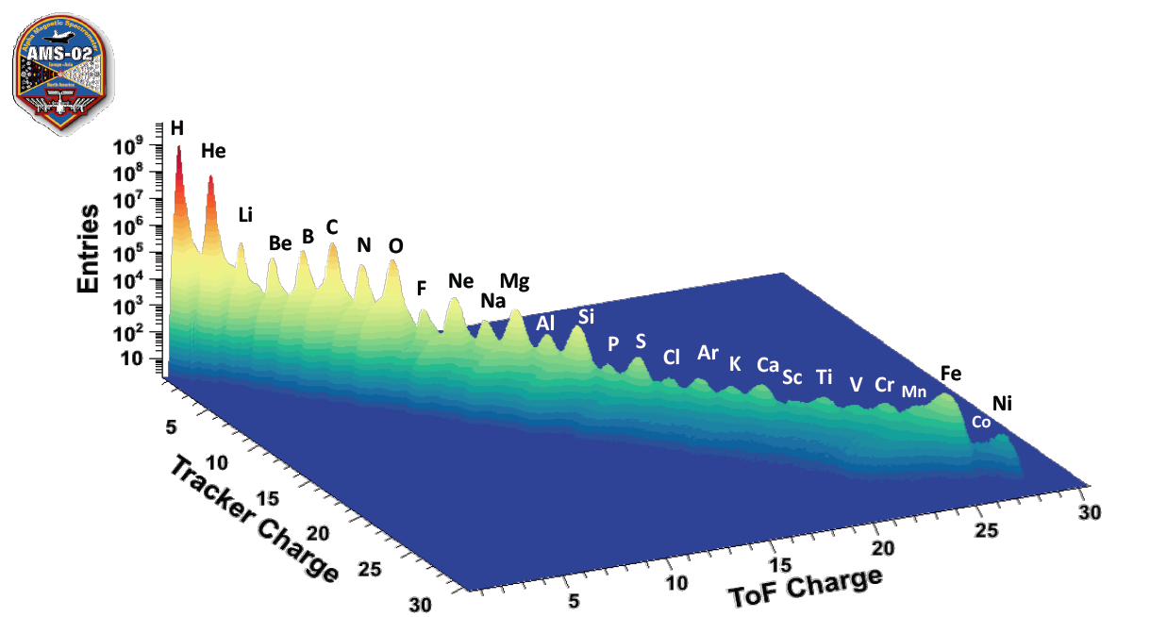
Nuclei Identification in AMS: ToF and Tracker
18

Slide 21
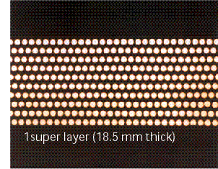
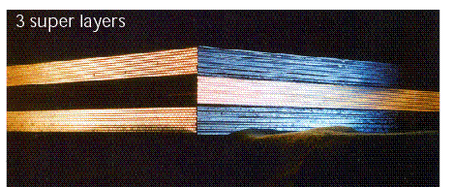
ECAL : Description
A 3-D sampling calorimeter made of
lead foils and scintillating fibers
One Super Layer
Lead (58%), Scintillating fibers (33%),
Optical glue (9%), Density ~ 6.8 g/cm3
Dimensions 648x648x167 mm
9 super layers : 4 in The X view and 5 in the Y views
Weight: 661 kg (“pancake” 512 kg)
Acceptance : 0.06 m²sr
18.5mm
z
particle direction
3D Imaging
Calorimeter
17 X₀
λ_{I}/X₀ ~22
Energy range 8 MeV To 1 TeV
y
x
21
19

Slide 22
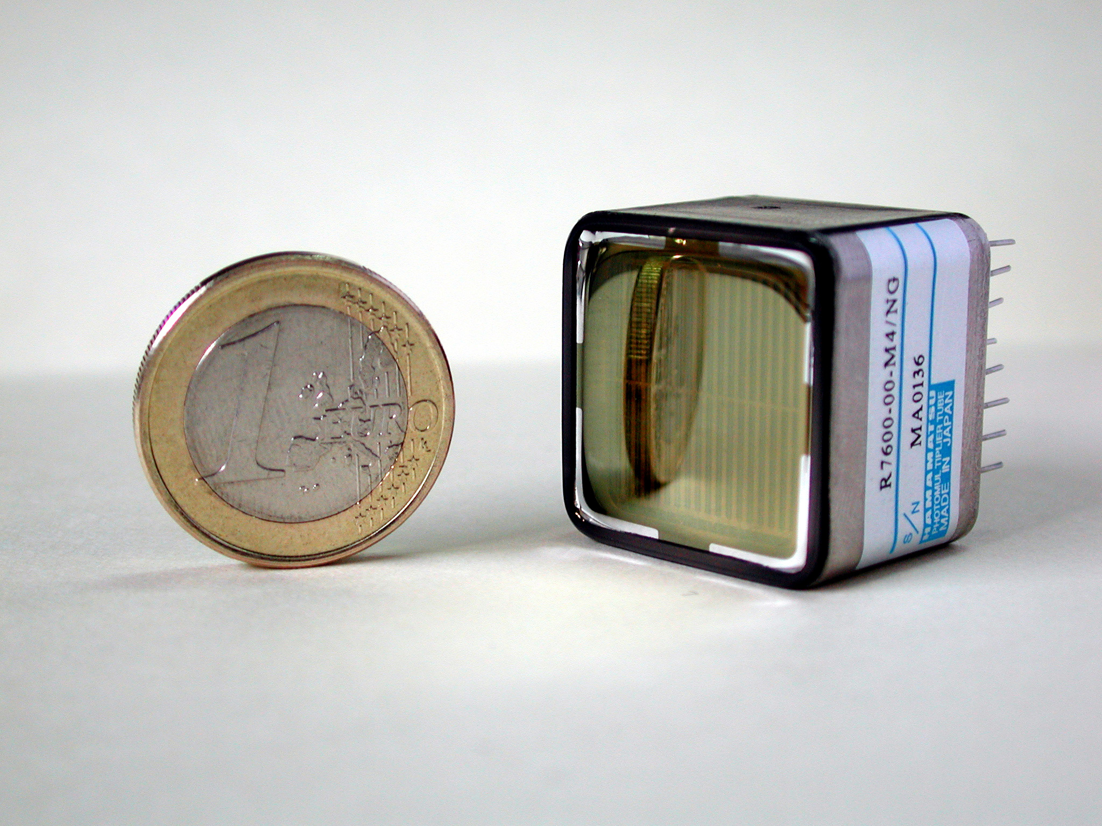
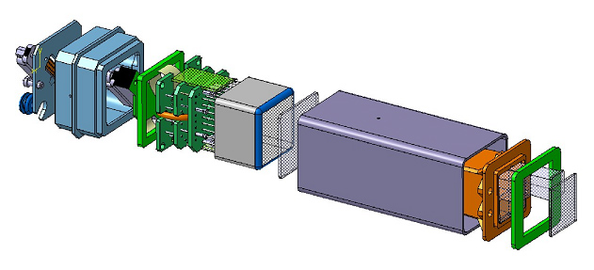
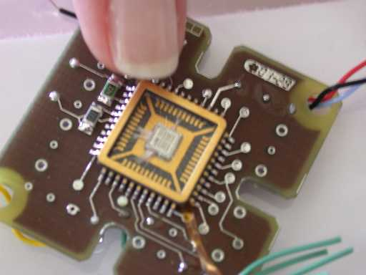
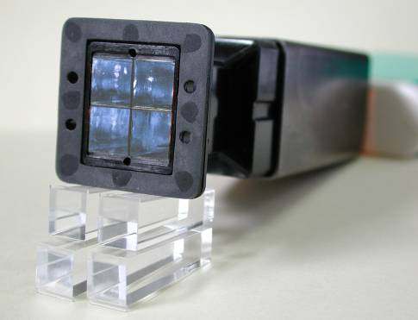
Front End and light collection system
- Robust (fulfill space constraints)
- Compact (70 mm long)
- Light (67 kg)
- Low Power consumption (12W)
HV Divider
PMT
Shielding
Front End Board with an ASIC
Calorimeter
Light guides
30 mm

Slide 23
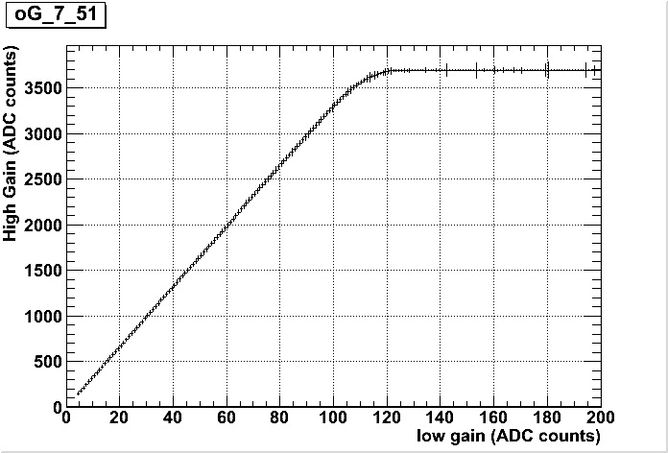
Front End electronics dependence with temperature
  Variation: Anti-correlated
  with temperature: - 0.36 ‰ per ^{O}C
Saturation
Slope = Gain Ratio

Slide 24
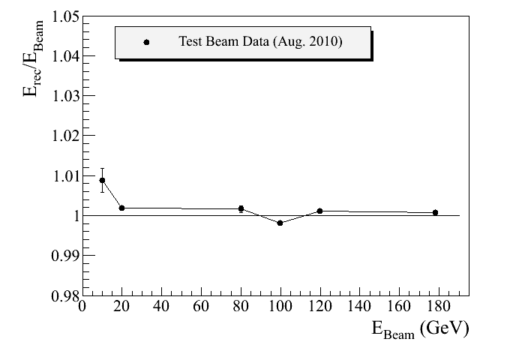
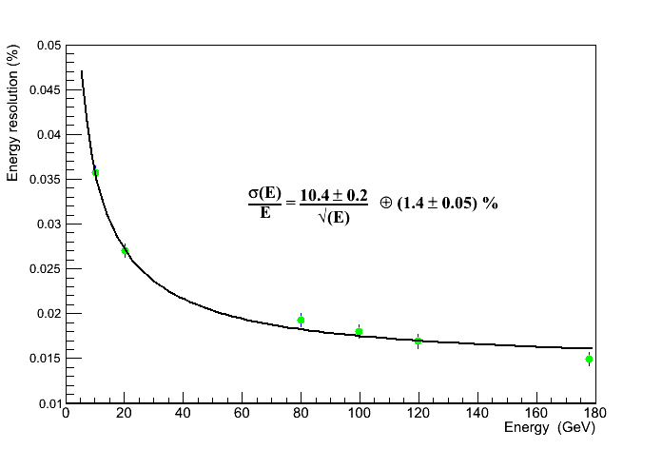
Energy Linearity and Energy resolution
Linearity better than 1%
Energy resolution better than 2 % for Energy>80 GeV
Test beam Data (Aug 2010)
20

Slide 25
Flux and Ratio measurements
Flux is given by:
Number of counts
Bin Width
Acceptance
(m² sr)
Efficiency(trigger, selection)
Exposure Time
K_{n} is the kinetic energy per nucleon, or the momentum for electron, positron is measured from TOF and RICH (beta)
or from Tracker (rigidity) or ECAL(leptons)
21

Slide 26
Spectrum unfolding
True
spectrum
Resolution function :
σ= 1/MDR
Measured
spectrum
Entries
Entries
×
=
1/R
1/R
1/R
Deformation
MDR
log(F ✕ R^{γ})
log(F ✕ R^{γ})
Unfolding
log(R)
log(R)
22

Slide 27
Protons - Systematic errors
Acceptance ε_{ac} = 2.8 %
Trigger efficiency ε_{trg.}= 1.0 %
Track reconst. Efficiency ε_{trk.}= 1.0 %
Total systematic errors of normalization :
ε_{norm.} = (ε_{acc}² + ε_{trg}² + ε_{trk}² ) ^{½} = 3.1 %
Systematic error of unfolding
ε_{unfold} < 1 % at R < 200 GV
ε_{unfold} = 5.4 % at R = 1 TV
P
γ
e
E_{Ecal} = E_{e}+ E_{γ}
23

Slide 28
Proton Flux
From 1 GV to 1.8 TV
Binning chosen
according to the resolution
Power law behaviour, index > 2.7, > 1000 protons above 1 TV
24

Slide 29
Protons Fluxes
Total Syst. errors
Unfolding errors
Stat. errors
25

Slide 30
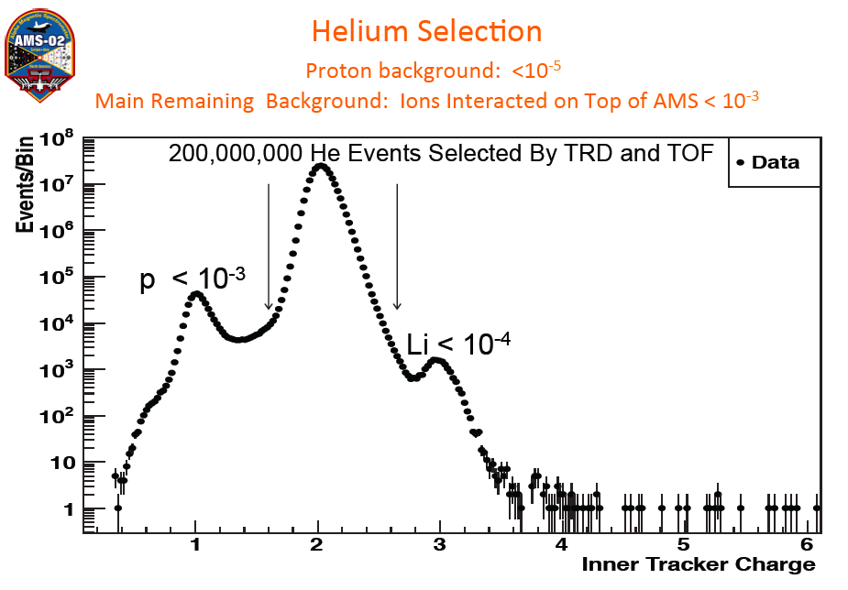
Ams-02 Helium flux
Power law behaviour, index < 2.7
26

Slide 31
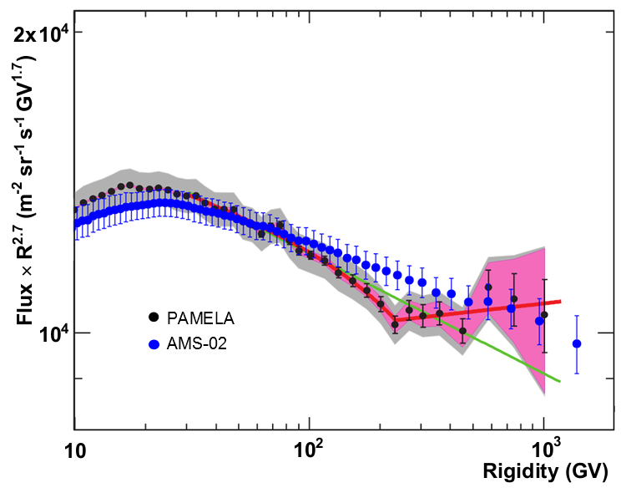
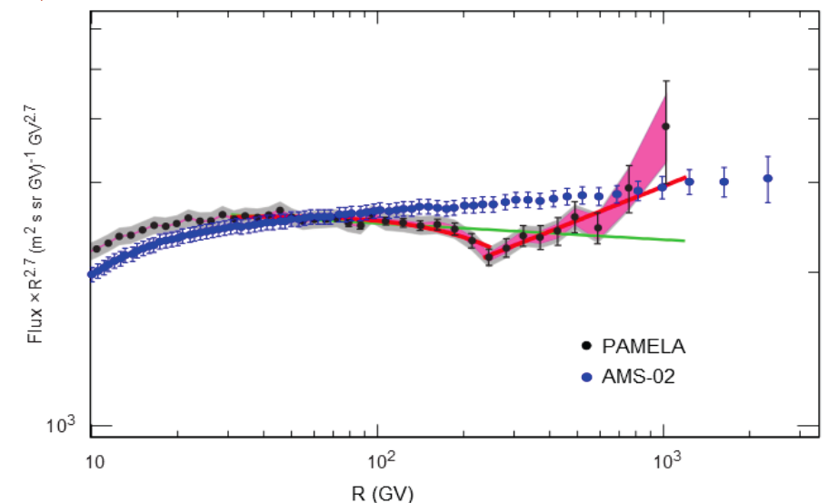
Helium - Comparison with Pamela measurements
H Power law behaviour, index > 2.7
He Power law behaviour, index < 2.7
Protons
Helium
27

Slide 32
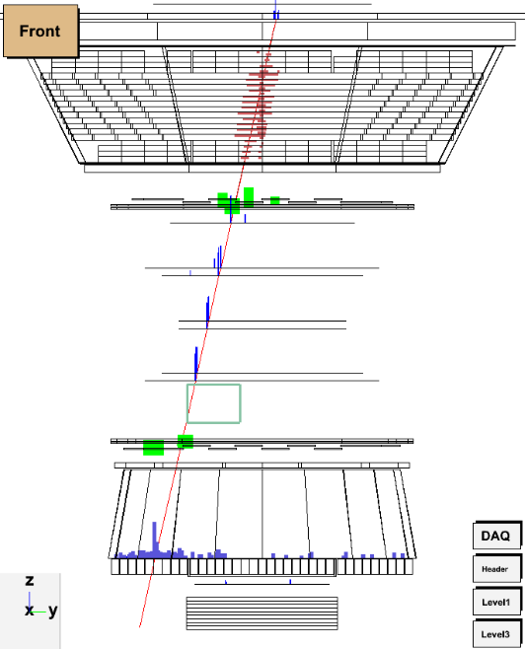
B/C :Identification of Fragmentation Events
Layer 1 = 6.1
Carbon
TRD = 6.0
UTOF = 7.6
Inner = 4.8
R = 10 GV
Boron
LTOF = 5.2
RICH = 5.0
One of the most systematic uncertainty : The fragmentation inside the detector.
The first layer do play a key role in the selection
28

Slide 33
Estimation of the fragmentation B/C
Acceptance is convolution of geometry and fragmentation effects.
Carbon selected with L1 and UTOF. Fragmentation distribution evaluated with LTOF.
Data and MC agreement evaluated being at 2% level.
29

Slide 34
AMS-02 - Boron/Carbon Ratio
30

Slide 35
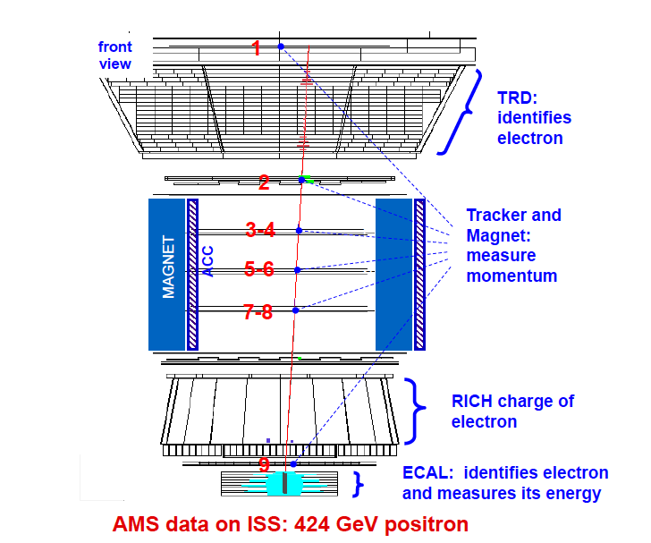



e+,e- Identification in AMS
Proton rejection goal > 1/100000 => 3 independent detectors are used
e⁻
p
MDR=2 TV
31

Slide 36


Proton rejection
ECAL estimator : Boost Decision Tree
based on the 3D shower shape features
83.2-100 GeV
ISS 50-100 GeV
TRD Estimator
350-500 GeV
Hadrons
Leptons
TRD estimator :likelihood based on
the signal amplitude in each layer (20 in total)
Ecal Estimator
32
Notes:
36
36

Slide 37

Electron rejection
Charge confusion average Tracker patterns
2 sources
Multiple scattering and finite resolution of the tracker
Secondary tracks produced along the the path of primary e⁺⁻ (tagged and controlled with the lower TOF)
Good agreement Data/MC
● Data
-- MC
33

Slide 38


Positron fraction
Phys.Rev.Lett. 110 (2013)
Anisotropy
r-<r>/<r>
The relative fluctuations of the ratio across the observed sky map show no evident pattern
6.8 millions of leptons
(170 citations)
34

Slide 39


Propagation Model tests
Independently of the origin of the Source
Medium Model
Minimal Model
Maximal Model
Maximal Model
---- Positron fraction from secondary
------ “+ Dark Matter
• AMS data
---- Positron fraction from secondary
------ “ + Dark Matter
• AMS data
---- Positron fraction from secondary
------ “ + Dark Matter
• AMS data
Excluded
Important to constraint the propagation model parameters to draw any interpretations (B/C and δ)
Important also to look at the positron and electron fluxes separately
36

Slide 40


Impact of the precision of the measurement: shape
If 100% WIMP DM origin
e+ e- from pulsars
I.Colis et al arXiv:1304.1840 [astro-ph.HE]
Di Mauro et al arXiv 1402.0.0321v1
“Dark Matter models in which the WIMP annihilates 100% into e+e- are no longer of producing positron rise in the positron fraction”
37

Slide 41


AMS-02 Electron and Positron fluxes
Index > 3 for electrons
Index < 3 for positrons
Scaled by E³
500 electrons expected in 4 years
above 500 GeV
=> primary sources of positrons
38

Slide 42


Positron flux and Pulsar interpretation
Effect of the propagation Models (P.Salati et al)
39

Slide 43

AMS-02 lepton Flux up to 350 GeV
Scaled by E³
Scaled by E³
The spectral index and its dependence on energy is clearly different from electrons
Statistical errors only
40

Slide 44

First flux measurements by AMS
In the past hundred years, measurements of charged cosmic rays by balloons and satellites have typically contained ~30% uncertainty.
AMS will provide cosmic ray information
with ~1-3% stat. uncertainty.
The 30 times improvement in accuracy will provide new insights.
The Space Station has become a unique
platform for precision physics research.
41

Slide 45


AMS Physics in the next 10 years
Positron, electron, lepton fluxes up to the TeV
B/C and heavy Nuclei up to the TeV ranges : test of the propagation model
Anti proton ratio and fluxes
Anti Matter flux
Positron fraction sensitivity In 10 years
pbar /p sensitivity in 10 years
Nearby Pulsars
Positron fraction
DM or 1 pulsar
Secondaries
42

Slide 46
Summary
AMS02 is operating on the ISS since the 19th May 2011 and has collected more than 40 billions of events: All AMS subsystems are fully operational and behaves as expected.
Variations of ambient conditions (temperature in first place) are accounted for, with proper calibrations and alignments
For most of the measurements, systematics uncertainties are estimated from the data thanks to the redundancy of AMS-02
Proton flux from 1 GV to 1.8 TV and Helium flux from 2GV to 3.2GV for have been measured by AMS during the first two years of operation on ISS
  In high rigidity region (R > 100 GV) : The spectra are consistent with a single power law and shows no structure nor break
B/C ratio has been measured between 05 to 670 GeV/n. the behaviour at high energy will become more clear with more statistics
Positron fraction has been measured from 0.5 to 350 GeV using the first 6.8 million positron and electrons. Nearby Primary positron sources are needed to explain the measurement.
An electron spectrum in the energy 1-500 GeV and and a positron spectrum in the energy range 1-300 GeV were shown with different spectral indices of electrons and positrons. Systematic errors being under study. The behaviour at high energy will become more clear with more statistics.

Slide 47
Errors and binning
Total Syst. errors
Unfolding errors
Stat. errors
Binning chosen
according to the resolution

Slide 48


Daily flux
Stat. Error < ~1%
(1 < R < ~20 GV)
Daily flux
Average

Slide 49

Daily normalized flux
R < ~30 GV : Variation due to
the solar modulation and solar events
9 Aug.2011 (X6.9)
27 Jan. 2012 (X1.7)
7 Mar. 2012 (X5.4)
17 May 2012 (M5.1)

Slide 50

Helium Nuclei Selection

Slide 51
Isotopic Fraction Evaluation
RICH evaluates the isotopic composition of Boron.
This fraction is used for the Tracker rigidity → kinetic energy conversion.
¹¹B/(¹¹B + ¹⁰B) = 0.7 ± 0.1 → ~ 1% systematic error on ratio

Slide 52

Positron fraction AMS
Results of the fit to the data in the energy range 1 to 350 GeV yields:
γ_{e-} − γ_{e+} = −0.63 ± 0.03, i.e., the diffuse positron spectrum is less
energetic than the diffuse electron spectrum;
γ _{e-} − γ _{S} = 0.66±0.05, i.e., the source spectrum is more energetic than the diffuse electron spectrum;
C_{e+} /C_{e-} = 0.091 ± 0.001, i.e., the weight of the diffuse positron flux amounts to ∼10% of that of the diffuse electron flux;
C_{S} /C_{e-} = 0.0078 ± 0.0012, i.e., the weight of the common source constitutes only ∼1% of that of the diffuse electron flux;
1/Ε_{s} = 0.0013 ± 0.0007 GeV⁻¹,
corresponding to a cutoff energy of 760⁺¹⁰⁰⁰ GeV.
=> Primary positrons are needed

Slide 53
Impact of the precision of the measurement: shape
If 100% WIMP DM origin: different branching ratio scenarios can be tested
I.Colis et al arXiv:1304.1840 [astro-ph.HE]
+ AMS data
+ AMS data

Slide 54

Pulsar as potential sources of the positron excess

Slide 55

Pulsar as potential primary positron sources

Slide 56

SNR acceleration and propagation as potential primary positron sources

Slide 57


Slide 58


Slide 59


Slide 60

Rigidity measurement (R=pc/Ze)
Challenges:
Alignment feature: Inner and external layers (due to the temperature variations on the ISS)
Track resolution depends on the number of layers included in the reconstruction
Span: Inner Tracker(L2->L8)
Span: Inner Tracker+Layers L1 and L9
19

Slide 61

Tracker Alignement Occuracy
18

Slide 62







Thermal Control
TRD
24 Heaters
82 Temperature Sensors
TOF & ACC
16 Heaters
64 Temperature Sensors
MS has no control of ISS orbits and movements of Solar Panels and Radiators.
1
Magnet
68 Temperature Sensors
TRD
Silicon Tracker
32 Heaters
142 Temperature Sensors
TOF
2
3-4
5-6
Tracker
7-8
TOF
RICH
RICH
16 Heaters
96 Temperature Sensors
ECAL
16 Heaters
80 Temperature Sensors
9
ECAL
Temperatures must be kept within limits. There are 1118 temperature sensors and 298 heaters
62
13
Notes:
62
62
62
62

Slide 63

Representative bins of the positron fraction
44

Slide 64



Positron mode : features and strategy
Particle Physics
(annihilation modes)
=
Positron flux
(Signal in data)
×
Propagation effect: probed zones for e+,e- within 1-4 kpc
Boost factor: over densities (clumps)
Background
protons : Φ_{p}∼ 10 ³⁻⁴ * Φ _{e+}
electrons : Φ_{e-}∼ 10 * Φ _{e+}
48

Slide 65


Anisotropy Measurements
Selected events are grouped in 5 cumulative energy bins:
16-350, 25-350, 40-350, 65-350 and 100-350 GeV
Their arrival directions are used to build sky maps in the galactic coordinate(b,l)
55

Slide 66

Anisotropy Measurements
r-<r>/<r>
The relative fluctuations of the ratio across the observed sky map show no evident pattern
The coefficients of the multiple expansion are found to be consistent with the expectations from isotropy.
Upper limits on the dipole parameter δ are set.
- After 20 years a sensitivity of the order of 0.014 is expected ⬄ could it constraint the pulsar component ?
56

Slide 67
Positron fraction
Positrons:
Φ_{e}+ = C_{e}+ E^{−γe+} + C_{s}E^{−γs} e^{-E/Es}
Secondaries plus source component
Electrons :
Φ_{e}- = C_{e}- E^{−γe-} + C_{s}E^{−γs} e^{-E/Es}
Secondaries+ Astrophysics primaries (SNR+..) plus the same source component
Positron source components: pulsars, Dark matter , secondaries near the SNR…
47

Slide 68


AMS-02 - Boron and Carbon Fluxes
BORON
CARBON
AMS-02
HEAO
TRACER
31

Slide 69



Pulsars: Possible sources of primary positrons
Mechanism : the spinning B of the pulsar strips electrons that emit gamma => production of e+e- pair that are trapped in the cloud, further accelerated and later released
The pulsar must be young (< 10⁵ years) and nearby (<1 kpc)
Predicted Flux:
16% of the pulsar energy goes into e+e- pairs for all the pulsars
Di Mauro et al arXiv 1402.0.0321v1
Positron Spectrum
Or
I.Colis et al arXiv:1304.1840 [astro-ph.HE]
Using also the constraint on e+ + e- data
Important to measure the positron and electron spectrum separately
Anisotropy for both electrons and positrons (r:distance, t=age

Slide 70
Cosmic Ray Issues
γ = α + δ ≈ 2.7 (Nuclei)
E^{-α}
Source spectrum
Injection rate
E^{-γ}
Measured
CR density
N_{cr}(E)
τ(E)
Q_{cr}(E)
E^{-δ} Diffusion/
confinement
time
α = 2.0 … 2.4
Measured spectrum index (γ) results from :
  Production/acceleration mechanism (α)
  Diffusion term (δ)
δ = 0.3 … 0.7
5

