Slide 1
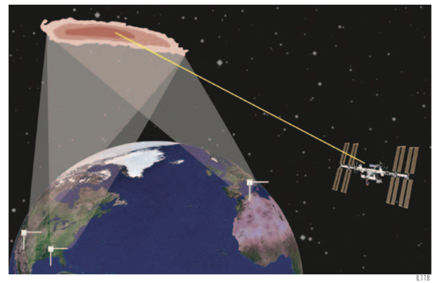

ISS-Lobster: A Future Observatory for the Multi-Messenger Era
Judy Racusin (NASA/GSFC)
On behalf of the ISS-Lobster Team
PI: Jordan Camp (NASA/GSFC)
GRBs in the Multi-Messenger Era -- Paris -- June, 16 2014

Slide 2
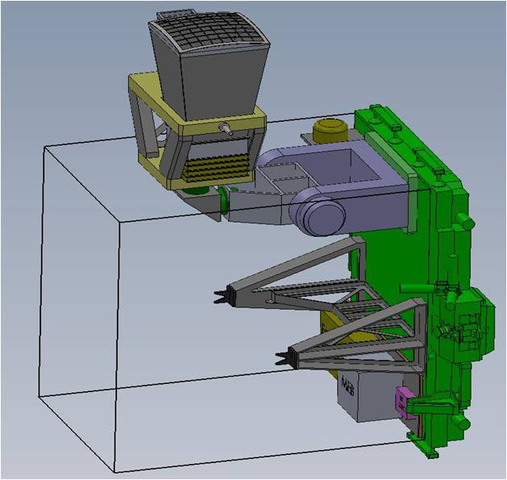
ISS-Lobster Instruments
Wide Field Imager (WFI)
Curved Microchannel plate optic + 3x3 CCD array
30 x 30 deg FoV
0.3-5 keV
1 arcmin localizations
Rapid autonomous repointing
Gamma-ray Transient Monitor (GTM)
Single NaI detector (GBM flight spare)
10 – 1000 keV
2π ster FoV (if unocculted by Earth at ISS)

Slide 3
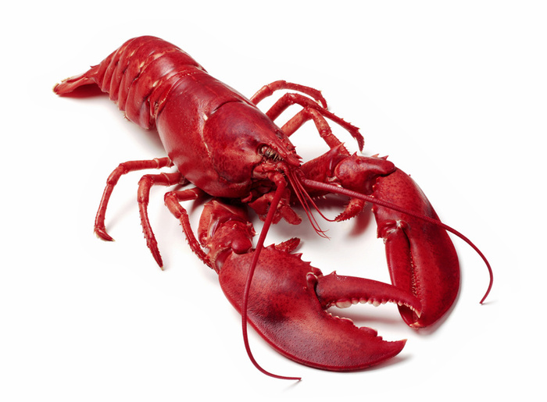
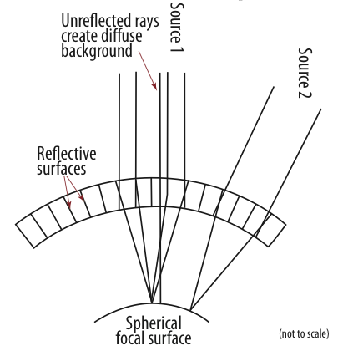
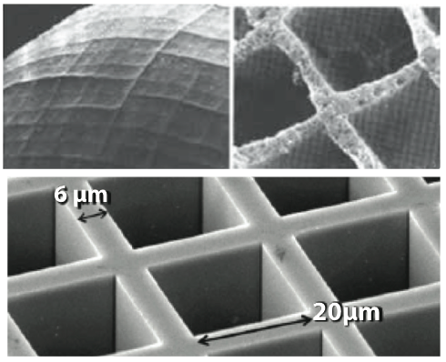
Lobster-Eye Optic
Lobster (crustacean)
Lobster (telescope)

Slide 4
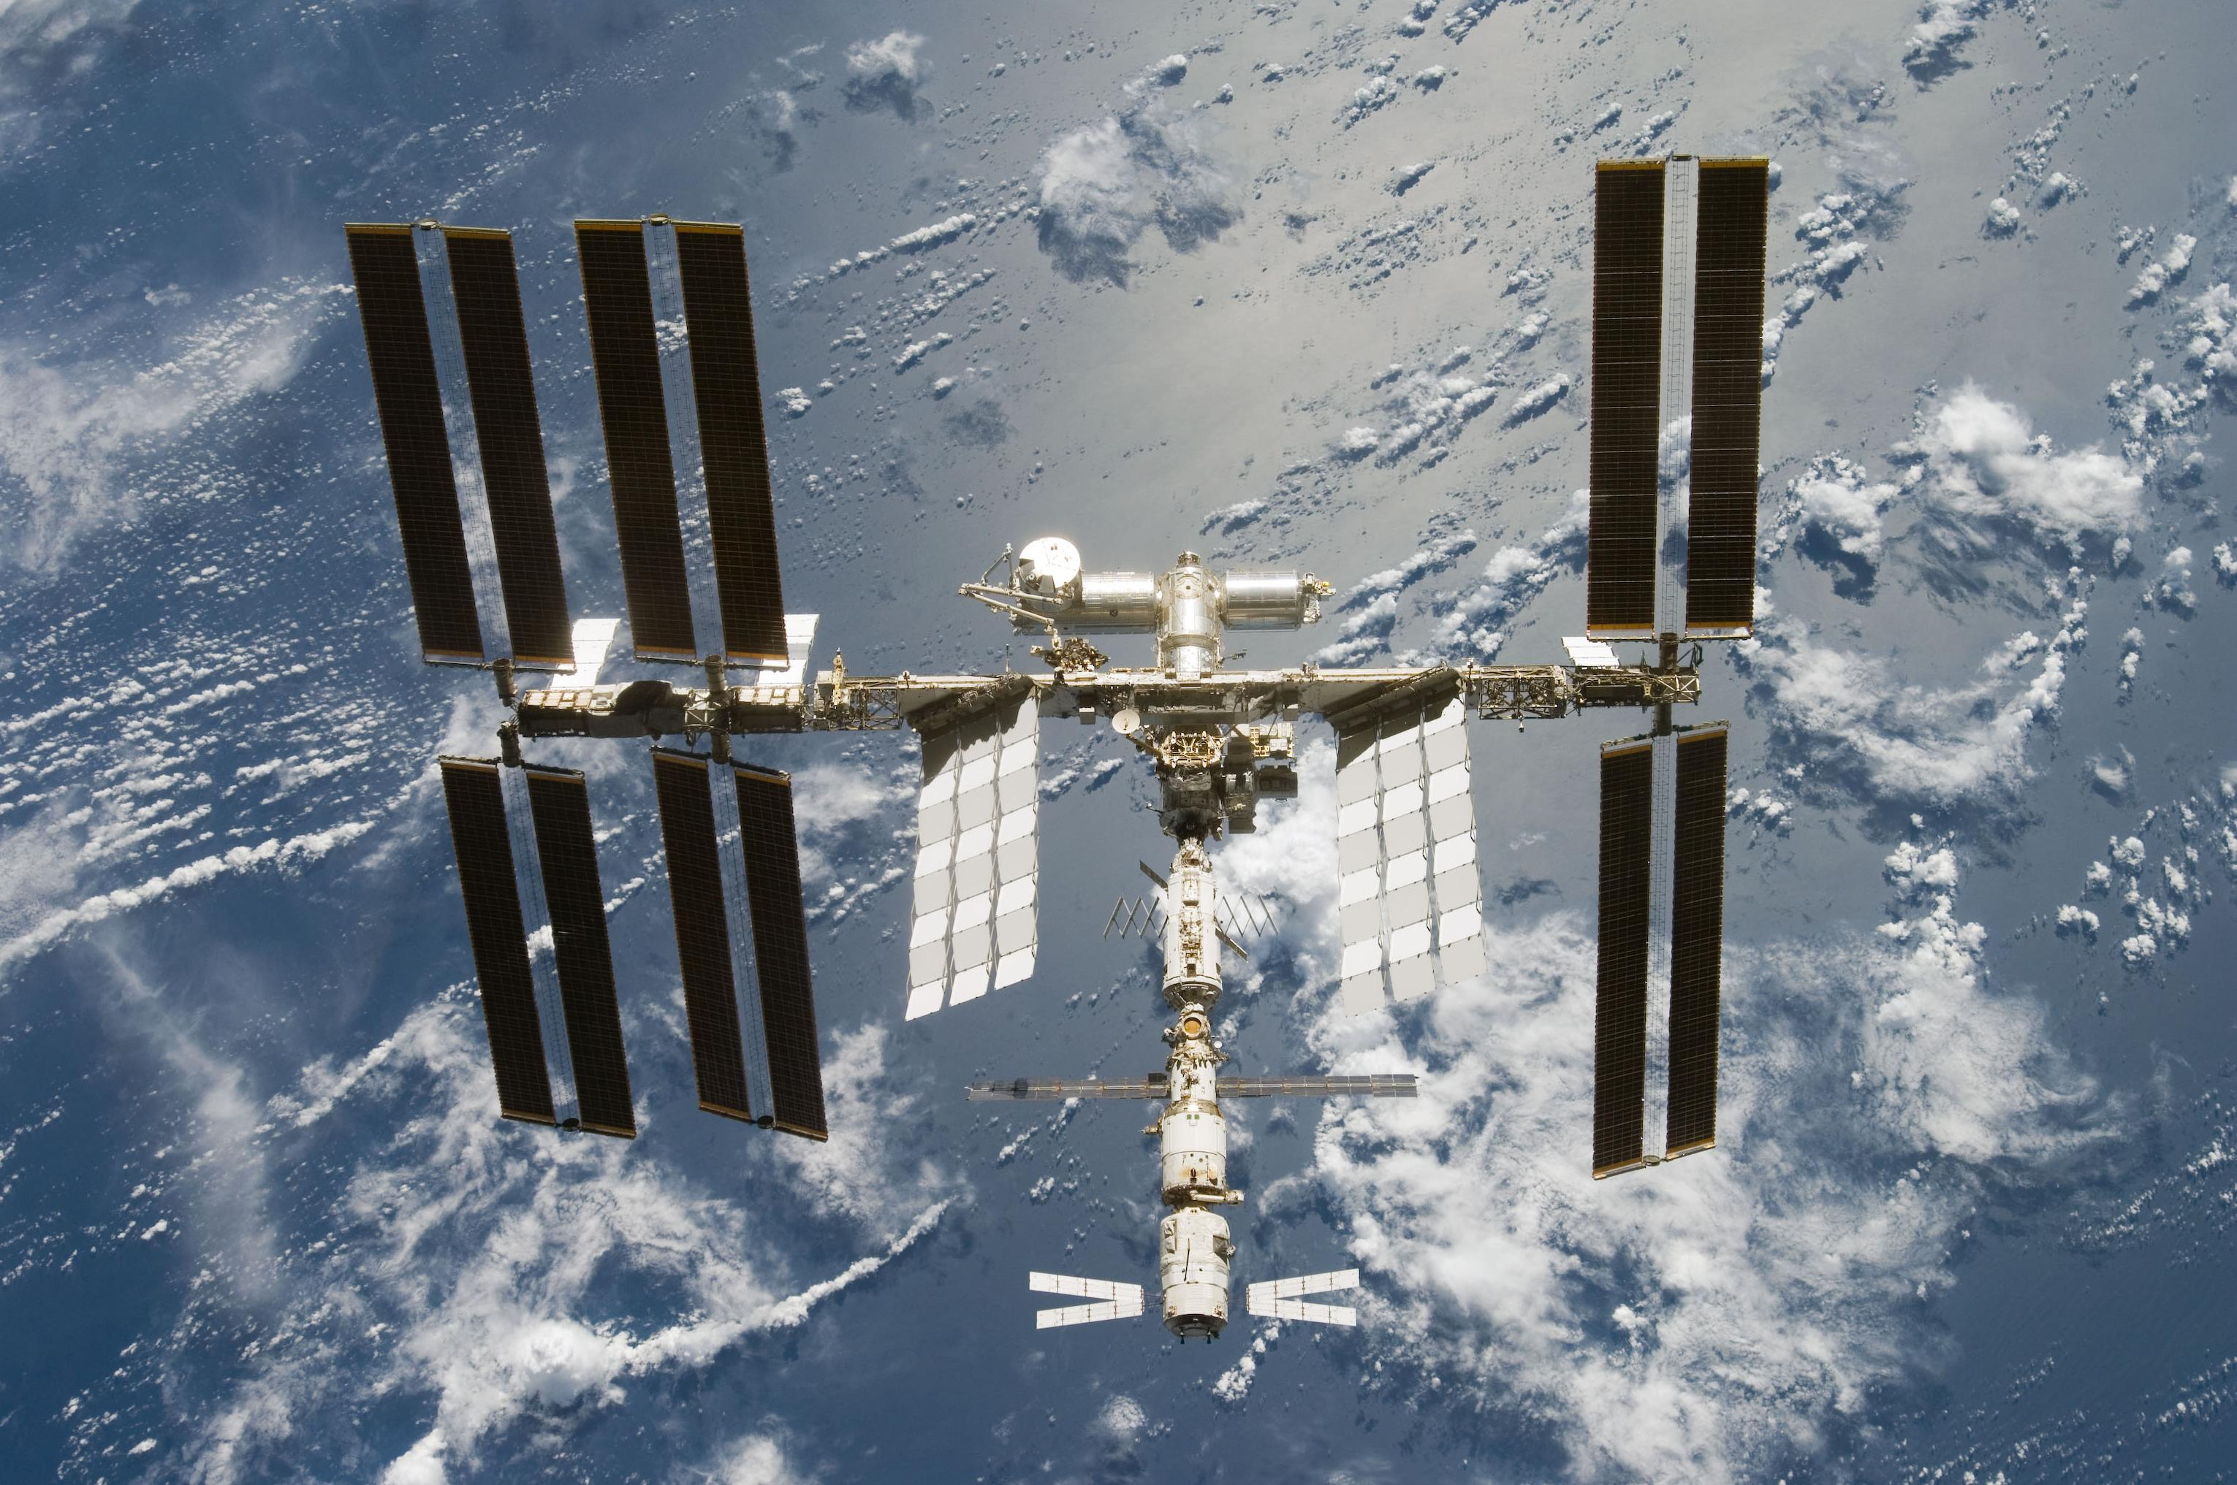
Advantages of the ISS Platform
Nearly continuous ground contact via TDRSS
  Fast response to uploaded observations, and triggers sent to ground
Powered from ISS
“Free” Launch
Science modules have available ports
Agency interest in ISS science
Huge science return for modest Mission of Opportunity budget

Slide 5
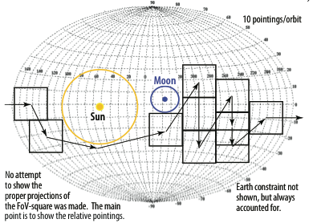
ISS-Lobster Observations
Soft X-ray (0.3 – 5 keV) Daily All-sky survey (WFI)
  Sensitivity of ~1.2 x 10⁻¹¹ erg cm⁻² s⁻¹ on full sky in 1 day, ~10⁻¹² erg cm⁻² s⁻¹ in ~50 ks exposure
  7-10 pointings per orbit
30x more sensitive than other all-sky X-ray timing instruments

Slide 6
ISS-Lobster New Transient Observing Scenarios
WFI Sky-Survey interrupted by onboard triggers on new transients
  GRBs, SN shock breakouts, other Galactic & Extragalactic X-ray transients
  Follow-up for 2 orbits
GTM will also trigger on short duration transients
  No positional information, however more sensitive at zenith of detector
  Tile WFI observations around zenith to search for new sources
Target of Opportunity observations uploaded from ground in minutes
  Gravitational Wave, Neutrino, optical, radio, X-ray, gamma-ray, etc. transients
  Provide rapid on-board localizations and downlink those in minutes

Slide 7
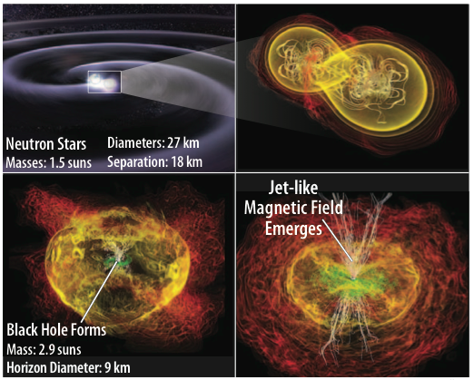
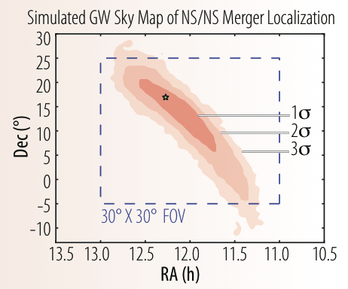
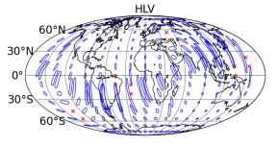
Electromagnetic Counterparts to Gravitational Wave Sources
Short hard bursts if associated with NS-NS merger
Within 200 Mpc (assuming 2019 advanced LIGO+Virgo at design sensitivity)
Coincident GW+EM trigger could push down significance threshold, extending horizon to 400 Mpc
Rezzola et al. 2011
Aasi et al. 2013

Slide 8
Electromagnetic Counterparts to Gravitational Wave Sources
Estimate ~1-2 detections of coincident GW-X-ray counterpart per year
ISS-Lobster to provide:
Rapid Localizations
  For follow-up
  Redshifts
Prompt Emission and early afterglow light curves & spectra
Swift Short GRB X-ray afterglows shifted to Advanced LIGO/Virgo coincident detection horizon

Slide 9
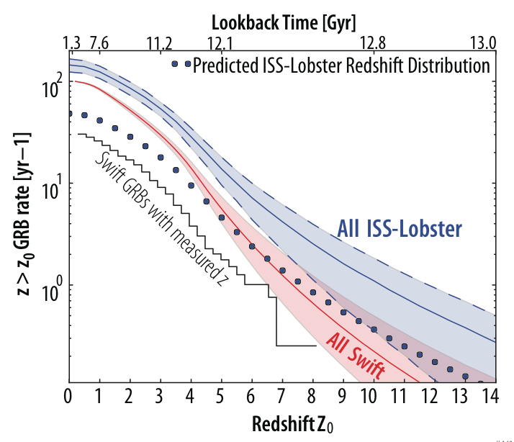
High Redshift GRBs
The WFI will detect >100 GRBs per year
  ~20% short
  ~80% long
~15 will be at z>5
  Assuming redshift measurement success rate in Swift era, ~5 will have measured redshifts
Excellent high-z sources for JWST
Follow-up optical spectroscopy will probe cosmic chemical evolution
Adapted from Butler et al. 2010

Slide 10
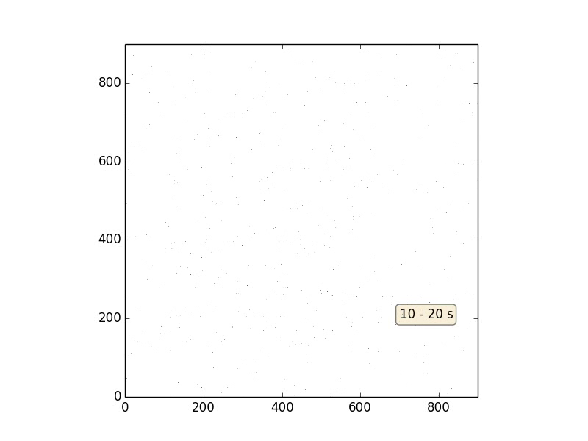
GRB Detection
Simulation of WFI Observations of GRB 130427A
4σ Sensitivity

Slide 11
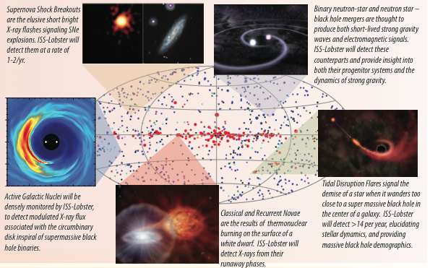
Transient and Survey Science
AGN Monitoring
  ~400 (weekly)
  ~50 brightest (daily)
  Long period (~1 year) binary SMBHs, that might be detectable by PTA ~0.5 (year⁻¹)
Tidal Disruption Flares ~14 (year⁻¹)
Stellar Super Flare 50-500 (year⁻¹)
ccSN shock breakout 1-2 (year⁻¹)

Slide 12
Current Status and
Future Prospects
Received positive feedback in 2012 Explorer/Mission of Opportunity review – selection cancelled
Plan to re-propose at next available announcement of opportunity (late 2014?)
Launch 2019 would be well-timed for
  GW detectors
  LSST
  JWST
  CTA
  And other future transient/survey facilities
Other Lobster-like mission concepts
  BepiColombo (ESA) – to Mercury (launch 2016)
  Einstein Probe (ESA-CSA)
  ASTAR (ESA)

Slide 13


