Slide 1
Neutrino Panel

Slide 2
Contents:
History
Regional Town Meetings
Initial report; highlights
Vision and next steps

Slide 3
History
Neutrino Panel

Slide 4
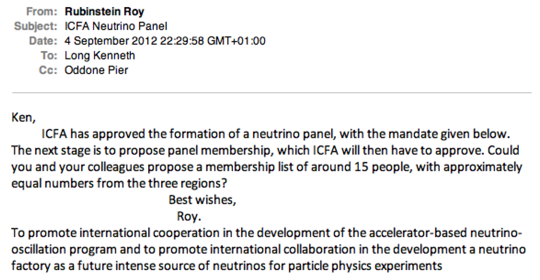
Initiation, September 2012:

Slide 5
Panel membership, February 2013:
Neutrino Panel endorsed by ICFA and that the proposed members were appointed for an initial three-year term

Slide 6
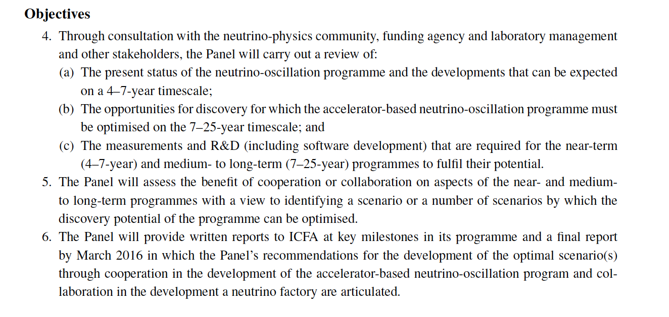
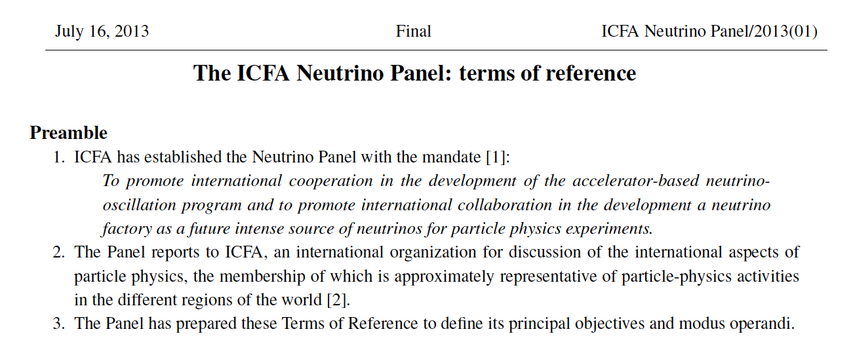
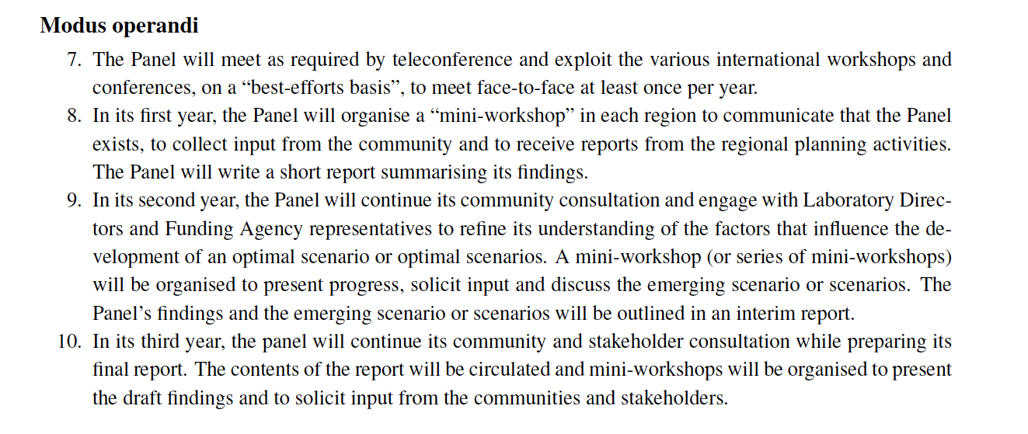
Terms of Reference, July 2013:

Slide 7
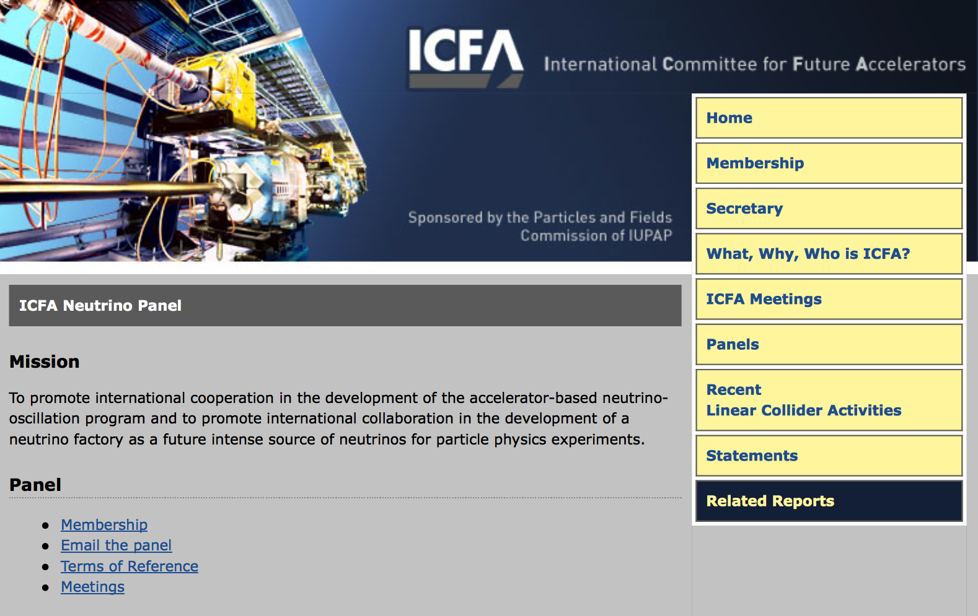
http://www.fnal.gov/directorate/icfa/neutrino_panel.html

Slide 8
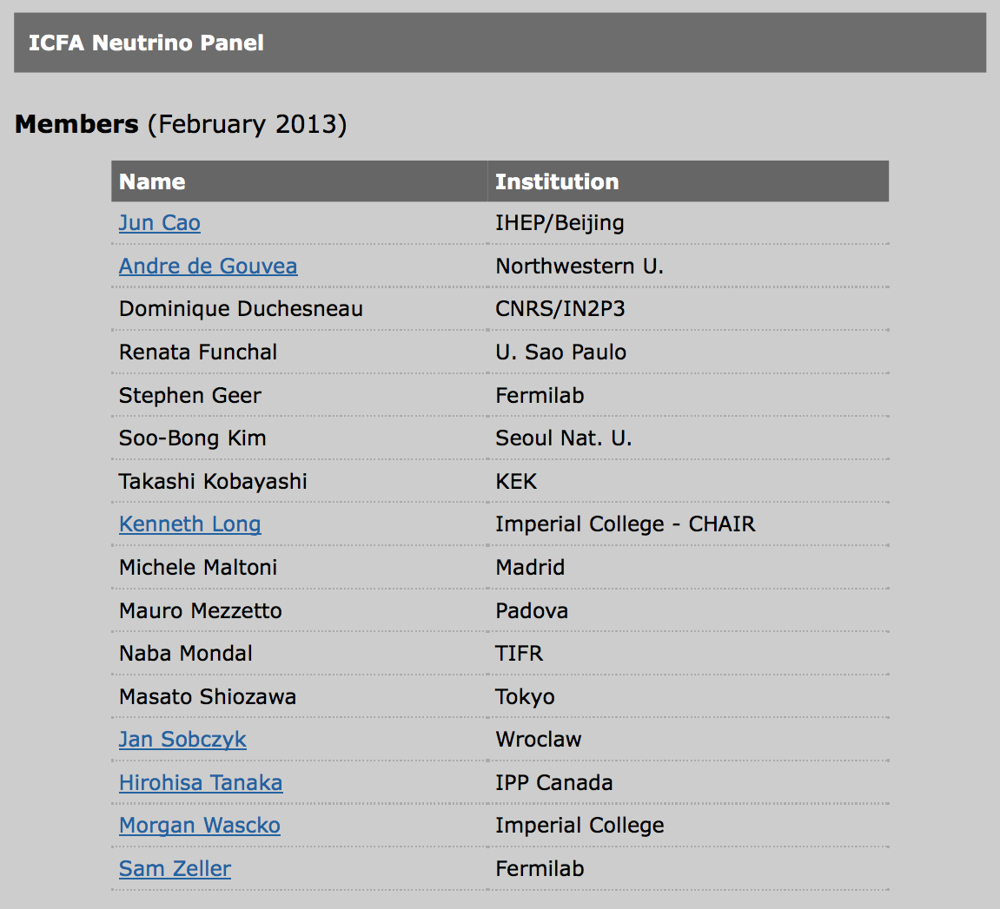
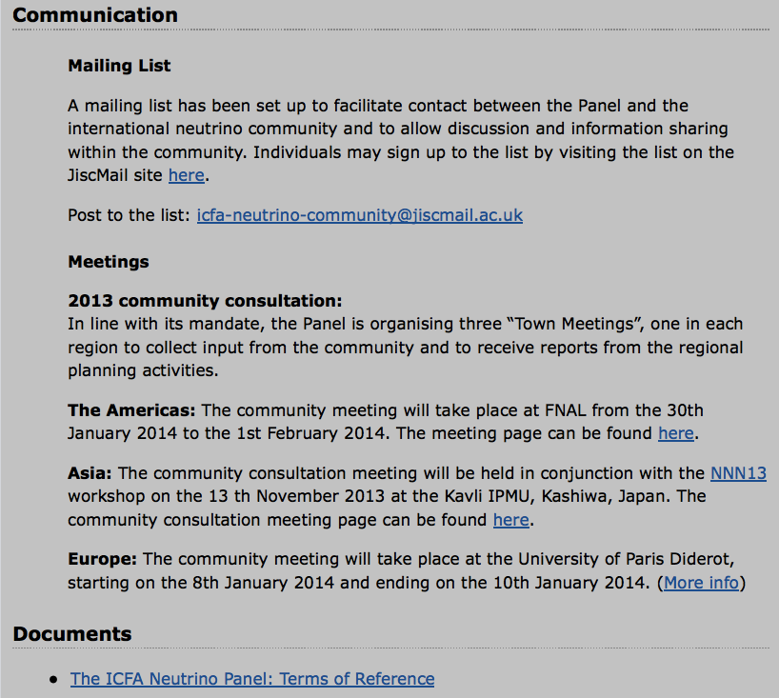

Slide 9
Regional strategic planning excersises:
Asia:
  KEK roadmap finalised April 2013;
    Informed discussion at the Asian Town Meeting
The Americas:
  Canada:
    2015-2020 TRIUMF 5-year plan
    2012-2016 Canadian (NSERC) long range plan in subatomic physics
  US:
    Community Summer Study (Snowmass):
      Community process complete;
      Particle Physics Projects Prioritisation Panel (P5) now “in session”
        What is known of considerations will inform The Americas Town meeting
Europe:
  European Strategy:
    Inform the discussions at the European Town Meeting

Slide 10
Issue for the Panel:
Or perhaps better:
  Issue for the international, accelerator-based neutrino-oscillation community …
What is the optimum programme?
  Is there an optimum “distribution” of the required infrastructures?
The Panel needs to consider:
  The “landscape”:
    LBNE/LBNO, T2HK, short-baseline experiments,
    development of Neutrino Factory, ESSν …
      Timescales and constraints
  Mission critical measurements:
    Hadro-production, νN scattering, theory/phenomenology …
      NA61/Shine, nuSTORM …
  R&D:
    Accelerator, detector, …
Hence the regional Town Meetings as a critical first step

Slide 11
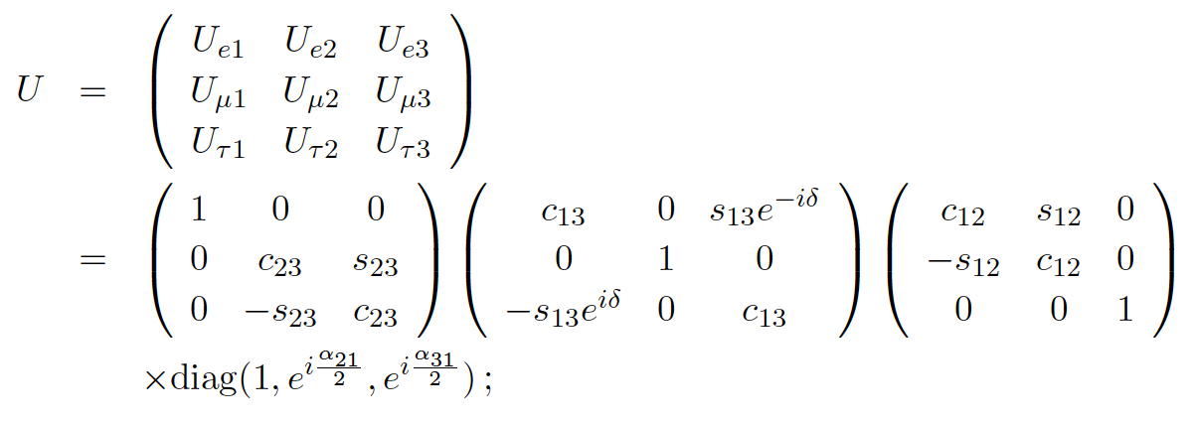
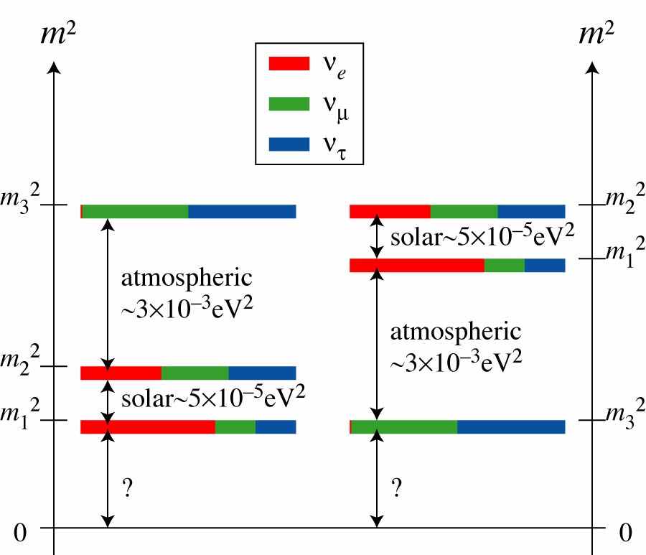
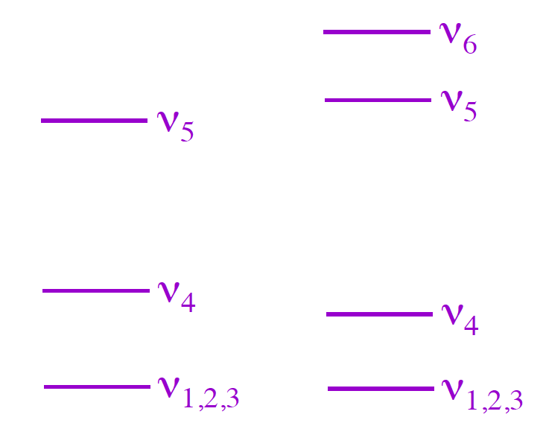
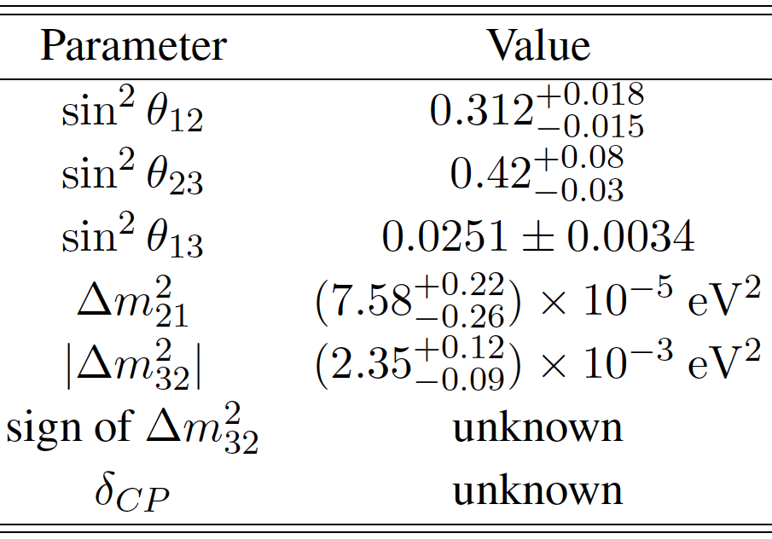
Steriles

Slide 12
Regional Town Meetings
Neutrino Panel

Slide 13
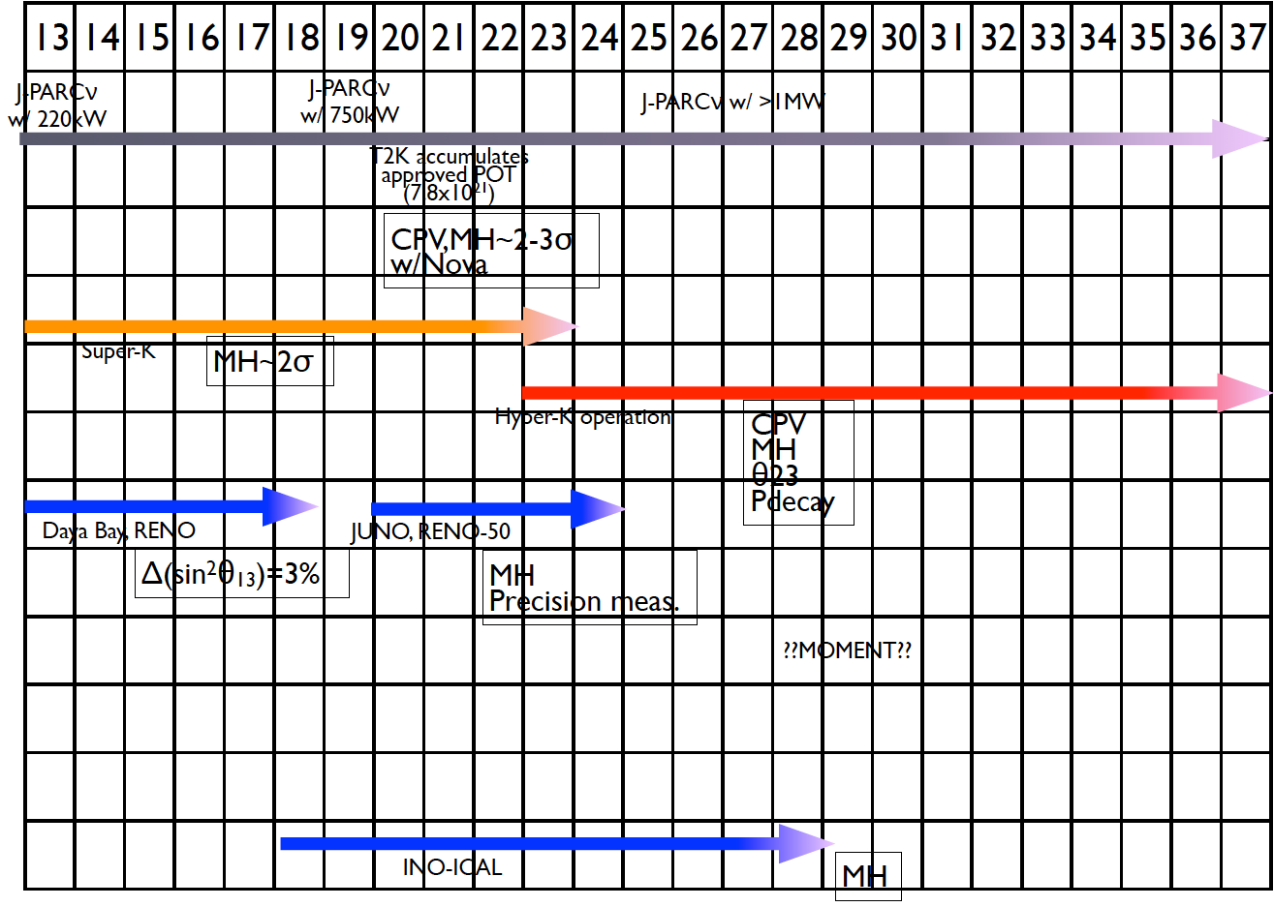
Asia:

Slide 14
Asia:
Status/4—7-year expectations:
  T2K:
    CPiV at ~2σ [25% of δ]; improved precision on θ₁₃ and θ₂₃;
  SK:
    MH and sgn(45º—θ₂₃) at ~2σ;
  RENO, Daya Bay:
    Precision on θ₁₃ at 3% level
  KamLAND/J-PARC/Korea:
    Improvements in sterile-neutrino limits
Opportunities 7—25-year timescale:
  HK and T2HK:
    CPiV at >3σ [74% of δ], MH, sgn(45º—θ₂₃)
      CPiV/MH degeneracy broken by reactor and atmospheric ν measurements
  JUNO, RENO-50:
    MH, Δm₃₁², θ₁₂, Δm₂₁²;
Measurements, R&D required for programme to reach its full potential:
  Proton-beam (J-PARC) power upgrade
    Near detector and HK;
  R&D for liquid scintillator and photo-sensors
  R&D for advanced detectors:
    Lar, Gd loaded water CH
  MOMENT:
    R&D for 15 MW proton SC linac, high-power target, muon transport, far detector
  Hadron production and neutrino cross section measurements

Slide 15
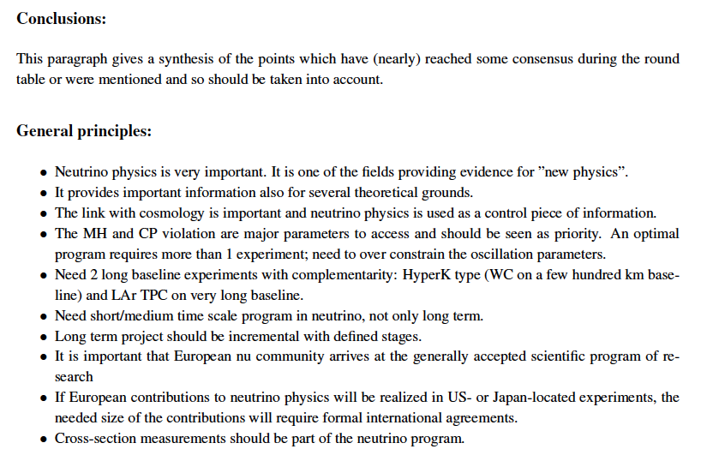
Europe:

Slide 16
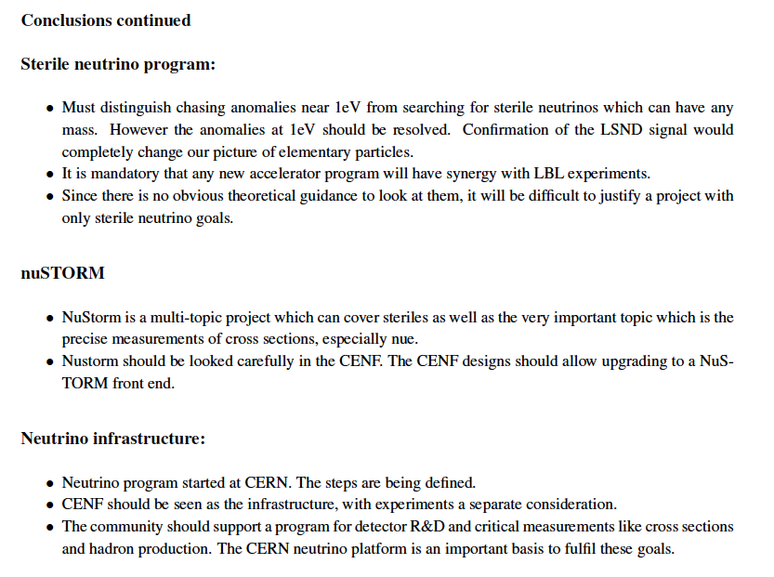
Europe:
APPEC:
  Neutrino “network” meeting at Paris APC 23-24 June 2014;
  ICFA Panel has been invited to contribute;
    A welcome development that will allow astro-particle aspects to be considered

Slide 17
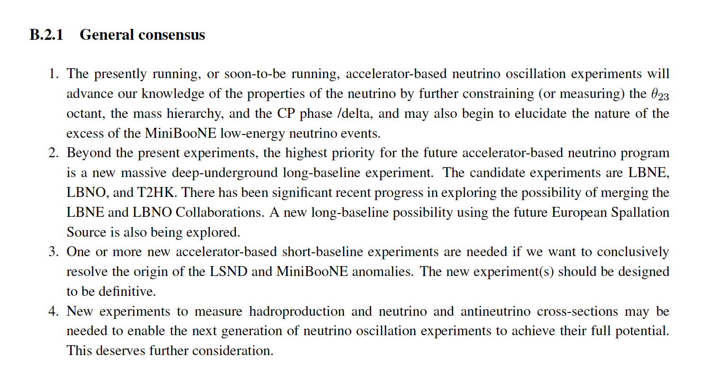
The Americas:

Slide 18
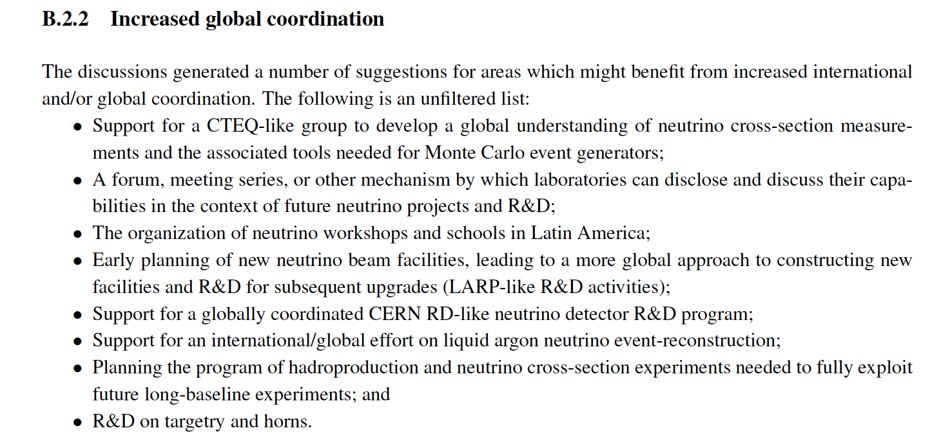
The Americas:
In the near term, FAs, labs are negotiating contributions to LBNE;
  These negotiations are not within the purview of the Panel, however;
  The Panel welcomes the positive developments

Slide 19
Points of consensus from Town Meetings:
Scientific imperative:
  Establish a programme to measure the properties of the neutrino with a precision sufficient to allow the underlying physics to be understood
Key steps:
  Completing the picture:
    Determine the mass hierarchy;
    Search for (and discover?) CP-invariance violation (CPiV)
    Determine (θ₂₃ – 45°)
  Testing the framework:
    Redundant set of precise measurements to:
      Establish the 3-neutrino mixing framework; or
      By establishing inconsistent parameter sets, or in consistent space-time behaviour, demonstrate the existence of entirely new phenomena
The accelerator-based programme is essential:
  The only means to study transitions between each of the three flavours;
  Conventional facilities are sufficient to:
    Determine the mass hierarchy, initial search for CPiV, sgn(θ₂₃ – 45°)
      i.e. complete the picture (depending on the value of δ)
  Novel facilities are required to:
    Test the framework:
      The Neutrino Factory is recognised to be the facility that offers the ultimate sensitivity and precision

Slide 20
Initial report; highlights
Neutrino Panel

Slide 21
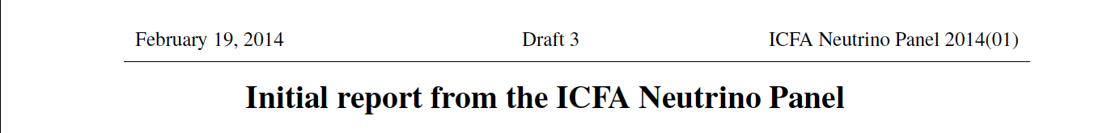
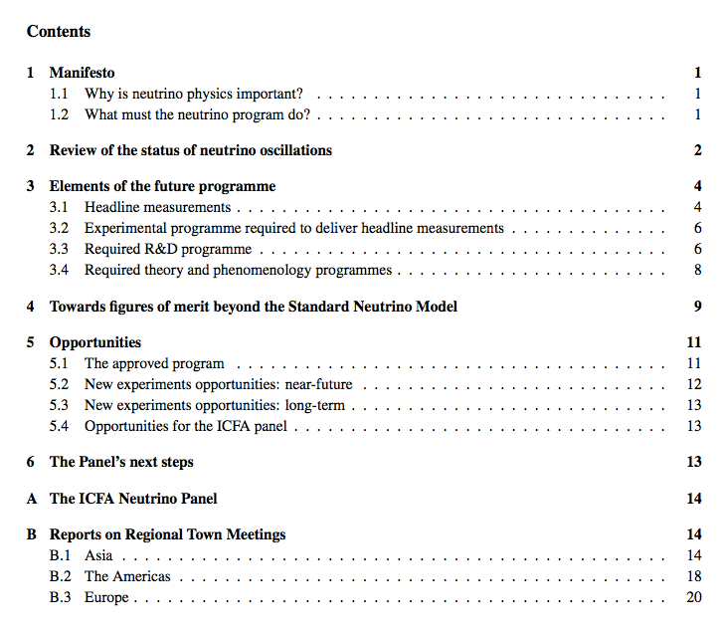

Slide 22
Elements of the future programme [1]:
Narrow-band and wide-band beams are complementary; they measure different things in different ways:
  Narrow-band beam:
    Low neutrino energy; relatively short baseline; very large (water Cherenkov) detector:
      Measure difference between neutrino and anti-neutrino rate
        Direct investigation of CPiV
    T2HK (on MEXT roadmap, supported by R&D programme); ESSnu (design study)
  Wide-band beam:
    High neutrino energy; long (or very long) baseline; large, high resolution (liquid argon) detector:
      Long baseline gives sensitivity to mass hierarchy via the matter effect
      Opportunity to measure neutrino energy spectrum (first and second oscillation measurent);
      Comparison of neutrino and antineutrino rate
      Determination of δ from spectrum
    LBNE:
      CD1 approval and $867M DOE planning line:
        Panel notes and welcomes recent progress in the “internationalisation” of LBNE
    LBNO:
      Design study to be completed by the end of 2014
  Substantial benefits:
    Different measurements with
    Different systematics exploiting
    Regional strengths

Slide 23
Elements of the future programme [2]:
Testing the framework:
  Sterile neutrinos (short-baseline programme):
    Accelerator-experiment anomalies:
      LSND:
        Electron antineutrino appearance
      MiniBooNE:
        Electron neutrino excess at low neutrino energy
    Can be interpreted as oscillations with Δm² ~ 1eV²
    Accelerator-based programme:
      Approved:
        MicroBooNE; LAr TPC to establish origin of MiniBooNE anomaly
      Proposed:
        Two, LAr TPCs at different baselines to address LSND and MiniBooNE anomalies:
          ICARUS/NESSiE at CERN; LArLAr at FNAL
        LSND-like experiment at ORNL
        Muon storage ring serving near/far detectors:
          nuSTORM: under consideration at CERN and FNAL
  Precision measurements in long-baseline oscillation experiments:
    Over constrain three-neutrino mixing matrix;
    Detailed measurements of all of the accessible oscillation channels;
    Investigation of space-time (L/E, L, E)
  Requires development of novel accelerator or detector capabilities:
    Neutrino Factory (design study supported by substantial R&D programme):
      Flexible; high-energy electron and muon neutrino beams;
        Capable of investigating all accessible channels
    Daedalus (design study):
      Electron-neutrino beam from muon decay at rest; exploit L dependence of oscillation spectrum

Slide 24
Elements of the future programme [3]:
Management of systematic uncertainties:
  Require to control uncertainties on flux and signal/background cross sections in line with statistical uncertainty:
    Eventually this requires systematic uncertainties at the (few) per-cent level
  Requires a coordinated programme of:
    Hadro-production measurements:
      NA61 (SHINE) at CERN; development of this programme likely to be required
    Neutrino-nucleus cross section measurements:
      Present/approved programme:
        T2K ND280
        Minerva, MiniBooNE, MicroBooNE at FNAL
      Proposed:
        nuSTORM (being considered at CERN and FNAL)
          Only way to measure electron-neutrino (signal) cross sections precisely
R&D programme:
  Essential both to:
    Deliver the next-generation programme; and to
    Realise the innovative accelerator/detector combinations required to complete and then to test the three-neutrino mixing picture
  Panel has identified programme required in:
    Detectors:
      Photo-sensors; LAr; magnetisation of large volumes; high granularity for near detectors
    Accelerators:
      High power proton source and target; pion/muon capture; ionization cooling; novel, rapid acceleration
    Software and computing
      LAr: reconstruction and visualisation, neutrino event generators, modeling of cross sections and final states …

Slide 25
Opportunities for promoting cooperation and collaboration:
The Panel can promote cooperation in:
  Simulation:
    Understanding and implementation of cross section and particle-production models
  Analysis:
    Combination of results with appropriate treatment of systematic uncertainties
  Programme of supporting measurements:
    Evaluation and planning of the necessary programme of hadroproduction and cross section measurements
The Panel is considering organising a w/s to foster/develop such cooperation
The Panel has identified opportunities to promote collaboration in:
  Detector and accelerator R&D:
    Great opportunity to define a coordinated/collaborative programme that plays to the strengths of each region
      The model of the CERN “RD” programme for LHC preparation could be a basis for this;
The timely implementation of the ambitious programme required first to complete and then to test the three-neutrino mixing model calls for coordination to optimise the collaborative exploitation of the infrastructures that exist across the world (CERN, FNAL and J-PARC)
  To work though the issues and opportunities now need to initiate the second phase of the Panel’s consultation process:
    The consultation with Laboratory and Funding Agency Directors

Slide 26
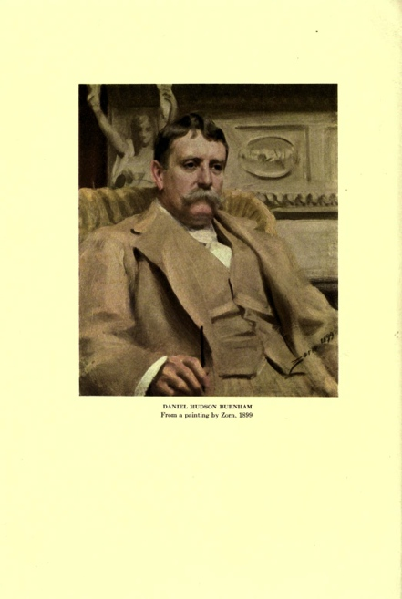
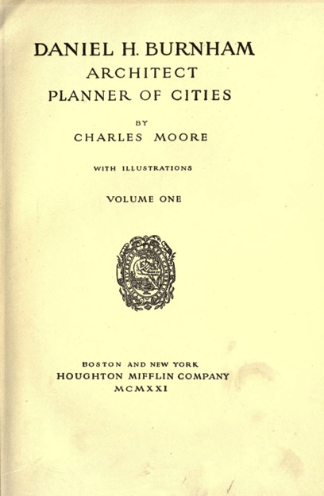
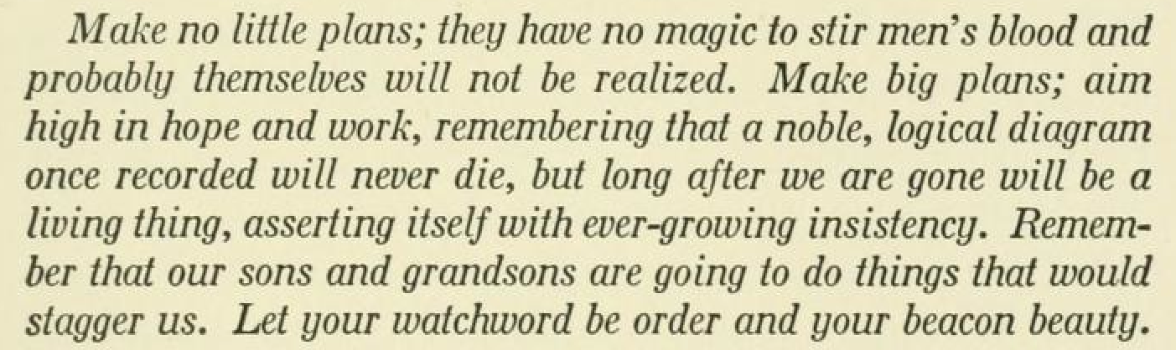
Vision and next steps:
Neutrino Panel

Slide 27
A coordinated programme; considerations:
Motivation:
  To optimise discovery potential:
    Neutrino community requires timely access to a number of complementary, powerful neutrino-beam facilities;
  For programme to reach its full potential require:
    Programme of measurement by which the systematic errors are made commensurate with the statistical power; and
    Parallel programme of accelerator and detector R&D
  To ensure timely access to necessary facilities:
    Exploit the the opportunities to develop infrastructures that exist at CERN, J-PARC and FNAL such that each region makes a unique and critically-important contribution;
  To maximise the impact that the expertise, experience and resources of institutes worldwide can have on the development and execution of the programme.

Slide 28
A coordinated programme; considerations:
Through consultation with Directors the Panel can engage to:
  Develop a road-map that:
    Exploits the articulated ambitions at CERN, J-PARC and FNAL;
    Includes the programme of measurement/test-beam exposure required to ensure that the programm fulfills its potential;
  Develop an “RD” programme:
    Conceived as detector and accelerator R&D; and
    In which each contributor can make an important contribution such that
    The whole is greater than the sum of the parts.
Can we articulate an
“International neutrino Programme” (IνP)?

