Slide 1

ESS
Mats Lindroos on behalf of the ESS
Milano, LASA, 12 March 2014

Slide 2




A European research center

Slide 3











Light and neutrons
H
Li
C
O
S
Mn
Zr
Cs
X-rays
neutrons

Slide 4

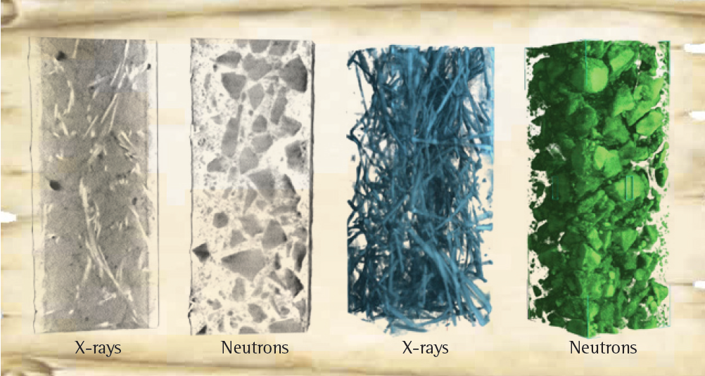
Engineering materials
Non-destructive analysis of a steel armed concrete block with neutron imaging and X-ray tomography.
Source: PSI, CEMNET workshop 2007

Slide 5
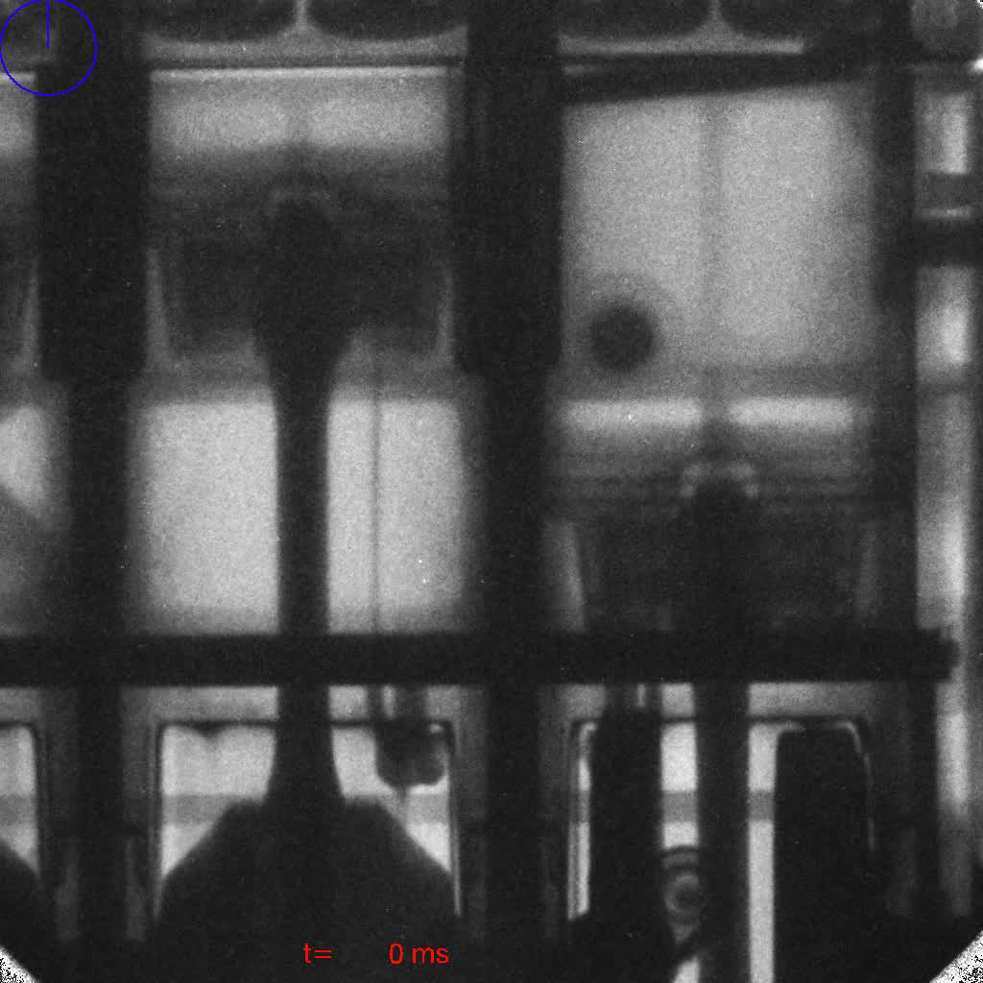
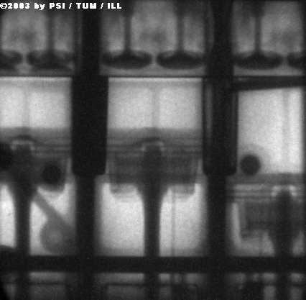
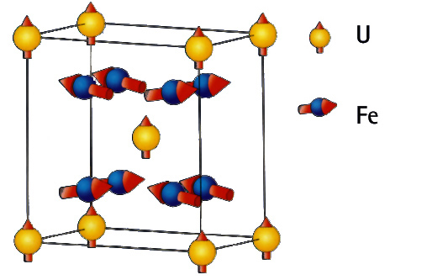
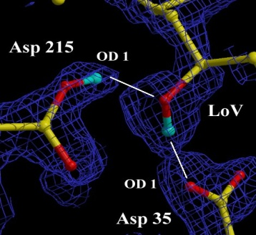
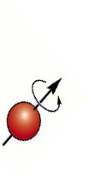

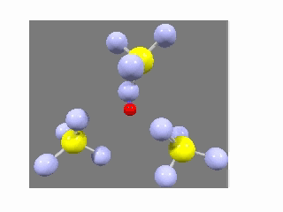
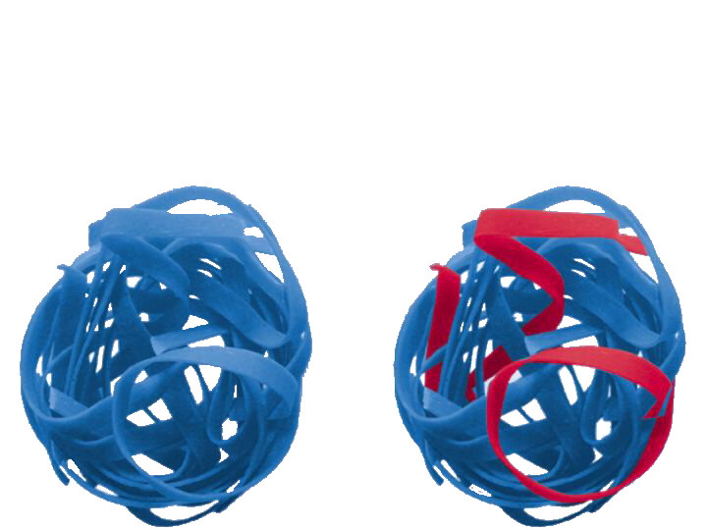
Neutrons and x-rays are complementary
- neutrons…
..see magnetic atoms
..see inside materials
..see light atoms
..see atoms move
..see isotopes
Courtesy of Ian S. Anderson
Notes:
Brief description:
Neutron scatter from the nucleus and not the electrons -> penetrating, see light atoms, and magnetic structures.
Top clockwise:
Neutron Radiograph (from Munich) of an operating BMW engine
X-rays reveal the protein crystal structure – neutrons reveal the positions of the H atoms which are key to the catalytic activity
Isotope contrast (H/D in this case) allows specific strands to be picked out in this complex polymer
Neutrons have mass similar to atoms – and can measure dynamics easily. This is a CH4 electrolyte – the H is transferred via a rotation and cross over mechanism – revealed by neutrons
Neutrons have a magnetic moment. Most magnetic structures have been determined with neutrons. Can also be applied to magnetic dynamics e.g. Spin waves – important in studies of high Tc materials.

Slide 6
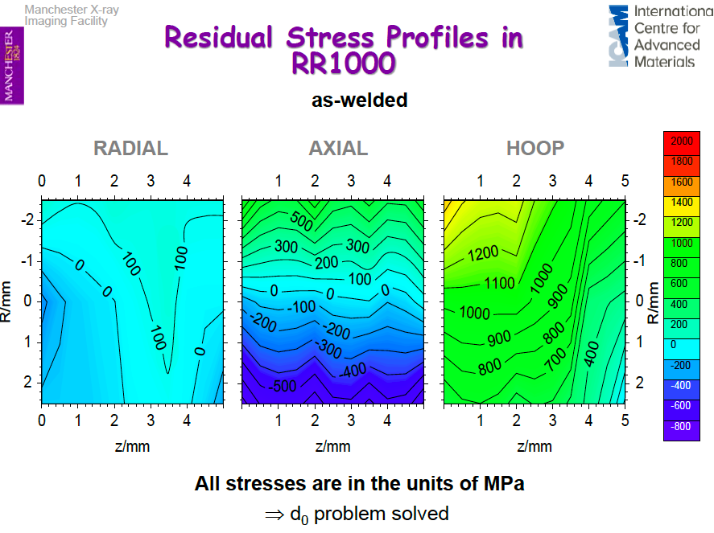
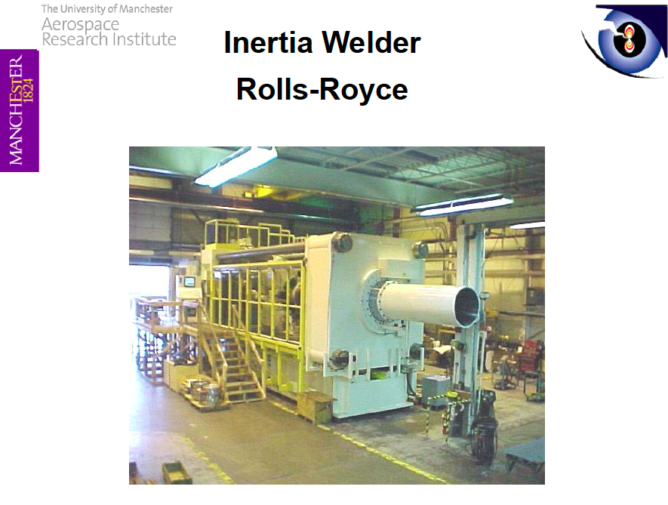
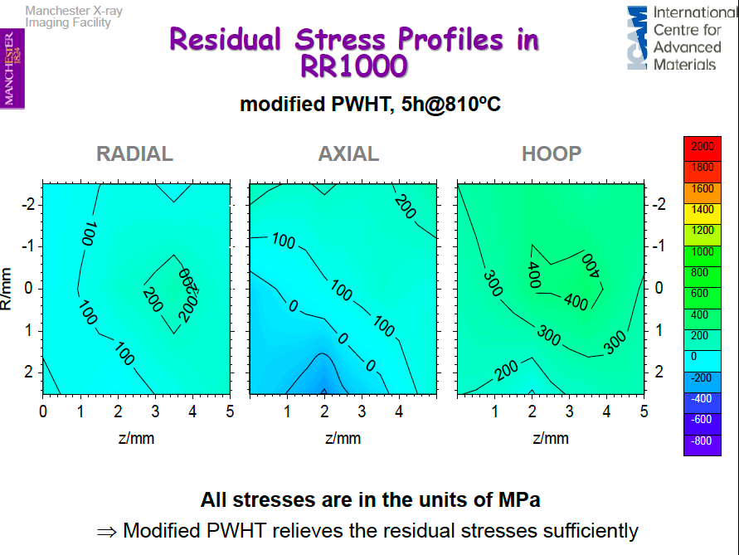
ICNS talk: Predicting and preventing failure
Prof. Phil Withers, Manchester University

Slide 7

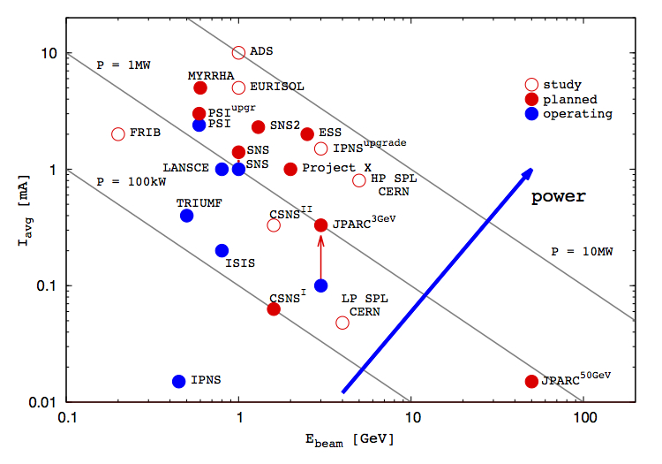
ESS - Bridging the neutron gap
10²⁰
J-PARC
ESS
SNS
MTR
NRU
HFIR
ILL
ISIS
10¹⁵
NRX
HFBR
ZINP-P/
IPNS
WNR
KENS
FRM-II
X-10
SINQ
Effective thermal neutron flux n/cm²-s
10¹⁰
CP-2
ZINP-P
CP-1
10⁵
Berkeley 37-inch cyclotron
350 mCi Ra-Be source
Steady State Sources
Pulsed Sources
1
Chadwick
1930
1940
1950
1960
1970
1980
1990
2000
2010
2020
(Updated from Neutron Scattering, K. Skold and D. L. Price, eds., Academic Press, 1986)
Notes:
Many of the reactor based neutron sources are being phased out = decline in the availability of neutrons = decline in competence and competitiveness
The vast majority of users will profit from a pulsed structure
A large fraction of users are fully satisfied by a long pulse source
Existing short pulse sources (ISIS, JPARC and SNS) can supply the present and imminent future need of short pulse users
Long pulse for physics flexibility (cold and thermal neutrons available)
++. Keep competency in communities – countries balance in science knowledge

Slide 8
ESS is a long pulse source

Slide 9












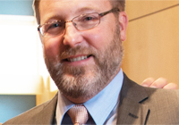






17 nations committed to build ESS
Cash contributions
from Sweden, Denmark and Norway
50% of construction and
15-20% of operations costs
In-kind contributions
from the other
14 nations
Construction cost: 1843 M€
Operation cost: 140 M€
Decommissioning cost: 177 M€
ESS AB 2014, ca 250 personer, 32 nationaliteter

Slide 10
Helicopter view of ESS

Slide 11
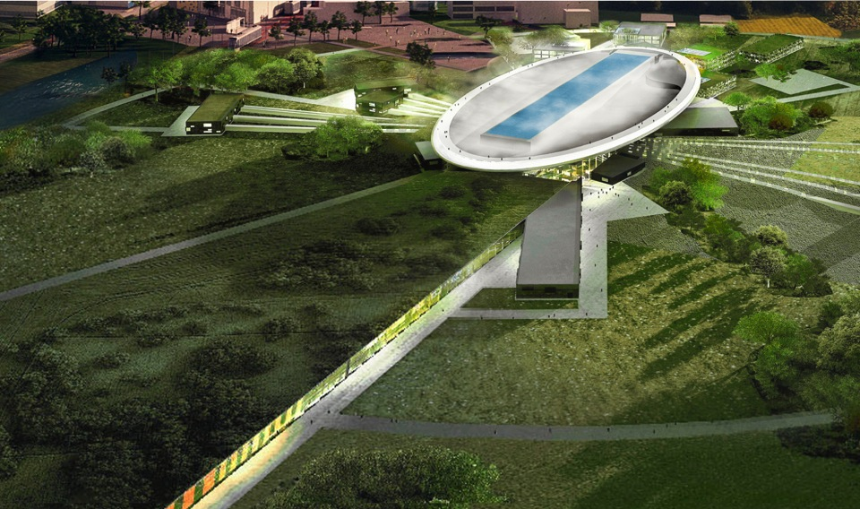
Road to realizing the world’s leading facility for research using neutrons
2025
ESS construction complete
2014
Construction work starts on the site
2023
ESS starts
user program
2009
Decision: ESS will be built in Lund
2019
First neutrons on instruments
2012
ESS Design Update phase complete
2003
First European design effort of ESS completed

Slide 12
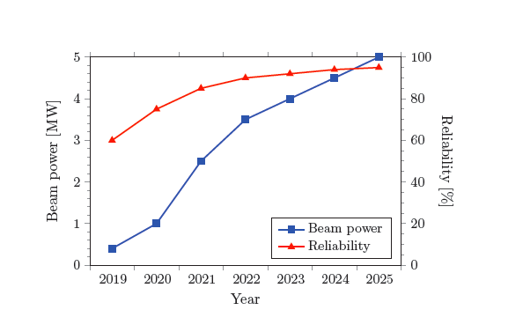
Commissioning and operations
Criteria for start of Initial Operations:
Deliver a measurable number of moderated neutrons to an instrument.
TDR Performance Goals
Strategy
Initially keep radioactivity
and doses low to allow
hands on maintenance.
Ramp up power quickly
to find limitations and
increase reliability
before user operations
start.
Initial User Ops

Slide 13

Collaborative projects
ESS is an emerging research laboratory with (still) very limited capacity in-house
Two possibilities:
  Limit the scope of the project so that it can be done with in-house resources
  Work in a collaboration where the scope of the project can be set by the total capacity (distributed) of the partners
The accelerator part of the project well suited for this as this community has a strong tradition of open collaboration
To keep cost down and to optimize schedule this requires that investments in required infrastructure is done at the partner with best capacity to deliver
13
Notes:
User driven innovation – external actor to be collective ownership

Slide 14
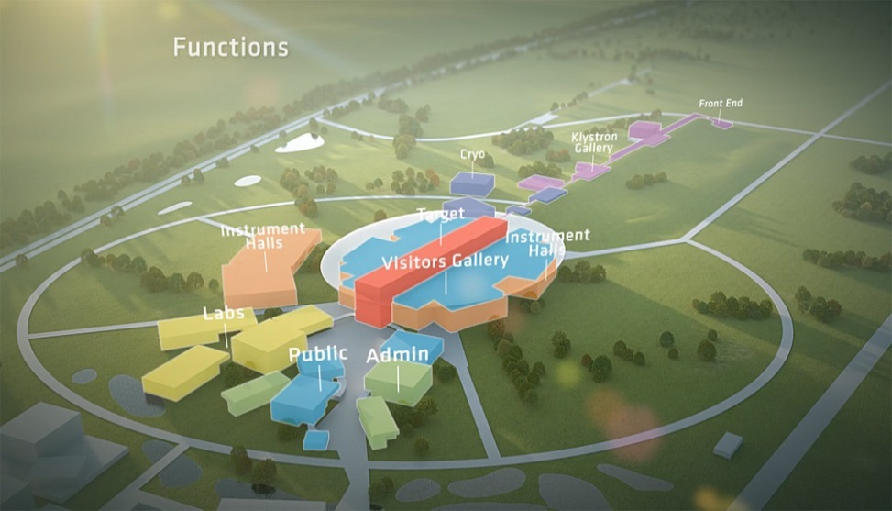
ESS accelerator
Design Drivers:
High Average Beam Power
5 MW
High Peak Beam Power
125 MW
High Availability
> 95%
Key parameters:
    -2.86 ms pulses
    -2 GeV
    -62.5 mA
    -14 Hz
    -Protons (H+)
    -Low losses
    -Attention is paid to cryoplant turn down capabilities to minimize use of electrical heaters at low temperatures and proper cryogenic design techniques to minimize static heat leaks
    -Flexible design for
    future upgrades

Slide 15
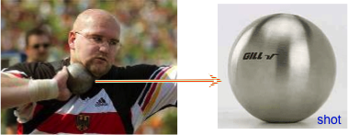
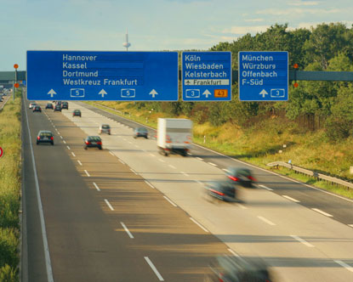
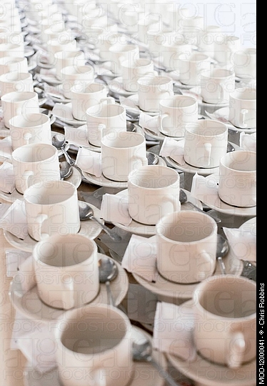
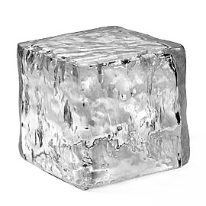
What is 5 MegaWatts?
At 5 MegaWatts,
  one beam pulse
    has the same energy as a 16 lb (7.2kg) shot traveling at
      1100 km/hour
      Mach 0.93
    Has the same energy as a 1000 kg car traveling at 96 km/hour
    Happens 14 x per second
  You boil 1000 kg of ice in 83 seconds
    A ton of tea!!!

Slide 16
ESS Linac
352.21 MHz
704.42 MHz
2.4 m
4.5 m
3.6 m
40 m
54 m
75 m
174 m
Target
Source
LEBT
RFQ
MEBT
DTL
Spokes
Medium β
High β
HEBT & Contingency
75 keV
3.6 MeV
90 MeV
220 MeV
570 MeV
2000 MeV
 | Energy (MeV) | No. of Modules | No. of Cavities | βg | Temp (K) | Cryo Length (m)
Source | 0.075 | 1 | 0 | – | ~300 | –
LEBT | 0.075 | – | 0 | – | ~300 | –
RFQ | 3.6 | 1 | 1 | – | ~300 | –
MEBT | 3.6 | – | 3 | – | ~300 | –
DTL | 90 | 5 | 5 | – | ~300 | –
Spoke | 220 | 13 | 2 (2S) × 13 | 0.5 βopt | ~2 | 4.14
Medium β | 570 | 9 | 4 (6C) × 9 | 0.67 | ~2 | 8.28
High β | 2000 | 21 | 4 (5C) × 21 | 0.86 | ~2 | 8.28
HEBT | 2000 | – | 0 | – | ~300 | –

Slide 17
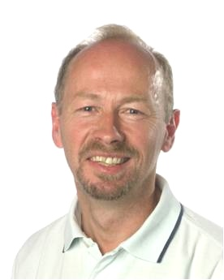
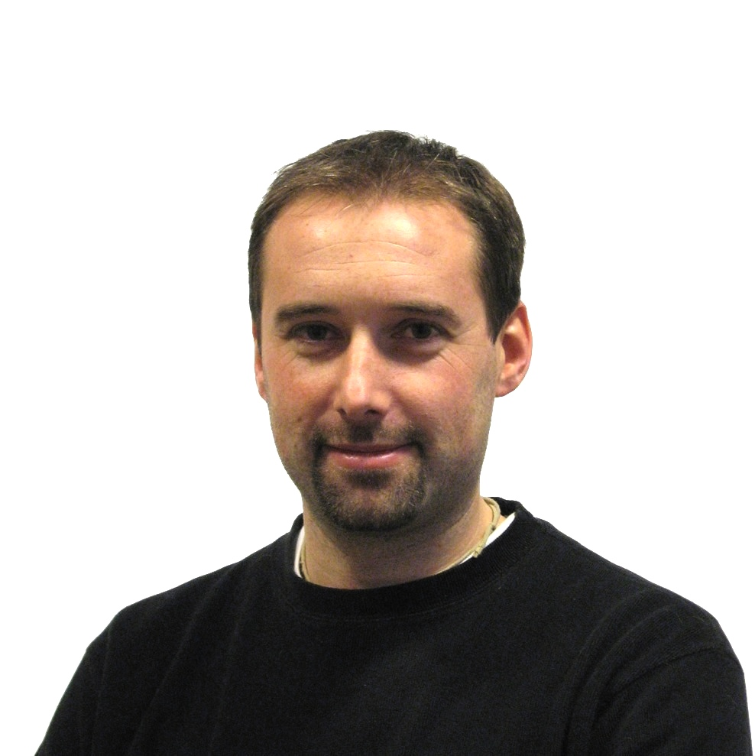


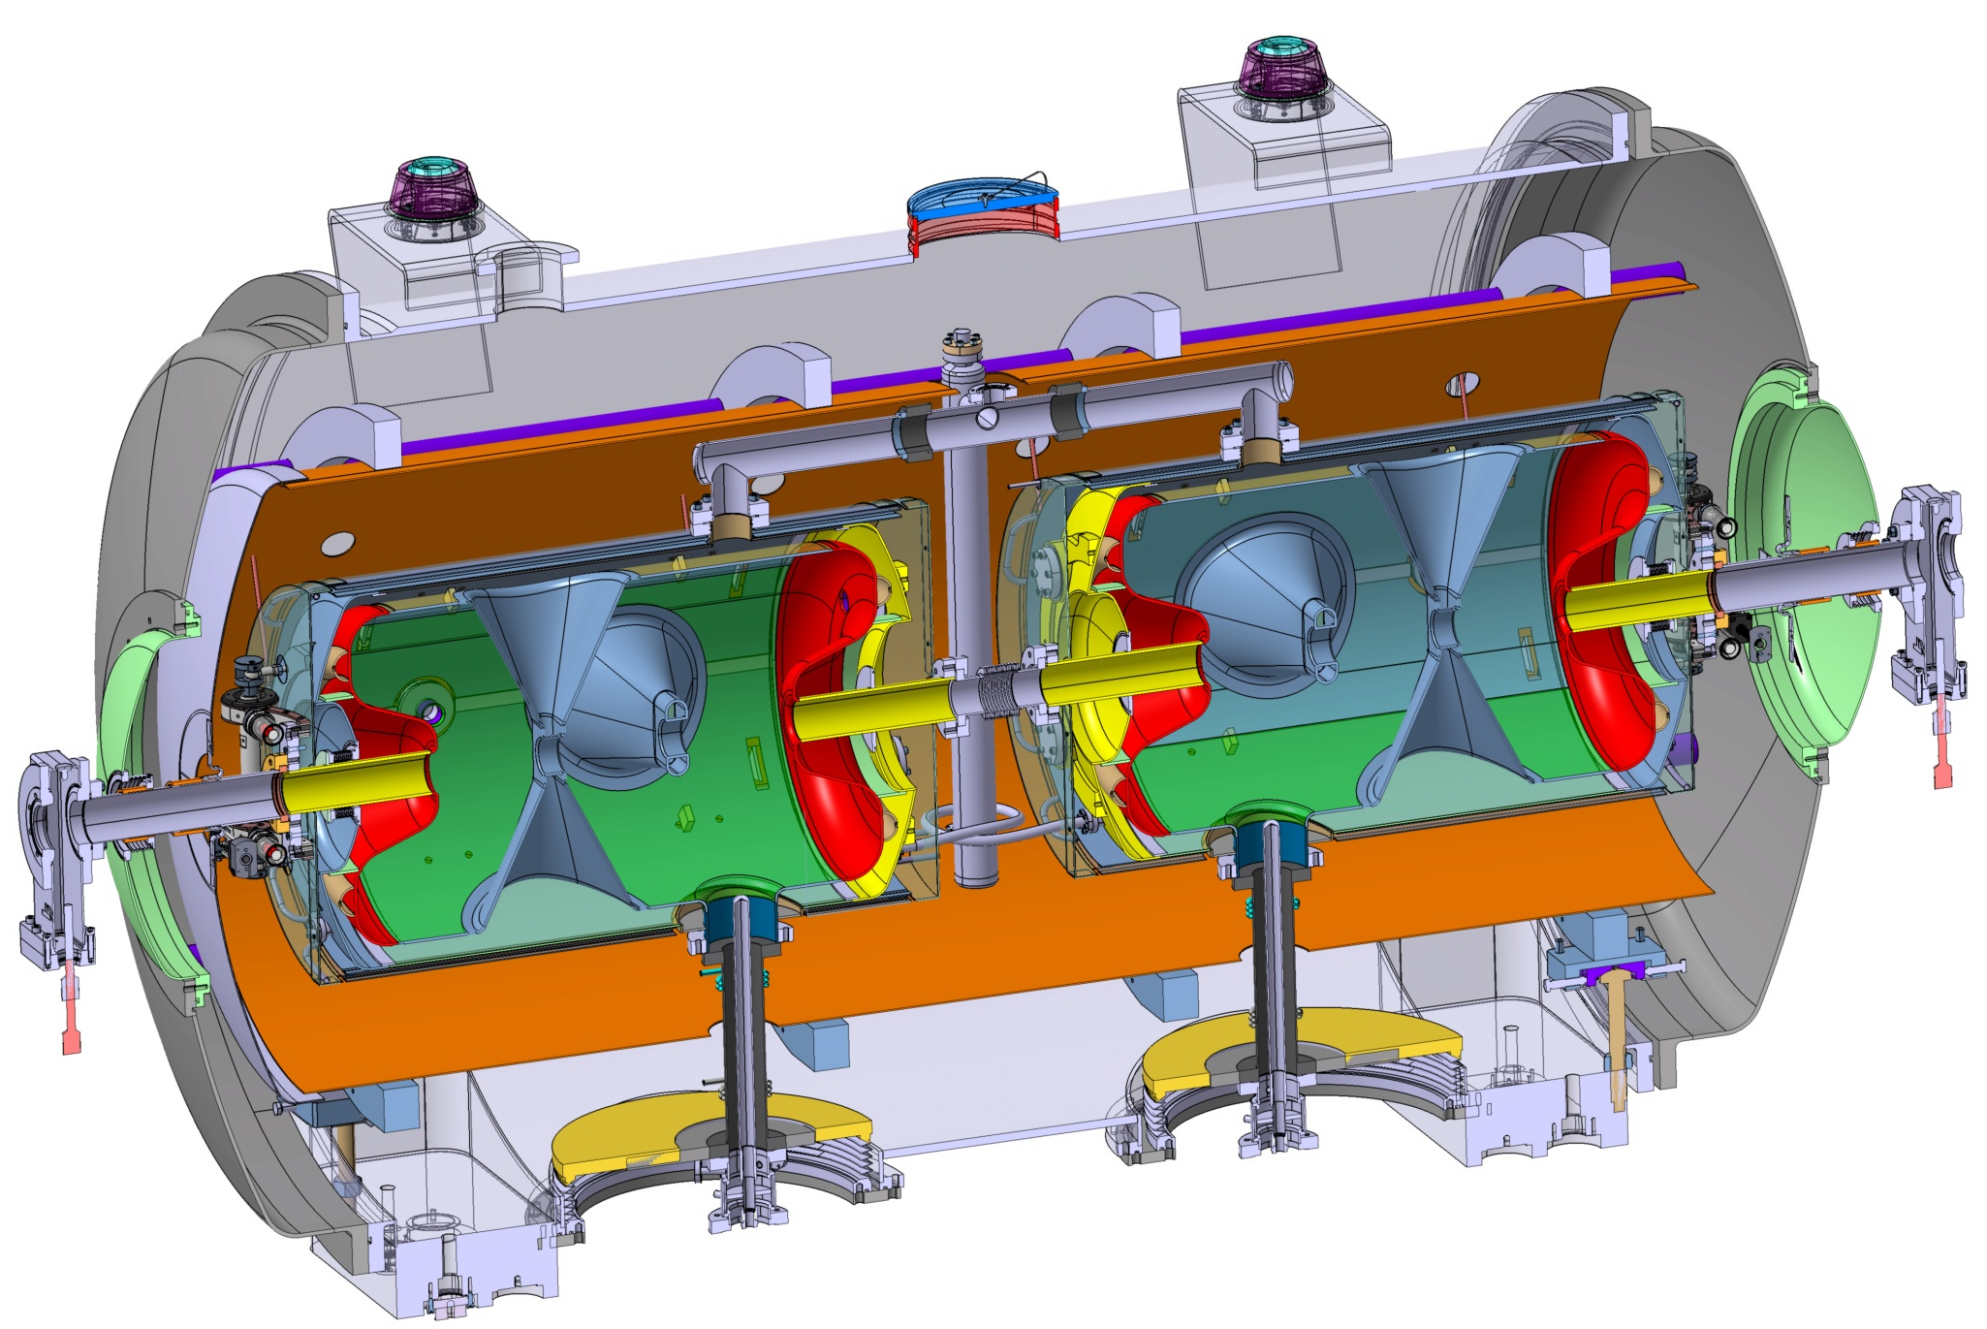
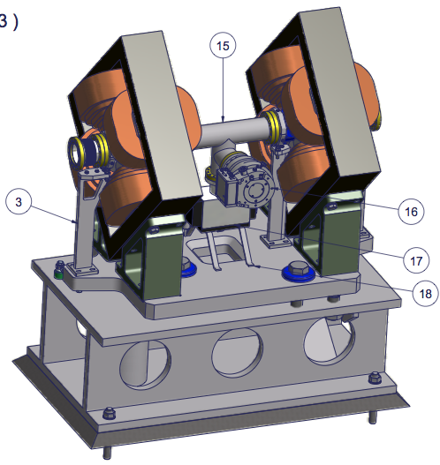
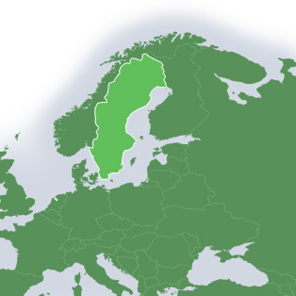
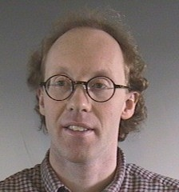


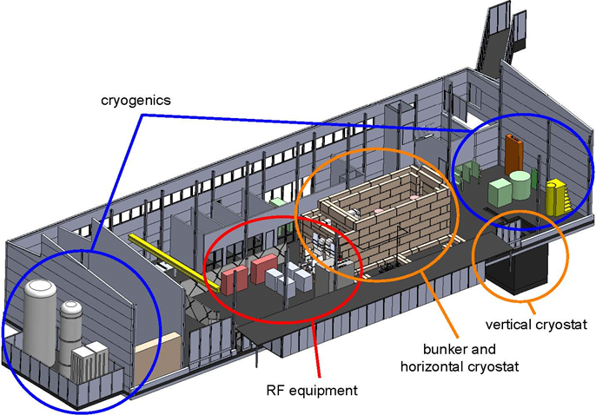
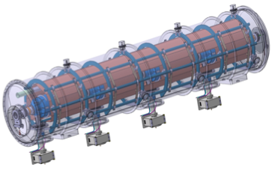

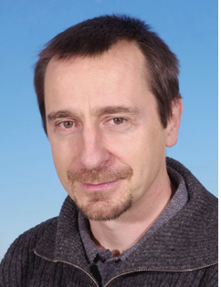
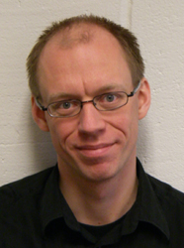
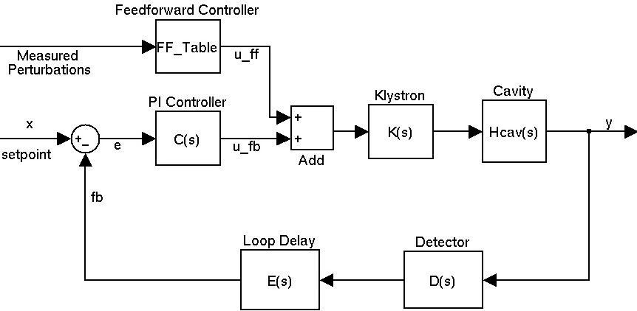

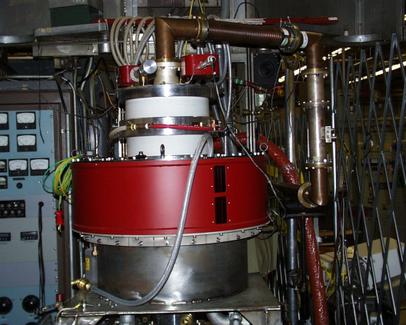


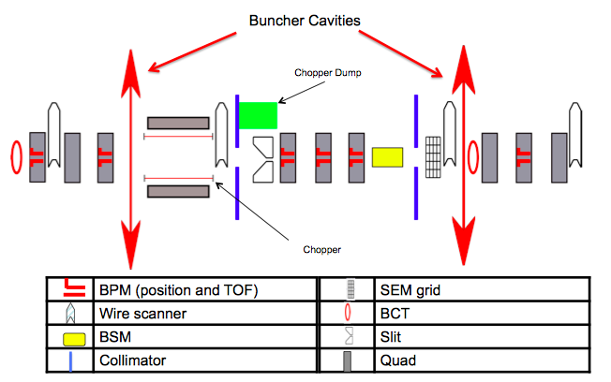
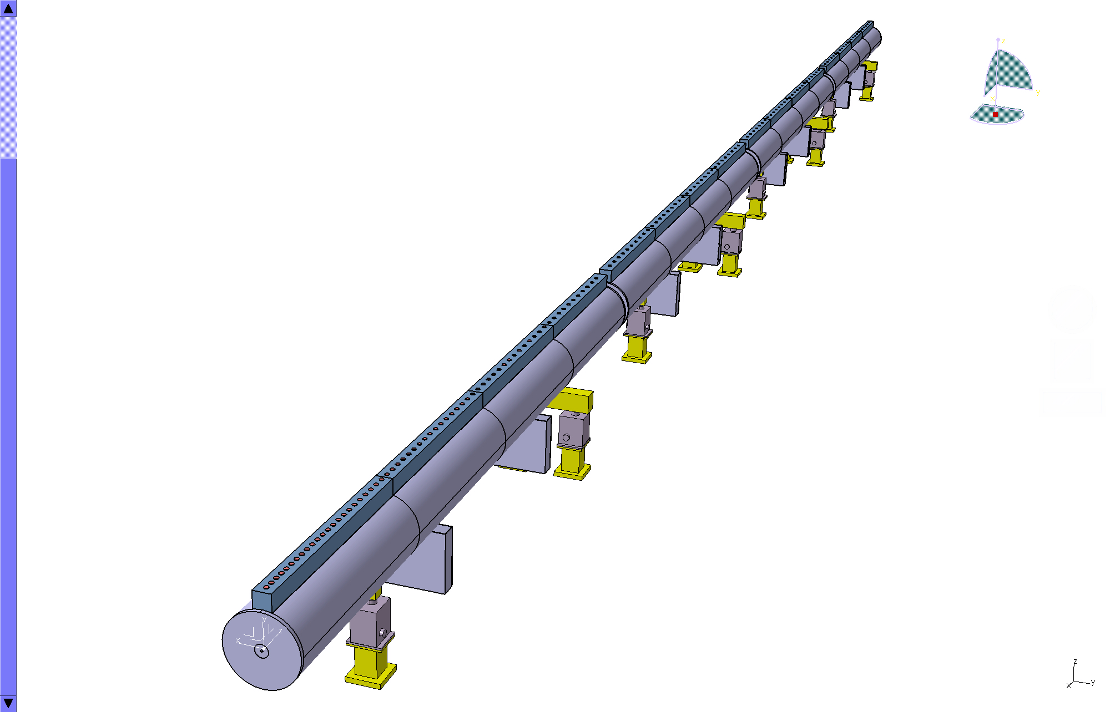
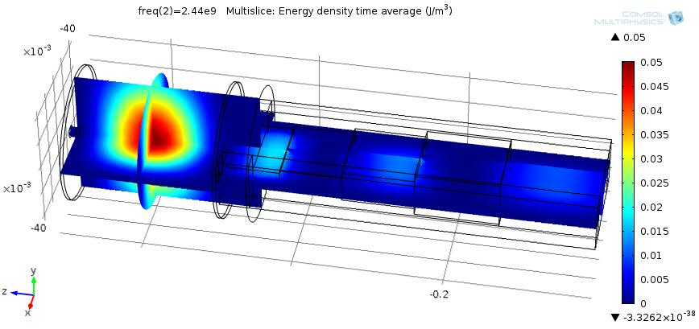
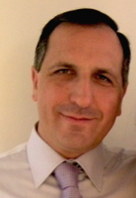


Prototyping the ESS accelerator
Søren Pape Møller
Sebastien Bousson
Roger Ruber
Pierre Bosland
Anders J
Johansson
CERN
The National Center for Nuclear Research, Swierk
Roger Barlow
Ibon Bustinduy
Santo Gammino

Slide 18
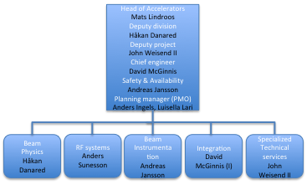
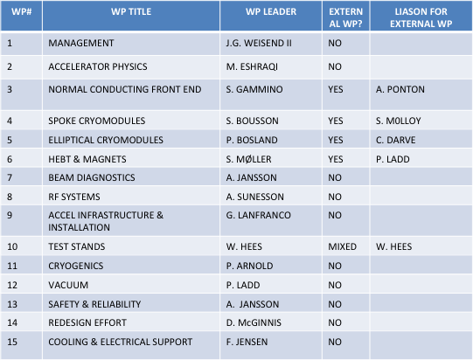
Organization and Work package leaders
Division and project aligned at high level
  “WP as a group” would make for too big fragmentation
  Four WPs have external leaders
Weekly or bi-weekly meetings at ESS Accelerator Division
  Management board of project and division
  WP leaders
  Lead engineers
  Safety
Regular meetings for ACCSYS project
  Technical board (all WP leaders and reps of labs/uni. with contract) as governance and CCB on project level (6 meetings per year)
  Collaboration board with reps of director of of labs/uni. with contracts as oversight committee
  Audits yearly of every WP
  Reviews (Conceptual, design, ready to build) as required mostly co-organized with audits
Lead engineers: Aurelien Ponton, Stephen Molloy, Tom Shea

Slide 19
Very high level Schedule
2010
11
12
13
14
15
16
17
18
19
20
21
22
23
ESS ADU starts
Redesign approved
Conceptual Design
First SC cavity ordered
CM prototypes launched
Spoke CM prototype available
Ellip CM productionlaunched
Decision on
Scope
SC linac 570 MeV ready
SC RF
NC and FE IK contracts
Injector test at Saclay
NC linac ready
NC linac
Klystrons and IOTs ordered
Prototype IOT tubes delivered
Decision IOT or klystrons
RF for medium beta ready
RF for High beta ready
RF
Cryo dist. line ordered
Acc cryoplant ordered
Early access cryo and test buildings
Cryoplant ready
Cryogenics
Early access to tunnel
First protons to target
1370 MeV protons available
2 GeV protons available
Services, installation and com.

Slide 20
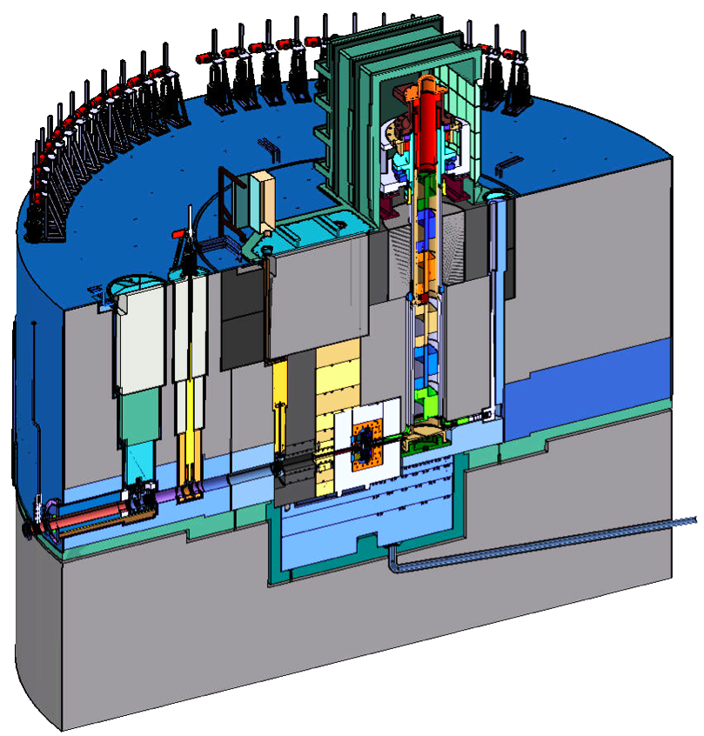
The target station design is detailed in the Technical Design Report
Helium-cooled rotating tungsten target
Nearly 5 MW of heat carried away by cooling systems
Entombed in 5 m of steel
Critical components become highly activated, requiring remote handling for servicing
Source: KIT
ESS Technical Design Report, ESS-2013-001, April 22, 2013, available at
http://eval.esss.lu.se/cgi-bin/public/DocDB/ShowDocument?docid=274 .

Slide 21
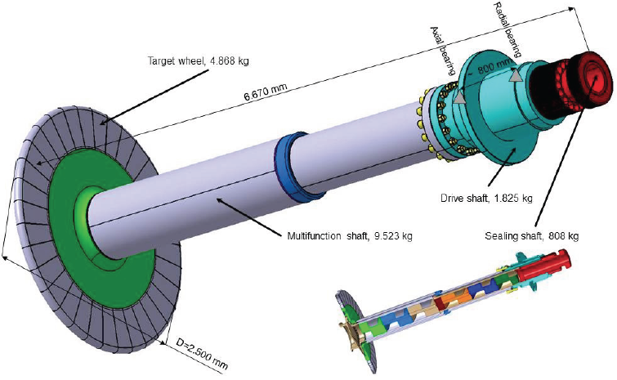
High beam power leads to an innovative design
Rotating tungsten target
  2.5 m diameter
  33 sectors
  Suspended on a 6 m shaft
  Total mass: 17 tonnes
  Rotational speed = 0.42 Hz
  Estimated lifetime = 5 years
Helium coolant
  3 kg/s flow rate
  4 bar inlet, 1 bar ∆P
  20°C inlet, 200°C ∆T
Source: KIT

Slide 22
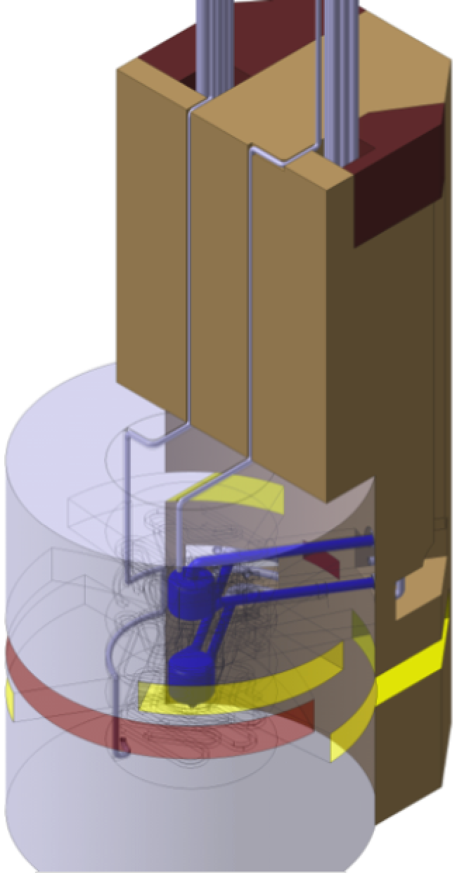
Liquid hydrogen moderators deliver cold neutrons to instruments
Moderator-
Reflector
Plug
Liquid para-hydrogen at 20 K carries away 20 kW
of deposited heat
Moderators surrounded by beryllium reflector provides peak neutronic performance
Moderator-reflector plug weighs 24 tonnes
Estimated lifetime = 1 year
moderators
inner Be
reflector
outer SS
reflector

Slide 23
ESS Reference suite of instruments

Slide 24
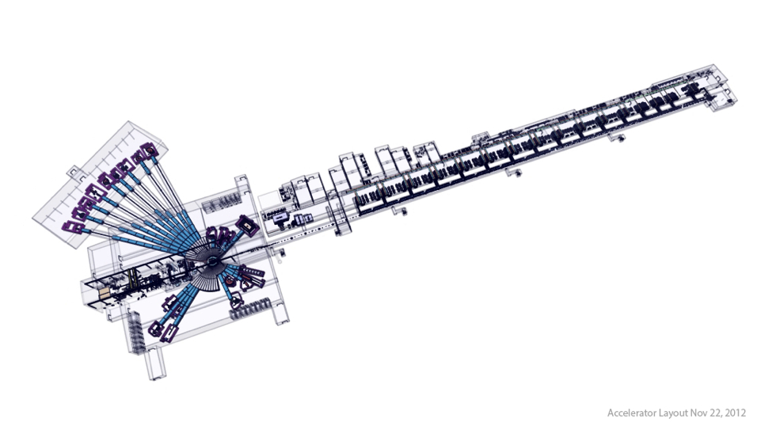
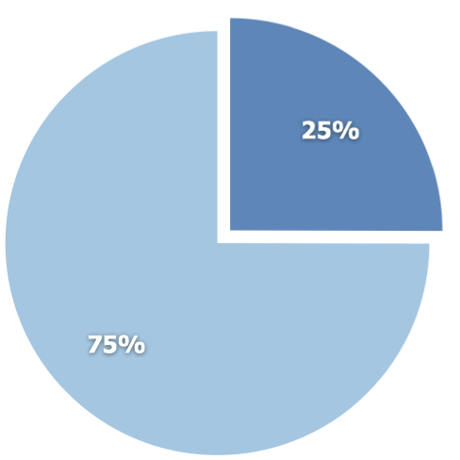
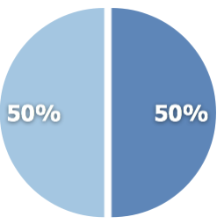
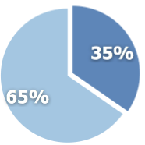
ESS In-kind contributions potential
Total construction cost:
€ 1,84 billion
Target station
€ 154M
Accelerator
€ 510M
In-kind
NSS/Instruments
€ 350M
Cash

Slide 25
Fundamental physics at ESS
The ESS Scientific and Technical Advisory Panel (STAP) on fundamental physics is charged to evaluate the scientific opportunities at the ESS for experiments that address questions in nuclear, particle, and astrophysics, as well as those that probe the character of the fundamental symmetries of nature and search for physics beyond the Standard Model. The STAP reports to the ESS Scientific Advisory Committee (SAC).
Last report “there are extraordinary opportunities for a class of fundamental neutron physics experiments that require the highest possible integrated neutron flux. Particularly notable among these is the proposed search for neutron-antineutron oscillations”
In addition to the neutron measurements relevant for fundamental physics possible at ESS the construction of a proton high intensity frontier accelerator also open possibilities for many other experiments such as neutrino oscillation measurements. The STAP recognized that this is beyond the competence of this committee to give recommendations.
ESS looking forward to relevant bodies in particle physics to study the case for ESSnuSB and make recommendations
25
Notes:
User driven innovation – external actor to be collective ownership

Slide 26
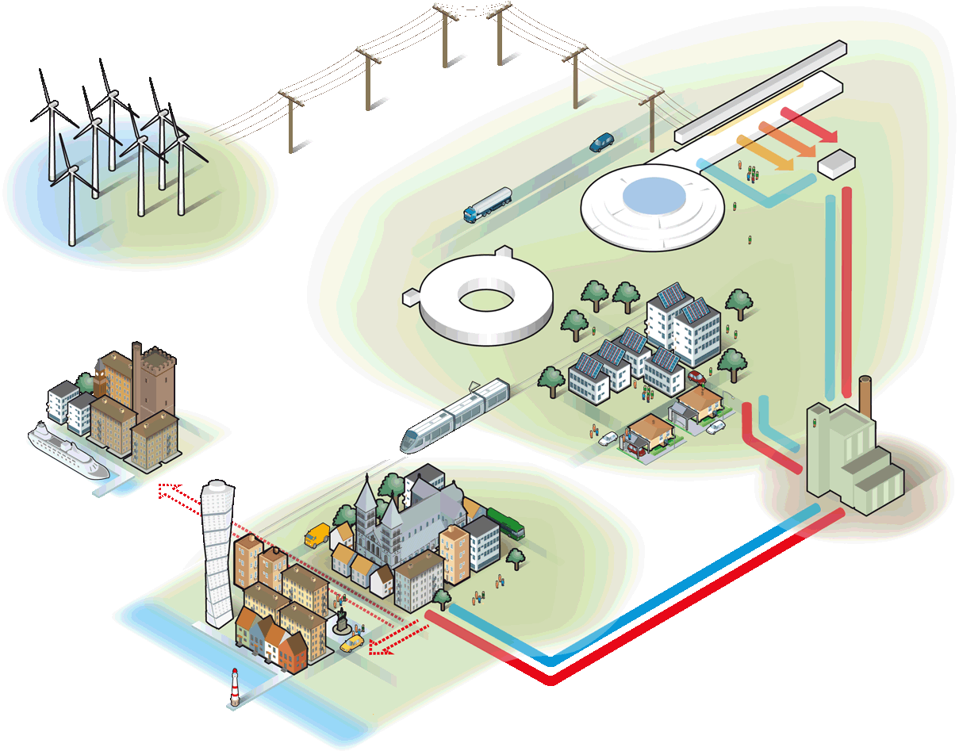
A sustainable research facility
Responsible
Carbondioxide:
- 30 000 ton/year
Renewable
Carbondioxide:
- 120 000 ton/year
Recyclable
Carbondioxide:
- 15 000 ton/year
Notes:
Högsta temp: 118 GWH
All värme: 215 GWh = 10 000 villor

Slide 27

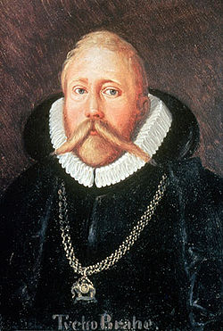
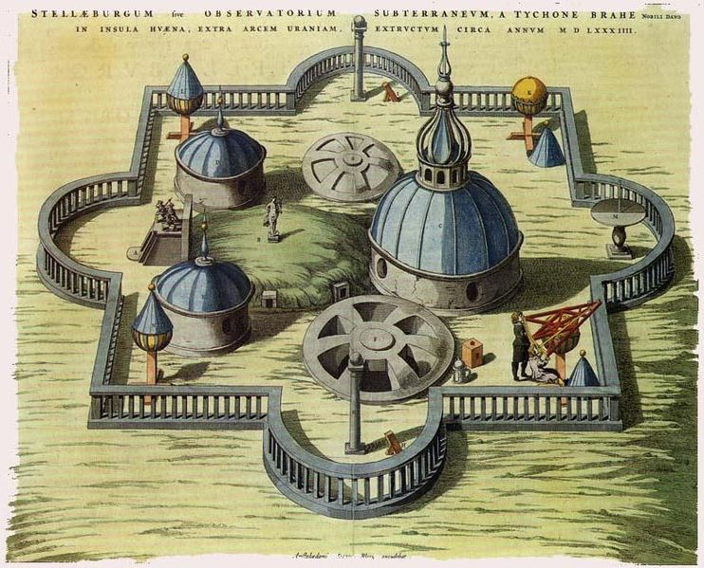
1.8 Billion Euros:
Biggest investment in Science ever in Scandinavia?
In modern time, definitely YES!
However, Tycho Brahe’s Stjärneborg costed the Danish king 1% of the state budget in 1580.
“With better measurements of the stars positions and movements I can make much better horoscopes for you, your majesty!”
Notes:
1% would be 1.7 Billion Dollars in 2011

Slide 28
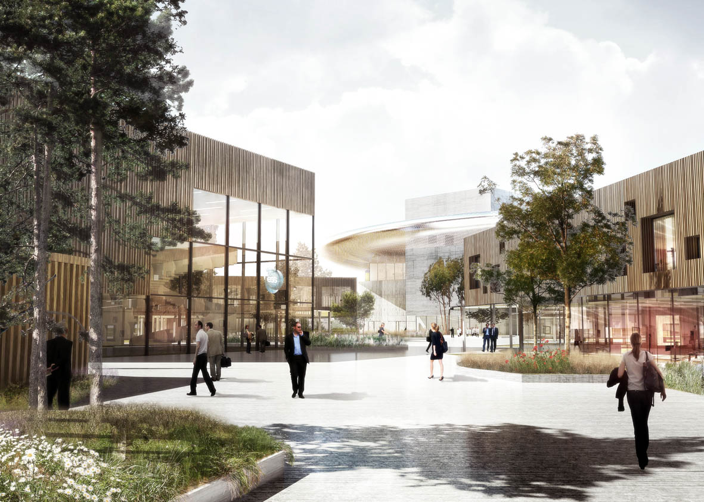

ESS will be at the proton high intensity frontier!
Welcome!

Slide 29
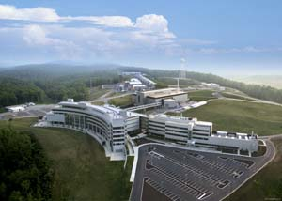

Short pulse neutron sources-SNS
SNS, SC LINAC/Storage ring, 2007, 1.4 MW, 1 GeV, 26 mA in linac, 627 ns long pulse, 60 Hz
Examples of challenges: Better understand stripping reaction in linac, accumulation in storage ring

Slide 30


Short pulse sources-LANCSE
LANCSE, NC LINAC /Storage ring, 1972, 100 kW, 800 MeV, 17 mA in linac, 600 ns, 20 Hz
Examples: Combined H- and H+ acceleration

Slide 31




Accelerated intensity at 800 MeV:
2.5x10¹³ ppp - 3.75x10¹³ ppp
(200 µA) (300 µA)
Neutron scattering facility
Two target stations
Muon facility
Examples of challenges: Ceramic vacuum chambers, high space charge synchrotron

