Slide 1

Présentation du Labex P2IO
Scientific Council – december 2014
Anne-Isabelle Etienvre

Slide 2
Welcome to the 3rd P2IO SC meeting
Goals of this meeting:
  Open session: summary of P2IO actions
    Presentations:
      Platforms, illustrative P2IO projects, teaching and outreach
    Poster sessions:
      R&D, post-doc and PhD
  Open discussion on the foreseen evolutions for P2IO post-2015 (tomorrow)
  Closed sessions:
    Discussions with several experts
    Interactions with Steering Com.
    First feedback from the Scientific Council and advices

Slide 3
Mandate
Suggested by Paris-Saclay University for the general 2015 LabEx evaluation
  Is the Labex fulfilling its objectives and goals? Is there a need to reconsider them?
  Relevance and ambition of future plans, and of the strategy to achieve them.
  What are the obstacles and problems the Labex faces up to? Is the Labex funding strategy appropriate?
  Are there key, overarching scientific questions that may have been overlooked in the current activities? Does the Labex promote the exploration of new frontiers?

Slide 4
P2IO in a few words
A network of 10 laboratories and 2 teams
  Funded by French Government in a general call (2011)
    14 M€ over 9 years (April 2011 – december 2019)
  Belong to 4 different organisms
    CEA, CNRS, Ecole Polytechnique, Paris Sud University
  1800 people (researchers & prof., engeneers, post-docs, PhD students)
  Goals:select and fund common actions to promote our science
  in an ambitious shared vision
    Explore: support for innovative and interdisciplinary initiatives
    Transform: enhance collaboration between P2IO members, create new common platforms,..
    Structure: contact point for internal and external collaborations

Slide 5
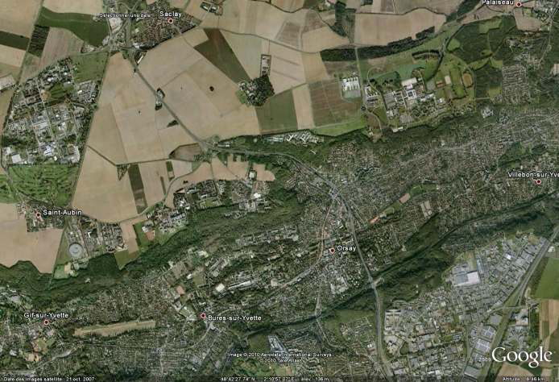

P2IO partners geographic localisation

Slide 6
P2IO in a few words
4 scientific themes:
  P1 :symmetries in the subatomic world,
  P2: dark components of the Universe and high energy gamma ray astronomy
  P3 : strongly coupled nuclear matter,
  P4 : formation of stellar systems and conditions for the emergence of life
3 technological themes:
  R1: innovations in accelerator science and their related spinoffs,
  R2 : advanced sensors and spinoffs,
  R3 : data mining and simulation
2 interdisciplinary themes:
  Energy : nuclear energy for the future;
  Health, new methods in imagery and therapies

Slide 7
P2IO added value
Internal
  Strengthening the links among the various members of P2IO
    Projects funded
    Dialog between directors, committees, working groups, outreach, newsletter ..
External
  Important role in the Paris-Saclay context (more during discussion with Jean Zinn-Justin)
    LabEx are key actors of the IdEx project → visibility
    P2IO is at the inteface between several research departments of Paris-Saclay
  Interactions with other french Labex on these topics
    Today: outreach and teaching; future: european calls?
  International: Paris-Saclay will be an important cluster → enhance P2IO labs attractivity

Slide 8
P2IO governance & evaluation
Steering Committee:
  Head of each P2IO member (10 labs + 2 teams)
  Coordination: A.I. Etienvre + Laurent Verstraete (Deputy)
  Main goals: funding decisions, scientific strategy elaboration, calls definition
  1 formal meeting/month (decisions taken by consensus)
P2IO evaluation:
  French Ministry (ANR) : report and meeting once a year
    Important step: June 2015 (mid-term evaluation)
  Overview report at the funding agencies: once a year
    Approves the budget and the overall strategy
  Scientific Council
    Advises the steering committee

Slide 9
P2IO actions: post-doc, PhD
Calls for post-doctoral and PhD students (700 k€ in average)
  Projects pre-selected by a specific committee (CSPD), final evaluation made by the Steering Committee
    Criteria: scientific intrinsic quality, synergy between P2IO teams for post-docs, added value for P2IO
    Candidates have to be validated by the steering committee
    PhD grants: half-grants only → increase global funding
  28 post-docs, 14 ongoing
  10 PhD, all ongoing
Outgoing P2IO post-doc (14):
  12 still in research: 10 with a non permament position, 2 on a permanent position
  2 on a permanen position within industry/bank
Reports required once a year
Poster session during SC

Slide 10
P2IO actions: post-doc
Project supervisor | Laboratory | Subject | Candidate
2011
ARNAUD | IRFU | Analysis of the cosmological clusters in the Planck catalogue (P2) | Antoine Chamballu
DELIOT | IRFU | Search for top quark (P1) | Lisa Mijovic
GROSDIDIER | LAL | QCD network computing (P1, R3) | Konstantin Petrov
MUNOZ | IPN | DVCS and extraction of GPD (P3) | Rafayel Paremuzyan
POULET | IAS | Mars climatic evolution and search of habitability conditions (P4) | J. Flahaut+ C. Massé
VAN TENT | LPT | Modified gravity and cosmological perturbations (P2) | Shuntaro Mizuno
2012 (Theory Post-Docs)
MOREAU | LPT | Higgs Bosons beyond the standard model | Roberto Barcelo
PETROPOULOS | CPHT | Black hole: microscopical and holographical aspects | M. Mukhopadhyay
WALLON | LPT | Theory and phenomenology of hard and exclusive QCD reactions | Leandro Almeida
2012 (Experimenter Post-Docs)
ARMENGAUD | IRFU | Search for WIMPs with EDELWEISS-III detectors (P2) | Marie-Cécile Piro
DELLA-NEGRA | IPNO | Meteorites, exobiology and the Andromeda project (P4) | Mickael Eller
LJUNGVALL | CSNSM | Electromagnetic moments in exotic nuclei (P3) | Alain Goasduff
MARTINET | IPNO | Superconducting materials: an alternative to massive niobium in cavities (R1) | Cédric Baumier
POESCHL | LAL | Pattern recognition and machine learning for imaging calorimeters (P1) | Naomi van der Kolk
2013 (Post-Docs)
BERNARD | LLR | HARPO | Philippe Gros
CANNES | IPNO | Electro-deposition of actinides in ionic liquids | Servando Lopez-Leon
CAPRINI | IPhT | Gravitional waves as a new probe of the dark side of the Universe | Nicola Tamanini
COUDERC | IRFU | CMS : spin-parity of the new boson | C. Favaro
D'HOSE | IRFU | COMPASS : proton transverse radius measurement | E. Fuchey
OLLIVIER | IAS | Instrumentation for characterizing planetary atmospheres | C. Danielski
GIULANI | CSNSM | Optimization of optical bolometers for dark matter and double beta decay experiments | D. Poda

Slide 11
P2IO actions: post-doc
2013 (inter-Labex)
MAMBRINI | LPT | QEAGE | Scott Robertson
2014 (post-docs)
ABADA | LPT | Physics of lepton flavor at LHC and high intensity experience era | T. Toma
BALDISSERI | IRFU | Upsilon study in Pb-Pb collisions and proton-proton in ALICE | A. Lardeux
LACROIX | IPNO | Microscopic description of fission (MicroFis Project) | Y. Tanimura
SALERNO | LLR | Study of the Higgs boson self-coupling in the CMS experiment | G. Ortona
VARIOLA | LAL | Characterization of collimation by crystal bent at LHC | L. Massacrier
YECHE | IRFU | Study of the dark energy with BAOs in eBOSS and LSST | A. Raichoor

Slide 12
After 3 years, reasonable equilibrium between themas/laboratories
 | CSNSM | IAS | IPNO | IRFU (6 labs) | LAL | LLR | LPT | CPhT | IPhT
P1 |  |  |  | Deliot Couderc | Grosdidier Poeschl | Salerno | Moreau Abada | Petro- Poulos
P2 | Giulani |  |  | Armengaud Arnaud Yeche |  | Bernard | VanTent |  | Caprini
P3 | Ljungvall |  | Munoz Lacroix | D’hose Baldisseri |  |  | Wallon
P4 |  | Poulet Ollivier | Della Negra
R1 |  |  | Martinet |  | Variola
Ener-gie |  |  | Cannes

Slide 13
P2IO actions: PhD
10 PhD ongoing, all co-funded by P2IO
  Several co-funding sources have been investigated with a high rate of success
Project supervisor | Laboratory | Subject | Candidate | cofunding
2013
DESCOTES-GENON | LPT | Search for right weak currents in the quark sector | Luiz Vale Silva | CNRS/INP
RIMBAULT | LAL | Fast luminosity monitoring using diamond sensors for super luminous B meson factories | Dima El Khechen | ED 517
URBAN | IPNO | Collective modes in the internal crust of a neutron star | Noël Martin | CNRS/IN2P3
LANGER | IAS | Magnetic fields at very large cosmologic scales | Jean-Baptiste Durrive | complete financing
GRANA | IPhT | String theory | M.Nkotos | ED 107
2014
BACHACOU | IRFU | Discovering the Higgs boson produced in association with a top-anti-top pair using boosting techniques | Eloi Le Quilleuc | CEA
DORE | IRFU | Characterization of fission fragments and development of FALSTAFF device | Loic Thulliez | CEA
HELLO | LAL | Search of gravitational waves with Advanced Virgo and Advanced Ligo detectors | J. Casanueva | IN2P3
RAMNSTEIN | IPNO | Studying excited states of the nucleon with the HADES detector at GSI | F. Scozzi | GSI
M. El Khaldi | LAL | Development of a copper compact accelerating section with strong gradient in band S (3 GHz) for Thom-X LINAC | L. Garolfi | Industry

Slide 14
P2IO actions: R&D
R&D small upstream projects (2011, 2013, ..): 550 k€
  Projects are pre-selected by a specific committee (CSRD)
    Criteria: innovative project, synergy between labs,
    added value for P2IO
    Final selection: steering committee
  2011 projects (9) : all well advanced → see poster session (+ 1 talk)
    Mid-term report required
  2013 call: 9 projects out of 25 have been selected
  Poster session today

Slide 15
Actions : R&D
2011 call
Project Supervisor | Laboratory | Subject | Allocated budget(k€)
Bambade | LAL | Development and implementation of semi-conductor sensors for measuring ATF2 beam halo and detect Compton recoil electrons after interaction point | 55
Bernard | LLR | Astronomy of high angular precision and polarimetry, over the threshold of pair creation, MeV-TeV | 81
Chamont | LLR | GridCL | 61
Delagnes | IRFU | SAMPIC | 70
Lunney | CSNSM | A novel antiproton‐decelerator concept | 96
Marnieros | CSNSM | New generation cryogenic sensors for Astrophysics and Cosmology observation | 70
Martinet | IPNO | Superconducting Thin Film multilayered for SRF accelerating cavity | 80
Tatischeff | CSNSM | Development of a small Compton telescope prototype with gamma rays | 40
Yvon | IRFU | Ionization detector for CALIPSO project | 40
TOTAL |  |  | 593

Slide 16
P2IO actions : R&D
2013 call

Slide 17
P2IO actions : R&D
Summary (18 projects, 590 + 530 k€)
 | CSNSM | IAS | IMNC | IPNO | IRFU | LAL | LLR
R1 | Lunney (96) |  |  | Martinet (80) |  | Delerue (50)
R2 | Marnieros (70) Tatischeff (40) | Brunetto (74.5) |  | Blumenfeld (67) | Schwemling (56) Nones (76) Delagnes (70) Gunsing (43) | Leroy (58) Bambade (55) | Bernard (81) Zabi (42.5)
R3 |  |  |  |  |  |  | Chamont (61)
Santé |  |  | Ménard (65) |  | Yvon (40)

Slide 18
P2IO actions: new platforms
Proposals made by our technological groups:
    Acceltech, CaptInnov , Radiomatter, Virtual data, Spacetech
First call (2012): 2 projects
    CaptInnov : 200 k€ from P2IO + 140 k€ from the Region Ile de France: an illustration of a way to maximize the impact of our limited resources
    Virtual data (300 k€)
    See presentations today → impressive collaborative work
Second call (2014): 3 projects selected
    Intrapix: characterization of the intrapixel answer variations for astrophysics detectors (150 k€ from P2IO + add. Funding from Ile de France)
    PANAMA:surface characterization and cryogenic properties measurements
    ACTIF: radioactive surface studies, within the CACAO facility

Slide 19
P2IO actions
Call for platform operations (90 k€)
  Decreasing ; will be centered on specific P2IO platforms in the future
Teaching and outreach (120 k€)
  See L.Verstraete’s talk today
Visitors, conferences

Slide 20
P2IO open day
3/11/2014: summary of P2IO actions/projects to our local community
  Excellent feedback
  200 people
  https://indico.in2p3.fr/event/10666
Consequently, meeting with ANR (French National Agency)
  Very positive feedback on the progress made by P2IO (publications, R&D breakthroughs, structuration)
  Mid-term report: ready in March, oral presentation in june

Slide 21
Success criteria
Current definition
Criteria | 2015 | 2020 | Achieved (2014)
Number of scientists incoming | 2 | 8 | No specific grant 16 visitors
Number of national and international contracts | 5 | 10 | 2 (platforms) 8 (PhD Grants)
Publications | 25 | 60 | 55
Conferences | 5 | 10 | 6 specific P2IO 25 funding
Technological breakthroughs | 3 | 8 | 6 R&D projects achieved
Platforms | 4 | 8 | 5
Common bids | 3 | 8 | 3
Actions inter Labex | 3 | 5 | 2
Interdisciplinary partnerships | 2 | 5 | 3
Industrial partnerships | 2 | 5 | 1

Slide 22
Success criteria
Possible update
Criteria | Comments
Number of national and international contracts | Submitted/successful + specify amount of money thus obtained Separate national and european contracts
Publications | Could be more ambitious then the actual criteria
Conferences | Could be more ambitious (require high level conferences related to incoming visitors,..)
Technological breakthroughs | Give the number of patents?
Platforms | OK
Interdisciplinary partnerships | Number of P2IO interdisciplinary projects
Industrial partnerships | Difficult to disentangle from strong, existing partnerships → underestimated now

Slide 23
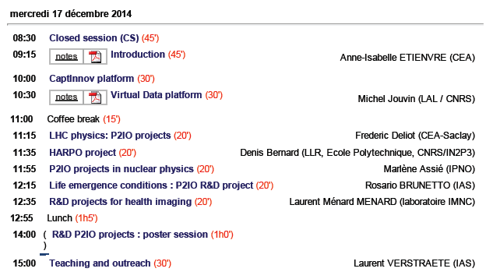
CSI 2014

Slide 24
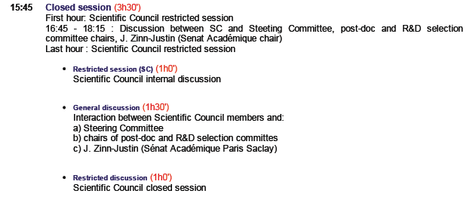
CSI 2014

Slide 25


CSI 2014

Slide 26
Budget
2014 budget consistent with the predictions
Poste budgétaire | Budget prévisionnel 2014 (k€) | Budget réalisé 2014 (k€)
R&D | 500 | 601,14
Post-docs/doctorants | 800 | 800
Valorisation | 50 | 50
Formation | 129 | 47.5
Jouvence plateformes | 90 | 0
Attractivité | 30 | 16.5
Gouvernance | 20 | 20
Total | 1569 | 1535,14

