Slide 1
CaptInnov Platform
− For new generation sensors and signal processing −
David Attié (CEA/Irfu)
on behalf of Rémi Cornat (LLR)
P2IO Scientific Council, December 17th, 2014

Slide 2
CaptInnov Group Within P2IO
Created in 2010: one of the 5 technical groups
Coordinator: Rémi Cornat
One representive: in each P2IO lab (except LPT)
P2IO staff involved in CaptInnov: 193 (physicists, ingineers & technicians)
Many international collaborations: CERN, FERMILAB, SLAC, INFN, DESY, PSI, KEK, ESA….
and networks: AIDA, RD51, NUPNET, …
National collaborations: Labex Univearth, … technical platforms (PTA, Minerve), Universities
and other labs of CNRS
Strong involvement of P2IO detection teams in Physics experiments: (HL-)LHC, ILC, AGATA,
Spiral(-2), Auger, Edelweiss(-II/III), Super-B, Planck, T2K, etc.
 | Bolometers |  | Photo- detectors |  | Gaseous detectors |  | Semi-conductors |  | Scintillators |  | Electronics |  | Mechanics | Vaccum | Cryogenics | Optics
 | R&D | Test | R&D | Test | R&D | Test | R&D | Test | R&D | Test | R&D | Test | R&D | Test | R&D | Test
CSNSM
IAS
IMNC
IPN
IRFU
LAL
LLR
CaptInnov test platform

Slide 3
Motivations of the CaptInnov Group
Expertise for R&D project pre-evaluation before submission to selection committee
In the field of semiconductor sensors/circuits
Develop informal relationship within the instrumentation/electronics community of P2IO labs
Share technical information and possibly share hardware, tools, facilities…
Propose common projects, in particular concerning facilities
High quality tools for detector & chip characterization and integration
Best performance wrt. existing tools (CERN, Carnot network, …)
Tools having no existence in close area institutes
Answered to P2IO call for platform proposal

Slide 4
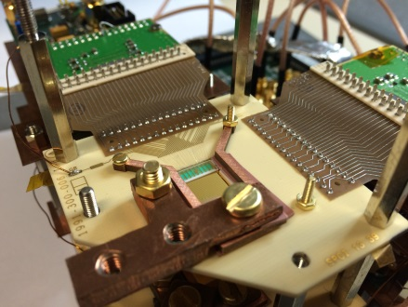
Examples of Potential Needs
Characterization of fine pitch, large size components is a key issue
Can concern semiconductor detector or chips, hybrids, printed circuits
R&D developments require reactivity, flexibility and home expertise
Needs are not always affordable for sub-contractors
Large size
High precision
R&D cycles
Octopuce board
2x4 matrix of Timepix chips
APV chip for COMPASS Double row bonding
Sap R&D for Space Mission
ILC – Si-W ECAL detector module : 18x18 cm, 1024 PIN
AFTER front end board (ILC TPC), 13x6 cm²
ASIC bonded within the PCB thickness

Slide 5
CaptInnov Platform
Proposal for sharing top level equipment Intended for electronics/detector integration and high precision testing
Consensus to give priorities to a probe station and a bonding machine Can be extended thanks to next calls for projects?
“Platform” concept:
equipment located in 2 sites (LAL, CEA)
free/easy access to site(s)
opened to every P2IO members, partners and external structures (fees)
Coordination by an executive committee
User support thanks to trained expert person
The platform concept comes essentially from the building of a small (engaged) user community? link with existing professional networks (IN2P3)
Home site
Executive committee
Expert
P2IO members
Partners
External users
User
User

Slide 6
Funding of the Platform
EQUIPEX project (original):
2 – 3 M€, 4 FTE
Measurement Intruments
…continued under the CaptInnov group
Emission microscope
1st call (2012)
Achievement phase (Q3’13)
Acoustic scanner
P2IO
Probe station
Upgrade to largest dimensions 20 cm → 30 cm
Probe station
CAPTINNOV 1
Capability for thermal regulation
SESAME
LLR
Bonding M.
P2IO
Trainings
Bonding machine
Auto → Semi-Auto
Pick&Place machine
200 k€ from P2IO (+maintenance)
140 k€ @LLR from regional community (Ile-de-France Region)
Buildings

Slide 7
Initial Platform Funding Summary

Slide 8
Achievements of the Project
The two machines ordered end of July’13
Bonding machine is installed in clean room at Irfu (October’13) and first training passed
New dedicated clean room (LAL) is functional
Probe station and thermal system installed at LAL (July’14)
In qualification phase
Finalizing a platform convention (management, access rules, terms of use, …) to be agreed at the P2IO level
Training of experts (2 operators @ CEA, 1 CDD @LAL) opening to the community: next year

Slide 9
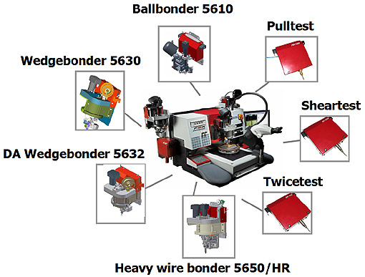
Bonding machine: DELVOTEK 5632
Universal Semi-Automatic Wire Bonder

Slide 10
Bonding machine: DELVOTEK 5632
Semi-automated machine:
fully programmable step mode
pattern recognition unit (alignment)
controlled z axis positioning
online wire shape control (angle, tense, bending)
manual operation allowed
360° operations
deep access head allow bonding in cavities or close to components
Several heads may be ordered in addition for various type of bonding:
wedge- or ball-bonding
gold or aluminum material
wire or ribbon
mechanical pull/shear tests (require additional head, not ordered)
Current configuration: wedge-bonding with aluminum wire

Slide 11
Bonding Machine Status
3 people trained since end of September 2014
First works done
for IAS: connection wires of CCD have been repaired (aluminum)
for Irfu: gold bonding on flex cable for IXO cryogenic detector R&D
Need to improve experience before becoming expert
A platform agreement has been written between CEA and CNRS
1 day a week for practice
Team pending

Slide 12
Probe Station: SIGNATONE WL350
Have chosen complete thermal system against full automation and performance (<100 fA, 100 fF levels)
Partly-automated machine: open software allows any kind of programming
Features:
30cm workholder in a micro chamber: black box & faraday cage, triaxial connectors
Any kind of characterization (DC, AC -50GHz, S, noise, 1/f)
Large choice of DC & RF probes
Wafer level tests or single die
Probe card holder for specific probe configuration
Micrometric resolution
12° spin correction
Temperature control -60° to 200°
Installed in a clean room at LAL

Slide 13
First Pictures (Installation)
Probe holder
9 cm
Chuck (opened)
Probe
EMI enclosure
Microscope
DUT in position

Slide 14
Probe Station Status
Microworld, provider company, will solve
a planarity issue (<5 µm)
the compatibility issue between compressor-thermal unit
Teams are pending the availability of the probe machine:
LAL, IPNO, IAS, CEA and LLR for detector with pixels or strips
but also APC
Two days of training are planning end of January and beginning of February next year

Slide 15
CaptInnov Extras
The CaptInnov group also take care of:
Training: Some training courses possible + help of experts
Hardware pool: Will (try to) share probes and measurement hardware
Software options:
Automation capability or user friendly control environment
Control of external hardware in NOT included as well as acquistion
Planning of user access and maintenance operations Coordinated by dedicated experts
Forge web site : https://forge.in2p3.fr/projects/P2ioCaptinnov (internal, will be opened within few months)

Slide 16
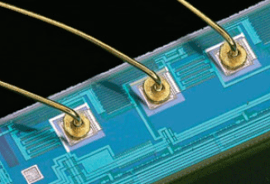
Conclusions
Two high quality machines have been installed
High potential for R&D, a large set of projects are already interested in:
ATLAS pixels (vertex) and 3D electronics
TF2 (diamond sensors)
ILC TPC & large micromegas R&D
Compton telescope (DSSD detector + ASICs)
ILC ECAL (large PIN diode matrices, SoC ASICs, big production tests, …,…,….)
…
The platform can be completed later on… Keyence Digital microscope ordered last week at Irfu
Organization, rules, access and hardware qualification are on-going
The platform should be opened to local community within ~1 yr.
Future functioning will be based on goodwill and user’s contributions

Slide 18
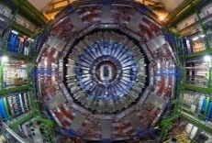
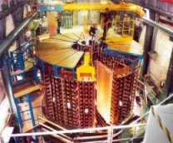
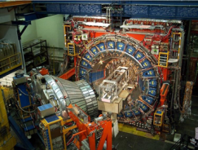
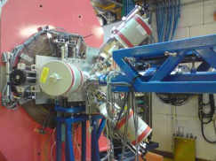
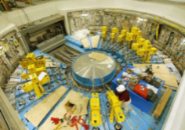
Detectors studied by the labs of P2IO (1)
Applications
Challenges
Fields of research
Experiments/R&D
High granularity(10⁷channels)
Large size
High B field (→ 4 T)
High rate
Radiative environment
Material « budget »
Semiconductors
Gaseous
Low pressure
Scintillators
Photodetectors
Microelectronics
ATLAS,CMS,ALICE
HL-LHC upgrades
ILC
COMPASS
CLAS12
Spiral(2)
…
Calorimetry &
Trajectography
High number of channels (10⁵)
Low background
Single photon sensitivity
Gaseous detectors
Photodetectors
Microelectronics
T2K
Double Chooz
ANTARES
…
Neutrinos
Single photon sensitivity
Precise timing
Digital treatment
Semiconductors
Gaseous detectors
Digitization
SuperB
Fazia
…
Particle Id
AGATA
S³
…
γ spectroscopy
Nuclear phys
High resolution detectors
Low noise → cooling
Digital treatment
Semiconductors
Low noise FE
Digitization
Large size> 1 m²
Precision Mechanics
Spatial resolution < 1 mm
Good S/N
Timing
CLAS12
Demin
Sedine
NFS
Neutron
detection
Photodetectors
Gazeous detectors

Slide 19
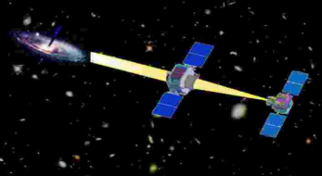
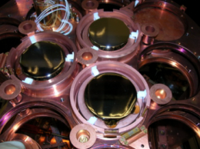
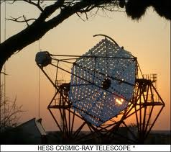
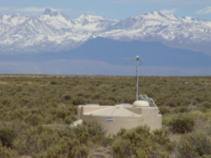
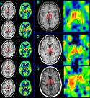
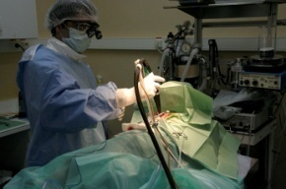
Detectors studied by the labs of P2IO (2)
Applications
Challenges
Fields of research
Experiments/R&D
Low noise
Space environment
Miniaturisation
Low power
Large number of channels
Semiconductors
Microelectronics
Scintillators
MACSI
Solar orbiter
Compton camera
Spaceborn
spectro-
imagers
Low background
Low noise
Ultra low temperature
Material purity
Bolometers
Gaseous detectors
Photodetectors
Low noise electronics
Edelweiss(-II/III)
SuperNemo
Cast
…
Dark matter
search
Cosmic Rays
Single photon sensitivity
High efficiency
Precise timing
Digital treatment
Photodetectors
Ultrafast digitizers
Antennas
Auger
H.E.S.S.(2)
Codalema
Spatial resolution(mm)
Detection efficiency
B field (IRM PET)
Miniaturization
Ergonomics
Biomedical
Scintillators
Photodetectors
Semiconductors
Microelectronics
ART
CALIPSO
SIPMED
PIXSIC
MONITEP

Slide 20
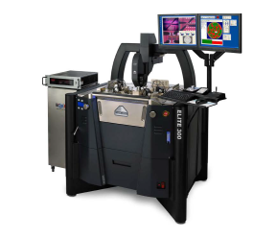
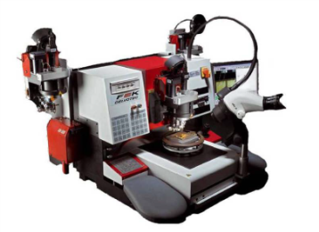
Supports of P2IO for detection systems
No postdoc funded
Support for collaborative R&D on detectors: 300 k€ funded in 2011 (for 3 years)
Project | Field | CSNSM | IAS | IMNC | IPNO | IRFU | LAL | LLR
New generation of cryogenic detectors | bolometers
HARPO | Space techno, gaseous detector
SAMPIC | Fast timing electronics, Photodetectors
CALIPSO ionisation | biomedical
COMPTON telescope | Space technologies, semicon, scintillators.
CaptInnov test platform (182 k€):
Advanced probe station + bonding machine,
Usable for large area devices,
Usable for detectors & (micro-)electronics,
« Seed » funding of P2IO complemented by application to Univ. Paris-Sud and IdF region
Other supports:
Workshops (PhotoDet 2012, …) and schools (Rencontres de physique de l’infiniment grand à l’infiniment petit 2011/2012, …)
Support for visitors (P^{r} Savvidis, …)
Platform operational supports (~10 k€): Cryogenic, Dalton, Calva

Slide 21
Prospects and conclusions
Each year:
Yearly status reports for each R&D project
Longer term:
CaptInnov platform: operational next year (mi-2013)
Starting point to improve synergy between detector teams of P2IO labs
P2IO supports are precious for risky and innovative R&D of detector systems
Initial stage of R&D before asking funding to agencies (Cnes, ESA, ANR, …).
These platform and R&D projects can be a starting point for partnership with industries
Platform are also planned to be used for teaching purposes

