Slide 1
Toward the Paris-Saclay University
Since at least two decades, at the government level, there is constant will to develop a number of large, world-class
research, teaching and innovation ecosystems. The Shanghai ranking has accelerated the process.
One of the largest ecosystem (and the more complex to create) will be the Paris-Saclay University,
a federation of 19 partners corresponding to 23 institutions located in the south--south-west of Paris.
The driving force behind the transformation is the Fondation de Coopération Scientifique (FCS) du campus Paris-Saclay, which manages the Idex project and the corresponding funding

Slide 2
The partners: National research organizations and their local laboratories
1. Centre national de la recherche scientifique (CNRS) ;
2. Commissariat à l’énergie atomique et aux énergies alternatives (CEA) ;
3. Institut des hautes études scientifique (IHES) ;
4. Institut national de la recherche agronomique (INRA) ;
5. Institut national de recherche en informatique et automatique (Inria) ;
6. Office national d’études et de recherches aérospatiales (ONERA) ;
7. Institut national de la santé et de la recherche médicale (Inserm) ;

Slide 3
The partners: Higher education and research institutions
8. Institut des sciences et industries du vivant et de l’environnement Agro Paris Tech (APT) (to move to the Paris-Saclay campus)
9. Ecole centrale Paris (ECP) (to move to the Paris-Saclay campus)
10. Ecole des hautes études commerciales (HEC)
11. Ecole polytechnique (X)
11. Ecole normale supérieure de Cachan (ENS Cachan) (to move to the Paris-Saclay campus)
13. Ecole nationale supérieure des techniques avancées (ENSTA ParisTech)
14. Ecole supérieure d’électricité (Supélec)
15. Groupe des écoles nationales d'économie et statistique (GENES) ;
16. Institut Mines-Télécom (IMT) (to move to the Paris-Saclay campus)
17. Institut d’optique Graduate School (IOGS)
18. Université Paris Sud (UPSud)
19. Université de Versailles-Saint-Quentin-en-Yvelines (UVSQ).

Slide 4
The UPSay campus: some figures
About 10% of French public research
10500 teachers and researchers
60000 students
8000 publications per year
3 Nobel prizes
6 Fields medals
More than 70 ERC Grants (15% France, 2% Europe)
5 700 PhD students
25 000 Master students
Proportion of foreign students and researchers: 23%
A number of large companies are building research centers on the campus. New transportation systems and housing are planned.
More on the campus Paris-Saclay site: www.campus-paris-saclay-fr

Slide 5
The present situation
A chart proposed by the partners is in the hand of the various ministers involved to be approved (hopefully before the end of the year) for an official creation of the federation (technically a COMUE) beginning 2015, in such a way that the students at the beginning of the 2015-2016 academic year will belong to the UPSay and well as the various institutions.

Slide 6
A few achievements
A regular meeting (every other week) of the head of institutions and representatives of national organizations.
A unique denomination for the “doctorat” (PhD)
Doctorat de l’Université Paris-Saclay
80 % of the graduate schools now common to more than one institutions
80 % of the master courses now common to more than one institutions
A few common research projects and programs. Creation of a few specific chairs. Part of the funding coming from the IDEX.
There is a notion of shared project to be agreed later.

Slide 7
A few achievements
A temporary Scientific Council (Sénat Académique, 140 members of all fields) has been elected by all researchers and teachers of the campus, the first time the researchers and teachers have been involved in the process.
Candidates had to provide a short scientific CV,
Additional members have been chosen by the president of the FCS but on a restricted list of established scientists.
It advises the FCS on all scientific matters either upon request or on its own decision
Topical departments, eventually responsible for proposing a common research strategy, are under construction.
Once the departments are officially created, the Labex have to be coordinated with the corresponding departments.

Slide 8
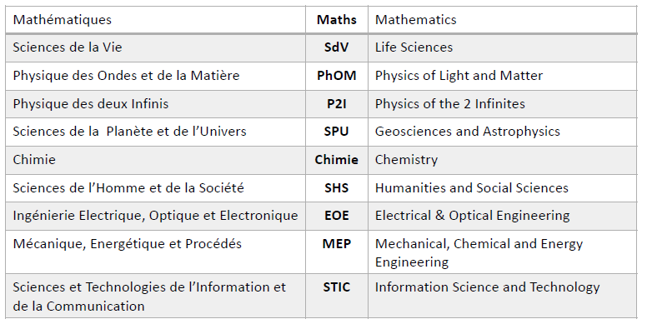
Departments: situation on 17-12-2014

Slide 9
Achievements and Near future
Teaching will be organized around Schools, like Basic Sciences, of Engineering, Humanities…
A structure to accelerate technology transfer has been created
In 2015 a new Administration Board, which will contain representatives of partners and elected members, will be formed. It will elect the president of the UPSay.
In September 2015 the students should have an ID with Paris-Saclay University on it together with their affiliation to a partner institution.

