Slide 1
Discussion: développement du système de lecture des photomultiplicateurs pour le prototype de détecteur Argon liquide de LBNO
Réunion: APC, LAPP, Omega
21/11/2013

Slide 2
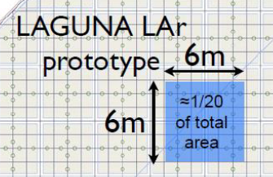
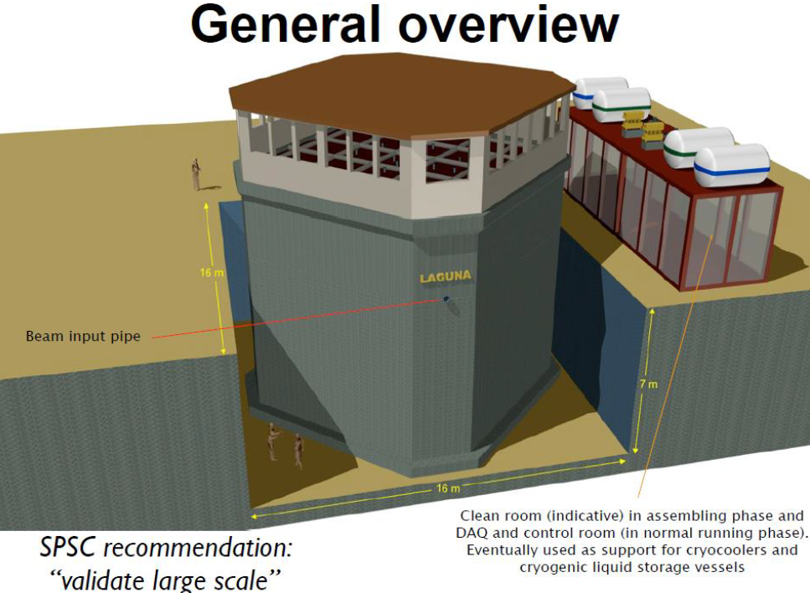
Large scale 300 t LAr Prototype at CERN
WA105
To install in CERN North Area
With charged particle beam
6x6x6m3 active volume LAr TPC detector with double phase + charge amplification + 2-D collection readout PCB anode.
Exposure to charged hadrons beam (1-20 GeV/c)

Slide 3
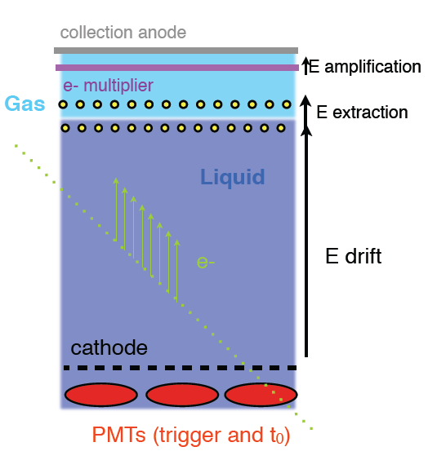
Liquid Argon TPC
Homogeneous massive target and ionization detector
Principle: 3D imaging in a large volume Liquid Argon TPC
very pure LAr (<0.1ppb) → electrons can drift over large distances (>1.5 m)
UV scintillation light (5000 photons/mm @128 nm) for t₀
Primary ionization in LAr: 1 m.i.p ~ 20000 e- on 3 mm
    → 3D reconstruction with ~1 mm resolution
25 cm
Double phase: signal readout on 2 view collection anode!
Signal amplified in the gas
85 cm
ICARUS
Muon decay
T600 test
Run 960, Event 4 Collection Left

Slide 4
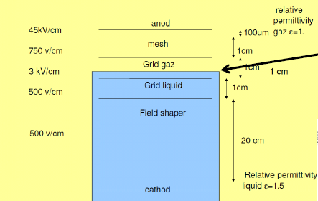
Prototyping is needed for this very large detector
Principle: double phase Argon (liquid / gaz) readout after drift distances up to 20m
Several technical items have to be validated with a large scale prototype
  LNG tank construction technique
  Purity in non evacuated membrane tank
  Long electron drift distance
  High voltage system for the cage field 300-600 KV
  Double phase readout
  Cold front end electronic
  Interaction reconstruction in the TPC

Slide 5
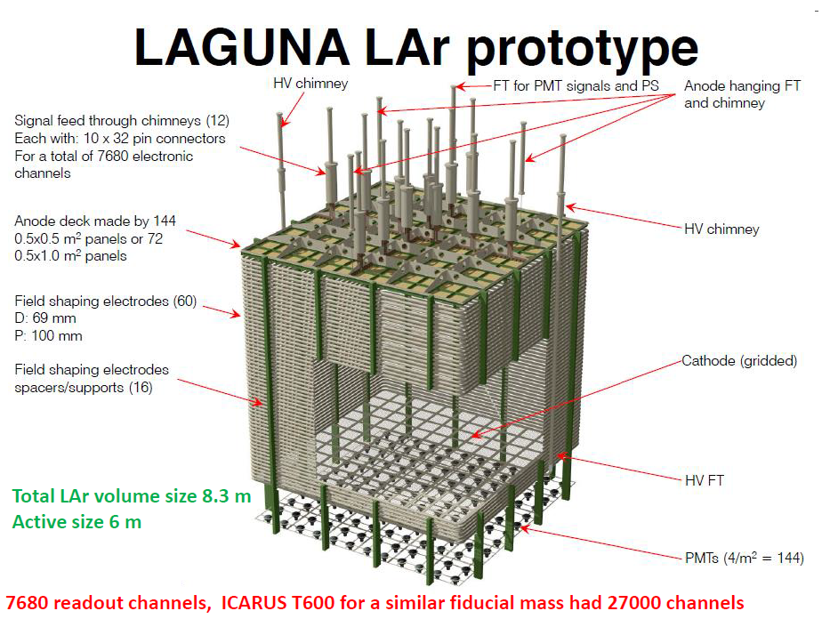
Large scale 300 t LAr Prototype at CERN
WA105

Slide 6
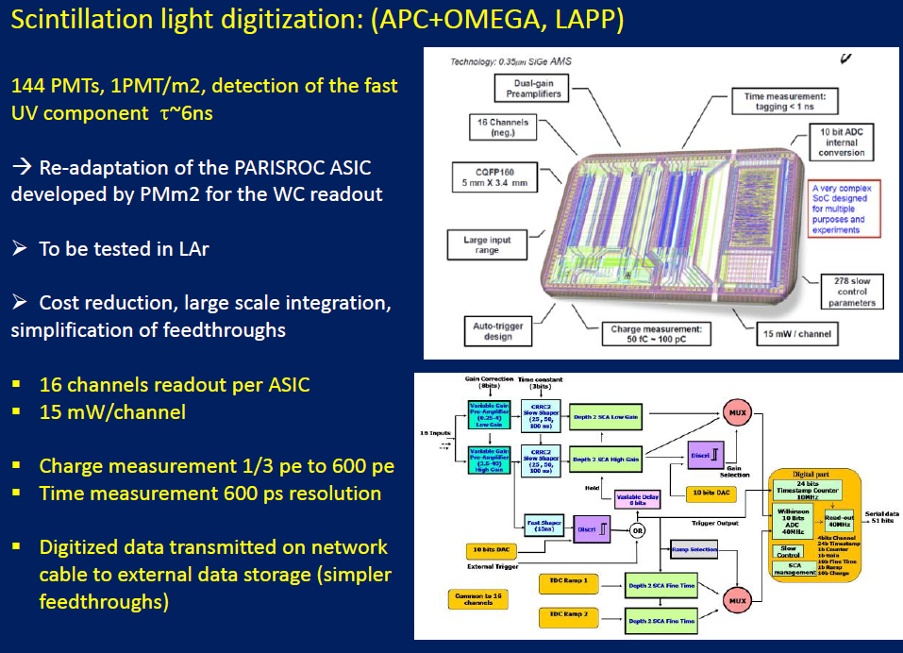
Présentation au CS IN2P3 27/06/2013 (D. Autiero)

Slide 7
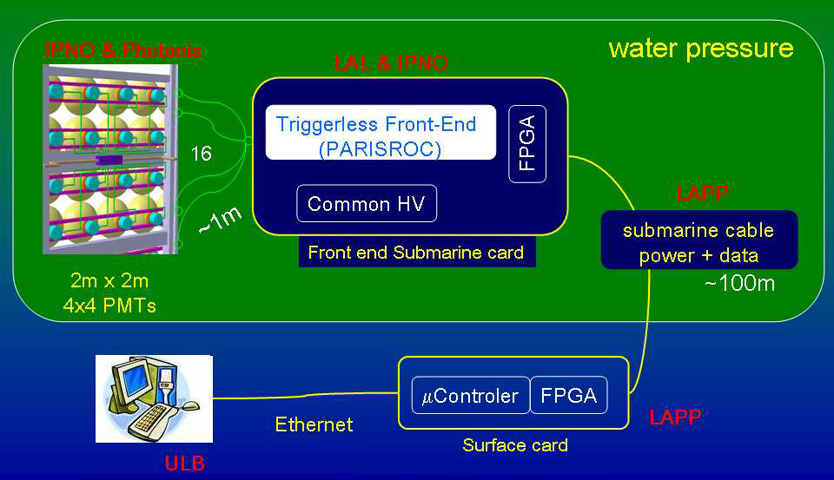
Schéma du développement PMm2 (2010):

