Slide 1
Super KEK B-factory project:
SuperKEKB and Belle II
Yutaka USHIRODA, KEK
October 2013

Slide 2
B-factory
B-factory is a collider to produce a large number of B mesons like a factory and a detector to analyze them. For what? g Karim’s talk
The one at KEK in Japan: KEK B-factory
  Name of accelerator: KEKB
  Name of detector and collaboration: Belle
The upgraded one: Super KEK B-factory
  New accelerator: SuperKEKB
  New detector, collaboration: Belle II

Slide 3

Name of Belle
bottom quark (= beauty quark) g belle (in French)
Collide electron (el) and positron (le), generate B
By having “B”, symmetry (elle) is broken
A beautiful name which we are proud of…
  Hope French people, especially Isabelle, will also love it
el
B
le

Slide 4
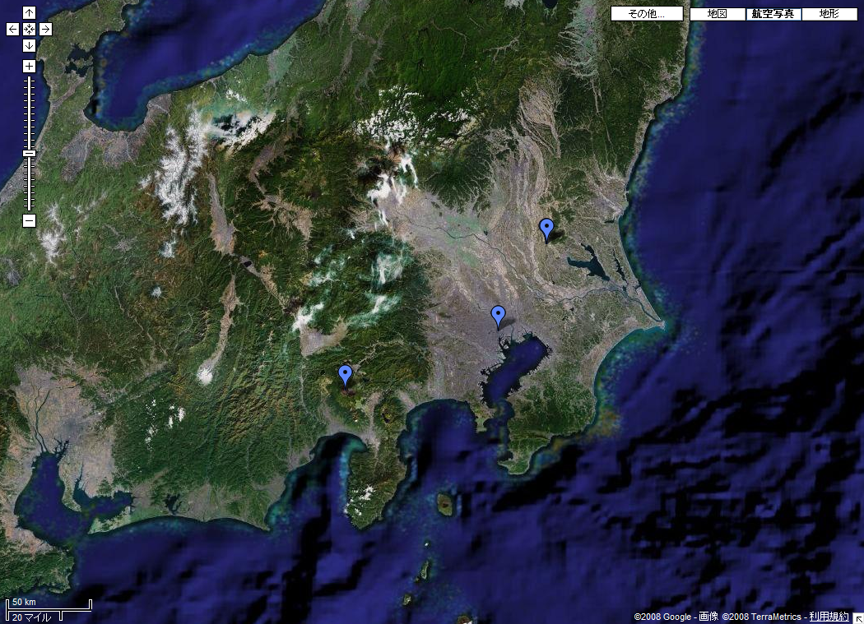
Where is KEK?
Tsukuba
Tokyo
Mt. Fuji

Slide 5
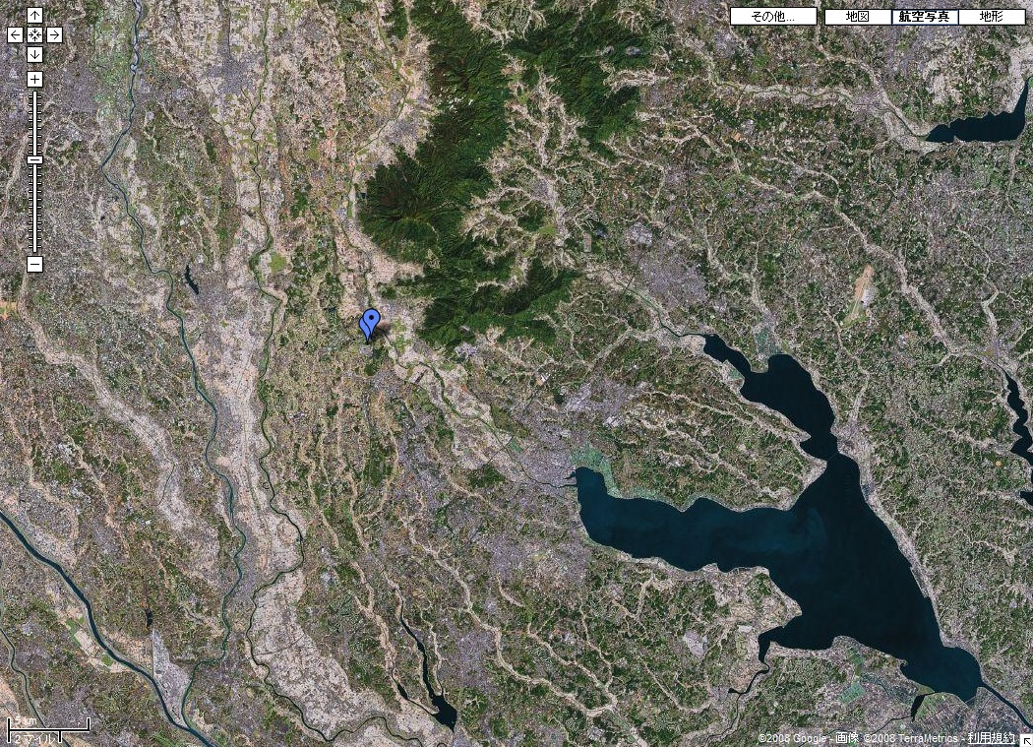
Where is KEK?
Mt. Tsukuba
KEK
Kasumigaura

Slide 6

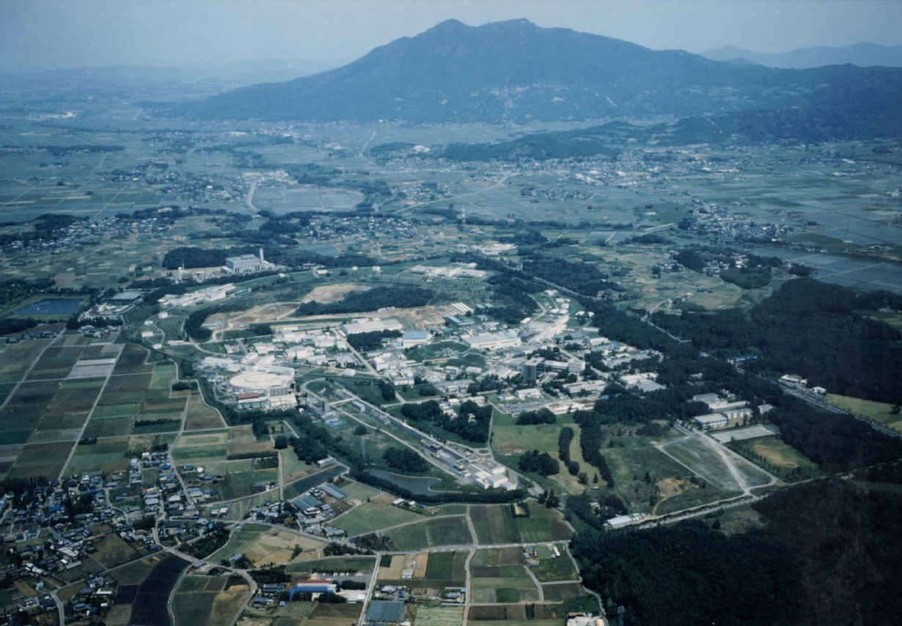
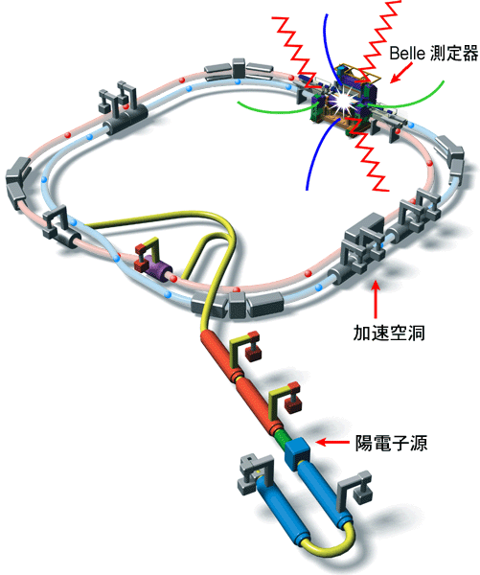
KEK and KEKB (before upgrade)
3.5 GeV e⁺ X 8.0 GeV e⁻
crossing angle = 11 mrad.
Mt. Tsukuba
KEKB
Belle
~1 km in diameter
~3 km circumference

Slide 7
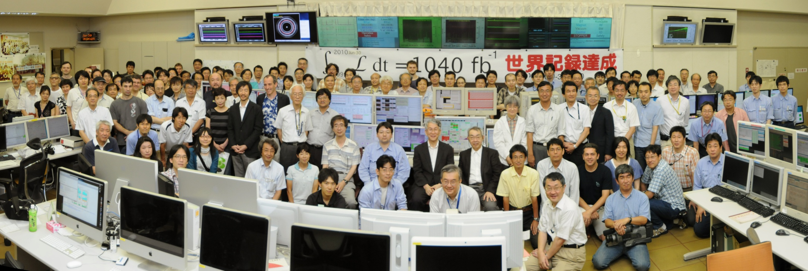
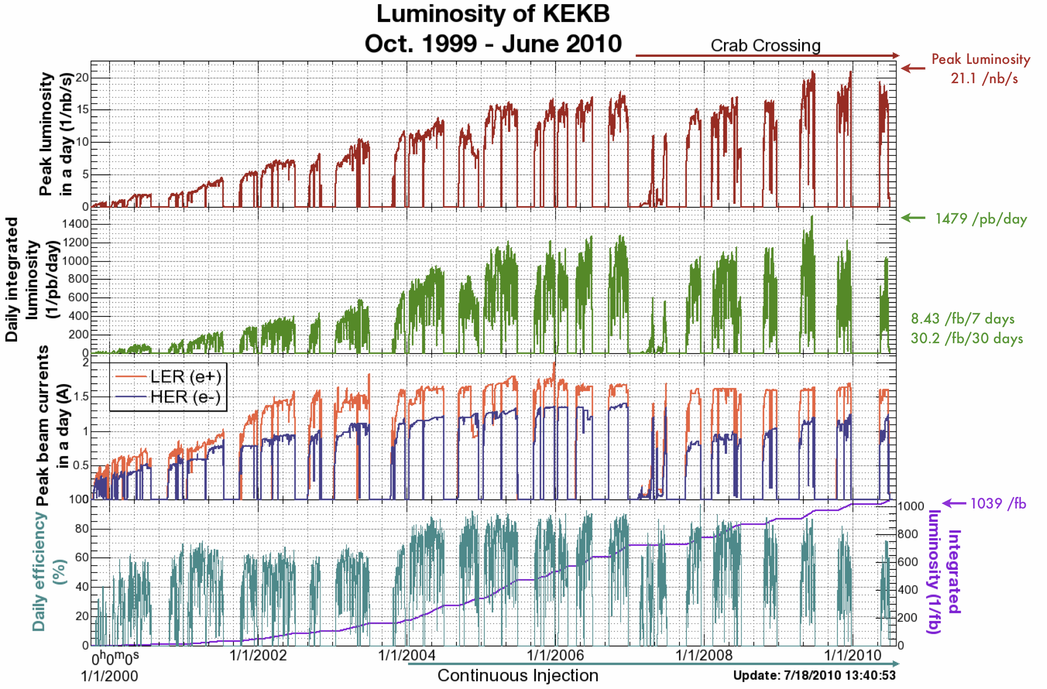
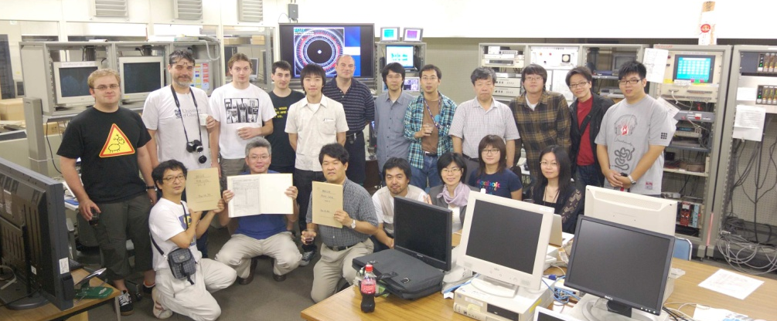
The last beam abort of KEKB on June 30, 2010
First physics run on June 2, 1999
Last physics run on June 30, 2010
L_{peak} = 2.1x10³⁴/cm²/s
L > 1ab⁻¹

Slide 8
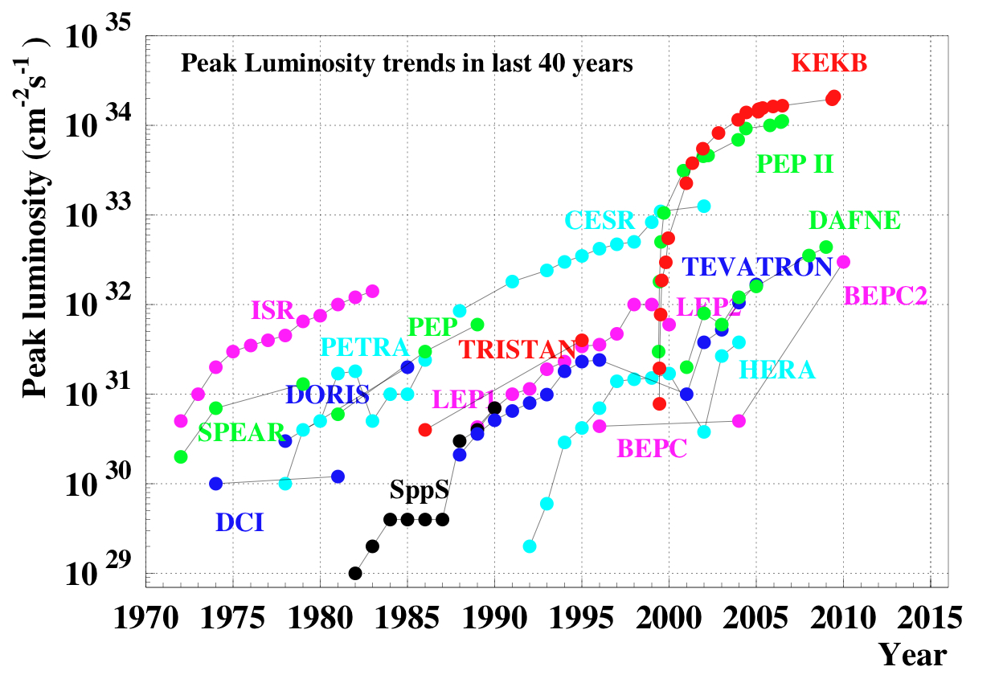
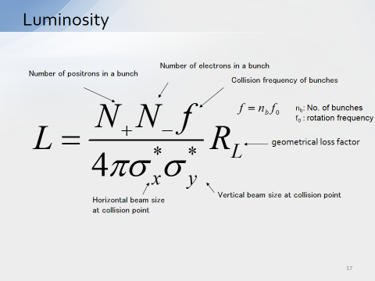
Peak Luminosity Trend
SuperKEKB

Slide 9
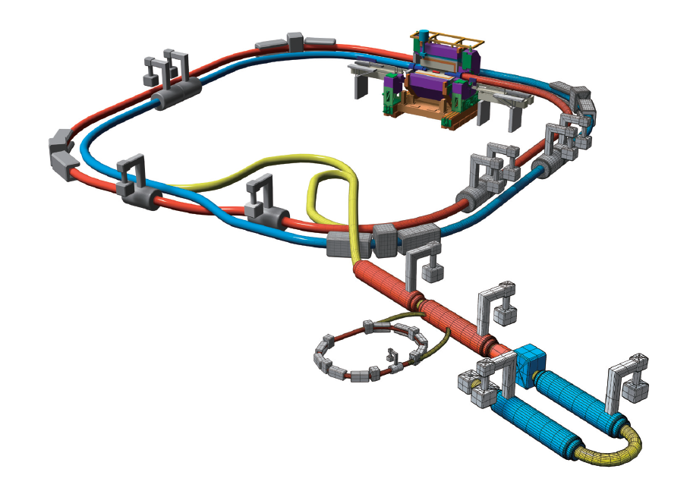
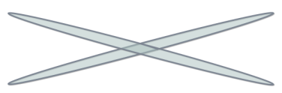
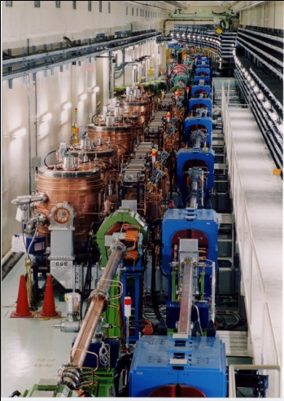

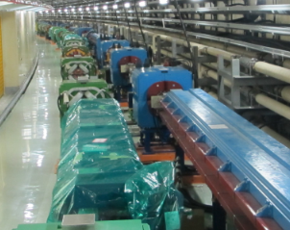

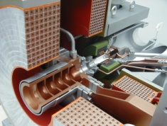
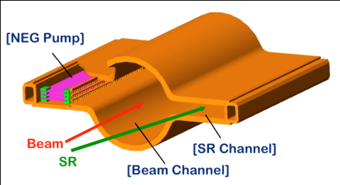
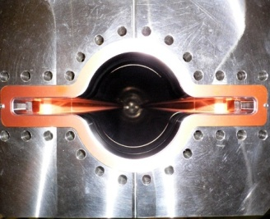

SuperKEKB and Belle II
Belle II
New superconducting /permanent final focusing quads near the IP
New IR
Colliding bunches
e⁺ 4GeV 3.6 A
e⁻ 7GeV 2.6 A
SuperKEKB
Target: L = 8x10³⁵/cm²/s
Replace short dipoles with longer ones (LER)
Add / modify RF systems for higher beam current
Positron source
New positron target / capture section
Redesign the lattices of HER & LER to squeeze the emittance
Damping ring
TiN-coated beam pipe with antechambers
Cu for wigglers and Al alloy for the rest
@1.1 GeV
To inject low emittance positrons
Low emittance gun
To inject low emittance electrons
9

Slide 10
SuperKEKB construction schedule
Calendar
2010
2011
2012
2013
2014
2015
2016
2017
・・・
Japan FY
2010
2011
2012
2013
2014
2015
2016
2017
・・
Oct. 2013
Jan. 2015
SuperKEKB construction
Detector upgrade to Belle II
SuperKEKB operation
Belle II roll in
QCS install
VXD install
Belle roll out
KEKB
operation
Dismantling KEKB
Accelerator tuning
BEAST
Fabrication and tests of ring components
Physics run
Install and set up
Electricity and cooling facility
MR & DR buildings
DR tunnel
Upgraded Linac operation
for SuperKEKB, PF, PF-AR
Linac
Linac upgrade / operation for PF&PF-AR

Slide 11
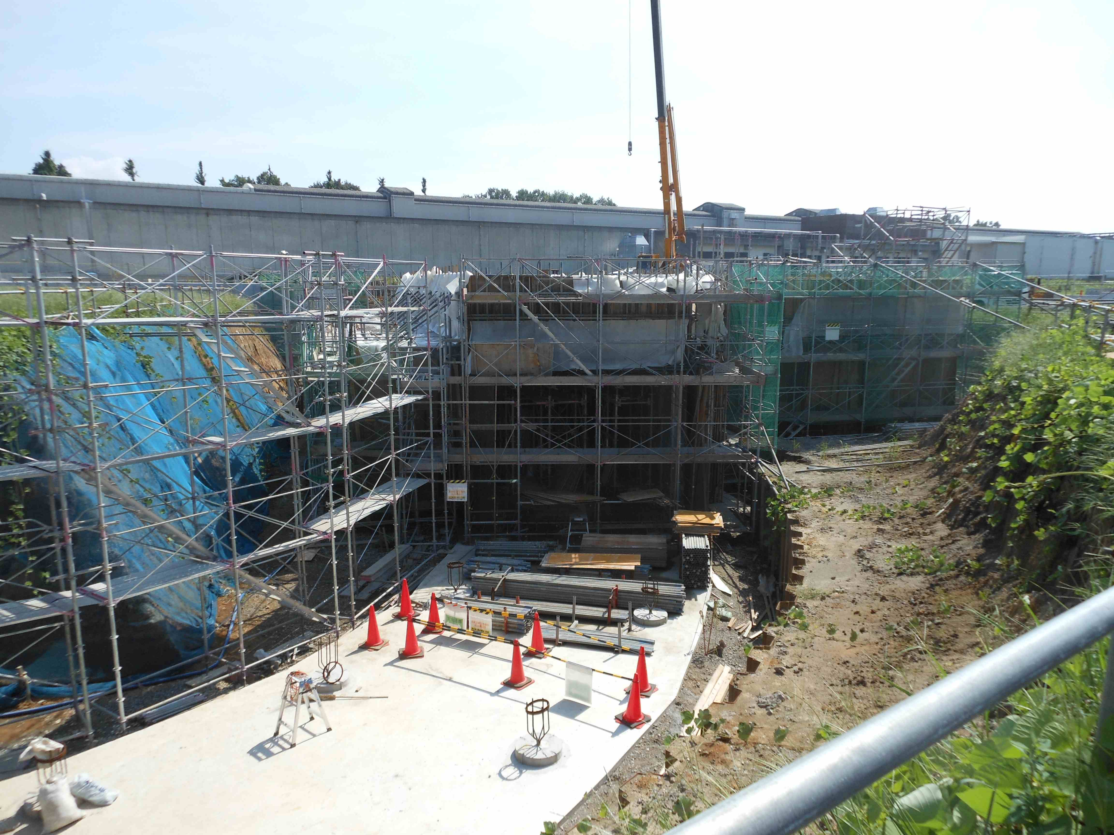
New Tunnel for damping Ring
Dig a new tunnel
Bury underground
Lid

Slide 12
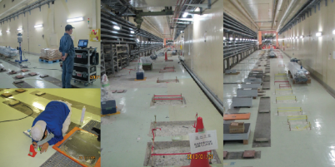
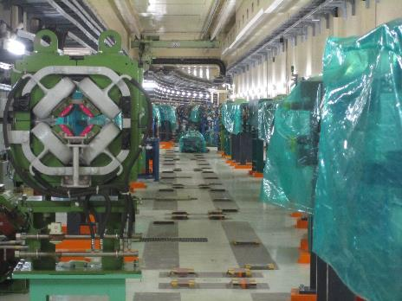
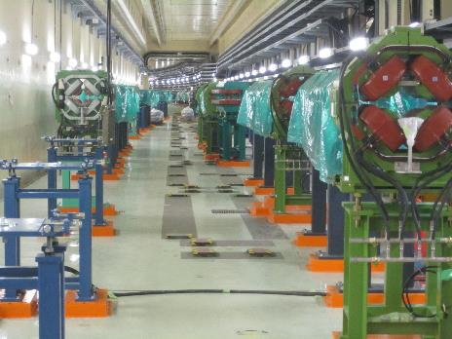
Vicinity of Interaction Point
Components cleaned up, new bases placed (Jan. 2013)
New magnets in place and surveyed (Aug. 2013)

Slide 13
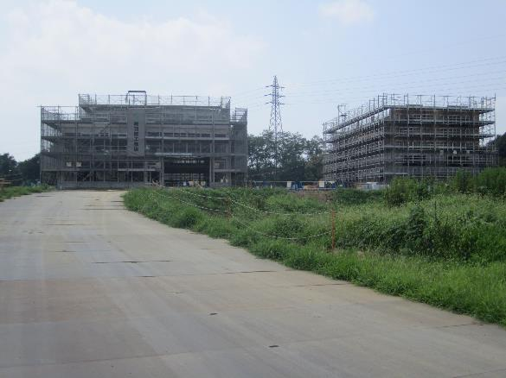
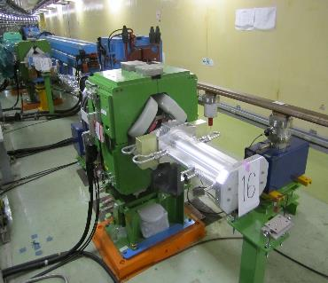
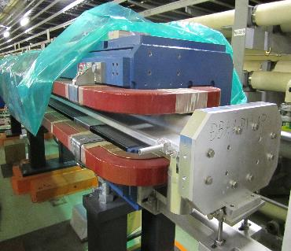
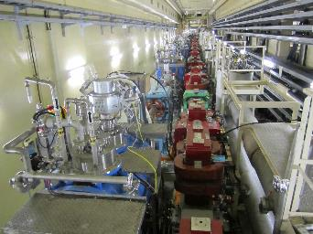
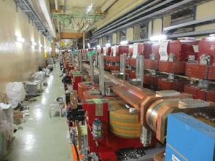
New buildings for
Magnet Power Supply under construction
New LER chambers in place
New Wigglers

Slide 14
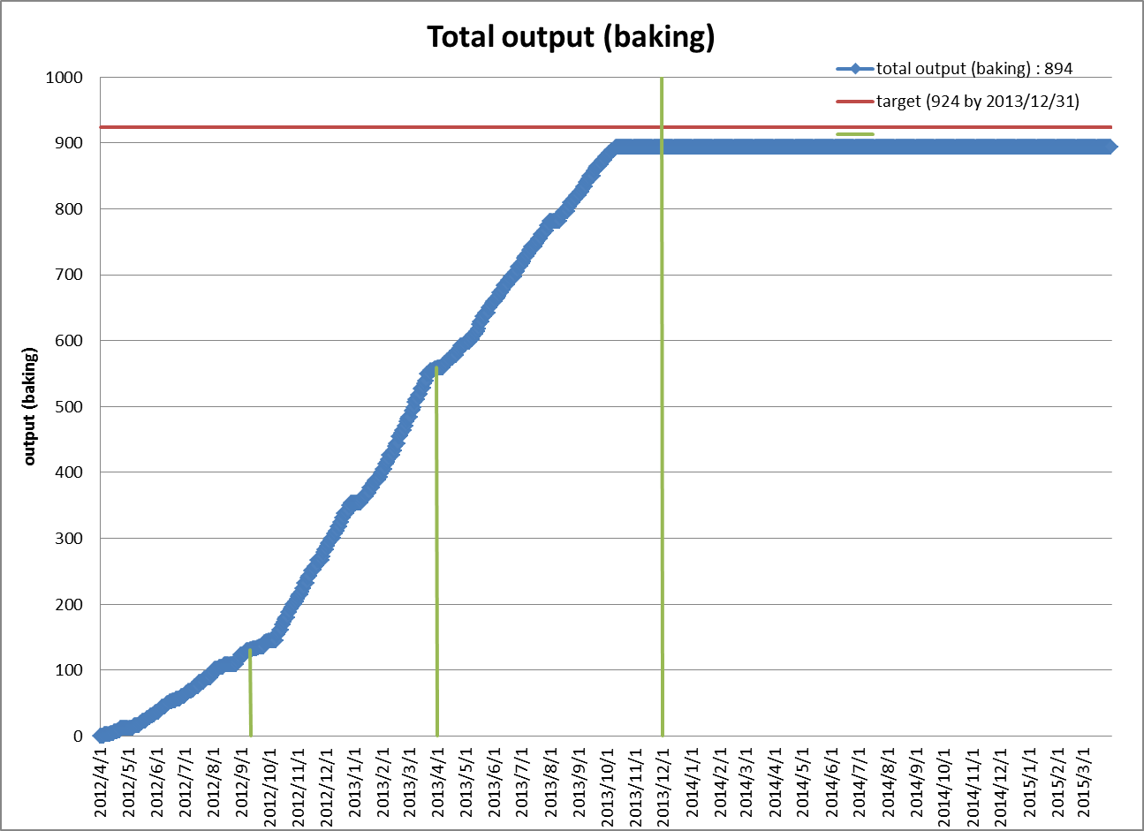
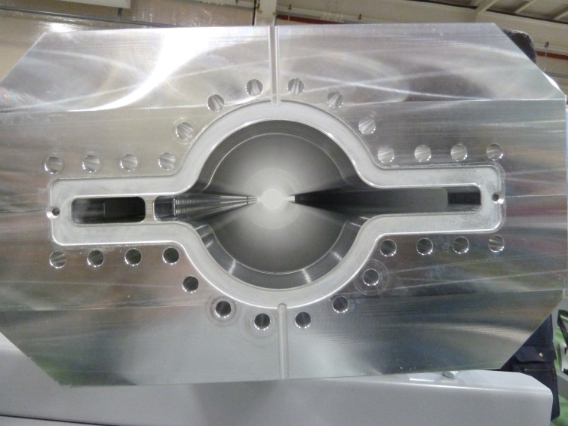
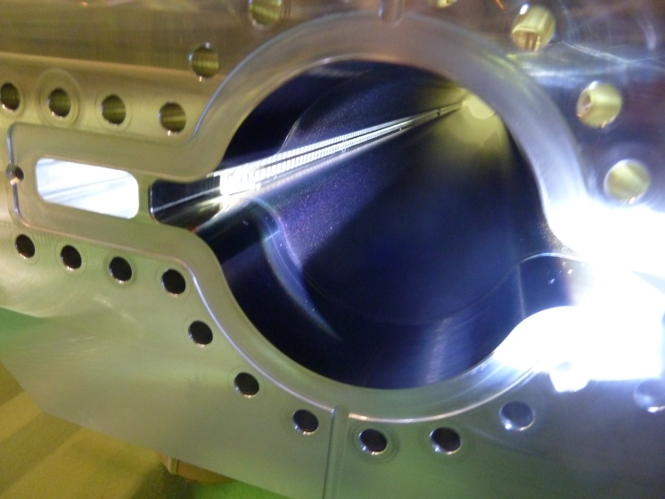
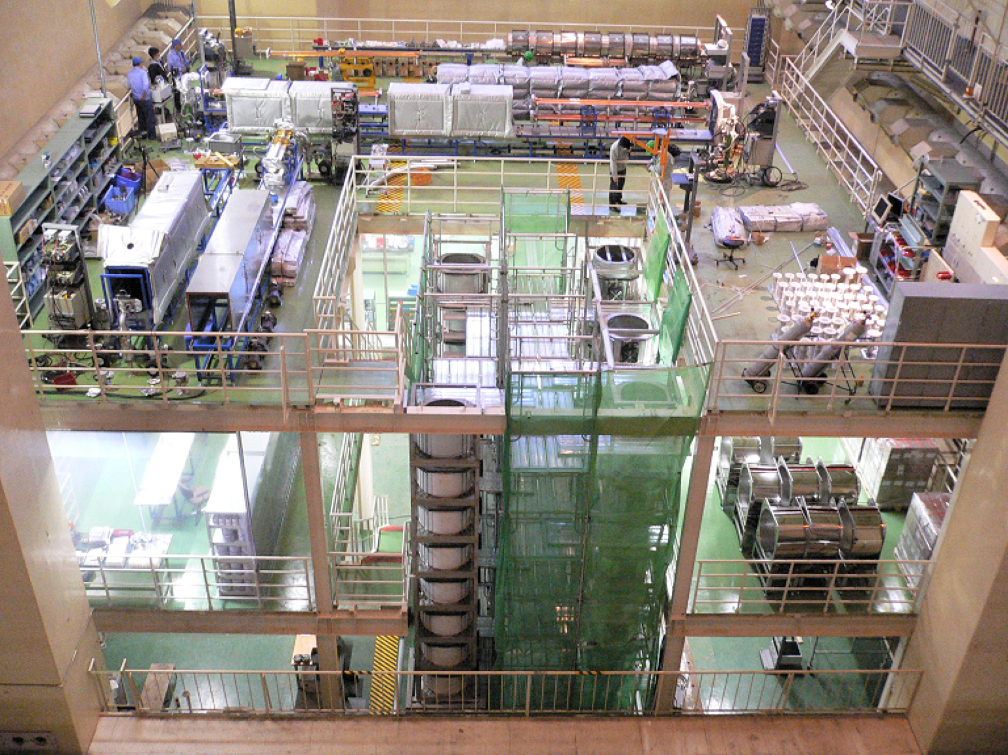
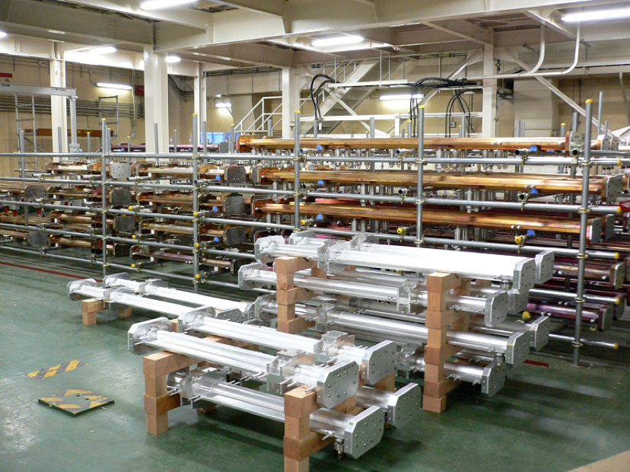
Vacuum Chambers
TiN coating and baking steadily going on at Oho-hall in KEK
~900 pipes in this CY (plan)
Will be completed in Nov.
~1200 in total in 2 years
Al BP before coating
After TiN coating
before baking
After baking
B2
B3
B4

Slide 15
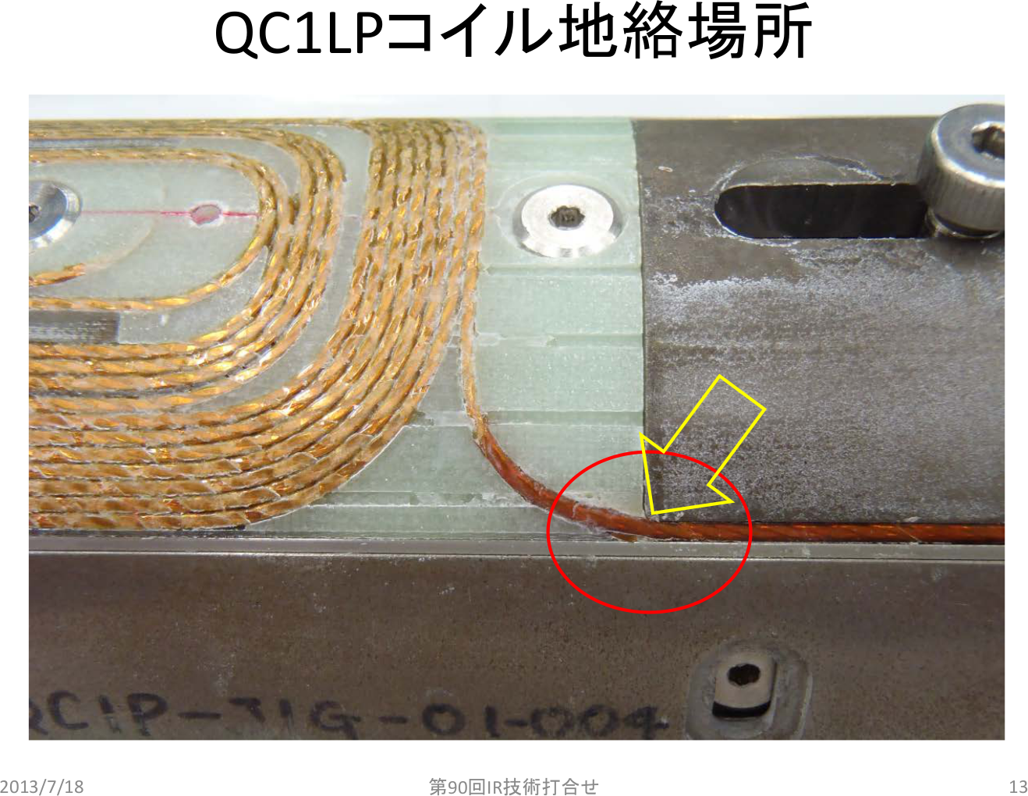
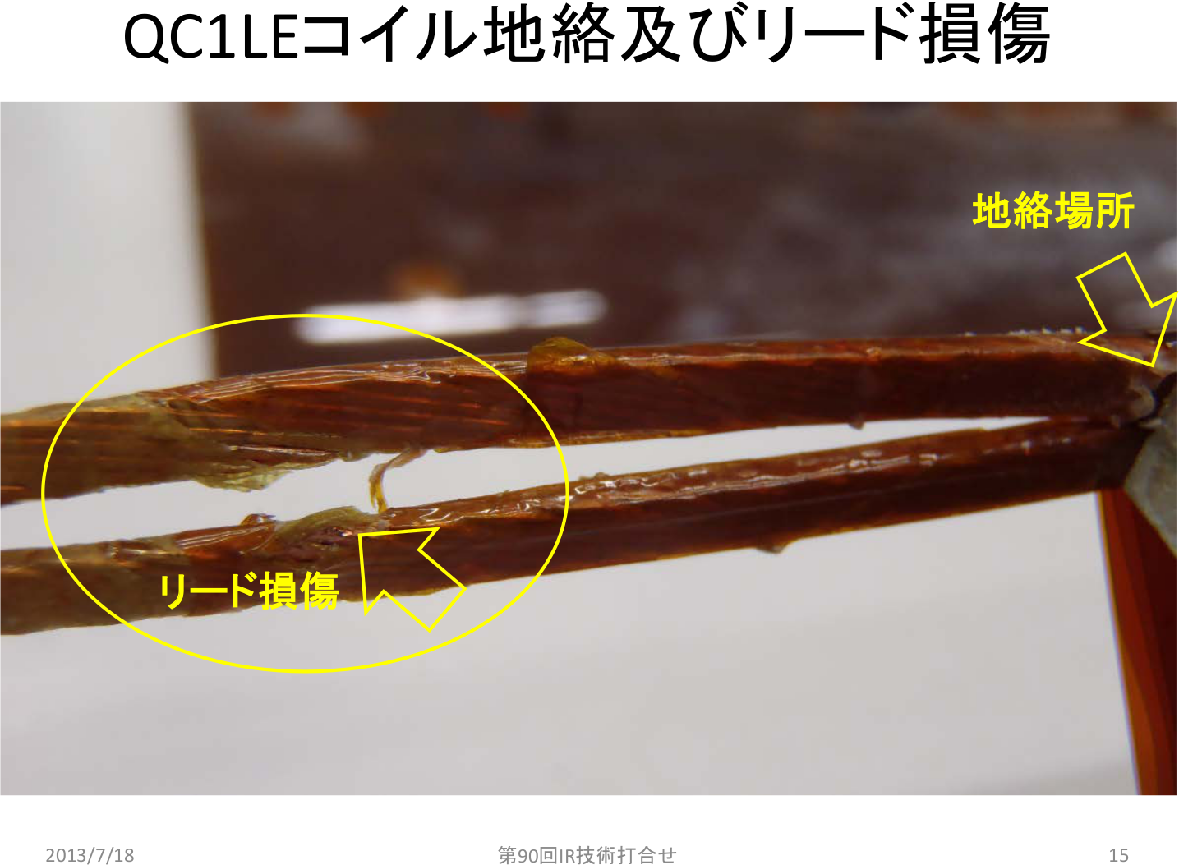
Final Focusing System (QCS)

Slide 16
Belle II Detector
K_{L} and muon detector:
Resistive Plate Counter (barrel outer layers)
Scintillator + WLSF + MPPC (end-caps, inner 2 barrel layers)
EM Calorimeter:
CsI(Tl), waveform sampling (baseline)
(opt.) Pure CsI for end-caps
Particle Identification
Time-of-Propagation counter (barrel)
Prox. focusing Aerogel RICH (fwd)
electron (7GeV)
Beryllium beam pipe
2cm diameter
Vertex Detector
2 layers DEPFET + 4 layers DSSD
positron (4GeV)
Central Drift Chamber
He(50%):C2H6(50%), Small cells, long lever arm, fast electronics

Slide 17
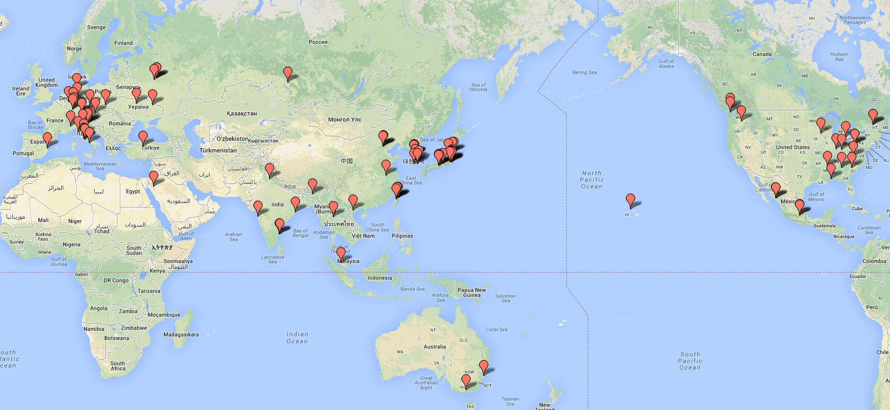
Belle II Collaboration
20 countries/regions, 70 institutions, 459 collaborators
+1 country, 6 institutions in March 2013
+2 countries, 18 institutions in July 2013
---
23 countries/regions, 94 institutions, >565 collaborators

Slide 18
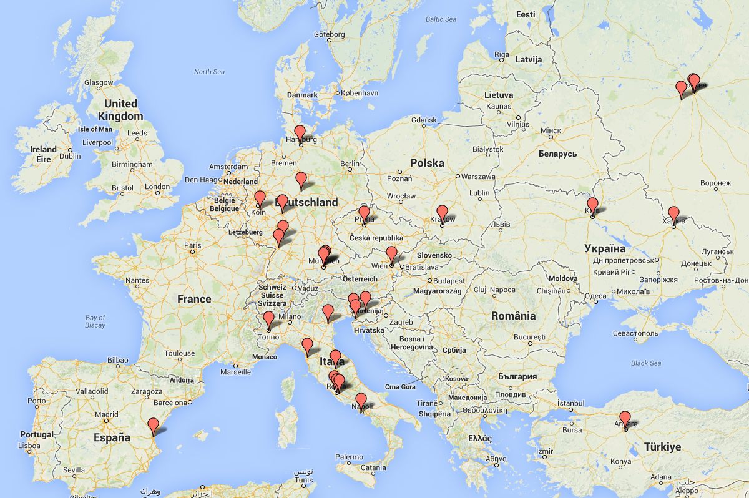
Belle II in Europe

Slide 19
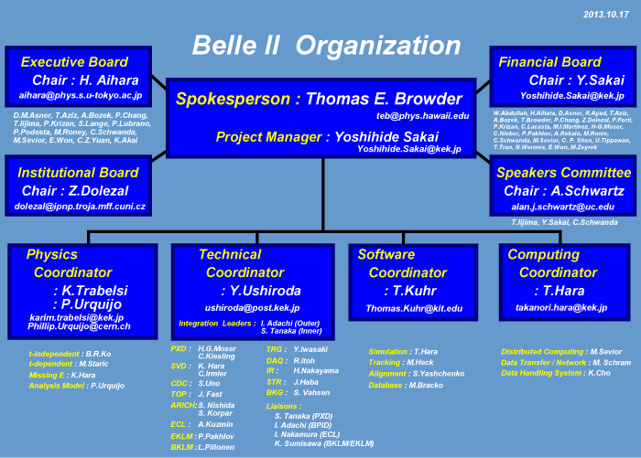
Belle II Organization

Slide 20
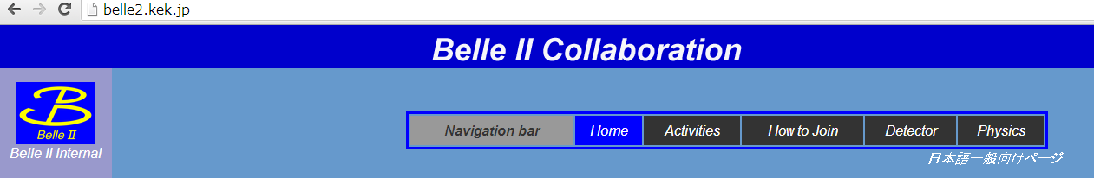
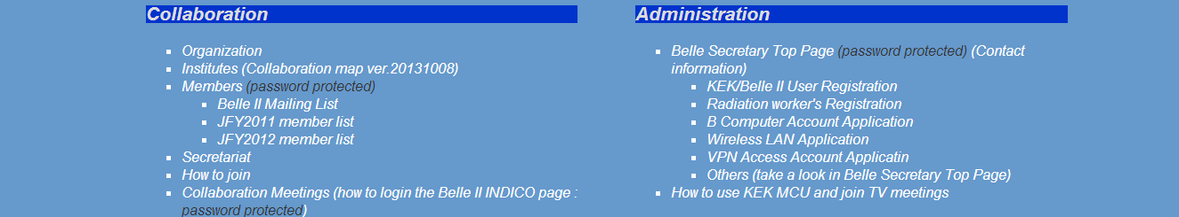
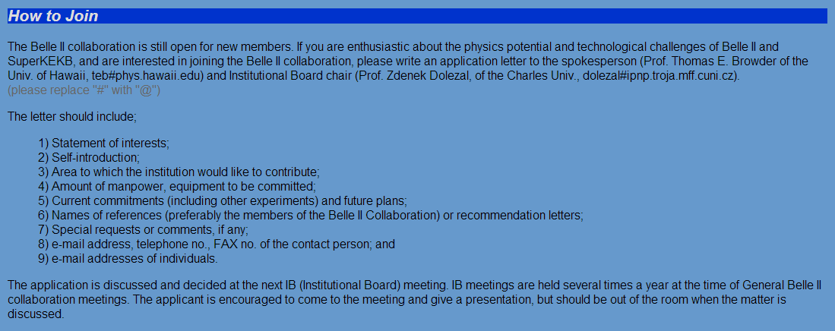
How to join (http://belle2.kek.jp)

Slide 21
Belle II construction schedule
Machine operation starts in Jan. 2015 (JFY2014); BEAST phase 1
Detector construction except for VXD by summer 2015
Detector roll-in in July 2015; Cooling and field measurement of QCS final focusing quads
Phase 2 machine commissioning for ~5 months till summer 2016; L>10³⁴/cm²/s; BEAST phase 2
“Physics Run” from autumn 2016

Slide 22
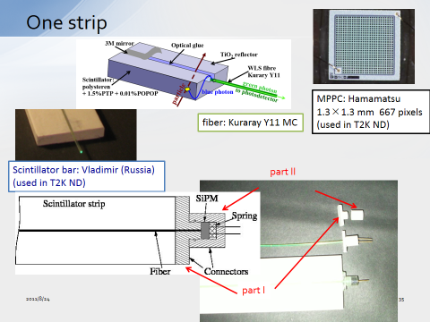
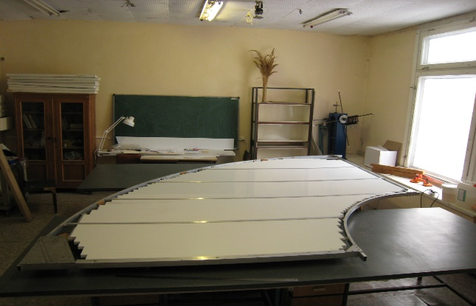
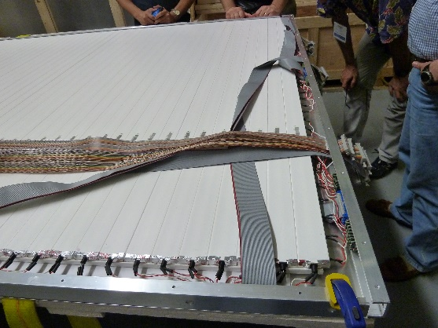
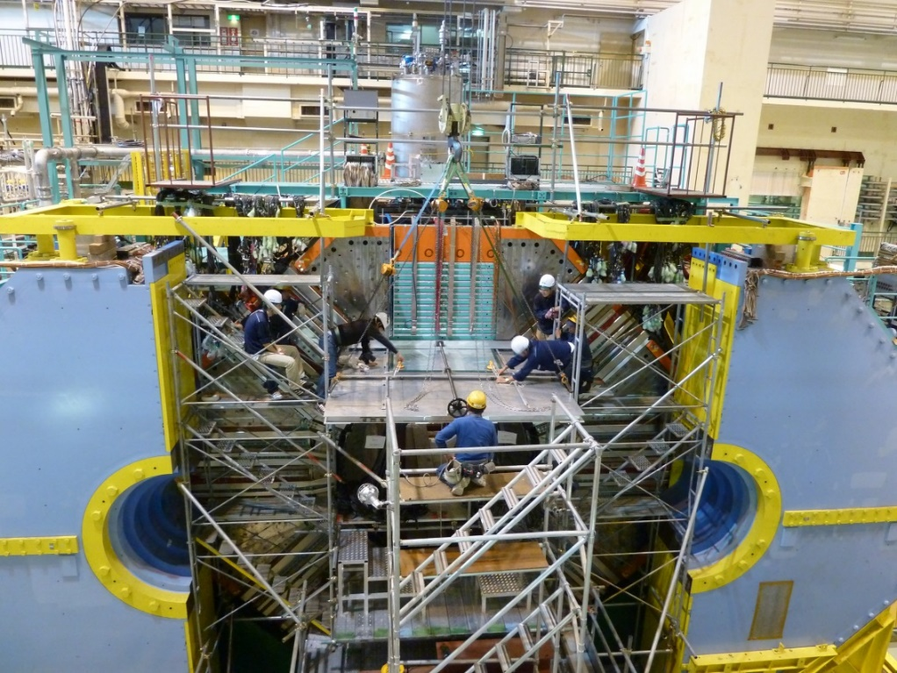
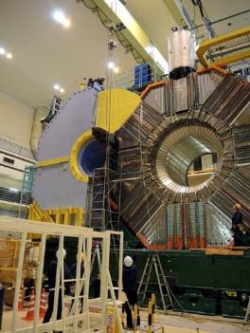
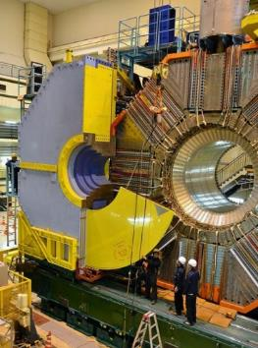
KLM
Endcap module (Russia)
Barrel module (US)
Old BKLM modules extracted (Oct. 2013)
New ones to be installed soon
First two EKLM modules
installed (May 2013)
Oct. 18, 2013

Slide 23
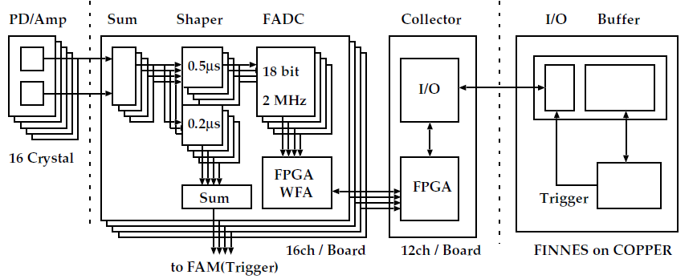
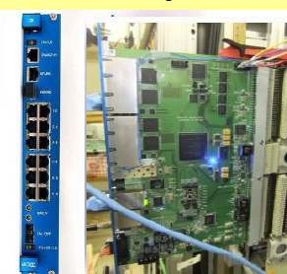
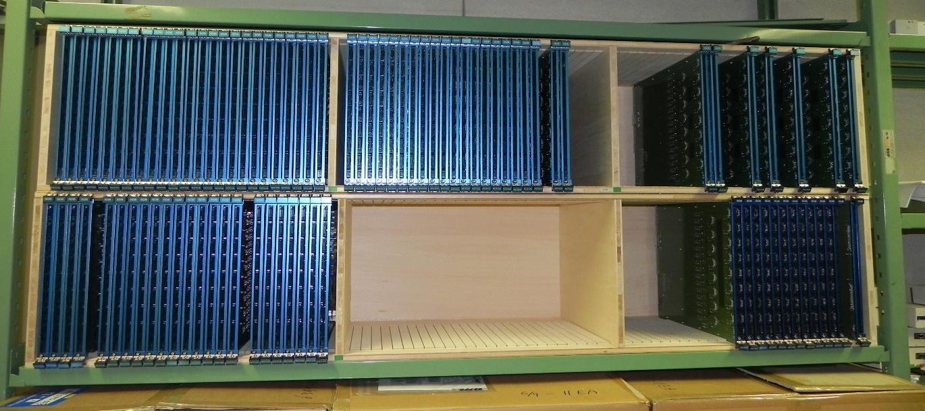
New ECL Readout Electronics Status
Firmware for Belle2Link readout was developed and is being tested.
Firmware to upload ShaperDSP firmware and coefficients under development
112 ShaperDSP modules has been produced and tested
Another 280 by end of this FY
Bias voltage filters has been modified for BWD endcap
FWD to be done in Feb.-Mar.
Russia
Japan
Korea
…

Slide 24
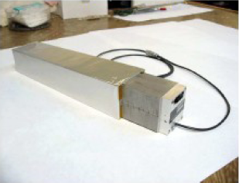
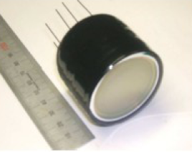
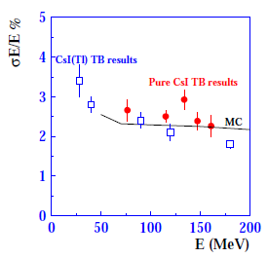



Pure CsI + Photo-Pentode Option
+Study of LAAPD by Italian team
New collaborators from Canada and Italy joined this activity
Grant to fund crystals being applied
Mechanical design of counter started by Canadian team
Russia
Japan
Ukraine
Canada
Italy
…

Slide 25

Particle Identification
Time of Propagation Counter (TOP) for Barrel
charged particle
K
2650mm
Cherenkov photon
π
Aerogel Ring Imaging Cherenkov
(ARICH) for endcap
quartz radiator
L
Hamamatsu HAPD
Aerogel radiator
n~1.05
200mm
Cherenkov photon
charged particle

Slide 26



Endcap PID (Aerogel RICH)
layered aerogel radiator
Specification finalized
refractive index n = 1.045, 1.055
DESY test beam setup (May 2013)
Japan
Slovenia
…
Frontend electronics
ASIC bare chips ready,
packaging by Mar. 2014
Board and firmware being finalized
HAPD by Hamamatsu
mass production started ~8% of 450pcs in hand
8-9 photons per track

Slide 27
Barrel PID (TOP)
Optics (bars, mirrors and prisms) on production
(time consuming to polish quartz bars)
MCP-PMTs by Hamamatsu
under mass production
>60% of 550 pcs in hand
[being finalized]
Frontend electronics
Quartz bar box with tight gas seal
Backend electronics
US
Japan
Slovenia
…
4-5 modules / 16+2 being processed

Slide 28

CDC
Belle
 | Belle | Belle II
inner most sense wire | r=88mm | r=168mm
outer most sense wire | r=863mm | r=1111.4mm
Number of layers | 50 | 56
Total sense wires | 8400 | 14336
Gas | He:C2H6 | He:C2H6
sense wire | W(Φ30μm) | W(Φ30μm)
field wire | Al(Φ120μm) | Al(Φ120μm)
Belle II
Japan
Taiwan
Viet Nam
…

Slide 29






CDC status
Wire stringing of small cell part has been completed.
Gas leak check and HV test are fine. Stability test and cosmic ray test are going on.
32MHz-FADC waveform
of cosmic ray
Drift time
dE/dx
The number of installed wires in main and conical part
completed 83%
Dec. 2012
Oct. 2013
Wire stringing is going well as scheduled.

Slide 30





CDC status
Beam test on Oct. 2013
LEPS beam line at SPring-8 (Japan)
The latest readout
electronics (ver.4)
~1 GeV/c electron
Drift time
dE/dx
Result of quick analysis for position resolution
8-layer Main test chamber
XY test chambers
113um
The results of quick analysis are competitive
with Belle-1 performance

Slide 31



VXD (=PXD+SVD)
Belle II Belle
X-angle 83mrad 22mrad
Beam Pipe r = 10mm 15mm
DEPFET
Layer 1 r = 14mm
Layer 2 r = 22mm
DSSD
Layer 3 r = 38mm 20mm
Layer 4 r = 80mm 43.5mm
Layer 5 r = 104mm 70mm
Layer 6 r = 135mm 88mm

Slide 32



PXD and SVD
PXD 2 lyr simple barrel
Mockup
SVD
1 lyr with straight ladder
3 lyr with slant part
Mockup
End-Rings to mount ladders
Support Cone (CFRP)

Slide 33
Summary
Super KEK B-factory = SuperKEKB + Belle II
  SuperKEKB by mainly KEK + collaboration with BNL, SLAC, …
  Belle II by collaboration of 23 countries/regions, >565 researchers
Machine construction in good progress
  Still many challenges especially in interaction region
Detector development in good progress
  Installation started
  Delay in full TOP delivery
Collaboration is growing rapidly, and still open
Issues being more important from now on:
  BEAST, background monitor, interlock system, slow control
  Endcap ECL with pure CsI
  Database management, tracking, … more on software

