Slide 1
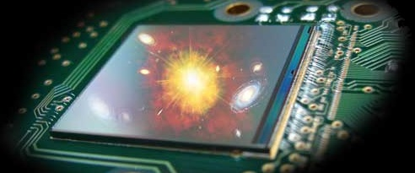
Microelectronics Group of IPHC
Belle II visiting IPHC - 24/10/2013 Claude COLLEDANI

Slide 2
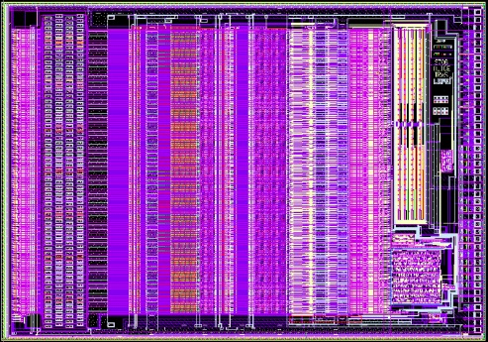
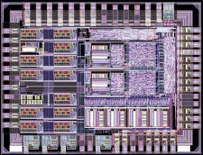
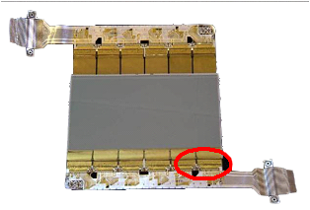
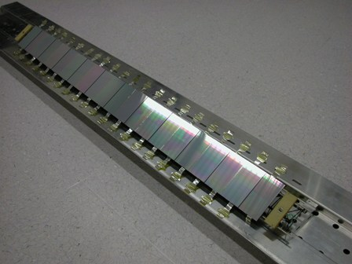
Microelectronics group of IPHC
19 Engineers - Dr Christine HU, Group Leader
  12 for Microelectronics Design
  Silicon Sensor Design
  6 for Test: Asics & Instrumentation
  1 for CAD Tools Support
1 Prof. of Microelectronics
1 Post Doc
4 PhD Students in µE ➔ > 12 PhD Thesis
More than 15 years of R&D dedicated to silicon sensors
  Initialy for silicon strips
    Sensor Design
    Front End Chips Design
      STAR Double-Sided Silicon tracker
        ALICE 128 Front End chip ➔ 5000 samples
        COSTAR chip ( Control for STAR) ➔ 1000 samples
      ALICE Double-Sided Silicon Tracker
        HAL25 Front End chip ➔ 35000 samples
        Sensor Modules assembled ➔ 1698 samples
        by the µTechnics Group of IPHC
  PICSEL is the main actual project
    80 % of the engineers task force of the group
    Merge both Sensor & FEE Design Know-How
ALICE128 8.6x6 mm²
Costar :
4.2 x 3.1 mm²
HAL25 3.6x11 mm²
1 698 modules
72 ladders
1 698 modules répartis
sur 72 échelles

Slide 3
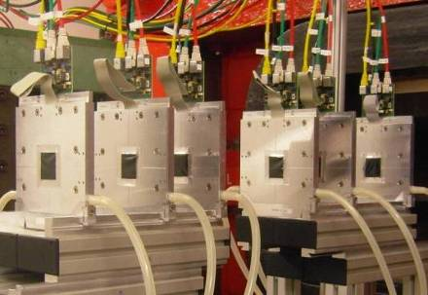
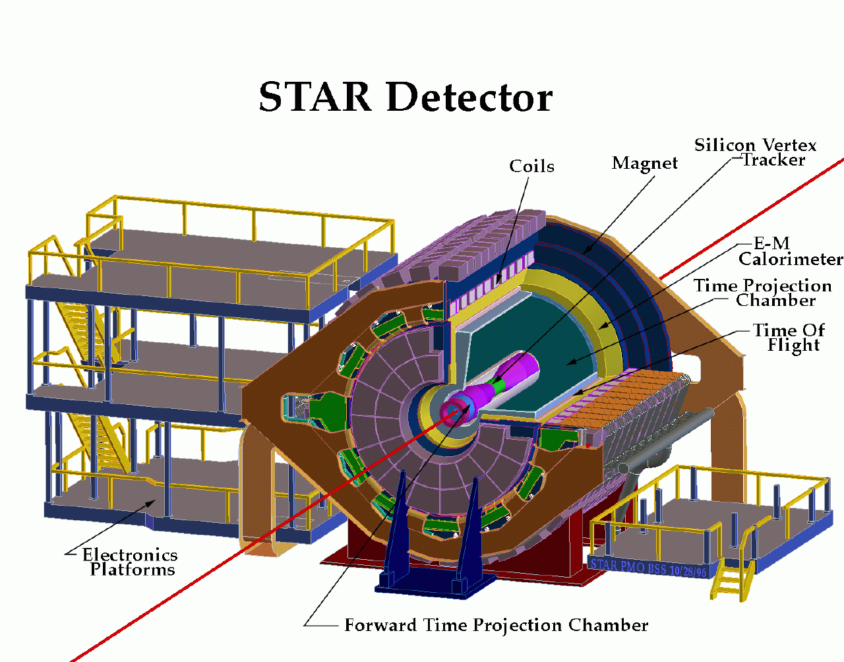
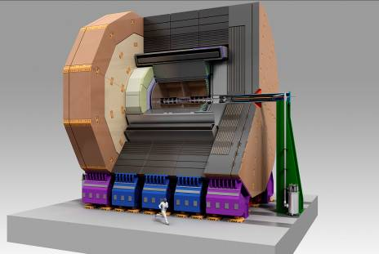
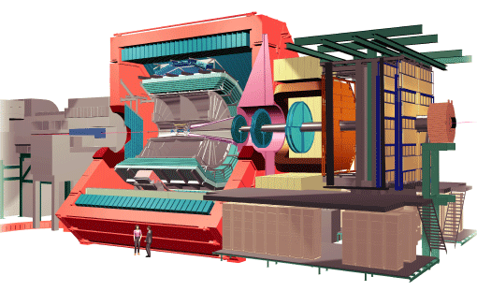
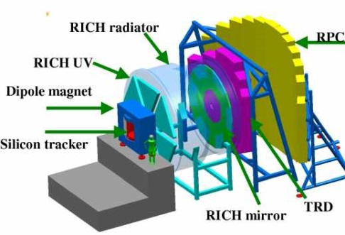
PICSEL for CMOS Pixel Sensors (CPS): A Long Term R&D
Main objective: ILC, with staggered performances
  MAPS applied to other experiments with intermediate requirements
EUDET 2006/2010
Beam Telescope
EUDET (R&D for ILC, EU project)
STAR (Heavy Ion physics)
CBM (Heavy Ion physics)
ILC (Particle physics)
HadronPhysics2 (generic R&D, EU project)
AIDA (generic R&D, EU project)
FIRST (Hadron therapy)
ALICE/LHC (Heavy Ion physics)
EIC (Hadronic physics)
CLIC (Particle physics)
…
STAR 2013
Solenoidal Tracker at RHIC
ILC >2020
International Linear Collider
ALICE 2018
A Large Ion Collider Experiment
CBM >2018
Compressed Baryonic Matter

Slide 4
CPS a Structuring Project for the µE Group
EUDET 2006/2010
Beam Telescope
STAR 2013
Solenoidal Tracker at RHIC
M
i
c
r
o
e
l
e
c
t
r
o
n
i
c
s
T
e
s
t
s
&
M
e
a
s
u
r
e
s
Pixels & Matrix
  Charge collection optimisation
  Matrix steering and readout strategies (vitesse/puissance)
  Embedded data processing architectures
Digitization
  Discriminators, ADC, Zero Suppression
Building Blocks
  ADC spécifiques, DAC, PLL / DLL
  Bandgap, Régulators
  I/O LVDS, Sérialiser 8b10b
  Slow control JTAG
Process Investigation
  0.35; 0.25; 0.13; 0.18; 3D-IC
  Wafer Epi, HRES Epi
  AMS, XFAB, IBM, TOWER, 3D-TEZZARON
Rad tolerance (~1MRad @ T_{room})
  Ionizing Particules, neutrons, SEU, Latchup
Test bench
  PCB design for chip test and DAQ
  Test & caracterization
  FW & SW code
Beam Test DAQ
  Slow Control
  Acquisition
  Monitoring / GUI
Ladders of sensors prototyping
  PCB & FLEX
µTechnics
  Chip Probing & Bonding
  Construction / Setups integration
ILC >2020
International Linear Collider
CBM >2018
Compressed Baryonic Matter
ALICE 2018
A Large Ion Collider Experiment
Visite DAT 04/09/2013

Slide 5
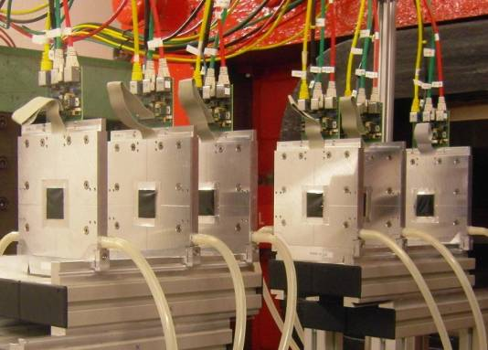
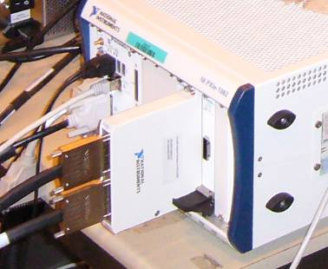
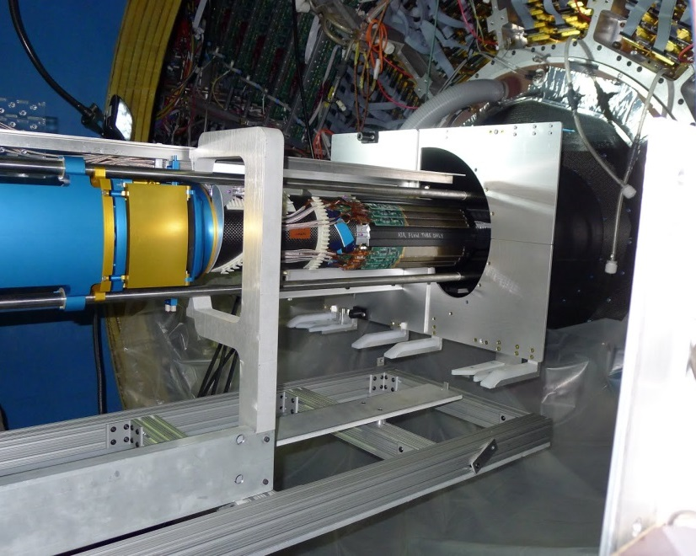
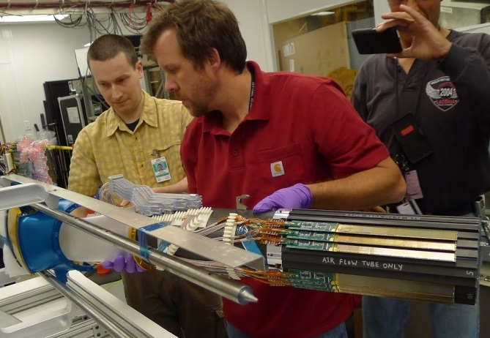
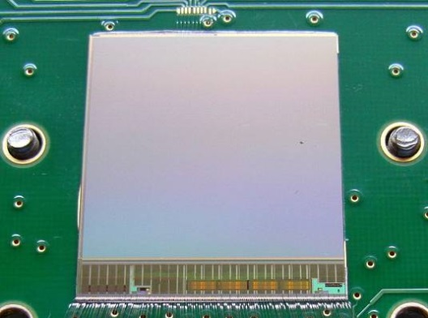
Established Architecture
EUDET – Beam Telescope - MIMOSA26 (2010)
  Proof of concept → Triggers great interest 18 wfrs, 1400 sensors
  DAQ :PXI express for EUDET JRA1 program
    >10 systems distributed to collaborators
STAR – PXL- MIMOSA28 sensor
  3 Run Engineering for prototyping
  100 Wafers Production = 5000 sensors
Architecture
  Rolling shutter readout
  In-pixel amplifier + cDS ➔ analogue output
  Pixels organised in columns ended with discriminators
  Discriminators followed by integrated zero suppression
  µ circuit logic (SUZE)
  2 output buffers storing the SUZE results
  JTAG for parameters setting and control
  0.35 µm twin-well technology
    only NMOS can be used in pixel cell
  Resulting of a 10 years R&D with 4 at 5 prototypes/year
MIMOSA26
MIMOSA28
(A.K.A ULTIMATE)
2x2 cm²
Installation May 8, 2013
Run ended June 10, 2013
3 Sector Engineering Detector
5

Slide 6
Towards Higher Read-Out Speed and Radiation Tolerance
Next generation of experiments calls for improved sensor performances
Main improvements required to comply with forthcoming experiments’ specifications :
  For Aim of higher radiation tolerance
    High resistivity epitaxial layer
    smaller feature size process
  For Aim of high readout speed
    more parallelised read-out
    Optimised pixel size and number
    new pixel array architectures
  Aim of lower power consumption
Addressing these requirements while remaining inside the virtuous circle of
  spatial resolution, speed, power, material budget
  Imposed to move from 0.35 µm process to 0.18 µm
Expt-System | σ _{t} | σ _{sp} | TID | Fluence | T _{op}
STAR-PXL | <~ 200 µs | ~ 5 µm | 150 kRad | 3x10¹² n_{eq}/cm² | 30 °C
 |  ? |  |  ? |  ?
ALICE-ITS | 10-30 µs | ~ 5 µm | 700 kRad | 10¹³ n_{eq}/cm² | 30 °C
CBM-MVD | 10-30 µs | ~ 5 µm | <~10 MRad | <~ 10¹⁴ n_{eq}/cm² | <<0 °C
ILD-VXD | <~2 µs | <~ 3 µm | O(100) kRad | O(10¹¹ n_{eq}/cm²) | <~30 °C

Slide 7
Sensors R&D for the upgrade of the ITS: General Strategy
Rolling Shutter
CMOS Pixel Sensor Architecture
@ IPHC
Upstream
Downstream
R&D of up- & down-stream of sensors performed in parallel at IPHC in order to match timescale
2 developments for upstream of sensors
  MIMOSA: based on the architecture of MIMOSA26 & 28
    End-of-column discrimination
  AROM (Accelerated Read-Out Mimosa)
    In-pixel discrimination
for 2 final sensors
  - MISTRAL (~3x1 cm²) = MIMOSA Sensor for the inner TRacker of ALICE
    Mature architecture
    Relatively low readout speed (200 ns/ 2rows)
      ~ 200 mW/cm² for inner layers, ~ 60-130 mW/cm² for outer layers
  - ASTRAL (~3x1 cm²) = AROM Sensor for the inner TRacker of ALICE
    New architecture
    Higher speed (100 ns/ 2rows)
    Lower power consumption
      ~ 85 mW/cm² for inner layers, ~ 30-60 mW/cm² for outer layers
Modular design for R&D optimisation ➔ Full Scale Building Block

Slide 8
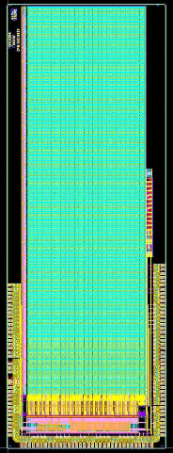
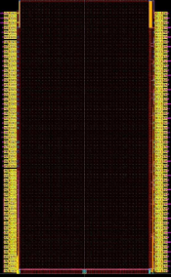
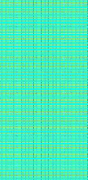
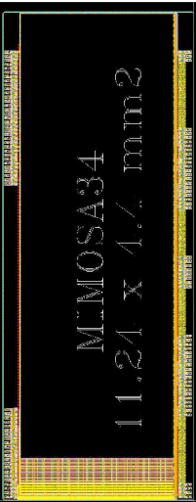
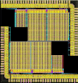
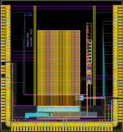
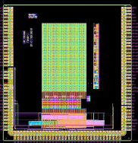
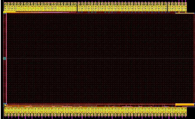
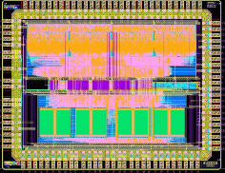
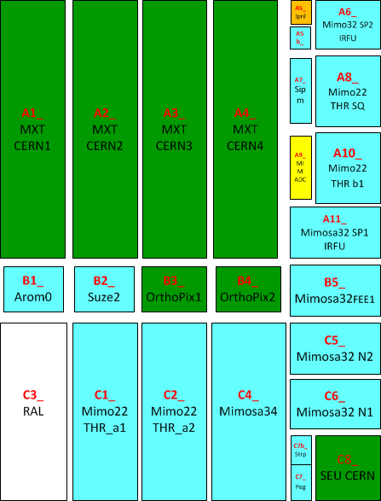
Development Steps toward MISTRAL & ASTRAL -1-
1 parameter per prototype
MISTRAL RO Architecture
ASTRAL RO Architecture
Diode + in-pixel amplification Optimisation
1D/colunm
InPix Discri
Proof of Concept
Amp Opt
RTS Noise
Px Pitch
& Diode Sz
Ro Arch
Slow Control
2D/column
August run
MIMOSA-32FEE
MIMOSA-32N
AROM-0
MIMOSA-34
AROM-1
0.18µm Validation
MIMOSA-22THRB
Previous runs
MIMOSA-32 & ter
MIMOSA-22THRA
~1 cm
Zero Suppress Logic
Reticle 21.5 x 31 mm²
~1,3 cm
~1 cm² array
~1 cm² array
~1 cm² array
SUZE02
MIMOSA-32 & -ter
SUZE
SUZE
SUZE
Previous runs
LVDS
Serial read out
LVDS
RD block
PLL
Engineering Run: Submitted March 13 – Delivered July 13

Slide 9
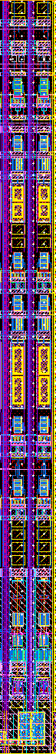
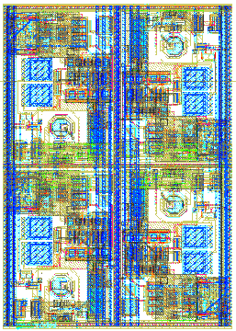
Development Steps toward MISTRAL & ASTRAL -2-
    Upstream Mistral: Pixel Mx with End-of-column discrimination
Pixel level
Column level
Layout of 2 discri.
(1 columns)
~300 µm
    Upstream Astral : Pixel Mx with in pixel discrimination
44 µm
66 µm
~20 µm
    Common Downstream : Zero suppress
2x2 pixels
…….…
Window of 4x5 pixels
Summer 2013 ➔
Lab & Beam Tests (Desy)
Results ➔ Presented
@ Twepp & NSS
Row M-1
Row M
Row M+1
….….…
2965 µm
HIT
2162 µm

Slide 10
Conclusions
IPHC Microelectronics group efforts are focused on R&D for the PICSEL project
2 sensors equipping Facility Setup and Experiment
  MIMOSA26 for EUDET Telescope
  MIMOSA28 for PXL detector of STAR
IPHC is committed in ALICE ITS upgrade
  2 new sensors are under development - .18µm CMOS node -
    Mature architecture
    Promising architecture
  Aggressive schedule which address ITS mile stones
R & D toward a sensor running @ σ_{sp} : 5 µm, σ_{t} : 20µs, T_{op} : 30°C
  Q4/13 ➔ AROM-1b Optimized pixel & embed discriminator
  Q1/14 ➔ 1/3rd scale prototype of Full Chain Based on FSBB-MISTRAL approach
  Q4/14 ➔ 1/3rd scale prototype of Full Chain FSBB-ASTRAL or MISTRAL
  Q4/15 ➔ Final prototype of ASTRAL or MISTRAL

Slide 11
THANK YOU

Slide 12

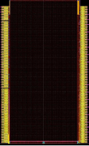

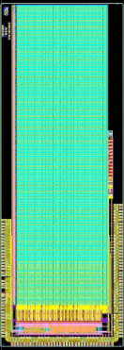
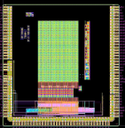
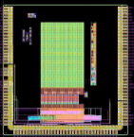
Upstream of MISTRAL Sensor
Pixel level
Column level
Designed by Y. Degerli (IRFU/AIDA)
Layout of 2 discri.
(1 columns)
~300 µm
MIMOSA-34
Sensing node opt.
Pixel level:
  Sensing node: N_{well}-P_{EPI} diode, optimisation f (diode size, form, No. of diodes/pixel, pixel pitches)
    Test results of MIMOSA34 under analysis ➔ see M. Winter's talk in this conference
  In-pixel amplification and cDS:
    Limited dynamic range (supply 1.8 V) compared to the previous process (3.3 V)
    Noise optimisation especially for random telegraph signal (RTS) noise
      Sensing diode: avoid STI around N-well diode
      RO circuit: avoid minimum dimensions for key MOS & avoid STI interface
      Trade off between diode size, input MOS size w.r.t. S/N before and after irradiation
Column level:
  Discriminator: similar schematics as in MIMOSA26 & 28
    Offset compensated amplifier stage + DS (double sampling)
    200 ns per conversion
  Read out 2 rows simultaneously ➔ 2 discriminators per column (22 µm)
MIMOSA-32FEE
Amp opt.
MIMOSA-32N
RTS opt.
MIMOSA-22THRB
Chain opt. => 2 D/col
MIMOSA-22THRA1&2
Chain opt. => 1 D/col

Slide 13
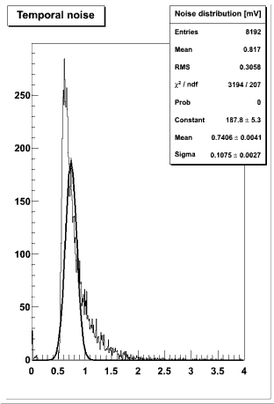
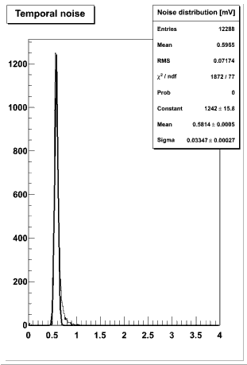
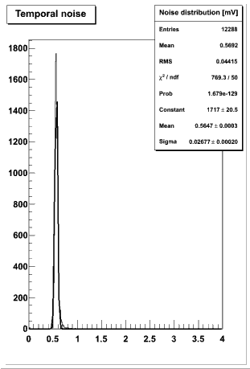
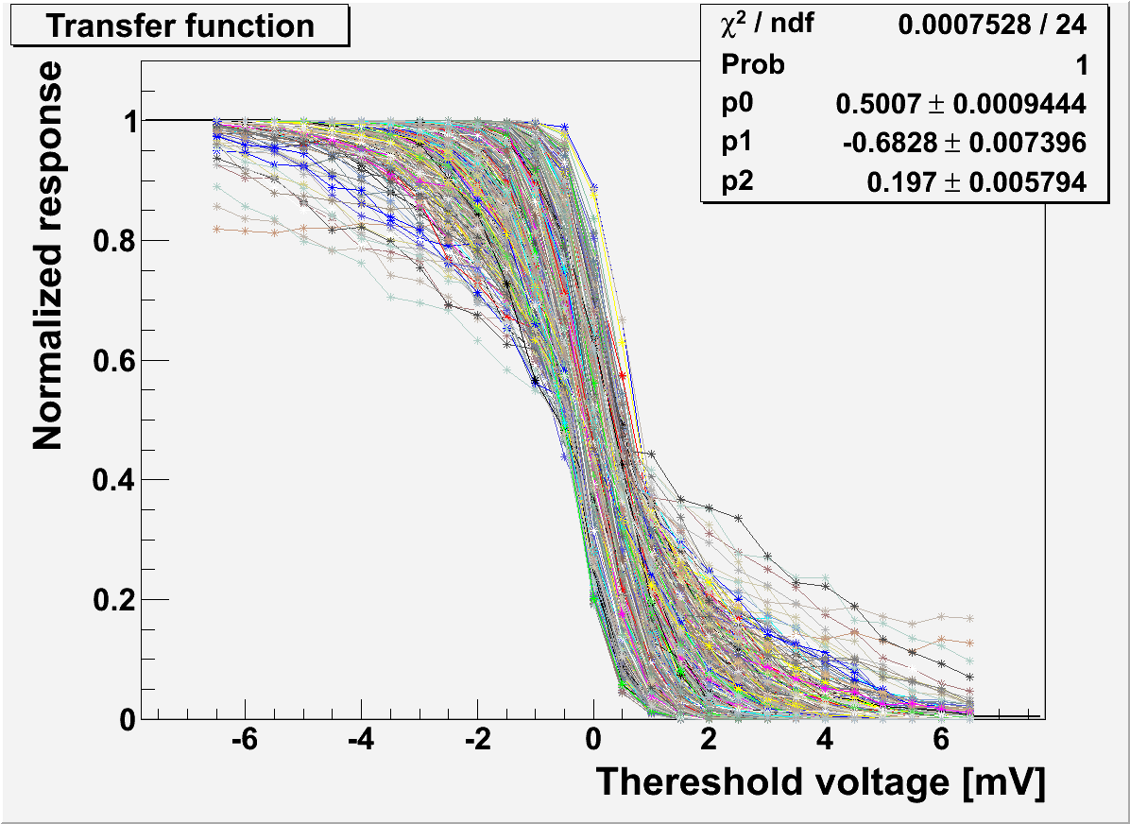
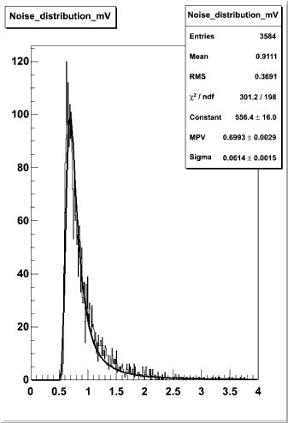
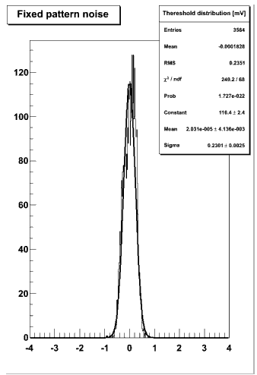
Test Results of the Upstream of MISTRAL Sensor
Lab test results @ 30 °C (MIMOSA22-THRA1 & 2, MIMOSA22-THRB) :
  Diode optimisation ➔ see M. Winter's talk in this conference
    CCE optimisation: surface diode of 8-11 µm² (22x33 µm²)
  In-pixel amplification optimisation
    Reduction of RTS noise by a factor of 10 to 100
  MISTRAL RO Architecture: (single & double raw RO)
    2-row RO increases FPN by ~1 e⁻ ENC ➔ negligible impact on ENC_{total}
    ➔ Design of the upstream of MISTRAL validated
Beam test results (DESY): ➔ see M. Winter's talk in this conference
  SNR for MIMOSA-22THRA closed to 34
    8 μm² diode features nearly 20 % higher SNR (MPV)
  Detection efficiency ≥ 99.5% while Fake hit ratio ≤ O(10⁻⁵)
  22×33 μm² binary pixel resolution: ~ 5-5.5 µm as expected from former studies
  Ionisation radiation tolerance assessment under way
L_{in}xW_{in} = 0.18 µm²
ENC ~ 14 e⁻
L_{in}xW_{in} = 0.36 µm²
ENC ~ 14 e⁻
L_{in}xW_{in} = 0.72 µm²
ENC ~ 15 e⁻
Pixel not corrected for RTS noise
ENC ~ 17 e⁻
ENC ~ 4 e⁻

Slide 14
Upstream of ASTRAL sensor
44 µm
66 µm
Thanks to the quadruple-well technology, discriminator integrated inside each pixel
  Analogue buffer driving the long distance column line is no longer needed
    Static current consumption reduced from ~120 µA to ~14 µA per pixel
  Readout time per row can be halved down to 100 ns (2 rows at once) due to small local parasitic
Sensing node & in-pixel pre-amplification as in MISTRAL sensors
In-pixel discrimination
  Topology selected among 3 topologies implemented in the 1st prototype AROM0
  Test results in laboratory: total noise ~30 e-, ➔ ENC 1.5-2 times higher but phenomena understood
  Full functionality validated
Further R&D will focus on large sensor integration along with power consumption and noise reduction
2x2 pixels
AROM-0
Thermal Noise
ENC ~ 28 e⁻
FPN
ENC ~ 7 e⁻
AROM-1

Slide 15
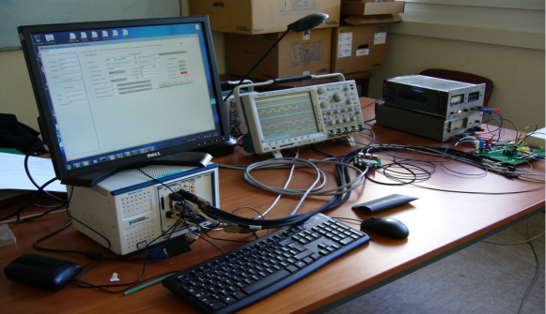
Downstream of Sensors: Zero Suppression Logic (SUZE02)
Identical both for MISTRAL & ASTRAL architecture
  AD conversion (pixel-level or column-level) outputs are connected to inputs of SUZE
Encoding: more efficient than SUZE01 implemented in MIMOSA28 sensor
  Sizable and suitable to process the binary information generated by a 1 cm long pixel array
    Hit density of ~100 hits/collision/cm² + safety factor of 3-4
    Compression factor: 1 to 4 order of magnitudes
  Identify hit clusters in 4x5 pixel windows
  Store Results in 4 SRAM blocks allowing either continuous or triggered readout
  Multiplex Sparsified data onto a serial LVDS output
    Prototype data rate: 320 Mbit/s per channel (1 or 2 channels in SUZE02)
SUZE02 preliminary test results: functional for main configurations @ full speed
  Full sequence of signal processing steps validated using various types of patterns
  SEU has to be evaluated
MISTRAL / ASTRAL: 0.5-1 Gbit/s data rate required
  One channel output per sensor
    INFN Torino is working on data transmission up to 2 Gbit/s
…….…
Row M-1
Row M
Row M+1
Window of 4x5 pixels
2965 µm
….….…
HIT
2162 µm

Slide 16
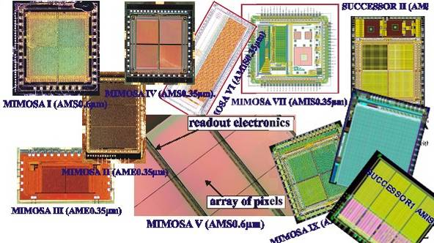
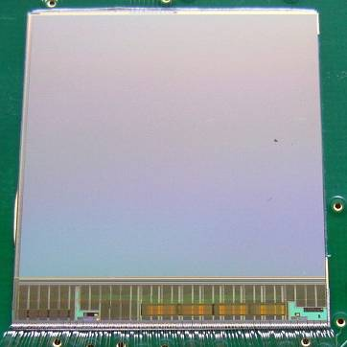
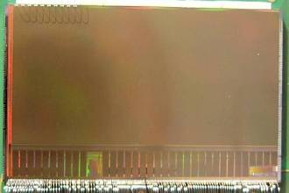
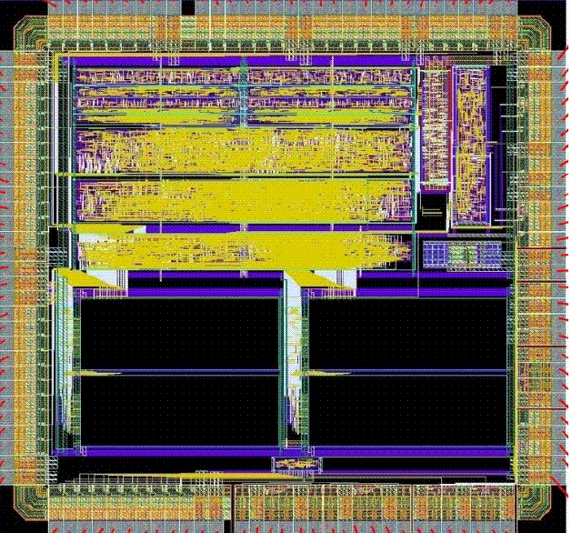

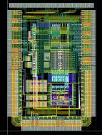
Mimosa: une évolution cohérente
Etudes collection de charge/géométrie & techno - Démonstrateurs simples
Réticule- Proto. éch. 1, ½ - Rendement
Réticule 2x 2 cm 2006
Production
~2 cm
~2 cm
Mimosa28 2010
Mimosa26 2008
Mimosa22 2007
Suze 2007
Sara 2006
Circuits finaux – Intégration des sous-ensembles
Compaction des données - Numérisation

