Slide 1
Constraining the CKM Angle γ at LHCb
Laurence Carson, University of Edinburgh
on behalf of the LHCb Collaboration
Rencontres de Moriond EW 2014

Slide 2
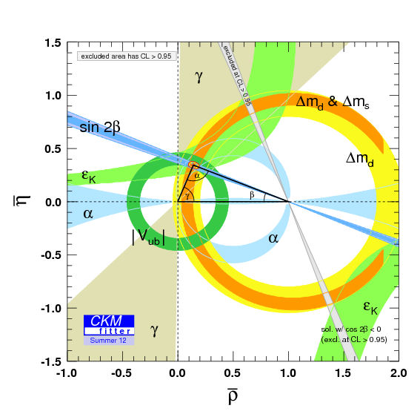
γ in Tree-Level B Decays
γ is the least well-constrained angle of the CKM triangle.
Fits in summer 2012 (before the inclusion of LHCb data) gave:
γ = 66±12° (CKMFitter), γ = 76±10° (UTFit)
Measurements of γ from B decays mediated only by tree-level transitions provide an “standard candle” for the Standard Model.
This can be compared with γ values from B decays involving loop-level transitions
For example B⁰_{(s)}→hh’ decays
Significant difference between these would indicate New Physics contribution to the loop process.

Slide 3
Menu of Results
LHCb gamma combination from time-independent methods, using B⁺→D⁰K⁺ and B⁺→D⁰π⁺ (Phys. Lett. B 726 (2013) 151), and updated preliminary combination using B⁺→D⁰K⁺ only (LHCb-CONF-2013-006)
Time-independent γ measurement with 3/fb, using B⁺→D⁰K⁺ and B⁺→D⁰π⁺ with D⁰→K_{S}Kπ (LHCb-PAPER-2013-068, submitted to Phys. Lett. B)
First observation of B_{s}→D⁰φ (Phys. Lett. B 727 (2013) 403)
Studies of beauty baryon decays to D⁰ph and Λ_{c}h (Phys. Rev. D 89 (2014) 032001)
Studies of beauty baryon decays to pairs of charm hadrons (LHCb-PAPER-2014-002, submitted to Phys. Rev. Lett.)
NEW!
NEW!

Slide 4
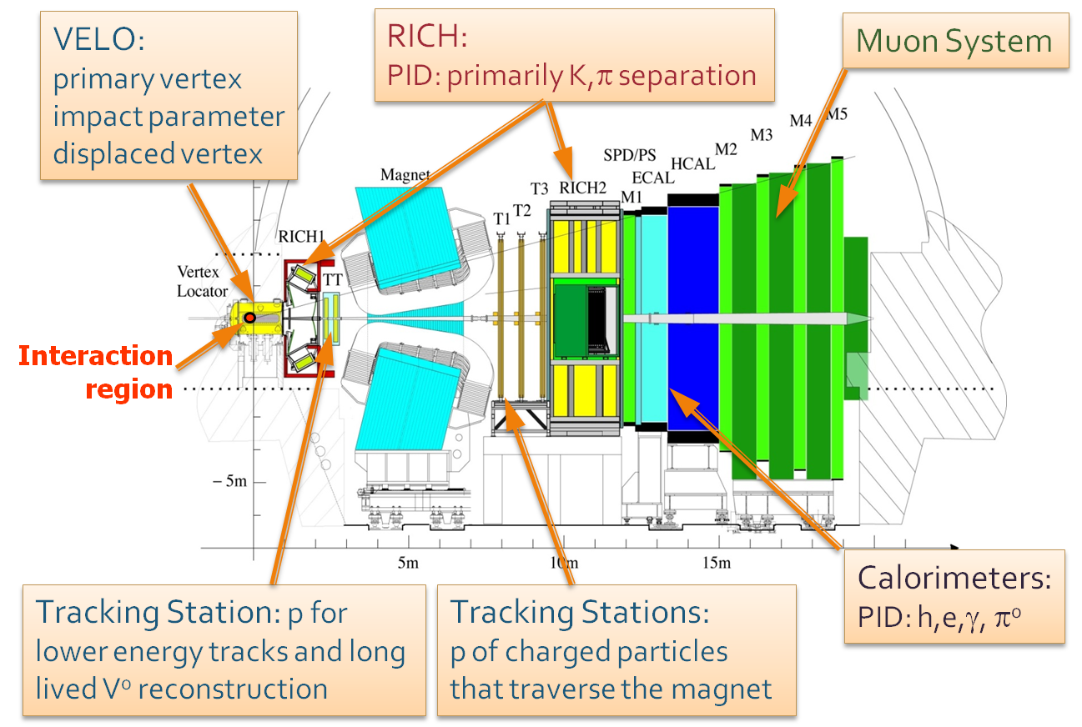
The LHCb Experiment
Forward arm spectrometer, optimised for study of B and D decays.
Collected 1/fb of data at E_{CM} = 7 TeV in 2011 and 2/fb at 8 TeV in 2012
Key capabilities:
High trigger efficiency, including on purely hadronic final states.
Excellent Impact Parameter (IP) and Mass Resolution
Hadronic PID over wide momentum range

Slide 5
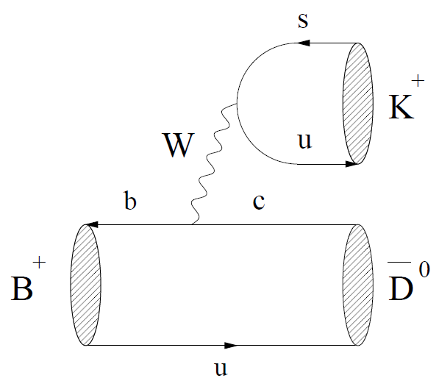
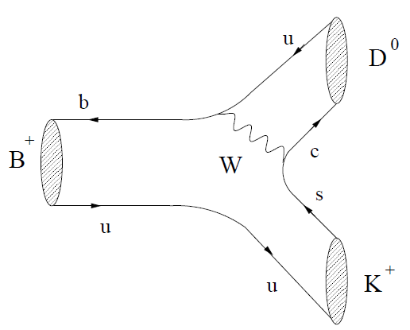
Time-Integrated Methods
Sensitivity to γ from interference between b→c and b→u transitions at tree level, when D final state is accessible to both D⁰ and D⁰
Aside from γ, have hadronic unknowns r_{B(D)}, δ_{B(D)}, where ratio of suppressed to favoured B(D) decay amplitudes is r_{B} e^{i(δB- γ)} (r_{D} e^{iδD})
Method to extract these hadronic unknowns (and γ) depends on the D final state
Three main methods:
GLW: D→ CP-eigenstate, e.g. ππ, KK (Phys. Lett. B 253 (1991) 483, Phys. Lett. B 265 (1991) 172)
ADS: D→ quasi-flavour-specific state, e.g. Kπ, Kπππ (Phys. Rev. Lett. 78 (1997) 257, Phys. Rev. D 63 (2001) 036005)
GGSZ: D→ self-conjugate 3-body final state, e.g. K_{S}ππ, K_{S}KK (Phys. Rev. D 68 (2003) 054018, Phys. Rev. D 70 (2004) 072003)

Slide 6
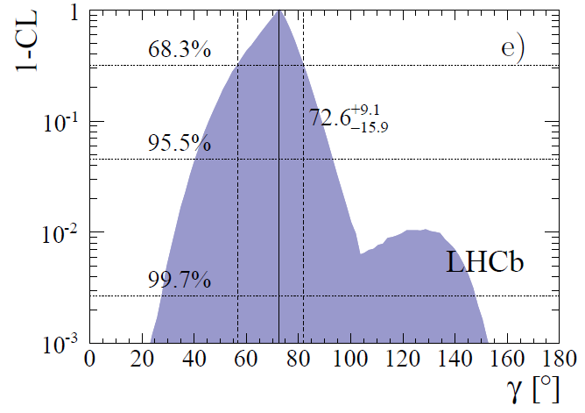
Gamma Combination
The published LHCb combination uses analyses of B→Dh with:
D→Kπ, KK or ππ using 1/fb (Phys. Lett. B 712 (2012) 203),
D →Kπππ using 1/fb (Phys. Lett. B 723 (2012)) 44),
D→K_{S}KK or K_{S}ππ using 1/fb (Phys. Lett. B 718 (2012) 43),
Plus CLEO data on D→Kπππ strong phase (Phys. Rev. D 80 (2009) 031105)
The experimental likelihoods are combined as , where A are the experimental observables (R_{CP}, x₊, etc) and α are the physics parameters (γ, r_{B}, etc).
Confidence intervals are rescaled, to account for undercoverage and neglected correlations between systematics.
The effects of D⁰-D⁰ mixing, and of possible CPV in the D decays, are taken into account.
68% CL confidence interval using DK and Dπ is:

Slide 7
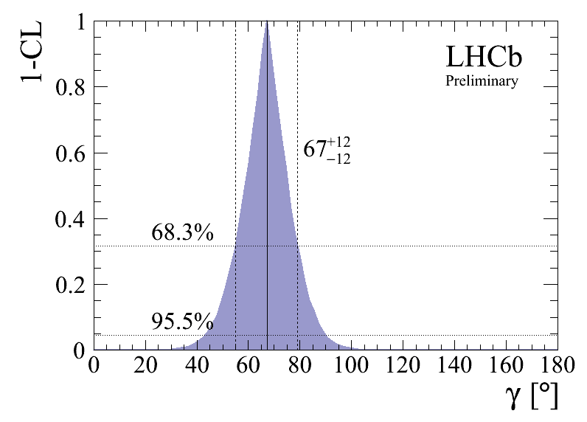
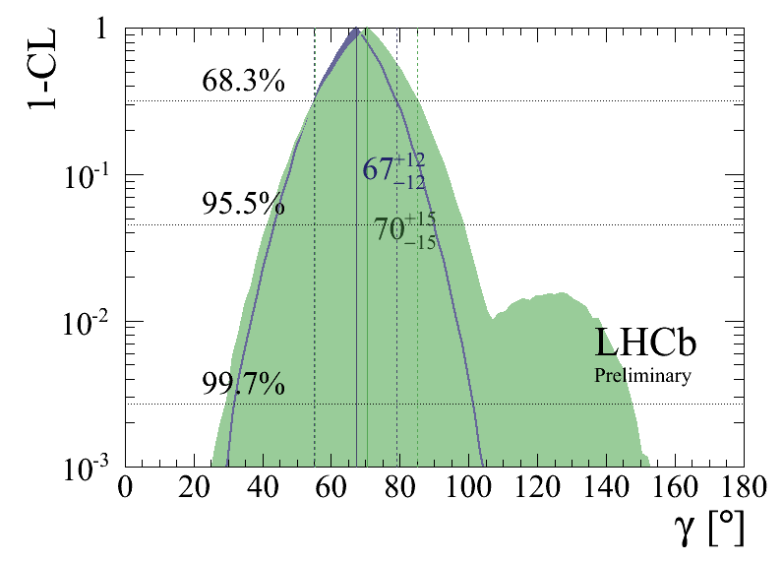
Gamma Combination
There is also a more recent, preliminary LHCb combination.
This uses analyses of B→DK from the same analyses as the published combination, adding the information from an updated analysis with D→K_{S}KK or K_{S}ππ using the 3/fb dataset (LHCb-CONF-2013-004).
Preliminary result is γ = 67±12°
Comparison of 1/fb-only and updated confidence intervals for DK
These results lead to updated CKM fits:
+8.0
γ = 68.0 ° (CKMFitter, FPCP 2013),
γ = 70.1±7.1° (UTFit, EPS 2013).
-8.5

Slide 8
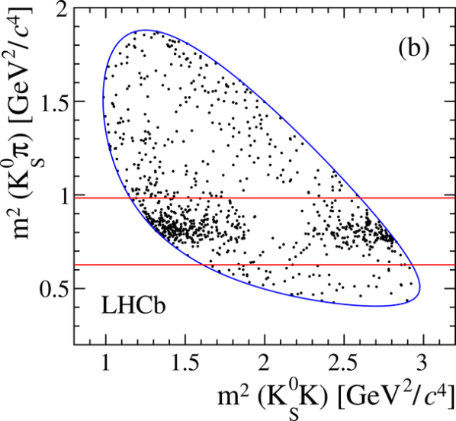
Observables for B⁺→D⁰(→K_{S}Kπ)h⁺
NEW!
This is the first ADS-like analysis to use Singly-Cabibbo-Suppressed (SCS) modes. Label final states as OS or SS comparing K± with B±
Analysing three-body D final state requires knowledge of how the average interference amplitude (κ_{KSKπ}) and strong phase difference (δ_{KSKπ}) vary across the D Dalitz plot
This is taken from a CLEO-c measurement, Phys. Rev. D 85 (2012) 092016
Decay rates for B⁺→D⁰K⁺ are:
Measure yield ratios (e.g. R_{DK/Dπ, SS}) and charge asymmetries (e.g. A_{SS,DK}) between the OS and SS samples, and between DK and Dπ final states.
Analysis is done across whole Dalitz plane, and in a restricted region around the K*± resonance, where the coherence factor κ_{KSKπ} is higher (≈1.0 vs ≈0.7).

Slide 9
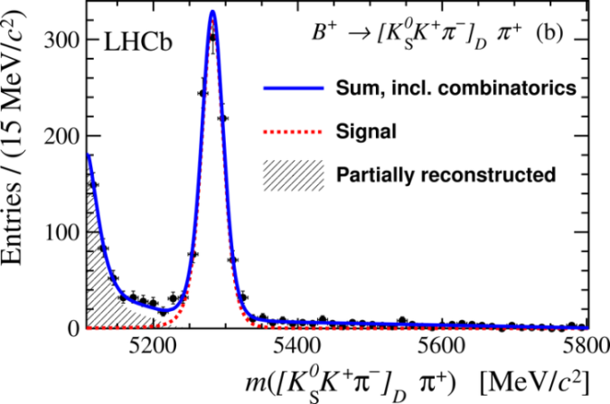
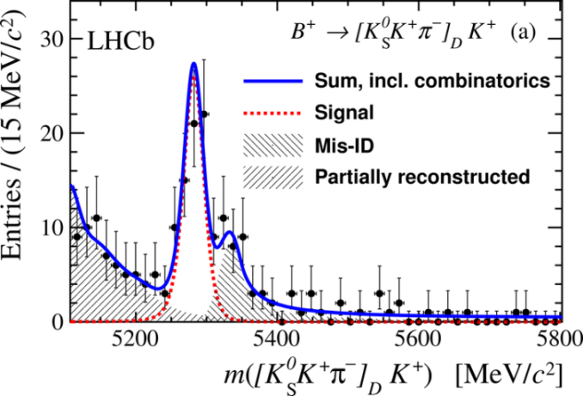
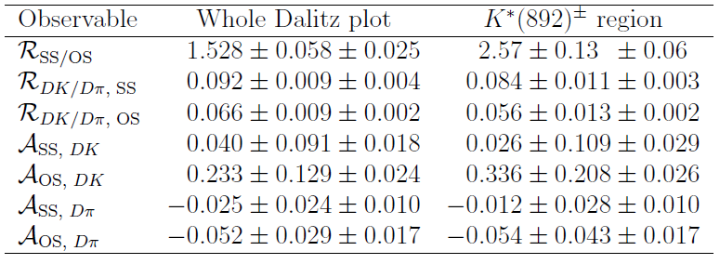
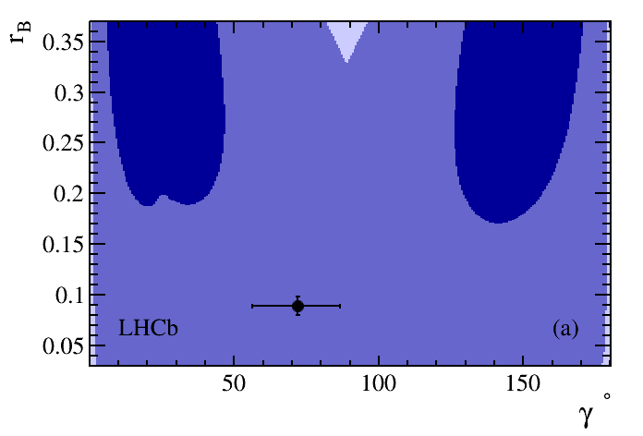
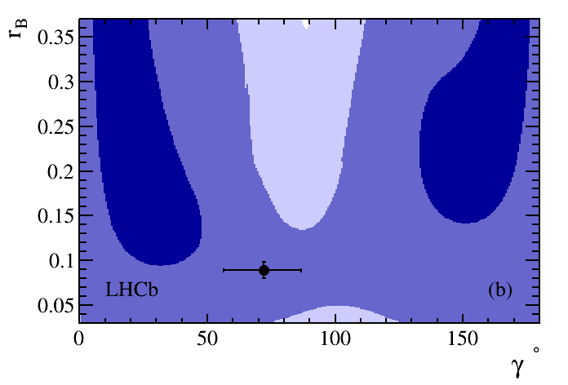
Results for B⁺→D⁰(→K_{S}Kπ)h⁺
Measure 8 yields, with B⁺→D⁰K⁺ and B⁺→D⁰π⁺ separated by OS/SS and charge of B±
Charge-summed yields for OS and SS D⁰K⁺ are 71 and 145 respectively.
NEW!
Sensitivity to γ appears to be improved by taking K*± region, due to higher coherence factor.
Good prospects for future analysis of K*± region with more statistics.
r_{B}
r_{B}
1σ
2σ
1σ
2σ
Whole Dalitz plot
γ
K*± region
γ

Slide 10
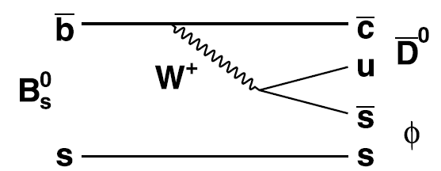
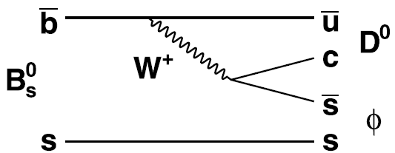
Observation of B_{s}→D⁰φ
Time-dependent analysis of the B_{s}→D⁰φ decay can measure γ and φ_{s} (Phys. Lett. B 253 (1991) 483).
Using the now-known sign of ΔΓ_{s} , this determination can be made unambiguous (Phys. Rev. D 85 (2012) 114015).
A time-independent analysis can also measure γ, provided enough D⁰ final states are included (Phys. Rev. D 69 (2004) 113003, Phys. Lett. B 649 (2007) 61). This has advantages for LHCb, as it means flavour-tagging is not required.
First step is to make the first observation of the decay, using the Cabibbo-favoured D⁰→K⁺π⁻ decay mode.

Slide 11
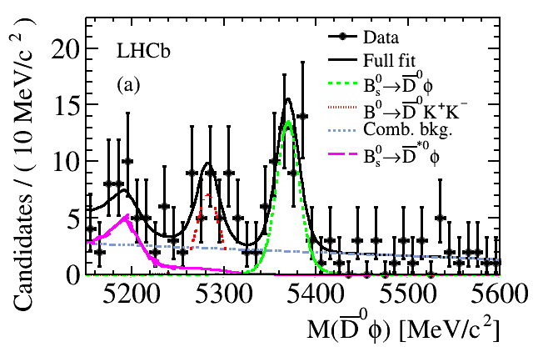
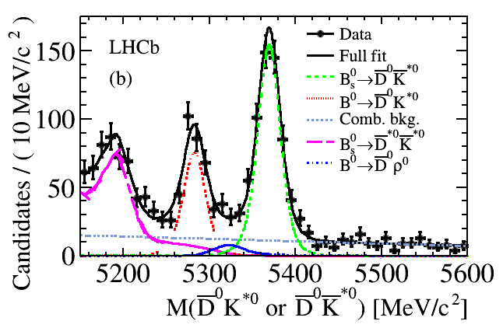
Observation of B_{s}→D⁰φ
LHCb searched for B_{s}→D⁰φ with a blind analysis of 1/fb of data.
First observation of B_{s}→D⁰φ is made, with significance of 6.5σ.
N_{Bs→D0φ} = 43 ± 8
Branching fraction (B) is measured relative to the B_{d}→D⁰K^{*0} decay. Also improve the measurement of B(B_{s}→D⁰K^{*0}) relative to B_{d}→D⁰K^{*0}:
With more data, can add more D⁰ final states, such as KK, ππ, K_{S}ππ, …

Slide 12
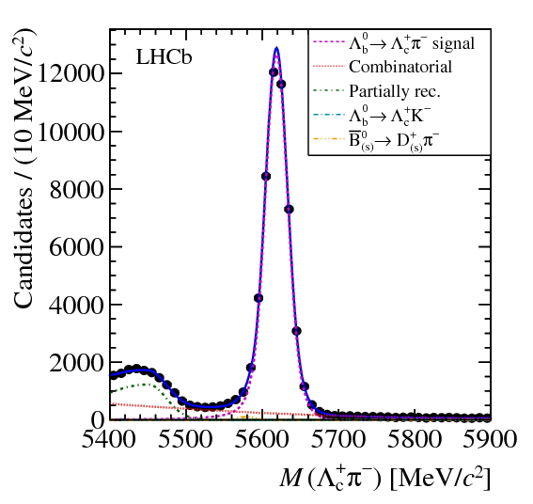
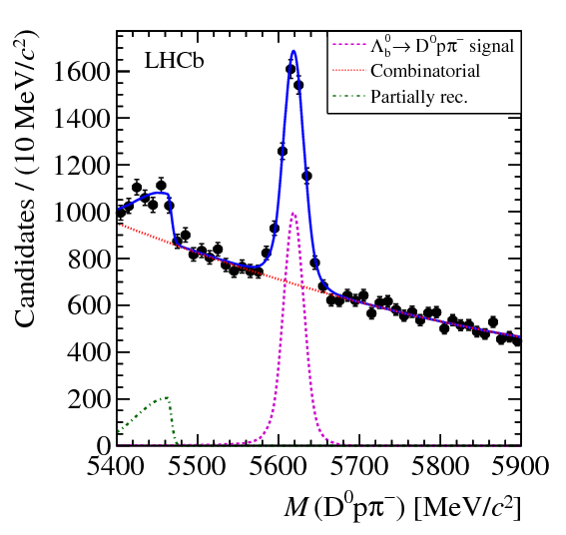
Baryon Decays to D⁰ph, Λ_{c}h
Beauty baryon sector remains largely unexplored.
Decays such as Λ_{b}→D⁰Λ and Λ_{b}→D⁰pK⁻ can be used to measure γ (Z. Phys. C 56 (1992) 129, Mod. Phys. Lett. A 14 (1999), Phys. Rev. D 65 (2002) 073029)
LHCb has studied beauty baryon decays to D⁰ph⁻ and Λ_{c}h⁻ final states, using 1/fb of data.
The Caibibbo-favoured final states D⁰→K⁻π⁺ and Λ_{c}→pK⁻π⁺ are used.
Common pK⁻π⁺h final state reduces systematic uncertainties.
Firstly, use a loose, cut-based selection to measure:
Λ_{c}π ⁻
D⁰pπ ⁻
( )
factoring out poorly-known B(Λ_{c}→pK⁻π⁺ )

Slide 13
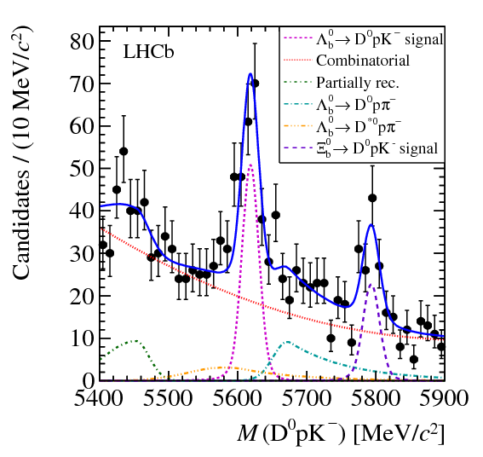
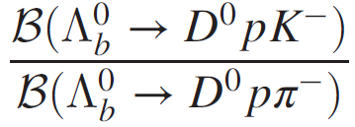
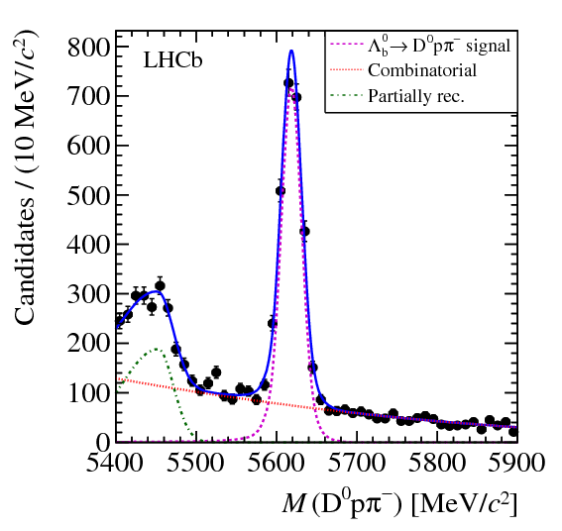
Baryon Decays to D⁰ph, Λ_{c}h
Tighter selection (with BDT) used to make the first observations of Λ_{b}→D⁰pK⁻ (9.0σ) and Ξ_{b}→D⁰pK⁻ (5.9σ), and measure:
D⁰pK⁻
The D⁰pK⁻ spectrum can also be used to measure the mass difference:
D⁰pπ ⁻
(Systematic is dominated by background modelling in mass fit)
Combining with the LHCb measurement of m_{Λb} using Λ_{b}→ J/ψΛ (PRL 110 (2013) 182001) gives:
Most precise to date!

Slide 14
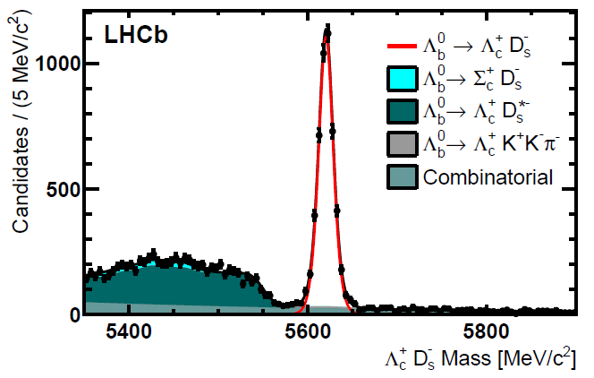
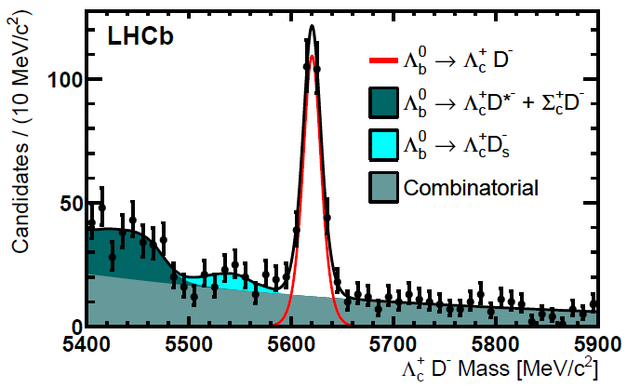
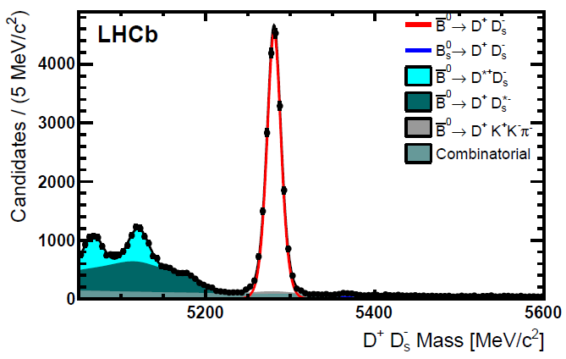
Baryon Decays to Two Charm Hadrons
Another showcase for LHCb’s capabilities with beauty baryons is the analysis of their decays to pairs of charm hadrons, using 3/fb.
NEW!
Events are selected using a BDT trained on signal decays to the relevant single charm hadron: B_{d}→D⁻π ⁺, B_{s}→D_{s}⁻π ⁺ or Λ_{b}→Λ_{c}π ⁻.
Clear first observations are made of the decays Λ_{b}→Λ_{c}D_{s}⁻ (CF) and Λ_{b}→Λ_{c}D⁻ (SCS), with:
Λ_{c}D_{s}⁻
Λ_{c}D⁻
D⁺D_{s}⁻
The Λ_{b} branching fractions can be normalised to B_{d}→D⁺D_{s}⁻, but the fragmentation fraction ratio f_{Λb} /f_{d} is known to depend on the p_{T} of the b-hadron (LHCb, Phys. Rev. D 85 (2012) 032008)…

Slide 15
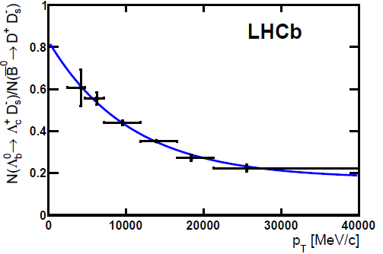
Baryon Decays to Two Charm Hadrons
Adopting the p_{T}-dependence of f_{Λb} /f_{d} measured by LHCb using B_{d}→D⁻π ⁺ and Λ_{b}→Λ_{c}π ⁻ (LHCb-PAPER-2012-004, in preparation), the double ratio is measured:
NEW!
In addition, the modes B_{{d,s}}→ Λ_{c}⁺Λ_{c}⁻ are searched for, and no significant signal is found. The following 95% C.L. limits are set:
p_{T}-dependence of Λ_{b} / B_{d} yield ratio
Finally, the very similar Q-values of the B_{d}→D⁺D_{s}⁻ and Λ_{b}→Λ_{c}D_{s}⁻ decays allows a precise measurement of the mass difference:
Dominant syst is due to τ(D⁺) >>> τ(Λ_{c})
Using the World Average B_{d} mass gives the most precise result to date for the absolute Λ_{b} mass:

Slide 16
Summary & Prospects
Preliminary LHCb γ combination with B⁺→D⁰K⁺ decays, using various methods (ADS, GLW, GGSZ) gives γ = 67±12°, more precise than the B-factory measurements.
At the moment, no one method dominates the sensitivity.
Always looking to add new B decays, and new D final states
First constraints on γ with B⁺→D⁰(→K_{S}Kπ)h⁺ just submitted to PLB
Promising new mode B_{s}→D⁰φ now observed
Wealth of measurements now being done with b-baryons, may throw up some interesting surprises.
Stay tuned for more results in the future!
Many measurements are awaiting the inclusion of the 2.0/fb collected at 8 TeV in 2012

Slide 17
Backup

Slide 18
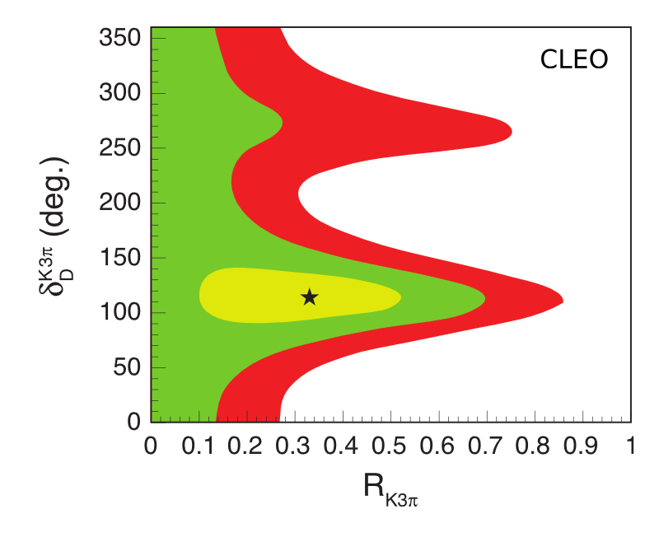
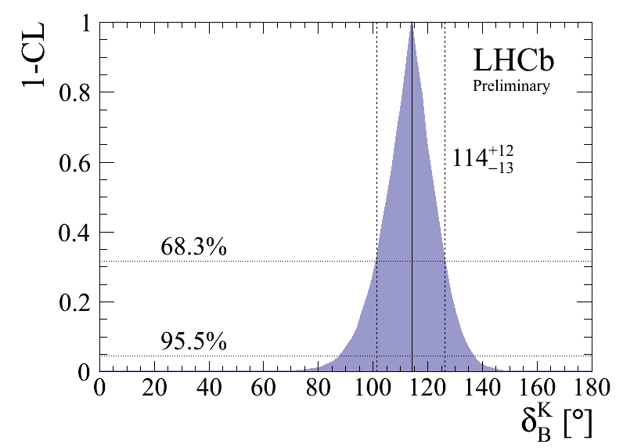
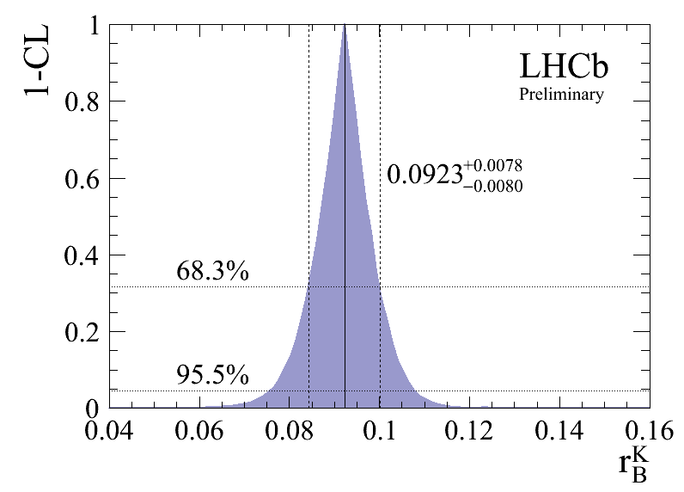
Gamma Combination
CLEO-c result on D→ Kπππ :
Other parameters measured:

Slide 19
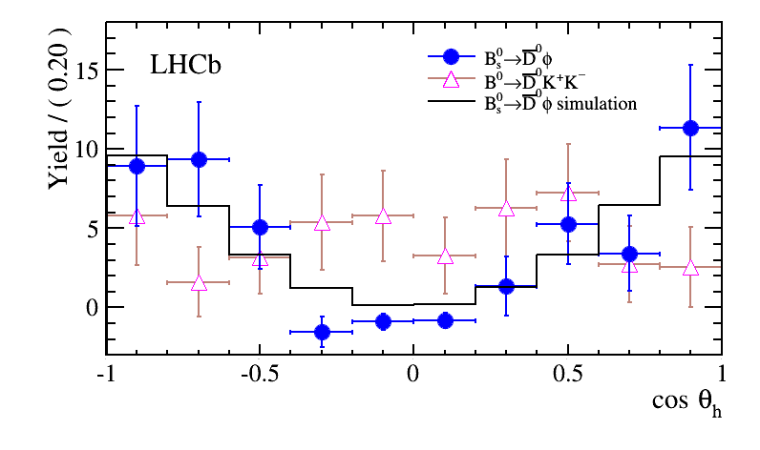
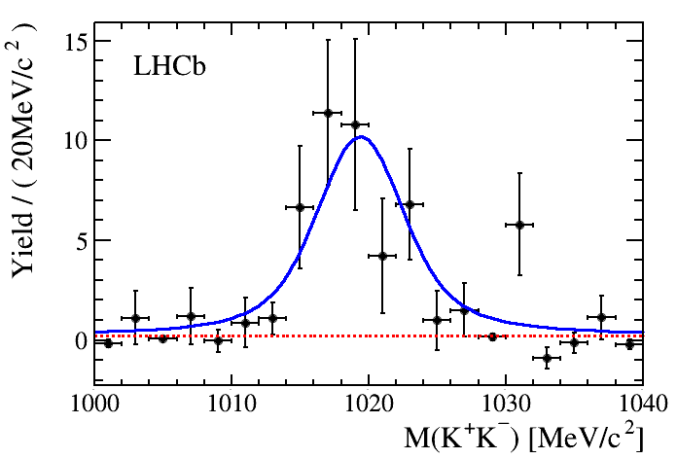
Helicity Structure for B_{s}→D⁰φ
Distribution of the helicity angle for selected signal events shows that the B_{s} mass region is dominated by a vector resonance, as expected for a final state. In contrast in the B_{d} mass region is not.
The B_{d} distribution supports what was seen in the LHCb paper on the discovery of the B_{d}→D⁰K⁺K⁻ decay, Phys. Rev. Lett. 109 (2012) 131801.
The B_{s} distribution is reinforced by the m(KK) distribution in the B_{s} region:

Slide 20
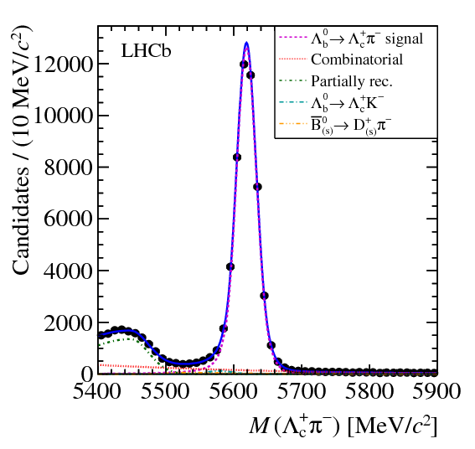
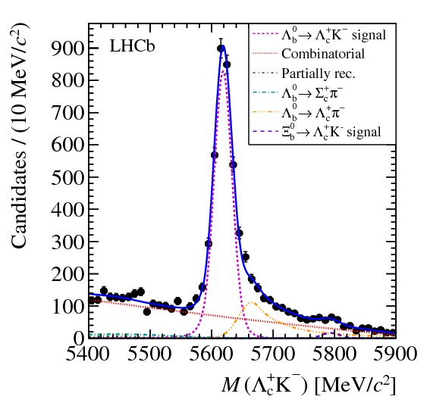
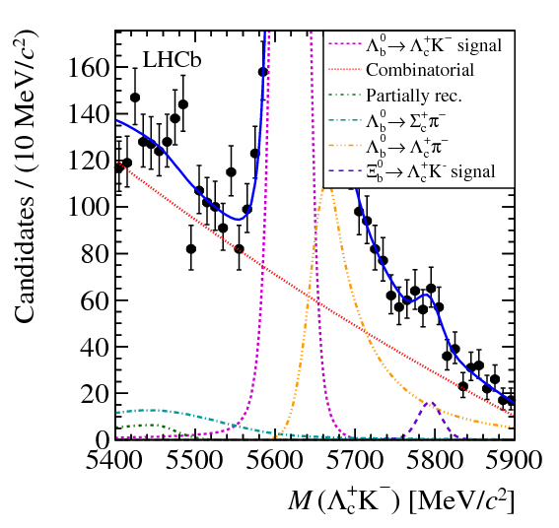
Baryon Decays to D⁰ph, Λ_{c}h
The tighter selection is also applied to the Λ_{c}h⁻ spectra, to clearly observe Λ_{b}→Λ_{c}K⁻ , and find evidence for Ξ_{b}→Λ_{c}K⁻ (3.3σ):
Λ_{c}K ⁻
Λ_{c}π ⁻
zoom Λ_{c}K ⁻

Slide 21
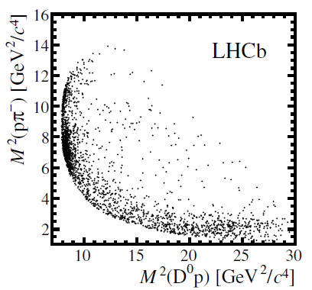
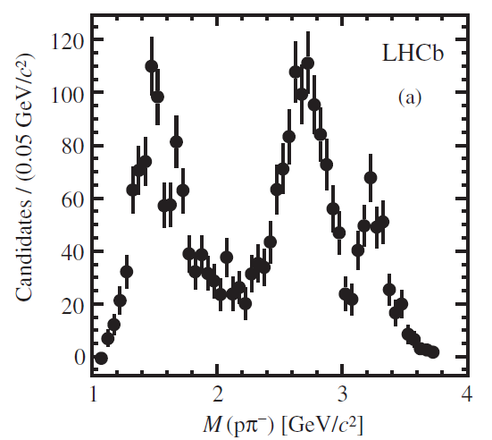
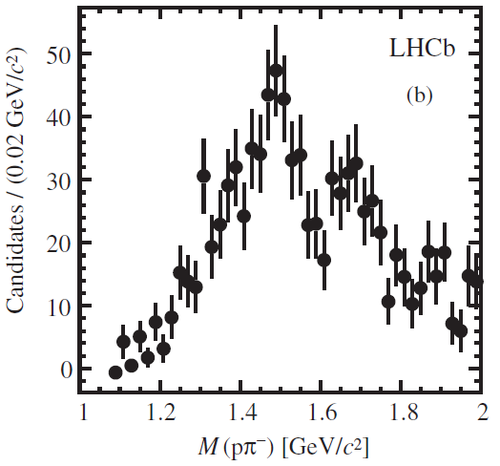
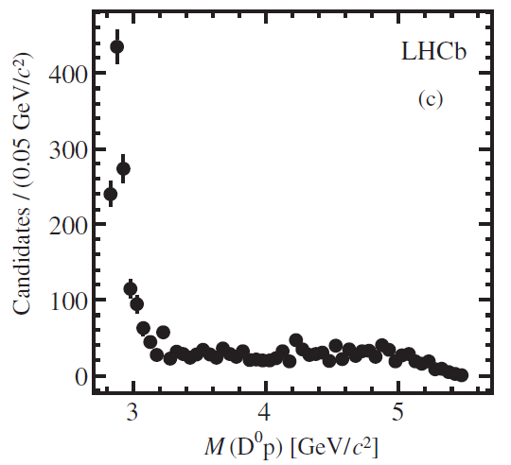
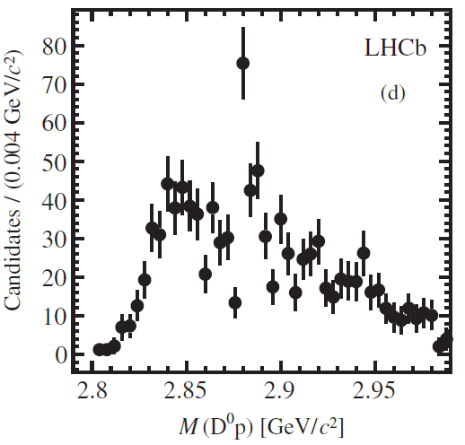
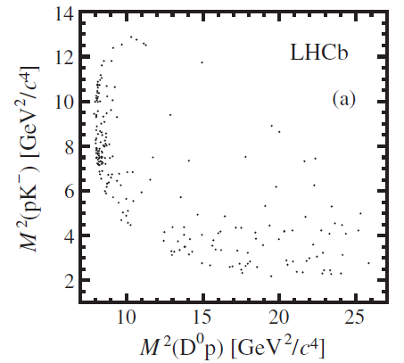
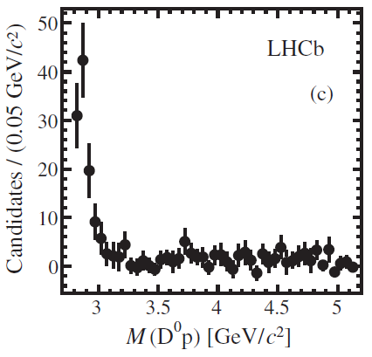
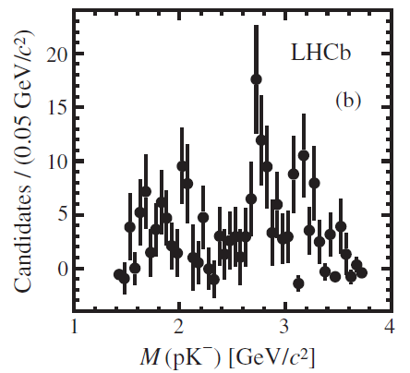
Λ_{b}→D⁰ph⁻ Dalitz Plots
zoom to low-mass
D⁰pπ ⁻
m(pπ ⁻)
zoom to low-mass
m(D⁰p)
D⁰pK ⁻
m(pK ⁻)
m(D⁰p)

Slide 22
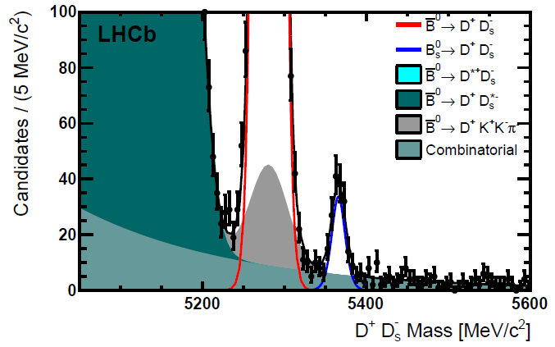
B(B_{s}→D⁺D_{s}⁻ ) Measurement
The “two charm hadrons” analysis also makes the most precise measurement of B(B_{s}→D⁺D_{s}⁻ ):
zoom y-axis

