Slide 1
Bulk job submission
DIRAC Project

Slide 2
Parametric Jobs
A parametric job consists in submission of a set of jobs where only one parameter make the difference between the jobs.
  Parametric jobs share the same Input Sandbox
The parametric job must define a JDL attribute “Parameters”. It can take the following values:
  A list (strings or numbers).
    Parameters = {”value1”,”value2”,”value3”};
  Or, an integer specifying the number of parameters to generate, in this case the JDL attributes ParameterStart and ParameterStep/ParameterFactor must be defined in order to create the sequence of values:
    P₀ = ParameterStart
    P_{i} = P_{i-1}*ParameterFactor + ParameterStep

Slide 3
Parametric Jobs
The %s placeholder is substituted by the parameter value and can be put in any JDL attributes.
  Not all the attributes can be parameterized this way, e.g. Input Sandbox files can not be parameterized.
The %n placeholder is replaced by the parameter sequential number
  Useful to be used in job and file names
  Left padded with zeros to make names alphabetically sortable
The %j placeholder is replaced by the DIRAC job ID
  Can be useful in the OutputPath JDL attribute

Slide 4
Parametric Job - JDL
Executable = "testParametricJob.sh";
JobName = ”Parametric_%n";
Arguments = "%s";
Parameters = 20;
ParameterStart = 0;
ParameterStep = 0.02;
ParameterFactor = 1;
StdOutput = "StdOut_%j";
StdError = "StdErr_%j";
InputSandbox = {"testJob.sh"};
OutputSandbox = {"StdOut_%j","StdErr_%j"};
Placeholder replaced by Parameter
number value for each job
Placeholder replaced by Parameter
value for each job
Placeholder replaced by Parameter
value for each job

Slide 5
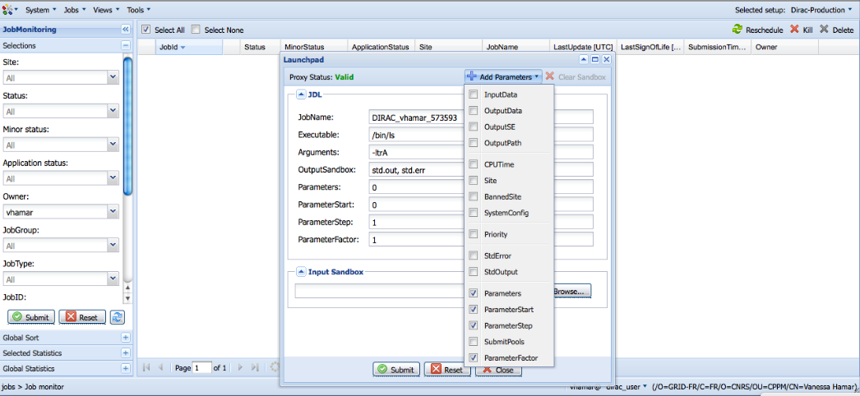
Parametric Job - JDL
Parameters
in JDL
Add parameters

Slide 6
Tutorial
Submit series of “mandelbrot” jobs with Web Launchpad
  Submit multiple jobs to explore the C seeds
  Submit multiple jobs with increasing precision to make a series of frames for the Mandelbrot movie
  Submit jobs to multiple sites, one per site
  Monitor jobs
  Store results in the grid SE
Goals
  Understand bulk job description
  Understanding job input/output data

Slide 7
Wiki
https://github.com/DIRACGrid/DIRAC/wiki/JobManagementAdvanced

