Slide 1
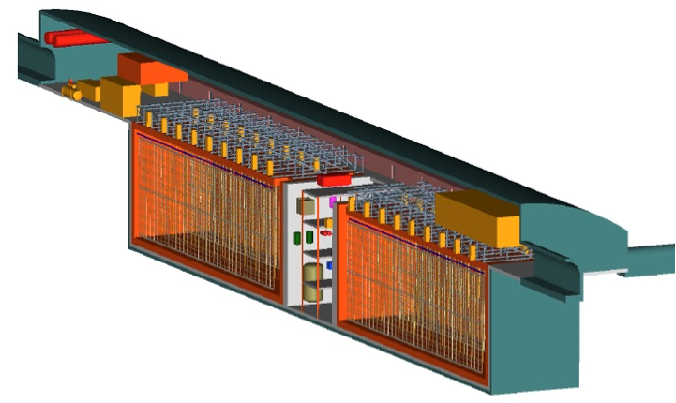
Europe in LBNE
Alfons Weber
University of Oxford
STFC/RAL

Slide 2
European Collaborators
UK
  University of Cambridge
  University of Lancaster
  University of Liverpool
  University College London
  University of Manchester
  University of Oxford
  University of Sheffield
  University of Sussex
  University of Warwick
  (Rutherford Appleton Lab)
Italy
  Catania Group
  Gran Sasso
  Gran Sasso Science Inst.
  Milano
  Milano & INFN Bicocca
  Padova
  Pavia
  Napoli

Slide 3
UK Programmatic Review
Every few years STFC undertakes a programmatic
  Critical look on current activities
  Find a balanced approach to the future under different funding scenarios
Output
  Roadmap
  Define (broadly) priorities and funding lines for next 10 years in particle physics, astronomy and nuclear physics
Finished last summer
  Result to be released soon
Expected general consensus (CEO)
  Neutrinos are VERY important
  Priority as high as LHC upgrades

Slide 4
UK Activities
SoI was accepted by STFC
Proposal for preparatory phase
  together with HK
  To be submitted in spring 2014
Areas of interest/activities
  DAQ
  35t prototype
    Operation
    HV monitoring
  R&D TPC components
    APA, Could be installed in LAr1-ND
  Software
    LAr reconstruction: PandoraPDF
    Neutrino generator: GENIE

Slide 5
HL DAQ Design
Each process sees all data
from one part of detector
Each process sees all data
from one millislice
On RCE
Push from Xilinx
Stage 1
buffer
Stage 1
process
Stage 2
buffer
Stage 2
process
Wait for slow
external trigger
Stage 3
stores
Stage 3
process
Upstream FPGAs
Data transferred
with PGP
Trigger
manager
Stage 1 | Parallelized by detector section. Receive RCE data, merge micro to milli-slice, route to correct stage 2, per-view trigger processing
Stage 2 | Parallelized by milli-slice. With overlaps. SN trigger caching. Complete trigger calculation in milli-slice and overlap.
Stage T | One process in detector, arbitrate spill, calibration, and detector triggers.
Stage 3 | Parallelized by milli-slice. Buffer data during trigger decision. Receive trigger decisions, splice milli-slice to event.
Stage T
Each stage pushes
data to the store of
the next stage where
it waits in queues.

Slide 6
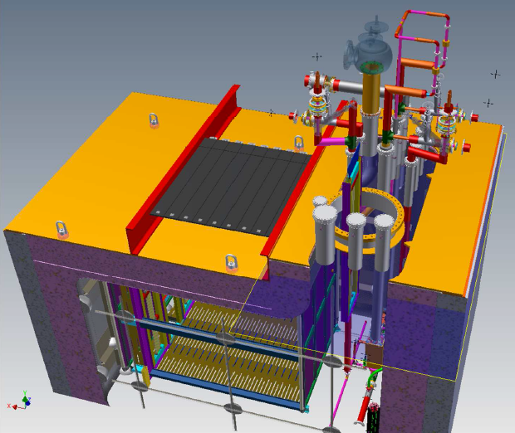
35t Prototype
Membrane cryostat and cryogenics now finished
Goal is to demonstrate LBNE technology
Two phases
  1st is a purity demonstration
  2nd has LBNE TPC and photon detectors
Essential for TDR
Cosmic rate in 6 m² ~ 600 Hz
Drift time ~1.5 ms
TPC: 2.2 x 1.8 x 2 m³

Slide 7
Timeline
Oct
‘13
Oct
‘14
Oct
‘15
Oct
‘16
Oct
‘17
Install TPC&PD for 2nd phase
Data run
nominally 3 months
Analysis,
JINST papers,
TDR sections
Fill 35T w/ LAr for 1st phase
CD-2
Status
  Commissioning Nov ‘13
  70% filled Dec ’13
  2 msec lifetime achieved
  Now 100% filled
UK contributions
  Operations
  Software testbed
  Analysis of cosmics
  HV breakdown camera
  DAQ

Slide 8
LAr Reconstruction
CLIC, arXiv:1209.4039
PandoraPFA is a set of software tools developed for fine-grain reconstruction.
  Initially applied to linear collider.
  Has become central to ILC/CLIC physics studies.
Tools are fast, flexible and reusable
  readily applicable to automated event reconstruction in LAr
Developing pattern recognition algorithms for MicroBooNE and LBNE.
  Reached advanced stage
  Chain of 3D algorithms in place.
LBNE, arXiv:1307.7335
Andy Blake, John Marshall, Mark Thomson (Cambridge University)

Slide 9
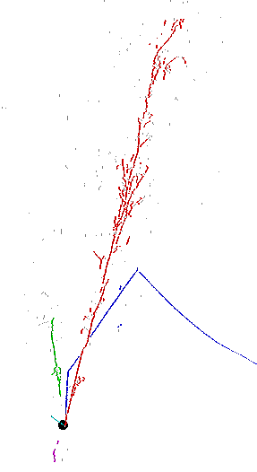
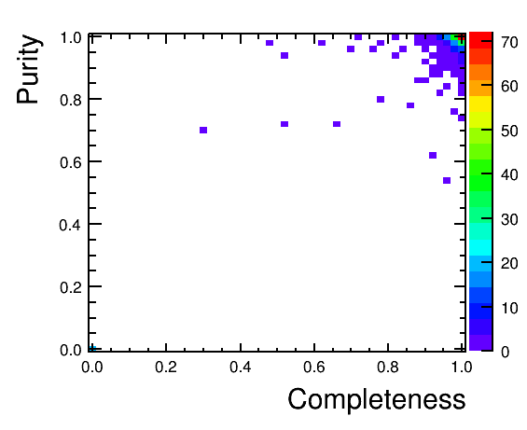
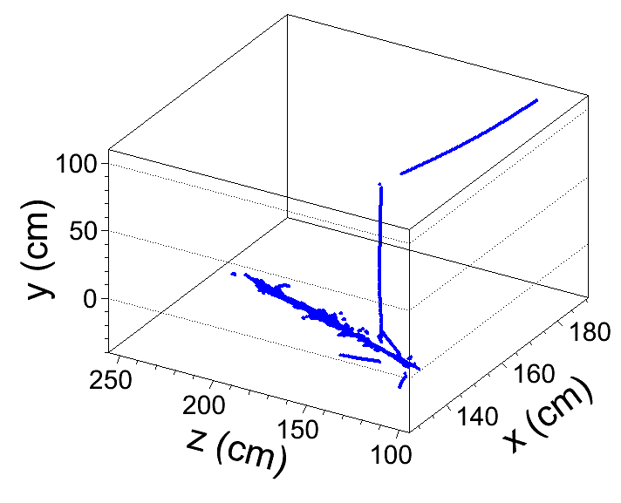
LAr Reco Performance
2D Reconstruction
4 GeV ν_{e} CC interaction (fully simulated,
using MicroBooNE geometry)
CC Muon
3D Reconstruction
2
1
1
2
3
5
3
z
4
4
5
x

Slide 10
Italian Activities (I)
Very interested
  Original developer of LAr TPC technology
  Currently 8 institutions are LBNE collaborators
  NESSiE Collaboration
    6 additional Italian & other nationalities
    Long-term interest in LBNE
  Precise scope being discussed
  Push technology: R&D and experiment
    Incl. WA104 @ CERN
  Some people propose to provide 1 complete TPC of own design
    Need significant resources outside INFN budget

Slide 11
Italian Activities (II)
Ongoing high level discussions
  FNAL director ⬄ vice president of INFN
  LBNE project & collaboration⬄ VP of INFN
    Including President of commission 2 (Neutrinos)
  LBNE leadership ⬄ C. Rubbia
  11th US-Italy Joint Commission on Science & Technology Cooperation
    Washington, 12-13 Dec 2013
      Chaired by DOE/HEP ass.director & VP INFN
    LAr technology and SBL/LBL program @ FNAL
      Major point of discussion on working level/physics
  Further 3-way discussions
    DOE/HEP ⬄ CERN DG ⬄ INFN president

Slide 12
LAGUNA/LBNO
200 members with large cross section of European particle physicists
  9 CERN member states
  1 accession state
  2 observer states
Nearing the completion of EU funded design study
  Detailed engineering & full costing
    Locations: Frejus, Gran Sasso, Pyhäsalmi
    Technologies: LAr, LScint, Water Cherenkov
  Part of which is LAr detector @ Pyhäsalmi
    Phase I: 20 kt
    Phase II: 70 kt
Scientific goals & technology are very similar

Slide 13
LBNO-LBNE Discussions
  Leadership agreed
    work towards common goals would be mutually beneficial
Task force to discuss joining forces
  Meeting every ~2 weeks
  5 members from each Executive Committee
Joint physics task force
  Comparison of analysis
  Common understanding of science strategy
Common R&D centred around WA105@CERN
    To be completed around 2017
  Comparison 1- & 2-phase readout
  Prototyping both LBNE & LBNO hardware
    P.a. large membrane cryostat

Slide 14
Summary
Opportunity
  Europe can contribute to make LBNE a better experiment
    Underground location
    ND detector
    Fiducial mass
  Valuable Expertise
    LAr technology
      ICARUS, LAGUNA-LBNO
    LBL experiments
      MINOS, T2K, OPERA
    Electronics/DAQ, engineering, physics, software
    Near Detectors
Physics reach is important
  Have to be able to do first class science to get funding

