Slide 1
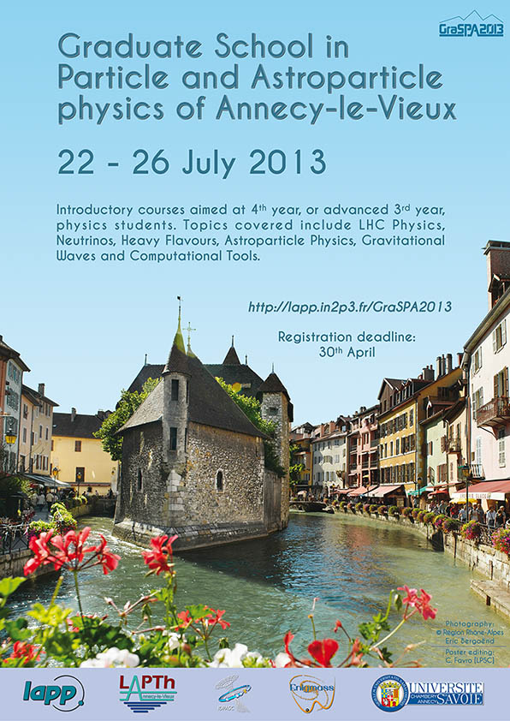
GraSPA 2013: outcome and GraSPA 2014: project
Lucia DI CIACCIO
Pablo DEL AMO SANCHEZ
and many others… (thanks!)
08/11/2013

Slide 2
Context
Constant, uniform decrease in physics students recruitment
Particle and Astroparticle physics school offer for 3rd year students mostly inexistent
(plenty of offer for doctoral and young postdoctoral students)
LAPP/LAPTh (UniSavoie) members of International Doctorate in Particle, Astroparticle physics and Cosmology (IDPASC) network
Neutrino anomalies
The STEREO experiment
Postdoc proposal
Conclusions

Slide 3
Goals
Inspire brightest among french and international students to pursue Particle and Astroparticle physics fields BEFORE THEY CHOOSE A MASTER TOPIC (3rd & 4th year students)
Bonus: increase international visibility of ENIGMASS labs and Universities before choice of PhD!
Neutrino anomalies
The STEREO experiment
Postdoc proposal
Conclusions

Slide 4
School format
~1 week-long summer school
introductory lectures on main Particle and Astroparticle topics:
electroweak sector
flavour physics
neutrinos
cosmic rays
gravitational waves
computing session
~4h/topic, usually 2h theory + 2h experiment
lecturers mostly from ENIGMASS labs + some external lecturers
Our lecturers working closely with students is the goal!
highly subsidized because of target audience (undergrad and master students). Accommodation + lunches paid by School.
Neutrino anomalies
The STEREO experiment
Postdoc proposal
Conclusions

Slide 5
Budget
INCOME (€ HT)
Université de Savoie, DRI 2013 | 3 000
ENIGMASS | 2 271,70
TOTAL INCOME | 5 271,70
EXPENDITURES (€ HT)
Accomodation (16 students) | 2 187
Lunches | 1 211,11
Social dinner | 1 159,85
Excursion (Annecy lake) | 368,49
Coffee breaks, reception | 252
IDPASC director hotel | 84,70
Posters | 50
TOTAL EXPENDITURE | 5 313,15
Plus:
IDPASC network financed travel expenses of
4 students
(~1500 €)

Slide 6
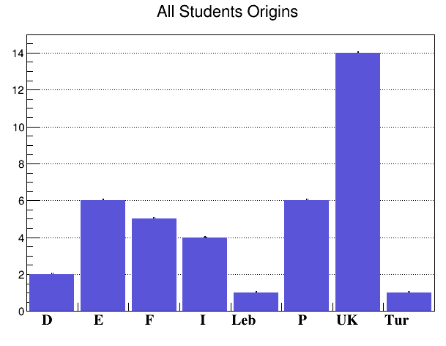
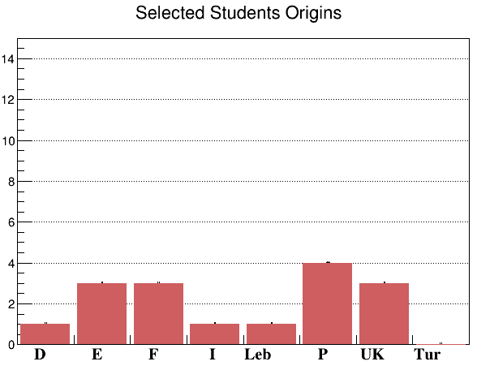
Students
39 valid applications from 8 different countries
16 students kept
6 LAPP+1 LAPTH stagiaires also participated
23 students in total
39 applicants
16 selected
Neutrino anomalies
The STEREO experiment
Postdoc proposal
Conclusions

Slide 7
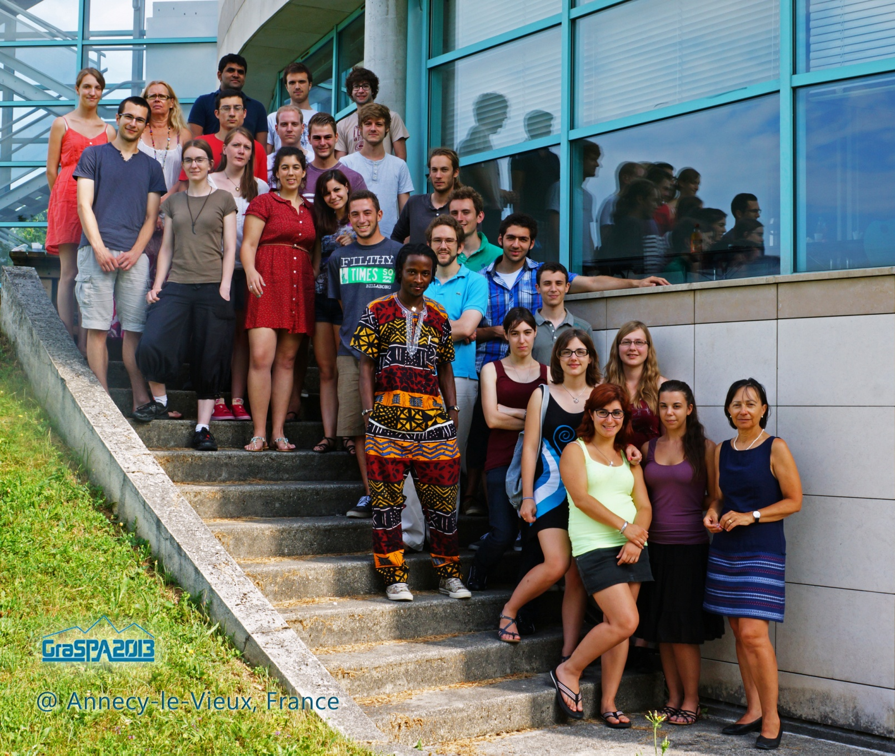
Students
Strong involvement
from ENIGMASS
lecturers

Slide 8
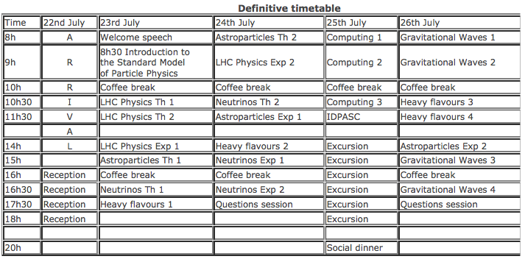
Programme, lecturers
6 LAPP lecturers (P. del Amo Sanchez, D. Buskulic, L. di Ciaccio, P. Ghez, G. Lamanna, E. Petit)
3 LAPTh lecturers (E. Pilon, P. Serpico, P. Salati)
1 LSM lecturer (F. Piquemal)
1 IDPASC lecturer (F. Barao)
Strong involvement
from ENIGMASS
lecturers

Slide 9
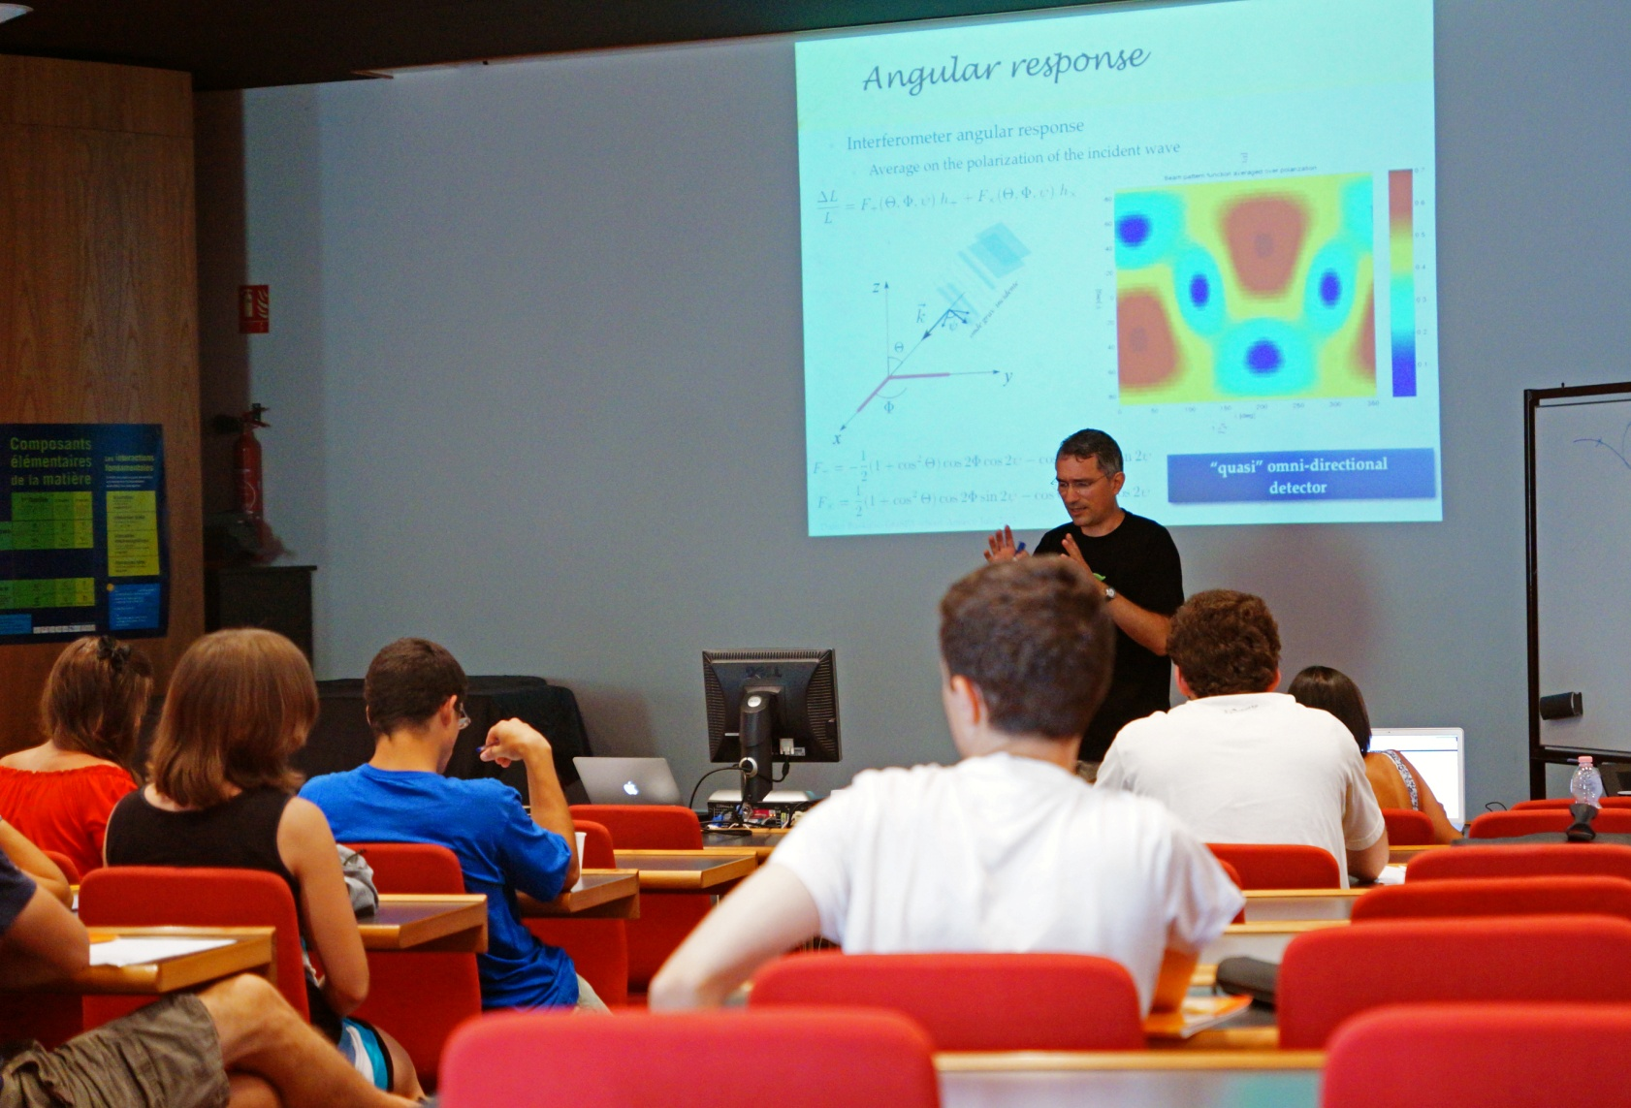
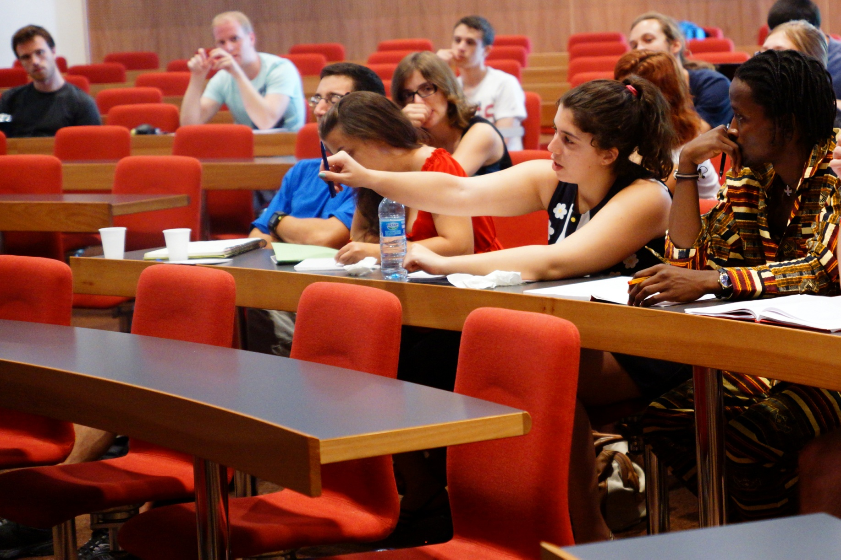
Some pictures…
Strong involvement
from ENIGMASS
lecturers

Slide 10
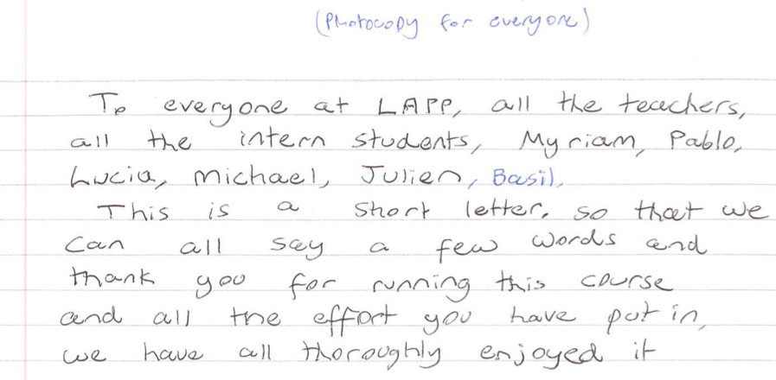
Feedback
Very positive feedback!
Students extremely enthusiastic about School
Some points to improve too… (see next slide)

Slide 11
Proposal for 2014
Bigger! (25 students instead of 16)
Longer! (5 days instead of 4; 6h lectures/day instead of 7h)
Additional international, well-known lecturers
Improved organization (set up small steering committee covering most of the topics)
Request: 8 000 € Université de Savoie
4 000 € IDPASC (travel expenses)
4 000 € ENIGMASS
Neutrino anomalies
The STEREO experiment
Postdoc proposal
Conclusions

Slide 12
Conclusions
International School on Particle and Astroparticle physics for 3rd and 4th year physics students held in Annecy in July 2013
Good demand from students
Very positive feedback too!
Already been contacted by 2 students asking for stages/theses
Excellent advertising of our laboratories among tomorrow’s researchers
Should profit from momentum and try to durably establish such a School within the ENIGMASS perimeter

Slide 13
BACKUP
SLIDES

