Slide 1
Strongly interacting quantum particles in one dimension
Tailored dynamics of confined few-body systems
Critical Stability 2014
Santos, Brazil
October 17th 2014

Slide 2
A one dimensional world
Identical bosons
Distinguishable fermions
r
r
Relative wave function
Interaction
Source: G. Zürn, thesis
Strong interactions -> Impenetrability!

Slide 3
Strongly interacting bosons
|g_{1D}|→∞ limit
Tonks (1936)-Girardeau (1960) gas of impenetrable bosons
Mapping identical bosons to spin-polarized fermions. Girardeau (1960).
Impenetrable bosons
Antisymmetrized fermions
Lieb-Liniger (1963) used Bethe ansatz to solve N boson problem for any g>0

Slide 4
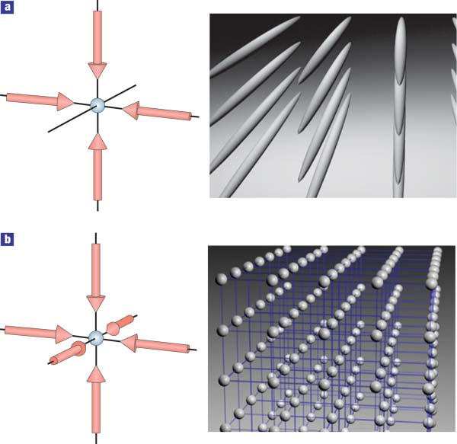
Experimental realization
Optical lattices
Confinement-induced resonances
Maxim Olshanii
Phys. Rev. Lett. 81, 938 (1998)
Divergent at specific point depending on lattice and 3D Feshbach resonance
I. Bloch, Nature Physics 1, 23 (2005)

Slide 5
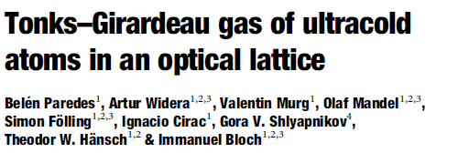
Experimental realization
Nature 429, 277 (2004)
Science 305, 1125 (2004)
Experimentally produced and probed the Tonks-Girardeau gas on the repulsive side g>0

Slide 6
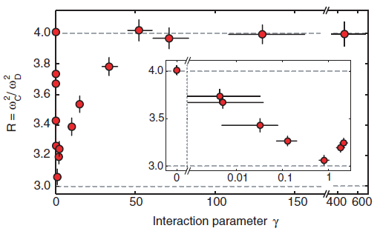
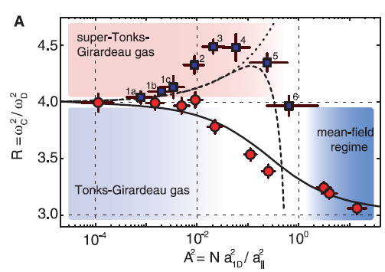
Experimental realization
Study of the crossover from g>0 to g<0 in the strongly-interacting regime.
Science 325, 1224 (2009)

Slide 7
1D fermions – a frontier
Two kinds of relative motion for two-body states!
Source: G. Zürn, thesis
Fermionization of two fermions in a 1D harmonic trap: G. Zürn et al., Phys. Rev. Lett. 108, 075303 (2012).

Slide 8
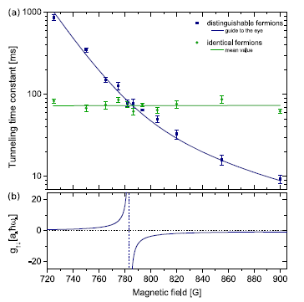
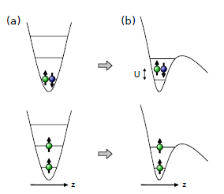
Experimental realization
Two-body tunneling experiments
Fermionization of two fermions in a 1D harmonic trap: G. Zürn et al., Phys. Rev. Lett. 108, 075303 (2012).

Slide 9
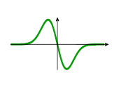
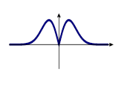
Three fermions
Relative wave functions. What should we take?
or
???
Conjecture: Use the symmetric choice for non-identical pairs for any N-body system
M.D. Girardeau, Phys. Rev. A 82, 011607(R) (2010).

Slide 10
Three fermions
Let’s keep an open mind!
Two strict conditions:
In limit g_{1D}->∞, relative wave functions have not vanish at zero for identical and non-identical pairs!
Identical fermions must have odd relative wave functions!
a₁
a₂
IDEA: Keep a₁ and a₂ as free parameters and do a variation!
r
0
Non-identical relative wave function
A.G. Volosniev et al., arXiv:1306.4610 (2013)
Nature Communications, in press (October 2014).

Slide 11
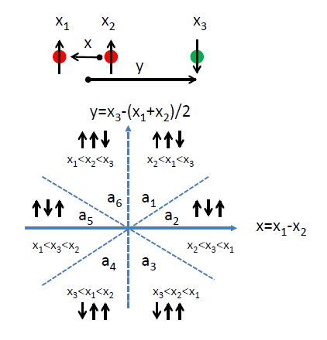
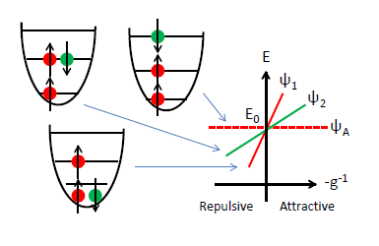
Three fermions - Solution
Split space in patches
Spectrum on resonance
Important: Antisymmetric state!
General solution
Optimize derivative!
Pauli and parity reduces problem to a₁, a₂, and a₃.

Slide 12
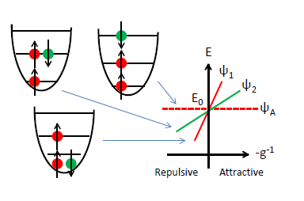
Three fermions - solution
a₁=a₂=a₃
Non-interacting state
Extremizing solutions are:
a₁=a₃ and a₂=0
Excited state, even parity
2a₁=2a₃=-a₂
Ground state, odd parity
IMPORTANT: Coefficients are generally NOT the same!
A.G. Volosniev et al., arXiv:1306.4610 (2013)
Nature Communications, in press (October 2014).

Slide 13
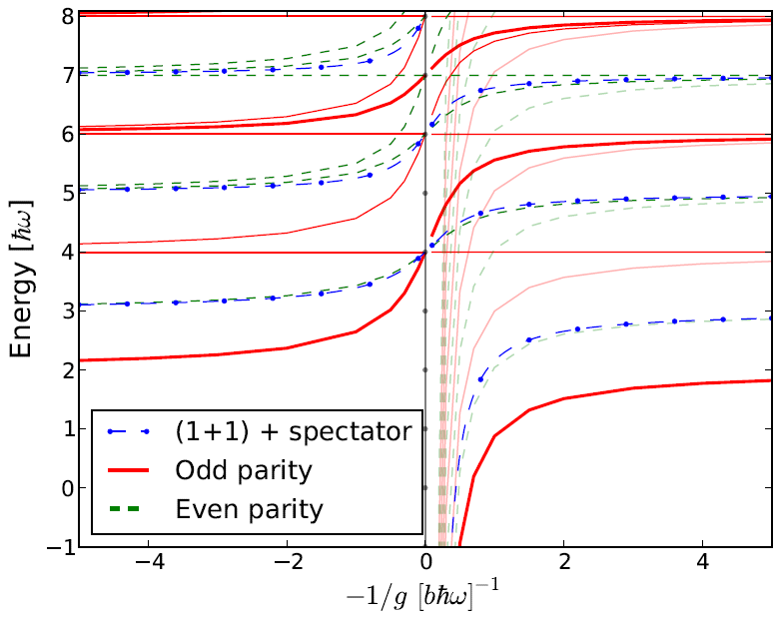
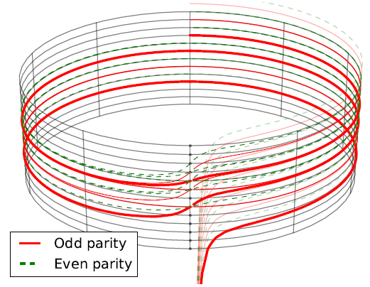
Harmonically trapped systems
Standard style
Elegant style
E.J. Lindgren et al., New J. Phys. 16, 063003 (2014).
S.E. Gharashi and D. Blume, Phys. Rev. Lett. 111, 045302 (2013)

Slide 14
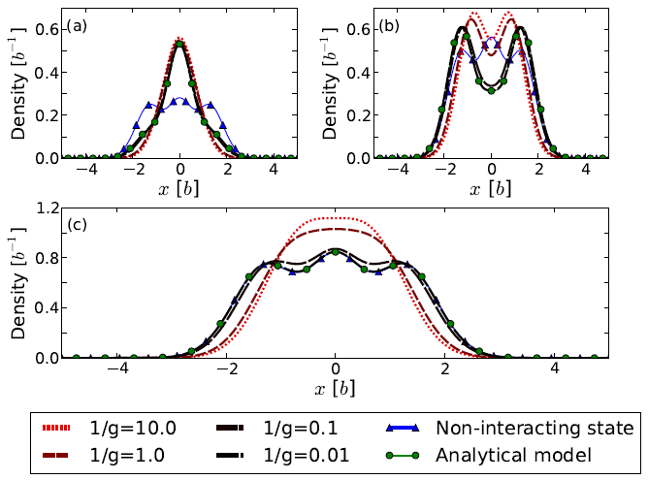
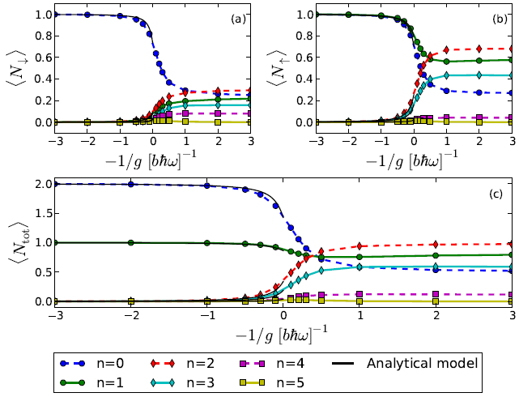
Ground state properties
Trap density
Occupation numbers
E.J. Lindgren et al. New Journal of Physics 16, 063003 (2014).

Slide 15
Fermionization of fermions
It is different from identical bosons and spin-polarized fermions!
The ‘democratic’ solution or trivial Bose-Fermi mapping uses:
between all non-identical pairs.
In the 2+1 case it is NOT a relevant eigenstate but rather a linear combination!
ψ_{BF}= (8^{1/2}ψ_{gs}+ ψ_{non})/3
BUT can we tell the difference in experiments?
S.E. Gharashi and D. Blume, Phys. Rev. Lett. 111, 045302 (2013)
A.G. Volosniev et al., arXiv:1306.4610 (2013)

Slide 16
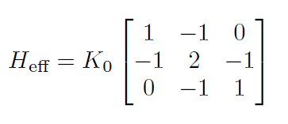
Mapping to spin model
Consider the slope of the energy
Solution obtained by extreming is an eigenvalue problem
Can we interpret the right-hand side matrix as the effective Hamiltonian?

Slide 17
Mapping to spin model
Diagonal entries map a configuration to itself
Indeed we can! Go back to the physical meaning of coefficients in terms of the spins!
Mapping a₂ to a₃ or:
Off-diagonal elements correspond to magnetic exchange terms!

Slide 18
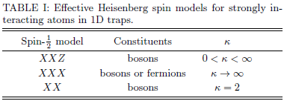
Spin models
We can map strongly interacting two-component 1D systems in a trap to a spin model of XXZ type and do ENGINEERING!
Nearest-neighbor interactions are tunable via external trap!
Note: It is not a lattice index! It is a particle index.
Confinement is taken into account exactly.
A.G. Volosnievet al., arXiv:1408.3414 (2014).

Slide 19
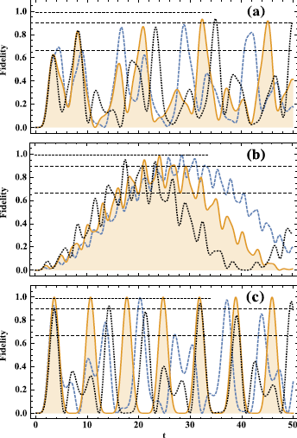
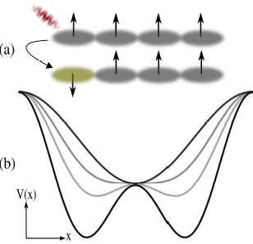
State transfer
Fidelity of quantum state transfer
Fermions or hard-core bosons
Use trap to manipulate dynamics – example of quantum state transfer
Bosons
kappa=1/2
Bosons
kappa=2
A.G. Volosnievet al., arXiv:1408.3414 (2014).

Slide 20
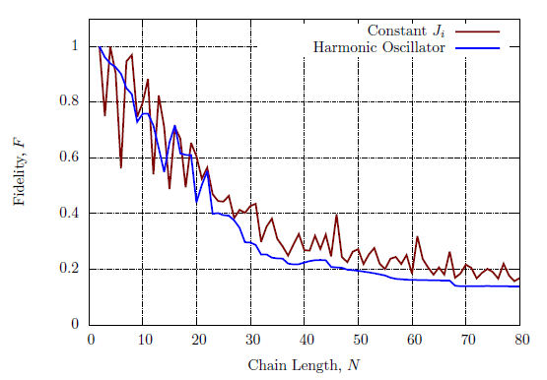
Fidelity for larger systems
Calculation by Jonatan Midtgaard (Aarhus University)
Constant J Heisenberg model transfer:
S. Bose, Phys. Rev. Lett. 91, 207901 (2003)
Approximate expression for harmonic oscillator J coefficients from
J. Levinsen et al. arXiv:1408.7096 (2014).
Neither constant (box potential) or harmonic potential are good for large fidelity transfers beyond about N particles!
Need to tailor potential to optimize transfer protocols!
A.G. Volosnievet al., arXiv:1408.3414 (2014).

Slide 21
Main messages
Complete theory goes beyond Bose-Fermi mapping
Must connect states to eigenstates in the spectrum
‘Magnetic’ correlations are accessible
Good agreement with experimental data
Fermions and bosons can be VERY different even in the hard-core limit!
Engineering of ferro- and antiferromagnetic states!
Wave functions and not energies are the most important objects!

Slide 22
Acknowledgements
Artem Volosniev, postdoctoral researcher (Aarhus)
Amin Dehkharghani, graduate student (Aarhus)
Dmitri Fedorov and Aksel Jensen (Aarhus)
Manuel Valiente (Heriot-Watt University, Edinburgh)
Jonathan Lindgren, graduate student (Chalmers)
Christian Forssén and Jimmy Rotureau (Chalmers)
Jochim group in Heidelberg: Selim Jochim, Gerhard Zürn, Thomas Lompe, Simon Murmann, Andre Wenz
Thank you for your attention!

