Slide 1
Tribute to Mahir Saleh Hussein
His activities at the University of São Paulo in the last ~40 years

Slide 2
Mahir Hussein: More than 40 years devoted to Physics at the University of São Paulo
With more than 320 papers published and more than 4200 citations – one of the most
productive and important physicist of USP.
Theorist with a great interest in the promotion of experimental activities -Strong collaboration with experimental nuclear physicists.
Excellent teacher: his nuclear physics courses at the graduate school of IFUSP formed most of nuclear physics community of USP

Slide 3
Mahir Hussein’s contribution to RIBRAS (Radioactive Ion Beams in Brazil) system
1998 Organization of a workshop to discuss future of the Pelletron Laboratory at IFUSP: Rick Casten, James Kolata, Antonio Villari
Decision : Installation of a superconducting solenoid sytem for production of radioactive ion beams at USP.
Coordinator of first FAPESP grant for the purchase of the solenoids and ancillary systems
Continuous interest of physics results of RIBRAS

Slide 4
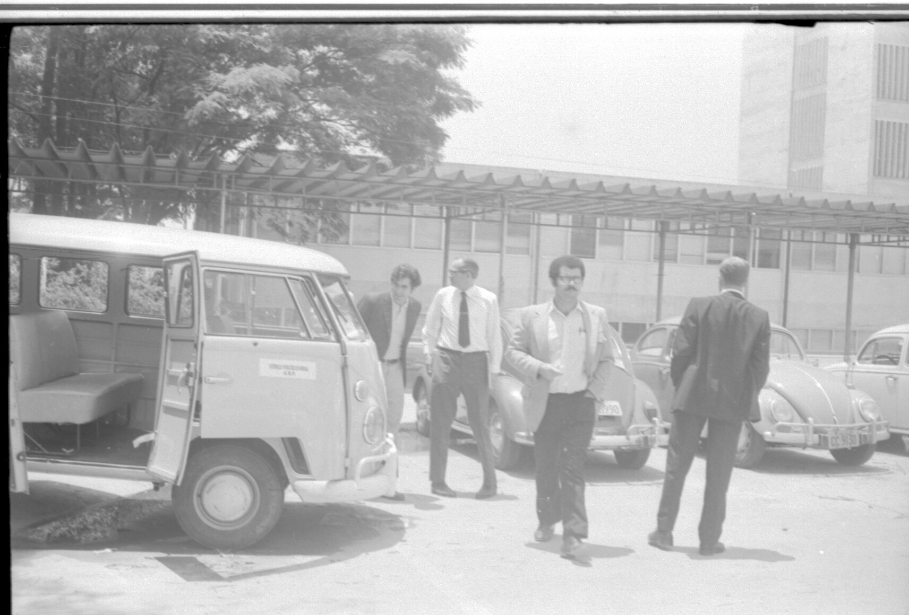
International Symposium on Nuclear Physics IF-USP 1971
Just a few months after his arrival to Brazil

Slide 5
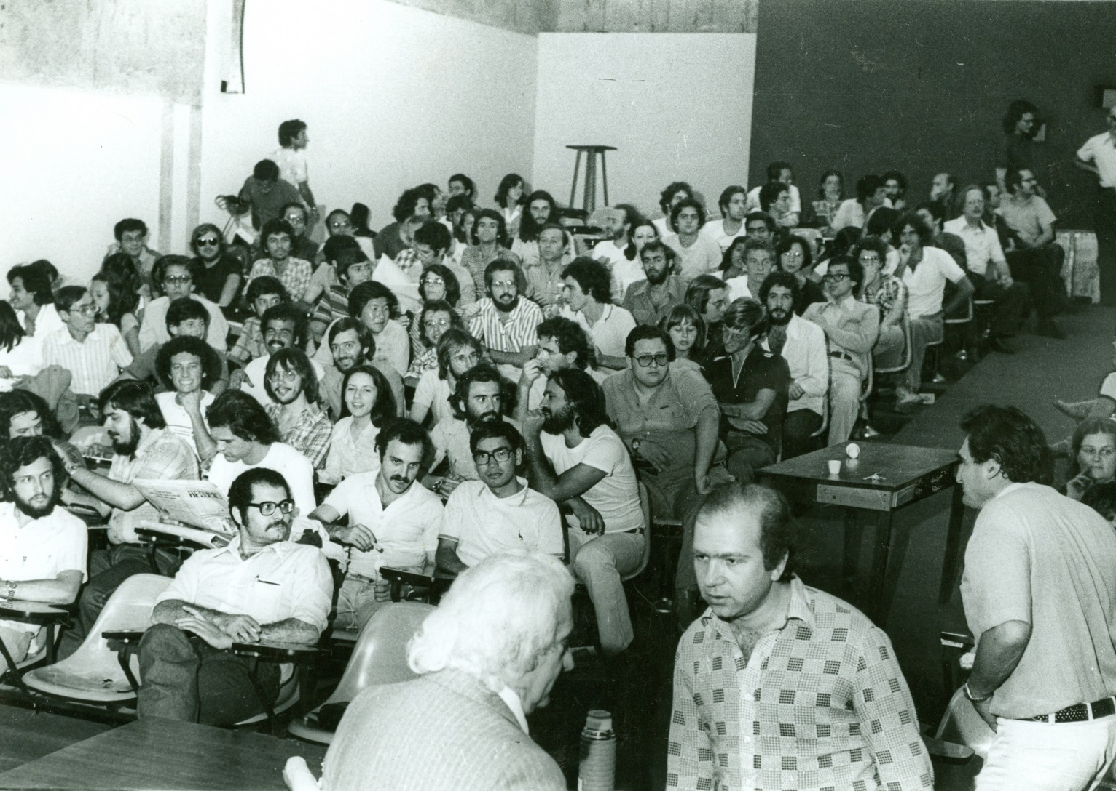
Relativity Course given by Mario Schenberg 1978

Slide 6
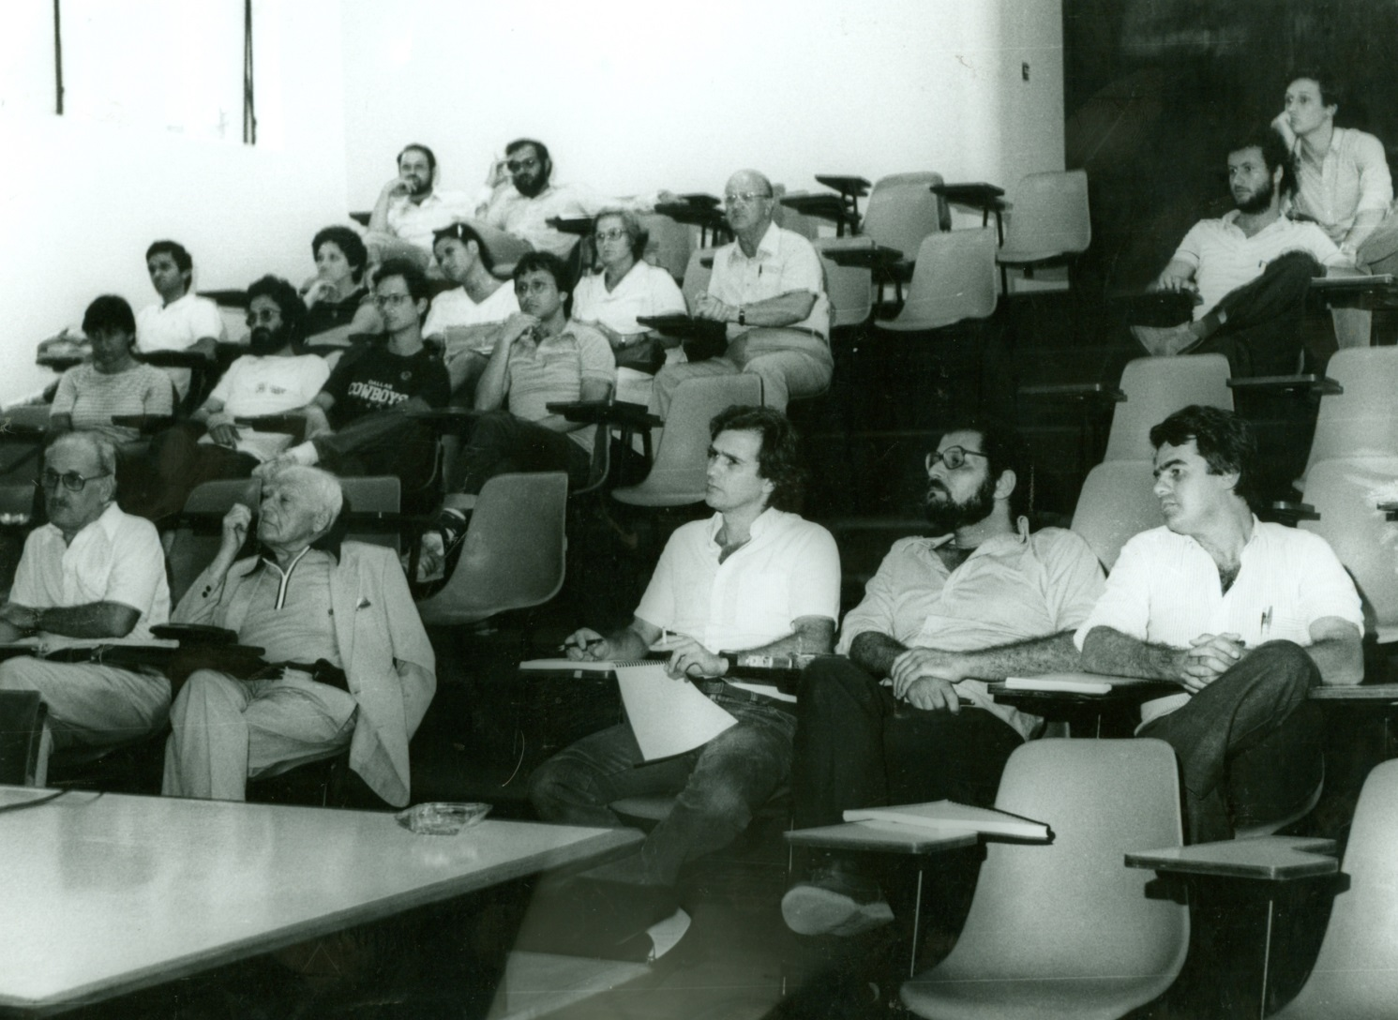

Slide 7
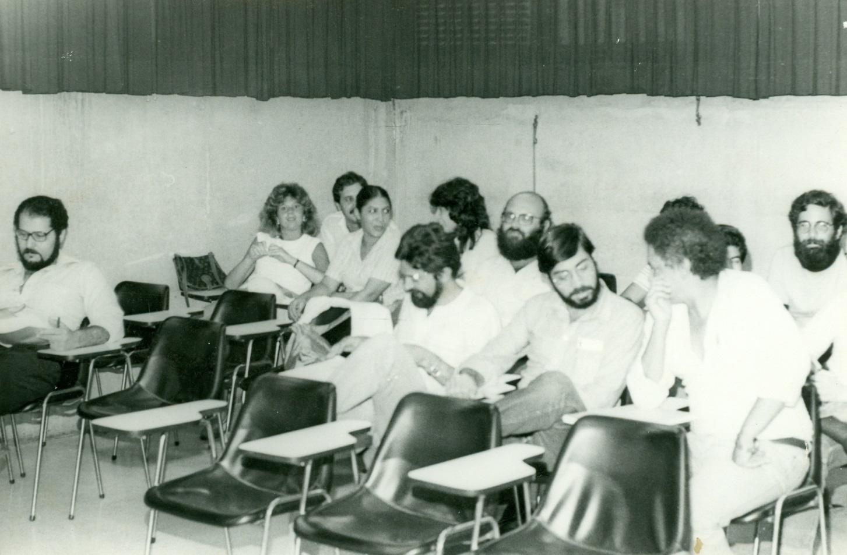
Colloquium of Nuclear Physics ~1978

Slide 8
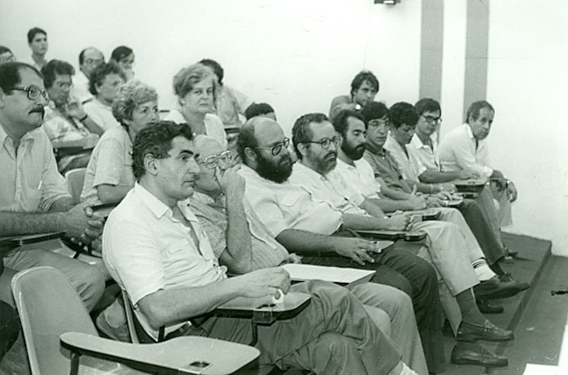
Colloquium of José Goldemberg 1986

Slide 9
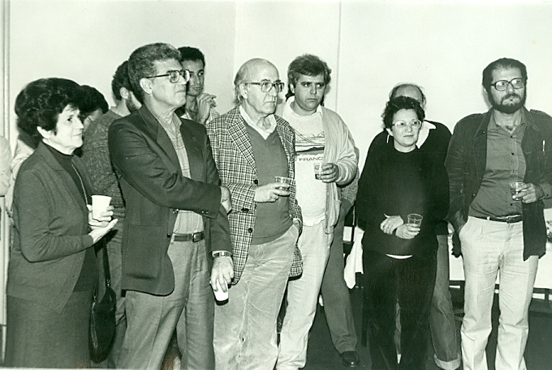
IFUSP 1998

Slide 10
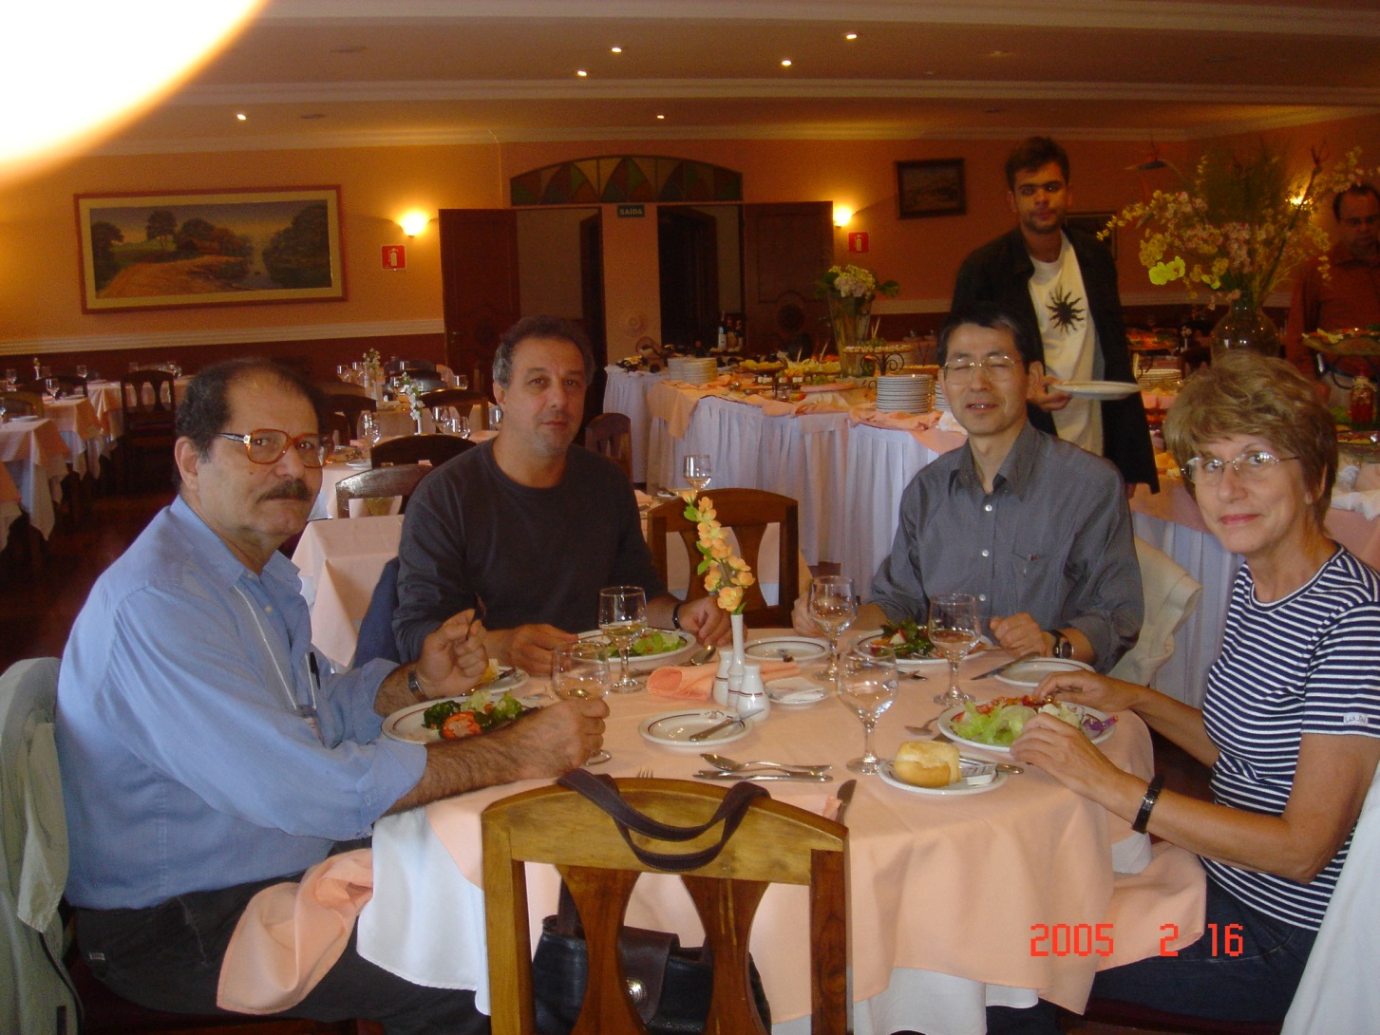
Nuclear Physics Symposium at Campos de Jordão 2005

Slide 11
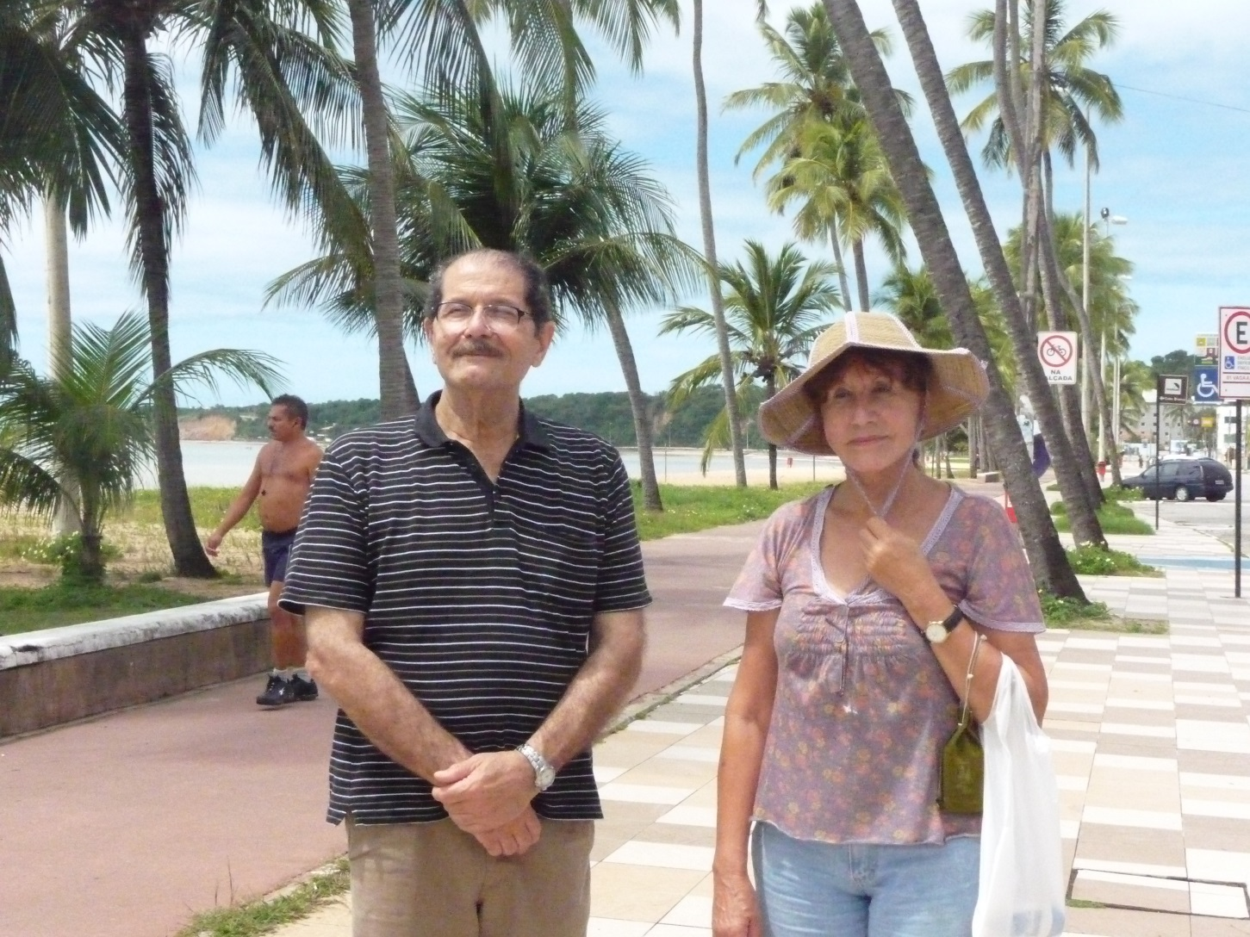
Pan American Advances Studies Institute –PASI 2009, João Pessoa

Slide 12
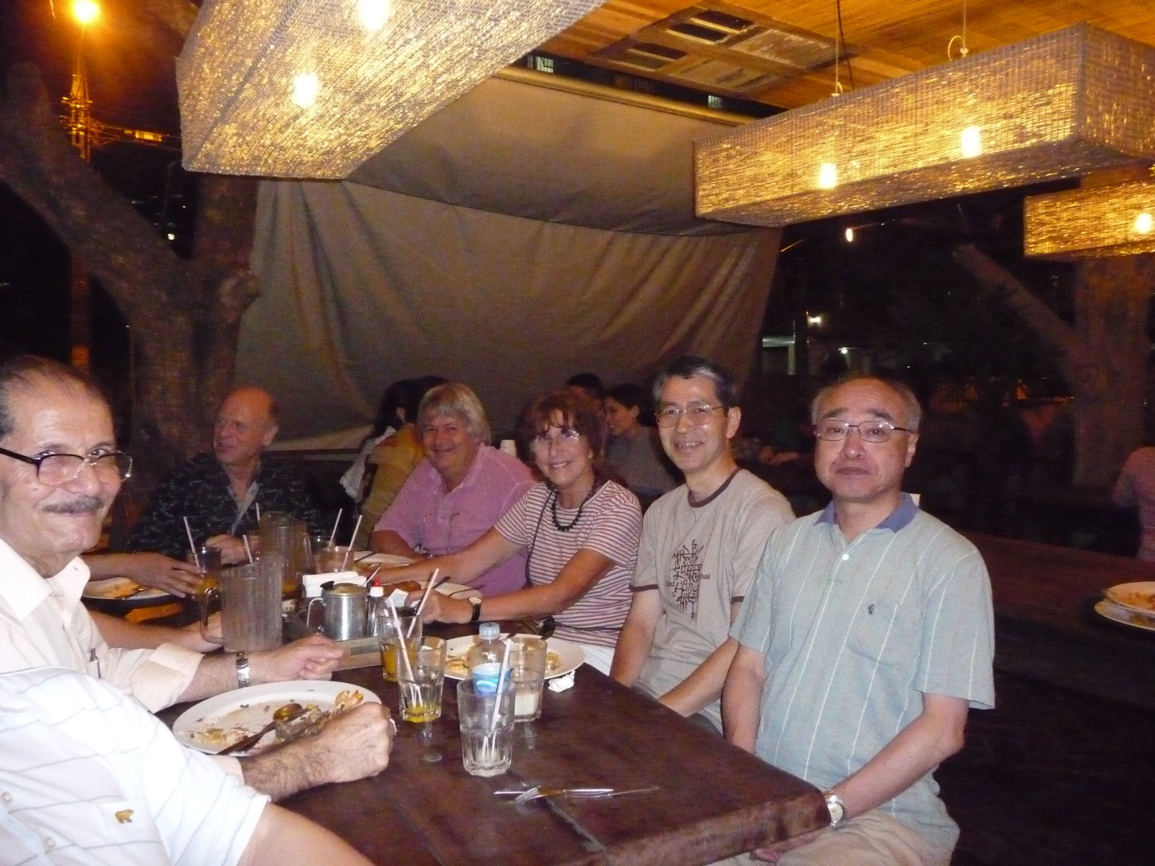
PASI 2009, João Pessoa

Slide 13
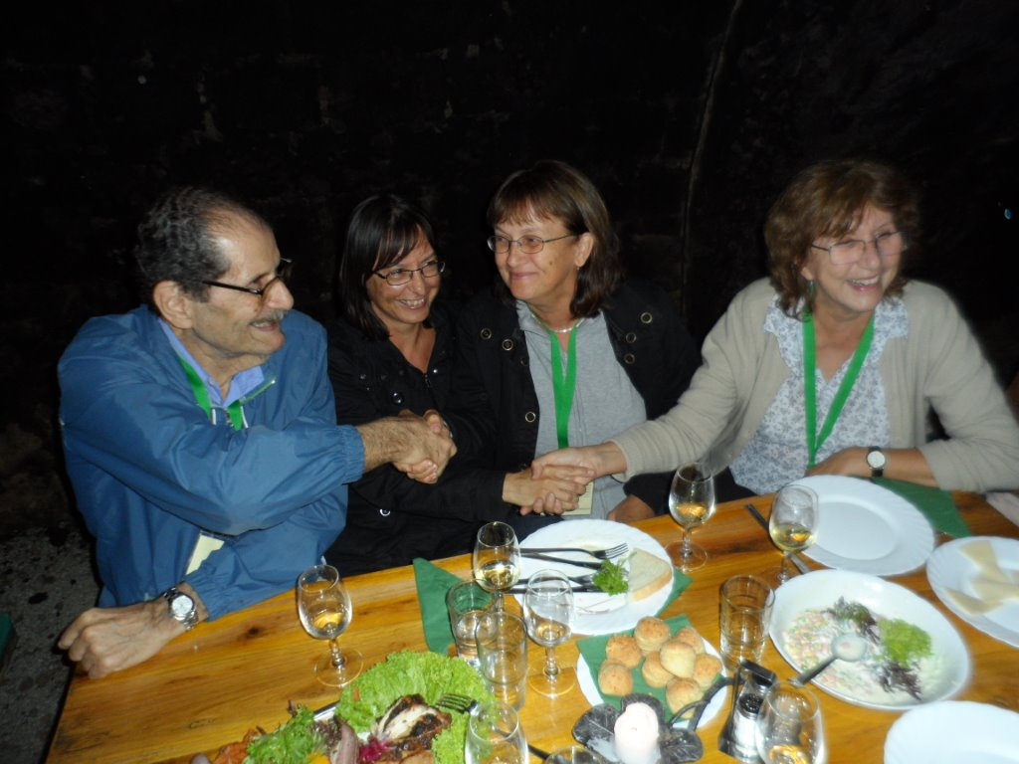
At the Cluster12 conference in Debrecen 2012

Slide 14
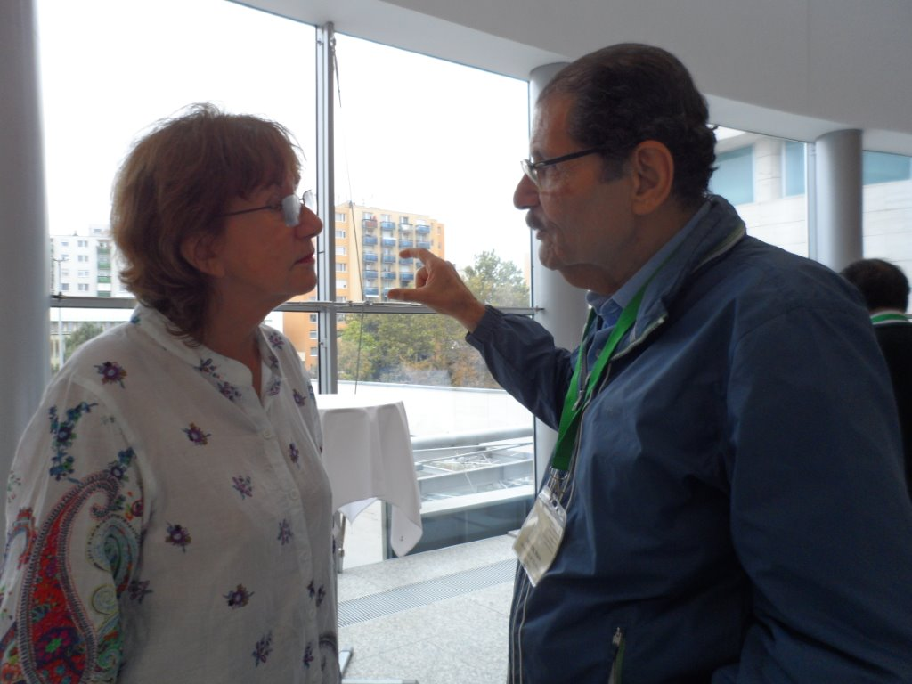
Discussion at the Cluster12 conference Debrecen 2012

Slide 15
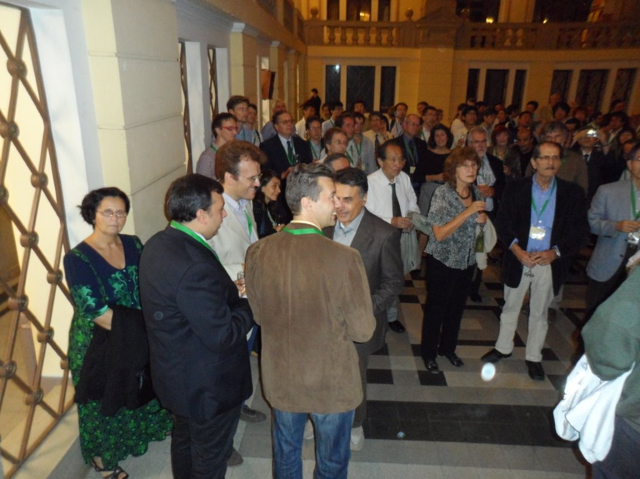
At the banquet of Cluster12 conference 2012

Slide 16
We wish you all the best and the continuation of your brilliant and fruitfull life for many years

