Slide 1

Critical Stability 2014
October 13 , 2014 – Santos (Brazil)
Monte Carlo simulations of the unitary Bose gas
Maurizio Rossi
Department of Physics and Astronomy
“Galileo Galilei”

Slide 2


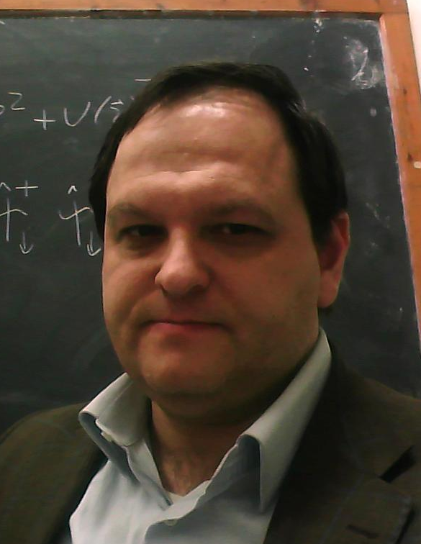

In collaboration with:
F. Toigo
Condensed Matter Theory Group
Dipartimento di Fisica
Univeristà degli Studi di Padova
L. Salasnich
F. Ancilotto
Notes:
work done in collaboration with Flavio Toigo, Luca Salasnich and Francesco Ancilotto of the Cond Mat Group in Padova

Slide 3
outline
Bose gas in unitary regime
“Variational” Monte Carlo simulations for the homogenous gas
Density Functional Theory for the non-homogeneous gas
conclusions
quick experimental overview
quick theoretical overview
construction of the many-body wave function - I
cut-off condition
construction of the many-body wave function – II
energy per particle
condensate fraction
comparison of static properties with VMC
comparison with GPE
monopole and quadrupole frequencies
momentum distribution: comparison with experiment
Notes:
brief overview on the unitary Bose gas, both from the experimental and theoretical point of view
ou know all this stuff better than me, but it’s just to fix the notation
study of a homogeneous Bose gas with a Quantum Monte Carlo approach
extract also dynamical information by DFT

Slide 4
Unitary regime
s-wave scattering length
effective range
The length scale is fixed by , the average distance among particles
Expected universal properties depending only on the density
Unitary Fermi gas largely investigated [see book by Zwenger (Springer, 2012)]
Unitary Bose gas only marginally studied…
problem
Unitary Bose gas is experimentally inaccessible [Ho, PRL 2004]
Positive diverging means a bound state in the potential well
No Pauli’s exclusion principle for Bosons
The Bose gas is mechanically unstable at low T
particles tend to form bound couples and triplets (3 particle loss) [Li & Ho, PRL 2012]
self-bound ground state (cluster formation or Thomson collapse)
no hope?
Notes:
unitary regime: dilute system, diverging a and vanishing effective radius
average distance among the particles as the sole relevant relevant scale: properties depend only on the density: universality
Unitary Fermi gas largely and successfully studied, not so for its bosonic counterpart: experimentally inaccessible
a bound state is going to be, or already, formed in the potential well +no Pauli exclusion principle => pairs of particles tends to form “molecules” that are able to escape the trap, REM : the true ground state at the typical experimental temperature is a solid

Slide 5
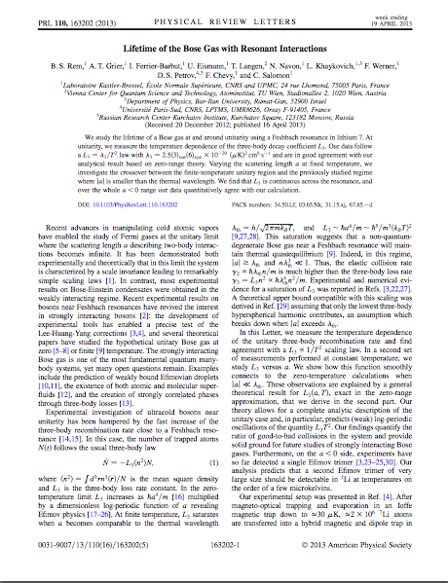
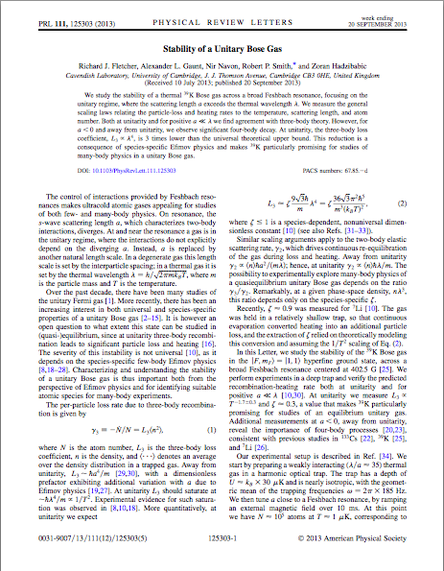
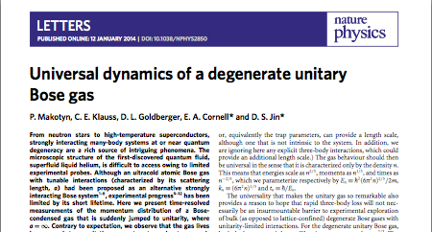
Experimental overview
⁷Li:
³⁹K:
⁸⁵Rb
the 3body dynamics that spoils the unitary regime is slower than the 2body one
the degenerate Bose gas evolves dynamically on a fast time scale than losses
unitary Bose gas can be experimentally created and probed
the unitary Bose gas is a metastable state!
Notes:
experiments: really few papers, the most relevant in the last 2 years
Last year the Salomon’s group in Paris by studying Lithium-7 have shown that the ratio between the 3body scattering rate and the 2body one is less that 1, opening the possibility for the realization of the unitary regime for Bosons
Soon after, in Cambridge, a even better ratio has been observed for Potassium-39
At the beginning of this year, the group of Cornell and Jin in Colorado, has realized the first unitary bose gase

Slide 6
Theoretical overview
Experimental lower bound [Salomon & co.w. PRL 2011]
RNG-theory [Lee&Lee PRA 2010]
HNC method [Stoof & co.w. PRA 2011]
RNG-theory [Stoof & co.w. arXiv 2013]
n(k)- VAR. method [Song&Zhou PRL 2009]
LOCV method [Pethick & co.w. PRL 2002]
question
why results are so scattered?
Notes:
theoretical side: puzzling landscape
LOCV (lowest order constrained variational): E = 1.75, n0 = 0
Variational on n(k): E = 0.48, n0 = 0.50
RNG: E = 0.39, n0=undetermined
in 2011 experimental lower bound for E
Hypernetted Chain: E = 0.67, n0= 0.75
RNG: E = 0.85, n0 = 0.50
Why so scattered?

Slide 7
No standard technique to face metastable states: results will depends on how the phases space is restricted!
problems
strong interactions rule out mean-field approaches
metastability calls for “adjustments” in standard equilibrium techniques
M. Rossi, L. Salasnich, F. Ancilotto & F. Toigo, PRA 89, 041602(R) (2014)
direct Monte Carlo (MC) simulation of
N = 500 bosons in a cubic box with periodic boundary conditions interacting via a square well potential
tune by changing
Notes:
results depend on how the ground state is excluded from the analysis
challenging also because the strong interactions prevent the use of mean-field approaches
metastability put severe limitations to standard equilibrium techniques
Our approach: direct MC simulation of a large system of Bosons
periodic boundary conditions; square well potential.
the idea is to tune the scattering length playing with the well depth

Slide 8
square well potential
In our simulations &
so that we explore also the unitary regime
Notes:
scattering length and the effective radius are known analytically
several values of the well depth that corresponds to increasing positive values of the scattering length
we fix the box simulation such that the average distance among the particle is larger that the effective range.
Thus we can explore the unitary regime fixed by this condition

Slide 9
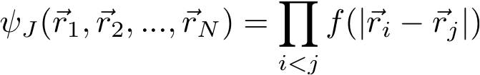
many-body wave function - I
T = 0 K
the system is dilute
only 2 body correlations are retained:
standard Jastrow – Feenberg ansatz
is the exact solution of the 2 body problem with energy
in the limit the interaction potential can be replaced by the boundary condition [Bethe & Peierls Proc.R.Soc.London A 1935]
Notes:
Now we have to construct the many body wave function:
since we want to describe an excited state, we take as 2body wave function the exact solution of the two body problem that corresponds to a free state
When the radius of the potential is small compared to the other length scales of the problem, we can replace the potential in the 2body schroedinger equation
with this well known boundary condition, and our f2 takes a more simple expression

Slide 10
many-body wave function - I
in order to account for many-body effects and for periodic boundary conditions
is smoothly joined with a constant at a certain distance
the only parameter left is , which cannot be fixed via a variational approach (undesired energy minimum for )
standard QMC choice
standard LOCV method choice
[Cowell et al. PRL 2002]
Notes:
many-body recipe and to account for many body effect and boundary condition we join our two body solution with a constant at a certain point Rm
Unfortunately, it is well known that Rm cannot be determined in a variational approach, so we have to fix it as a parameter of the model:
the standard QMC choice is to fix it as half of the box side
while in the lowest order constrained variational method it is fixed by requiring this normalization (this have been proved to be a winning choice both at low and high densities)
Now we are ready, we can perform our simulations!
And the results is…

Slide 11
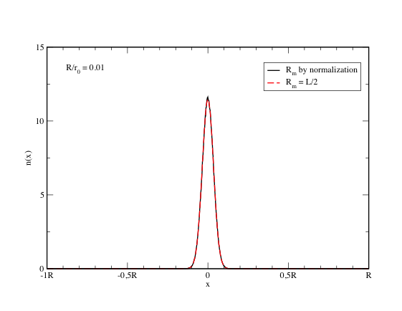
…unfortunately when diverges the equilibrium configuration is not the desired uniform gas, but rather a compact cluster
the extreme compactness is due to the unphysical lack of hard core repulsion in the interaction potential
Notes:
Now we are ready, we can perform our simulations!
And the results is…a compact cluster!!!
Independently on how the simulation is started (random or lattice positions) or on the choice of Rm.
extreme compactness of this cluster is surely not reliable, it is a drowback of the lack of a repulsive hard core in the pair potential

Slide 12
many-body wave function - II
we must correct the wave function to prevent particles to fall too close each other:
we introduce a cut off:
is the outermost node of
we tried also a smoother cutoff, but the energy increases
the variationally optimized is as flat as possible in
to avoid that , is fixed via the normalization condition
Notes:
if we want to simulate the metastable gas, which is uniform, we have to prevent the formation of such self-bounded configuration.
cut-off: we ask the wave function to be identically null up to its outermost node
too drastic? no parameter is left for a variational optimization of the wave function.
We tried then a more gentle cut off: the best wave function is as flat as possible in the region between 0 and Rn

Slide 13
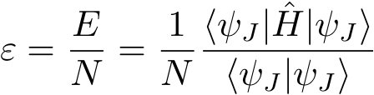

thus our many-body wave function:
provides the long range correlations dictated by the scattering length
keeps the density uniform preventing the formation of clusters
keeps the nodes and the normalization of the actual 2body scattering wave function
this seems reasonable since, due to the extreme diluteness of the gas, the particle pairs should experience only the tails of f
given the many-body wave function we have direct access to:
the energy per particle
the condensate fraction
Notes:
to recap now we have a wave function that
has the correct behavior at large distances, fixed by the scattering length
prevent the formation of the clusters
maintains the same nodes and the same normalization of the exact two body wave function
this seems reasonable also because in conditions of extreme diluteness the particles experiences
only the tails of the wave function (the same spirit of the effective potentials approach)

Slide 14
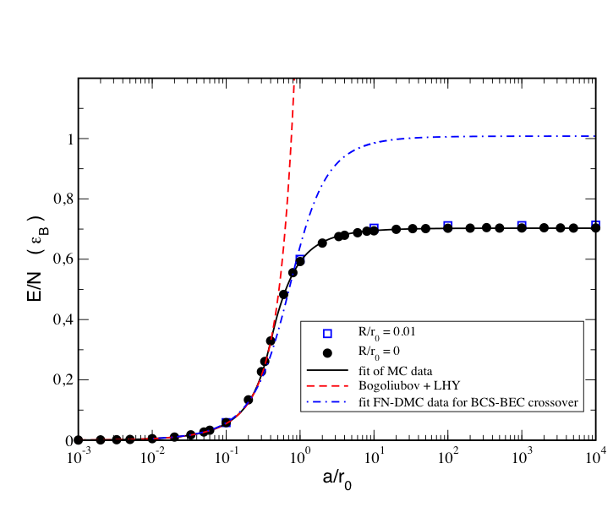
it converges to the constant value of 0.70 ε_{B} as : signature of universal behavior
Energy per particle
in the weakly interacting regime we recover the universal Bogoliubov prediction ε_{LHY}
Notes:
these are our results for the energy per particle
blue squares: keeping the square well potential
black dots: with the Bethe Peierls Boundary Conditions.
the most striking feature is that while a is diverging, the energy converges to a constant value of 0.73, this is a signature of the desired universal behavior.
the dotted blue line is the Manini-Salasnich fit for a Fermion gas.
Our results are in a remarkable agreement with the Bogoliubov + Lee Huang Yang correction in the weakly interacting regime, supporting the fact that our
recipe for the wave function is reasonable

Slide 15
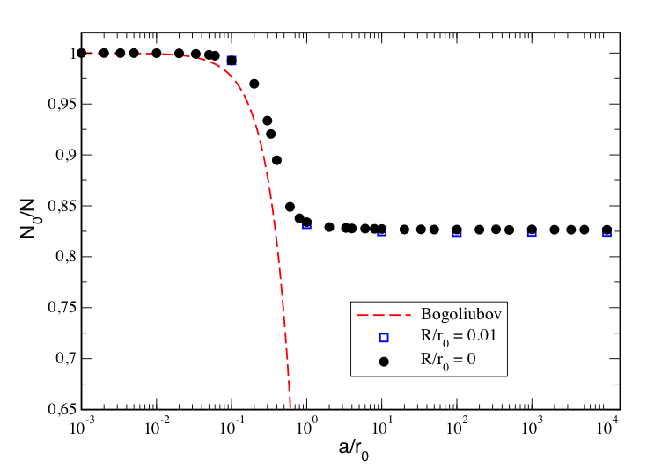
it converges to the constant value of 0.83
condensate fraction
Notes:
also the condensate fraction converges to a finite value as the scattering length diverges.
Again the red line is the Bogoliubov prediction that, as known, falls to zero when the scattering length increases.

Slide 16
Theoretical overview
Experimental lower bound [Salomon & co.w. PRL 2011]
RNG-theory [Lee&Lee PRA 2010]
MC [Rossi et al. PRA 2014]
HNC method [Stoof & co.w. PRA 2011]
RNG-theory [Stoof & co.w. arXiv 2013]
n(k)- VAR. method [Song&Zhou PRL 2009]
LOCV method [Pethick & co.w. PRL 2002]
Notes:
We can now complete this picture and include also the present results.
energy value compares well with the average value among different approaches
we are predicting the largest condensate fraction (83%).

Slide 17
MC data can be fitted with the function ( )
that allows the computation of other useful quantities via thermodynamic relations
chemical potential
pressure
sound velocity
Tan’s 2body contact density
α = 9.02 compares acceptably well with previous theoretical estimates
[Stoof et al. PRA 2011, arXiv 2013; Sykes et al PRA 2014]
Notes:
MC data for the energy can be fitted with an analytical function that can then be used for extract other information about the
unitary gas.
For the 2body contact we recover the expected behavior with the density, and in particular our factor alpha = 9.02 Is comparable
with previous theoretical calculations

Slide 18
Density Functional theory of a trapped Bose gas with tunable a
M. Rossi, F. Ancilotto, L. Salasnich & F. Toigo arXiv:1408.3925
time-dependent Density Functional Theory for an inhomogeneous system of interacting Bosons at zero temperature within the local density approximation
energy per atom of a homogeneous system with density and scattering length
external confinement
total energy functional
as we take the MC equation of state
Notes:
We can use the MC data also to built a suitable density functional theory that allows the study of larger system
with a computational cost definitely lower than MC.
The Padua group has a long tradition in this.
We refer to a local density approximation for describing the properties of a confined unitary gas.
As confinement we chose a standard isotropic harmonic trap.

Slide 19
integrated density profile
DFT: obtained by imaginary
time propagation
VMC: obtained by adding
a 1 body term to the wave function
[BuBois & Glyde, PRA 2001]
static properties: comparison with MC
good agreement except near the surface
mainly due to the form of the 1body term, the value of a is “dominated” by the central region.
Notes:
to validate the functional by comparing its prediction with a full MC simulation.
1body term account for the confinement, its functional form is standard, and the alpha
parameter has been variationally optimized.
DFT and QMC results agree quite well except near the surface, the suspect is that the value of the alpha
parameter is dominated by the more dense central region

Slide 20
if DFT reduces to Gross-Piatevskii Equation
average radius of the trapped gas
GPE
TF limit
static properties: comparison with GPE
DFT
convergence to a constant value is expected for the unitary regime where the properties of the system depends only on the density
Notes:
We can compare our result with a GP by simply changing the functional form of the equation of state.
GPE predicts an expanding cluster when a increases, behavior fixed by Thomad Fermi limit
DFT predicts a cluster whose dimension saturates ad the scattering length diverges

Slide 21
monopole (breathing or compressional) mode frequencies are obtained by slightly changing
quadrupole (surface) mode frequencies are obtained by using the initial state
ground state wave function
small parameter
standard quadrupole operator
empty sym. : N = 500
filled sym. : N = 80000
monopole
TF limit (independent of a)
dynamical properties: mono- and quadru -pole frequencies
non interacting regime
non interacting regime
unitary limit
(statistic independent)
[Castin CRP 2004]
TF regime:
quadrupole
TF limit (independent of a)
Notes:
we have access also to the dynamical properties:
monopole frequencies (or breathing mode) can be obtained by slightly changing the frequency trap
- the quadrupole frequencies (or surface mode) can be obtained by perturbing the ground state wave function with a suitable operator.
Two sizes of the system, upper curves = monopole frequencies, lower ones = quadrupole frequencies.
the monopole frequency starts at the expected value of two times the trap frequency, increases to reach the TF value (this is better seen
in the largest system, where the TF condition is easily fulfilled) and then decreases to the expected value in the unitary regime.
On the other side, the quadrupole frequencies fulfills the expected limits in the non interacting regime and In the TF limit.

Slide 22
3 body losses can be accounted including the standard term
we can investigate the effects on the collective excitations
surface mode only slightly affected by 3body losses
dynamical properties: 3 body losses
the monopole mode follows the evolution of the average radius with superimposed oscillations at the expected frequency
Notes:
We can account also for 3body losses via the standard term, and we have investigated the effects on the collective excitations.
quadrupole and the monopole average momenta as a function of time:
quadrupole mode is slightly affected by the 3body loss, and its frequency is the one expected for the system without losses in the same conditions
monopole mode follows the evolution of the average radius of the gas, with superimposed oscillations at the expected frequency.

Slide 23
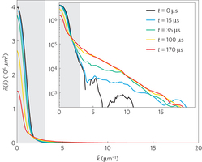
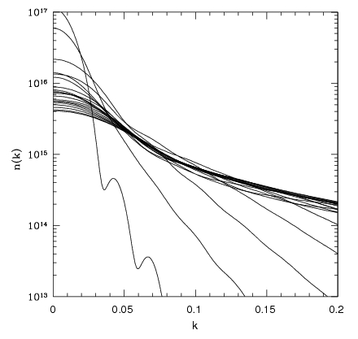
few experimental data to compare with: one is the momentum distribution after a sudden quench to unitary [Conell & co.w. Nat.Phys. 2014]
A quasi-steady-state distribution is reach
dynamical properties: momentum distribution
TDDFT
quite similar behavior!
Our distribution still evolves on large time scales as already noted with a disspipative GPE approach
[Rançon & Levin PRA 2014]
Notes:
really few experimental data to compare with, the most recent one is the momentum distribution after a sudden quench of a
The Cornell experiment provide a quasi-steady momentum distribution.
momentum distribution is accessible via TDDFT
qualitative comparison: similar evolution
the DFT momentum distribution goes on in evolving on a extremely slow time scale.
The same behavior has been observed recently in a dissipative GPE approach suggesting that there are two time scale in
the momentum distribution evolution.

Slide 24
conclusions
we have studied the zero temperature unitary Bose gas via a Jastrow ansatz on the many-body wave function that avoids the formation of the self-bound ground state. We have computed the energy per particle ε and the condensate fraction n₀
in the weakly interacting regime we recover the Bogoliubov predictions
in the unitary regime both ε and n₀ converge to a finite value: signature of the universal behavior
MC data can be used to extract also other useful information
via standard thermodynamic relations (μ, P, c_{s}, C₂…)
by constructing a density functional theory
TDDFT based on the MC equation of state provides also dynamical properties
monopole mode: fulfills the expected limiting values
quadrupole mode
effect of 3body losses can be included
(qualitative) comparison with the experimental momentum distribution evolution after a sudden quench
Thank you for your attention
Notes:
unitary bose gas at T = 0 studied via a Jastrow ansatz on the many body wave function that prevent the formation of bounded states
we have computed via a MC quadrature the energy per particle and the condensate fraction finding that both converge to finite values
when the scattering length diverges, which is the clear signature of a universal behavior.
The MC data can be used to extract other information via standard thermodynamic relation or by constructing a suitable density functional theory.
Within the local density approximation we have investigated the behavior of the monopole and the quadrupole modes and also the
effect of the 3body losses.
We hope that the near future experiments on the Unitary bose gas could provide data to compare with.
Thanks for your attention and patience

