Slide 1



SiPM Readout ASIC
LAPP Contribution
JM Dubois, N. Fouque, R. Hermel, G. Lamanna,
F. Mehrez, J.L. Panazol, J. Prast, S. Rosier

Slide 2
ASIC Design Project @ LAPP
CTA context and LAPP priority.
Photo detector characterization.
ASIC specifications.
Ongoing work & future perspectives.
Conclusion.

Slide 3
Context CTA and LAPP Priority
CTA context:
  Member of LST community: collaboration with INFN.
  Member of MST community: collaboration with NECTARCAM.
Main goal at LAPP:
  Design an SiPM readout ASIC that will interface with NECTAR (Dragon interface is also to be studied)
Main past microelectronic activities of the LAPP team:
  AMS ECAL FE chip (2005)
  64 channels mixed A/D ASIC for multi Anode PMT readout (2010)

Slide 4
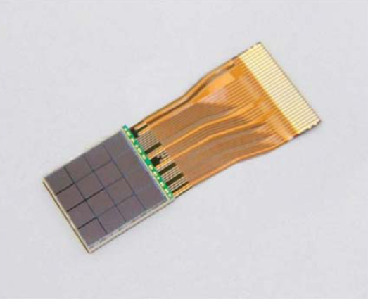
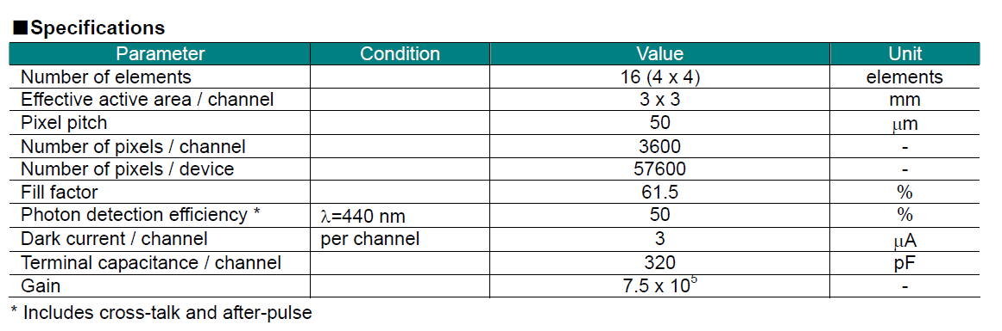
Photo detector characterization
Hamamatsu detector: 4x4 macro pixel array
  1 macro pixel =3x3 mm² SiPM.
  1 macro pixel = 3600 micro pixel(50µm).
Goal: to extract our ASIC’s specifications.
(Ref S11829-3344MF)

Slide 5
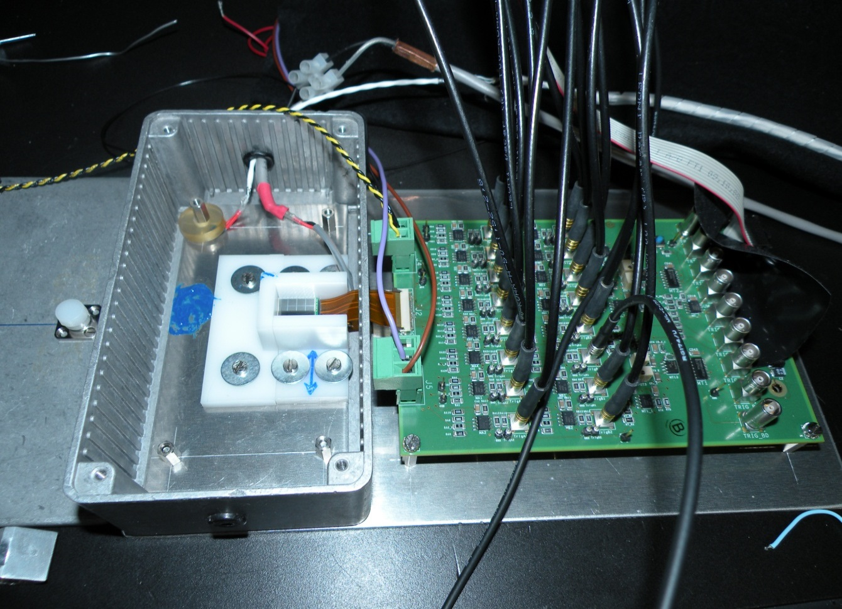
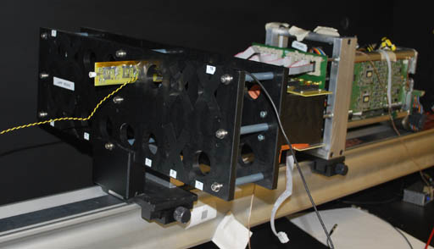
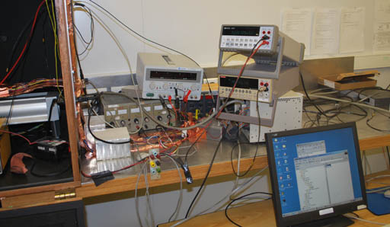
Test Bench at LAPP: Evolution of the HESS2 PMT calibration setup
DAQ system
SiPM matrix
interface board
Test with light source.
An interface of gain stage and inversion => compatible with the HESS2 module.

Slide 6
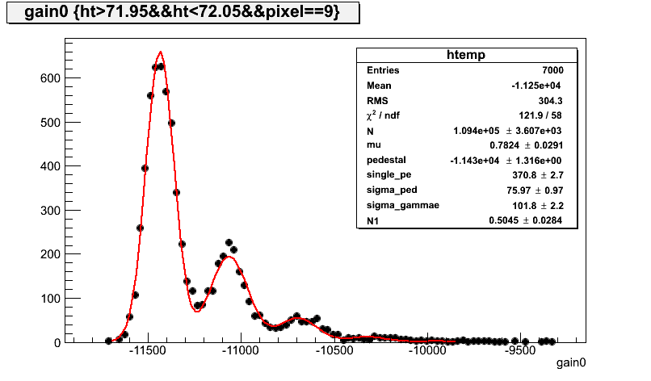
Photodetector tested at LAPP : 4x4 MPPC Hamamatsu matrix
(16 3x3 mm² pixels) : Measured spectra at room temperature
One pixel
Temperature ~25 degrees
Measurement on 16 pixels - 4x4 SiPM matrix (16 3x3 mm² pixels)
with the LAPP test bench , using the HESS readout system
PhotoElectron peak

Slide 7
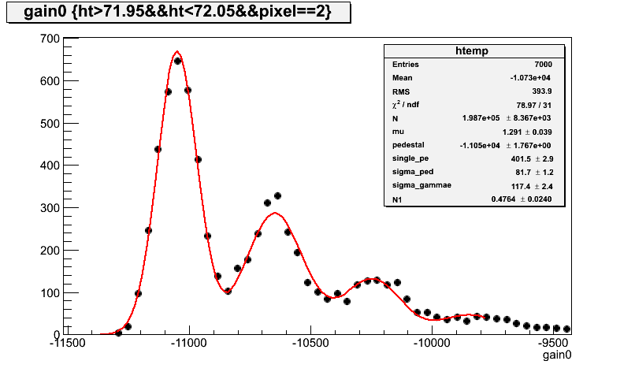
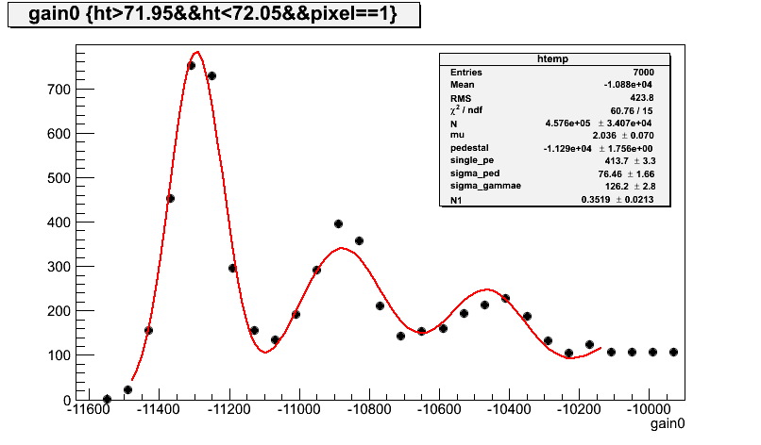
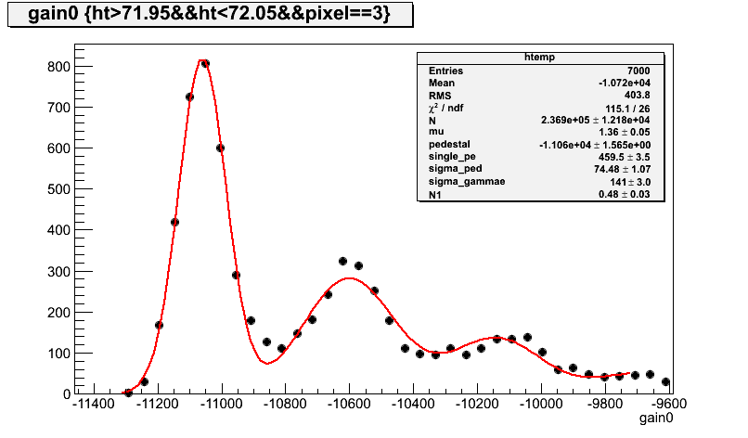
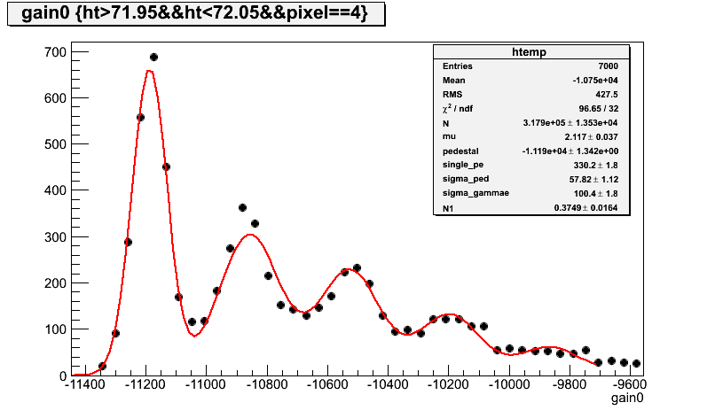
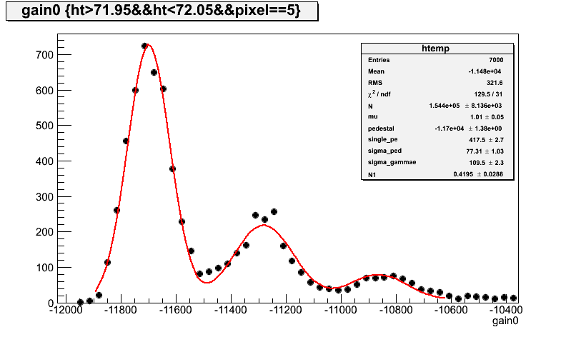
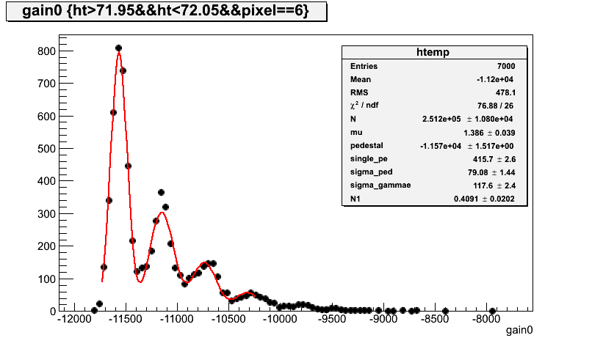
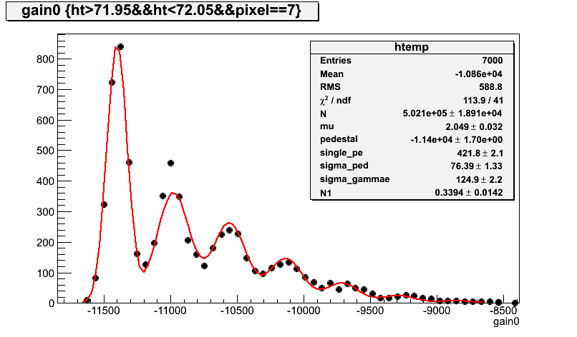
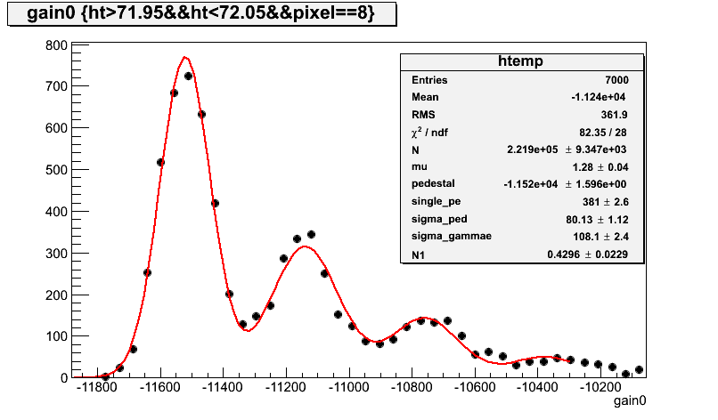
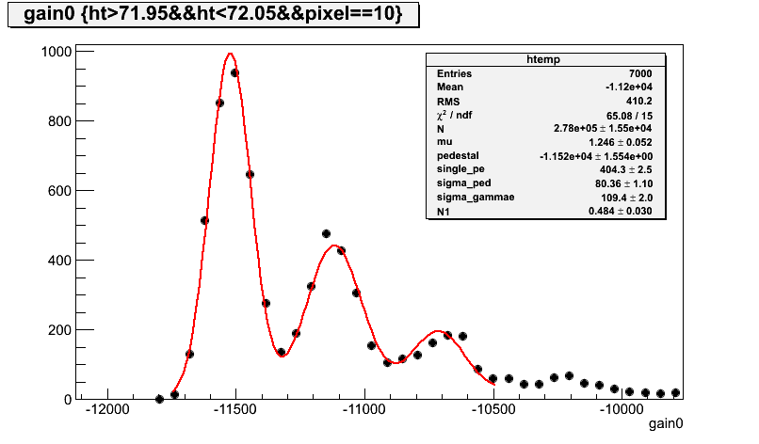
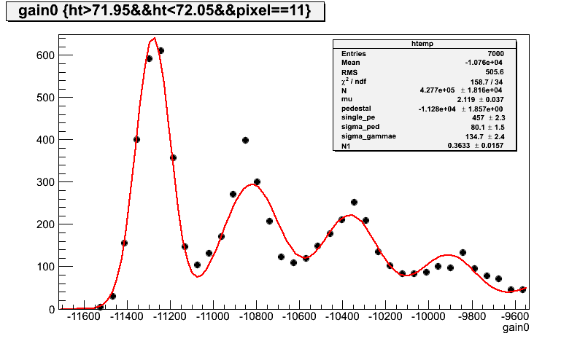
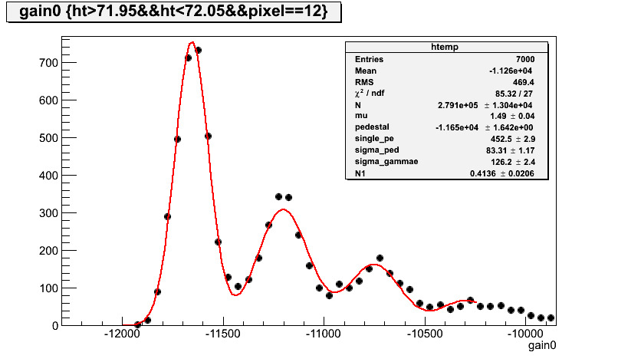
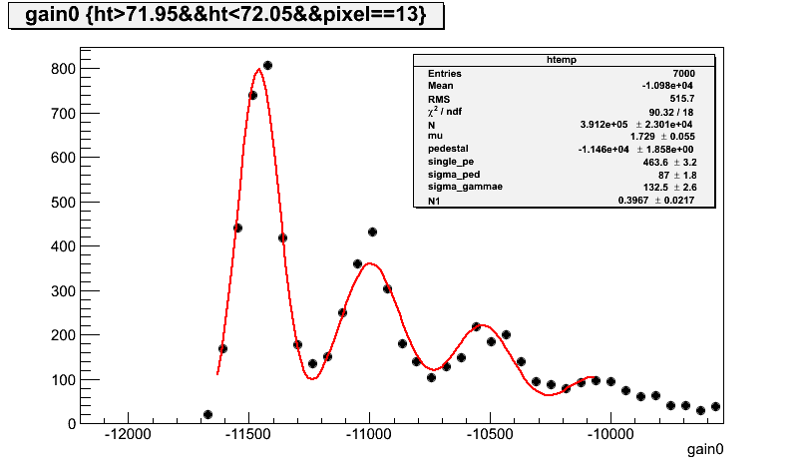
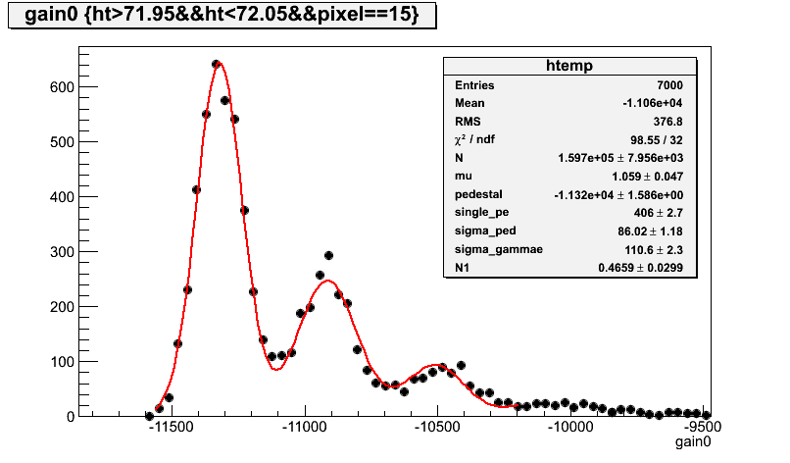

Photodetector tested at LAPP : 4x4 MPPC Hamamatsu matrix
(16 3x3 mm² pixels) : Measured spectra at room temperature
The Hamamatsu matrix
tested at LAPP

Slide 8
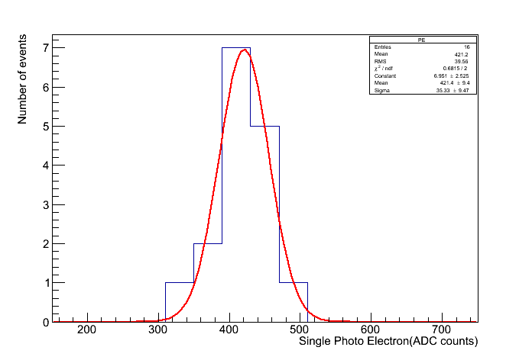
Photo detector characterization (conclusion)
Temperature ~25 degrees
Photoelectron ranging from : 371 to 490 (ADC counts) for HV=72 Volts, equivalent to a gain of 5 10⁵
Spread ~ 10 %
  => On-chip DAC for pixel overvoltage adjustment (performance optimization: gain and cross talk)

Slide 9
ASIC Specifications
16 readout channels per chip
  1 p.e. measurement with S/N ≥ 5
  2000 p.e. full scale split in 2 gains
  On-chip gain adjustment
  On-chip DAC for pixel overvoltage adjustment
  Trigger :
    Fast discriminator with programmable threshold
  2 differential analog outputs
  Interface with DRAGON / NECTAR
  + Service functions: Bandgap, Slow control registres, DACs, …

Slide 10
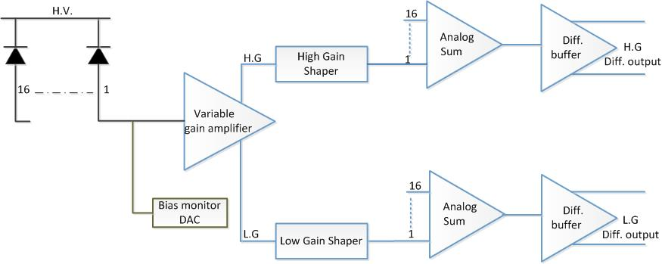
ASIC block diagram (I)
(PRE AMPLIFIER)
Technology: AMS- SiGe- BiCMOS 0,35

Slide 11
Trigger
Pixel Trigger rate
  Dark current
  After Pulse rate
  Cross talk
  Night Sky Background, few MHz (depends on the size of the pixel)
  Proton background
  => Fast discriminator (programmable window) with programmable threshold (3-4 ? p.e ) at the matrix level then perhaps by combining few matrixes together.
  depends on the SiPM ,
  time coincidence at the matrix level, will reduce the trigger rate

Slide 12
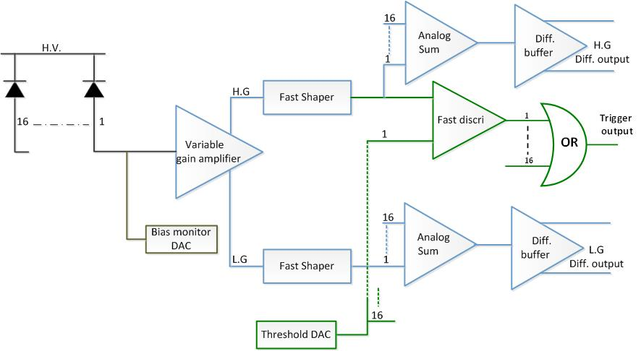
ASIC block diagram (II)
(PRE AMPLIFIER+Trigger)
Notes:
Why the trigger output?

Slide 13
Ongoing work & future perspectives
SiPM tests to be continued:
  PDE
  Crosstalk, after pulse.
  Dark current, noise.
FBK photo detector test in our INFN collaboration.
ASIC circuit design and simulation.
  Foundry: end of 2013/beginning 2014.
  Test: mid 2014.
Future readout chip of several photo detector matrices.
  Advanced trigger function for time coincidence.

Slide 14
Conclusion
LAPP is involved in LST/Dragon and MST/NECTAR collaborations.
Ongoing: design a demonstrator for a SiPM camera with its preamplifier (ASIC) within the NectarCam/Dragon frames.
Next: include a trigger function for time coincidence purpose and an extension to a multi channel readout chip.

