Slide 1
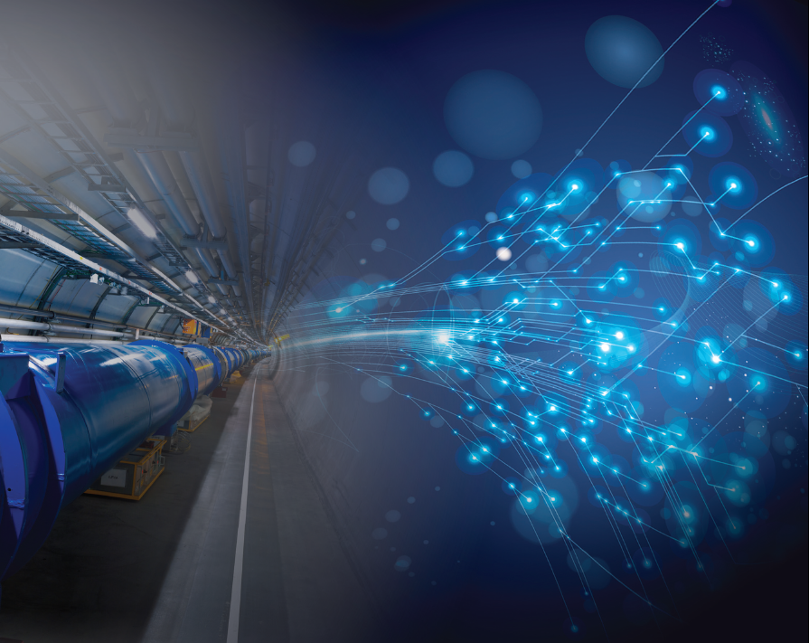

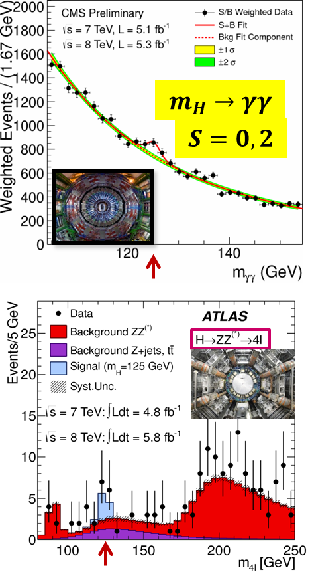
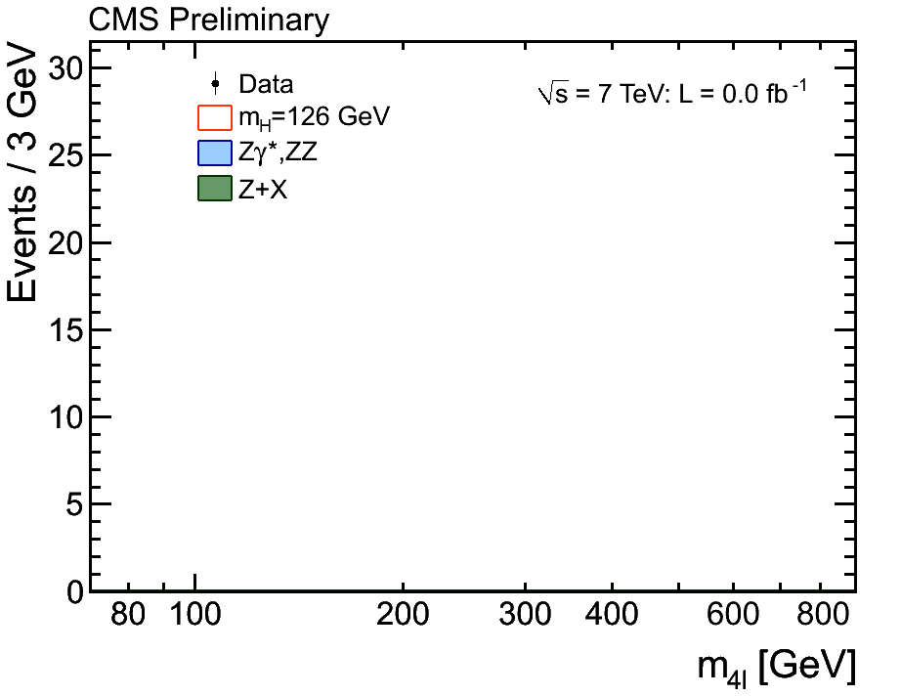
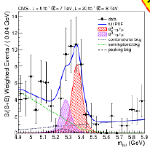
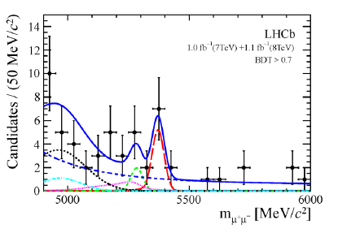
TLEP/VHELHC: an exciting vision for Particle Physics
Roy Aleksan 4 Oct. 2013
CPPM
The Frontiers of PP
What to do Next and which Strategy
Next Accelerator Technology Challenges for PP
Conclusion
m_{H} ~ 125.6 ± 0.4GeV
High Precision Measurements
Very High Energy Reach
High Intensity ν Beams
No direct sign of New Physics in range ~200 – 3000 GeVdepending on type of NP
B_{s}’μμ =(2.9 ±0.7)10⁻⁹
Θ₁₃ ~ 9°

Slide 2
Possible Strategy
Measuring the electroweak sector with the HIGHEST possible precision with e⁺e⁻ collisions
Observation of deviations from the SM providing indications on the scale of New Physics
Exploring this New Physics directly with pp collisions
If needed, complement the studies with other types of collisions
  e^{+/-}p collisions
  γγ collisions
  μ⁺μ⁻ collisions
A « >50-year » programme !

Slide 3
Possible Scenarii (cont’d)
When
What
after LHC
@14 TeV
Standard Higgs and nothing else
Non standard Higgs and/or new physics
Decision in 2018
e⁺e⁻ Collider :
e.g. TLEP
Depending of NP scale e⁺e⁻ and/or pp : CLIC or TLEP+VHE-LHC or VHE-LHC directly
VHE-LHC (pp 100 TeV)
or μμ collider (if new physics hints <5 TeV)
We should develop a strategy from Precision measurements toward Very High Energy … …possibly with the same complex?

Slide 4
Can one do this all in one?
Make
E=mc²
Extended Multiprobe Collider Complex

Slide 5
Extended Multiprobe Collider Complex
80-100 km tunnel
TLEP : e⁺e⁻, up to
√s ~350 GeV
(possibly 450-500 GeV)
PSB
PS (0.6 km)
SPS (6.9 km)
LHC (26.7 km)
VHE-LHC : pp,
√s ~ 100 TeV
in same tunnel
including possibly ep collisions and/or γγ collisions if needed
(CERN implementation
capitalizing on existing infrastructures

Slide 6
If you want to know more about TLEP see
arXiv:1308.6176v1 [hep-ex] 28 Aug 2013
Website: http://tlep.web.cern.ch/

Slide 7
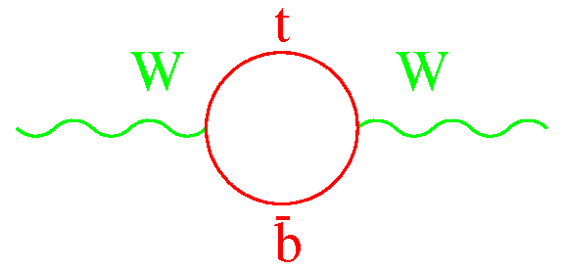
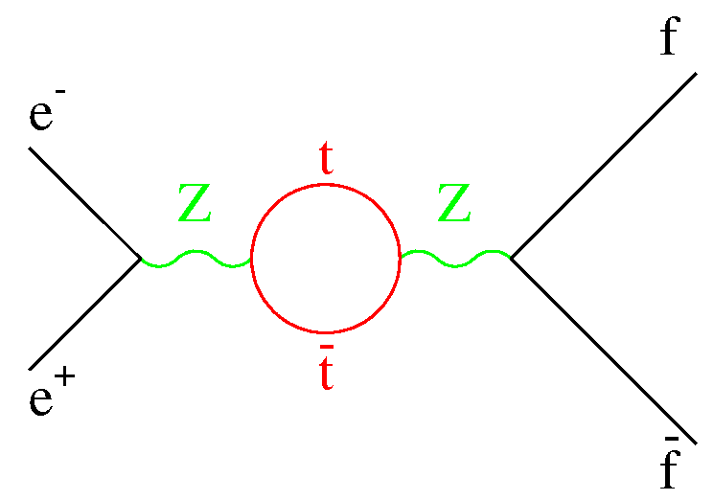
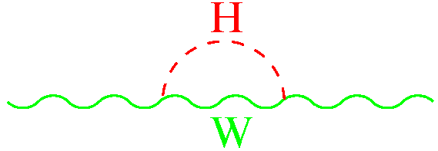
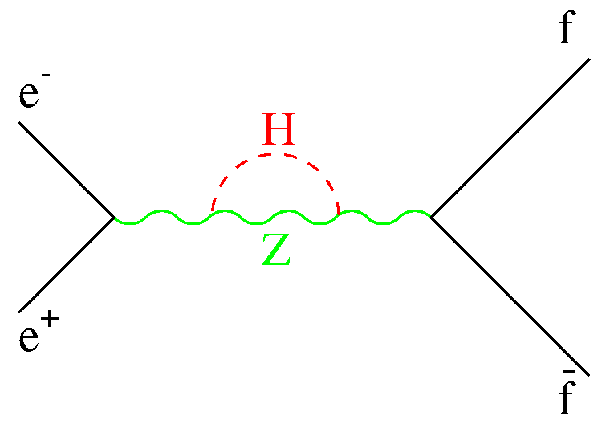
…Why e⁺e⁻…
Improve further the consistency tests of the Standard Model
Moriond EW ’12
Z pole measurements
Standard Model
∝ M_{t}²
∝ ln(M_{H})
Direct m_{W}, m_{top}
measurements
M_{W}= 80.385 ± 0.015 GeV
Affects Z lineshape, Asymmetries, Cross section, Decay Rates…
M_{t}= 173.5 ± 1.0 GeV
M_{H}= 93 ± ²⁶ ₂₀ GeV
Need to improve
Measurement @Z-pole
M_{w} and M_{t} ( @threshold)
M_{H}

Slide 8
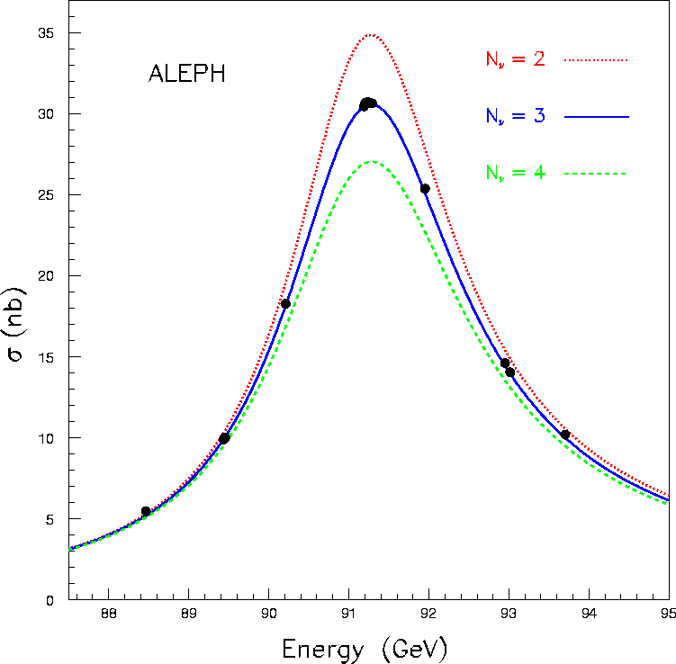
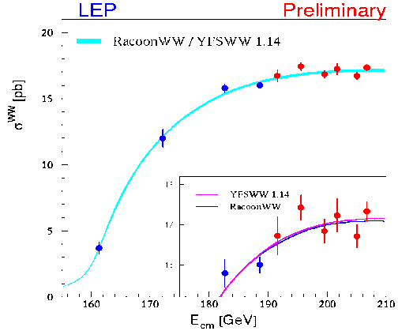
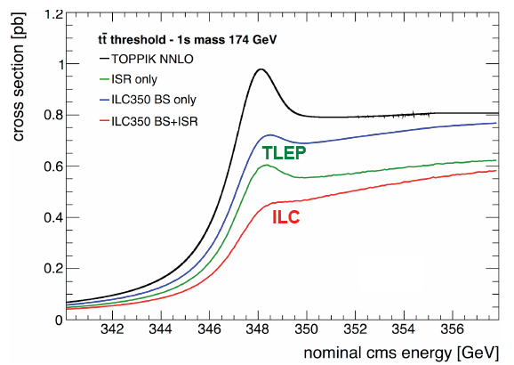
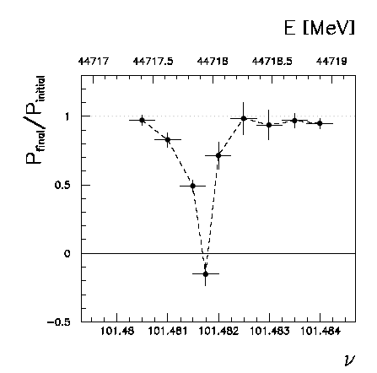
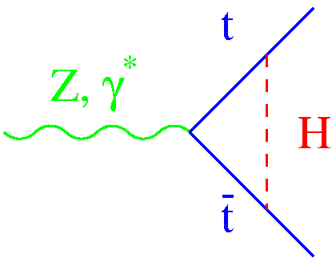
TLEP instant. luminosity (cm⁻²s⁻¹) | 5.6 10³⁵ @Z-pole | 1.6 10³⁵ @161 GeV | 5 10³⁴ @240 GeV | 1.3 10³⁴ @~350 GeV
TLEP Programme | #Z in 1 year @Z-pole | #W in 1 year @161 GeV | #H in 5 years @240 GeV | #top in 5 years @~350 GeV
# events@TLEP with 4 detectors | ~ 10¹² | ~ 5 10⁷ | ~ 2 10⁶ | > 10⁶
Beam E cal. with
reson. depolar.
 | LHC(300) | LHC (3000) | ILC programme | TLEP programme | Comment/caveat
Δm_{W} (MeV) | ~10 | ~10 | ~7 | <0.5 | Theor. limited
Δm_{t} (MeV) | 800-1000 | 500-800 | 34 | 10 | ~100 from theo.
Δm_{H} (GeV) indirect | -25 | ~20 | ~5 | ~1.4 | Theor. errors should match!
Δm_{H} (MeV) direct | ~100 | ~50 | ~35 | ~7 | Overkill for now

Slide 9
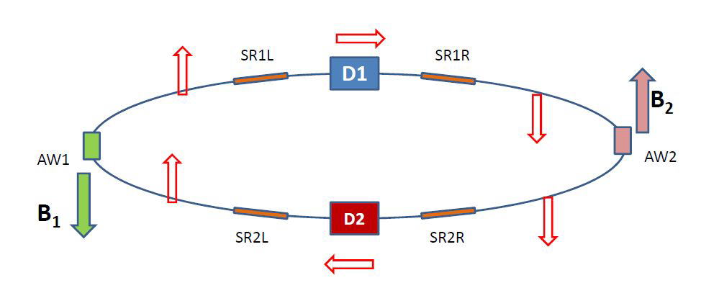
Polarization at circular colliders
e⁻(e⁺) spin naturally align along dipole magnetic field
Transverse polarization builds up by synchrotron radiation emission (or if needed using wigglers)
Transverse to longitudinal polarization is achieved with Spin Rotators
RF-m
B⊥
Resonant depolarization is achieved with small field (perpendicular to dipole field) RF-magnet with frequency in phase with precession frequency. (Precession period is proportional to beam energy)
Depolarizing RF-magnet frequency measures beam energy with <0.1 MeV

Slide 10
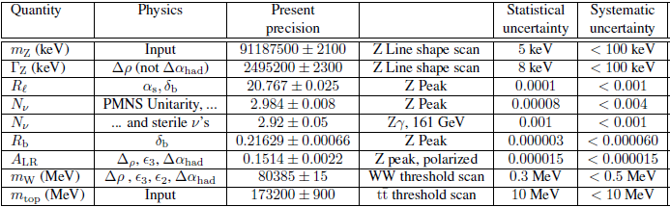
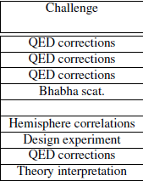
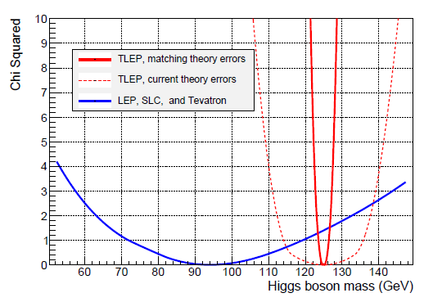
High precisions at Z pole and WW and top thresholds
Indirect m_{H} measurement error
TLEP + matching theory a δm_{H} ± 1.4 GeV
TLEP + present theory a δm_{H} ± 11 GeV
E_{beam} calibration with resonant depolarization unique to circular collider
a δE_{beam} < 0.1 MeV should be possible @TLEP

Slide 11
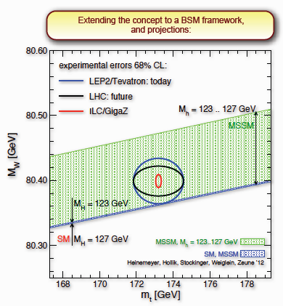
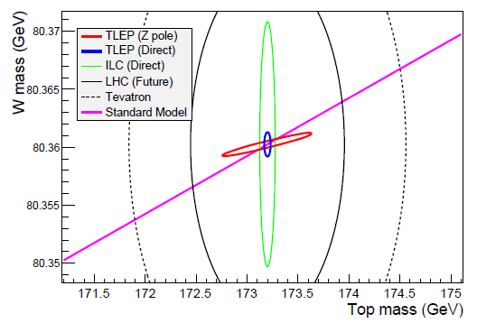
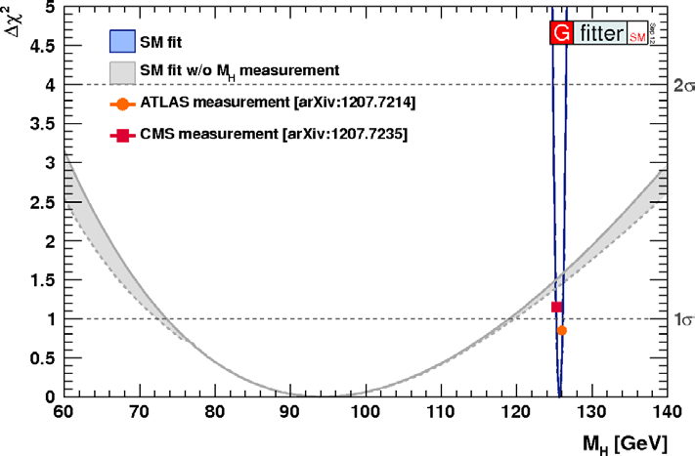
High precisions at Z pole and WW and top thresholds
(HL-LHC)
TLEP
Indirect:M_{H}=94.0 ± 1.4
Direct: M_{H}=125.500 ±0.007
.
Actual M_{H}

Slide 12
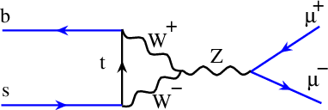
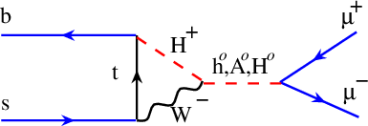
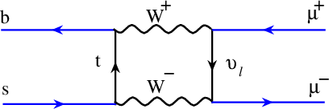
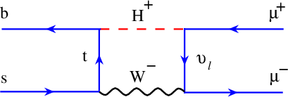
High precisions at Z-pole
Many other measurements would benefit from Tera-Z production
Channels | Production/year | Physics
τ⁺τ⁻ | 3 10¹⁰ pairs | Rare decays, conservation laws…
c or b quarks | > 2 10¹¹ | CP violation, rare decays…
 | e.g. > 3 10¹⁰ B_{s} | Large B_{s} sample with clean environment within SM, > 1000 B_{s} g τ⁺τ⁻ detected
Complement to B_{s} g μ⁺μ⁻ for NP search
SM
Example of non-SM
τ⁺
τ⁻
τ⁺
τ⁻
… or any NP loop process favoring 3rd generation
τ⁺
τ⁻
τ⁺
τ⁻

Slide 13
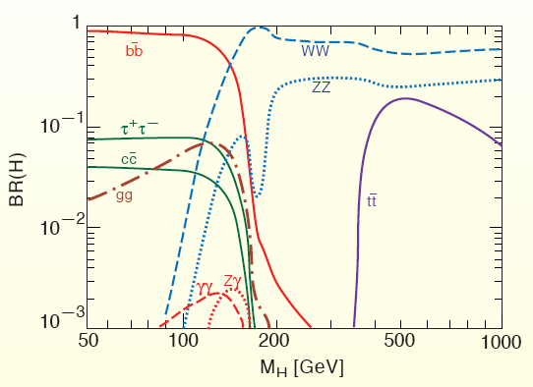



Study further the Higgs properties and couplings
$V_{Higgs}={−μ}^{2}$ $φ^{†}φ+λ{φ^{†}φ}^{2}$
$$+\left[\overline{ψ_{Li}}Y_{ij}ψ_{Rj}φ+h.c.\right]$$
$${m_{ij}^{}≡ Y}_{ij}v$$
H coupling to fermions ∝ m_{f}
H
∝ Yν
f
f

Slide 14
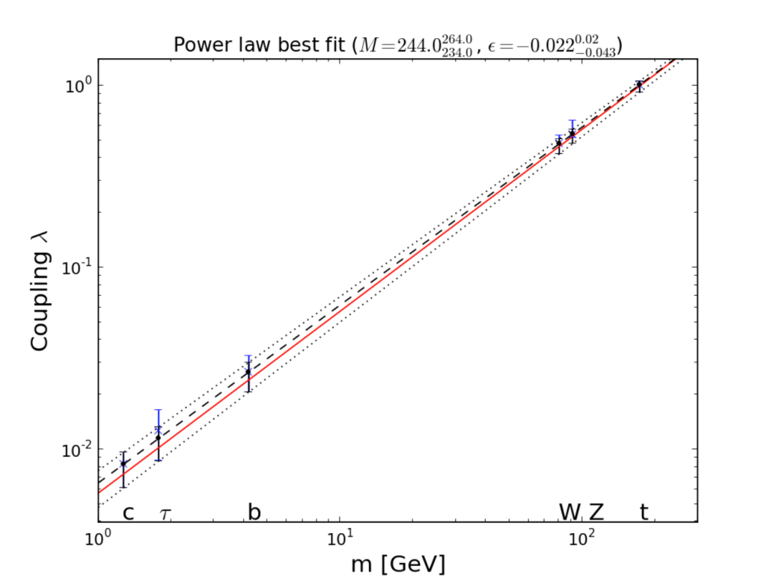

High precisions physics at H threshold
LHC is the benchmark Higgs Factory
Accelerator → Physical quantity ↓ | LHC 300fb⁻¹ /exp | HL-LHC 3000fb⁻¹ /exp
Approx. date | 2021 | 2030-35?
N_{H} | 1.7 x 10⁷ | 1.7 x 10⁸
Δm_{H} (MeV) | 100 | 50
ΔΓ_{H/}Γ_{H} | -- | --
ΔΓ_{inv/}Γ_{H} | 18 – 14% | 11 – 7%
Δg_{Hγγ}/g_{Hγγ} | 7 – 5% | 5 – 2%
Δg_{Hgg}/g_{Hgg} | 8 – 6% | 5– 3%
Δg_{Hww}/g_{Hww} | 6– 4% | 5 – 2%
Δg_{HZZ}/g_{HZZ} | 6– 4% | 4 – 2%
Δg_{HHH}/g_{HHH} | -- | < 30% ? (2 exp.)
Δg_{Hμμ}/g_{Hμμ} | ~30% | ~10%
Δg_{Hττ}/g_{Hττ} | 8 –6% | 5 – 2%
Δg_{Hcc}/g_{Hcc} | -- | ~7%
Δg_{Hbb}/g_{Hbb} | 13 – 10% | 7 – 4%
Δg_{Htt}/g_{Htt} | 15 – 14% | 10 – 7%
Δm_{t} (MeV) | 800-1000 | 500-800
Δm_{W} (MeV) |  | ~10
Coupling measurements with precisions:
in the range 4-15% with 300 fb⁻¹ per exp.
in the range 2-7% with 3000 fb⁻¹ per exp.

Slide 15

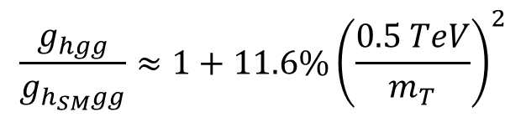
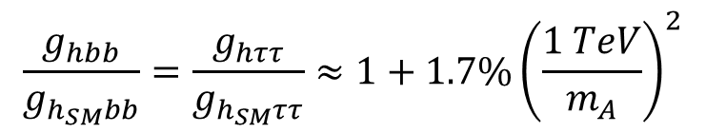
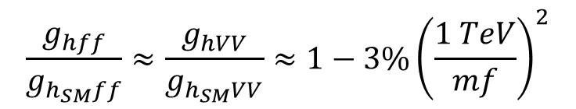
ElectroWeak Symmetry Breaking precision measurements
Example : Precision for Higgs couplings
SUSY modifies tree-level couplings
e.g. Pseudo-scalar A is difficult to find for moderate tanβ=5
H. Baer, M. Peskin et al.
Largest effet expected for bb, ττ
$$\frac{g_{hbb}}{g_{h_{SM}bb}}=\frac{g_{hττ}}{g_{h_{SM}ττ}}≈1+1.7\%{\left(\frac{1 TeV}{m_{A}}\right)}^{2}$$
e.g. light stop is an important search (hierarchy problem)
$$\frac{g_{hgg}}{g_{h_{SM}gg}}≈1+11.6\%{\left(\frac{0.5 TeV}{m_{T}}\right)}^{2}$$
$$\frac{g_{hγγ}}{g_{h_{SM}γγ}}≈1−3.2\%{\left(\frac{0.5 TeV}{m_{T}}\right)}^{2}$$
Compositness
All couplings reduced according to compositness scale
$$\frac{g_{hff}}{g_{h_{SM}ff}}≈\frac{g_{hVV}}{g_{h_{SM}VV}}≈1−3\%{\left(\frac{1 TeV}{mf}\right)}^{2}$$
Higgs couplings should be measured as precisely as possible!

Slide 16
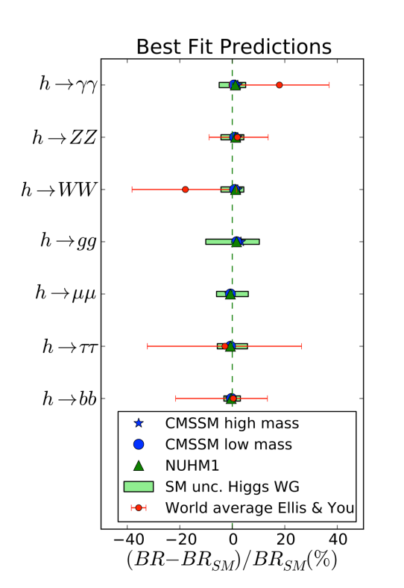
High precisions at H threshold
Sub % sensitivities on Higgs couplings are highly desirable to probe new physics at and above the TeV scale

Slide 17
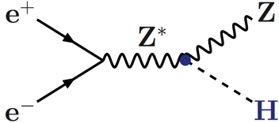
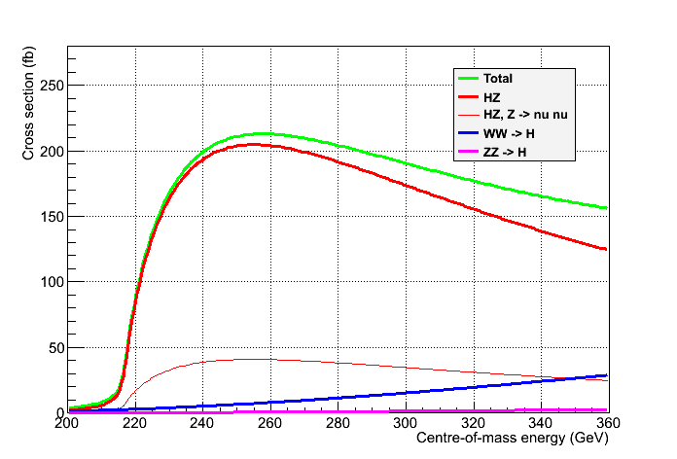
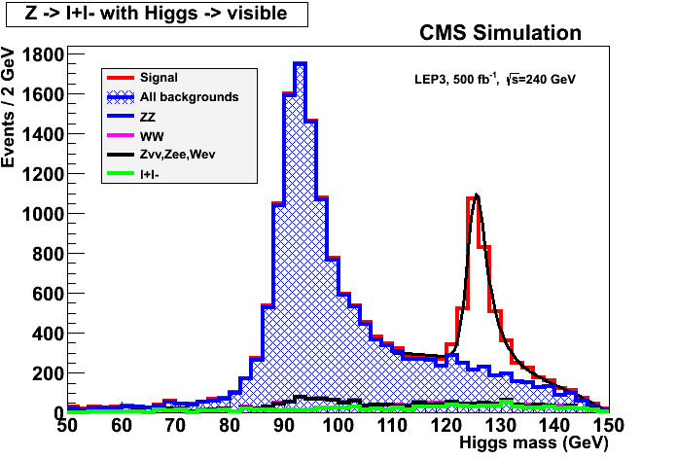

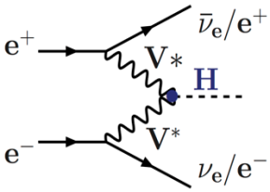
High precisions Higgs couplings at 240 GeV and 350 GeV
Great e⁺e⁻ asset: Tagged Higgs sample
  Total Higgs decay width
  Individual branching ratios to sub %
  Invisible and exotic decays
Reconstruct Z
Determine recoil mass
(thanks to be beam-energy constraint)
But …
Cross section modest a very large luminosity
Unpolarized cross sections
P Janot and G. Ganis
σ_{Hνν,} BRs,
width
Spin,
mass
σ_{HZ,} BRs,
width
Z → All
Z → νν
δ(σ_{HZ}) = 0.4%

Slide 18
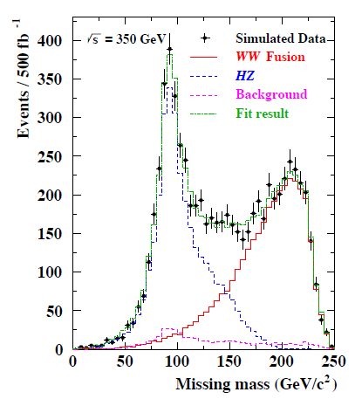
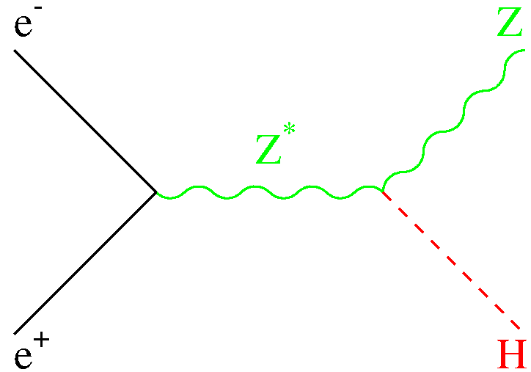
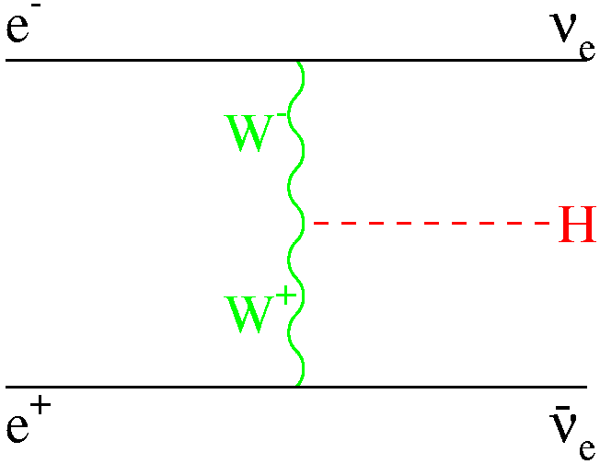
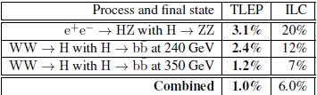
Total Higgs decay width can also be extracted from W-fusion
ν
ν
ν
δ(σ_{WWgHgbb} )
= 0.6%
ΔΓ_{H} /Γ_{H}

Slide 19
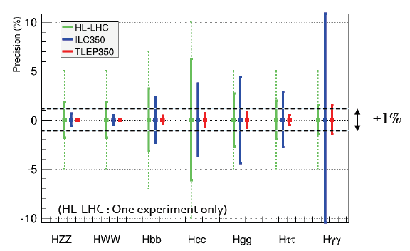
Accelerator → Physical quantity ↓ | HL-LHC 3000fb⁻¹ /exp | ILC (250+350) | TLEP 240 +350 4 IP
ΔΓ_{H/}Γ_{H} | -- | 6.0% | 1.0%
ΔΓ_{inv/}Γ_{H} | ~7% | 2.9% | 0.45%
Δg_{Hγγ}/g_{Hγγ} | 2.0% | 14.5% | 1.5%
Δg_{Hgg}/g_{Hgg} | 3.0% | 4.4% | 0.8%
Δg_{Hww}/g_{Hww} | 2.0% | 0.5% | 0.19%
Δg_{HZZ}/g_{HZZ} | 2.0% | 0.9% | 0.15%
Δg_{Hμμ}/g_{Hμμ} | <10% | 45% | 6.2%
Δg_{Hττ}/g_{Hττ} | 2.0% | 2.9% | 0.54%
Δg_{Hcc}/g_{Hcc} | ~7% | 3.8% | 0.71%
Δg_{Hbb}/g_{Hbb} | 4.0% | 2.4% | 0.42%
Sensitivity to Higgs Coupling at TLEP using data at 240 and 350 GeV (5 years at each energy)
Comparison with of TLEP sensitivities with HL-LHC and ILC

Slide 20
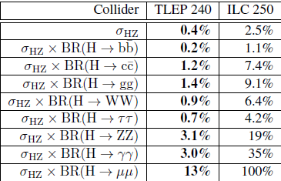
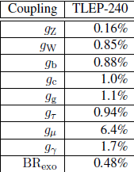
Sensitivity to Higgs Coupling at TLEP using data at 240 GeV (5 years, 4 detectors)

Slide 21
High precisions at ttbar threshold
Scan of the tt threshold
  Observables σ_{tt}, A_{FB} and <p^{@max}> sensitive to m_{top} , Γ_{top} , and λ_{top} (ttH Yukawa coupling)
    Experimental precision for ILC with 100,000 tt events
      No beamstrahlung and 500,000 tt events at TLEP
    Expected sensitivity for TLEP (full study to be done) and ILC
-
-
m_{top} = 175 GeV
σ_{tt}
p^{@max}
A_{FB}
M. Martinez and R. Miquel, 2003
 | Δm_{top} | ΔΓ_{top} | Δλ_{top}/λ_{top}
TLEP | 10 MeV | 11 MeV | 13%
ILC | 31 MeV | 34 MeV | 40%

Slide 22
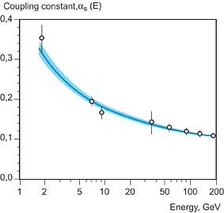
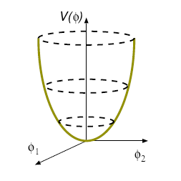
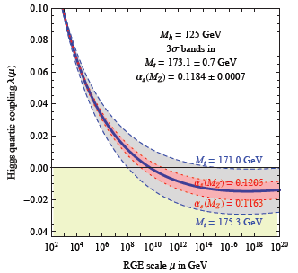
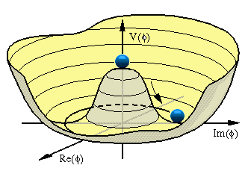


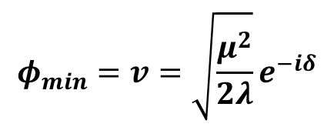
Study of the Higgs properties, its couplings and the potential
$V_{Higgs}={−μ}^{2}$ $φ^{†}φ+λ{φ^{†}φ}^{2}$
Interaction strength varies with energy scale, depends on quantum numbers and particle species
field self coupling
$$φ_{min}=v=0$$
H potential
Strong coupling
H
H
∝ λ
H
$${φ_{min}=v=\sqrt{\frac{μ^{2}}{2λ}}e}^{−iδ}$$
H
H
∝ λ^{1/2}M_{H}
H
λ runs too
H
Consistency
Check
$$υ=246 GeV$$
Vaccuum instability
$$M_{H}=\sqrt{{2λv}^{2}}$$

Slide 23
Do we have the technology to carry out these measurements?
 | LHC(300) | LHC (3000) | ILC (250+350) | TLEP (240+350) | Comment
Δm_{H} (MeV) | ~100 | ~50 | ~30 | ~7 | Overkill for now
ΔΓ_{Η}/Γ_{Η} (ΔΓ_{inv}) | --(14) | --(7) | 6(2.9)% | 1.0(0.45)%
H spin | P | P | P | P
Δm_{W} (MeV) | ~10 | ~10 | ~7 | <0.5 | Theo. limits
Δm_{t} (MeV) | 800-1000 | 500-800 | 31 | 10 | ~100 from theo.
Δg_{HVV}/g_{HVV} | 4-7%* | 2%* | 0.5-14.5% | 0.15-1.5%
Δg_{Hff}/g_{Hff} | 6-13%* | 2- 7%* | 2-2.5% | 0.2-0.7%
Δg_{Htt}/g_{Htt} | 14%* | 7%* | ~40% | ~13%
Δg_{HHH}/g_{HHH} | -- | ~30% | 44%** | -- | Insufficient ?
Could be significantly improved at VHE-LHC
*Assuming systematic errors scales as statistical and theoretical errors are divided by 2 compared to now
**Sensibility with 2ab⁻¹ at 500 GeV

Slide 24
Recommendations from European Strategy Group (cont’d)
High-priority large-scale scientific activities (2)
Recommendation #2
d) To stay at the forefront of particle physics, Europe needs to be in a position to propose an ambitious post-LHC accelerator project at CERN by the time of the next Strategy update, when physics results from the LHC running at 14 TeV will be available.
CERN should undertake design studies for accelerator projects in a global context, with emphasis on proton-proton and electron-positron high-energy frontier machines. These design studies should be coupled to a vigorous accelerator R&D programme, including high-field magnets and high-gradient accelerating structures, in collaboration with national institutes, laboratories and universities worldwide.

Slide 25


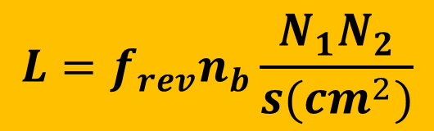
Most of the fundamental particles (13/17) have been
discovered thanks to accelerators
u
g
Z⁰ W±
d
τ
ν_{μ}
?
μ
ν_{e}
s
c
b
t
ν_{τ}
H
1930 |  | 1940 |  | 1950 |  | 1960 |  | 1970 |  | 1980 |  | 1990 |  | 2000 |  | 2010 |  | 2020
Accelerator era
Superconductivity era
Both energy and intensity frontiers had to be challenged in past 50 Years
Today
E_{max}=8 TeV @ LHC(pp collider)
L_{max}=2x10³⁴ cm⁻²s⁻¹ @ KEKB (ee collider)
$$L=f_{rev}n_{b}\frac{N_{1}N_{2}}{s(cm^{2})}$$
$$S=4πσ_{x}σ_{y}$$

Slide 26
From past … toward new frontiers
>2(3) orders of magnitude in Energy in e(p) colliders
>5 (3) orders of magnitude in Luminosity for e (p) colliders

Slide 27
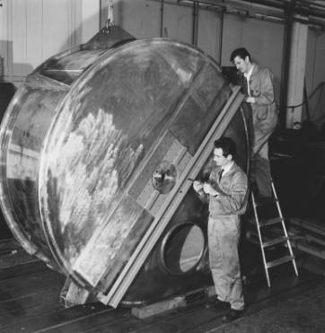

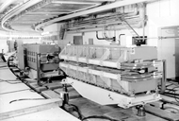



Accelerator issues
$$P_{sr}∝I{\left(\frac{E}{m}\right)}^{4}B^{}$$
Get highest possible
accelerating gradient
PS 19MHz cavity
Make B small! Possibly 0
or use large m particles
ρ(m)$=\frac{P(GeV)}{0.3qB(T)}$
PS 19MHz cavity
First PS dipole
Make B as large as possible
Get large momentum acceptance
Make flat beams
High top-up rate
$$∝\left(\frac{E}{m}\right)\frac{dQ}{dS}$$
Beamstrahlung:

Slide 28





SC has enabled great progress
Two main areas: Magnets and RF cavities
LHC Cavity cryomodule
LHC dipole
XFEL Cavity
B ≈ 8.3 Τ
NC CLIC Cavity
G rad. ≈ 40MV/m @1.3 GHz
ESS type elliptical & spoke Cavities
Grad. ≈ 100MV/m @12 GHz

Slide 29



The « revolution » of circular e⁺e⁻ colliders
The Top up scheme
Continuous High luminosity
K; Oide
8x10³⁵@superKEKB

Slide 30
e⁺e⁻ colliders «clean HIGGS FACTORIES»
e⁺ e⁻
Linear
Colliders
CLIC
Circular Colliders
CERN
SuperTRISTAN
ILC
250 GeV + Klystron based
500 GeV
250 GeV– 40, 60 km tunnel
250 GeV
500 -1000 GeV
LEP3 at LHC tunnel
> 1500 GeV
TLEP – New tunnel, 80 km
Chinese HF
250 GeV, 50 or 70 Km tunnel

Slide 31



ILC
Gradient Range Yield Gain
~30km
500GeV
Energy CM (GeV) | 250 | 500 | 1000
Luminosity (x10³⁴cm⁻²s⁻¹) | 0.75 | 1.8 | 3.6
Beam size (σ_{x}/σ_{y} nm) | 730/8 | 470/6 | 480/3
Pulse duration (ms) | 0.75 | 0.75 | 0.9
Beam power (MW) | 8.4 | 10.5 | 27.2
Total AC power (MW) | 158 | 162 | 300
Cavity Gradient (MV/m) | 31.5
#9-Cell cavities | ~16000
#Cryomodules (2K) | ~1800
#RF units (10MW Kly) | ~560

Slide 32
Some further ILC challenges
Achieving and maintaining nano beam size (σ_{y} =6-8nm) with 2x10¹⁰ e/bunch
ATF2 operating since 2009 at KEK objective: 37nm @1.28 GeV
February 2012 σ_{y}=166±7 nm
Dec. 2012 σ_{y}=72±5 nm with low b-intensity (2x10⁹ e/bunch)
Strong R&D on these issues is on-going
Carried out by international collaborative
Several issues still being addressed
Proposal from the Japanese physics community
Realization of very low emittance damping rings with ultra fast kickers for extraction
TIARA collaboration with SLS @PSI (<1pm @2.86 GeV)
Achieving the required positron rate
photons from 150 GeV beam through 150m of small-aperture SC undulator
or 125 GeV beam through 250 m of SC undulators
Industrialization of technology at very high scale
XFEL =5% of ILC

Slide 33






Two Candidate Sites in
Japanese mountainous locations
5 m
SEFURI
Japanese HEP community proposes to host ILC based on the “staging scenario” to the Japanese Government.

Slide 34



CLIC
Achieving very high gradiant (100Mv/m) with low enough breakdown rate (<10 ⁻⁶ )
International collaboration around CFT3 @CERN
Demonstrated with a few cavities
Energy CM (GeV) | 500 | 3000
Luminosity (x10³⁴cm⁻²s⁻¹) | 2.3 | 5
Beam size (σ_{x}/σ_{y} nm) | 202/2.3 | 40/1
Pulse duration (ns) | 177 | 155
Beam power (MW) | 4.9 | 14
Total AC power (MW) | 270 | 589

Slide 35
Some further CLIC challenges
Same type of difficulties as for ILC though more severe, e.g.
  smaller beam size (~1nm)
  Shorter bunch length (150ns)
  Normalized y emittance ~20nm and its preservation
    Ultra precise alignment and magnet stabilization
Strong R&D on these issues is on-going
Developed by international collaborative
Some difficulties are specific to CLIC, e.g.
  Production of RF power
  Stable deceleration of drive beam
  And main beam acceleration
Although a lot of progress have been achieved, still a lot of R&D needed to deliver a TDR

Slide 36


TLEP Ring e⁺e⁻ collider: Primary Cost Driver Tunnel: ~60% cost
Building on existing technologies and experience (LEP, KEKB, PEPII…)
LEP/LHC
b
80-100 km tunnel
Using SC cavities
Energy CM (GeV) | 90 | 160 | 240 | 350
Luminosity (x10³⁴cm⁻²s⁻¹)/IP | 56 | 16 | ~5 | ~1.3
Cavity Gradient (MV/m) | 20 | 20 | 20 | 20
#5-cell SC cavities | 600 | 600 | 600 | 600
Beam lifetime (mn) | 67 | 25 | 16 | 20
Total AC power (MW) | 250 | 250 | 260 | 284
Could cover a wide range of energy up to 350 Gev collision energy.
Most parameters have been achieved or are planned at SuperKEKB

Slide 37

UNK Higgs
Factory, 2012
FNAL site filler, 2012
LEP3 2011
West Coast
design, 2012
LEP3 on LI, 2012
LEP3 in Texas, 2012
Chinese Higgs
Factory, 2012
SuperTristan 2012
circular Higgs factories around the world

Slide 38
An important parameter is the power per unit of luminosity
~20 MW-h/H⁰
~2 MW-h/H⁰
*Luminosity not corrected
for peak 1% factor

Slide 39

Although based on strong experience in building circular collider, several challenges have to be overcome:
Beamstrahlung:
a Beam lifetime reduction (should not be much smaller than bhabha scattering limits
τ>4 s at η=1.5% (4 IPs)
τ>50 s at η=2.0%
τ>6mn at η=2.5%
τ>27mn at η=3.0%
Idea is rather new triggered by low Higgs mass but based on long and mature experience in circular colliders
superKEKB is a very effective technology test case
Promising possibility a need to set up a international study
a Need to study the energy acceptance of the collider (>2.5%) a optic design is challenging
Explore synergies for
a Very Large Collider Complex
e⁺e⁻, pp, ep?
Bremstrahlung:
a Need to study heat extraction and radiation damage and shielding issues
τ>10mn at superKEKB
Top up ring:
a Need to study the injection system

Slide 40

Example of beam lifetime simulation with Beamstrahlung

Slide 41
TLEP parameters -1
soon at SuperKEKB:
β_{x}*=0.03 m, β_{Y}*=0.03 cm
 | LEP2 | sKEKB LER/HER | LHeC | TLEP-Z | TLEP-W | TLEP-H | TLEP-t
beam energy Eb [GeV] circumference [km] beam current [A] #bunches/beam #e−/beam [10¹²] horizontal emittance [nm] vertical emittance [nm] bending radius [km] Momentum comp. α_{c}[10⁻⁵] SR power/beam [MW] β∗_{x} [m] β∗_{y} [cm] σ∗_{x} [μm] σ∗_{y} [μm] hourglass F_{hg} ΔE^{SR}_{loss}/turn [GeV] | 104.5 26.7 0.004 4 2.3 48 0.25 3.1 18.5 11 1.5 5 270 3.5 0.98 3.41 | 4/7 3 3.6/2.6 2500 226/163 3.2 0.0081 16/104 0.032 0.027 10 0.047 1/3x10⁻³ | 60 26.7 0.1 2808 56 5 2.5 2.6 8.1 44 0.18 10 30 16 0.99 0.44 | 45.5 80 1.18 4400 1960 30.8 0.07 9.0 9.0 50 0.5 0.1 124 0.27 0.71 0.04 | 80 80 0.124 600 200 9.4 0.02 9.0 2.0 50 0.5 0.1 78 0.14 0.75 0.4 | 120 80 0.0243 80 40.8 9.4 0.02 9.0 1.0 50 0.5 0.1 68 0.14 0.75 2.0 | 175 80 0.0054 12 9.0 10 0.01 9.0 1.0 50 1 0.1 100 0.1 0.65 9.2
SuperKEKB:ε_{y}/ε_{x}=0.25%

Slide 42
TLEP parameters -2
LEP2 was not beam-beam limited
 | LEP2 | sKEKB LER/HER | LHeC | TLEP-Z | TLEP-W | TLEP-H | TLEP-t
V_{RF,tot} [GV] δ_{max,RF} [%] ξ_{x}/IP ξ_{y}/IP f_{s} [kHz] E_{acc} [MV/m] eff. RF length [m] f_{RF} [MHz] δ^{SR}_{rms} [%] σ^{SR}_{z,rms} [cm] L/IP[10³²cm⁻²s⁻¹] number of IPs b.lifetime [min] | 3.64 0.77 0.025 0.065 1.6 7.5 485 352 0.22 1.61 1.25 4 360 | 0.0094/0.015 0.0028/0.0012 0.0881/0.0807 0.6/0.5 8000 1 10 | 0.5 0.66 N/A N/A 0.65 11.9 42 721 0.12 0.69 N/A 1 N/A | 2.0 4.0 0.07 0.07 1.29 3 600 700 0.06 0.19 5600 4 67 | 2.0 5.5 0.10 0.10 0.45 3 600 700 0.10 0.22 1600 4 25 | 6.0 9.4 0.10 0.10 0.44 10 600 700 0.15 0.17 480 4 16 | 12.0 4.9 0.10 0.10 0.43 20 600 700 0.22 0.25 130 4 20
Lifetime at superKEKB = 10 min
LEP data for 94.5 - 101 GeV consistently suggest a beam-beam limit of ~0.115

Slide 43

TLEP will enable to probe further the SM with very high precision, search for rare processes and new light particles (<~200 GeV)
If deemed necessary, the c.m. energy could be pushed to 400-500 GeV, but to reach much higher scales hadron colliders is necessary (on-going study to determine E_{max} with L=10³⁴ with 4 detectors)
500 GeV
We need a tool to search for direct production of new particles up to energy scale in the 10 TeV range
Why not repeating the success story of LEP/LHC with TLEP/VHE-LHC!

Slide 44


LHC + HL-LHC: Great tool to Search for new particles/phenomena
Sensitivity on SUSY can be signicantly improved … in particular for stop
High energy and luminosity are necessary to probe the V_{L}V_{L} scattering
and verify that unitarity is preserved, thanks to the « Higgs » discovered
Example: ZZ VBS on top of the SM VBS contribution (i.e. VV+ 2 forward jets):
>5σ for C_{φW}/Λ² >15 TeV⁻²

Slide 45

Strong R&D on these issues is necessary
Very substantial programme a collaborative R&D needed
All this work is a first step toward higher energy
Increase beam current a protect SC dipole (diffracted protons)
8T-15m (20 magnets) a 11T-2x5.5 m dipoles
Reduce beam size at IP a Larger aperture quads near IP
Change Quadrupole Triplets a 140T/m, 150mm (13T, 8m)
Protect Electrical Distribution Feedbox’s (DFBX)
a 2×100 kA ~500m HTS links
Improve and adjust the luminosity with beam overlap control
a SC RF «Crab» Cavity, for p-beam rotation at fs level!

Slide 46


Upgrading LHC luminosity early 2020’s
Increase beam current a protect SC dipole (diffracted protons)
Reduce beam size at IP a Stronger focussing quads near IP
8T-15m a 11T-11m dipoles
5.5 m Nb₃Sn
3.5 m Collim
5.5 m Nb₃Sn
Fermilab/CERN Collaboration
Demo single bore 11T , 2m
Test: very good to 10.4 T
Next model twin-bore by beginning of 2013
Change Quadrupole Triplets
200T/m, 70mm (~8T, <6m>)
a 140T/m, 150mm (13T, 8m)

Slide 47

Target parameters for
HL-LHC run
Efficiency is defined as the ratio between the annual luminosity target of 250 fb⁻¹ over the potential luminosity that can be reached with an ideal cycle run time with no stop for 150 days: t_{run}= t_{lev}+t_{dec}+t_{turn}. The turnaround time after a beam dump is taken as 5 hours, t_{decay} is 3 h while t_{lev} depends on the total beam current
baseline

Slide 48




LQS-4m
LARP (US LHC program) Magnets
Test:~220T/m
~11T
G.L. Sabbi , LBNL
HQ
Test:~200T/m
13T

Slide 49



HTS links
Protection of Electrical Distribution Feedbox’s (DFBX)
In the tunnel, feed power from room temperature power converters to
the « cold world » of LHC. Actual LHC use short Nb-Ti links.
4.5 K
1.9 K
D1
DFBX
Q3,Q2,Q1
IP5
∼3 m
Need to be protected against radiation and provide easier access
Move DFBX on surface
To be decided
2×100 kA
~500m HTS links
Note: LHC uses 1400 Bi-2223
current leads

Slide 50




On going HTS link test at CERN
2m long MgB₂ cables tested
at 2x4500A
HTS cabling
Possible cable configuration for high current :
7 × 14 kA, 7 × 3 kA and 8 × 0.6 kA cables
Itot∼120 kA @ 30 K
Φ = 62 mm
Nexan Cryoflex® line (20 m long semi-flexible cryostat of link) procured and installed in the CERN SM-18 laboratory
20 kA – 4 to 80 K test
Very encouraging results:
16kA reached with MgB₂ in 20m cryostat
MgB₂, YBCO… tests
started end 2012
A. Ballarino, CERN

Slide 51

« Crab » Crossing
Improving further the luminosity by better overlap of the 2 beams
SC RF «Crab» Cavity, for p-beam rotation at fs level!
Technology pioneered successfully
on KEKB, Japan
Effort at SLAC-ODO and in BNL, USA
Effort in Daresbury (Cockcroft Institute and STCF) with CERN.
Also help to adjust the luminosity to ease
experiments’ life (Luminosity levelling)
Z→ μμ event from 2012 data with 25 reconstructed vertices

Slide 52




Progress in SC « Crab » Cavities
UK - Cockcroft
USA (ODU)
Several types
of prototypes
being designed
and made…
… as well as cryomodule
L. Xiao et al.
~250 mm outer radius
Y. Yakovlev et al.

Slide 53




Grand unification of Interactions (Strong, Weak, Electromagnetic)
Additionnal particles (such as supersymmetric partners) with energy scales of TeVs affect the running of the coupling constants
$$\frac{1}{α_{1}}$$
$$\frac{1}{α_{2}}$$
$$\frac{1}{α_{3}}$$
Need to explore higher energy regions (up to ~10 TeV)

Slide 54


Whatever is found or not, reaching higher energies is unavoidable
To search for new particles up to 10 TeV, very high energy (>50TeV) is necessary
To probe V_{L}V_{L} scattering up to 10 TeV region, very high energy is necessary
It will also allow more precise SM measurements
∝ λ^{1/2}M_{H}
H
H
H
Coutesy M. Mangano
Δg_{Htt}/g_{Htt} | <1%
Δg_{HHH}/g_{HHH} | <5%
VHE-LHC is THE tool for Htt and HHH couplings

Slide 55

The detailed study of such a machine is needed, including the complete injection chain (no major difficulties expected)
Strong R&D on these new very high field magnet is necessary
a collaborative R&D needed
Either using existing
LEP/LHC tunnel to reach 26-32 TeV collisions
VHE
VHE-LHC
Or build (or reuse) a 80-100 km tunnel to reach 80-130 TeV collisions VHE-LHC
a more detailed study of such a tunnel starting
In both cases, SC challenge to develop 16-20 Tesla magnets!
Magnets for HL_LHC is an indispensible first step

Slide 56


First consistent conceptual design
Using multiple SC material
L. Rossi
15 T
20 T field!
Magnet design: 40 mm bore (depends on injection energy: > 1 Tev)
Approximately 2.5 times more SC than LHC: 3000 tonnes! (~4000 long magnets)
Multiple powering in the same magnet for FQ (and more sectioning for energy)
Only a first attempt: cosϑ and other shapes needs to be also investigated

Slide 57


Slide 58
Conclusion
The last few years were very exciting
Many teams have contributed to this success, they have to be warmly congratulated
Thanks to this work, prospects for the Future looks very promising, with many new ideas emerging
The European Strategy was an opportunity to bring these ideas on the table and provide further momentum toward our quest for understanding the fundamental laws of the Universe
The Strategy is an important opportunity to open up a medium and long term ambitious vision and programme for Particle Physics in Europe : Top priority in the Strategy
Accelerator R&D is vital to enable the realization of our vision once we get the results of the LHC runs @ 13-14TeV and should remain at the highest priority within our strategy

Slide 59
Main Conclusion
Study Scope and Structure
Future Circular Colliders - Conceptual Design Study
Infrastructure conceptual design study
tunnels, surface buildings, access roads
civil engineering, cooling ventilation, electricity, cryogenics infrastructure, environmental impact, safety
Hadron injectors
conceptual design Machine optics and dynamics
Funct. system specs
Critical technical systems
VL Hadron collider
conceptual design study
Machine optics and dynamics
Functional system specs
Critical technical systems
Including start of R+D programs
e+ e- collider
conceptual design Machine optics and dynamics
Funct. system specs
Critical technical systems
Injector
HE LHC option?
Comparison with VL LHC
e- p option
Additional requirements
Integration
A single effort, i.e. the final product is a single CDR

Slide 60
Main Conclusion
An 80-100 km complex (TLEP and VHE-LHC) would provide a FANTASTIC post-LHC physics programme
A TLEP Design study has started
Ambitious milestones have been set up
CDR in 2 years
TDR in 5 years, in a timely fashion with an update of the European Strategy in 2017-18, after the first round of operation of the LHC@13-14 TeV
A technically possible timeline (to be confirmed by the DS)
 | 2010 |  |  |  |  |  | 2015 |  |  |  |  | 2020 |  |  |  |  | 2025 |  |  |  |  | 2030 |  |  |  |  | 2035 |  |  |  |  | 2040
LHC
HL-LHC | R&D + constr
TLEP* |  |  |  | Design + R&D + construction
VHE-LHC* | Design + R&D + construction

Slide 61
Main Conclusion
Workshops
  CERN: October 16-18 (TLEP workshop)
  CepC in Bejing December 16-18, 2013 (Chinese effort)
  CERN: Kickoff meeting (February 12-14, 2014)

