Slide 1
Update 22/07/2013
Naomi van der Kolk

Slide 2
Systematic errors
Considered sources:
Electron contamination
Muon contamination
Multi-particle events
Cut variables (dominant at low energy)
Contamination with non-interacting events (dominant at high energy)

Slide 3
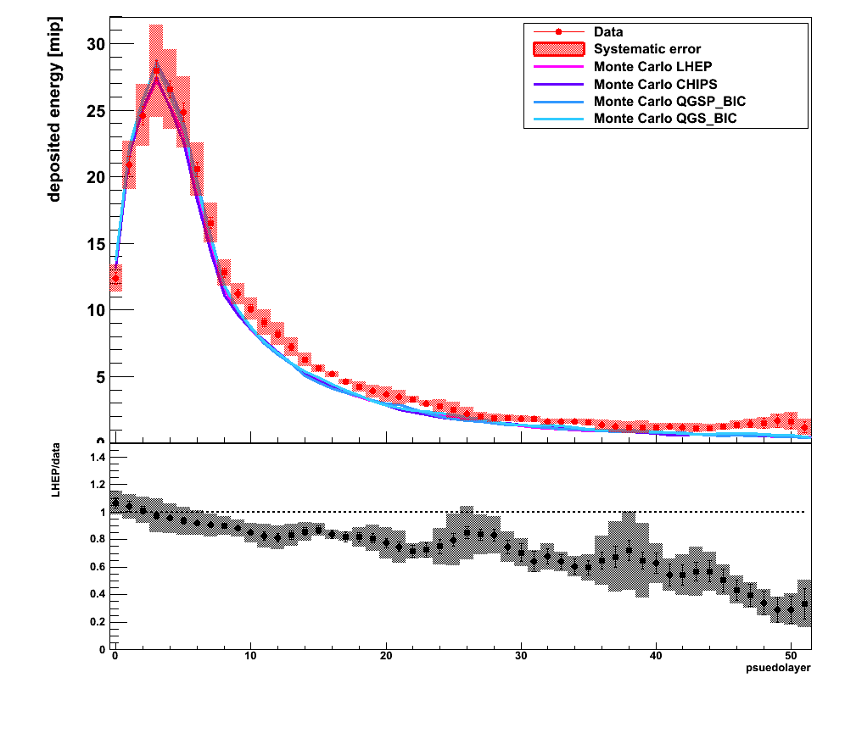
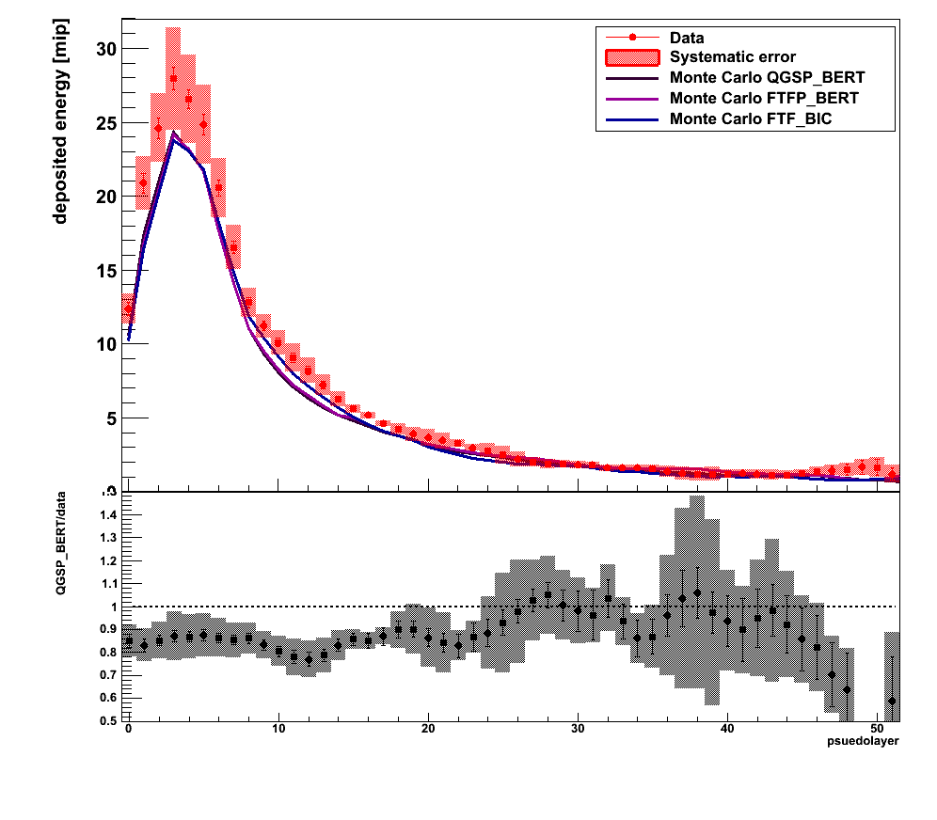
Longitudinal energy profile @2GeV

Slide 4
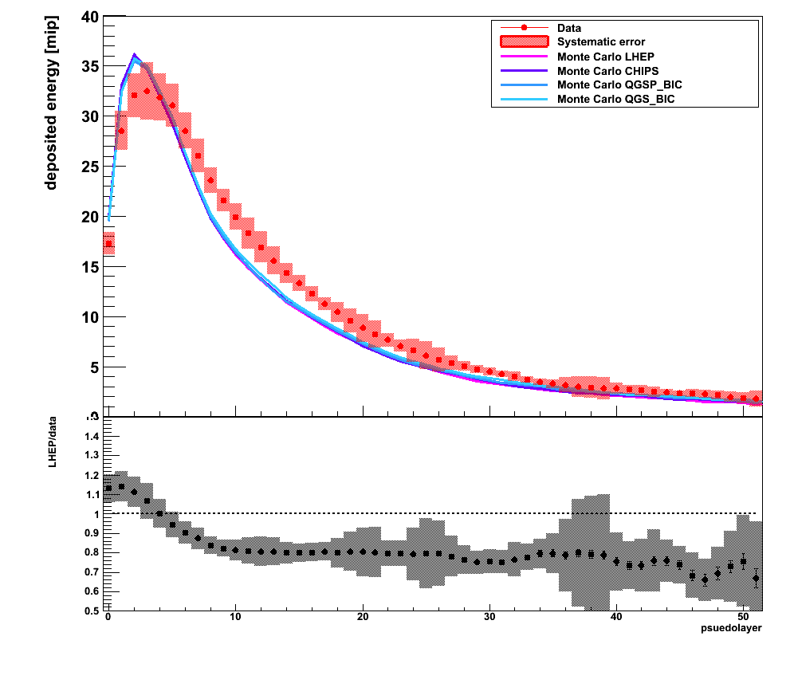
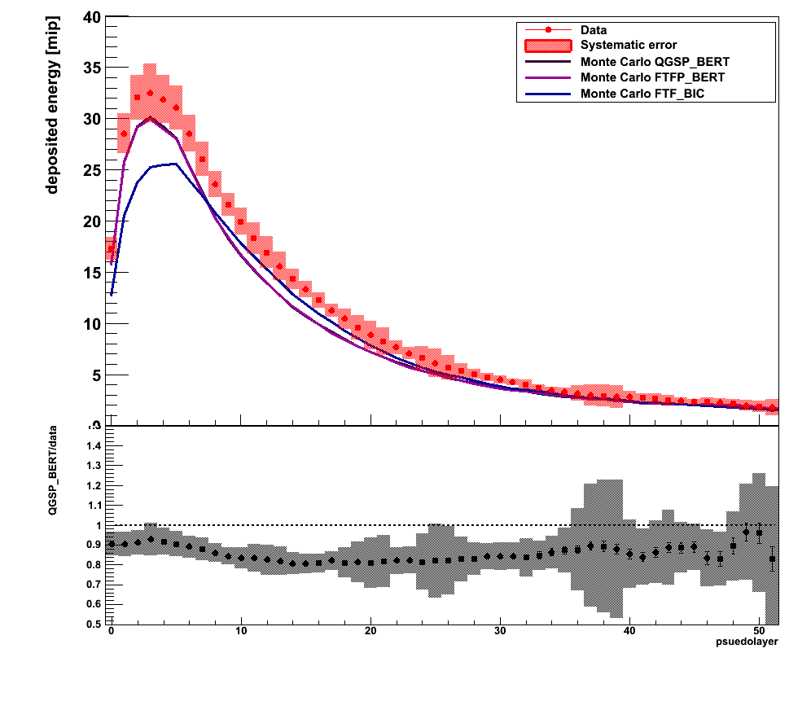
Longitudinal energy profile @4 GeV

Slide 5
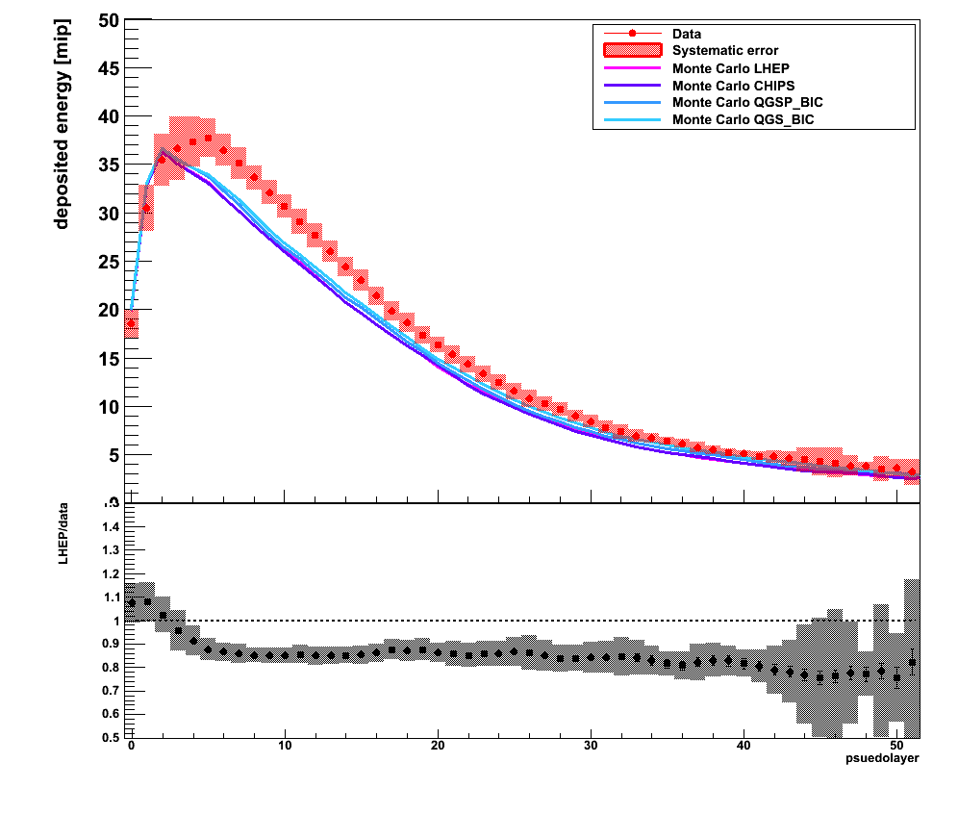
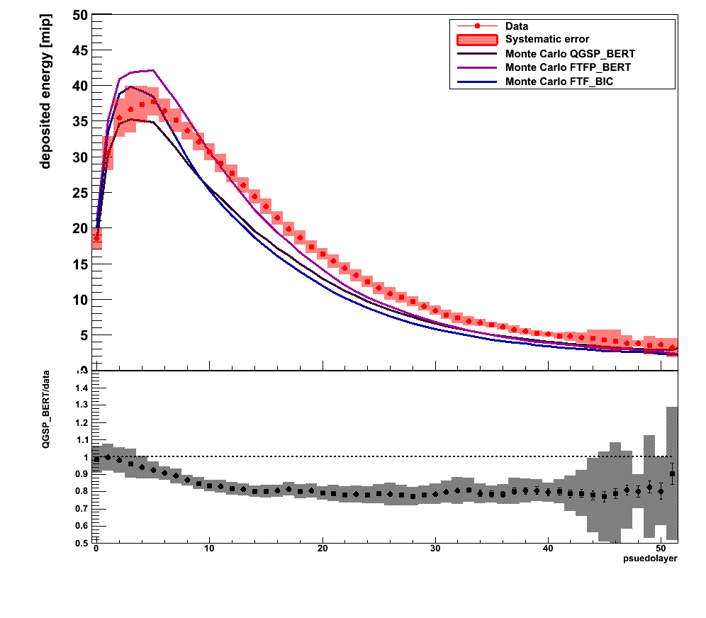
Longitudinal energy profile @6 GeV

Slide 6
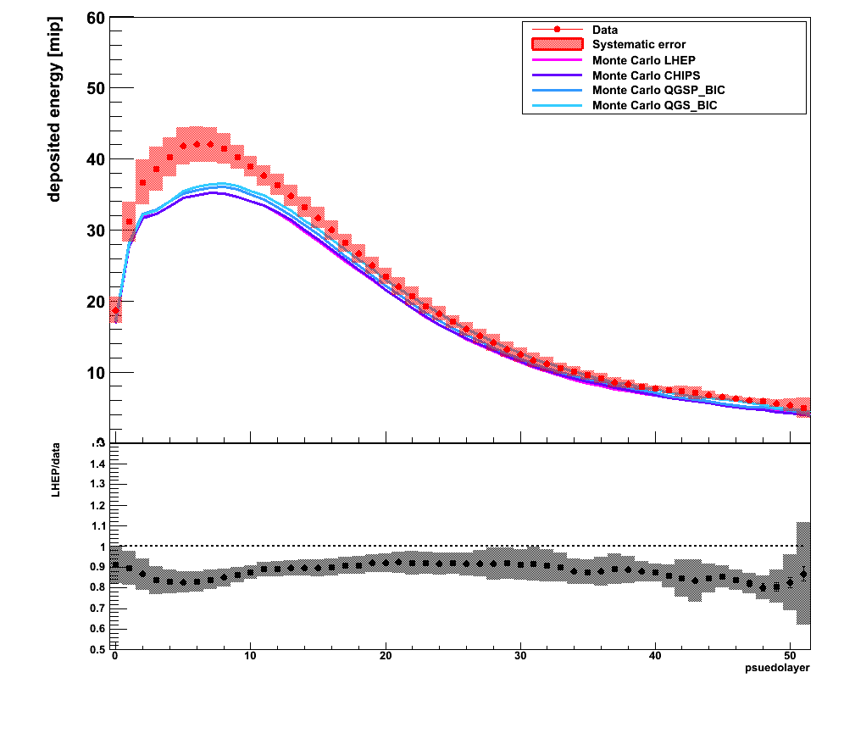
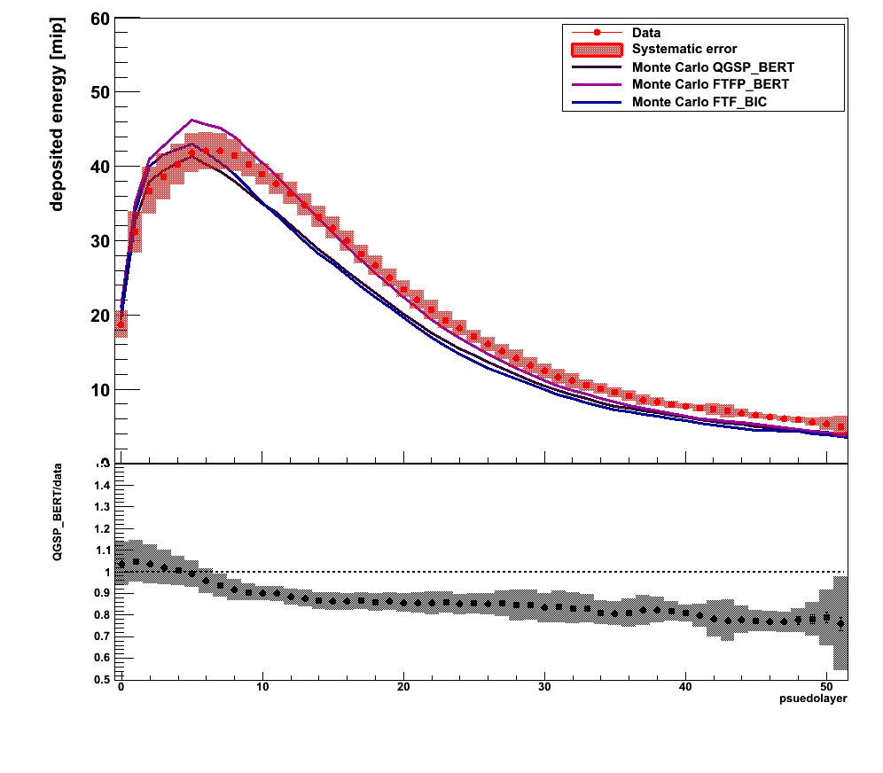
Longitudinal energy profile @8 GeV

Slide 7
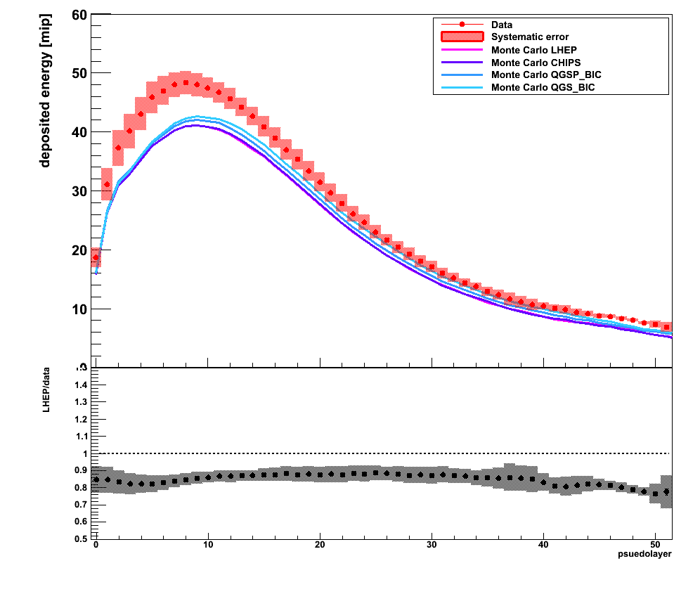
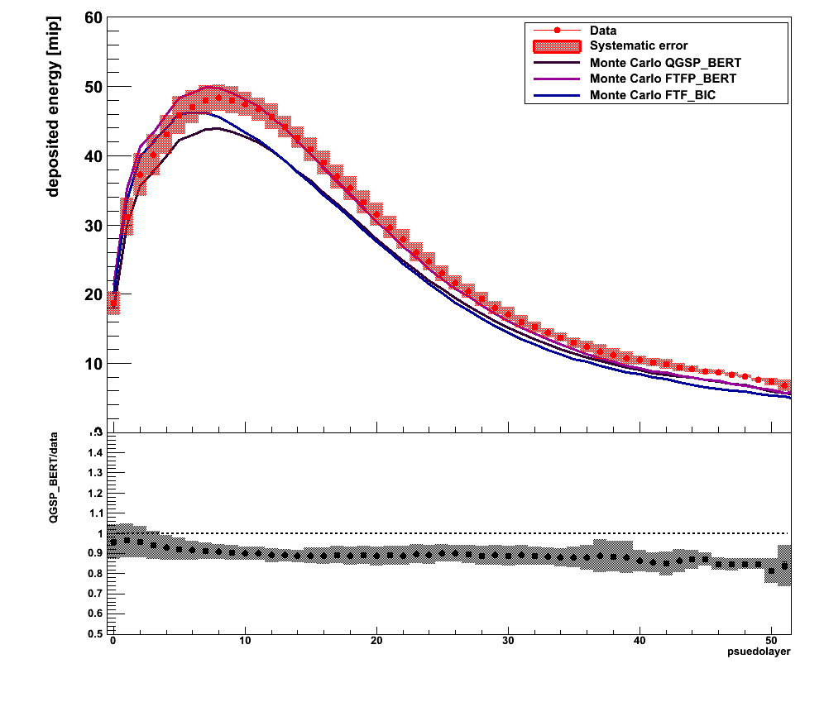
Longitudinal energy profile @10 GeV

Slide 8
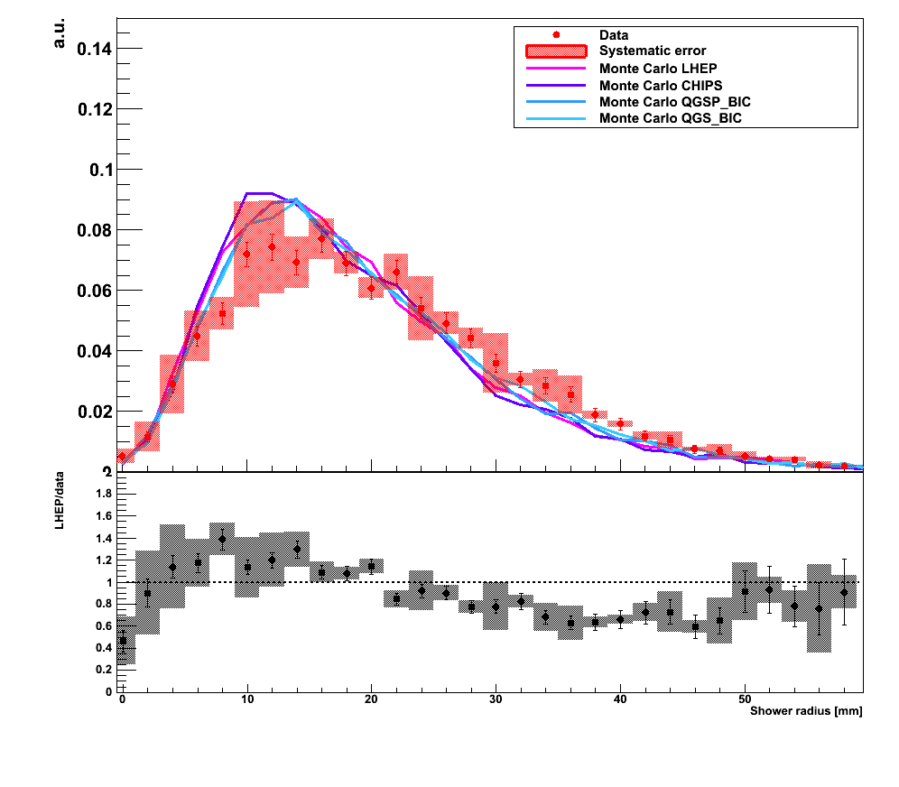
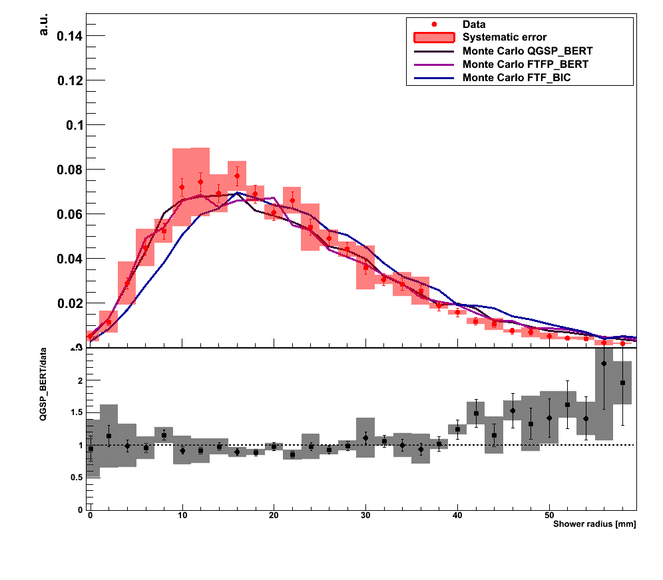
Mean shower radius @2 GeV

Slide 9
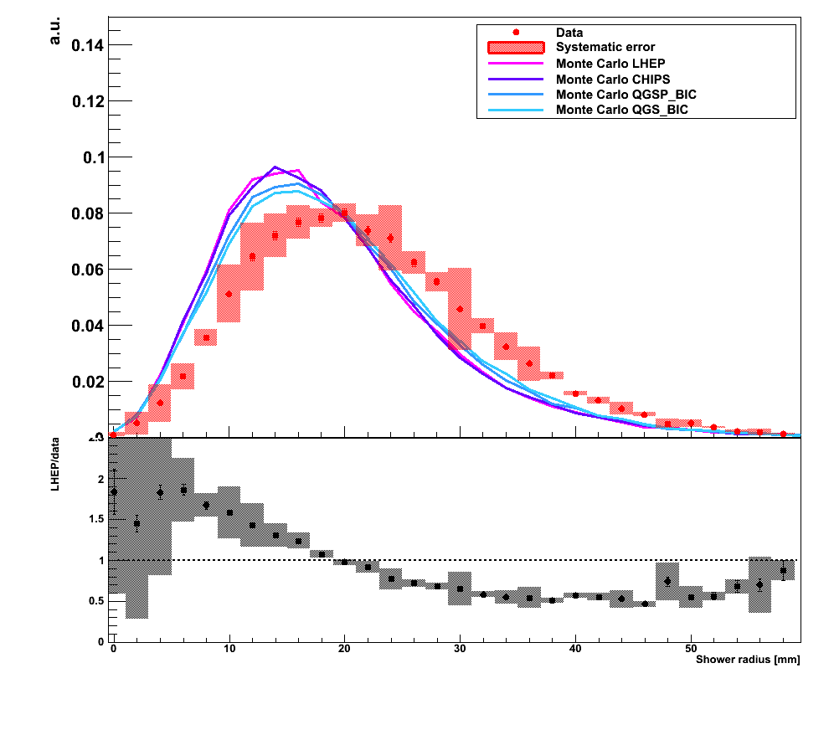
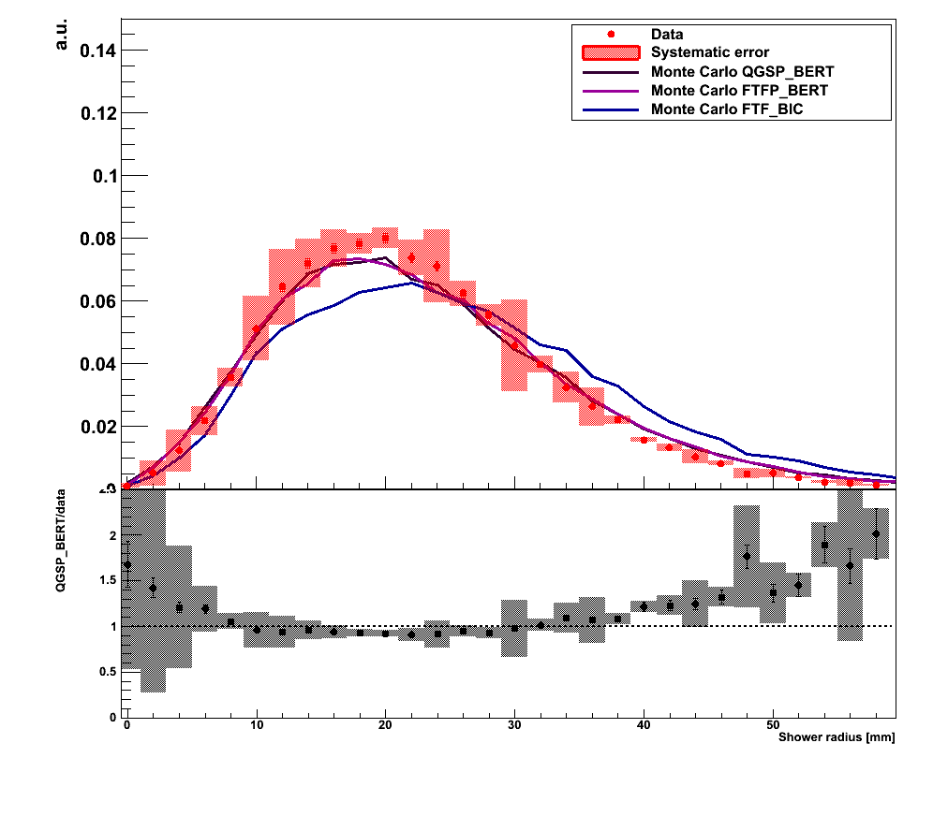
Mean shower radius @4 GeV

Slide 10
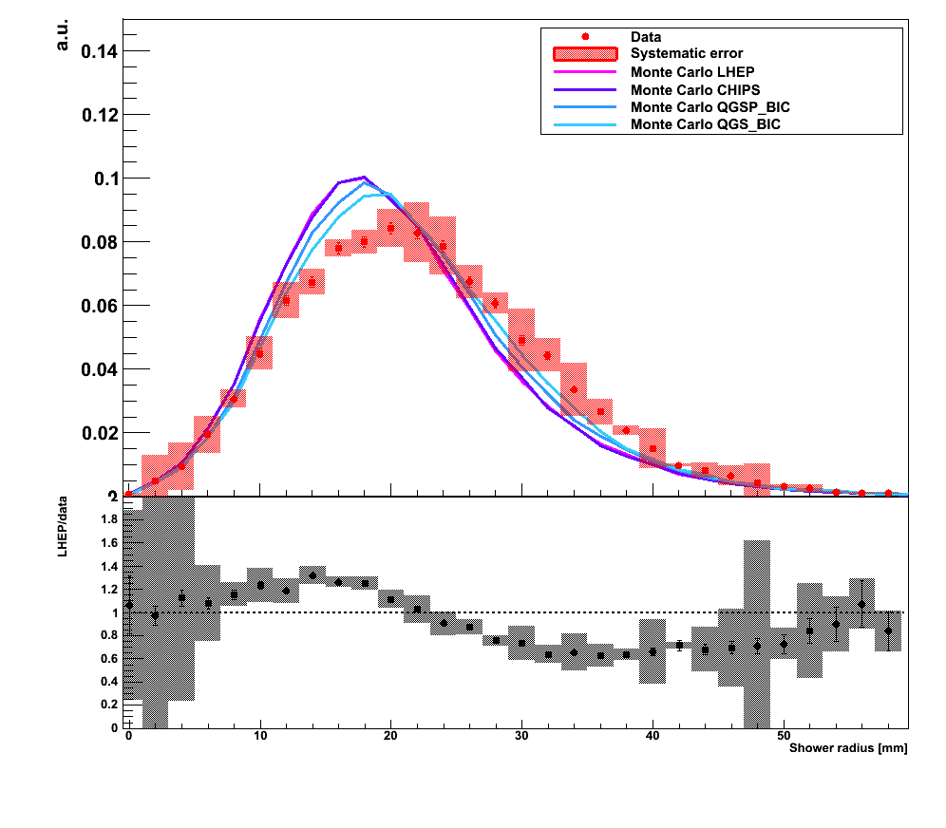
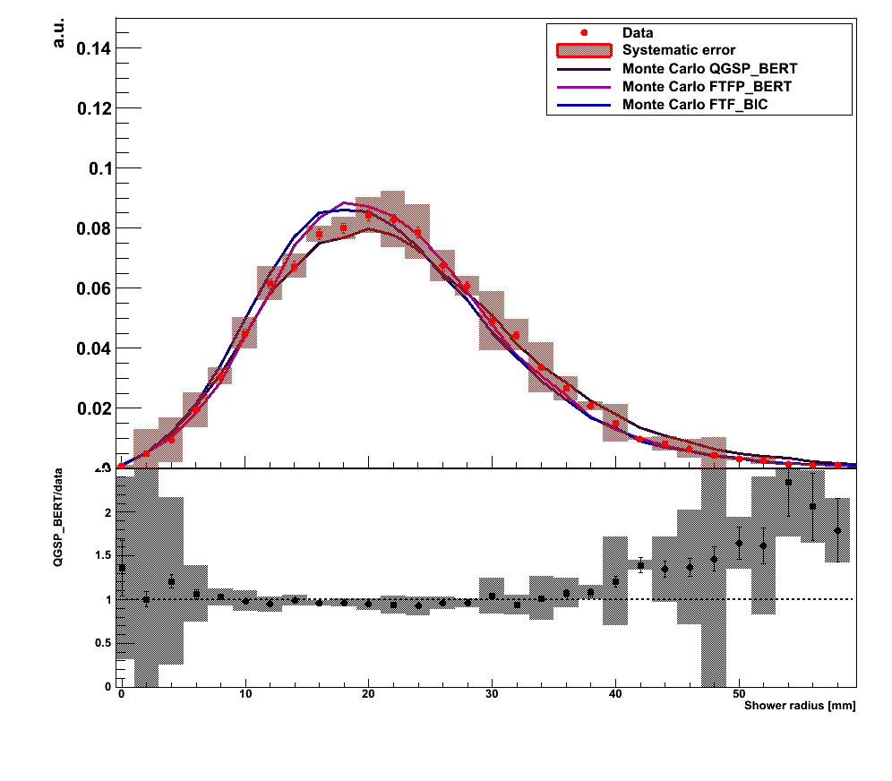
Mean shower radius @6 GeV

Slide 11
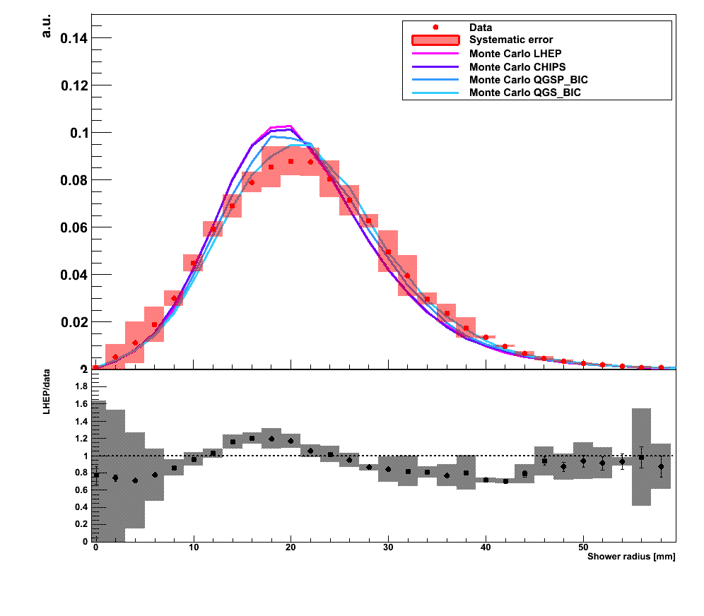
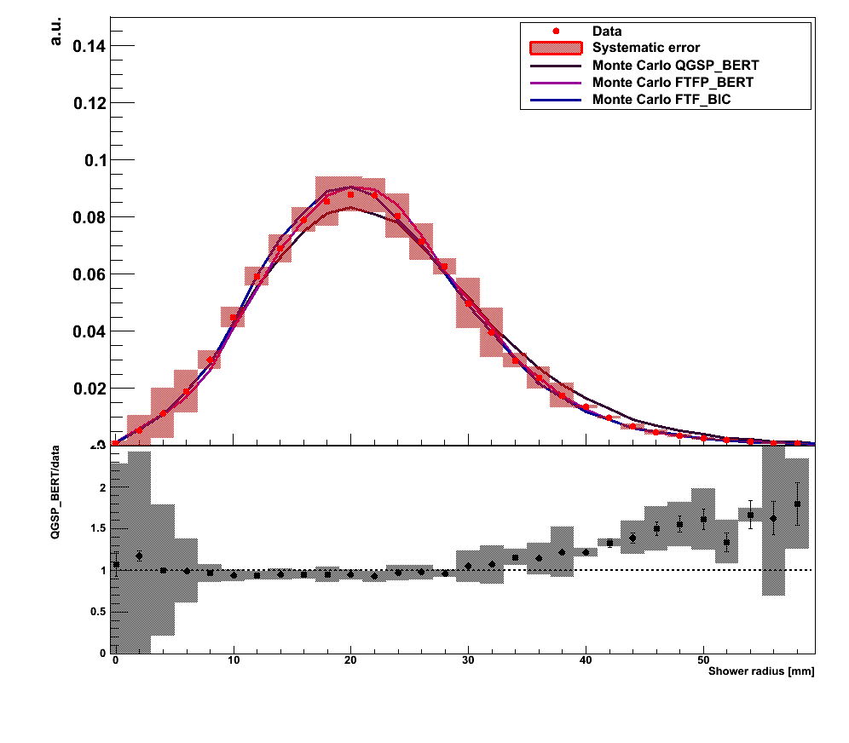
Mean shower radius @8 GeV

Slide 12
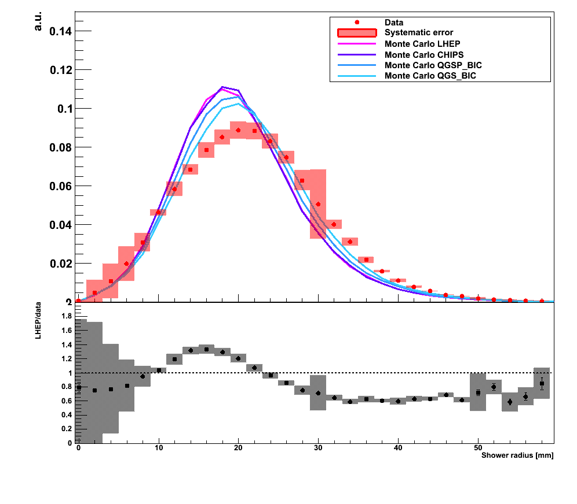
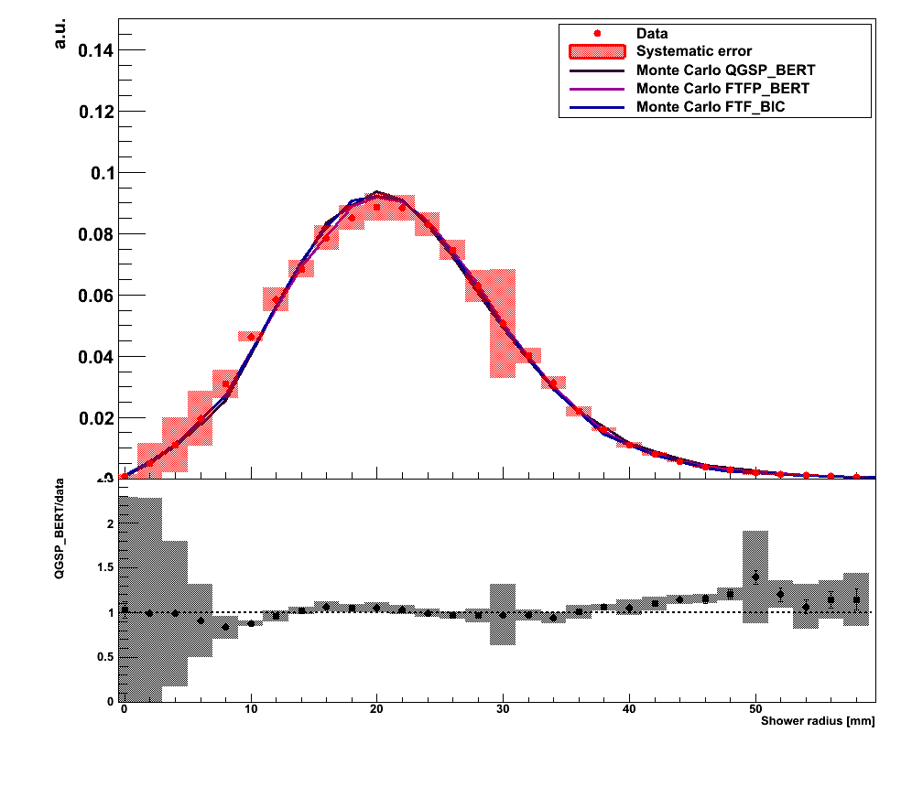
Mean shower radius @10 GeV

Slide 13
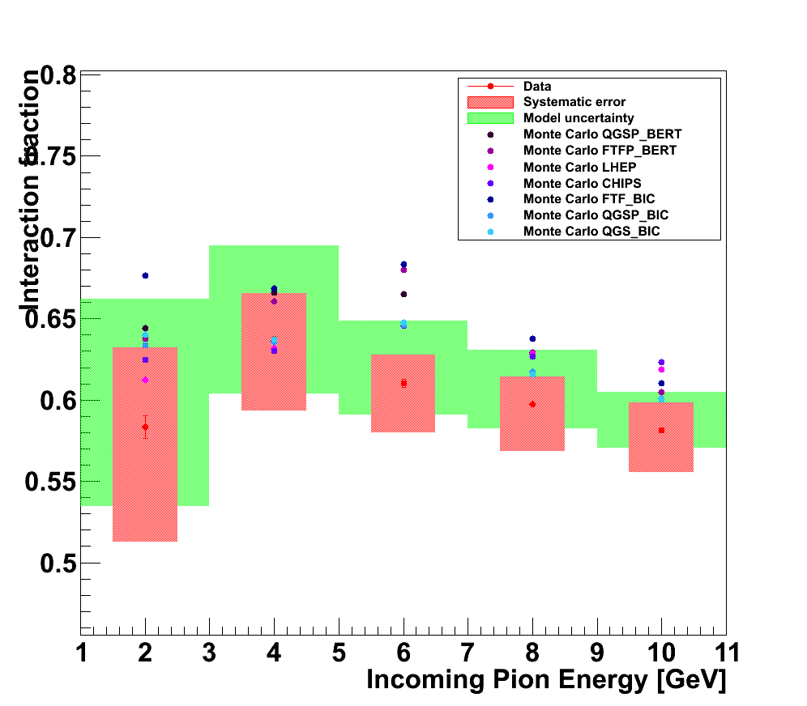
Interaction fraction

