Slide 1
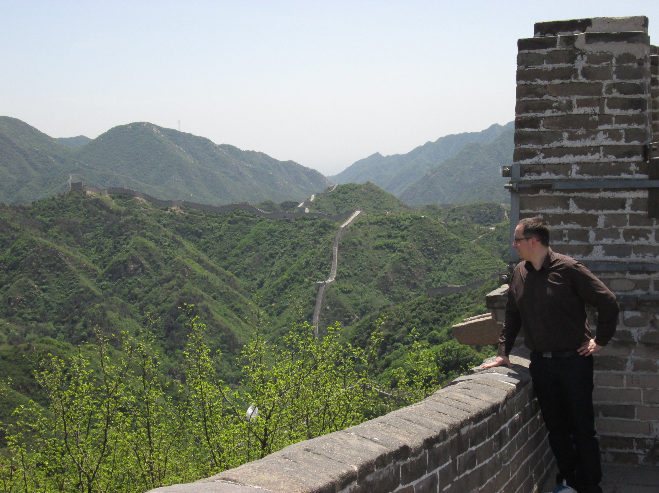
Next developments for MadAnalysis 5 ?
Why do F77 always spoil the landscape ?

Slide 2
Several ideas …
slide 2

Slide 3
Several ideas for new developments
Reinforcing the validation procedure
Histograms in ASCII art → ROOT becomes an optional package
Externalizing the report generator from Python interface
Tutorials
Multijobs @ multilevels
Creating module with particles properties
Improving installation MA5 package + system diagnostic
Interface to Delphes
Optimizing MA5 by using timing and profiling tools
Implementing boosted-top identification (FastJet)
Interface to showering program : Pythia 6, Pythia 8, Herwig 5, Herwig ++
MadAnalysis 4 replaced by MadAnalysis 5 in MadGraph release
Parallelizing the full processing chain
Interface to Rivet
slide 3

Slide 4
Sorting the ideas
User friendly
NLO
Improving installation MA5 package + auto-diagnostic
Histograms in ASCII art → ROOT becomes an optional package
Tutorials & focus
Externalizing the report generator from Python interface
Interface to showering program : Pythia 6/8, Herwig 5/++
Weights in NLO generator (PDF, …)
Multijobs @ multilevels
Optimization
Parallelizing the full processing chain
Using timing and profiling tools
Fast sim
Communication
Interface to Delphes 3.0
Creating module with particles properties
Interface to Rivet
Reinforcing the validation procedure
MA4 fully replaced by MA5 in MG5
Top physics
Interfacing boosted-top algo (FastJet)
slide 4

Slide 5
Validation procedure
Current procedure:
Installing a release from BAZAR repository and setting one of the allowed compilation mode.
3 series of automated tests: checking presence of crash and error display. Policy used: one bug fix → a new test Last of the validation: about 3 hours
Automated tests for checking C++ warnings.
Our needs (1/2):
Checking with other release of g++ / other systems (in particular Mac).
Checking the expert mode: analysis generator + several implementations of typical analysis.
slide 5

Slide 6
Validation procedure
Our needs (2/2):
Checking MA5 behaviour on heavy samples and on long term jobs (1 day). Problem of storage.
Checking MA5 usage with screen.
Checking output file (LHE/LHCO):
Merging mode: Input = output
Jet clustering: comparing simplified LHE file with initial STDHEP/HEPMC files
Checking the analysis reports:
Cut table / sample table (number comparison)
Histograms (statistics comparison or image comparison ???)
Question: how to test tab completion ?
Generating and compile all these information in HTML reports
All this work can be done independently from MA5 development (internship ???)
slide 6

Slide 7
Externalizing the plot layout
Current architecture:
Current issues:
Big installation issue with pyROOT libraries.
Difficulties to handle problems occurred during C++ job treatment.
No report in Expert mode.
Python interface
C++ job
report
Solution: report generator →a stand-alone program questions: C++ or python ? ROOT / Matplotlib ?
Deep change in the software structure
slide 7

Slide 8
“Full processing chain”
MadAnalysis 5 = Super Interface + Configurator
Interface to showering program : Pythia 6/8, Herwig 5/++
5. Interface to Delphes
aMC@NLO
Pythia / Herwig
Delphes
MadAnalysis
Event 1
Event 1
STDHEP
HEPMC
Event 1
Event 1
LHE
ROOT
analysis
Event 2
Event 2
Event 2
Event 2
. . .
. . .
. . .
. . .
Event n
Event n
Event n
Event n
slide 8

Slide 9
“Full processing chain”
MadAnalysis 5 = Super Interface + Configurator
Interface to showering program : Pythia 6/8, Herwig 5/++
5. Interface to Delphes
with the pipe-line structure:
aMC@NLO
Pythia / Herwig
Delphes
MadAnalysis
Event 1
Event 1
Event 1
Event 1
LHE
analysis
Event 2
Event 2
Event 2
Event 2
. . .
. . .
. . .
. . .
Event n
Event n
Event n
Event n
slide 9

Slide 10
Parallelizing the processing chain
The simplest method:
Distributing the input files on several cores :
Dividing N files by n cores
Number of files sent to a core depend on the disk size
More sophisticated technique:
Split file into several files (gain of time ?)
Optimizing inline the parallelization in order to take into account : core avaibility,
sample contents,
sample format,
location of the file.
Done by PROOF
How ?
Several possible libraries: POSIX threads, ROOT threads (POSIX)
Boost threads, OpenMP, …
slide 10

Slide 11
Parallelizing the processing chain
 | POSIX | Boost | OpenMP
Installation | Usually included in Linux distributions. | Known and installed by C++ developers (but not by theorists) | To be installed
Portability | Some difference between Unix & MacOSx. No Windows. ROOT fixes portability problems. | Full | Full
Level | Low | Medium | High
Management | Manual management | Automated system | Automated system
Best performances must be obtained with POSIX if properly used !
slide 11

Slide 12
Multijobs @ multilevels
Goals:
Defining several analyses @ any levels of sophistication (parton, shower, reco).
Defining several output (LHE, LHCO).
Using different clustering algorithms or settings.
Defining filters
in a same job
This functionality in the expert mode:
→It is available since 1.1.6 but nobody knows it.
This functionality in the normal mode:
To be implemented but it is not a piece of cake !
Find a intuitive and user-friendly syntax to do that.
→ Discussion with Benj ongoing ….
slide 12

Slide 13
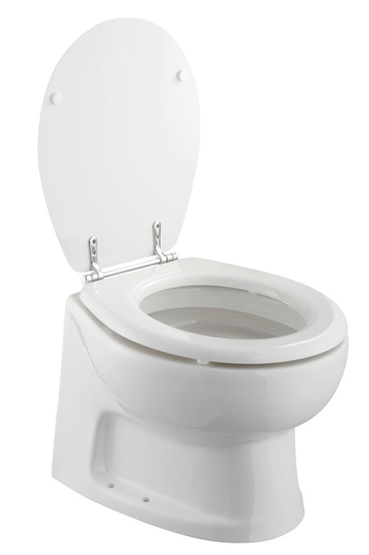
Rejected ideas …
FastSim package in MadAnalysis 5
GUI for MadAnalysis (first attempt by G. Serret)
MadAnalysis on Windows or on cygwin (could be saved from the flush → undergraduate MasterClasses)
Rewritting MadAnalysis in Oberon language (Adam’s ATER ? )
slide 13

Slide 14
Rejected ideas …
FastSim package in MadAnalysis 5
GUI for MadAnalysis (first attempt by G. Serret)
MadAnalysis on Windows or on cygwin (could be saved from the flush → undergraduate MasterClasses)
Rewritting MadAnalysis in Oberon language (Adam’s ATER ? = JOKE)
slide 14

Slide 15
Defining priorities…
slide 15

Slide 16
Different kinds of users
Kind users &students
Fabio and co
(MadGraph/aMC@NLO)
BATS
slide 16

Slide 17
Sorting the ideas
User friendly
NLO
+2
Improving installation MA5 package + auto-diagnostic
Histograms in ASCII art → ROOT becomes an optional package
Tutorials & focus
Externalizing the report generator from Python interface
Interface to showering program : Pythia 6/8, Herwig 5/++
Weights in NLO generator (PDF, …)
Multijobs @ multilevels
+2
Optimization
Parallelizing the full processing chain
Using timing and profiling tools
Fast sim
Communication
Interface to Delphes 3.0
Creating module with particles properties
Interface to Rivet
Reinforcing the validation procedure
MA4 fully replaced by MA5 in MG5
Top physics
Interfacing boosted-top algo (FastJet)
slide 17

Slide 18
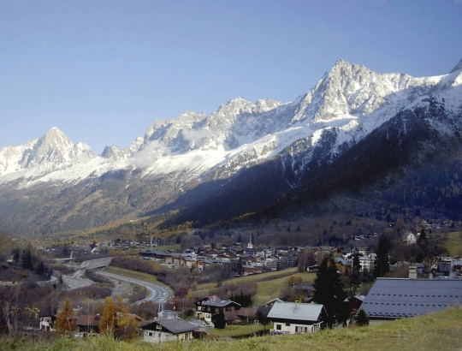
Les Houches workshop
Tasks could be considered in Les Houches 2013 (second session):
Interface to showering program : Pythia 6/8, Herwig 5/++
Weights in NLO generator (PDF, …)
New formats → 5. Interface to Delphes & 14. boosted-top algo
slide 18

Slide 19
Summary
List of the priorities:
slide 19

