Slide 1
GIT ("personne pourrie" en argot britannique)
End of CVS at Cern
CMSSW code will be hosted on github.com
Users free to choose GIT/svn and the hosting site for their code
My choice : host my code at Cern with GIT
personnal preference to use a server from a lab
possibility to have a restricted access

Slide 2
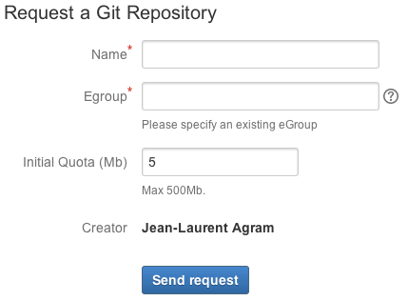
Create a GIT repository @ Cern
go to https://cernforge.cern.ch/cernforge/ to request a repository
info needed :
repository name
egroup name (can be changed later,
but I don’t know how)
initial quota (default is 5MB, max 500MB)
egroup :
used usually for mailing lists
used here to restrict usage of repositery
best is probably to create a new one and add the other code users to it. (do this step before asking for the rep.)
https://e-groups.cern.ch
https://espace.cern.ch/e-groups-help/Users%20Guide/Overview.aspx

Slide 3
CVS2GIT
Recipe to move your code from CVS to GIT with all its history http://cms-sw.github.io/cmssw/usercode-faq.html
First part of the recipe (cvs2git) worked for me with CMSSW_5_3_11 on lxplus6 (slc6)
> create 2 local files containing the cvs code history
Second part of the recipe had to be adapted (import everything to git)
Tags will not be converted. But in GIT each commit is considered as a global tag.

Slide 4
Import the code into GIT rep.
Recipe :
git clone https://:@git.cern.ch/kerberos/MY_REP
cd MY_REP
cat ../git-blob.dat ../git-dump.dat | git fast-import
git config http.postBuffer 524288000
git push -u origin master
Now everything is sent to GIT. You can check it here : https://git.cern.ch/web/
But your local directory MY_REP is still empty !!
(Remove it and) redo git clone https:….MY_REP .
Now everything is fine
checkout the GIT rep.
use files created by cvs2git
and send the code to GIT

