Slide 1

Scintillating Bolometers –
Rejection of background due to standard two-neutrino double beta decay
D.M. Chernyak ^{1,2}, F.A. Danevich², A. Giuliani¹,
M. Mancuso¹, C. Nones³, E. Olivieri¹, M. Tenconi¹, V.I. Tretyak²
¹ Centre de Spectrometrie Nucleaire et de Spectrometrie de Masse, Orsay, France
² Institute for Nuclear Research NASU, Kyiv, Ukraine
³ Service de Physique des Particules, CEA-Saclay, F-91191 Gif sur Yvette, France

Slide 2
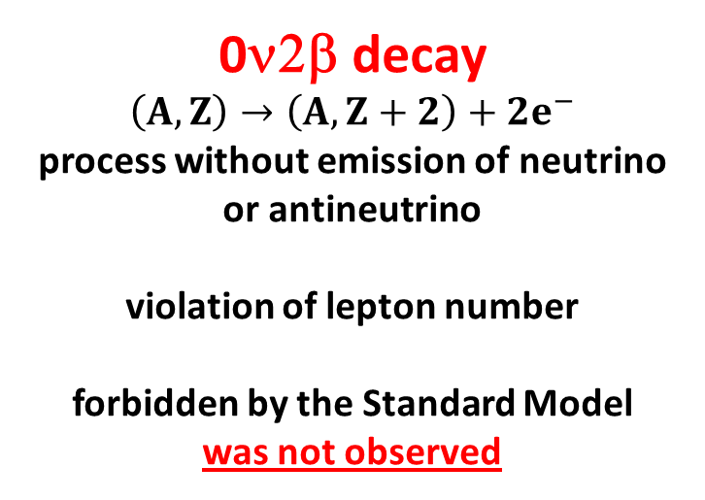
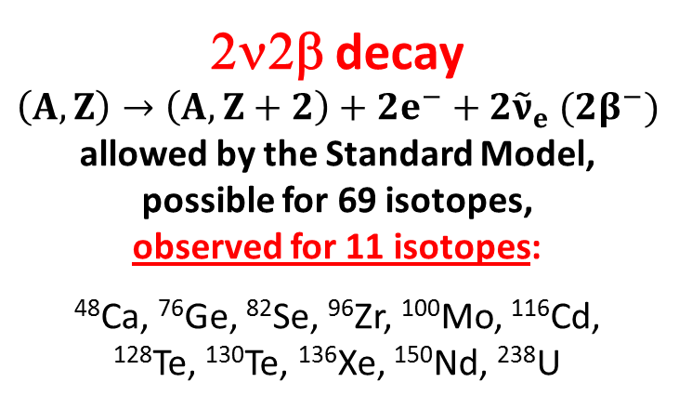
Double beta decay (2β) is a rare nuclear transition which changes the nuclear charge by two units.
Motivation to study the 2β decay
2ν2β decay
$$\left(A,Z\right)→\left(A,Z+2\right)+2e^{−}+2{\tilde{ν}}_{e} (2β^{−})$$
allowed by the Standard Model, possible for 69 isotopes,
observed for 11 isotopes:
⁴⁸Ca, ⁷⁶Ge, ⁸²Se, ⁹⁶Zr, ¹⁰⁰Mo, ¹¹⁶Cd,
¹²⁸Te, ¹³⁰Te, ¹³⁶Xe, ¹⁵⁰Nd, ²³⁸U
0ν2β decay
$$\left(A,Z\right)→\left(A,Z+2\right)+2e^{−}$$
process without emission of neutrino
or antineutrino
violation of lepton number
forbidden by the Standard Model
was not observed
Observation of 0ν2β:
      prove the lepton number violation
      establish the Majorana nature of the neutrino
      determine of the absolute scale of neutrino masses

Slide 3
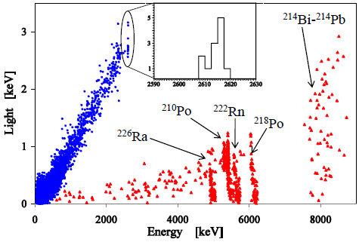
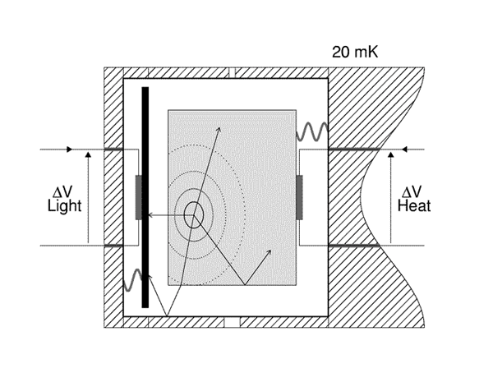
Cryogenic scintillating bolometers
High energy resolution (≈ 4-7 keV @ 2615 keV)
High detection efficiency (80–90)%
Excellent α/β discrimination
Energy resolution 5.6 keV for 2615 keV
Optical detector
(Ge disk)
Scintillating crystal
βγ
30 mK
α
ZnMoO₄
Ge-NTD
Ge-NTD
Reflector
(figure from presentation of Pierre de Marcillac)
L. Gironi et al., JINST 5 (2010) 11007

Slide 4

Background from 2ν2β events
T${}_{1/2}^{2ν}(2ν2β)$ = (7.16 ± 0.54)×10¹⁸ y [1]
Excellent energy resolution (< 1%) is mandatory
[1] L. Simard (NEMO-3 Collaboration) J Phys. Conf. Proc. 375 (2012) 042011

Slide 5
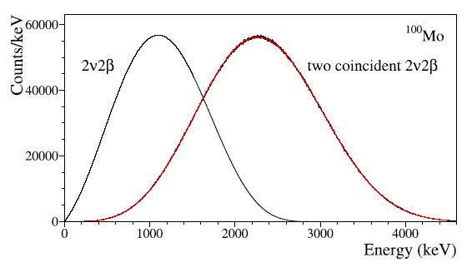
Random coincidence of 2ν2β events
0ν2β
Poor time resolution of scintillating bolometers
Background from random coincidence of 2ν2β events
Pulse shape discrimination of the signals

Slide 6
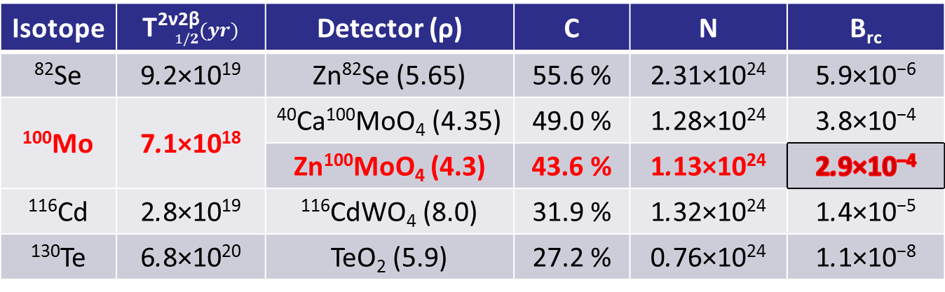
Counting rate of a randomly coincident 2ν2β events
Expected level of background in a region of interest for a future
ZnMoO₄ experiments is ~ 10⁻⁴ counts/(keV·kg·yr)
Isotope | T${}_{1/2}^{\text{2}\text{ν}\text{2}\text{β}}{(yr)}$ | Detector (ρ) | C | N | B_{rc}
⁸²Se | 9.2×10¹⁹ | Zn⁸²Se (5.65) | 55.6 % | 2.31×10²⁴ | 5.9×10⁻⁶
¹⁰⁰Mo | 7.1×10¹⁸ | ⁴⁰Ca¹⁰⁰MoO₄ (4.35) | 49.0 % | 1.28×10²⁴ | 3.8×10⁻⁴
 |  | Zn¹⁰⁰MoO₄ (4.3) | 43.6 % | 1.13×10²⁴ | 2.9×10⁻⁴
¹¹⁶Cd | 2.8×10¹⁹ | ¹¹⁶CdWO₄ (8.0) | 31.9 % | 1.32×10²⁴ | 1.4×10⁻⁵
¹³⁰Te | 6.8×10²⁰ | TeO₂ (5.9) | 27.2 % | 0.76×10²⁴ | 1.1×10⁻⁸
Random coincident 2ν2β events can be the main source of background
Volume of each detector is 100 cm³. Enrichment of ⁸²Se, ¹⁰⁰Mo, and ¹¹⁶Cd set to 100%, while for Te the natural isotopic abundance (34.08 %) is taken.
C − mass concentration of the isotope of interest
ρ − density of the material (g/cm³)
N − number of 2β candidate nuclei in one detector
B_{rc} − counting rate at Q_{2β} (counts/(keV·kg·yr))
D.M. Chernyak et al., Eur. Phys. J. C 72 (2012) 1989

Slide 7
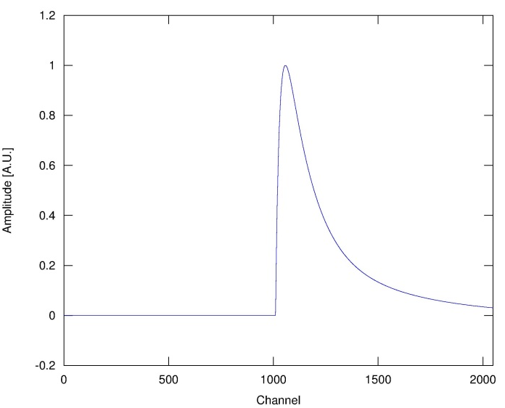
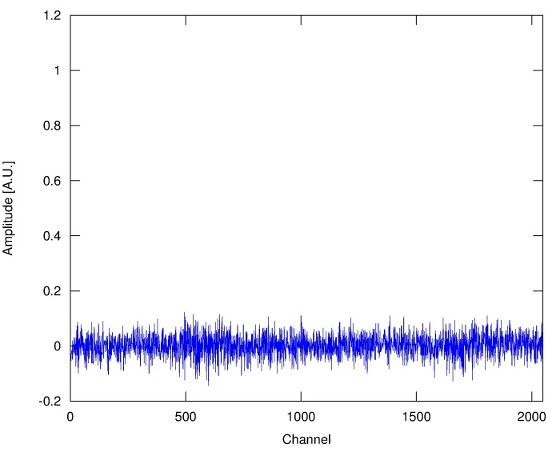
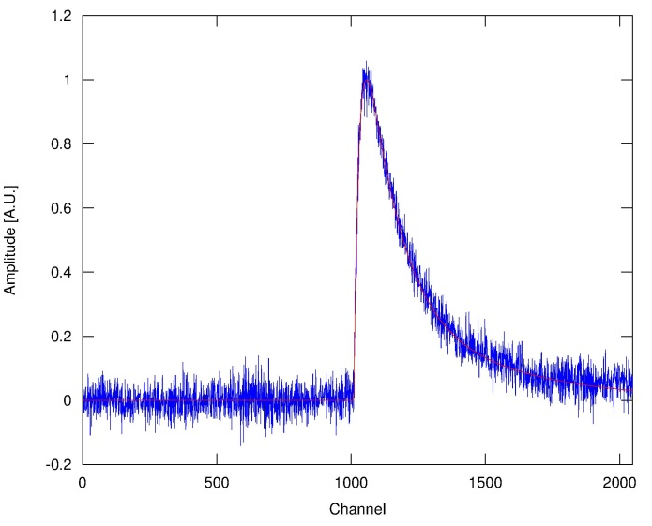
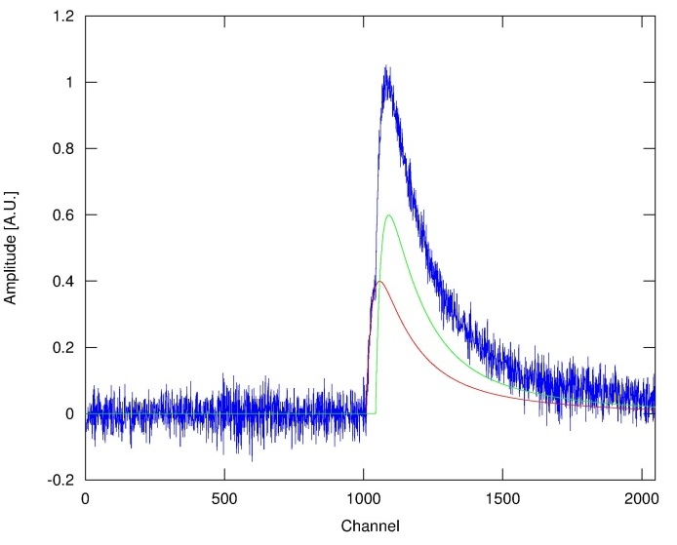
Generator of the pulse profiles
Pulse shapes and noise were used from a real light detector coupled to a 313 g ZnMoO₄ crystal working as a cryogenic scintillating bolometer in LSM (Modane).
Average pulse
Built from a single pulses with energy of ~ 3 MeV
Noise baseline
More than 12000 baselines were used
S/N ratio = 30
(light channel)
Single pulse
Coincident pulse

Slide 8
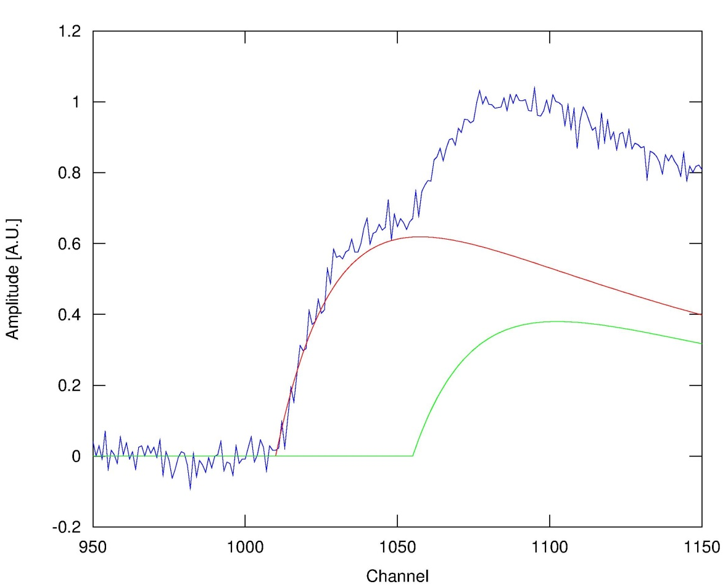
Generator of the pulse profiles
Amplitude of the first pulse A₁ was extracted by sampling the 2ν2β distribution
Amplitude of the second pulse A₂ was chosen as Q_{2β}(¹⁰⁰Mo) − A₁ + ΔE, where ΔE is a random component in the interval [−5, +5] keV.
Coincident pulse
A₁
A₂
Δt = 0-40 ms
10000 single and 10000 coincident pulses were generated
Pairs of pulses were generated with random time distances with a flat distribution up to 40 ms.

Slide 9
Methods for pile-up rejection
Four methods were studied for pile-up rejection:
    Rise-time
    Mean-time
    Optimal filter
    χ²
use an average pulse as a standard shape function
We defined a 95% efficiency in accepting a single pulse from the light detector as a potentially good 0ν2β pulse

Slide 10
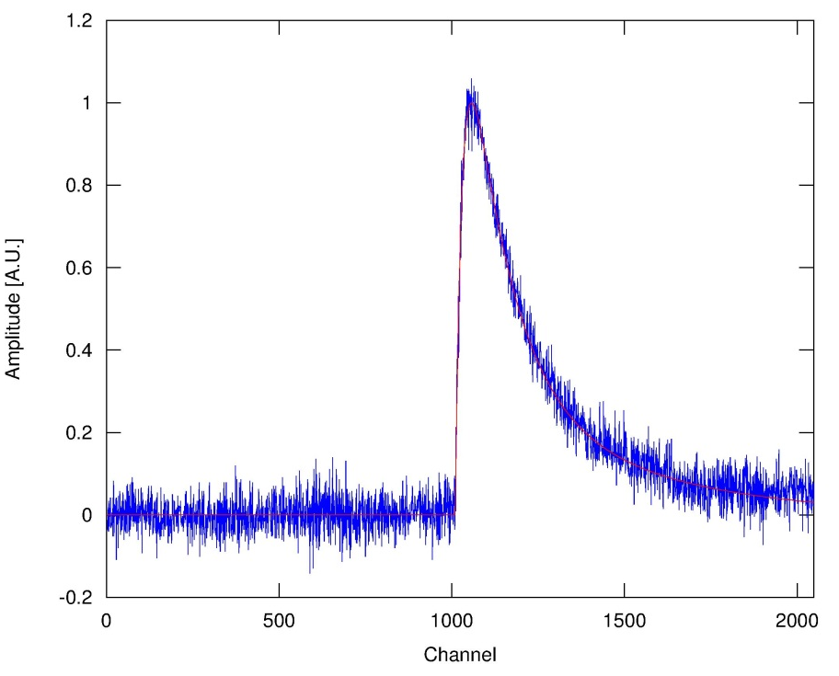
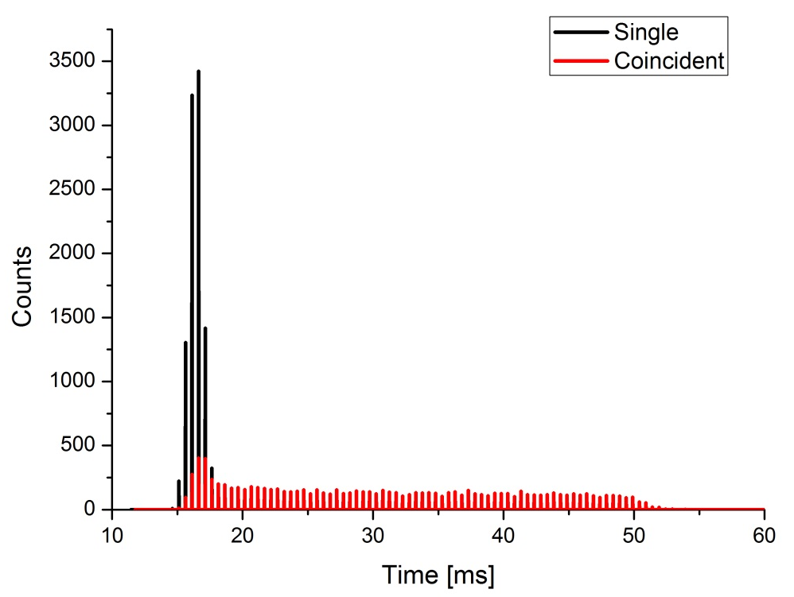
Rise-time method for coincidences discrimination
Calculate baseline and subtract it from a signal
Find maximum amplitude of the signal
Calculate rise-time from X% to Y% of the maximum amplitude for single pulses
Find threshold for the rise-time at the 95% efficiency in accepting a pulse (i.e. rejection efficiency 5%)
Repeat 1-3 for coincident pulses
Find rejection efficiency of the rise-time method
Y
X

Slide 11
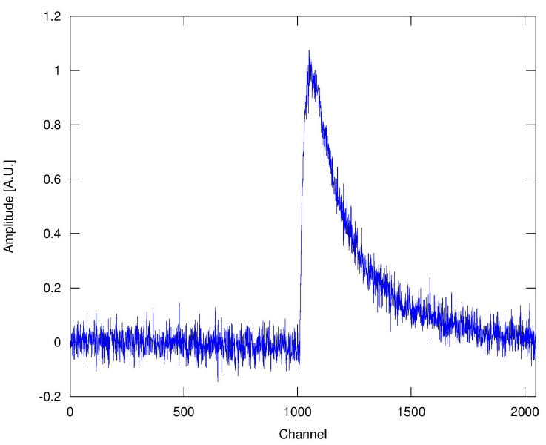
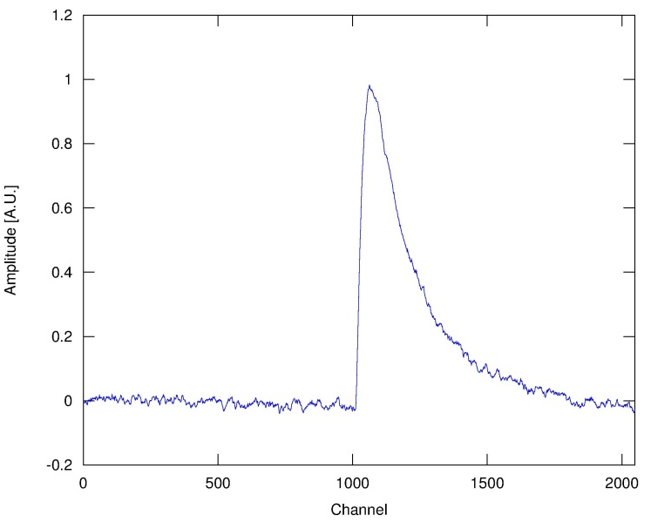
Optimization of the rise-time method
Which shape of the pulse is better for the rise-time criteria: raw or filtered?
Raw pulse
Filtered pulse
?
Shape of the signal | Rise-time calculation interval, % | Rejection efficiency for 10000 generated coincidence events
Raw | 10-90 | 16.5
 | 15-90 | 79.4
 | 20-90 | 73.4
Filtered* | 10-90 | 85.3
 | 15-90 | 82.0
 | 20-90 | 77.9
* Band pass filter was used

Slide 12
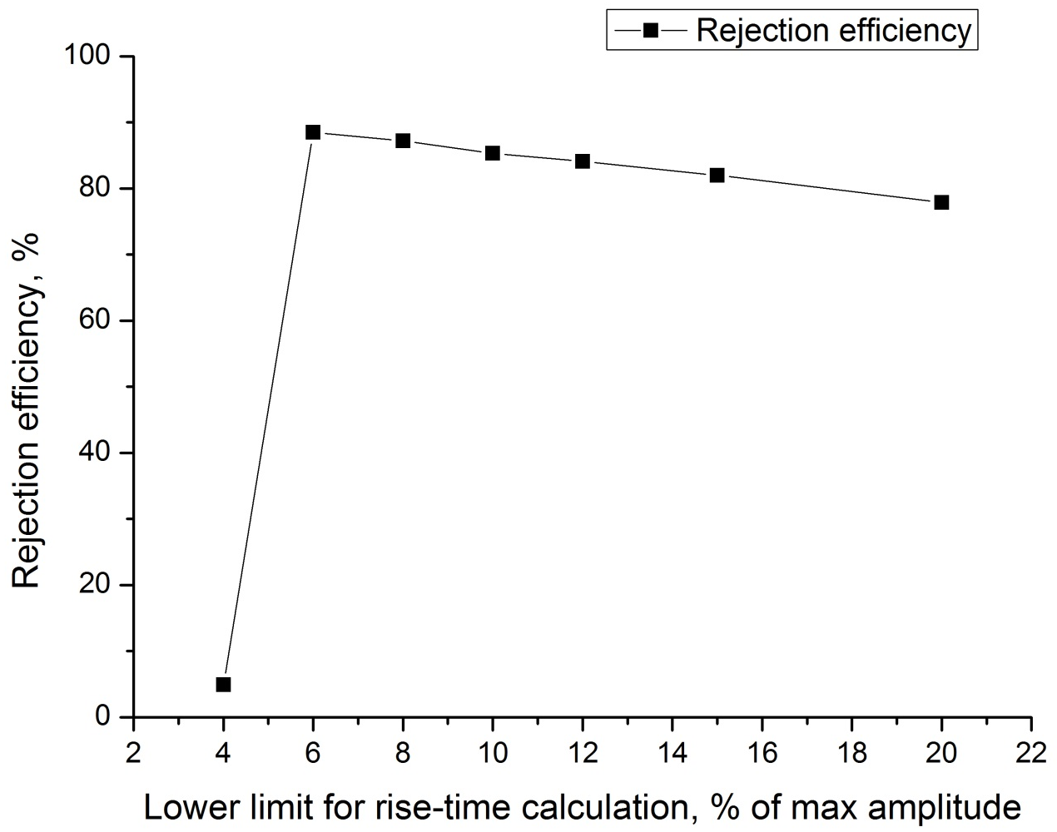
Optimization of the rise-time method
Which rise-time calculation interval gives higher rejection efficiency?
Lower limit for rise-time calculation, % of max amplitude | Rejection efficiency, %
4 | 4,9
6 | 88,5
8 | 87,2
10 | 85,3
12 | 84,1
15 | 82,0
20 | 77,9

Slide 13
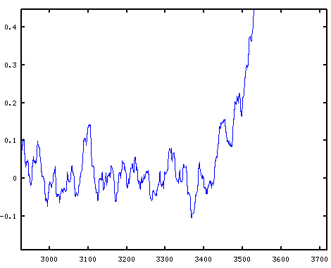
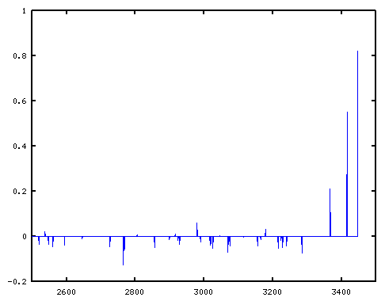
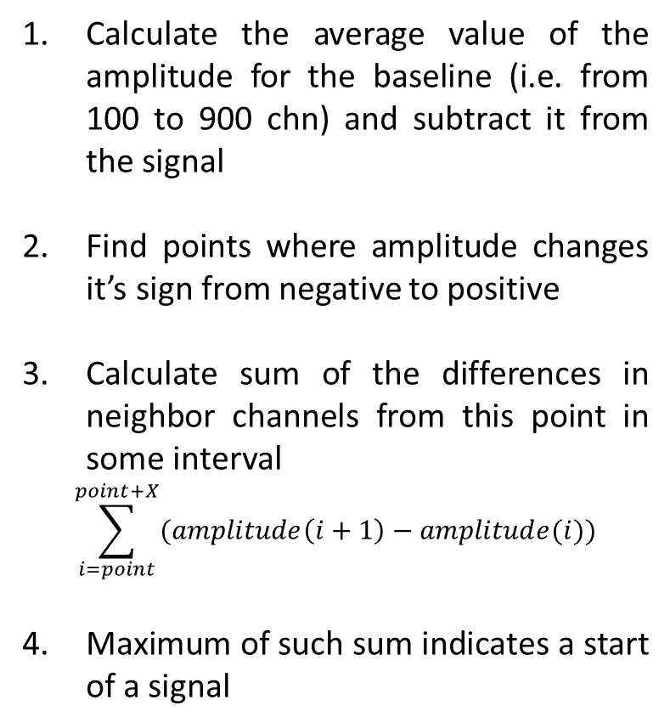
Method to search start of the signal
Calculate the average value of the amplitude for the baseline (i.e. from 100 to 900 chn) and subtract it from the signal
Find points where amplitude changes it’s sign from negative to positive
Calculate sum of the differences in neighbor channels from this point in some interval
$$\sum_{i=point}^{point+X}{(amplitude\left(i+1\right)−amplitude(i))}$$
Maximum of such sum indicates a start of a signal
Amplitude [A.U.]
Σ
Channel

Slide 14
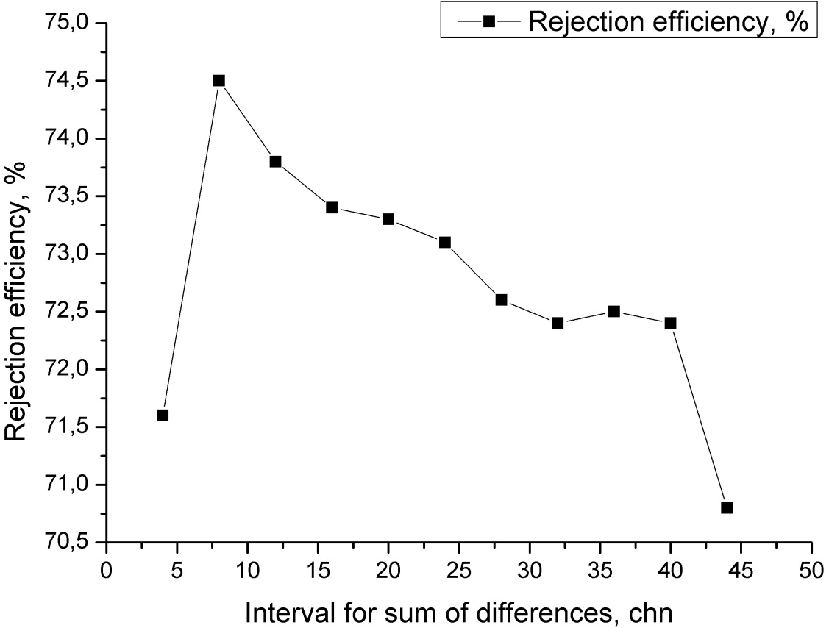
Optimization of the method to search start of signal
Which interval for calculation sum of the differences gives better rejection efficiency?
Interval for sum of the differences, chn | Rejection efficiency for optimal filter method, %
4 | 71,6
8 | 74,5
12 | 73,8
16 | 73,4
20 | 73,3
24 | 73,1
28 | 72,6
32 | 72,4
36 | 72,5
40 | 72,4
44 | 70,8

Slide 15
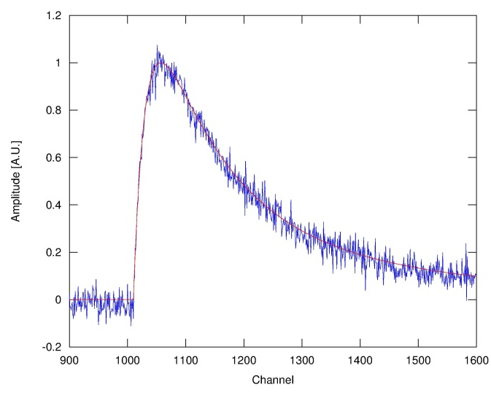
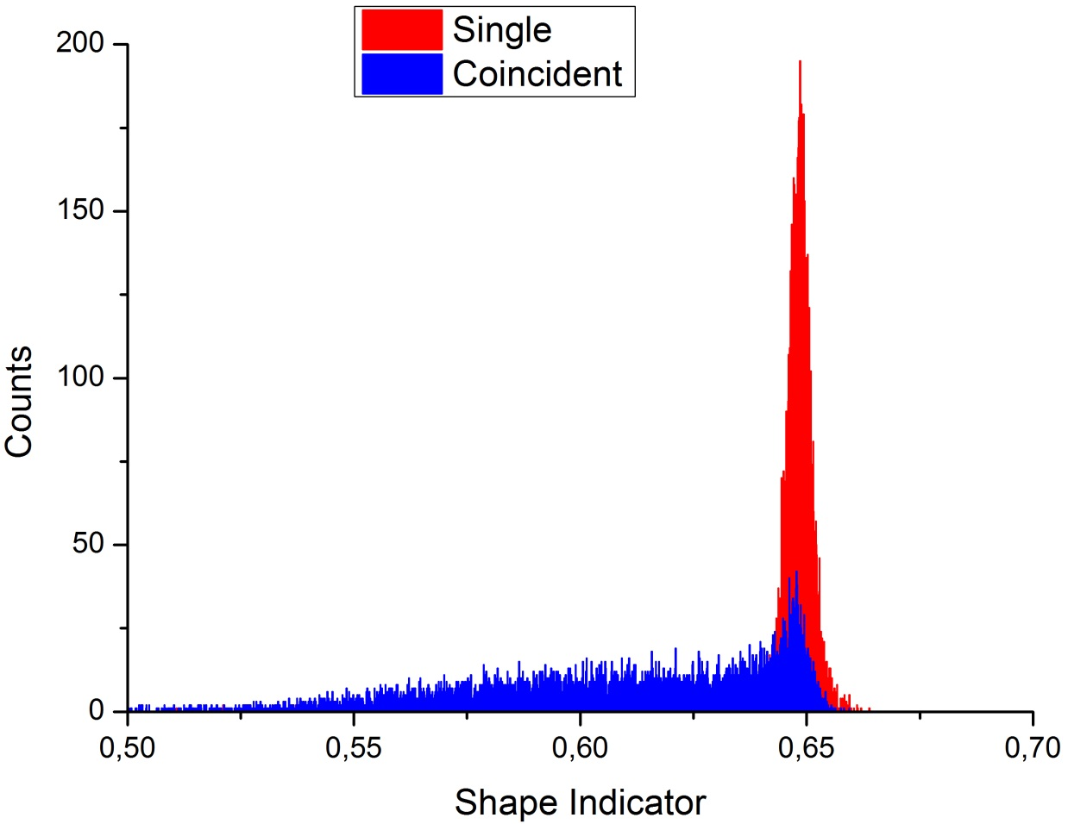
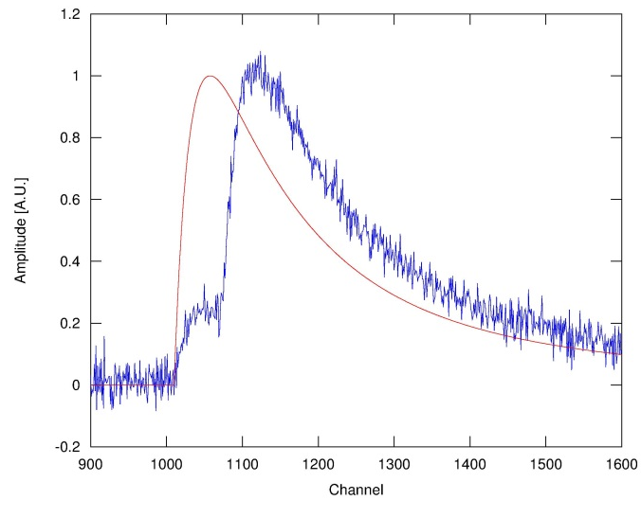
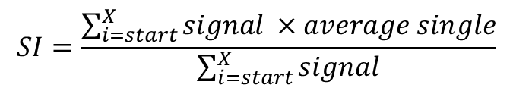
Optimal filter method for coincidences discrimination
Calculate shape indicator from start of the pulse to some X channel as
$$SI=\frac{\sum_{i=start}^{X}{signal ×average single}}{\sum_{i=start}^{X}{signal}}$$
Single pulse
X
start
Amplitude [A.U.]
Coincident pulse
X
start
Channel

Slide 16
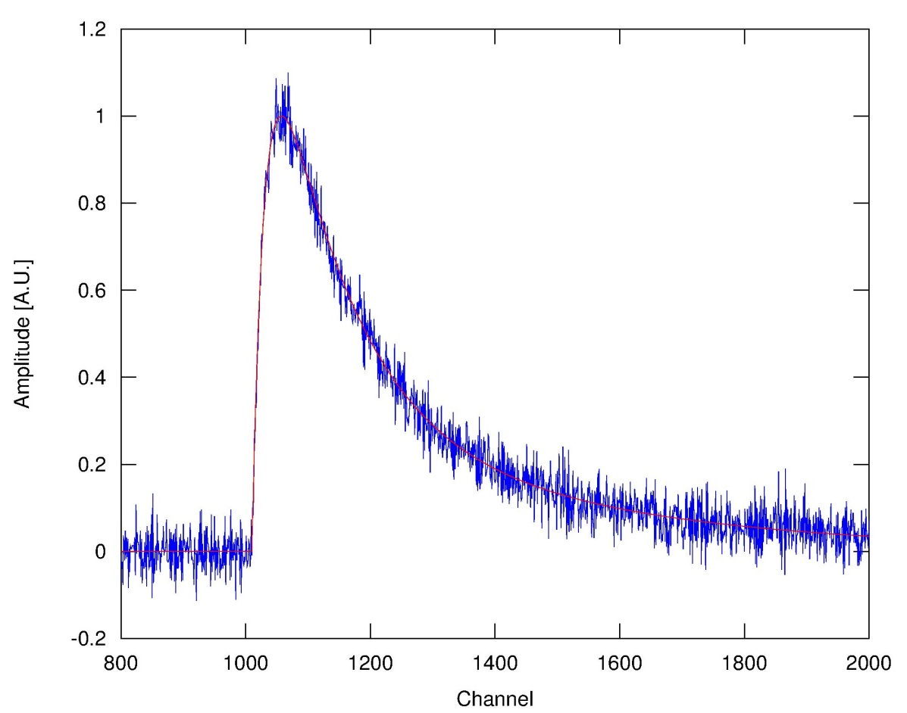
Optimization of the optimal filter method
Which interval for the shape indicator calculation gives better rejection efficiency?
+150 chn
Interval for shape indicator calculation, chn | Rejection efficiency, %
150 | 60,5
200 | 72,0
300 | 80,8
400 | 81,6
600 | 78,5
800 | 74,5
+200 chn
+400 chn
+600 chn
+800 chn
start

Slide 17
Comparison of the methods for pile-up rejection
With 95% efficiency in accepting a single pulses from the light detector as a potentially good 0ν2β pulse
Method | Rejection efficiency, %
Rise-time | 88.5
Optimal filter | 81.6
Mean-time | 90.3
Χ² | 90.4

Slide 18
Comparison of the methods for pile-up rejection
However to check the rejection efficiency “capability” we fixed start of the signal manually at the real start and redo calculations
Method | Rejection efficiency, %
Optimal filter | 82.7
Mean-time | 98.9
Χ² | 97.8
Rejection efficiency can be increased by improving method to search start of a signal

Slide 19
Conclusions
The present bolometric detector technologies enable to control two-neutrino double 2ν2β decay form of background at the required level
Pulse shape discrimination technique allows to reduce background level to 10⁻⁴ counts/(keV·kg·yr) for future ZnMoO₄ experiments
Prospects
Use same methods for heat channel
Combine heat and light channels
Implement code into the data analyzing program

Slide 21
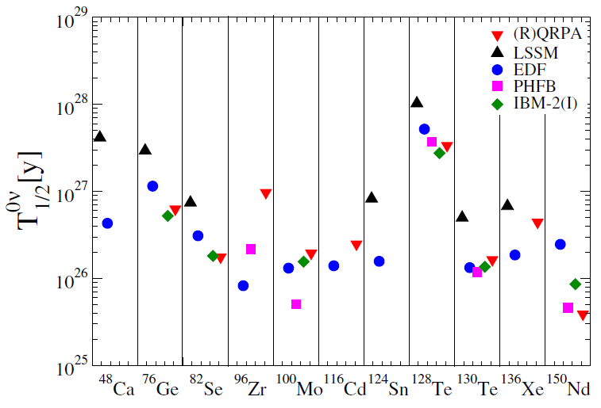

0ν2β decay of ¹⁰⁰Mo
$$\left\langle m\right\rangle =0.05 eV$$
J.D.Vergados, H.Ejiri, F.Simkovic, Rep. Prog. Phys. 75 (2012) 106301

Slide 22
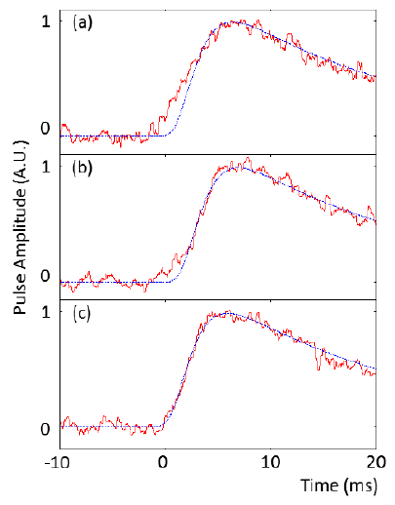
Pulse profiles of scintillating bolometer
Pulses and noise from a ZnMoO₄ scintillating bolometer were used to develop pulse-shape discrimination technique to select random coincident events
pile-up of two pulses shifted by 3 ms with equal amplitude
pile-up of two pulses shifted by 3 ms with amplitude ratio = 4 (the smaller pulse occurs first)
single pulse

Slide 23
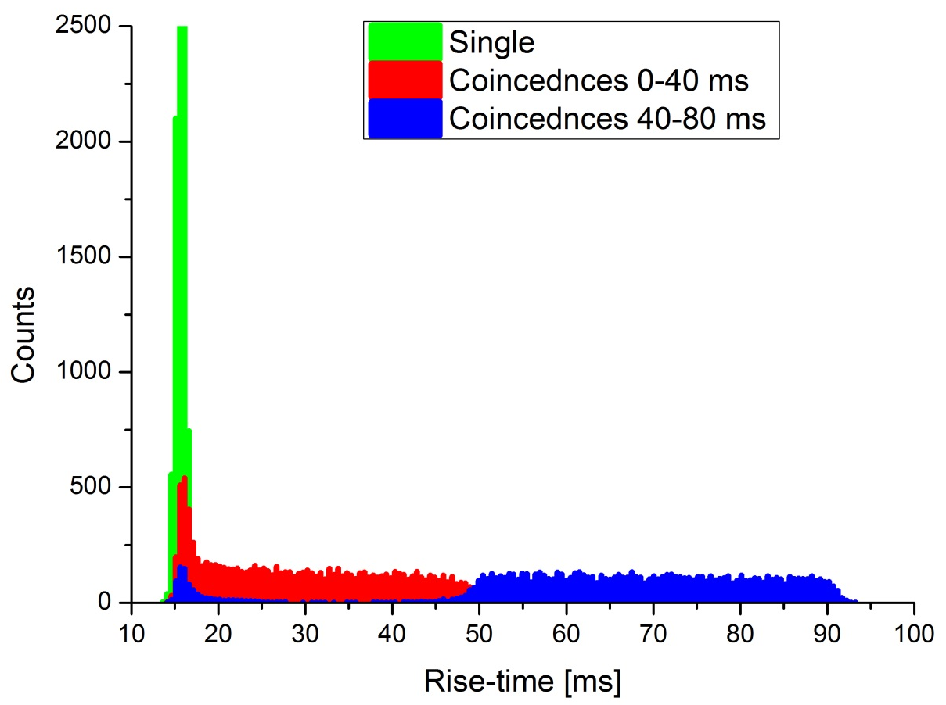
Optimization of the rise-time method
What’s about efficiency of the rise-time method for coincidences with a bigger time between two signals?
Time interval between two coincident pulses, ms | Rejection efficiency, %
0 (single) | 5,0
0-40 | 86,0
40-80 | 95,4
Rise-time was calculated for a filtered pulse from 10% to 90% of maximum amplitude

