Slide 1
3D Detector Simulation with Synopsys TCAD
Journée de la simulation 17/6/2013
V. Gkougkousis1,2, A. Lounis^{1,2}, N. Dinu¹, A. Bassalat^{1,3}
Laboratoire de L'accélérateur Linéaire
Université Paris-SUD XI
CERN

Slide 2
Outline
Introduction
Past advances and future intentions
The tool: Status and capabilities
Genic simulation principals
General Process Flow
Optimization strategies
Implantation models
Concrete cases
Test Diode example
2D IBL single pixel simulation
Full 3D IBL single and multiple pixel geometries
Edgeless Detectors Status
Dopant profile measurements
Conclusions and plans

Slide 3
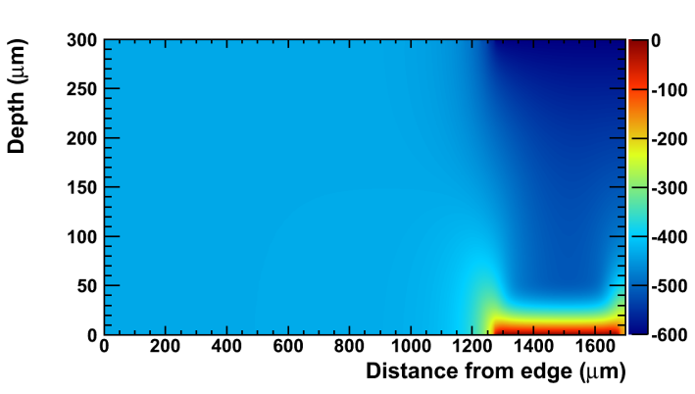
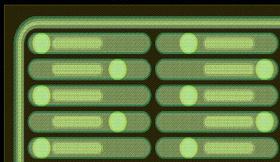
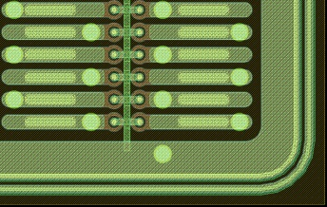
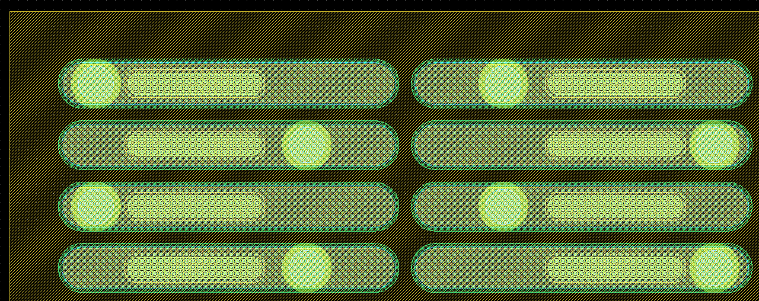
Introduction & Status
Tools
Passing to 3D Simulations
Migrating from SILVACO TCAD to Synopsys
Both process simulation and irradiation model integration
IBL Voltage simulation (600V - 5 x10¹⁵n_{eq}cm⁻²)
Intentions
Radiated IBL structures simulation
Charge sharing and electrical field distributions
Defects modeling and model testing
1 Guard Ring
Validate Edgeless VTT geometry and radiation hardness
Geometry and fabrication process flow simulation
Detailed investigation of electrical field on detector edge
Charge propagation in the substrate and boundary conditions effects
Radiation hardness modeling and simulation
Guard Ring + Bias Rail
No Guard Ring or Bias Rail

Slide 4
Introduction & Status
License
One available license with minimum parallelization
Three on-line license servers required
Managed by LAL, accessible only via intranet
No batch possibility at the moment (lxplus / ccage have no access to licenses)
Multiple instances can be used, up to two per tool
No multithreading support
Status
Portable Linux-based installation
Out-of-the-box functionality
No software dependences
Memory and CPU consuming
Technical support can be an issue
Central Licensing management plus bush capabilities essential

Slide 5
Generic Principals
Create a fabrication process flow to simulate geometry
Associate with corresponding mask directly from GDS files (usually provided)
Introduce the required parameters (dose, energy, implantations)
Set-up an appropriate meshing strategy for the desired application
Set up required re-meshing along the process to speed up simulation
Introduce variables and create multiple experiments
Preview strictures and profiles, feed-in parameters to other tools
-
+
No need for detailed geometry definition
Graphical interphase for speed with command functionality
Comprehensive simulation
Detailed process flow never known
Re-meshing mandatory in each geometry change
Optimized for small scale devices and interface simulation between different materials

Slide 6
Optimising…
The Mesh
Define meshing strategy adapted to the specific geometry with finer cell size in transition regions
Initial mesh valid until geometry change (first deposition, each), define re-meshing strategy before
Avoid thick photosensitive layers since they are even meshed after stripping
Usually simulate fist few microns of substrate wafer and add full silicon thickness at the end
In bilateral processes each flip causes geometry redefinition (no true bilateral integrated)
The model
MC simulation or numerical solution to diffusion differential equations
Number of particles to be simulated and extrapolate
Physical model to be used

Slide 7
Optimizing….
The refinements
Implants energy and dose relative and absolute error
Desired accuracy in concentration determination and profiles
Grid refinements in transition regions (necessary to calculate solutions in dopants)
Request multiprocessing
Implantation Model
Analytic implantation: simple Gaussian/Pearson and dual Pearson functions, based on spatial distribution of ions described by moments depending on species, energy e.c.t. Numerical values given by tables
Monte Carlo method atomistic simulation of ion implantation with Sentaurus MC, or Crystal-TRIM originated from the Transport of Ions in Matter (TRIM) code. Simulates ion implantation into single-crystalline materials or amorphous materials of arbitrary composition

Slide 8
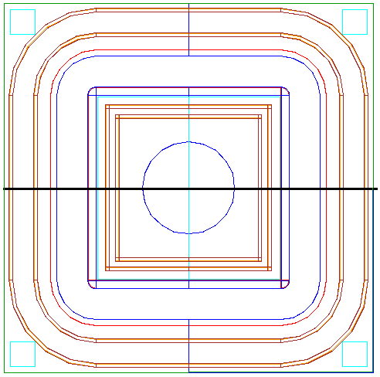
Concrete Cases: Test Diode
Simple geometry
Known dopant profiles
Large structure
Experimental iv curves to compere with simulation
Dimensions 3000 x 3000 μm
No Nitride layer – p-spray
Simulation fails!!!!!
Pros: Simple geometry that allows model testing with simulated process flow No Backside structure
Conns: Very large structure, enormous mesh with numerous cells which depletes available memory (in all platforms)

Slide 9
Concrete Cases: IBL 2D
Complete pixel geometry
Have to start from basic parameters (dopant profiles not exactly known)
Small structure
Experimental iv curves to compere with simulation
Simulation Succeeds!!!!!
Dimensions 250μm wafer thickness x80x25 Complete implantation
Pros: Complicated geometry with multiple layers Backside processing present Have to do front and back side separately and merge results Small size so limited number of grid cells
Conns: Aspects that are not yet completely understood in geometry file 24 hours for first imlantation

Slide 10
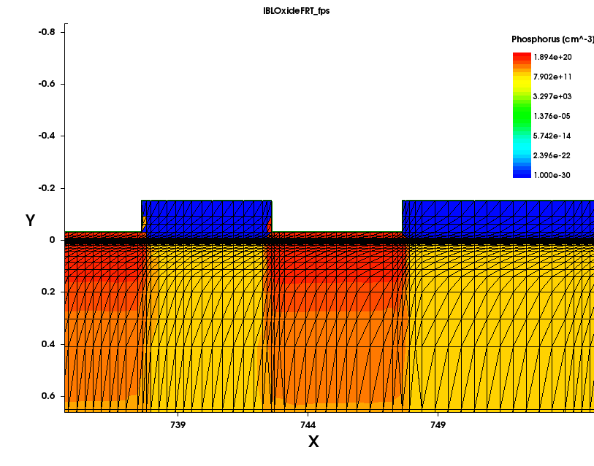
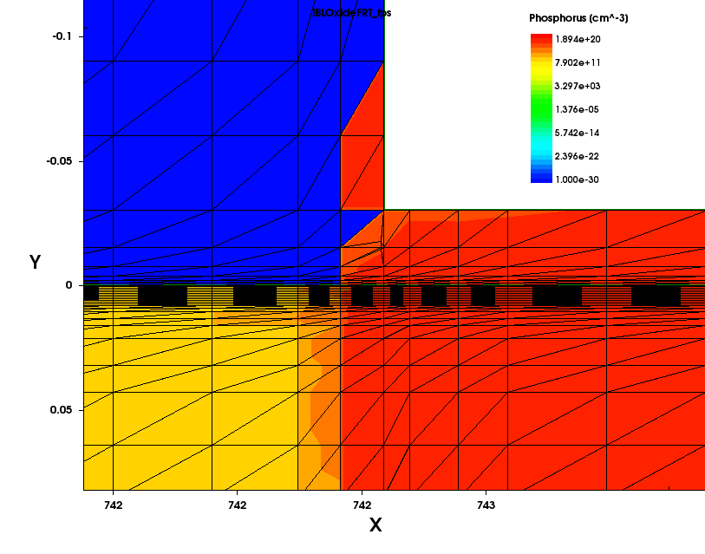
Concrete Cases: IBL 2D
Phosphorus profile
Adaptive meshing in transition regions
Transition region between Si – Oxide layer
Finer meshing in transition region
N profile in 2D IBL pixel simulation on the punch through side.
Wafer is N with concentration of 10¹¹ in the bulk. A thin 30nm Oxide layer remains.

Slide 11
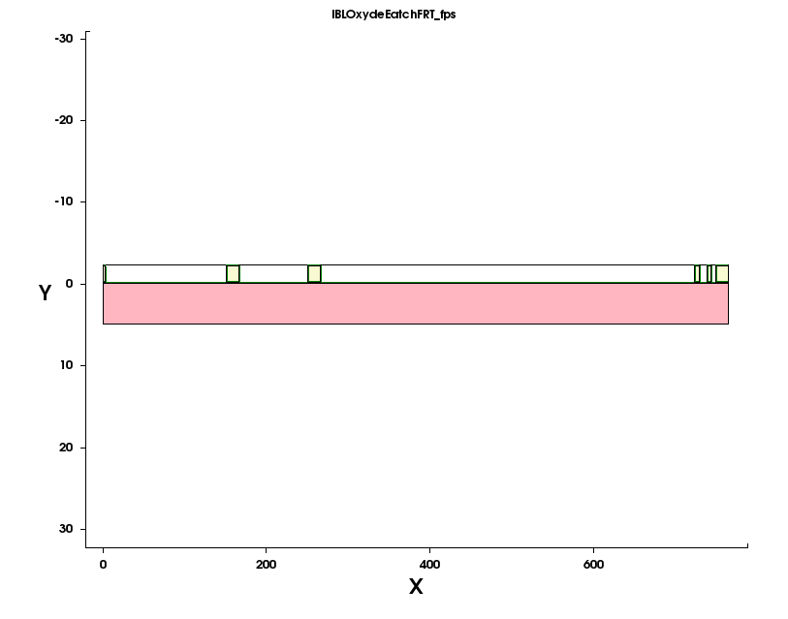
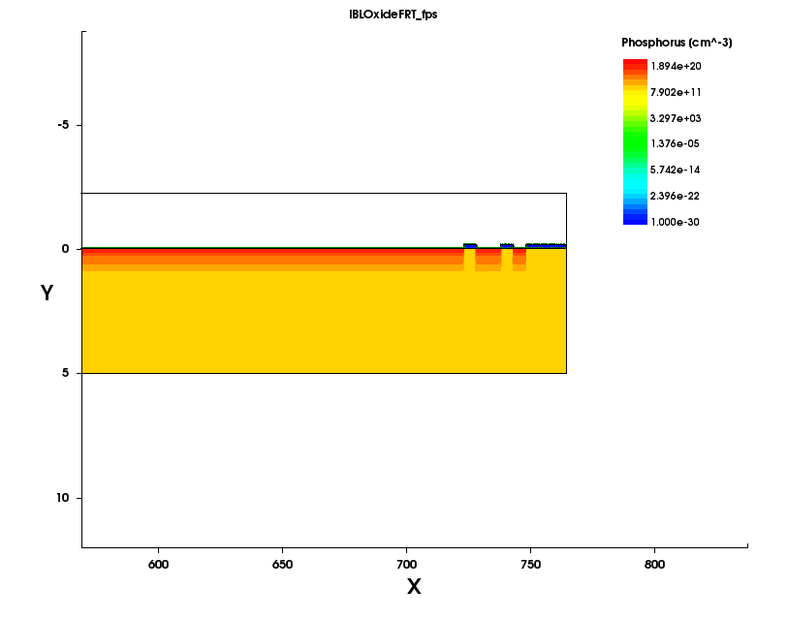
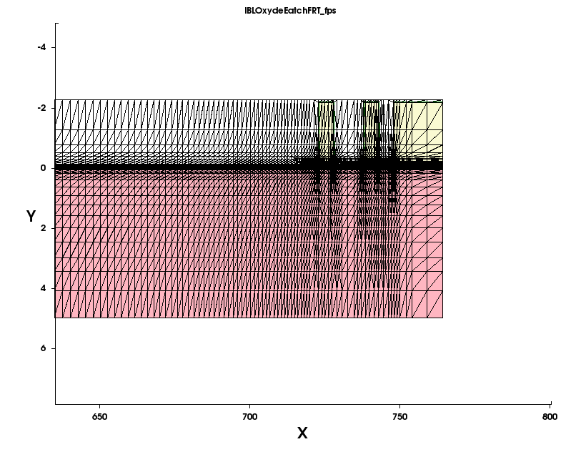
Concrete Cases: IBL 2D
Geometry
Phosphorus profile
Images of the same region of the pixel in the punch through side.
Dimension ration distorted to display surface structures
All 250 μm of the wafer are simulated
Photoresist is present in the upper left plot
Meshing of the photosensitive region

Slide 12
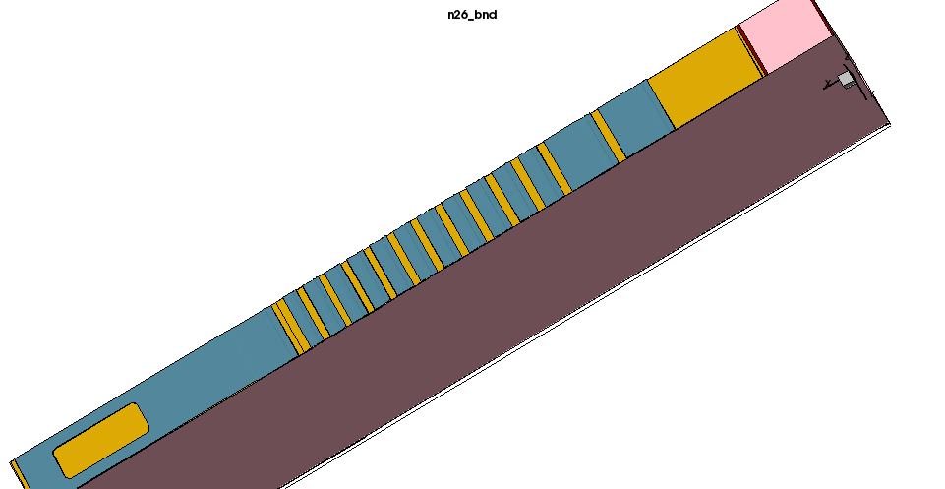
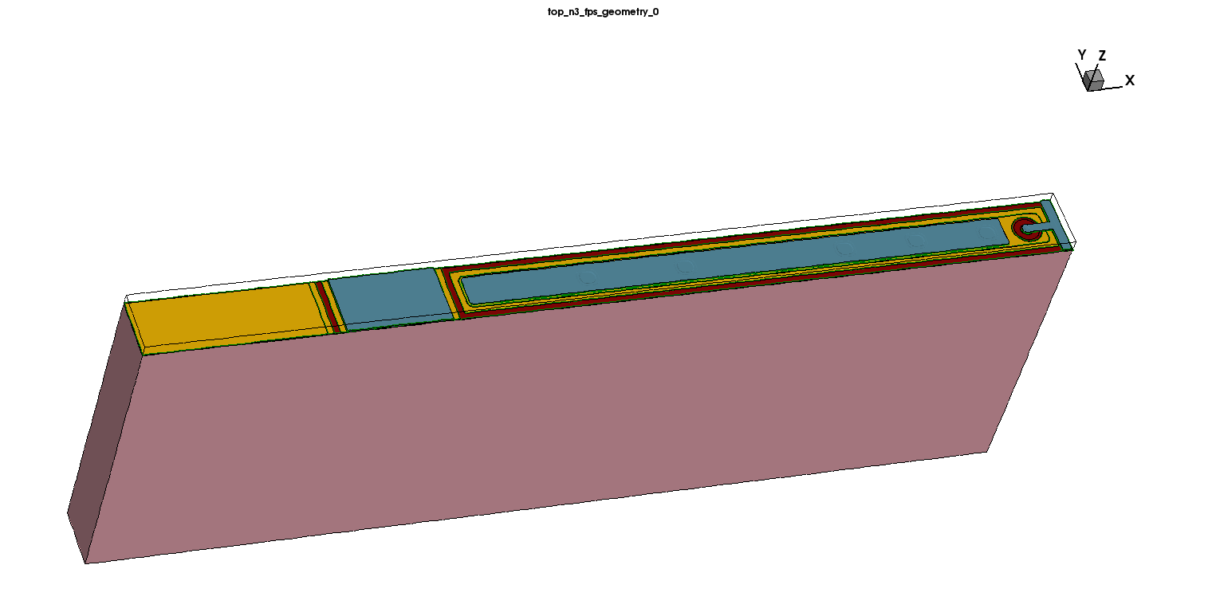
Concrete Cases: IBL 3D
Complete 3D double sided pixel geometry
Use basic parameters (dopant profiles not exactly known)
Full depth substrate simulation
Time of full single pixel run ~ 6h
Bilateral process flow
Process flow with ~50 stages
3 Pixel geometry also available
Carried out with one energy and dose but several scenarios are available

Slide 13
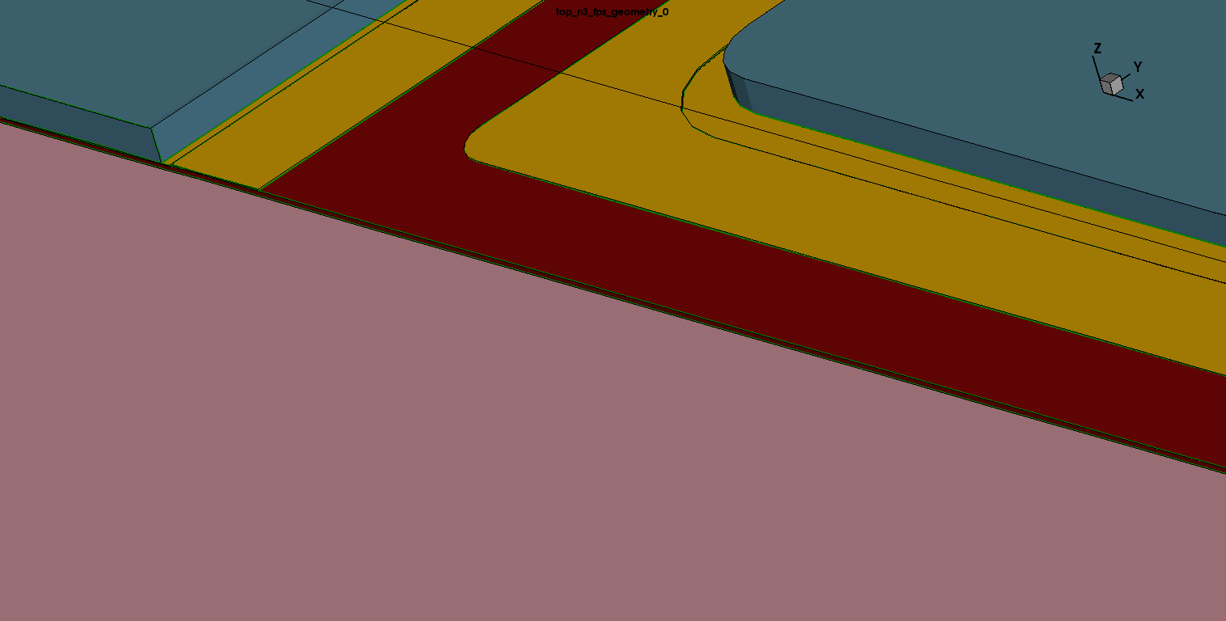
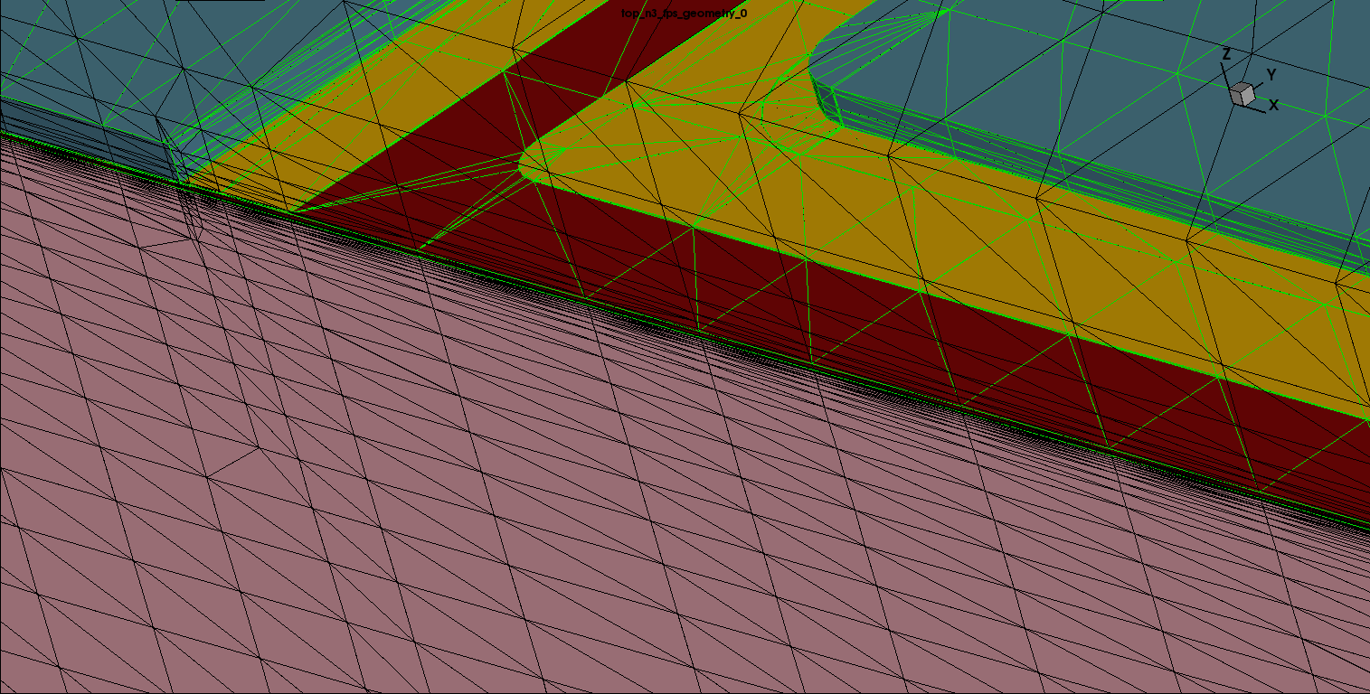
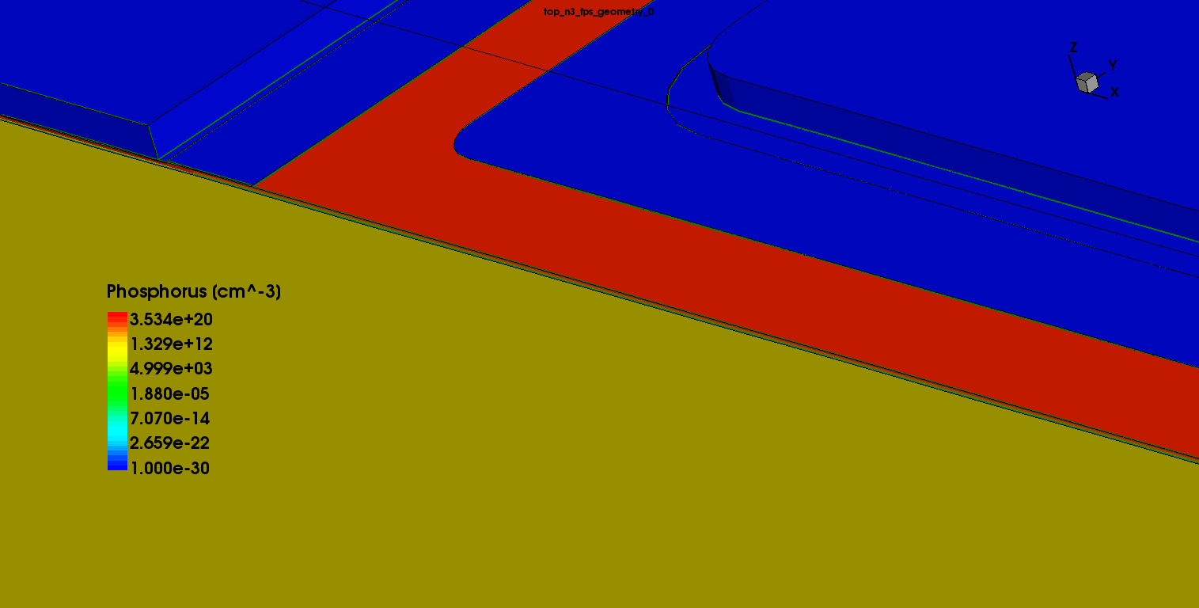
Concrete Cases: IBL 3D
P implant
Geometry
N implant
Meshing strategy
Detail of the p-Spray region between the pixels showing meshing, geometry and implants concentration

Slide 14
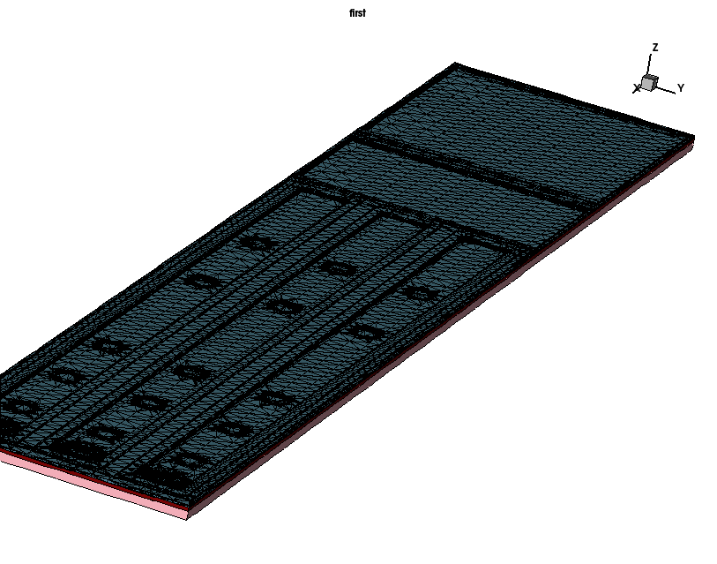
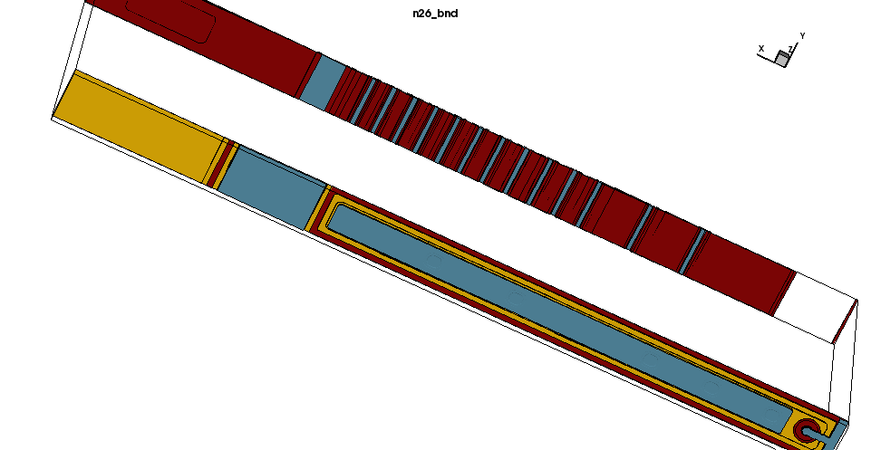
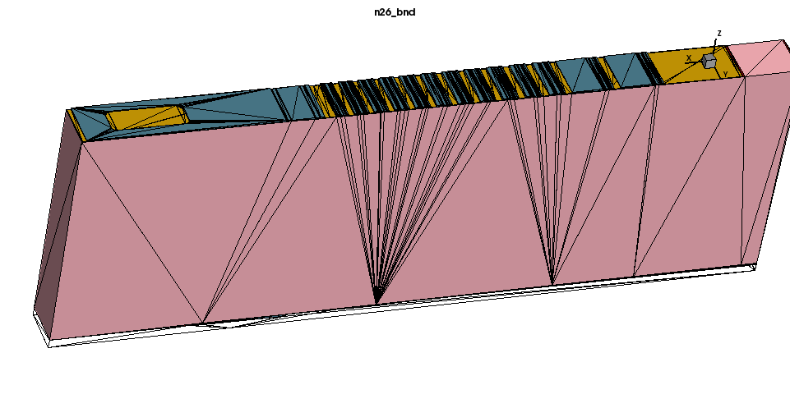
Concrete Cases: IBL 3D
Finer Meshing in the Guard Rings

Slide 15
Default Parameters
Silicon Substrate
Type: n, Phosphorus doped
Orientation: 100
Resistivity 5000Ohm/cm³
Thickness: 250μm (actual depth for simulation 5μm)
Oxide Layer
Isotropic deposition of 150nm
Anisotropic etching with a remaining 20nm layer
Photoresist
2μm isotropic deposition followed by strip etching after development
n Implant
Phosphorus at 60keV, dose of 10¹⁵ particles/cm² with angle of -90⁰

Slide 16
Default Parameters
P Spray
Boron at 100keV, dose of 10¹³ particles/cm² with angle of -90⁰
Annealing
300 minutes at 900 C, pressure of 1atm (literature reference of 3 temperature zones and pressures in the order of 500torr)
Metallization - Passivation
Aluminum contacts formation from isotropic CVD deposit
SiO₂ passivation layer for mechanical and electrical protection (no implication in simulation result)

Slide 17
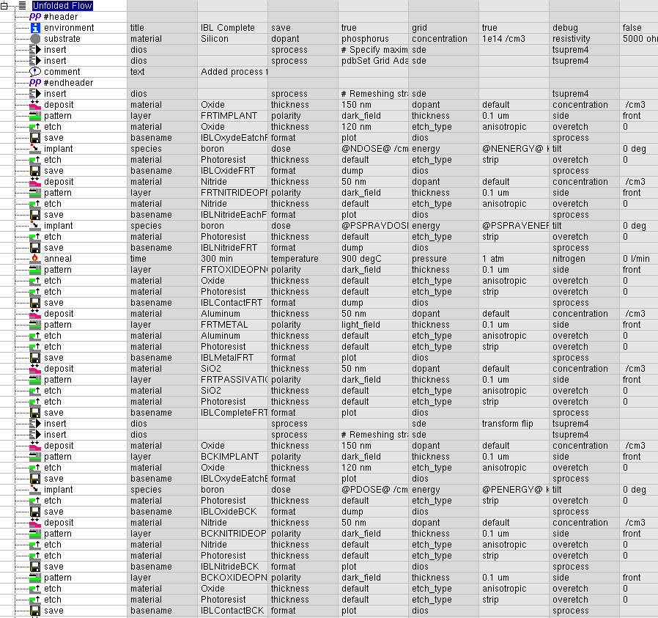
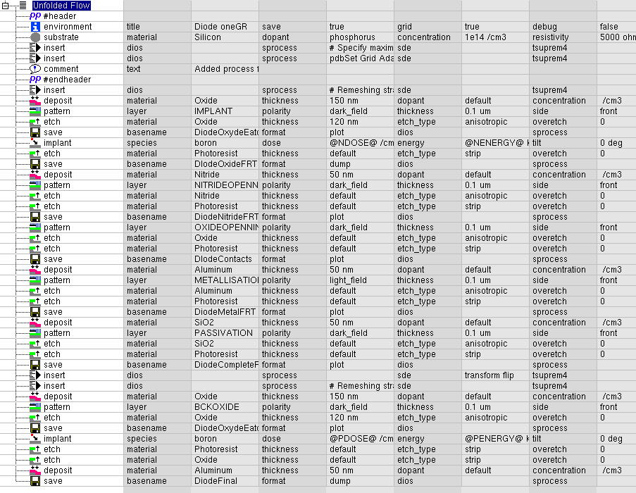
Process Flow Complexity
IBL
Diode
30 steps with 5 macros, no back processing
55 separated steps, various variables and 8 macros

Slide 18
Edgeless Detectors
GDS Files have been provided
Not complete understuding of the fabrication process
Scribe cleaning passivation poses simulation problem
Several efforts are in the way
Contacts in the near future with the industry (hoping to get input and details)
To Do, Effort on the way

Slide 19
Conclusions and plans
Support a central licensing management which would allow multiple instances and parallelization
Compare simulation results with experimental measurement in dopant profiles, charge shearing
Simulate irradiated detectors and describe their behavior in the effort for radiation hardness
Explore alternative geometries for bias rail / bias dot / guard ring structures
Goal to simulate edgeless detectors
likelihood approach for doping profiles to define correct parameters

Slide 20
Backup

Slide 21
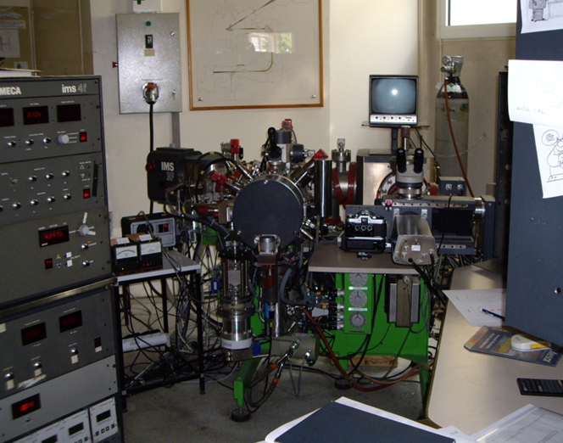
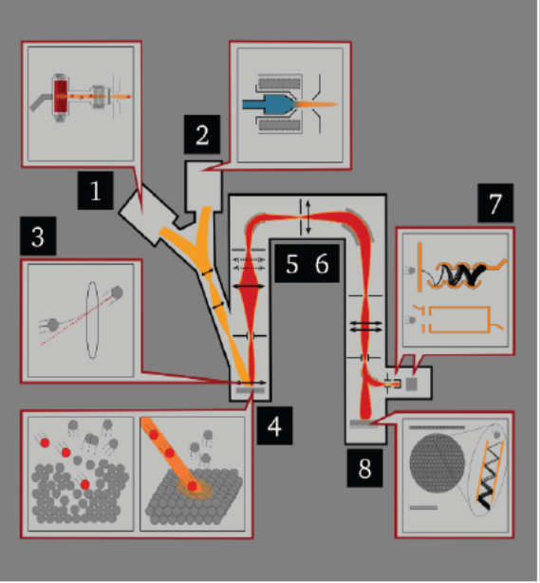
Easily accessible
Analytical technique to characterize the impurities in the surface and near surface (~30μm) region
Relies on sputtering of a primary energetic ion beam (0.5-20 keV) on sample surface and analysis of produced ionized secondary particles by mass spectrometry
Good detection sensitivity for many elements: it can detect dopant densities as low as 10¹⁴ cm⁻³
Allows multielement detection, has a depth resolution of 1 to 5 nm and can give a lateral surface characterization on a scale of several microns
Destructive method, since the act of the removing material by sputtering leaves a crater in a sample
It determines the total dopant density profile
SIMS system @ CNRS-Meudon (Cameca IMS 4F)
Dopants profiles - SiMS

Slide 22
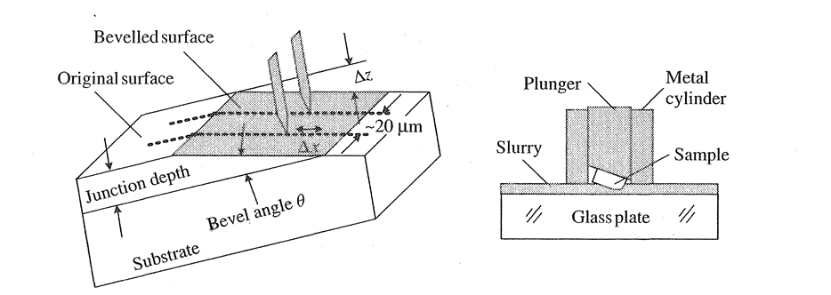
Analytical technique to characterize the majority carrier and active dopant concentration profiles in semiconductor structures
Procedure
Pair of specially conditioned point contact probes which are stepped across the bevel surface of the semiconductor sample
Resistance between two probes is measured at each step
Resulting data computer processed into detailed carrier concentration and resistivity profiles from which dopant concentration profiles can be deduced
Costly Technic carried out by Evans Analytical Group
No full control of used parameters
Development of in-house alternatives
Pros: Very high dynamic range (10¹² – 10²¹ cm⁻³) Capable of profiling very shallow junctions (nm regime)
Conns: Destructive method
Dopants profiles – SRP

Slide 23
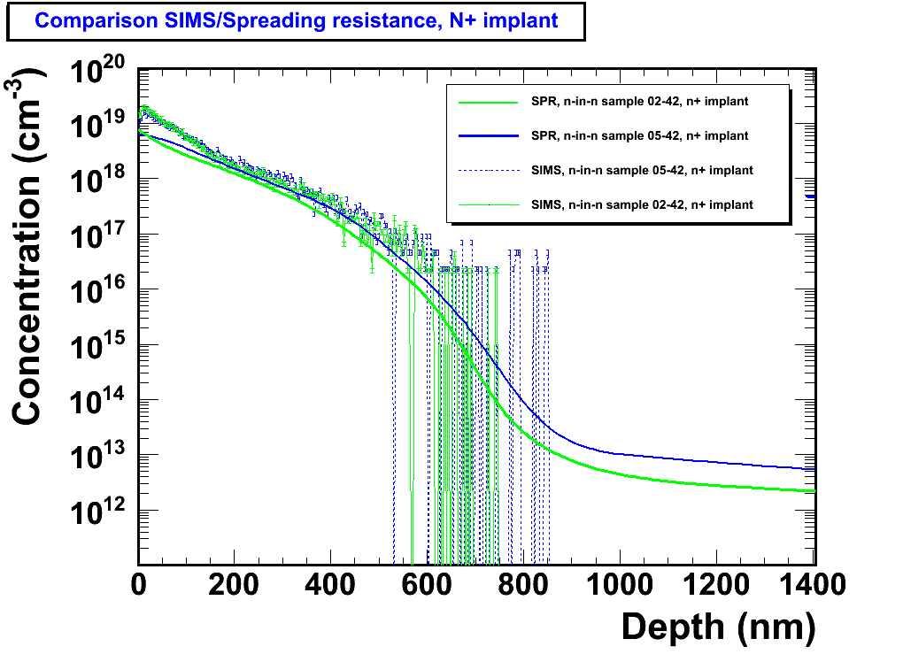
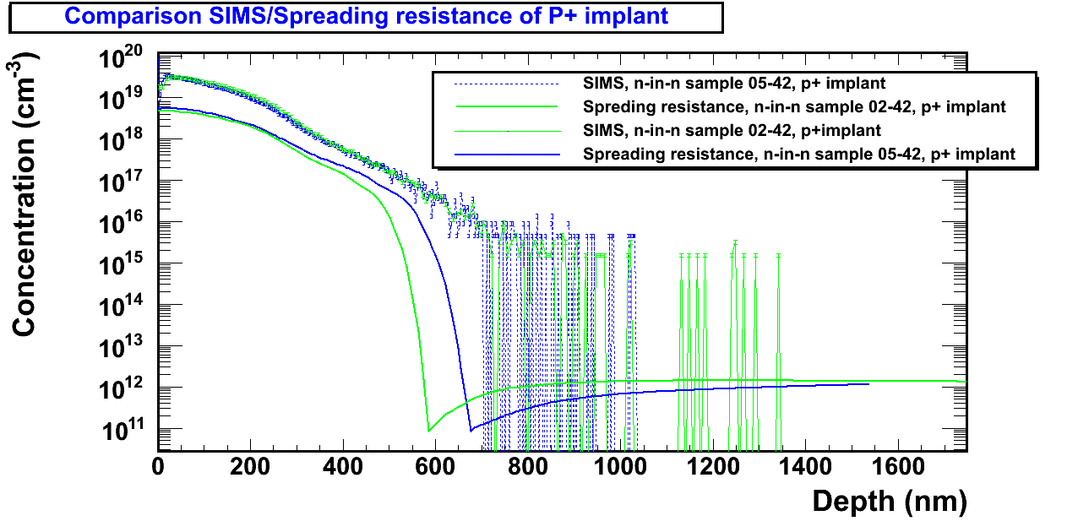
Dopants profiles
n⁺/n
p⁺/n
N+ implant characteristics
SIMS peak conc. N_{n} ~ 1x10¹⁹ cm⁻³
SRP peak conc. N_{n} ~ 8x10¹⁸ cm⁻³
P+ implant characteristics
SIMS peak conc. N_{p} ~ 3x10¹⁹ cm⁻³
SRP peak conc. N_{p} ~ 5x10¹⁸ cm⁻³
Measurements on n-on –n wafers
Good overall SiMS SRP agreement
Not all implanted dopant atoms are integrated in lattice positions, not all electrically active

