Slide 1
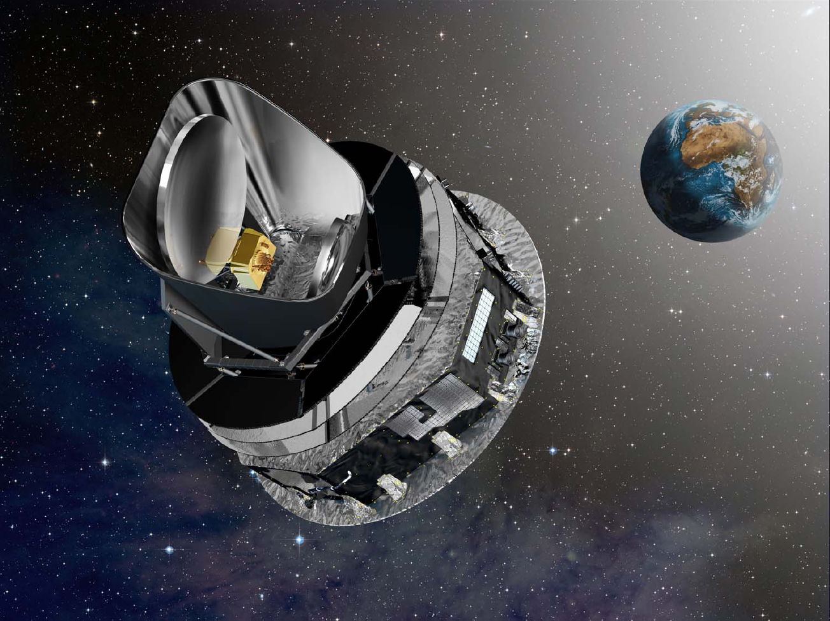
Planck implications for cosmology
LAPP seminar, 17.05.2013
J. Lesgourgues (EPFL, CERN, LAPTh)

Slide 2
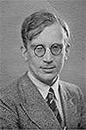


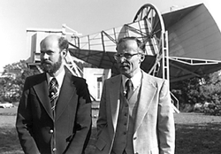
The Cosmic Microwave Background
… is the thermal radiation originating from the primordial plasma, predicted by Gamow, Zel’dovitch, Peebles, etc. (following theoretical arguments based on nucleosynthesis and the presence of hydrogen in the universe)
… was emitted at photon decoupling,
billions years ago, when T~eV
… first observed by Penzias and Wilson
in 1964
Zel’dovitch
Peebles
Gamow

Slide 3
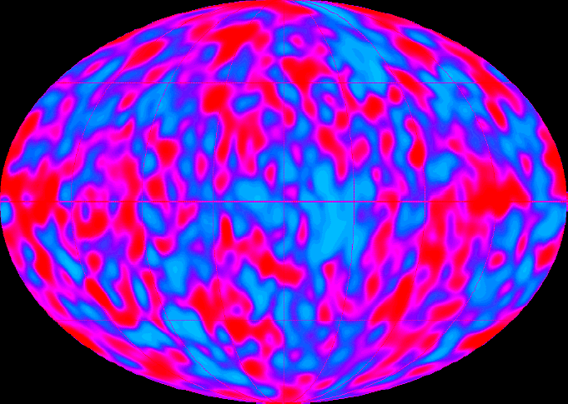
The Cosmic Microwave Background
… should contain temperature/density inhomogeneities, that are the seeds of all large structures in the universe (formed by gravitational collapse), predicted by theorists in the 70’s to be of the order of 10⁻⁵
… first observed on large angular scales by COBE in 1992 in the form of temperature anisotropies… and later by DASI as polarisation anisotropies …

Slide 4
The Cosmic Microwave Background
… anisotropies should contain non-trivial spatial correlations telling us about the mechanism that generated them, and about electromagnetic + gravitational interactions the early universe.
Detailed characteristics of these correlations predicted in the 70’s (Silk, Yu, Peebles, Zel’dovitch, … )
Standard model for CMB anisotropies:
  General relativity, simple QED, assumption of homogeneous and isotropic Friedmann-Lemaître universe with at least photons, electrons, baryons, neutrinos, CDM, Λ
  Primordial fluctuations from inflation induce temperature fluctuations in photon-baryon fluid
  Acoustic waves due to photon pressure, modulated by baryon inertia and gravitational interactions
  Photon-electron decoupling: diffusion processes inducing fluctuation damping and photon polarization
ingredients

Slide 5
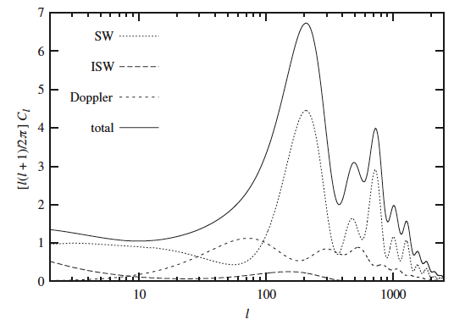
The Cosmic Microwave Background
Primary anisotropies: temperature 2-point function at decoupling features one correlation length = sound horizon at decoupling (real space), or peak series (multipole space)
Secondary anisotropies:
  Light deflection by gravitational lenses
  Gravitational redshifting by structures along line of sight
  Rescattering in reionized universe at low redshift

Slide 6
The Cosmic Microwave Background
Theoretical predictions for C_{l} precise at 0.01% level (0.1% in Planck analysis) with CAMB (www.cosmologist.info) or CLASS (class-code.net)
Peak structure first observed with good accuracy by Boomerang (2000), then many ground/balloon-based experiments, then WMAP, confirming standard model established in 1998 (= flat ΛCDM)

Slide 7
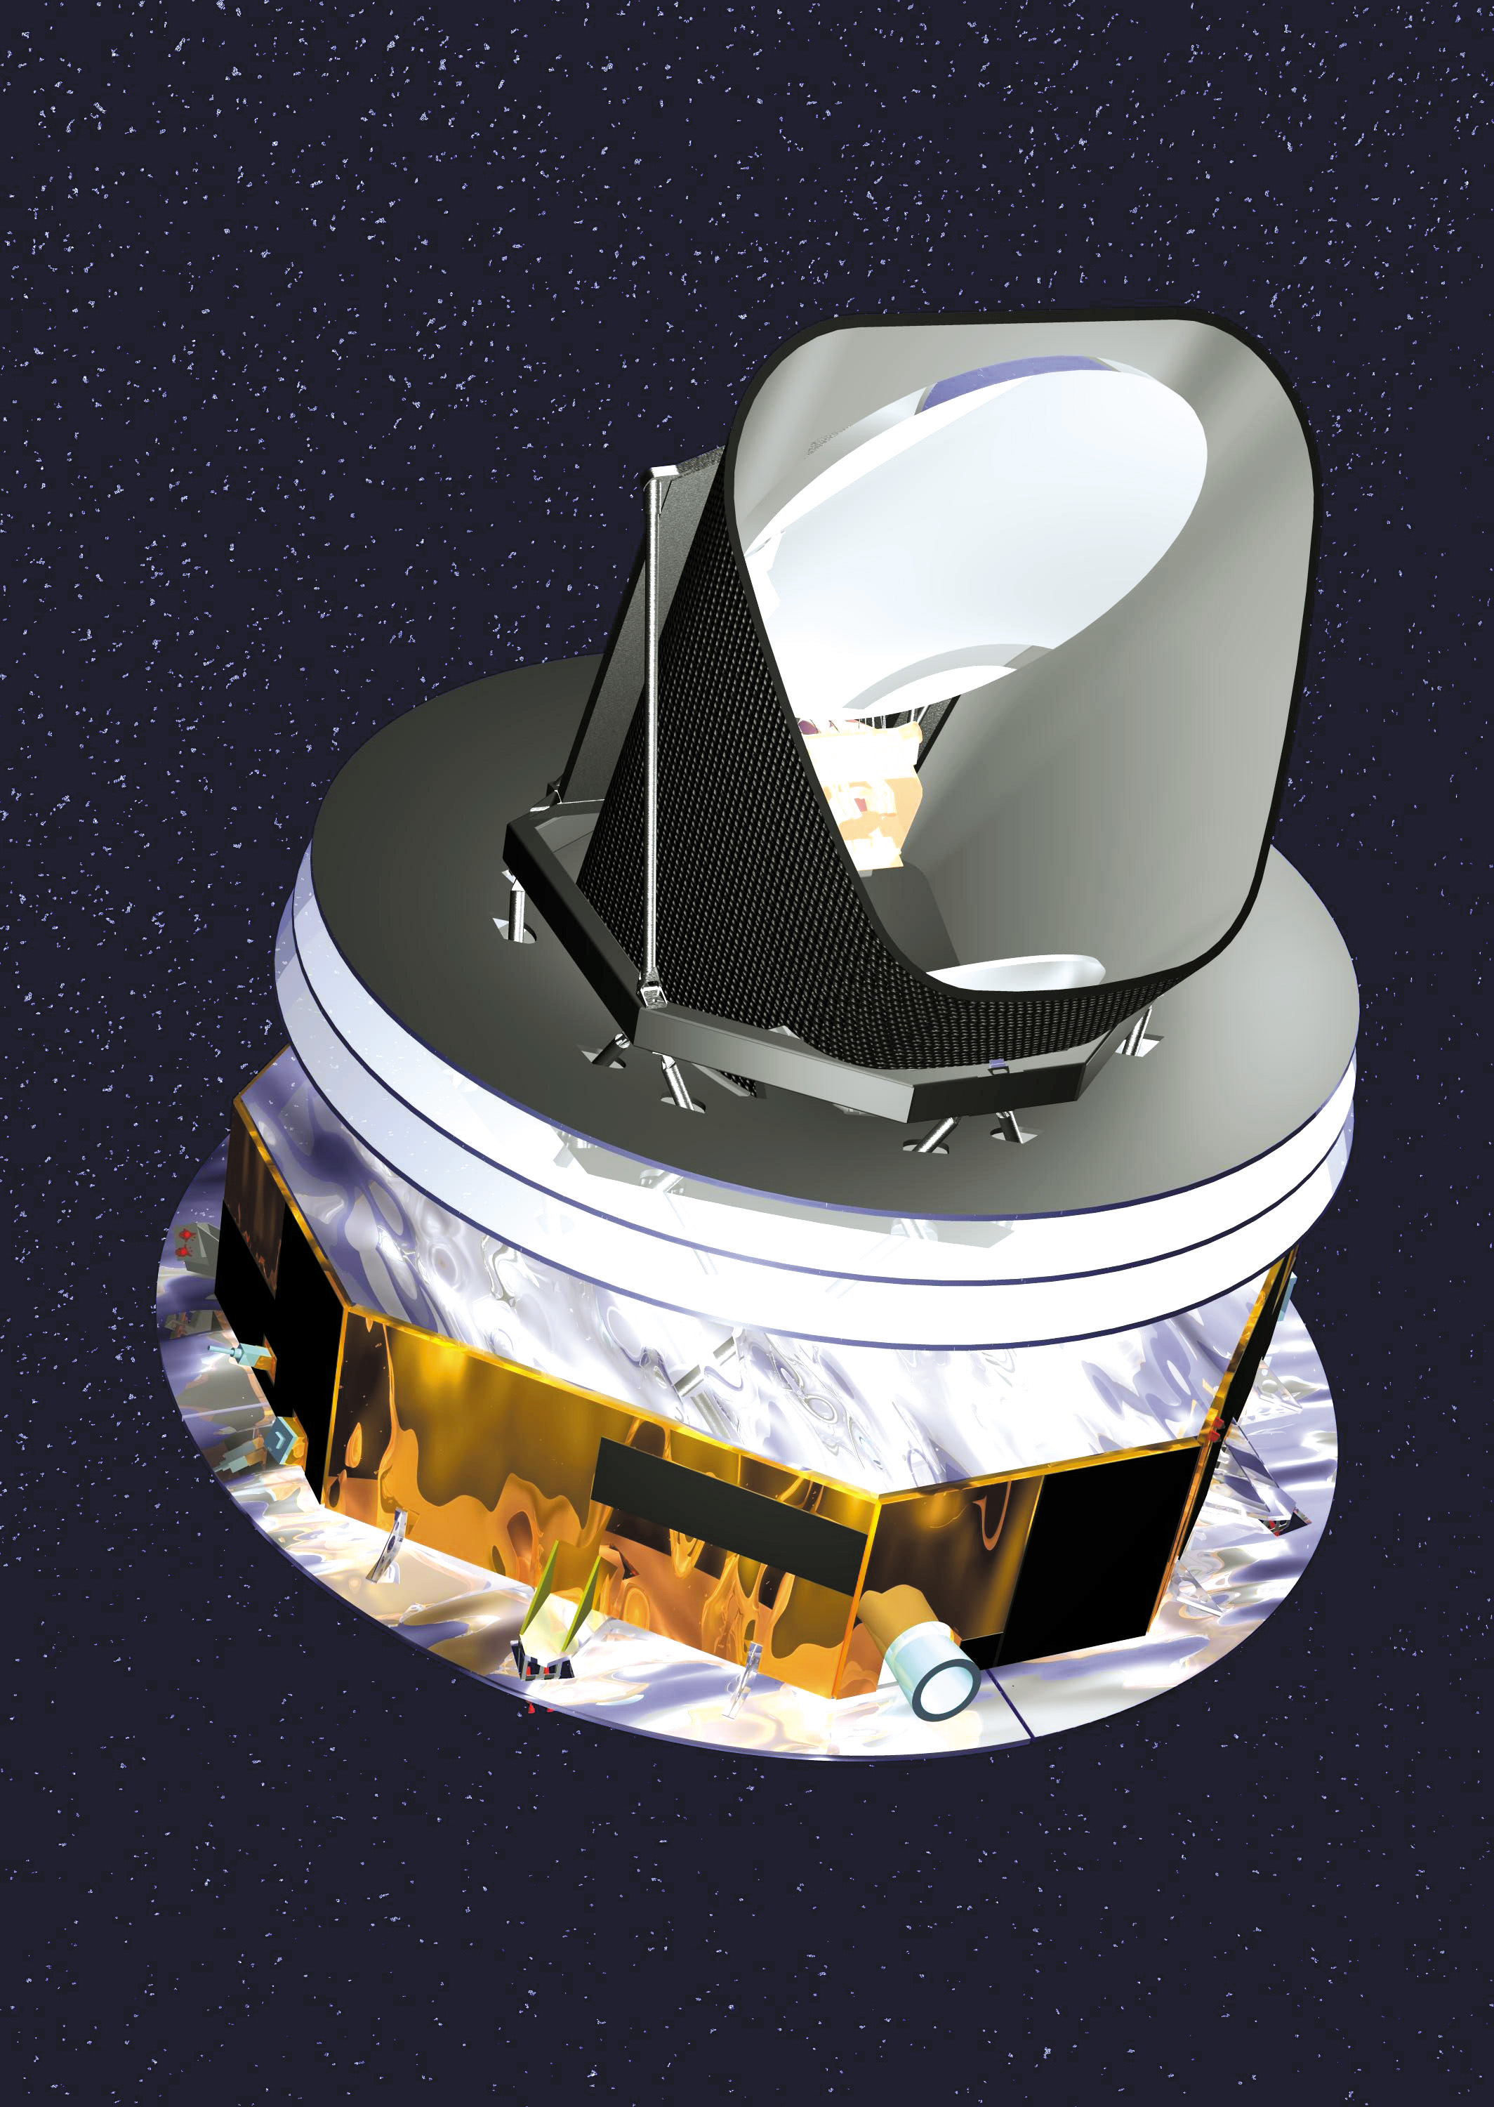
The Planck satellite
1.5 m telescope
2 instruments:
LFI (led by Italy)
- HEMTs (transitors)
- cooled at 20K
- sensitive to 30-100 GHz
HFI (led by France/UK)
- bolometer array
- cooled at 0.1K
- sensitive to 100-857 GHz
shield facing sun

Slide 8
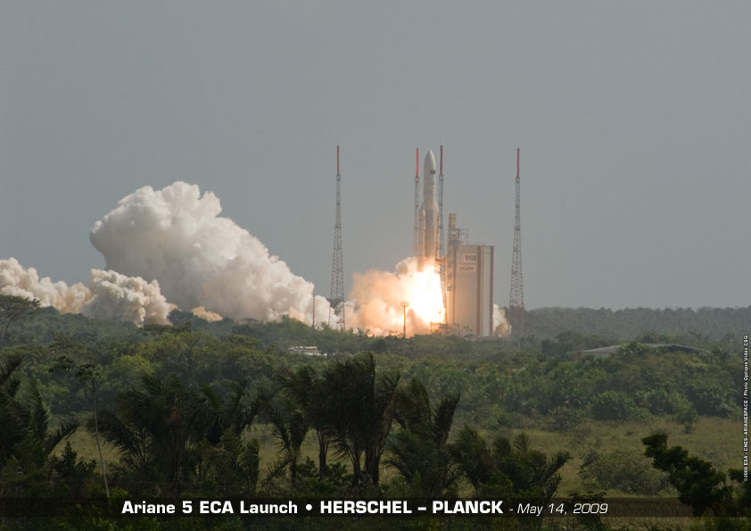
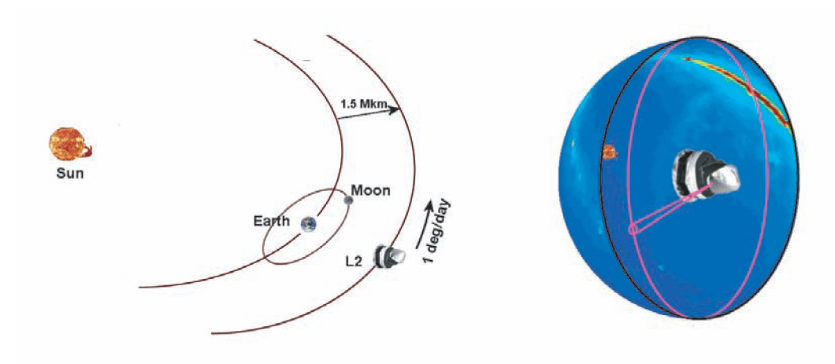
The Planck satellite
Launched by ESA and placed in L2 orbit in 2009. Full scan every 6 month.
1 rotation per minute
Cost: 5 cents/european/yr (700ME ), 400-650 scientists
2 tons, 4.2m diameter, 36’000 l of ⁴He, 12’000 l of ³He
10% of time for tiny manoeuvres
(data not used)

Slide 9
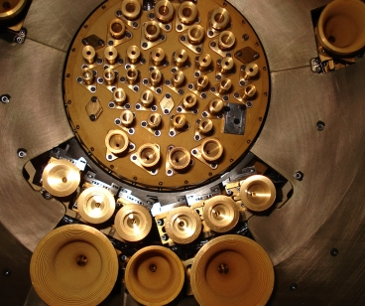
The Planck satellite
Launched by ESA and placed in L2 orbit in 2009. Full scan every 6 month.
75 detectors cover 9 frequency channels
detectors:
LFI | HFI
CMB blackbody
Frequency (GHz)

Slide 10
The Planck satellite
Launched by ESA and placed in L2 orbit in 2009. Full scan every 6 month.
75 detectors cover 9 frequency channels, grouped as “LFI” (HEM transistors) and “HFI” (bolometers).
Planck strengths: large and redundant sky coverage, number of channels & detectors, low detector noise (25 x better than WMAP). Resolution intermediate between WMAP (3 x better) and ACT, SPT.

Slide 11
The Planck satellite
Launched by ESA and placed in L2 orbit in 2009. Full scan every 6 month.
75 detectors cover 9 frequency channels, grouped as “LFI” (HEM transistors) and “HFI” (bolometers).
Planck strengths: large and redundant sky coverage, number of channels & detectors, low detector noise (25 x better than WMAP). Resolution intermediate between WMAP (3 x better) and ACT, SPT.
HFI requires complex cryogenic cooling at 0.1K (dilution of ³He in ⁴He). Designed for > 2 scans, achieved 5. Turned off in Jan 2012 (due to ³He level).
LFI requires cooling at 20K with ⁴He only and proceeds until autumn 2013 (8 scans).
This release is restricted to “nominal mission”, 15 months, > 2 scans.

Slide 12
From time-ordered data to maps
Sophisticated algorithms correct for systematics (detector noise and response, small cooling instabilities and seasonal effects, cosmic rays, pointing errors, beam shape …) and reduce data to nine temperature maps, or to a set of combined component-separated map
Polarization maps differed to 2014: analysis not yet mature
Temperature maps at 70, 100, 143, 217 GHz

Slide 13
From time-ordered data to maps
Combined CMB map

Slide 14
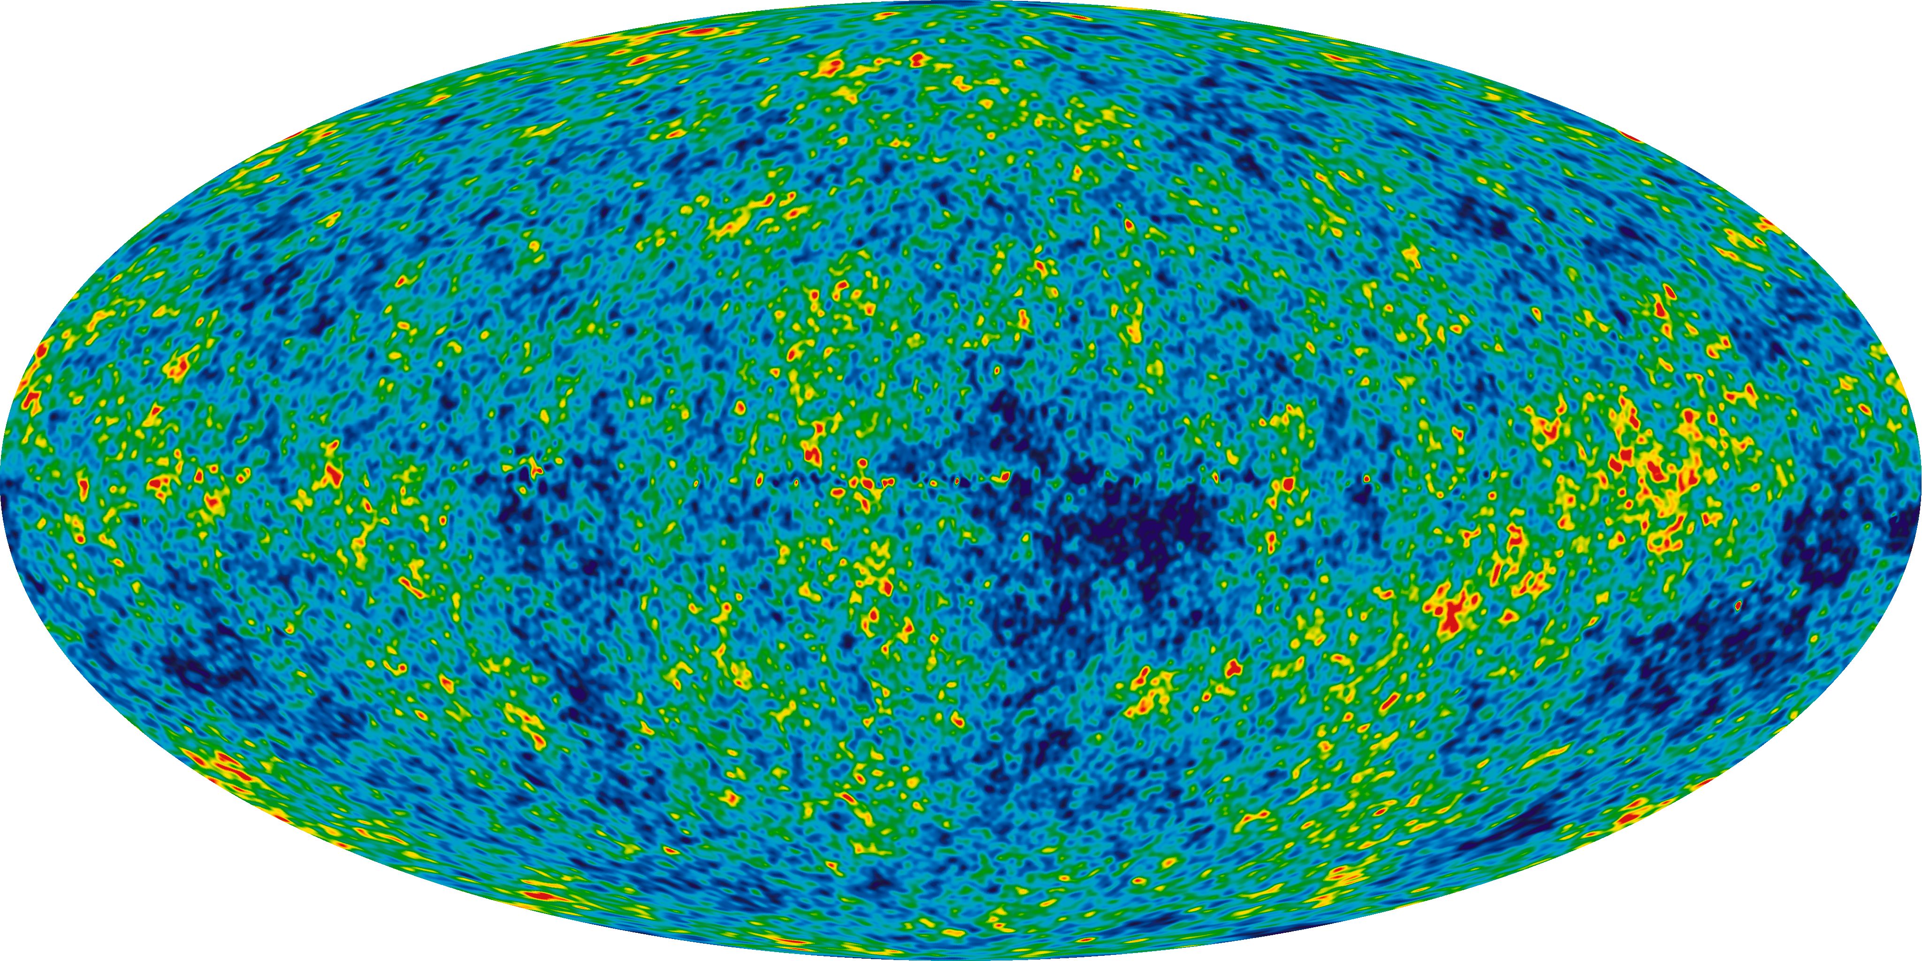
From time-ordered data to maps
CMB map from WMAP (different color scale)

Slide 15
From time-ordered data to maps
Combined CMB map

Slide 16
From maps to power spectrum
2-point correlation function in multipole space (C_{l}^{TT})
Comparison with theoretical models
Combined CMB map

Slide 17
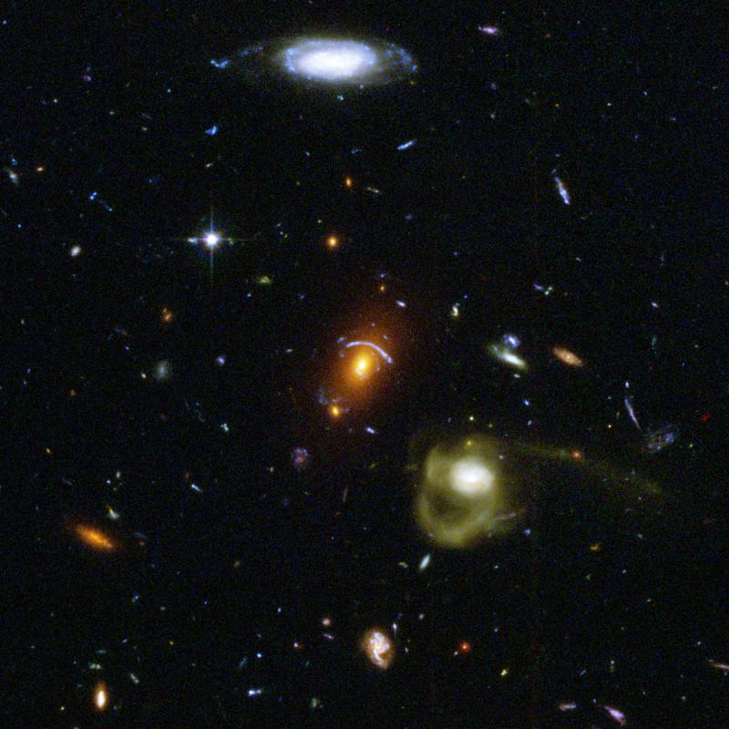
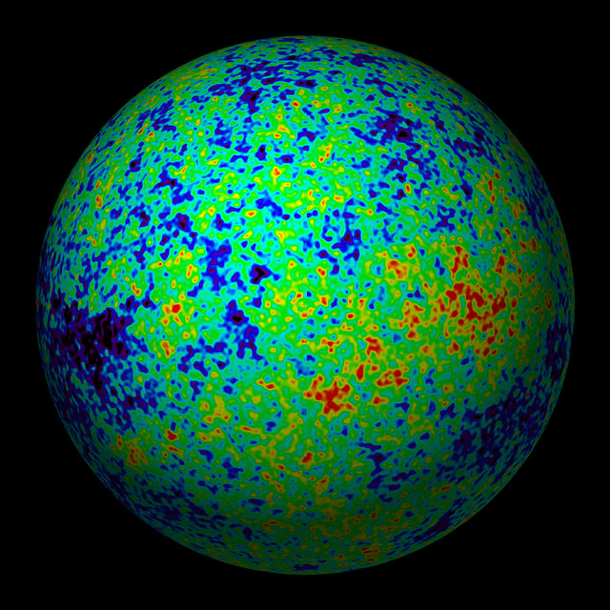
Fitting the minimal model
Minimal ΛCDM model relies on assumption of flat, homogeneous universe with 5 components (photons, baryons, CDM, neutrinos, Λ) and 4 stages :
--- commercial spot ----
“Neutrino cosmology”, CUP, 50 £
--- end of commercial spot ---
Minimal ΛCDM: 8 effects controlled by 6 parameters
6 free parameters (abundance of baryons, CDM, Λ ; amplitude and spectral index of primordial fluctuations ; epoch of reionisation due to star formation) easy to detect, some are more difficult (cosmic variance): degeneracie extensions bring more indepen
accélération
accélération
acceleration
décélération lente
décélération lente
slow deceleration
décélération rqpide
décélération rqpide
fast deceleration
accélération
accélération
acceleration
?
inflation
RD (radiation domination)
MD (matter domination)
inflation
radiation
matière
énergie noire
ΛD (Λ domination)

Slide 18
Fitting the minimal model
In minimal model,
CMB spectrum affected
by 8 physical effects
--- commercial spot ----
“Neutrino cosmology”, CUP, 50 £
--- end of commercial spot ---
Minimal ΛCDM: 8 effects controlled by 6 parameters
Some easy to detect, some are more difficult (cosmic variance): degeneracies
Extended models: some extensions bring more independent effects, some not

Slide 19
Fitting the minimal model
In minimal model,
CMB spectrum affected
by 8 physical effects
--- commercial spot ----
“Neutrino cosmology”, CUP, 50 £
--- end of commercial spot ---
Minimal ΛCDM: 8 effects controlled by 6 parameters
Some easy to detect, some are more difficult (cosmic variance): degeneracies
Extended models: some extensions bring more independent effects, some not

Slide 20
Fitting the minimal model
In minimal model,
CMB spectrum affected
by 8 physical effects
--- commercial spot ----
“Neutrino cosmology”, CUP, 50 £
--- end of commercial spot ---
Minimal ΛCDM: 8 effects controlled by 6 parameters
Some easy to detect, some are more difficult (cosmic variance): degeneracies
Extended models: some extensions bring more independent effects, some not

Slide 21
ΛCDM is a very good fit

Slide 22
ΛCDM is a very good fit
Using Planck + WP (= EE +TE from WMAP for l ≤ 23), at 1-sigma:
Peak scale 0.060%
Baryon density 1.3%
CDM density 2.3%
Primordial amplitude 2.5%
Primordial spectral index 0.76%
Reionization optical depth 0.13%
Derived (model-dependent) parameters:
Hubble parameter
Λ fractional density
Reionization redshift

Slide 23
ΛCDM is a very good fit
Using Planck + WP (= EE +TE from WMAP for l ≤ 23), at 1-sigma:
Peak scale 0.060%
Baryon density 1.3%
CDM density 2.3%
Primordial amplitude 2.5%
Primordial spectral index 0.76%
Reionization optical depth 0.13%
Derived (model-dependent) parameters:
Hubble parameter
Λ fractional density
Reionization redshift
Consistency with WMAP alone
preference for high CDM density, small H₀, small Ω_{Λ}
CDM density
(H₀ related)

Slide 24
ΛCDM is a very good fit
Using Planck + WP (= EE +TE from WMAP for l ≤ 23), at 1-sigma:
Peak scale 0.060%
Baryon density 1.3%
CDM density 2.3%
Primordial amplitude 2.5%
Primordial spectral index 0.76%
Reionization optical depth 0.13%
Derived (model-dependent) parameters:
Hubble parameter
Λ fractional density
Reionization redshift
tension with WMAP+SPT
explained as WMAP/SPT relative calibration error
Artificially low
damping tail
600 < l < 1500
high H₀ plus, if possible, new physics:
N_{eff} , negative running…

Slide 25
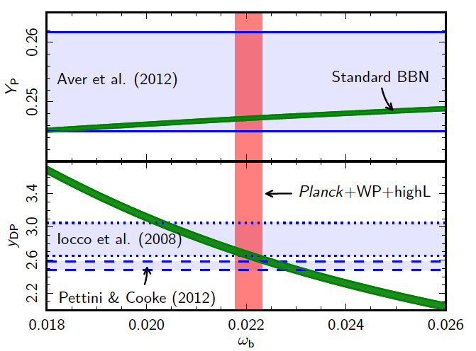
ΛCDM is a very good fit
Using Planck + WP, at 1-sigma:
consistency with theory of Nucleosynthesis
Peak scale 0.060% and measurement of primordial D, He
Baryon density 1.3%
CDM density 2.3%
Primordial amplitude 2.5%
Primordial spectral index 0.76%
Reionization optical depth 0.13%
Derived (model-dependent) parameters:
Hubble parameter
Λ fractional density
Reionization redshift
Helium fraction
deuterium fraction
baryon density ω_{b}

Slide 26
ΛCDM is a very good fit
Using Planck + WP, at 1-sigma:
consistency with
Peak scale 0.060% Baryon Acoustic Oscillations
Baryon density 1.3%
CDM density 2.3%
Primordial amplitude 2.5%
Primordial spectral index 0.76%
Reionization optical depth 0.13%
Derived (model-dependent) params:
Hubble parameter
Λ fractional density
Reionization redshift
BAO scale rescaled to best-fit ΛCDM
redshift z (~ distance from us)

Slide 27
ΛCDM is a very good fit
Using Planck + WP, at 1-sigma:
tension with
Peak scale 0.060% direct H₀ measurements
Baryon density 1.3%
CDM density 2.3%
Primordial amplitude 2.5%
Primordial spectral index 0.76%
Reionization optical depth 0.13%
Derived (model-dependent) parameters:
Hubble parameter
Λ fractional density
Reionization redshift

Slide 28
ΛCDM is a very good fit
Using Planck + WP, at 1-sigma:
consistency with
Peak scale 0.060% supernovae (SNIa) luminosity
Baryon density 1.3%
CDM density 2.3%
Primordial amplitude 2.5%
Primordial spectral index 0.76%
Reionization optical depth 0.13%
Derived (model-dependent) parameters:
Hubble parameter
Λ fractional density
Reionization redshift

Slide 29
ΛCDM is a very good fit
Using Planck + WP, at 1-sigma:
consistency with
Peak scale 0.060% galaxy 2-pt correlation
Baryon density 1.3%
CDM density 2.3%
Primordial amplitude 2.5%
Primordial spectral index 0.76%
Reionization optical depth 0.13%
Derived (model-dependent) parameters:
Hubble parameter
Λ fractional density
Reionization redshift

Slide 30
ΛCDM is a very good fit
Using Planck + WP, at 1-sigma:
consistency with
Peak scale 0.060% preliminary (raw) polarization spectrum
Baryon density 1.3%
CDM density 2.3%
Primordial amplitude 2.5%
Primordial spectral index 0.76%
Reionization optical depth 0.13%
Derived (model-dependent) parameters:
Hubble parameter
Λ fractional density
Reionization redshift

Slide 31
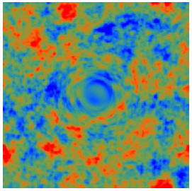
Lensing extraction
exaggerated effect of a huge cluster:
In fact, only 2’-3’ deflections, coherent over large scales: invisible by eye
Lensing potential = projected gravitational field (with some kernel: sensitive to structures at z~1-3)
Induces non-gaussianity with very specific correlations (between different angular scales). Can be extracted with specific “quadratic estimator”
Proposed by Hu & Okamoto (2001) First success in 2012 (SPT-ACT)

Slide 32
Lensing extraction
Lensing potential map:
Low signal-to-noise, but correlates at high level with different tracers of LSS (20 sigma with NVSS quasars, 10 sigma with SDSS LRG, 42 sigma with Planck’s CIB)

Slide 33
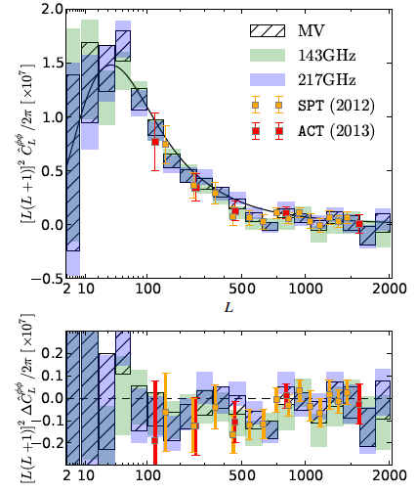
Lensing extraction
Lensing power spectrum consistent with ΛCDM
Helps removing degeneracies and measuring extended model parameters with Planck alone

Slide 34
Beyond minimal ΛCDM

Slide 35
Curvature
CMB alone (Planck+WP+HighL), despite geometrical degeneracy:
100Ω_{k} = -4.2 ± 4.5 (95%CL)
With lensing and BAO:
100Ω_{k} = -0.10 ± 0.63 (95%CL)

Slide 36
Relativistic d.o.f. (N_{eff})
In minimal ΛCDM model N_{eff} ≈ 3 (relic background of 3 flavor neutrinos); could have N_{eff}>3 due to lepton asymmetry, sterile neutrinos, other very light relics (gravitinos, axions, …)
N_{eff} induces specific effects in CMB (dominant one = suppression of damping tail)
No complete parameter degeneracy but partial one: positive correlation with H₀
  WMAP+SPT saw anomalously low tail: N_{eff} > 3 at 2 sigma

Slide 37
Relativistic d.o.f. (N_{eff})
In minimal ΛCDM model N_{eff} ≈ 3 (relic background of 3 flavor neutrinos); could have N_{eff}>3 due to lepton asymmetry, sterile neutrinos, other very light relics (gravitinos, axions, …)
N_{eff} induces specific effects in CMB (dominant one = suppression of damping tail)
No complete parameter degeneracy but partial one: positive correlation with H₀
  WMAP+SPT saw anomalously low tail: N_{eff} > 3 at 2 sigma

Slide 38
Relativistic d.o.f. (N_{eff})
In minimal ΛCDM model N_{eff} ≈ 3 (relic background of 3 flavor neutrinos); could have N_{eff}>3 due to lepton asymmetry, sterile neutrinos, other very light relics (gravitinos, axions, …)
N_{eff} induces specific effects in CMB (dominant one = suppression of damping tail)
No complete parameter degeneracy but partial one: positive correlation with H₀
  WMAP+SPT saw anomalously low tail: N_{eff} > 3 at 2 sigma

Slide 39
Relativistic d.o.f. (N_{eff})
In minimal ΛCDM model N_{eff} ≈ 3 (relic background of 3 flavor neutrinos); could have N_{eff}>3 due to lepton asymmetry, sterile neutrinos, other very light relics (gravitinos, axions, …)
N_{eff} induces specific effects in CMB (dominant one = suppression of damping tail)
No complete parameter degeneracy but partial one: positive correlation with H₀
  WMAP+SPT saw anomalously low tail: N_{eff} > 3 at 2 sigma
now, CMB alone (Planck+WP+HighL)
N_{eff} = 3.36 ± 0.66 (95%CL)
With lensing and BAO:
N_{eff} = 3.30 ± 0.52 (95%CL)
With H₀ and BAO:
N_{eff} = 3.53 ± 0.46 (95%CL)

Slide 40
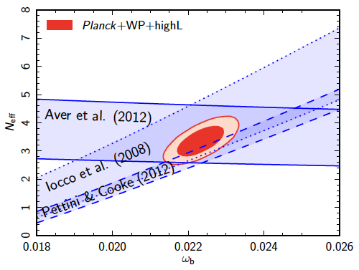
Relativistic d.o.f. (N_{eff})
In minimal ΛCDM model N_{eff} ≈ 3 (relic background of 3 flavor neutrinos); could have N_{eff}>3 due to lepton asymmetry, sterile neutrinos, other very light relics (gravitinos, axions, …)
N_{eff} induces specific effects in CMB
No complete parameter degeneracy
  WMAP+SPT saw anomalously low tail
Consistency with Nucleosynthesis
(with free N_{eff})
now, CMB alone (Planck+WP+HighL)
N_{eff} = 3.36 ± 0.66 (95%CL)
With lensing and BAO:
N_{eff} = 3.30 ± 0.52 (95%CL)
With H₀ and BAO:
N_{eff} = 3.53 ± 0.46 (95%CL)

Slide 41
Neutrino mass
CMB sensitive to Σm_{ν} (sum over all families) : specific effects mainly on secondary anisotropies (early integrated Sachs-Wolfe and lensing)
Neutrino oscillations imply Σm_{ν} > 0.06 (0.1) eV for Normal (Inverted) hierarchy
Loose upper bound from beta decay experiments (KATRIN could find Σm_{ν}<1.2eV (95%CL)

Slide 42
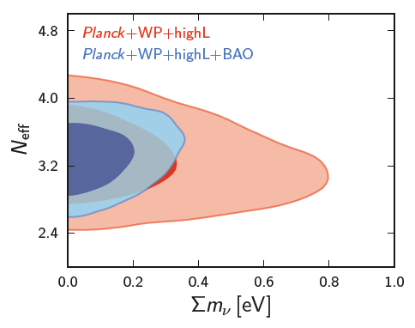
Neutrino mass
CMB sensitive to Σm_{ν} (sum over all families) : specific effects mainly on secondary anisotropies (early integrated Sachs-Wolfe and lensing)
Neutrino oscillations imply Σm_{ν} > 0.06 (0.1) eV for Normal (Inverted) hierarchy
Loose upper bound from beta decay experiments (KATRIN could find Σm_{ν}<1.2eV (95%CL)
CMB alone : Σm_{ν} < 0.66eV (95%CL)
With BAO : Σm_{ν} < 0.23eV (95%CL)
With lensing: Σm_{ν} < 0.85eV (95%CL)
Lensing spectrum likes small neutrino mass, temperature dislikes it (latter connected with low l region…)
Robust w.r.t cosmological extensions (excepted for curvature: 50% weakening)

Slide 43
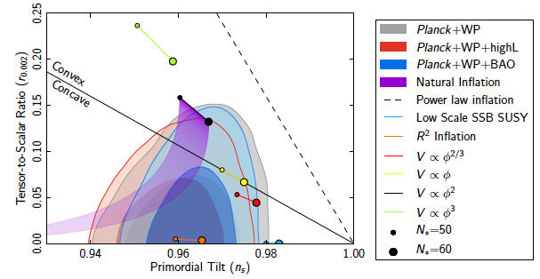
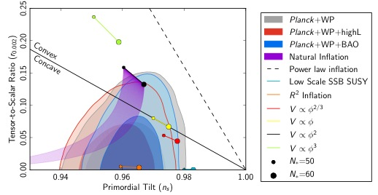
Tensors, spectral index and inflation
V* < (1.94 x 10¹⁶ GeV)⁴ (95%CL)
, Higgs inflation
Also OK: Hill-top with p=2 or p≥4; also disfavored: inverse power-law

Slide 44
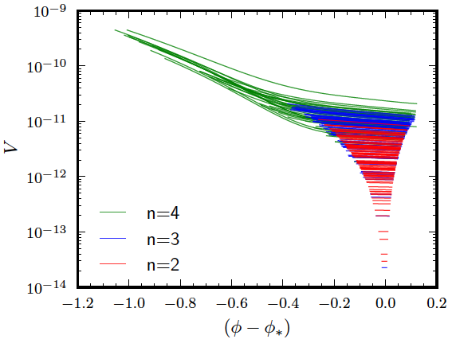
Inflation potential reconstruction
“observable window” of the inflaton potential, assuming that it can be
Taylor-expanded inside this region at order n = 2, 3, 4 (units of true m_{P})

Slide 45
Other investigated extensions
Significant detection ?
☒
☒
☒
☒
☒
☒
☒
☒
☒
☒
☒
☒
☒
Light sterile neutrino (thermal or non-thermal, m < 10 eV)
Dark energy with
  w ≠ -1
  w₀ + a w_{a} ≠ -1
DM annihilation (smooth background)
Variation of the fine-structure constant
Running of the primordial spectral index
Features in the primodial spectrum
  Binning method
  Parametric search
Primordial magnetic fields (neglect Faraday; non-helical case; vectors and scalars)
Isocurvature modes
  General correlated CDM, neutrino density/velocity
  Axion-like (CDM, uncorrelated)
  Curvaton-like (CDM, maximally correlated)
Primordial non-gaussianity

Slide 46
Primordial non-gaussianity
Amplitude of specific bispectrum shapes: (WMAP9)
  f_{NL}^{local} = 2.7 ± 5.8 (68%CL) 37 ± 20
  f_{NL}^{equi} = - 42 ± 75 (68%CL) 51 ± 136
  f_{NL}^{ortho} = - 25 ± 39 (68%CL) -245 ± 100
For trispectrum (4-point function):
  τ_{NL}^{local} < 2500 (95%CL)
Compatible with very small NG level predicted by canonical single-field inflationary models
Temperature bispectrum (3-point function)
after foreground cleaning

Slide 47
Isotropy
Confirmation of small perturbation variance on large angular scales
Less variance in nothern ecliptic hemisphere
on all scales (up to l~1500)
[ Even multipoles supressed till l~25 ]
Cold spot
Gone away:
  Low quadrupole
  Quadrupole-octopole alignement
Galactic foregrounds? Solar emission? Local universe?
Primordial fluctuations? Topology? Magnetic fields?
2-point correlation function in real (angular) space

Slide 48
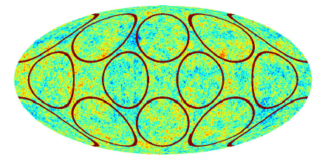
Topology
Search for matching circles
Search for specific patterns for flat spaces with cubic toroidal (T3), equal-sided chimney (T2) and slab (T1) topologies, three multi-connected spaces of constant positive curvature (dodecahedral, truncated cube and octahedral) and two compact negative-curvature spaces
Search for Bianchi VII_{h} cosmology
simulated maps with matching circles at 24º

Slide 49
Defects
Simulation of CMB distorted by cosmic strings:
temperature: spherical gradient:
Search through power spectrum distortions and specific types of non-gaussianity: no evidence (Gμ/c² < 10⁻⁷)

Slide 50
CMB Dipole
Newtonian gravity: motion of observer gives dipole from Doppler effect
GR: Doppler boost affects all multipoles at 10⁻⁵ level. Aberration (similar to coherent lensing) and modulation.
First detection of this effect:
v = 384 km.s⁻¹ ± 78 km.s⁻¹ (stat)
± 115 km.s⁻¹(sys)
Compatible with observed dipole: 369 km.s⁻¹
No evidence for anomalous primordial dipole

Slide 51
Conclusions
23 papers fro March contain thousand times more information…
fascinating that simplistic minimal model of 1998 is still a good fit, despite reduction of allowed parameter space volume by ~10⁵
Maximally Boring Universe or Maximally Elegant Model ?
  Actually none of them if anomalies are taken seriously !!
Potential of improvement for next year’s release:
  From nominal survey to full survey data
  Polarization
  Possible improvement of foreground modeling, mask reduction, manoeuvres inclusion

