Slide 1

Présentation du Labex P2IO
Introduction
Anne-Isabelle Etienvre
P2IO Coordinator

Slide 2
Welcome to the 2nd P2IO SC meeting
Goals of this meeting:
  Open session: present to our Scientific council and to our community
    P2IO actions:
      Platforms, post-docs, R&D, teaching and outreach
    Involvement of P2IO laboratories in LHC and Planck results & future
      Illustration of only a part of the important scientific results of P2IO labs
      But time constraints → illustration through these 2 highlights
      Other topics will be illustrated in future meetings
    P2IO in its environment (Paris-Saclay)
  Closed sessions:
    Evolution since last SC meeting
    First feedback from the Scientific Council and advices

Slide 3
P2IO in a few words
A network of 10 laboratories and 2 teams
  Funded by French Government in a general call (2011)
    14 M€ over 9 years (April 2011 – december 2019)
  Belong to 4 different organisms
    CEA, CNRS, Ecole Polytechnique, Paris Sud University
  2000 people (researchers & prof., engeneers, post-docs, PhD students)
  Goals:select and fund common actions to promote our science
  in an ambitious shared vision
    Explore: support for innovative and interdisciplinary initiatives
    Transform: enhance collaboration between P2IO members, create new common platforms,..
    Structure: contact point for internal and external collaborations

Slide 4
P2IO in a few words
4 scientific themes:
  P1 :symmetries in the subatomic world,
  P2: dark components of the Universe and high energy gamma ray astronomy
  P3 : strongly coupled nuclear matter,
  P4 : formation of stellar systems and conditions for the emergence of life
3 technological themes:
  R1: innovations in accelerator science and their related spinoffs,
  R2 : advanced sensors and spinoffs,
  R3 : data mining and simulation
2 interdisciplinary themes:
  Energy : nuclear energy for the future;
  Health, new methods in imagery and therapies

Slide 5
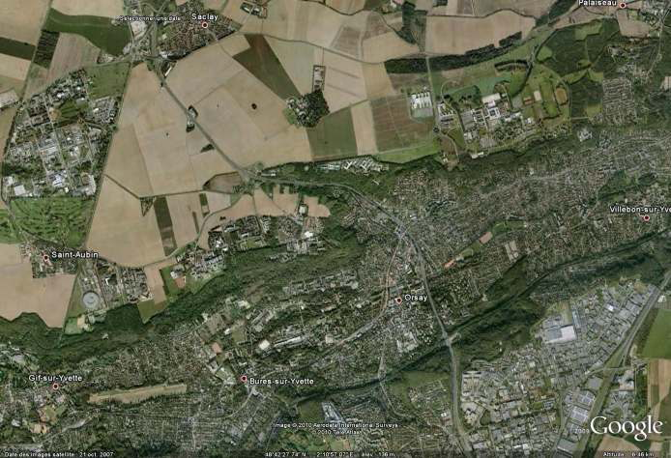

P2IO partners geographic localisation

Slide 6
P2IO governance & evaluation
Steering Committee:
  Head of each P2IO member (10 labs + 2 teams)
  Coordination: A.I. Etienvre + Laurent Verstraete (Deputy)
  Main goals: funding decisions, scientific strategy elaboration, calls definition
  1 formal meeting/month (decisions taken by consensus)
P2IO evaluation:
  French Ministry (ANR) : report and meeting once a year
    Important step: february 2016 (mid-term evaluation)
  Overview report at the funding agencies: once a year
    Approves the budget and the overall strategy
  Scientific Council
    Advises the steering committee

Slide 7
P2IO actions
Calls for post-doctoral and PhD students (750 k€ in average)
  Projects pre-selected by a specific committee (CSPD), final evaluation made by the Steering Committee
    Criteria: scientific intrinsic quality, synergy between P2IO teams for post-docs, added value for P2IO
    Candidates have to be validated by the steering committee
    PhD grants: half-grants only → increase global funding
Reports required once a year
  Today: first post-docs selected by P2IO present a poster session + 2 talks
2012 call: 47 proposals
  6 post-doc, 5 half-grants

Slide 8
P2IO actions
2012 Post-doctoral grants :
C. Cannes, IPNO+CSNSM (Actinide deposits in ionic liquids).
C. Caprini, IPhT (Gravitational Waves as a New Probe of the Dark Side of the Universe).
N. D’hose, SPhN+IPNO (COMPASS : Proton transverse radius measurement).
D. Bernard, LLR+SEDI (HARPO).
F. Couderc, SPP+LLR (CMS: Spin-parity of the new boson).
M. Ollivier, IAS+SAp (Instrumentation for the characterization of the planetary atmospheres)
2012 PhD grants :
C. Rimbault, LAL (Fast luminosity monitoring using diamond sensors for super luminous B meson factories).
S. Descotes-Genon, LPT+IPNO (Search for right handed currents in the quark sector)
M. Urban, IPNO (Collective modes inside the internal crust of a neutron star)
M. Langer, IAS ( Magnetic fields at very large cosmologic scales)
M. Grana, IPhT (String theory)

Slide 9
P2IO actions
R&D small upstream projects (2011, 2013, ..): 500 k€
  Projects are pre-selected by a specific committee (CSRD)
    Criteria: innovative project, synergy between labs,
    added value for P2IO
    Final selection: steering committee
  2011 projects (9) : all well advanced → see poster session (+ 1 talk)
    Mid-term report required
  2013 call: 9 projects out of 25 have been selected

Slide 10
P2IO actions
2013 R&D call
Project | Leader | Topic | Budget (k€)
ATLAS-DTBB | P. Schwemling (IRFU) | New digital electronic for the Level 1 Trigger of the ATLAS calorimeter (upgrade) | 56
DACTOMUS | N. Delerue (LAL) | Diagnostics and compact beam transport for multistages laser plasma accelerator | 50
INGMAR | R. Brunetto (IAS) | Ice and méteorites irradiation analysed by VIS-IR reflectance | 74.5
HARD | C. Nones (IRFU) | Very low background electronics (HEMT) for bolometers (Edelweiss) | 76
HighSPID | Y. Blumenfeld (IPNO) | Light particles identification within high granularity multi-detectors Si (Spiral2 phase2). | 67
MICROMEGAS Imager | F. Gunsing (IRFU) | Micromegas 2D for neutron detection (NTOF) | 43
PRIVAT | A. Zabi (LLR) | In line selection for data analysis ( Higgs couplings) - CMS upgrade. | 42.5
SONIM | L. Ménard (IMNC) | New small probes for charged particles detection on molecular imaging based on SIPMs | 65
THEOS | N. Leroy (LAL) | Cavities using malleable mirrors for high power lasers. | 58

Slide 11
P2IO actions
Call for new common platforms (500 k€ , for one or 2 projects)
  Proposals made by our technological groups:
    Acceltech, CaptInnov , Radiomatter, Virtual data, Spacetech
  First call (2012): 2 projects
    CaptInnov : 200 k€ from P2IO + 140 k€ from the Region Ile de France: an illustration of a way to maximize the impact of our limited resources
    Virtual data (300 k€)
    See presentations today → impressive collaborative work
  Next call: projects will be submitted at the end of the year (funding : 2014)

Slide 12
P2IO actions
Call for platform operations (90 k€)
  Might evoluate (under discussion)
Teaching and outreach (120 k€)
  See L.Verstraete’s talk today
Inter-Labex call:
  Idex Paris-Saclay call: 900 k€ (P2IO: 50), for projects involving at least 2 Labex
    10 projects selected out of 52, 4 involving P2IO teams
      QEAGE: Quantum Effects in Analogue Gravity Experiments (P2IO-LPT/PALM/NanoSaclay)
      NdS-NbSI: New supraconducting detectors using NbSi (P2IO-CSNSM/PALM)
      PulseSynth : Femtoseconds pulses synthesis and consistent combination (P2IO-LAL/PALM)
      VKStars: Fundamental Dynamo mechanisms: from VKS experiment to stellar magnetism (P2IO-IRFU/LASIPS/PALM)

Slide 13
P2IO added value
Internal
  Strengthening the links among the various members of P2IO
    Projects funded
    Dialog between directors, committees, working groups, outreach, newsletter ..
External
  Important role in the Paris-Saclay context (see Claude Chappert’s talk)
    LabEx are key actors of the IdEx project → visibility
    LabEx Steering Committee is strongly involved in the future research department definition
  Interactions with other french Labex on these topics
    Today: outreach and teaching; future: european calls?
  International: Paris-Saclay will be an important cluster → enhance P2IO labs attractivity

