Slide 1
Outreach and Training Initiatives
Laurent Verstraete
University Paris-Sud – IAS
On Behalf of formation group
12-09-2013 P2IO Scientific Council

Slide 2
Goals
Enhance visibility of P2IO research for students and society
Popularize the research carried out in P2IO
Share fundamental questions, technological developments and applications for society
Enhance training of master’s students on P2IO tracks
Practice with today’s research tools, go to platforms
Encourage students to choose P2IO tracks
master’s and PhD fellowships

Slide 3
Visibility of P2IO research
Rencontres des Deux Infinis
School of Physics in french for BSc students
(licence)
2 weeks (end of july), campus of Orsay and Saclay
Discovery talks by researchers, Visit labs
Discussions about physics, ideas and society
2013: dedicated to Emma Noether
2012: Ettore Majorana
2011: Georges Charpak

Slide 4
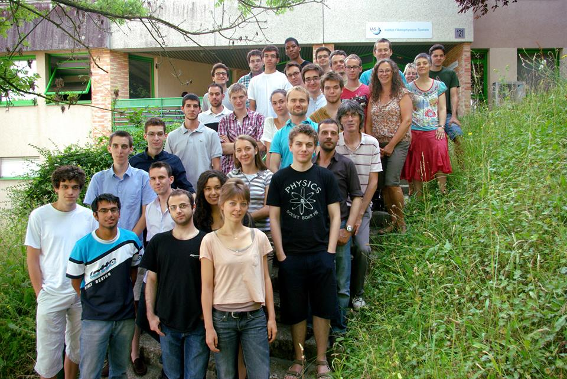
Visibility of P2IO research
Rencontres des Deux Infinis…
Each year 20-30 students from France (Paris and other regions)
From physics but also engineer’s track
Around 20 speakers presenting a
broad range of topics
Visit of research platforms @ Orsay, Saclay
and Paris
Lively discussions on physics, the real world
and the place of physics in society

Slide 6
Visibility of P2IO research
Rencontres des Deux Infinis...
Enthusiastic feedback from students,
http://www.facebook.com/Rencontres.Physique.Infinis
Trigger dedications: a few per year decide to join master’s track related to P2IO
funding: mostly P2IO, 25 kEuros + CEA (4k) and Physics depts (2k)
(Paris-Sud, Denis Diderot)
And strong commitment of administrative staff
➔ To be continued and amplified

Slide 7
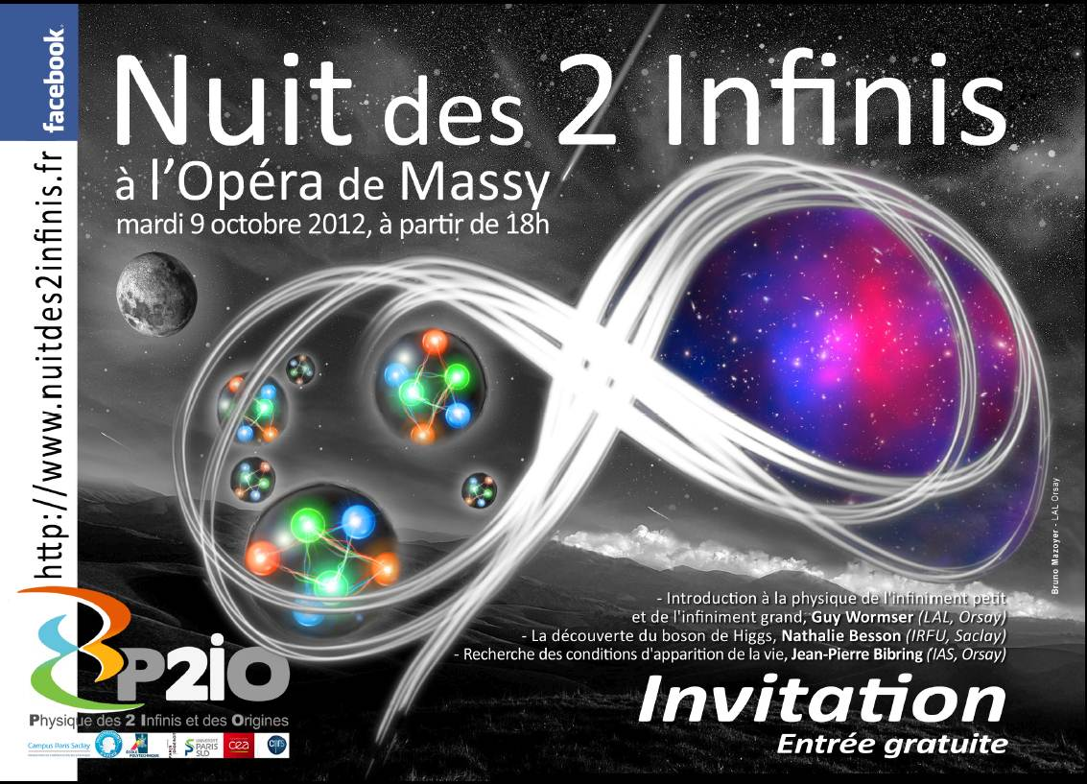
Visibility of P2IO research
Nuit des 2 Infinis October 2012, Massy Opera
Non-academically presenting the world and
the physics of P2IO to a large audience
Next night October 5th, 2013 LAL, Orsay
Cost: 15k

Slide 8
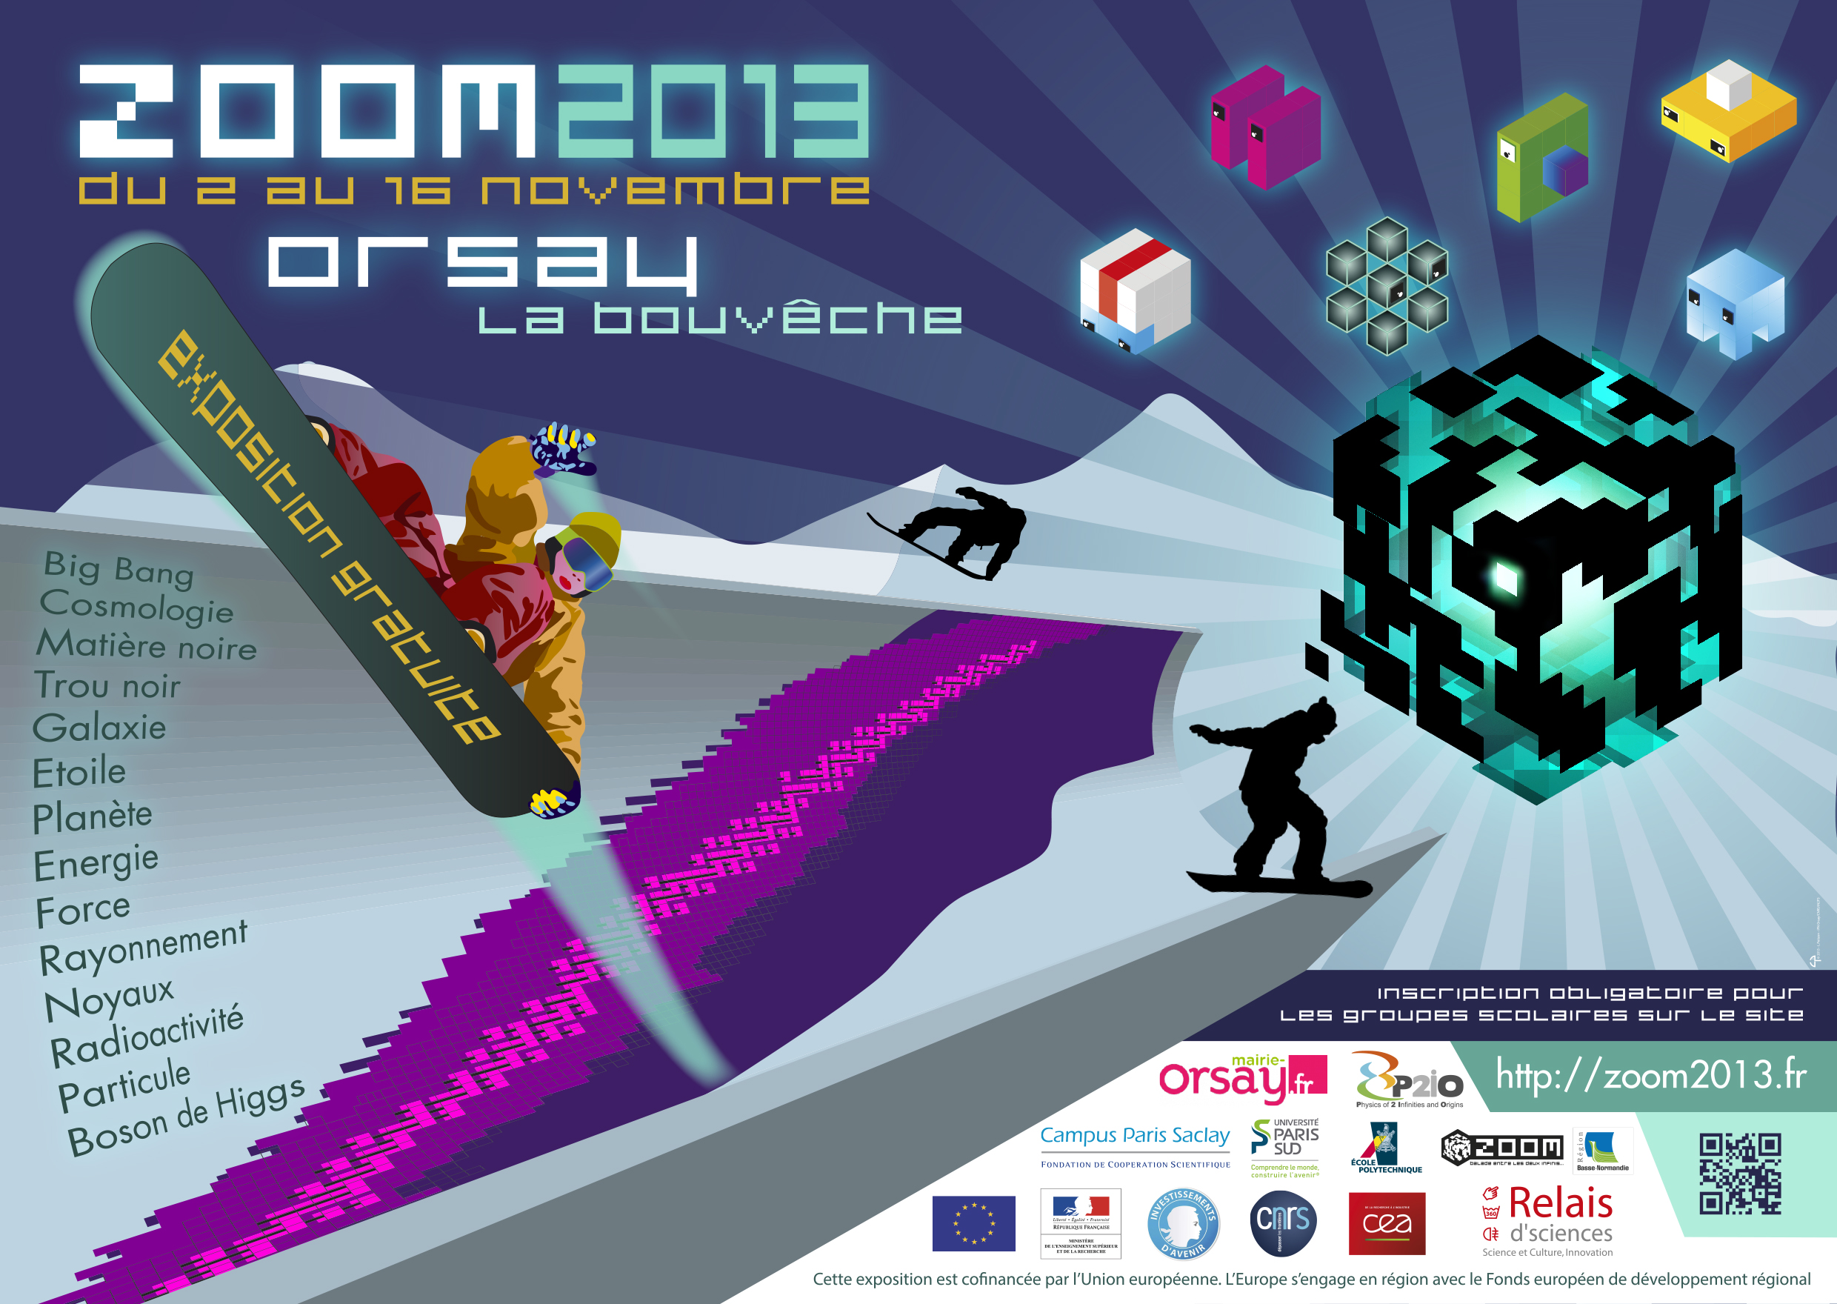
Visibility of P2IO research
Interactive exhibition for a large audience (high school, public)
Support from doctoral school 22k P2IO + 3.5k external

Slide 9
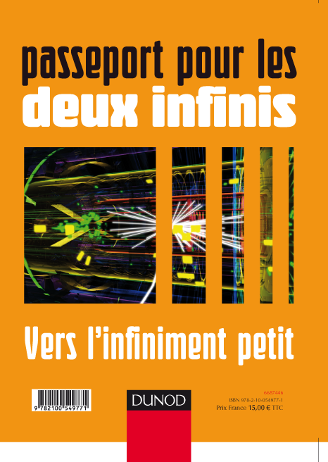
Visibility of P2IO research
Publication of a book+numerical tools
Presenting the world and the physics of P2IO
to high-school pupils and teachers
http://www.passeport2i.fr/
Cost: 5k
Proposal to pursue by organizing training sessions for teachers

Slide 10
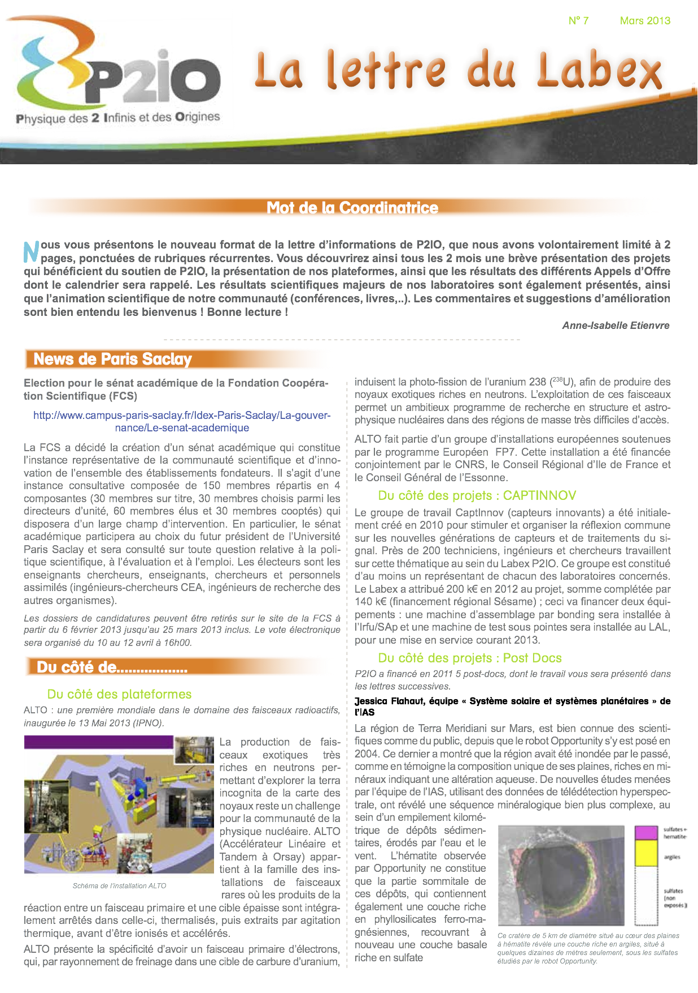
Visibility of P2IO research
@ http://www.labex-p2io.fr/
The P2IO project and related info
Publication of a newsletter
every 2 months.

Slide 11
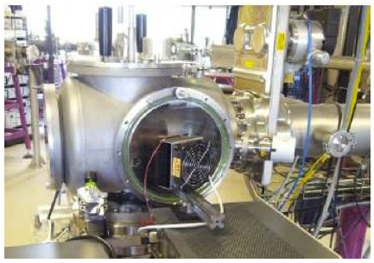
Enhance master Training
Instrumental work on P2IO platforms
For master 2 students on P2IO tracks:
Call for proposal April 2013,
selection by COPIL early July
5 projects, total of 85k

Slide 12
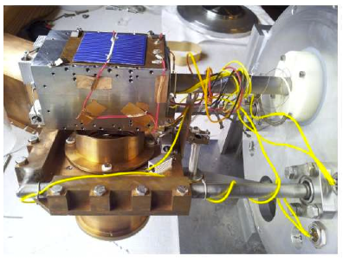
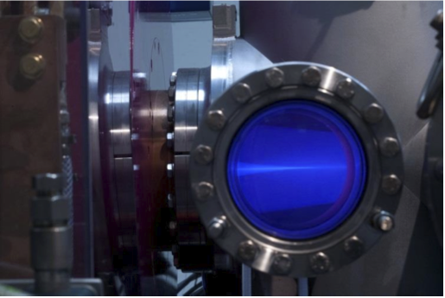
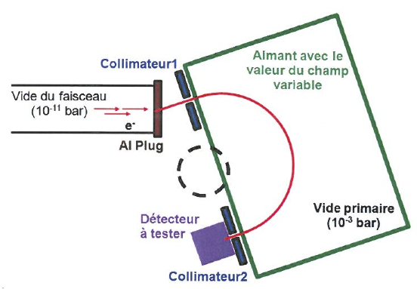
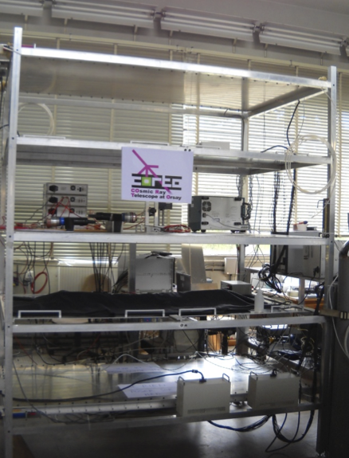
Enhance master Training
Material aging & cryogeny @ CSNSM
M2 AAIS, APIM/GI
Ion beam BETSI @ LAL and CEA
M2 NPAC, APIM/GI
Electron beam PHIL/LEETECH
@ LAL & CEA - M2 NPAC, APIM/GI
Cosmic ray telescope CORTO
@ LAL - M2 NPAC, APIM/GI

Slide 13
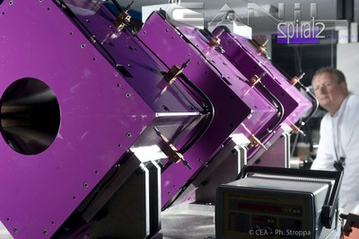
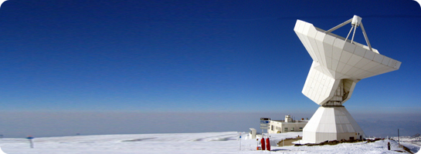
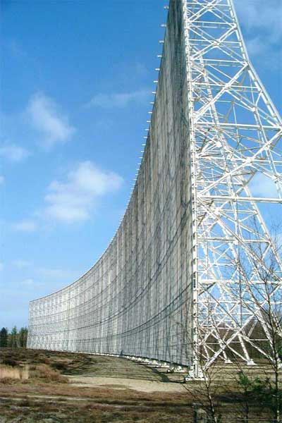
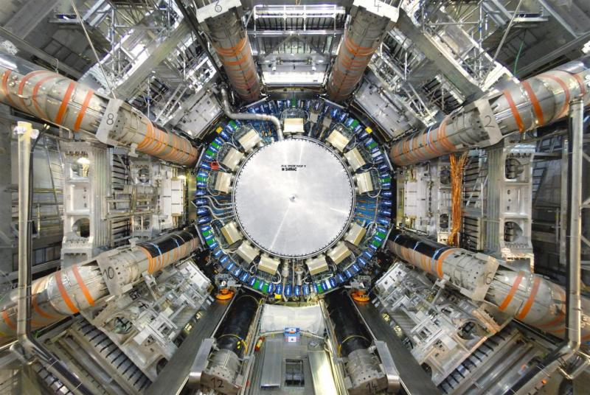
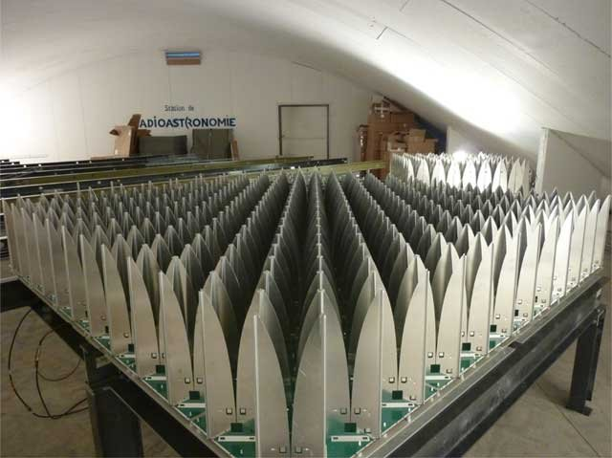
Enhance master Training
Visit and use international equipements
Training trips to international facilities (18k/year)
GANIL
IRAM 30m @ Pico Veleta, Spain
Nançay
CERN

Slide 14
Enhance master Training
- 2 Grants for master 2nd year students from abroad (8k/yr)
international opening
6 half PhD grants (50k / 3yrs)
complements grant distribution, targeted on selected topics
Cosmological B-field, String theory, neutron star, polarized quark currents,
B-meson factory

Slide 15
Summary & Perspectives
Thanks to enthusiastic commitment of P2IO staff and coordinators, numerous projects expanding visibility of P2IO research
- Feedback from public audiences, teachers, students is very positive
- For an average funding per year of 120 kEuros (excluding PhD grants)
Pursue yearly initiatives: school, night, exhibition
Further develop master training on platforms, develop new experiments « hands on » dedicated to training, develop european exchanges
After Zoom, develop link with high-school: conference cycles (with experiments ?), training of teachers…

