Slide 1
Highlights Spring 2013
April 15-19, Bologna, Italy
http://indico.cern.ch/conferenceDisplay.py?confId=220443

Slide 2
Overview
Site Reports : 17 contributions
Security & Networking : 7 contributions
  HA DNS architecture, Identity Management, Security, IPv6, Network monitoring
Storage & File Systems : 11 contributions
  AFS@CERN, Backup system migration at LAPP, Ceph Storage-as-a-Service, Long term data preservation in HEP, T1 Storage optization, Object Store, SAS expenders & software RAID optimization
Grid, Cloud & Virtualization : 5 contributions
EGI FedCloud testbed, Cloud layer over CMS HLT farm, Fermilab/ RAL experiences,
VM image sharing (vmcaster / vmcatcher)
IT infrastructures, Services, Business Continuity : 22 contributions
  CERN Agile Infrastructure, P2IO common facility in Orsay, CMDB, Puppet, Quattor, Messaging services, CERN Remote Data centre in Budapest…
Computing & Batch Services : 5 contributions
  GE monitoring, HS06 bench on recent AMD/Intel processors, Job packing @INFN, who can beat x86 ?

Slide 3
Topics
Many Talks from CERN
« Agile Infrastructure »
BigData (CEPH)
Tools : Puppet, Git, Owncloud, Drupal
Remote Tier-0 centre
  « Wigner Data Center » à Budapest
Identity Federation
Security
Business continuity, Service Management
High availability
Others
HEPix IPV6 (Testbed)
AFS future
Data preservation
Service Management (CMBBuild, CMDB deployment @ CC-IN2P3)
Tools : Monitoring, logs analysis(Splunk, noSQL use-case), Windows deployment (SCCM@Irfu)
New computing room in Orsay

Slide 4
Miscellaneous
Data center Energy Optimization
  Contact : Wayne Salter (CERN) IT Computing Facilities Group Leader
  HEPIX common effort on this topic ?
  Dedicated track on measures adopted at the different sites?
  Working group to share experience and advice on what measures could be taken by specific sites?
Open AFS future : BOF summary
  Still there is a community : Fermi, BNL, IN2P3, Beijing, DESY, Manchester, PSI…
  Create HEP AFS inventory found useful => to be done before the Fall 2013 HEPix Meeting
    Site contact, mid-term plans, AFS use-cases, requirements
  IPv6 & AFS : Towards a work plan
    Implementing it ourselves excluded
    What are our requirements ?
    Can we leave with private cells
  Gather information – Get in touch with core developers
  Set up a discussion and decide at the next HEPix meeting
  Follow-up by Peter van der Reest (DESY), Arne Wiebalck (CERN), Andrei Maslenniko (CASPUR)
SAS expanders and software RAID optimizations applied to CERN CC
  backup service

Slide 5
Site Reports

Slide 6
INFN Tier-1 site report
Luca dell’Agnello
CNAF’s 50 th anniversary
INFN Tier-1figures
  5 MVA - 1000 m2
  ~ 135 kHS06 => 13800 job slots (HT activated only on 10 % of the farm)
  11.4 PB disk,16 Po TAPE, 20 FTEs
  Upgrade to 40 Gb/S for LHCOPN/LHCONE + general IP upgrade to 20 Gb/s in April May 2013
Activities
  Complete transition to Jumbo Frame on LAN, 10Gbit gridftp and disk servers using JF, already enabled on WAN in 2010 - 2011
  IPV6 activation on general IP Q2 2013 : testing dual stack on dedicated services…Activation on LHCOPN Q4 2013
  SDN Software Defined Network openflow layout test
  Investigating GE as an alternative to LSF (comparison to SLURM)
  Virtual WNs on demand – VNoDeS solution distributed with EMI

Slide 7
GridKA Tier-1 site report
Manfred Alef
GridKa cluster
  146 kHS06 => 11800 phys. cores,
  17400 logical cores with HT, 14600 job slots, ~ 1 500 000 jobs/ month
  Was using PBSpro: many stability problems, problematic fairshares
Focus on LRMS migration from PBSpro to UNIVA GE
Fair-share configuration based on reserved usage (aka wall-clock time)
  CPU usage reported by qstat is reserved CPU aka walltime according to the fair-share settings
  Good feedback from Univa support desk located in Germany : patch provided

Slide 8
RAL Tier-1 site report
Martin Bly
RAL news : related to infrastructure & hardware changes
  power & cooling replacement and improvments still needed
HT : Enabled progressively at the end of 2012
  Previously no HT on WNs => accounting a nightmare with HT
Overcommit depends on node configuration
  2010/ 2011 generations of WNs : 12 cores 24 threads 20 job slots
  2012/2013 4GB / HT to enable 1 job per HT core
Asymmetric Data transfer rates in/out Tier-1 should be solved !
  Core C300 replaced by S4810P
RAL site network stability : LAN moving to mesh network
RAL (using CASTOR for TAPE access) - Next generation disk storage ?
  to run in conjunction with CASTOR : No clear obvious choice for now…Candidates : HDFS, Ceph …

Slide 9
CERN Tier-0 site report
Arne Wieback
LS1 until end of 2014 =>CERN Open days 27-30 september 2013
Remote Tier-0 : Wigner Data Center in Budapest
Data recorded : ~75 PB for LHC in 3 years
CERN will run out of public IPv4 addresses during 2014 (because of VMs !)
Oracle campus licence offer 2013-2018 : All WLC G sites can use a bundle of Oracle packages
Indico v 1.0 released in march
Version control : central git service as an alternative to SVN
  CVS planned to be stopped on June 2013
Savannah replaced by JIRA
Batch : SLURM investigation started

Slide 10
IT infrastructures, Services, Business Continuity

Slide 11
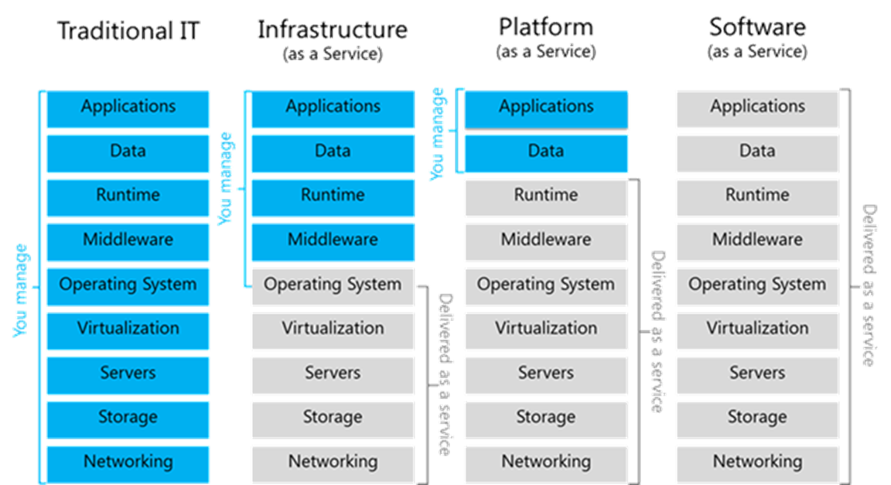
CERN Agile Infrastructure
Luis FERNANDEZ ALVAREZ
New resource & configuration management of IT infrastructure
  No increase in staff members => manage the infrastructure more efficiently
IaaS approach :
  private cloud based on Openstack (nova) / configuration with puppet
  Coll starting around Openstack with BNL, IN2P3, ATLAS/CMS, IHEP…
LCG context : enable remote management of 2nd Tier-0 data center
  unify the two CERN’s data
  centers located in Meyrin and
  in Wigner (Budapest)
90 % of hardware virtuali-
zed
In progress : Single source
  for accounting data

Slide 12
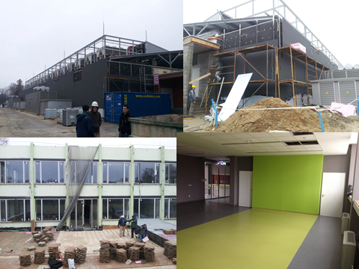
CERN Remote data center
Wayne Salter
Construction
  Started 21st May 2012
First room operational January 2013
Two 100Gbps links are operational since late January
  One commercial provider (T-Systems) and DANTE
    T-System RTT (Round Trip Time): 24ms
    DANTE RTT: 21ms
First servers delivered and installed March 2013
Operations
  Work still required to finalize operational procedures

Slide 13
Storage & File Systems

Slide 14
« My favorites »
Backup system migration at LAPP : from a local infrastructure to IN2P3 centralized system (Muriel Gougerot) Thanks to Remi Ferrand http://indico.cern.ch/contributionDisplay.py?contribId=30&sessionId=3&confId=220443
SAS expanders and software RAID optimizations applied to CERN CC backup service (Julien Leduc)
  http://indico.cern.ch/getFile.py/access?contribId=38&sessionId=3&resId=0&materialId=slides&confId=220443
  Comparison of RAID configurations : 5 RAID 10f2 vs 10 RAID 1E
  Switching to software RAID allowed more optimizations and more in depth knowledge and control than proprietary hardware RAID
  ext4 alignment optimizations

Slide 15
Ceph as an option for Storage-as-a-Service
Arne Wiebalck, Dan van der Ster
Storage at CERN : AFS, CASTOR, EOD, NetApp filers, block storage for Virtual Machins…
Looking for a consolidated generic storage system ?
Ceph, distributed, open-source storage system being evaluated at CERN (not ready for production)
  Unification : object store, block store, file system
  Traditional storage management : file systems and blocks storage
  Additional layer : Object store or Object storage
  Decoupling the namespace from the underlying hardware
    No central table / single entry point / single point of failure
    Ceph uses instead an algorithm (Controlled Replication Under Scalable Hashing) to maps data to storage devices
    No central metata data server : Algorithmic data placement with data replication and redistribution capabilities
Enhanced scalability of the storage system
Looks promizing as a generic storage backend
  For both image store/sharing and S3 storage service

Slide 16
Grid, Cloud & Virtualization

Slide 17
CMSooooCloud
Wojciech OZGA
Use of HLT farm farm during LHC LS1 : additional computing resources
  HLT farm :13312 cores 26 Tbytes RAM 195 kHS06
  CMS T0 121 kHS06 / CMS ∑ T1 150 kHS06 / CMS ∑ T2 399 kHS06
CMS specific computation on HLT farms
  Minimal change, opportunistic usage
  No reconfiguration no additional hardware
Cloudify the CMS HLT cluster : Overlay Cloud layer deployed with zero impact on data taking
Using Openstack
  Nova compute service manages the VM lifecycle
  Networking Virtualization (OpenVSwitch)
CMS online network seperated from CERN network
  Needs to increase the network connectivity to CERN Tier 0

Slide 18
Security & Networking

Slide 19
Security update (1/2)
Romain Wartel
Citadel incident : cf. CERT Polska public report http://www.cert.pl/PDF/Report_Citadel_plitfi_EN.pdf
Putting in place a malware infrastructure & Business model …
Still typical ssh-attacks in the academic community
Back to the 90s : Ebury revisited : old style (1990s) sshd trojan
  Actively used in 2011 ; found mostly on RHEL-base systems
  Attacks can be discovered just by checking checksums of installed
  RPMs/DEBs.
  Are we checking the integrity of binaries ? Which tools ?
WLCG Operational security : 10-12 incidents per year,
  2012 has been a quieter than usual
  Attacks are more and more sophisticated
Security paradigm shift

Slide 20
Security update (2/2)
Romain Wartel
The classic approach (strong controls mechanisms, well defined security parameters) … is to keep attackers outside
    the medieval approach
New approach is to grant access to trust users
  Security relies more on traceability & Ability to terminate access to users not following local policies
Manageable security :
  Attackers would never be allowed to…..
  Malicious users will be isolated
We will control the VMs .. BUT VMS
need access to local ressources and will
evolve dynamically
Isolation almost impossible
….traceability remains the key point

Slide 21
Common LHC Network monitoring
Shawn MC KEE
Common to the four experiments
Standardized network monitoring,
  Std tool/framework :perfSONAR
  Std measurement of network perf. Related metrics over time
WLCG Ops pS task force wiki : https://twiki.cern.ch/twiki/bin/view/LCG/PerfsonarDeployment
US ATLAS wiki : http://www.usatlas.bnl.gov/twiki/bin/view/Projects/PerfSONAR_PS_Mesh
PS-PS V3.3 (out very soon) will have all functionality for the mesh built-in
WLCG mesh configurations are hosted in AFS
https://grid-deployment.web.cern.ch/grid-deployment/wlcg-ops/perfsonar/conf/
LHC-FR Dashboard
http://perfsonar.racf.bnl.gov:8080/exda/?page=25&cloudName=LHC-FR

Slide 22

Next Meetings
HEPiX 2013 Fall Meeting, 28 Oct - 1 Nov, Univ. of Michigan, Ann Arbor, US
http://indico.cern.ch/conferenceDisplay.py?confId=247864
Spring 2014, May 19 – 23, LAPP !

