Slide 1
Network Monitoring and Troubleshooting with perfSONAR MDM
Domenico Vicinanza
DANTE, Cambridge UK
perfSONAR Training event for French Tier2 Sites
Paris, 4 April 2013

Slide 2
Outline
What is perfSONAR?
perfSONAR outside Europe
What does perfSONAR measure and how?
Interfaces:
Web UI
Mobile support (work in progress)
Weather maps

Slide 3
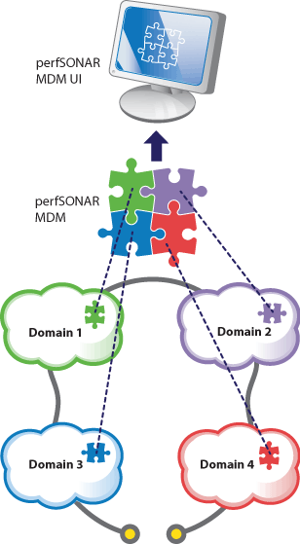
perfSONAR in a nutshell
Multi-domain distributed monitoring
International collaboration
GÉANT, Internet2, ESnet, and RNP
Flexibility, extensibility, open, and decentralization.
Currently
perfSONAR MDM within GÉANT: http://perfsonar.geant.net
perfSONAR PS within I2/ESnet: http://psps.perfsonar.net/
Open OGF protocol to exchange data
Web-service based

Slide 4
How does perfSONAR work?
Measurement points (MPs) across the networks.
Small server (or virtual server) connected to a network interface
MP runs the perfSONAR software to measure the following metrics:
Available Bandwidth
One Way Delay / Jitter (One Way Delay variation)
Route Tracing
PerfSONAR MDM web interface
Inspect measurements between any two MPs
Request a variety of ad hoc measurements.

Slide 5
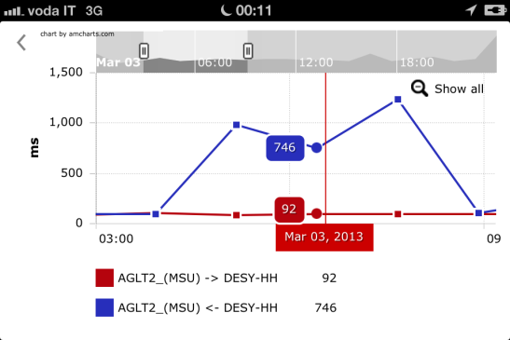
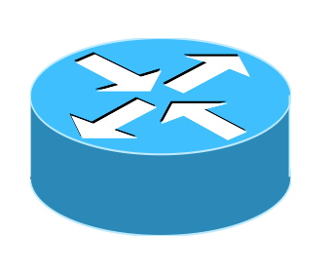
How does perfSONAR work?
Web UI
perfSONAR MP
Available Bandwidth
One Way Delay
Jitter
IP Route Tracing
perfSONAR MP

Slide 6
A new perfSONAR MDM: Compatible, open, interoperable
Actively working with the user community
direct user feedback
perfSONAR User Panel
Simplifying installation procedure
RPMs and DEB packages available
Virtual Machines images available
ftp://ftp.uni-ruse.bg/perfsonar-vm/
Live distribution on a USB stick
Revised documentation (lightweight and modular)
Interoperable with perfSONAR-PS

Slide 7
interoperability with perfSONAR PS (cont.)
Interoperable core components
perfSONAR user interface is able to interact with either perfSONAR MDM and PS archives
Retrieving and displaying measurements from any LHCONE MP

Slide 8
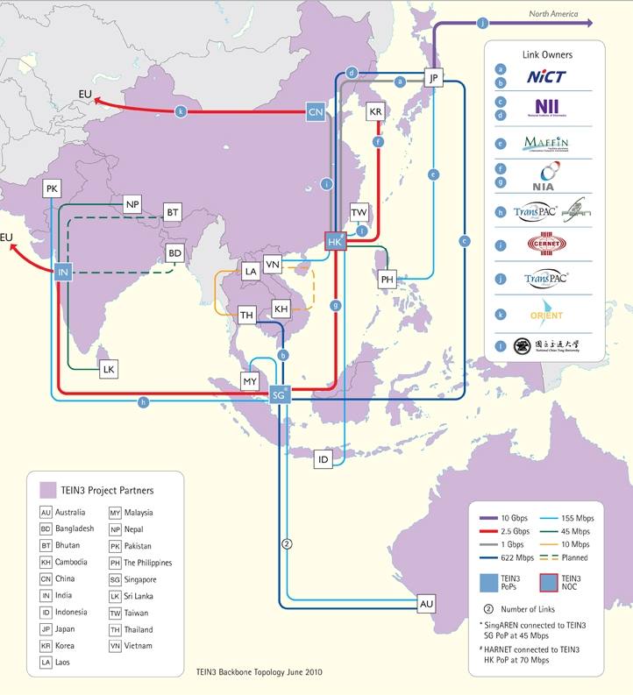
perfSONAR MDM deployment in Asia/Pacific
Active collaboration with TEIN3 NOC
3 Measurement Points:
Singapore
Hong Kong
Beijing
Already available in the current perfSONAR MDM UI

Slide 9
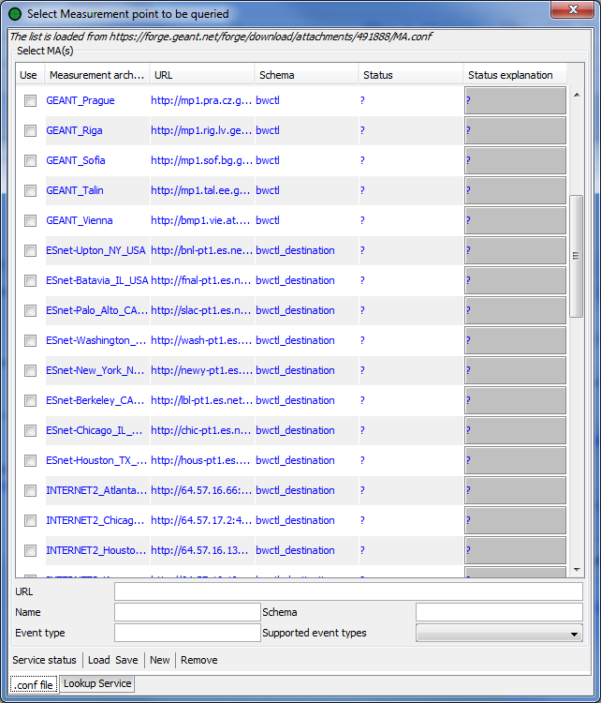
Interoperability with US deployments (ESnet/I2)
37 measurement points in the GÉANT service area
8 measurement points in ESnet
9 measurement points in Internet2
Measurements between perfSONAR MDM and PS from the same interface
Interoperability with perfSONAR-PS
Interest from perfSONAR-PS community in using our web UI
GEANT
ESnet
Internet2

Slide 10
What does perfSONAR measure and how?

Slide 11
Link utilisation, input errors, output drops (RRD-MA)
Purpose:
Monitor link utilisation, input errors, packet drops
Provide access to historical measurements
Strategy:
Query router interfaces statistics using SNMP
Store data into RRD files
made accessible through web-service

Slide 12
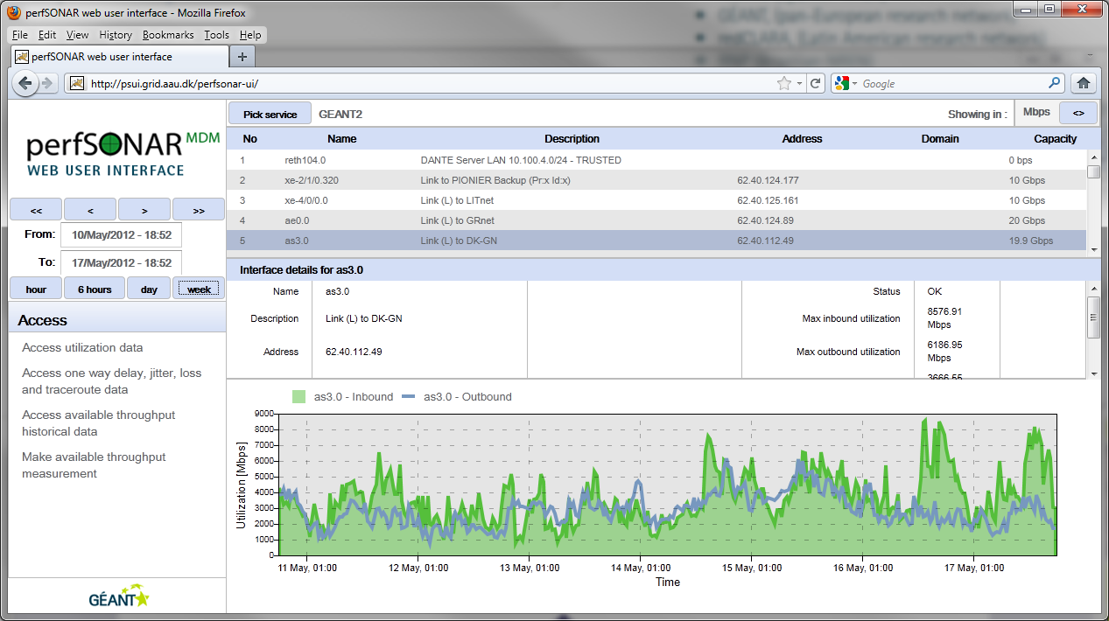
Link Utilisation User Interface

Slide 13
OWD, jitter, packet loss, traceroute (HADES/OWAMP)
Purpose:
Monitor OWD, jitter, packet loss, traceroute variations
Regularly scheduled
On demand (to be implemented)
Provide access to historical measurements
Strategy:
Sending 9 packets/minute between MPs (HADES)
Sending 10 packets/second between MPs (OWAMP)
Measure OWD, jitter, packet loss and tracking IP route
Store data into archives
made accessible through web-service

Slide 14
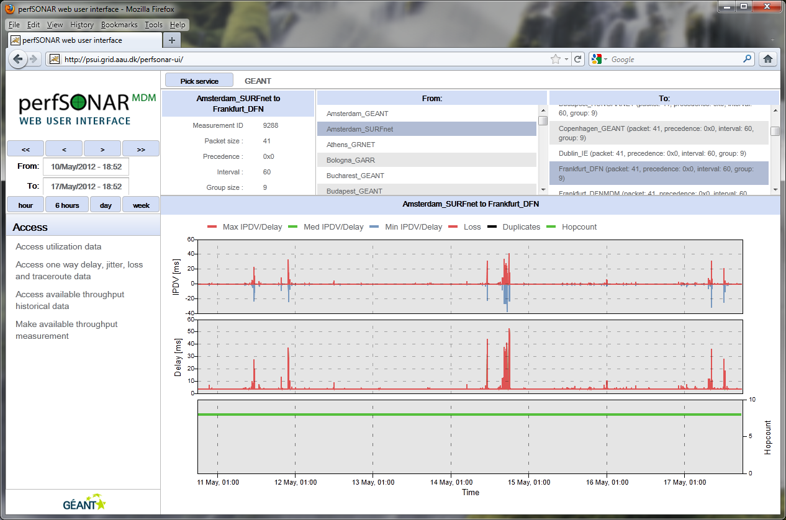
Web User Interface – OWD, jitter packet loss

Slide 15
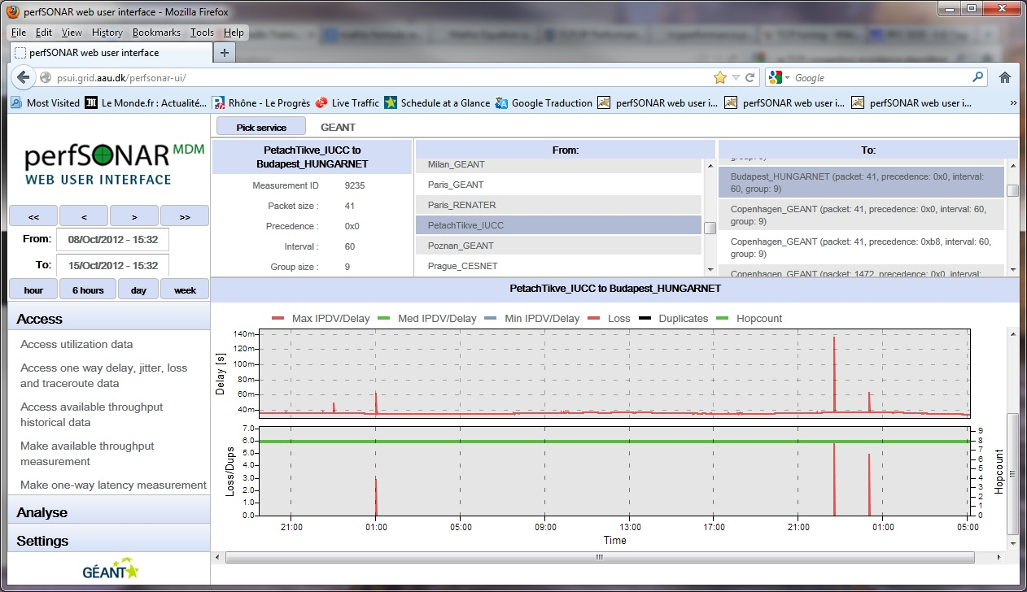
Example of packet loss: from regularly scheduled measurements
Look at here for packet loss

Slide 16
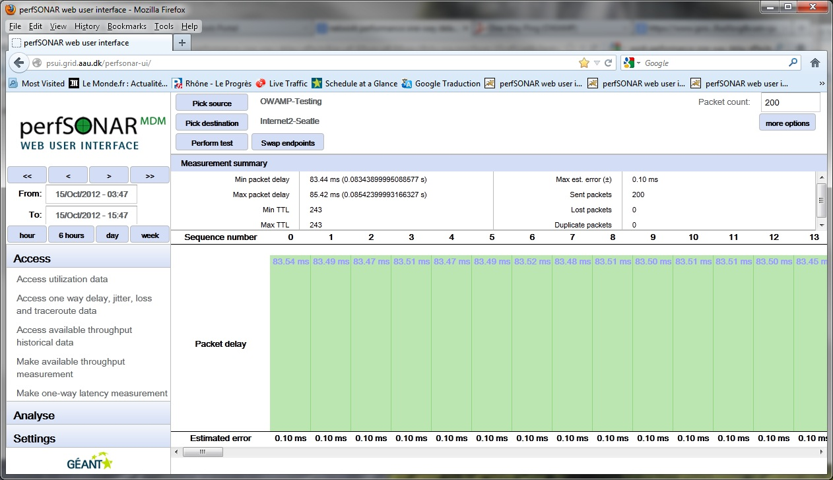
1-way delay on-demand (OWAMP)
Look at here for 1-way delay

Slide 17
Web User Interface – route comparison
Simple route comparison

Slide 18
Achievable bandwidth (BWCTL)
Purpose:
Measure the achievable bandwidth between two MPs
Regularly scheduled and
on demand (only for NREN NOC/PERT engineers)
Provide access to historical measurements
Strategy:
Run bandwidth test between MPs using a web-service interface to BWCTL
Display data with graph and store into perfSONAR SQL-MA archive
made accessible through web-service

Slide 19
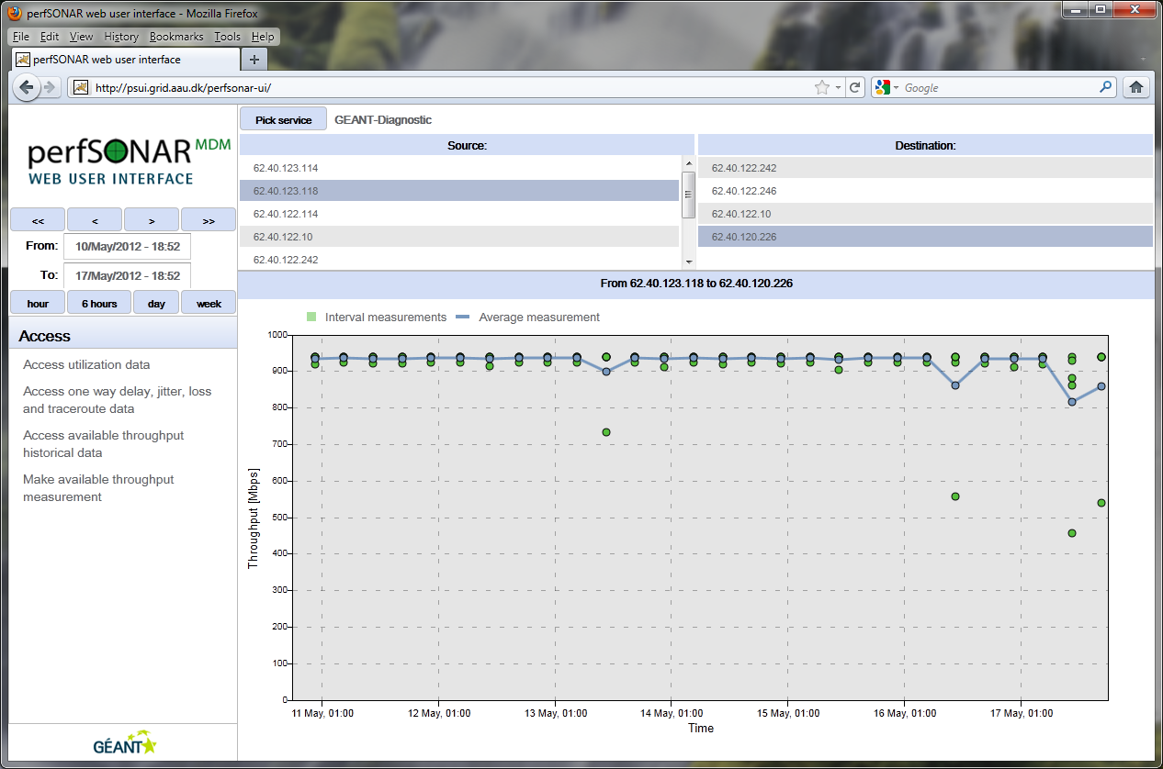
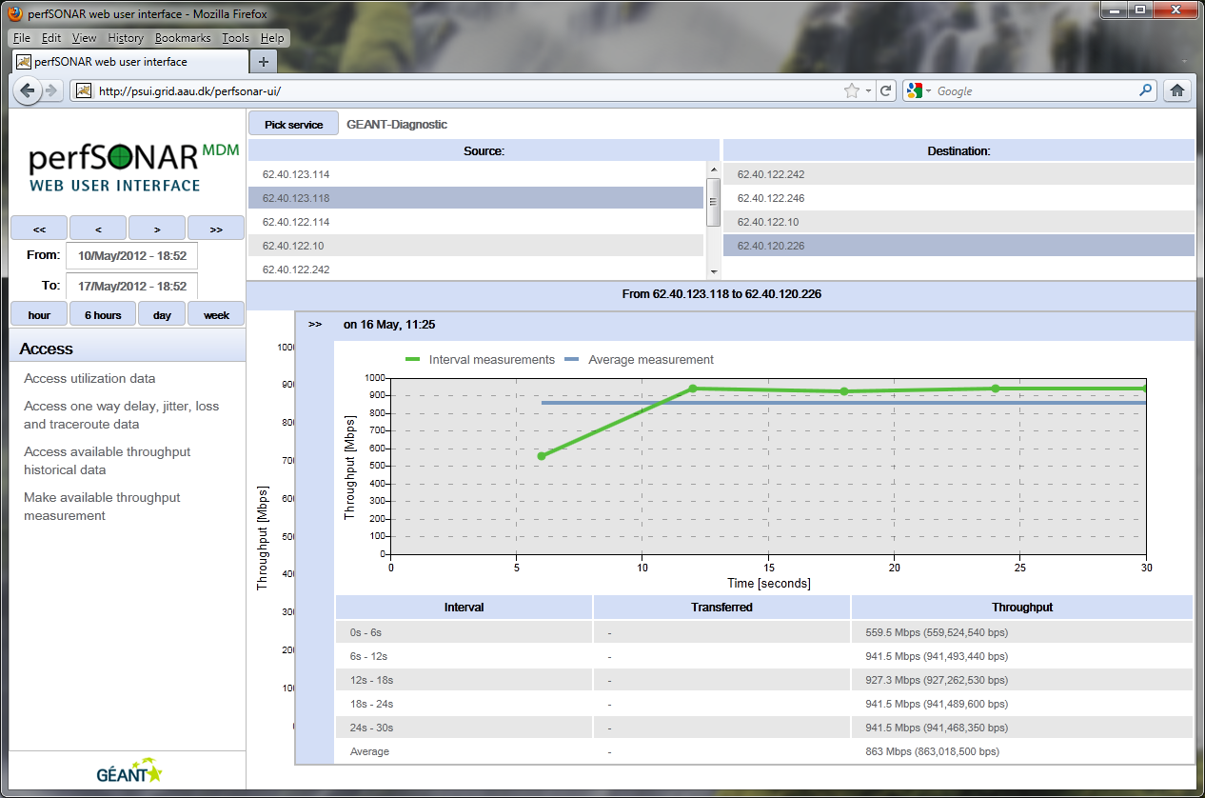
Accessing Historical Bandwidth Measurements
Each dot is a measurement.
Clicking on the dot a window displays the details

Slide 20
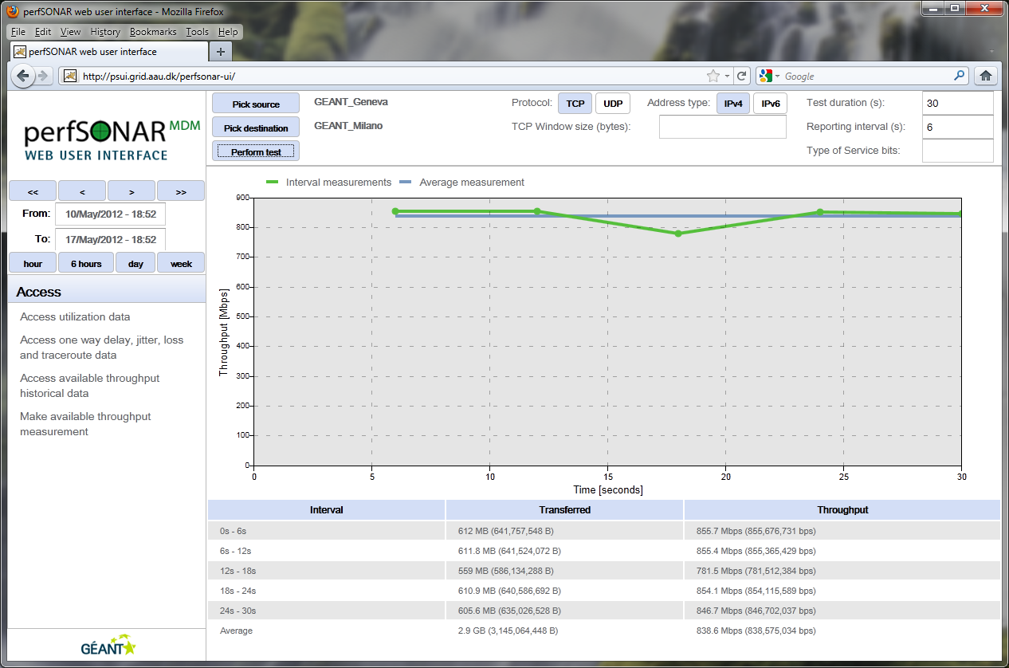
…and getting the results in two clicks from the web interface
Graph
Textual output

Slide 21
Support for mobile devices

Slide 22
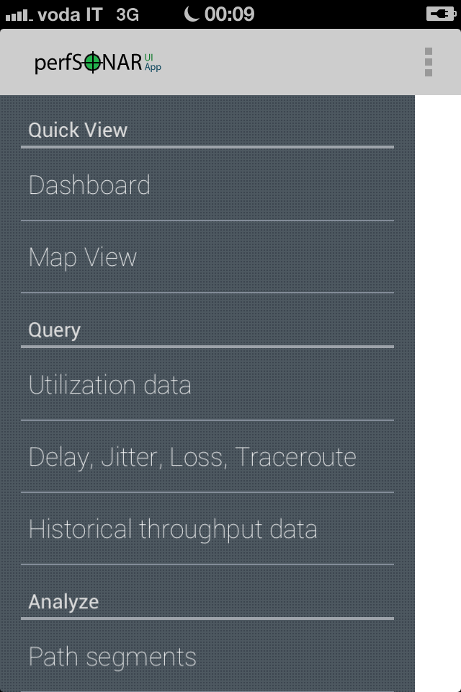
iPhone App (currently being developed)

Slide 23
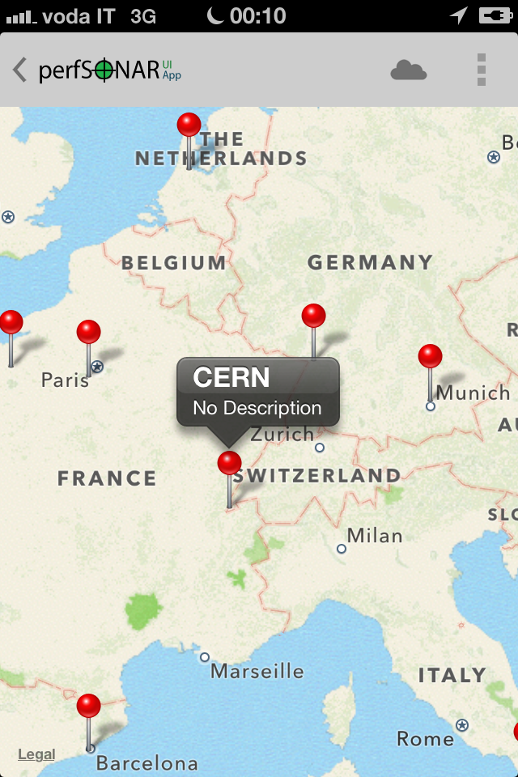
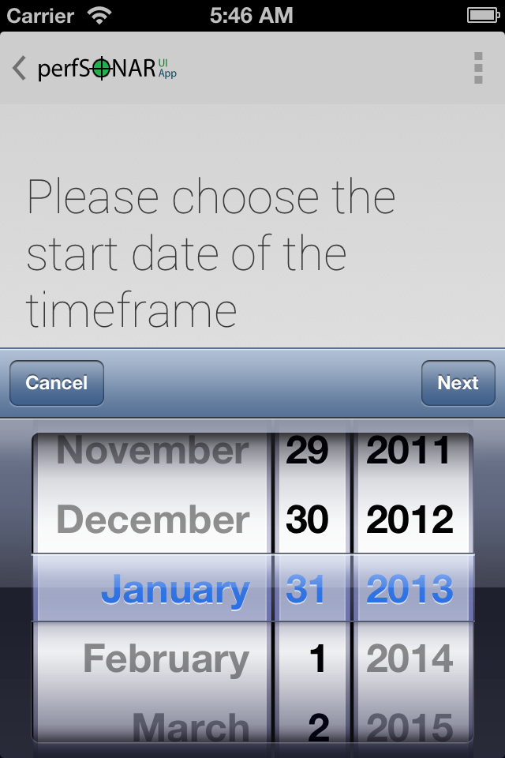
Native smartphone integration

Slide 24
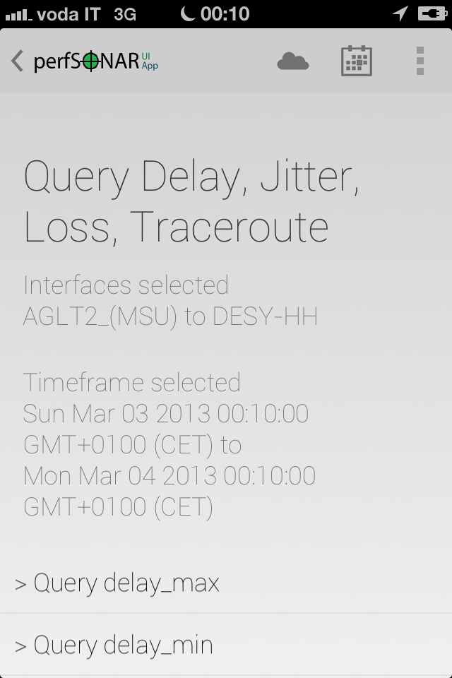
Example: Query One-Way Delay
Select end points and time
Timeframe selected

Slide 25
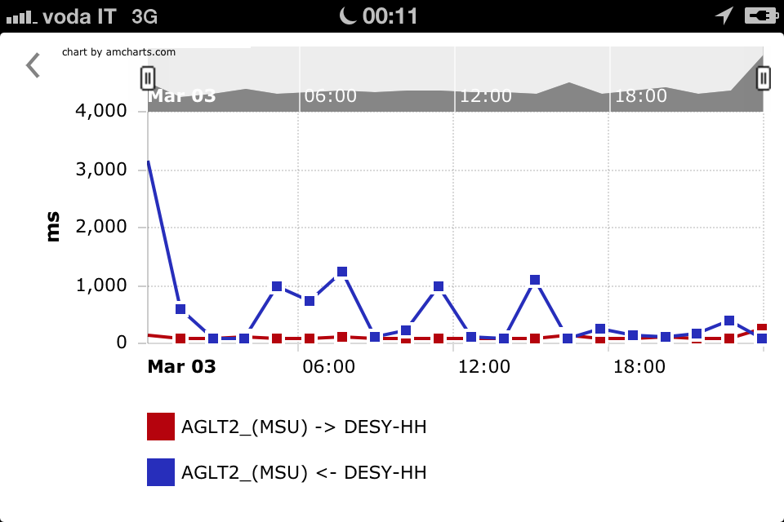
The result

Slide 26
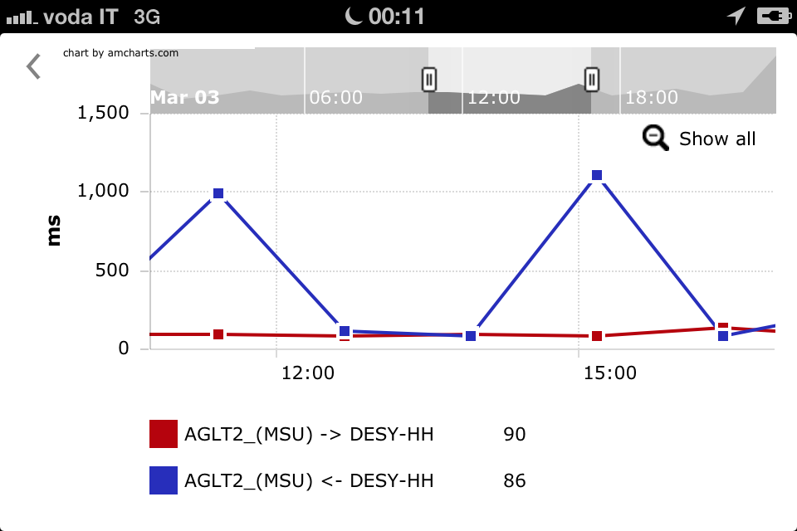
Zoom in/out

Slide 27
Detailed inspection

Slide 28
New developments: Integration of the new weather map

Slide 29
What’s new about the weathermap
Weather map reading live perfSONAR MDM data
Customisable coloured map
19 metrics implemented
The actual availability depends on what it is deployed on each site
Colour-coded according to the metric chosen
Wide variety of metrics to choose, including
OWD
Jitter
Packet Loss
Bandwidth
Link Utilisation / Input errors / Discarded packets

Slide 30
What’s new about the weathermap (cont.)
Interoperability:
Able to read OWAMP data
4 OWAMP metrics available at the moment (more to come)
Tested within the GÉANT/I2/ESnet collaboration framework DICE

Slide 31
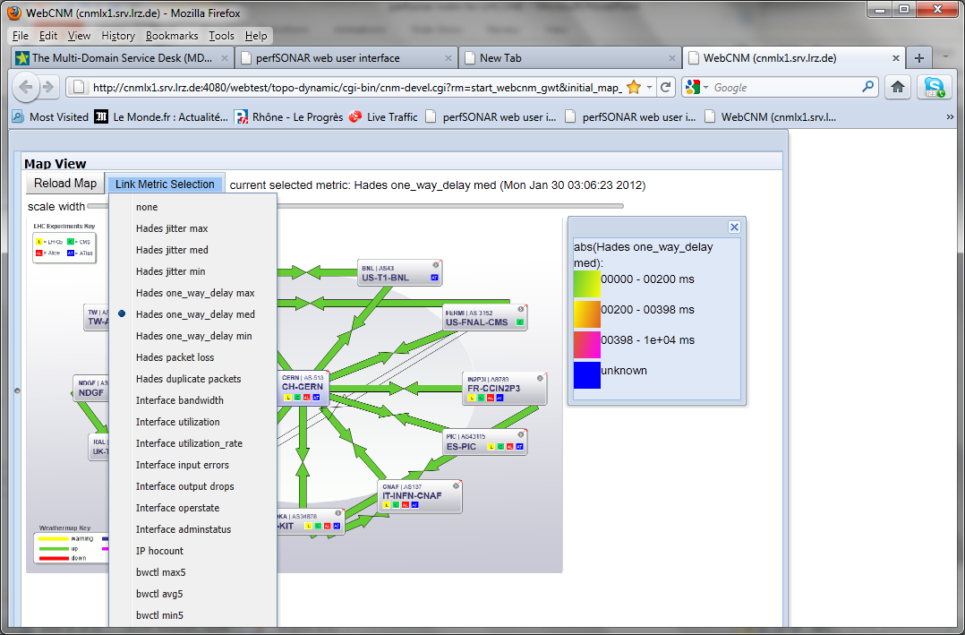
New weather map integration 19 perfSONAR parameters available

Slide 32
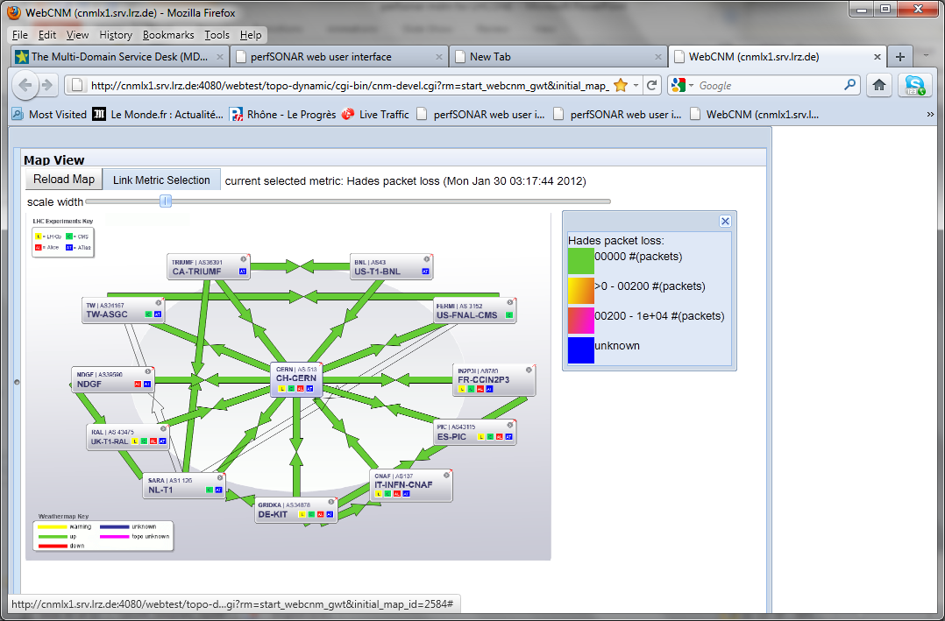
Weather map examples (Packet loss)

Slide 33
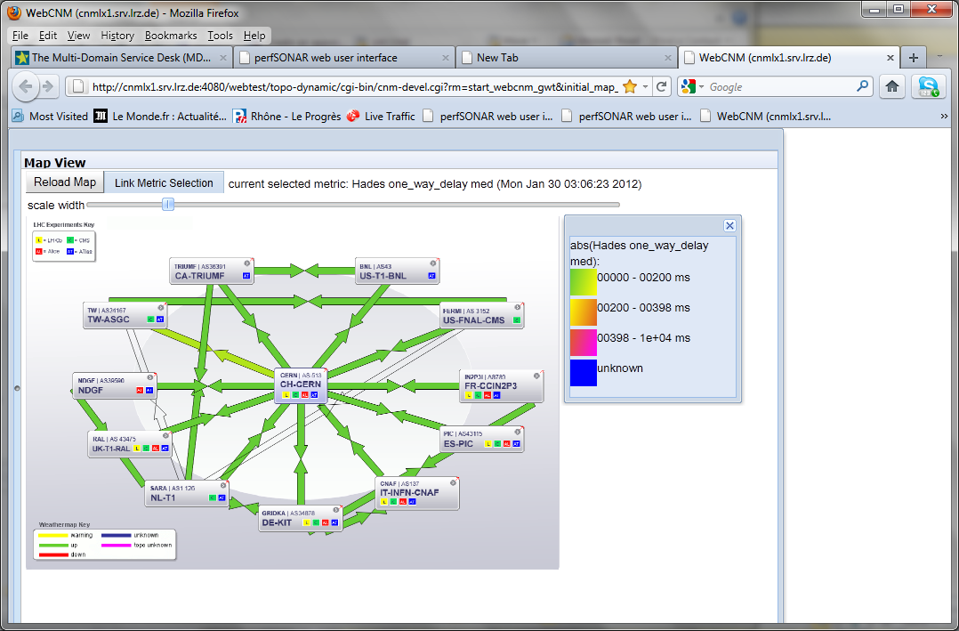
Weather map examples (One-way delay)

Slide 34
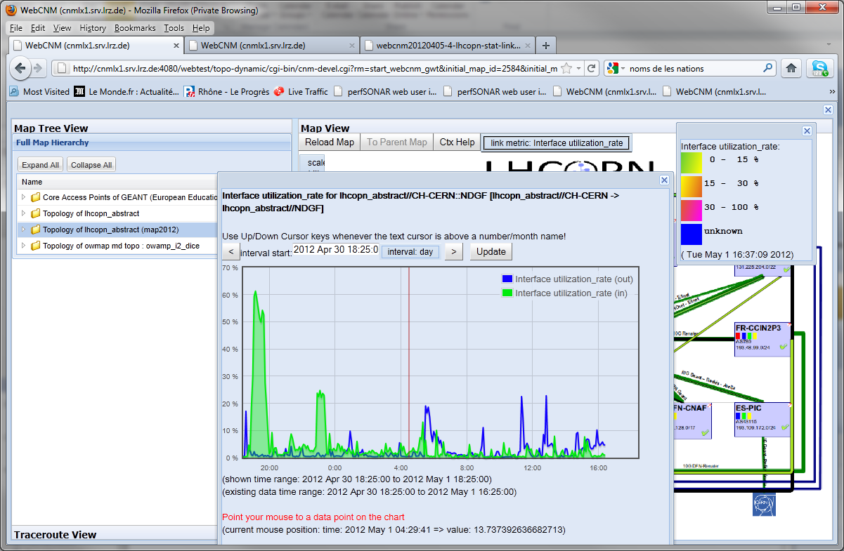
Another example: access to interface statistics

Slide 35
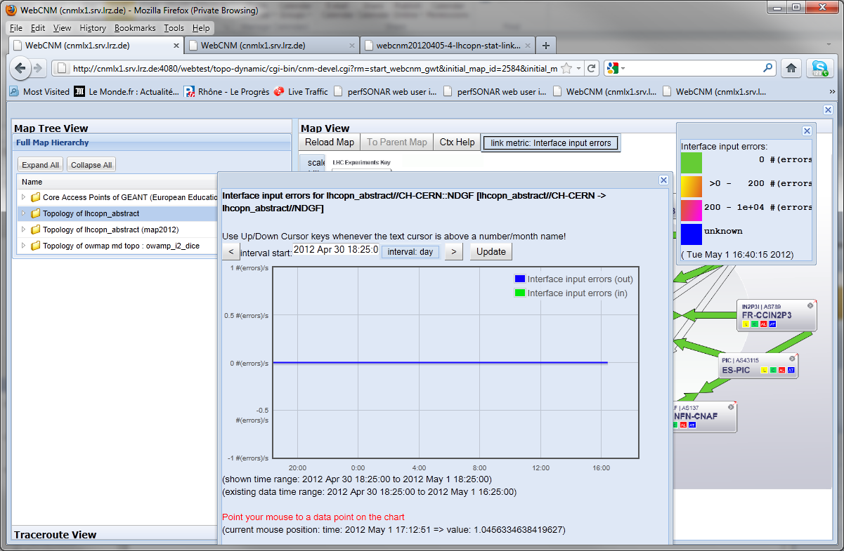
Another example: Interface input errors

Slide 36
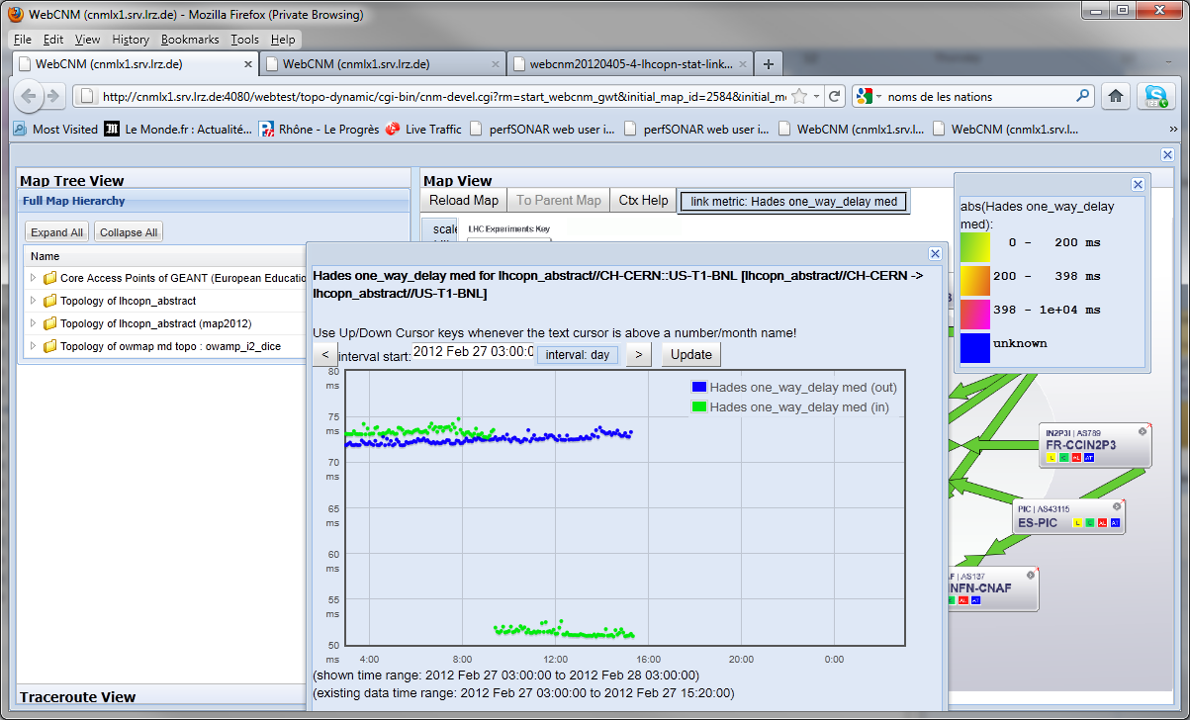
Example: Selecting one-way delay metric and clilcking on a link

Slide 37
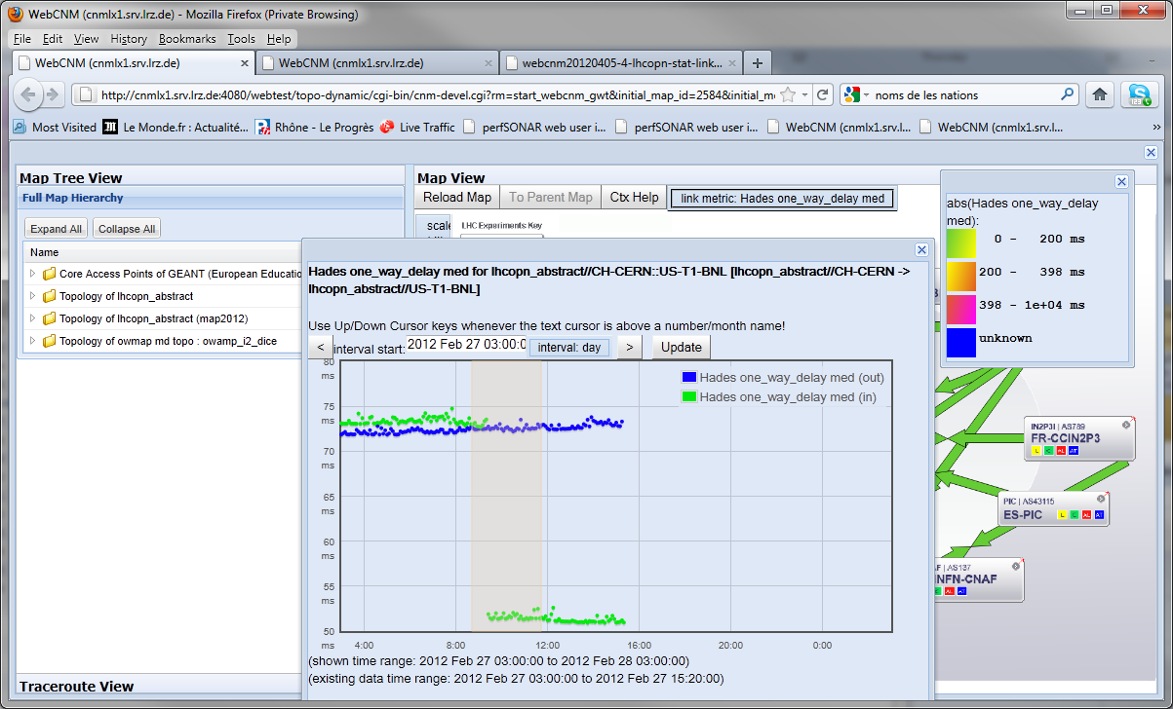
It is possible to select an area to magnify for further inspection

Slide 38
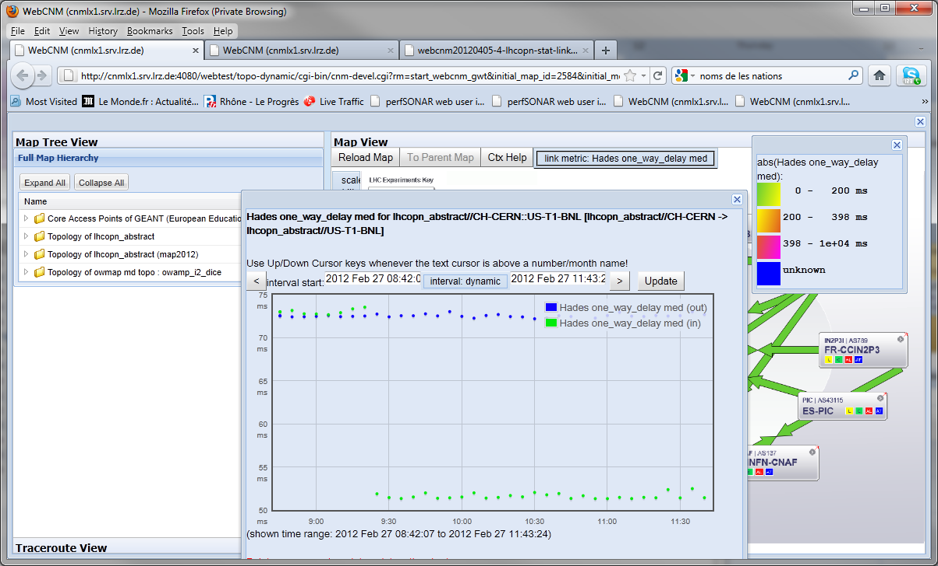
The OWD results after having magnified the area

Slide 39
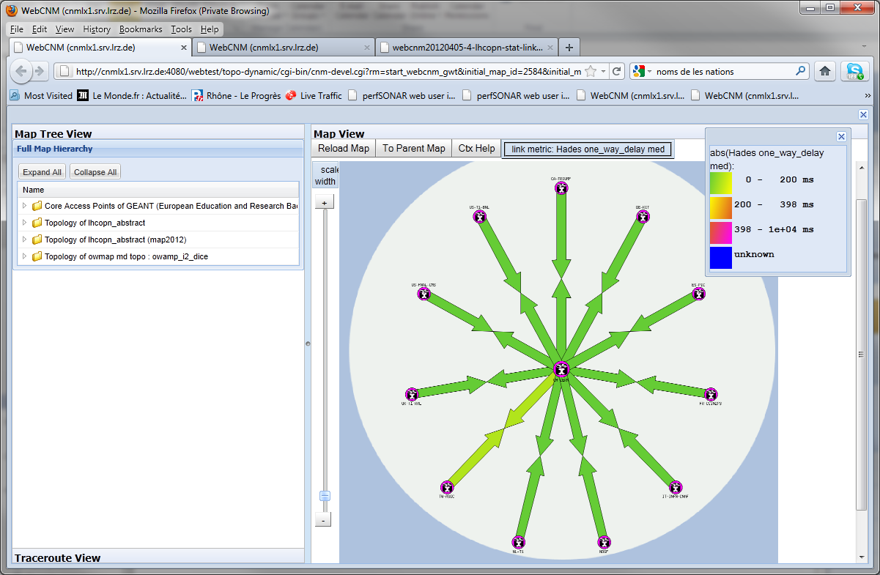
Site-specific star display shown when clicking on each site

Slide 40
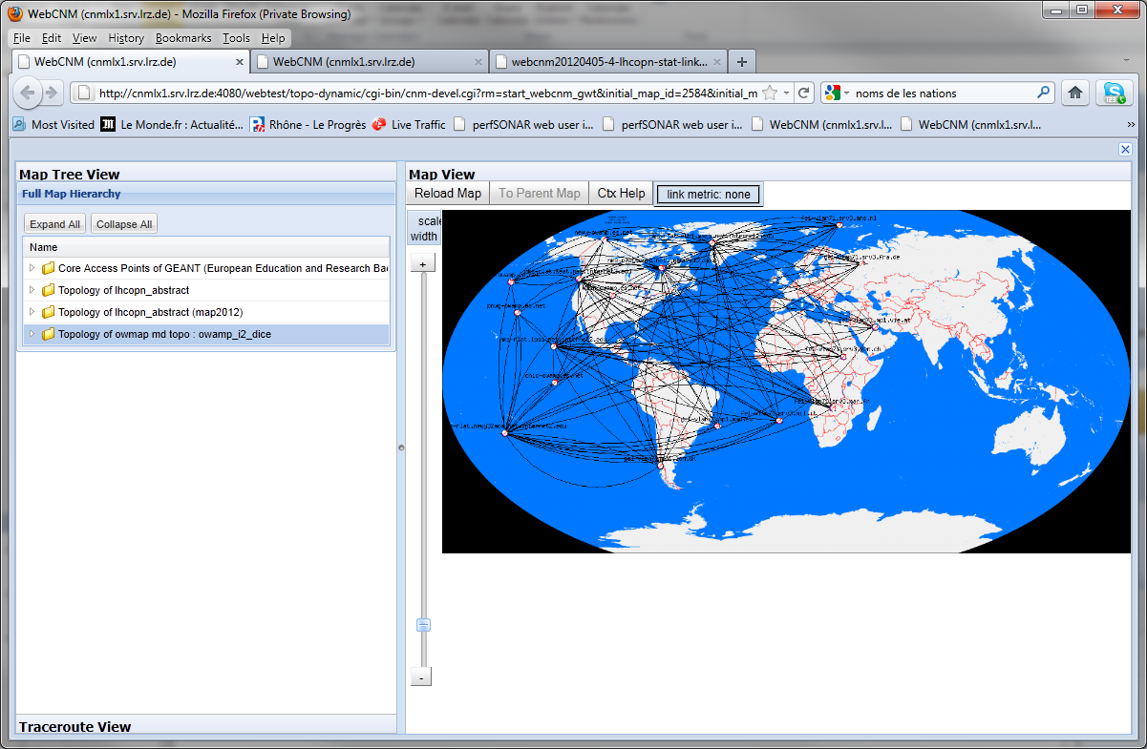
Interoperability with perfSONAR-PS

Slide 41
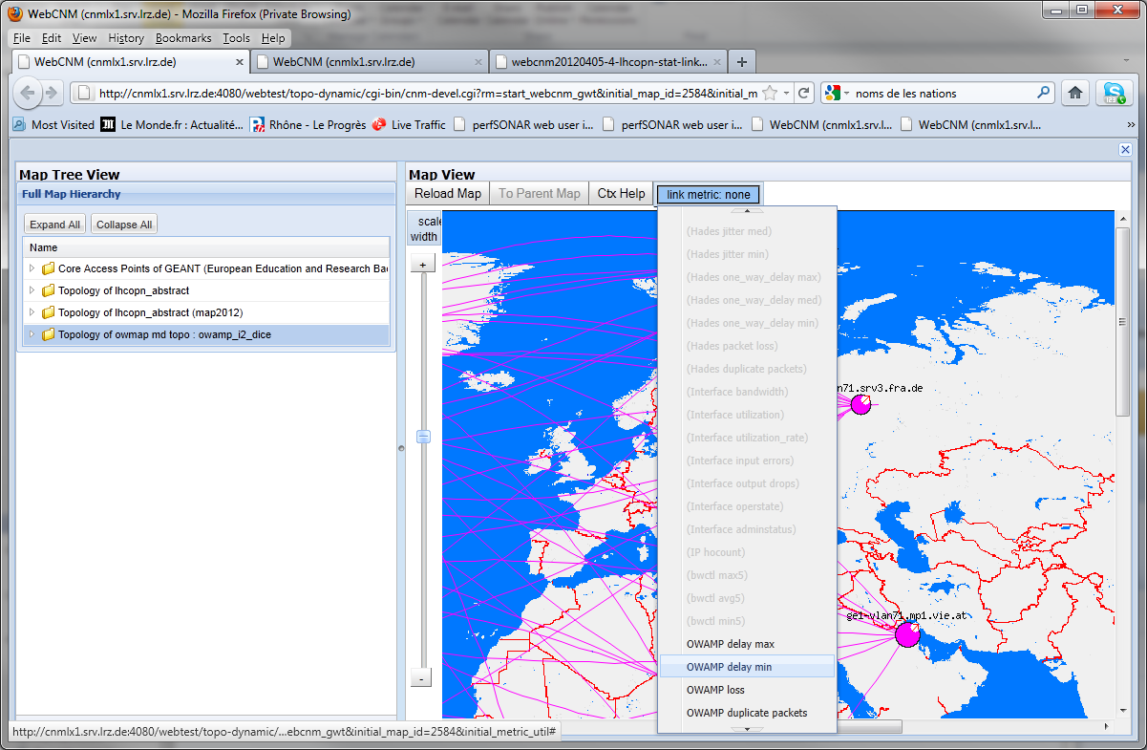
Four OWAMP metrics implemented up to now

Slide 42
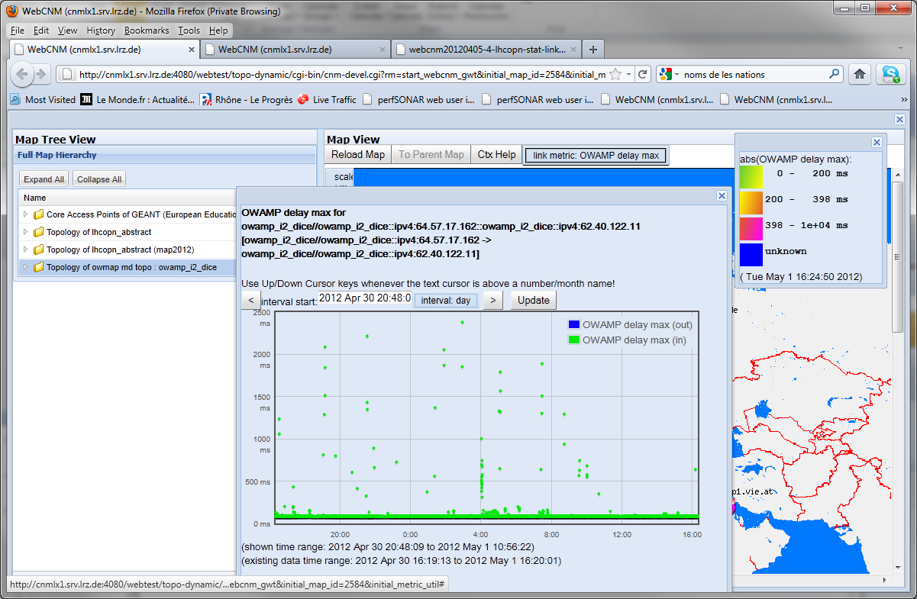
An example about OWAMP data retrieved by the interface

Slide 43
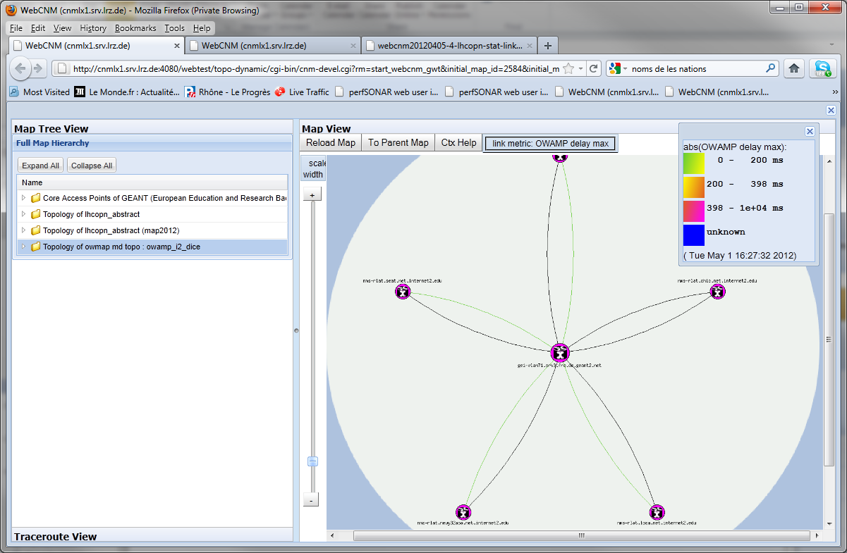
Details of the interoperability: perfSONAR MDM and PS connected
I2 Node with PS
GÉANT Node with MDM

Slide 44
Work in progress: The new weather-map for LHC (based on Open Street Map)

Slide 45
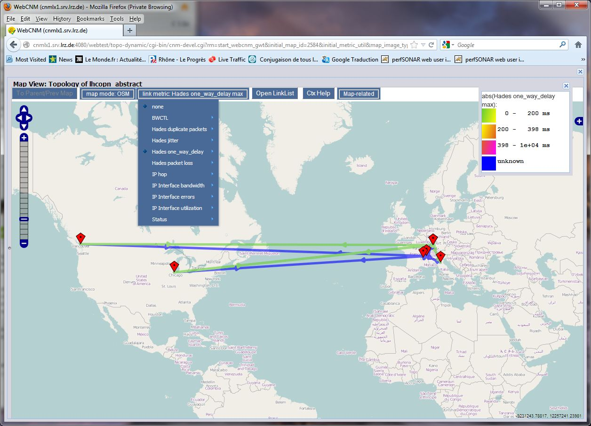
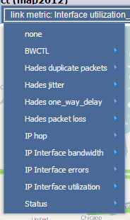
Several metrics to choose

Slide 46
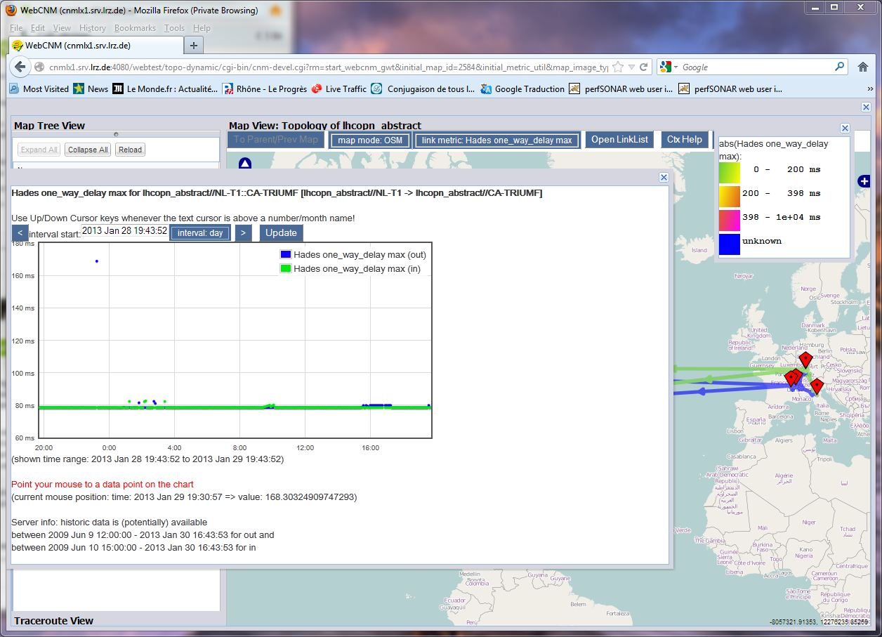
Graph
Notes:
Clicking on any link a graph is displayed showing the data from the perfSONAR archives

Slide 47
New developments. A proof of concept: VRF Monitoring with perfSONAR MDM

Slide 48
VRF Monitoring with perfSONAR MDM
VRF monitoring activity:
Both passive:
Monitoring VRF interfaces, link utilisation and errors/drops within the L3 VPN
And active
Bandwidth measurements
One Way Delay
Jitter
Packet Loss

Slide 49
perfSONAR VRF monitoring

Slide 50
LHCONE VRF monitoring
Three NRENs volunteered to start a first perfSONAR MDM deployment within the LHCONE L3VPN (VRF)
DFN
GARR
RENATER
Each NREN deployed a perfSONAR MDM server within LHCONE VRF
DANTE/GÉANT was running:
Central monitoring based on NAGIOS
Service desk (run by the Multi-Domain Service Desk)
Central archives
Central scheduling
perfSONAR web UI server
perfSONAR weathermap server

Slide 51
Status of the VRF monitoring
GARR, DFN, RENATER deployed three servers within LHCONE VRF
A perfSONAR dedicated web UI has been deployed for LHCONE
Nagios monitoring is in place
Service desk function is in place
More NRENs to come.
Please feel free to contact us to be added to the infrastructure or for additional info
Open to MDM and PS sites
On-demand capabilities only available with perfSONAR MDM
You can use a pre-installed VM image to be immediately onboard:
ftp://ftp.uni-ruse.bg/perfsonar-vm/

Slide 52
NAGIOS monitoring in place for LHCONE VRF MPs

Slide 53
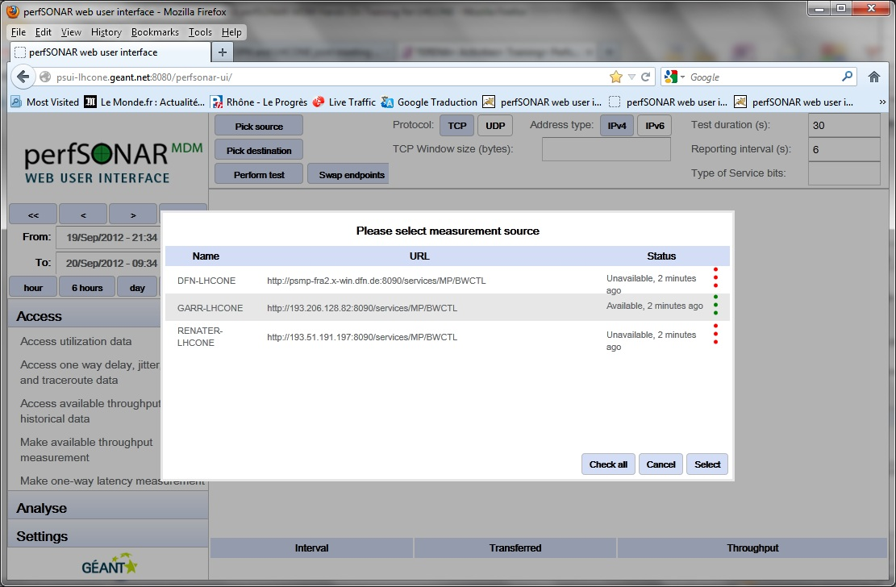
First screenshot of the LHCONE VRF monitoring

Slide 54
First results from LHCONE VRF monitoring web UI

Slide 55
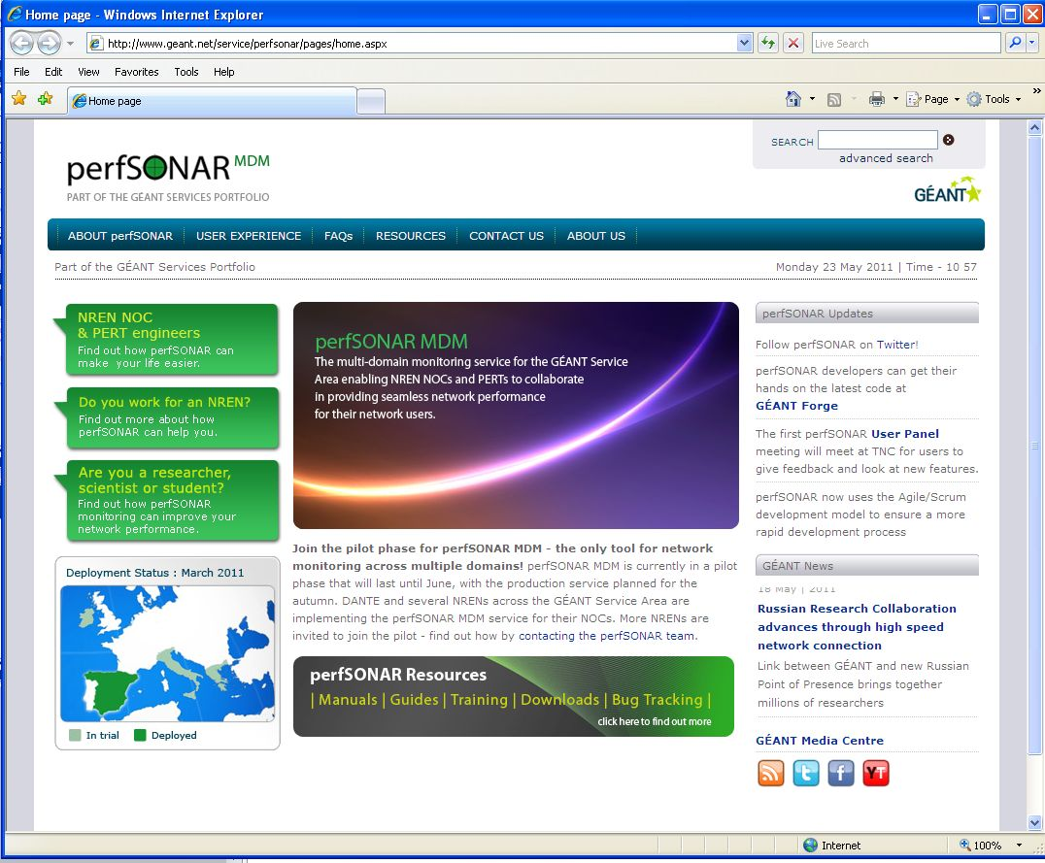
perfSONAR MDM website: http://perfsonar.geant.net
Goals:
Single point of access for perfSONAR
Contact points, FAQs, resources & downloads, and support
Host news and success stories from Users

Slide 56
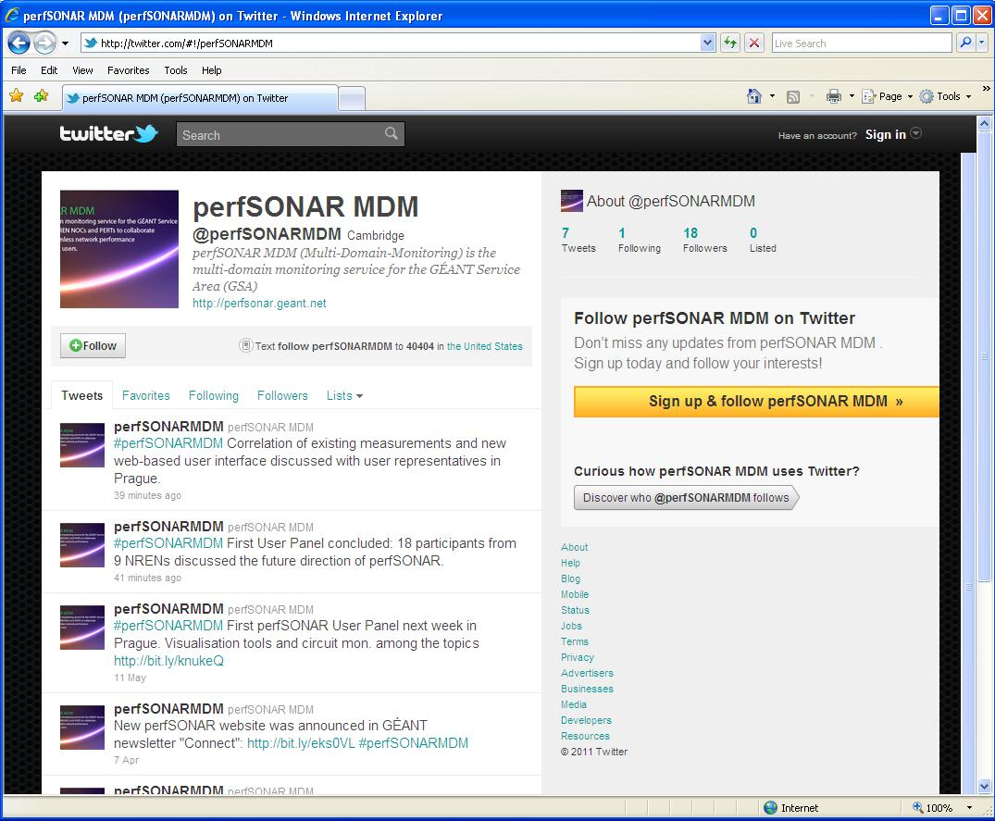
perfSONAR Twitter
Weekly tweets
Messages re-tweeted by other sister networks and organisations
Growing community of followers around the world
@perfSONARMDM

Slide 57
perfSONAR MDM. Be part of it.
Follow perfSONAR at:
http://twitter.com/#!/perfSONARMDM
Website: http://perfsonar.geant.net
Twitter: @perfSONARMDM
Info: domenico.vicinanza@dante.net

