Slide 1
CERN Computing Infrastructure Evolution
Tim Bell
Tim.Bell@cern.ch
IN2P3
2nd April 2013

Slide 2
Agenda
Problems to address
Ongoing projects
Data centre expansion
Configuration management
Monitoring
Infrastructure as a Service
Timelines
Summary

Slide 3
Outlook
LHC will be upgraded from 7TeV to 14TeV
The accelerator will be shutdown from March 2013 to end 2014
Next Long Shutdown due in 2017/2018
Trigger rates are expected to increase significantly
Data rates will double, at minimum
Computing requirements will need to match
Moore’s law alone may not be enough

Slide 4
Data Centre by Numbers
Hardware installation & retirement
~7,000 hardware movements/year; ~1,800 disk failures/year
Racks | 828
Servers | 11,728
Processors | 15,694
Cores | 64,238
HEPSpec06 | 482,507
Disks | 64,109
Raw disk capacity (TiB) | 63,289
Memory modules | 56,014
Memory capacity (TiB) | 158
RAID controllers | 3,749
Tape Drives | 160
Tape Cartridges | 45,000
Tape slots | 56,000
Tape Capacity (TiB) | 73,000
High Speed Routers (640 Mbps → 2.4 Tbps) | 24
Ethernet Switches | 350
10 Gbps ports | 2,000
Switching Capacity | 4.8 Tbps
1 Gbps ports | 16,939
10 Gbps ports | 558
IT Power Consumption | 2,456 KW
Total Power Consumption | 3,890 KW
Notes:
So, to the Tier-0 computer centre at CERN… we are unusual in that we are public with our environment as there is no competitive advantage for us. We have thousands of visitors a year coming for tours and education and the computer center is a popular visit.
The data centre has around 2.9MW of usable power looking after 12,000 servers.. In comparison, the accelerator uses 120MW, like a small town.
With 64,000 disks, we have around 1,800 failing each year… this is much higher than the manufacturers’ MTBFs which is consistent with results from Google.
Servers are mainly Intel processors, some AMD with dual core Xeon being the most common configuration.

Slide 5
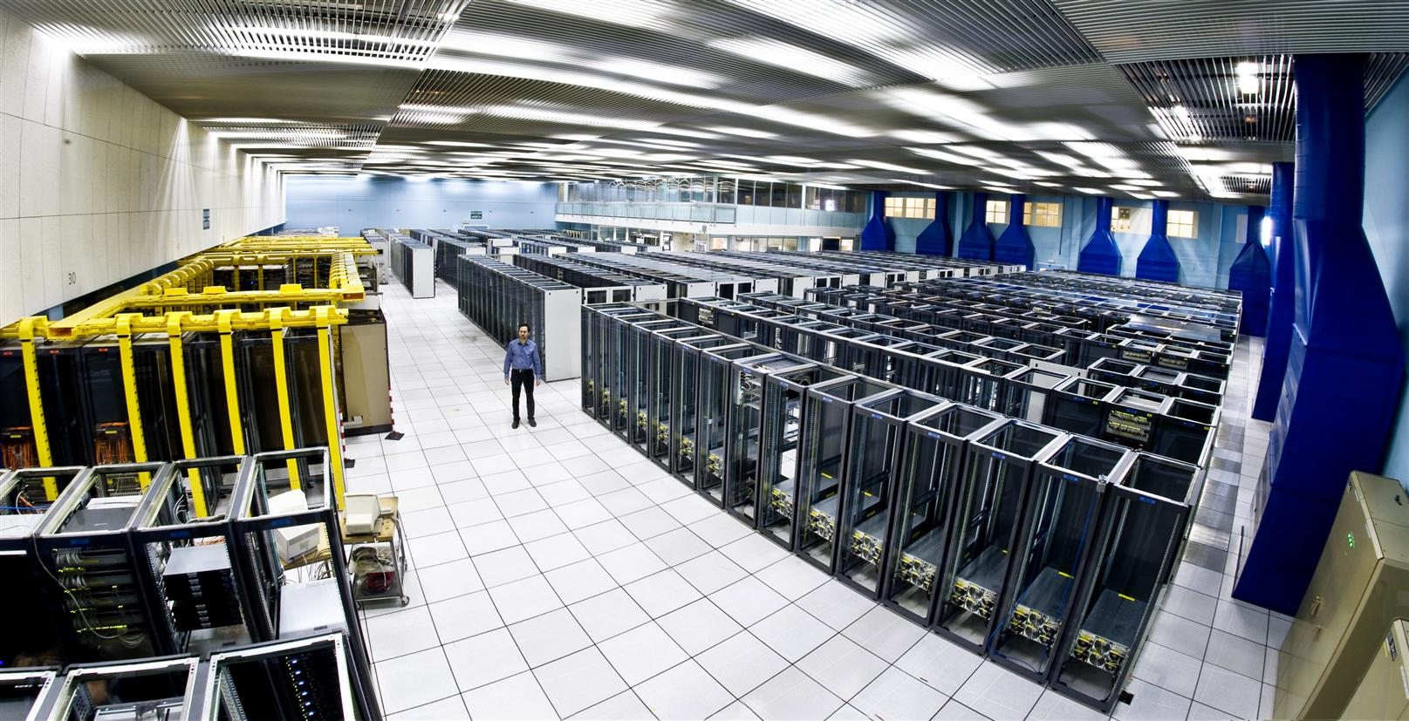
Notes:
Upstairs in the computer centre, a high roof was the fashion in the 1980s for mainframes but now is very difficult to get cooled efficiently

Slide 6
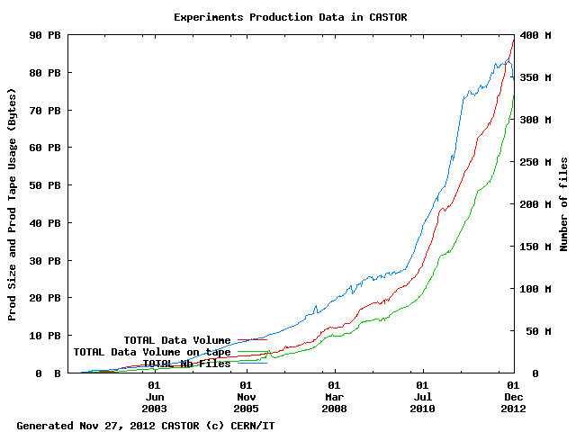
Data Storage Growth
>20 years retention
6GB/s average
25GB/s peaks
35PB/year recorded
Notes:
Our data storage system has to record and preserve 35PB/year with an expected lifetime of 20 years. Keeping the old data is required to get the maximum statistics for discoveries. At times, physicists will want to skim this data looking for new physics. Data rates are around 6GB/s average, with peaks of 25GB/s.

Slide 7
Expanding the Data Centre Facilities
Data centre in Geneva at the limit of electrical capacity at 3.5MW
Studies for additional centre at CERN in 2008/2009
Cost was high
Lack of on-site experience
Tendered for server hosting with CERN member states in 2011
3+1+1+1+1 year contract
Smart hands needed for installations, repairs and retirements
16 offers received from 10 countries
Short list of 5 selected which were evaluated in more detail
Adjudicated on price and service quality
CERN Finance Committee approved agreement in March 2012

Slide 8
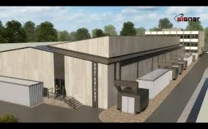
Winner was Wigner Research Centre
Based in Budapest, Hungary
Additional 2.7MW of usable power
Deploying from 2013 with 200Gbit/s network to CERN
Notes:
Studies in 2008 into building a new computer centre on the CERN Prevessin site
Too costly
In 2011, tender run across CERN member states for remote hostt
In March 2012, Wigner Institute in Budapest, Hungary selected
200Gbit/s links connecting the centres which is the fastest link across national boarders in the world
Expect to double computing capacity compared to today by 2015

Slide 9
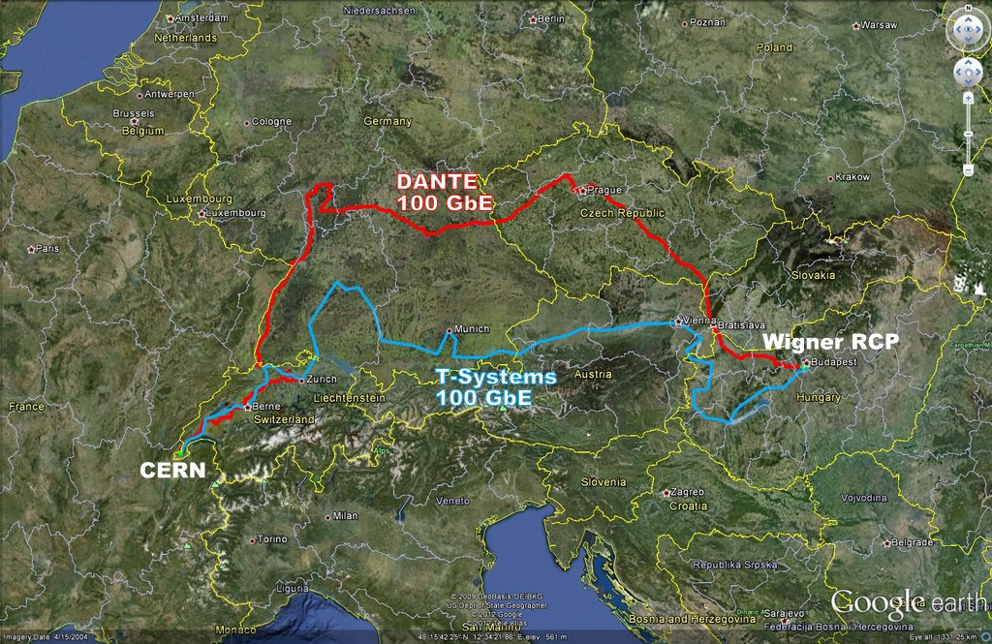
Wigner Networking

Slide 10
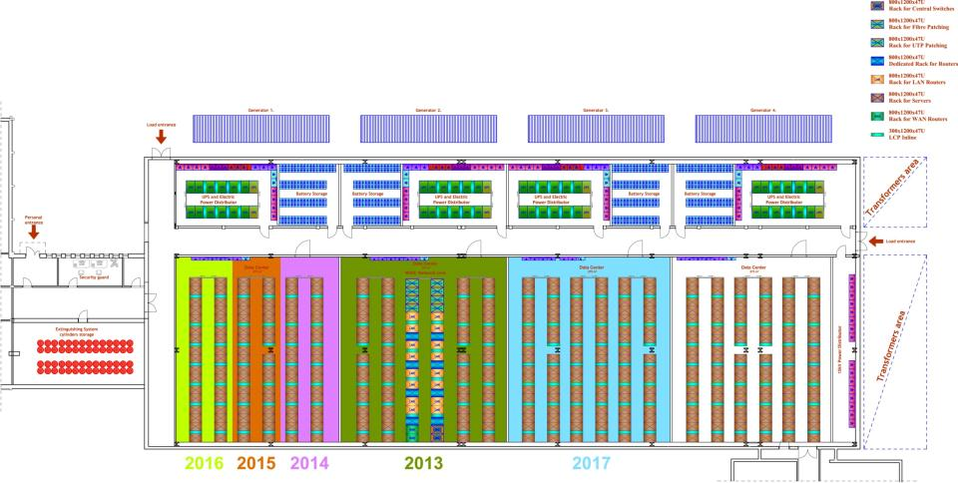
Staged Deployment

Slide 11
Time to Change Strategy
Rationale
Need to manage twice the servers as today
No increase in staff numbers
Tools becoming increasingly brittle and will not scale as-is
Approach
We are no longer a special case for compute
Adopt a tool chain model using existing open source tools
If we have special requirements, challenge them again and again
If useful, make generic and contribute back to the community
Address urgent needs first in
Configuration management
Monitoring
Infrastructure as a Service
Notes:
Double the capacity, same manpower
Need to rethink how to solve the problem… look at how others approach it
We had our own tools in 2002 and as they become more sophisticated, it was not possible to take advantage of other developments elsewhere without a major break.
Doing this while doing their ‘day’ jobs so it re-enforces the approach of taking what we can from the community

Slide 12
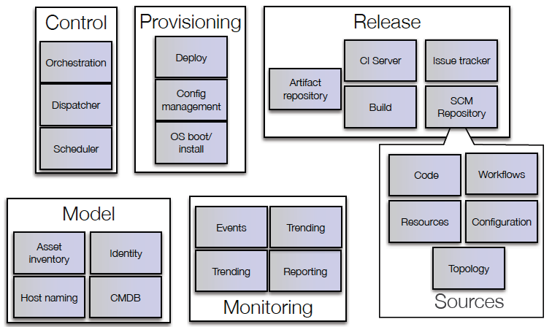
Building Blocks
mcollective, yum
Bamboo
Puppet
AIMS/PXE
Foreman
JIRA
OpenStack
Nova
git
Koji, Mock
Active Directory /
LDAP
Yum repo
Pulp
Hardware database
Lemon /
Hadoop
Puppet-DB
Notes:
Model based on Google Toolchain, Puppet is key for many operations. We’ve only had to write one new significant custom CERN software component which is in the certificate authority. Other parts such as Lemon for monitoring are from our previous implementation as we did not want to change all at once and they scale.

Slide 13
Chose Puppet for Configuration
The tool space has exploded in last few years
In configuration management and operations
Puppet and Chef are the clear leaders for ‘core tools’
Many large enterprises now use Puppet
Its declarative approach fits what we’re used to at CERN
Large installations: friendly, wide-based community
The PuppetForge contains many pre-built recipes
And accepts improvements to improve portability and function

Slide 14
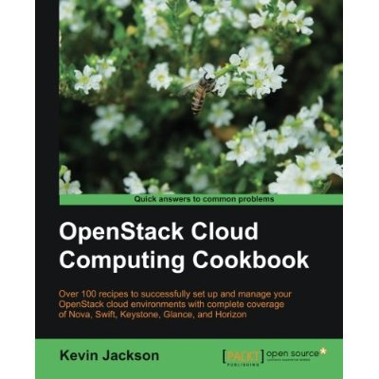
Training and Support
Buy the book rather than guru mentoring
Follow the mailing lists to learn
Newcomers are rapidly productive (and often know more than us)
Community and Enterprise support means we’re not on our own
Notes:
We’ve been very pleased with our choices. Along with the obvious benefits of the functionality, there are soft benefits from the community model.

Slide 15
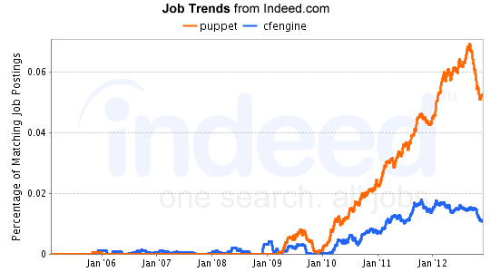
Staff Motivation
Skills valuable outside of CERN when an engineer’s contracts end
Notes:
Many staff at CERN are short term contracts… good benefits for those staff to leave with skills in need.

Slide 16
Puppet Experience
Basic puppet is easy to setup and can be scaled-up well
Well documented, configuring services with it is easy
Handle our cluster diversity and dynamic clouds well
Lots of resource (“modules”) online, though of varying quality
Large, responsive community to help
Lots of nice tooling for free
Configuration version control and branching: integrates well with git
Dashboard: we use the Foreman dashboard

Slide 17
Additional Functionality
Hiera provides a simple way to do conditional configuration
NTP Server = NTP1 if machine is in Geneva, NTP2 if in Budapest
PuppetDB provides a configuration data warehouse
Show me all the machines which have less than 4GB
Mcollective
Run this command on any machine which has a RAID card
Other OS support
Testing on Mac and Linux desktops
In the past, each of these were student projects to develop. Now, they are deployment and integration activities.

Slide 18
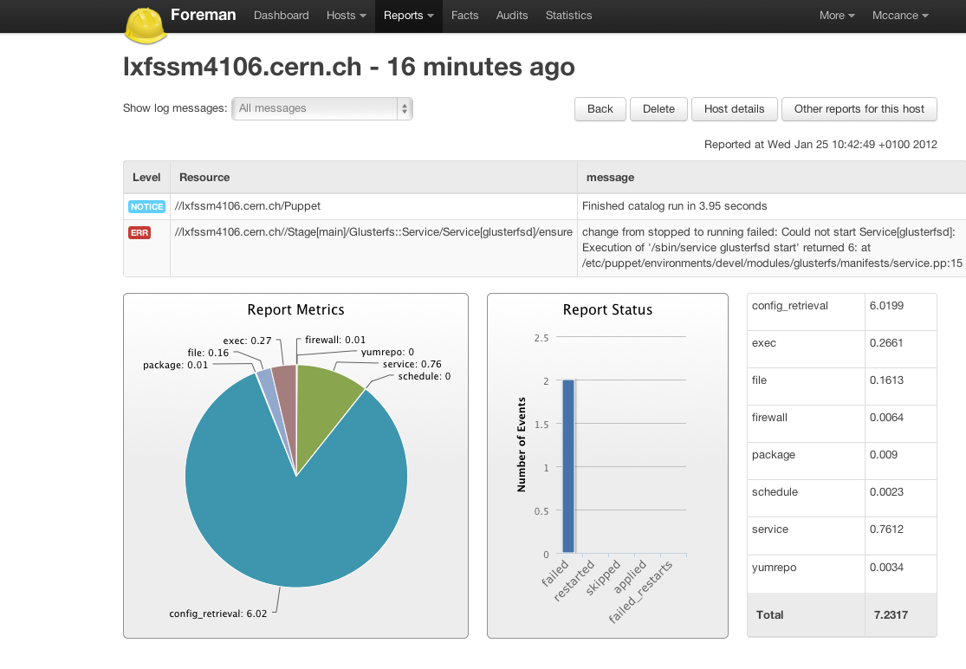
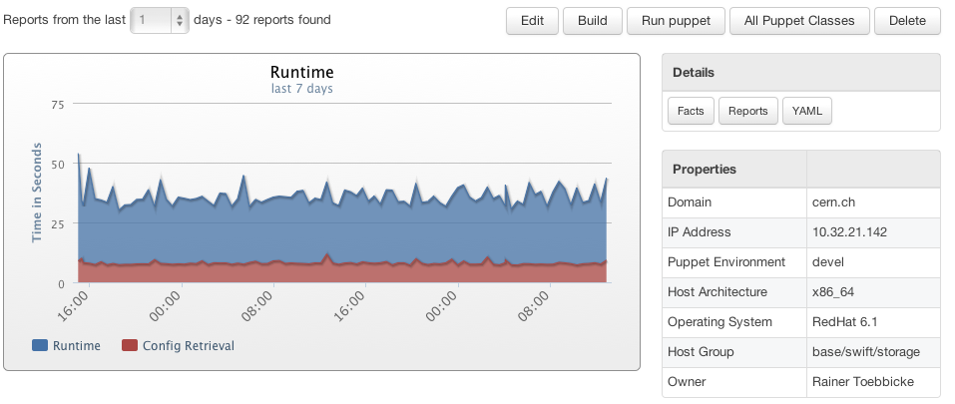
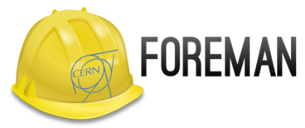

Slide 19
Monitoring evolution
Motivation
Several independent monitoring activities in IT
Based on different tool-chain but sharing same limitations
High level services are interdependent
Combination of data and complex analysis necessary
Quickly answering questions you hadn’t though of when data recorded
Challenge
Find a shared architecture and tool-chain components
Adopt existing tools and avoid home grown solutions
Aggregate monitoring data in a large data store
Correlate monitoring data and make it easy to access

Slide 20
Monitoring
Kibana?
Portal
Report
SNOW
Portal
Hadoop
Oracle
Analysis
Storage
Application
Specific
Logstash
Storage Feed
Alarm Feed
Custom Feed
Apollo
Aggregation
Lemon
Publisher
Sensor
Publisher
Sensor

Slide 21
Prepare the Move to the Clouds
Improve operational efficiency
Machine reception/testing by rapidly deploying batch VMs
Hardware interventions with long running programs by live migration
Multiple operating system coverage by multi-VMs per hypervisor
Improve resource efficiency
Exploit idle resources such as service nodes by packing with batch
Variable load such as interactive/build machines with suspend/resume
Improve responsiveness
Self-Service web interfaces rather than tickets to request resources
Coffee break response time
Support middleware simplification and cloud studies
Could we run LHC infrastructure with only an Amazon like interface?

Slide 22
Public Procurement Purchase Model
Step | Time (Days) | Elapsed (Days)
User expresses requirement |  | 0
Market Survey prepared | 15 | 15
Market Survey for possible vendors | 30 | 45
Specifications prepared | 15 | 60
Vendor responses | 30 | 90
Test systems evaluated | 30 | 120
Offers adjudicated | 10 | 130
Finance committee | 30 | 160
Hardware delivered | 90 | 250
Burn in and acceptance | 30 days typical 380 worst case | 280
Total |  | 280+ Days

Slide 23
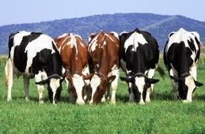
Service Model
Pets are given names like pussinboots.cern.ch
They are unique, lovingly hand raised and cared for
When they get ill, you nurse them back to health
Cattle are given numbers like vm0042.cern.ch
They are almost identical to other cattle
When they get ill, you get another one
Future application architectures tend towards Cattle but Pet support is needed for some specific zones of the cloud
Notes:
Puppet applies well to the cattle model but we’re also using it to handle the pet cases that can’t yet move over due to software limitations. So, they get cloud provisioning but flexible configuration management.

Slide 24
Service Consolidation with SCVMM/Hyper-V
Service consolidation using virtualisation based on Microsoft SCVMM/Hyper-V running dev/test and critical production workloads such as grid servers and Pension fund

Slide 25
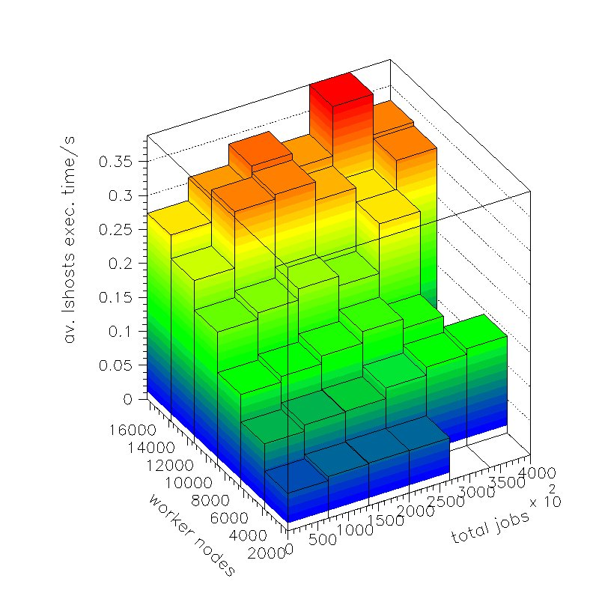
Cloud Interface Testing – Lxcloud
Tests to 16,000 VMs using OpenNebula and KVM testing virtual batch machines

Slide 26
IT as a Cloud Service Provider ?
Following industry reference structure
Infrastructure, Platform and Applications
Start first with Infrastructure-as-a-Service at scale
Just provide Amazon functionality
Value add increases up the chain so we need a vibrant ecosystem for PaaS and SaaS
 |  |  | Software as a Service
 |  | Platform as a Service
 | Infrastructure as a Service
Facilities

Slide 27
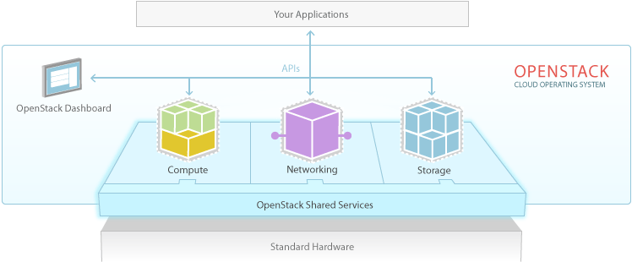
What is OpenStack ?
OpenStack is a cloud operating system that controls large pools of compute, storage, and networking resources throughout a datacentre, all managed through a dashboard that gives administrators control while empowering their users to provision resources through a web interface
Notes:
Started in Summer 2010 as a collaboration between NASA and Rackspace, combining parallel projects this has created an open source amazon like solution.

Slide 29
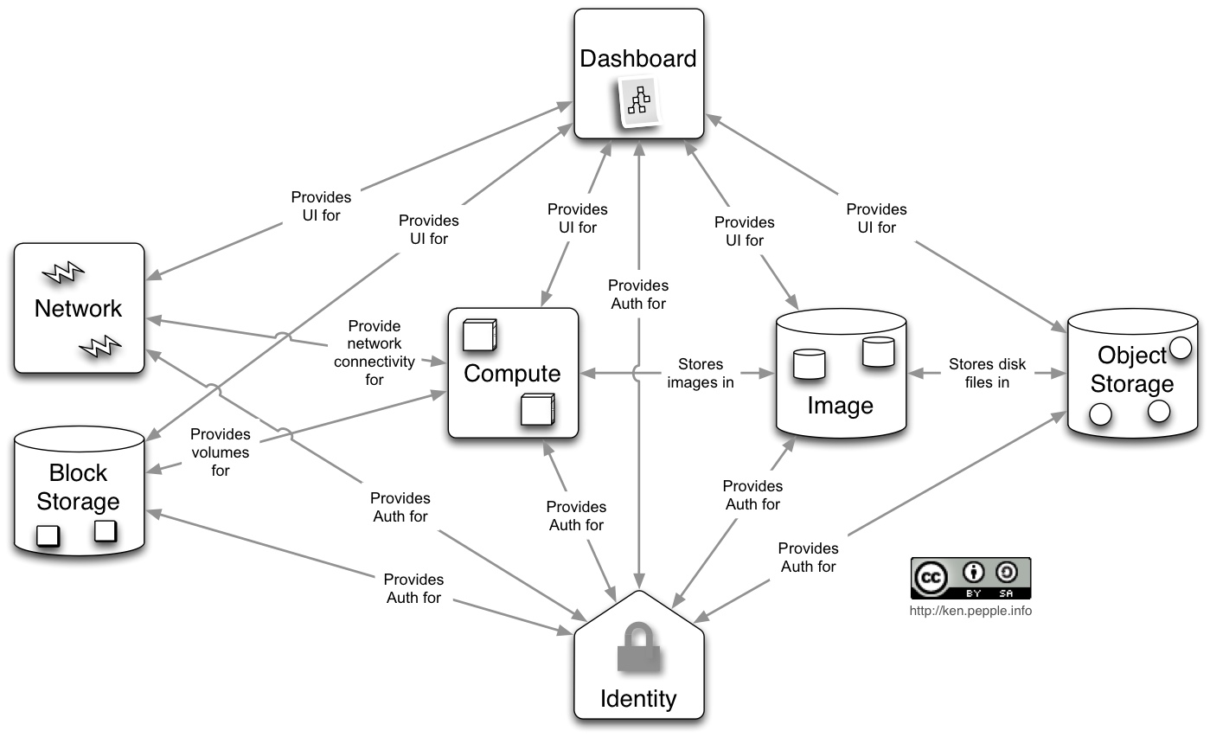
Many OpenStack Components to Configure
Notes:
Complex to configure… take advantage of the experience of others

Slide 30
When Communities Combine…
OpenStack’s many components and options make configuration complex out of the box
Puppet forge module from PuppetLabs
The Foreman adds OpenStack provisioning for user kiosk
Notes:
Communities integrating … when a new option is being used at CERN in OpenStack, we contribute the changes back to the puppet forge such as certificate handling. Even looking at Hyper-V/Windows openstack configuration…

Slide 31
Current Status of OpenStack at CERN
Working on an Folsom code base from the EPEL repository
Excellent experience with the Fedora Cloud SIG team
Cloud-init for contextualisation, oz for images (Linux and Windows)
Components
Current focus is on Nova with KVM and Hyper-V
Tests with Swift are ongoing but require significant experiment code changes
Pre-production facility with around 200 Hypervisors
Aiming for production access for CERN users in April

Slide 32
Active Directory Integration
CERN’s Active Directory
Unified identity management across the site
44,000 users
29,000 groups
200 arrivals/departures per month
Full integration with Active Directory via LDAP
Uses the OpenLDAP backend with some particular configuration settings
Aim for minimal changes to Active Directory
7 patches submitted around hard coded values and additional filtering
Now in use in our pre-production instance
Map project roles (admins, members) to groups
Documentation in the OpenStack.Org wiki

Slide 33
Opportunistic Clouds in Online Farms
The CERN experiments have High Level Trigger farms of 1000s of Linux servers close to the detectors to filter the 1PByte/s down to 6GByte/s to be recorded to tape
When the accelerator is not running, these machines are idle
Accelerator has regular maintenance slots of several days
Long Shutdown due from March 2013-December 2014
CMS has deployed OpenStack on their farm and ATLAS getting ready
Mainly simulation (low I/O, high CPU)
Ran 1,300 hypervisors over Christmas on CMS HLT

Slide 34
Next Steps
Support multi-site operations with 2nd data centre in Hungary
Exploit new functionality
Cells for scalability
Ceilometer for metering
Bare metal for non-virtualised use cases such as high I/O servers
Kerberos or X.509 user certificate authentication
Load balancing as a service
Heat for Orchestration
Cinder for block storage and live migration
Address functional gaps with the community
Boson for quota management
Hyper-V accounting

Slide 35
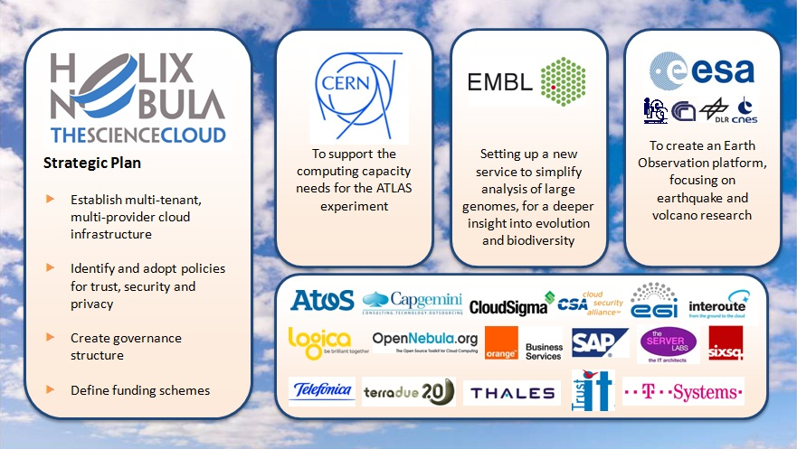
Federated European Clouds
Two significant European projects around Federated Clouds
European Grid Initiative Federated Cloud as a federation of grid sites providing IaaS
HELiX Nebula European Union funded project to create a scientific cloud based on commercial providers
EGI Federated Cloud Sites
CESGA | CESNET | INFN | SARA
Cyfronet | FZ Jülich | SZTAKI | IPHC
GRIF | GRNET | KTH | Oxford
GWDG | IGI | TCD | IN2P3
STFC

Slide 36
Hybrid Cloud Economics
Expect that the majority of computing requirements will be met from private cloud resources
“Why rent a car when I know I will need it every day for 3 years”
Hybrid scenarios are likely
Burst requirements coming up to conferences but short spin up times
Opportunistic capacity such as low SLA resources or grants
Barriers remain
API standardisation is limited… default to EC2?
Data distribution costs… network vs resident storage costs
Image formats and contextualisation vary

Slide 37
Sample Experiment Pilot in the Clouds

Slide 38
Collaboration and Communities
CERN’s Agile Infrastructure project contributes back to the open source communities
Thus, much collaboration focus is world-wide, industry-independent
Public mailing lists have more experts, don’t focus on HEP-only
There is much interest in our use cases and problems
However, some problems are specific to our communities
Grid specific software
Batch systems, non-elastic accounting, large scale federated identity
Collaborations already starting around
OpenStack with BNL, IN2P3, NECTaR (Australia), IHEP (China), Atlas/CMS Trigger teams
Puppet with LBNL, BNL, Atlas Online/Offline results shared at http://github.com/cernops

Slide 39
Timelines
Year | What | Actions
2012 |  | Establish IaaS in Meyrin data centre Monitoring Implementation Early adopters to Agile Infrastructure
2013 | Long Shutdown 1 New Data Centre | Production Agile Infrastructure Extend IaaS to remote CC Business Continuity Support Experiment re-work Migrate existing virtualisation solutions General migration to Agile with SLC6 Phase out old fabric management tools
2014 | To the end of LS1 | Remote data centre fully operational 15K hypervisors and over 100K VMs

Slide 40
Conclusions
CERN’s computing needs continue to grow
The second data centre in Budapest provides the facilities but no new staff
A move to Open Source popular tools used widely elsewhere provides a framework to address these new capabilities within existing staff numbers
Cloud computing supports legacy applications and enables migration to new models
Collaboration with other sites and organisations is welcome and underway

Slide 41
Questions ?
CHEP 2012 paper on Agile Infrastructure | http://cern.ch/go/N8wp
CERN Puppet Configurations | http://github.com/cernops
HELiX Nebula | http://helix-nebula.eu/
EGI Cloud Taskforce | https://wiki.egi.eu/wiki/Fedcloud-tf
Experiment testing of CERN cloud | http://cern.ch/go/Sj7g

Slide 42
Backup Slides

Slide 43
Principles
Open Source
Apache 2.0 license, NO ‘enterprise’ version
Open Design
Open Design Summit, anyone is able to define core architecture
Open Development
Anyone can involve development process via Launchpad & Github
Peer reviews mandatory
Continuous integration tests must pass before commit accepted
Over 200 commits/month
Open Community
OpenStack Foundation in 2012, now 190+ companies, over 800 developers, 7000+ members, 50 user groups worldwide
Notes:
Fully open… Rackspace handed over all intellectual property in 2012 to a foundation.
vendors want the possibility to adapt, developers want a meritocracy, users want to share and contribute

Slide 44
Efficiency Focus
There are many places we lose compute and storage capacity
Machines are delivered and wait before they are allocated for use
Hardware repairs are needed and machines drained
Repairs completed but not yet back in production
Operating system upgrades or migrations to be scheduled
Physical boxes oversized for their application
Servers only used during working hours or only at night
Out of warranty machines which still work well
Tools and processes need to be improved
To measure our current efficiency over entire lifetime of a resource
To understand how to limit lost capacity
To simplify multi-step, high latency processes

Slide 45
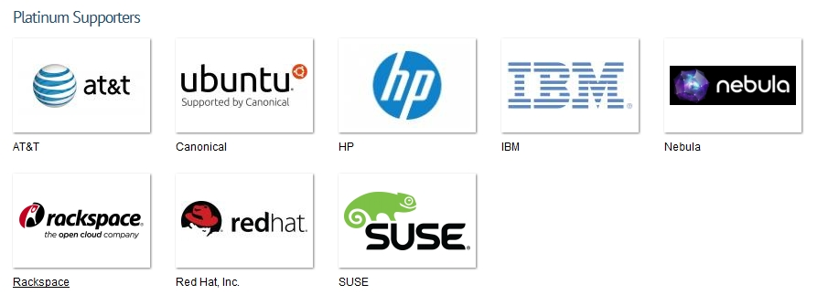
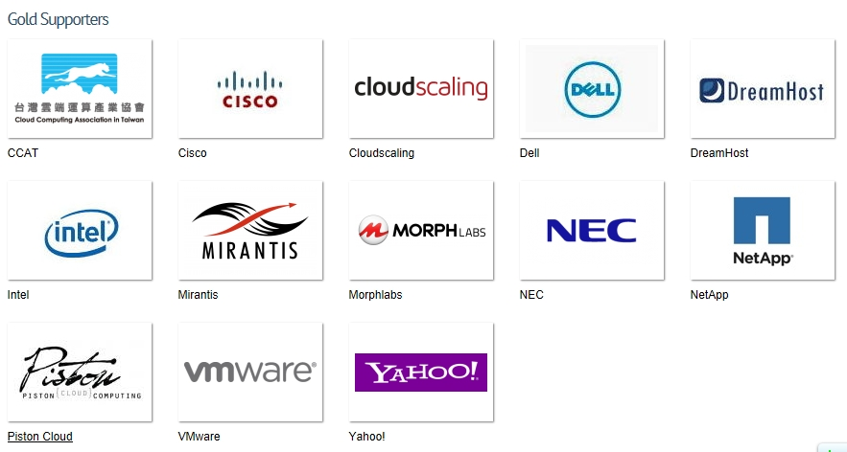

Slide 46
Foundation Governance
Notes:
The foundation is organised as
A technical committee with the project leads of each major component and some elected members. The voters are those who have contributed.
The board of directors consisting of those companies who have provided financial support and individual directors elected by the community
The user committee, which I am helping to set up, to represent the people who are using OpenStack to give feedback on the experience

Slide 47
Sample Repair
Monitoring identifies an ECC memory error
Alarm sent to the computer centre operator
Ticket assigned to system administrator queue
System administrator drains the batch machine (up to a week)
System administrator raises a vendor call with which chip has failed
Vendor visits (up to a week based on SLA) and repairs machine
System administrator checks machine is OK and returns it to production

Slide 48
OpenStack Cloud Components
Nova – Compute Layer like Amazon EC2
Swift – Object Store like Amazon S3
Quantum – Networking such as SDN or load balancing
Horizon – Dashboard GUI
Cinder – Block Storage like Amazon EBS
Keystone – Identity
Glance – Image management
Each component has an API and is pluggable
Other non-core projects interact with these components such as load balancers and usage tracking

Slide 49
LEP Computing trends hint at the LHC needs
Notes:
The experience during LEP shows how computing capacities can grow rapidly. The transition included migration from Mainframes to Unix.

Slide 50
New architecture data flows
Notes:
The CERN CA gateway was the only code that we needed to write ourselves. The rest has been integration and configuration.

Slide 51
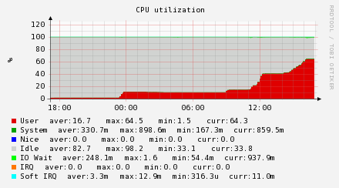
Scaling up with Puppet and OpenStack
Use LHC@Home based on BOINC for simulating magnetics guiding particles around the LHC
Naturally, there is a puppet module puppet-boinc
1000 VMs spun up to stress test the hypervisors with Puppet, Foreman and OpenStack
Notes:
LHC@Home is a magnet simulation tool to test multiple passes around the ring. We wanted to use it as a stress test tool and in ½ day, it was running on 1000 VMs.

Slide 52
Ongoing Projects
Preparation for production
Hardening infrastructure for high availability
Configuration Management
Migrate to Puppet 3.0
Assist experiments to convert from Quattor to Puppet
Cloud
Accounting and quota management collaboration with BARC and Rackspace
Investigating Gluster, NetApp and Ceph integration for block storage
Load Balancing
Monitoring
Migrate from Remedy to Service Now for hardware repairs
Include Windows monitoring

Slide 53
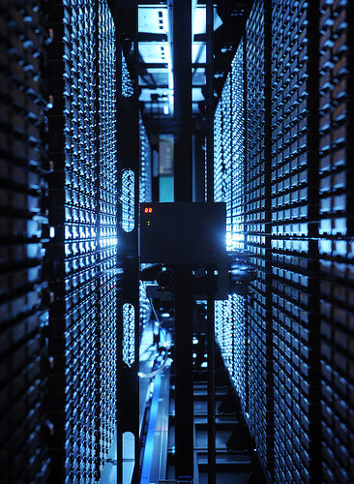
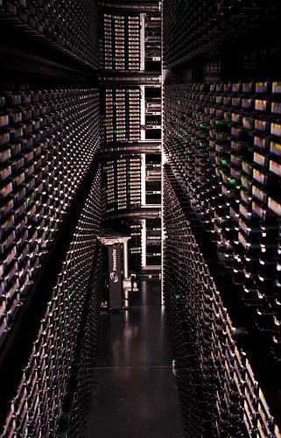
45,000 tapes holding 90PB of physics data
Notes:
Tape robots from IBM and Oracle
Around 60,000 tape mounts / week so the robots are kept busy
Data copied every two years to keep up with the latest media densities

