Slide 1


A_RD_9
Effort towards improving large scale production of SC cavities

Slide 2
Members for A_RD_9

Slide 3
Outline
Context and motivation for our proposal
New equipment at CEA/Irfu : Vertical Electro-Polishing (VEP) set-up
New equipment at KEK: Cavity Fabrication Facility (CFF)
New process
  Optimized Electron Beam Welding (EBW)
  Electro-Chemical Buffing (ECB)
  Modified VEP process by Marui Company
  Details of the program
  Summary

Slide 4
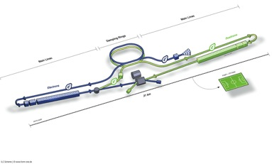
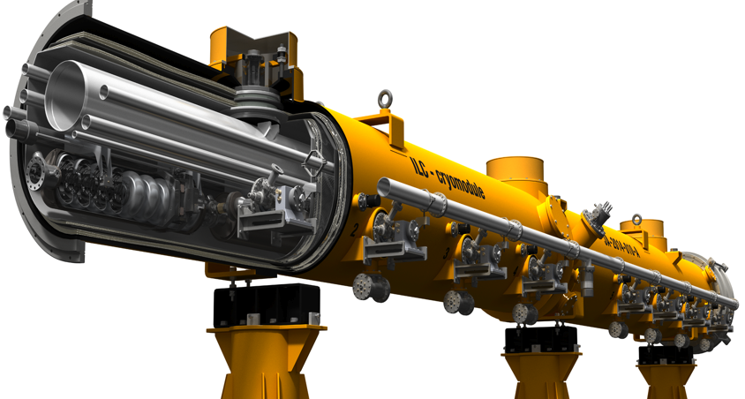
Context: SCRF Industrialization required for ILC
Parameters | Value
C.M. Energy | 500 GeV
Peak luminosity | 1.5 x10³⁴ cm⁻²s⁻¹
Beam Rep. rate | 5 Hz
Pulse duration | 0.73 ms
Average current | 5.8 mA (in pulse)
Av. field gradient | 31.5 MV/m +/-20% Q₀ = 1E10
# 9-cell cavity | 16,024 (x 1.1)
# cryomodule | 1,855
# Klystron | ~400
ILC
Linac (11km) x 2
High quality
16024 x 1.1(Yield = 90%)
~ 17600 cavities of mass-production

Slide 5
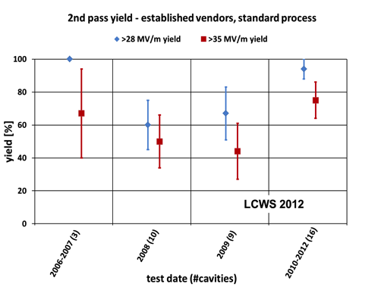
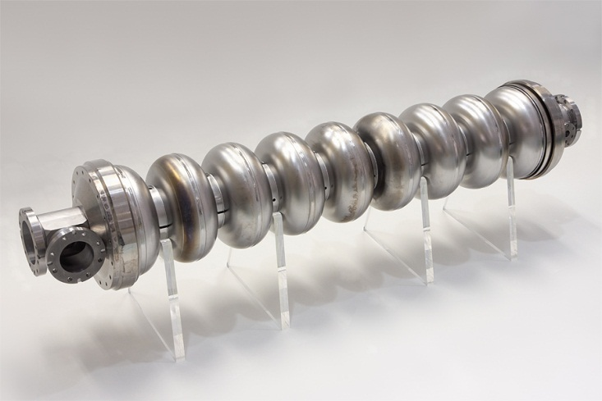
Progress in SCRF Cavity Gradient
Production yield:
94 % at > 28 MV/m,
Average gradient:
37.1 MV/m
reached (2012)
Issues of mass-production:
High Quality Assurance (QA)
Cost Reduction

Slide 6
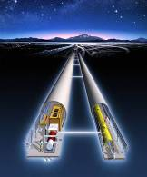
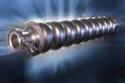
Motivation
Previous collaboration within A_RD_5 program: Surface treatment
>>> Very successful
We installed new equipments at KEK & Irfu.
  Extension of our expertise from cavity fabrication to Vertical Test.
  Equipments of KEK & Irfu are complimentary and this collaboration makes us the efficient R&D possible.
  The collaboration between KEK & Irfu will play the important role to establish the cavity mass-production of ILC.

Slide 7
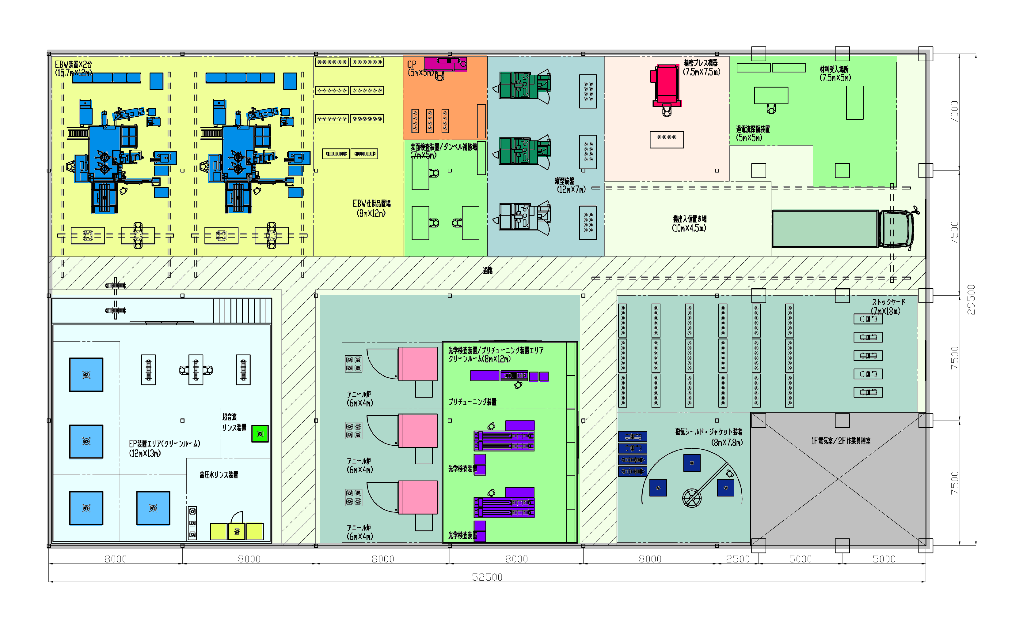
Simulation study of cavity production plant
Assuming area（53m x 30m）
KEK-MHI
Fabrication / R&D at KEK
EBW
EBW
CP
Eddy-current
scan
reception
Press forming
stock
Inspection
Trimming
parts delivery
surface treatment
R&D at CEA Saclay/ Irfu
Stock area
Bulk EP
anneal
Tuning machine
AC power area
Inspection
Jacket
Cavity fabrication and cavity surface treatment are the most important parts of ILC mass-production.
Assuming that final treatment and vertical test will be done in other place.

Slide 8
Vertical Electro-Polishing
(VEP) Set-up at CEA Saclay

Slide 9
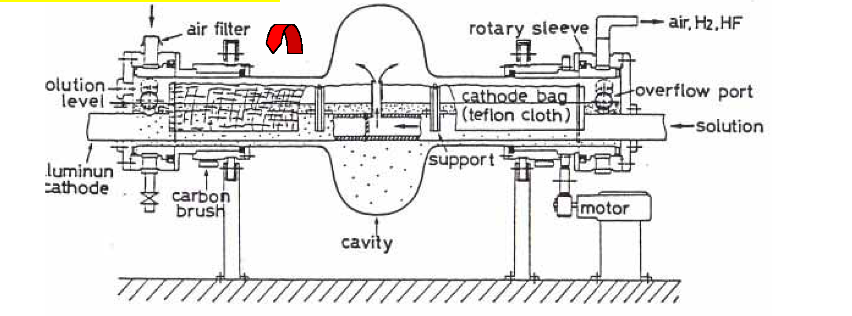
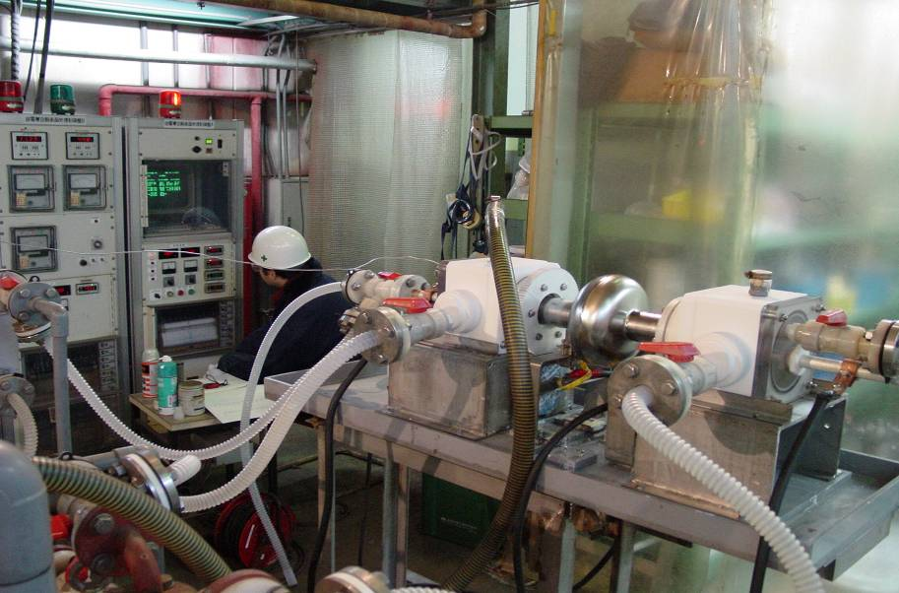
Horizontally Rotated Electro-Polishing (EP) - Conventional
2
Circulating EP acid
H₂SO₄(95%) : HF(46%)
= 10 : 1 in volume
Cavity X-section
Temperature
sensor
Beam Pipe
Acid
Level
EP acid
circulates
Cathode
bag
Back to EP-acid
reservoir
tank (100L)
Electric
Current
Cathode
Voltage ~ 20 V, Current ~ 40A

Slide 10
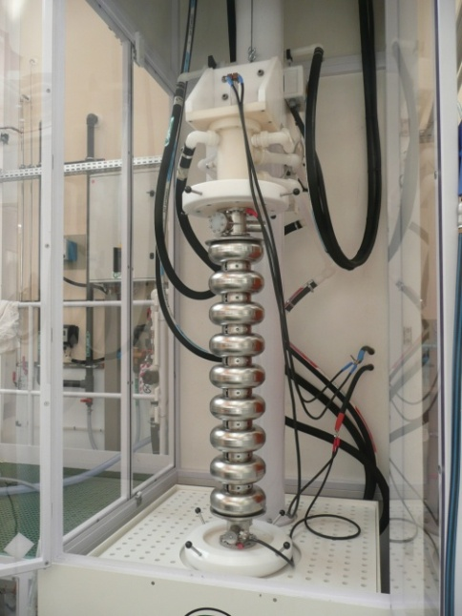
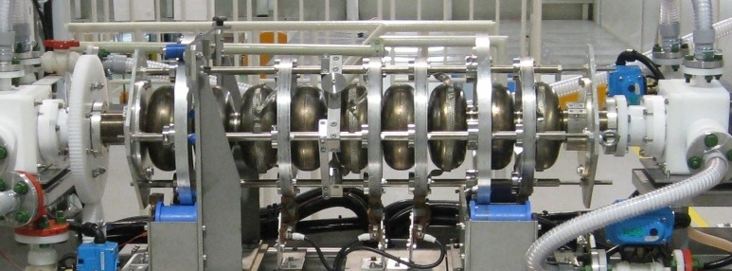
Horizontal vs Vertical
9-cell horizontal EP setup (KEK): electrolyte is half-filled
9-cell vertical EP setup (Ifru): electrolyte is fully filled.

Slide 11
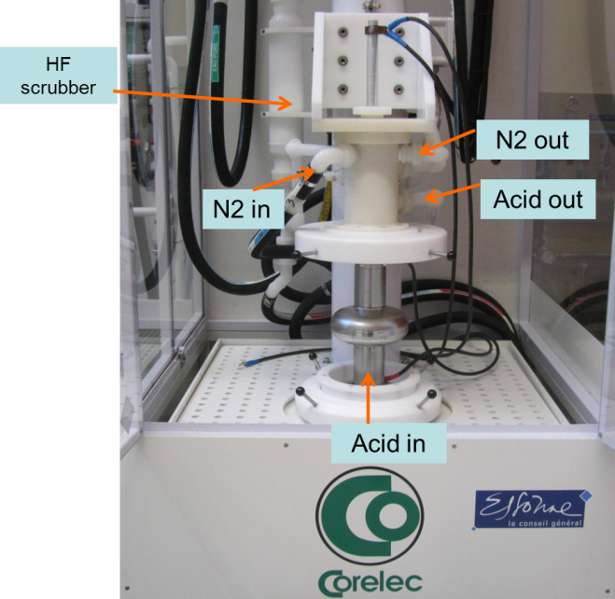

Overview
TB9RI025 cavity
Prior to VEP
Circulating acid
Constant voltage
Nitrogen blowing
VEP of 1Cell and 9-cell cavities
Focus on parameters: low voltage (~ 6V) – high acid flow (25L/min)
  Improved degassing (H₂ , O₂)
  Lower heating
Four 1-Cell cavities and one 9-cell cavity were prepared by VEP

Slide 12
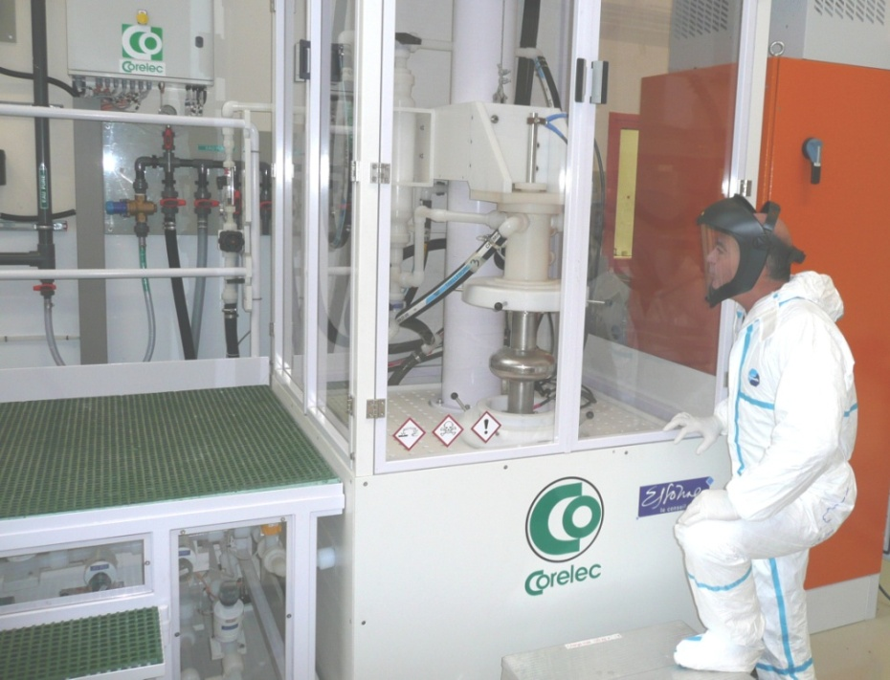
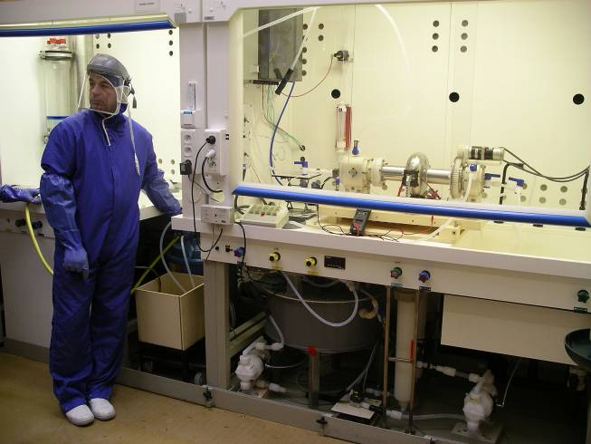
Horizontal vs Vertical
Pros:
Good evacuation of gases (cavity half filled)
Demonstrated performance
Large range of parameters
Pros:
Simple process (low cost)
Improved safety
Higher removal rate (Fully filled)
Cons:
Complicated process (high cost)
Rotary seals
Switching (vertical draining) of the cavity
Low removal rate (half-filled)
Cons:
Sensitive to fluid dynamics
Difficult evacuation of gasses
Proper parameters to be determined…
…Voltage and fluid velocity

Slide 13
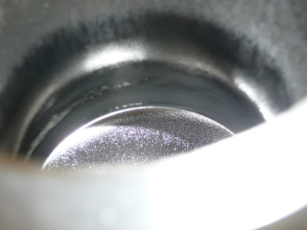
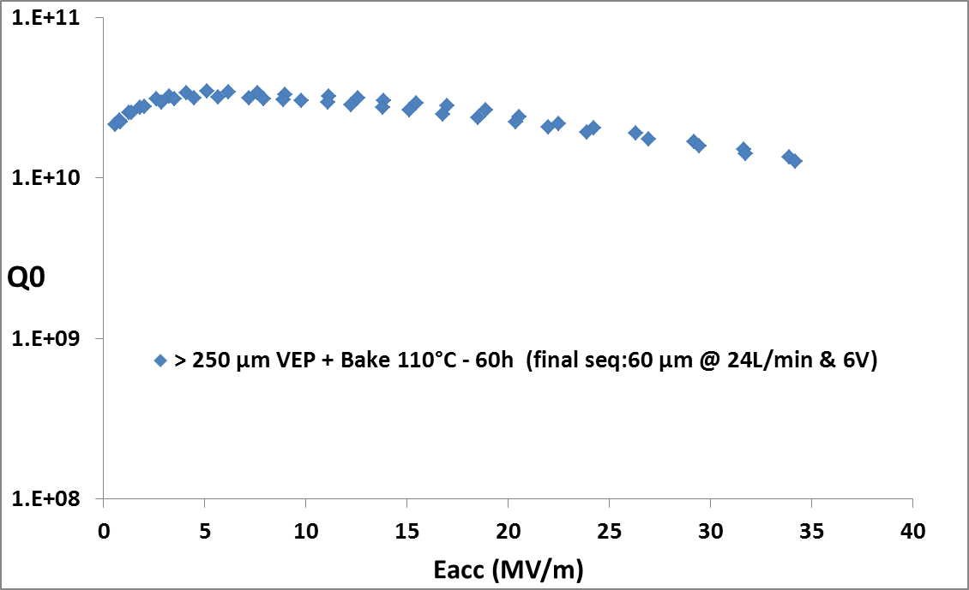
Low Voltage VEP: 1st Result
VEP of cavity with low surface quality (pits)
Better surface achieved
Pits partially removed
In spite of pits, the cavity is tested
→ Quench at 34MV/m at the pit area
(Standard Q-Slope before baking)
ILC specification of Eacc at VT: 35 MV/m

Slide 14

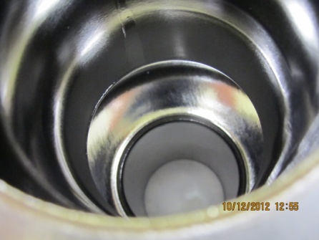
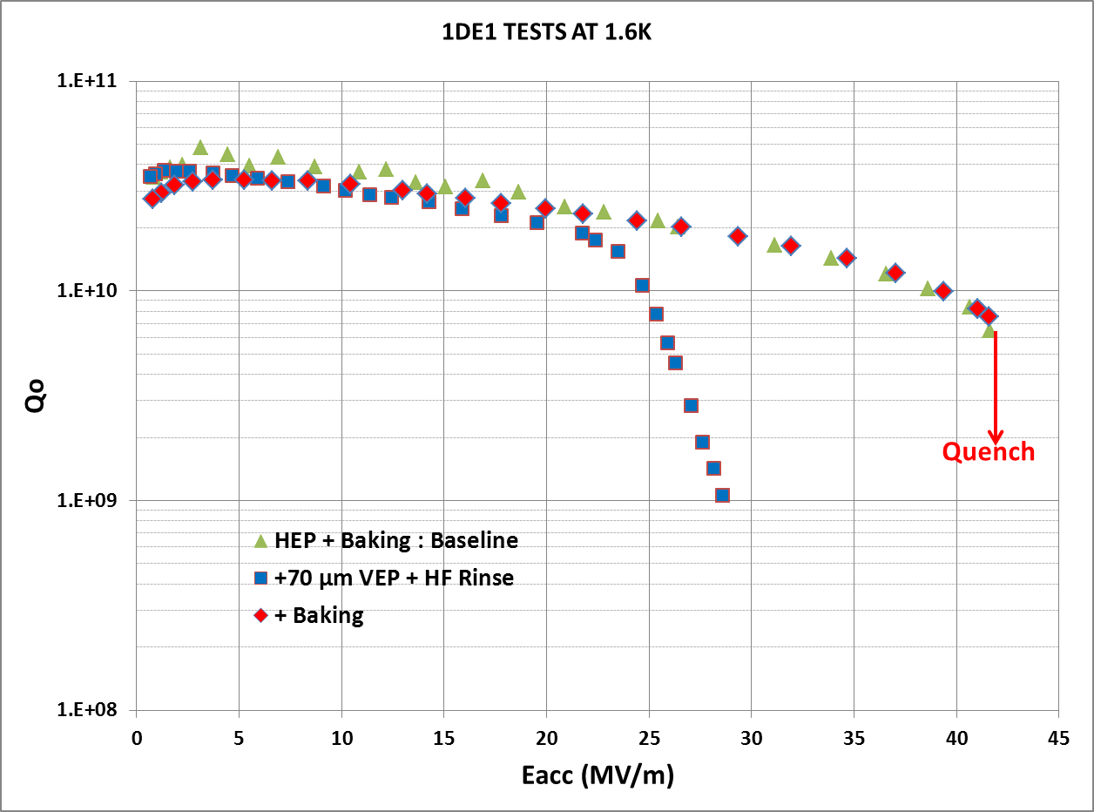
Eacc > 41 MV/m on 1Cell Cavity with Parameters:
Low Voltage – High Acid Flow
1DE1: Horizontal EP + 70 µm VEP
Parameters: 6V & >24L/min
Bright and smooth surface
Performance before/after baking similar to HEP
High gradient maintained after VEP
1DE1 after HEP + 70 µm VEP
ILC spec.
Aspects to improve:
Low removal rate at 19°C: 0.2µm/min
asymmetry: removal rate higher in the upper part of the cell (x 3)
higher local removal
Acid flow

Slide 15
Cavity Fabrication Facility
CFF at KEK

Slide 16
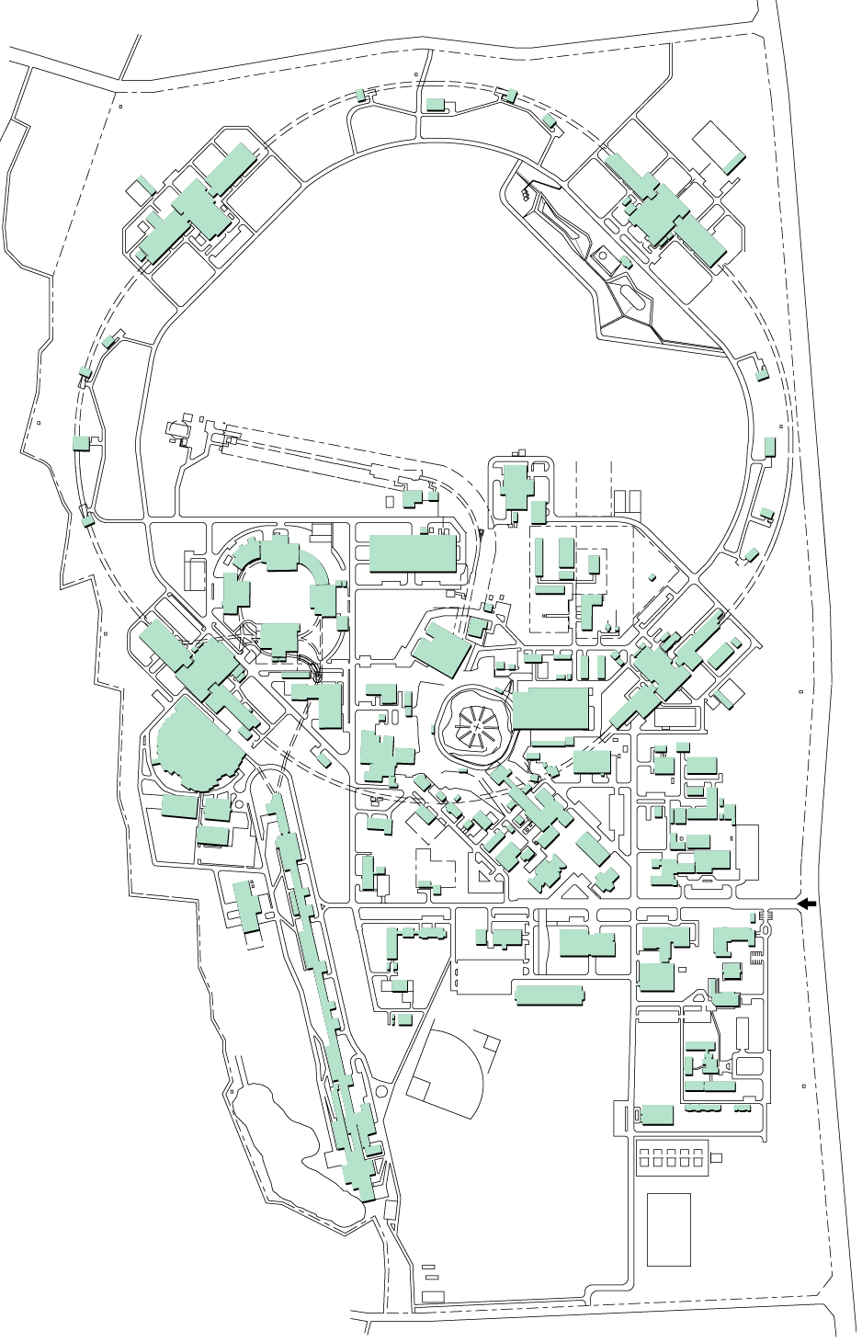
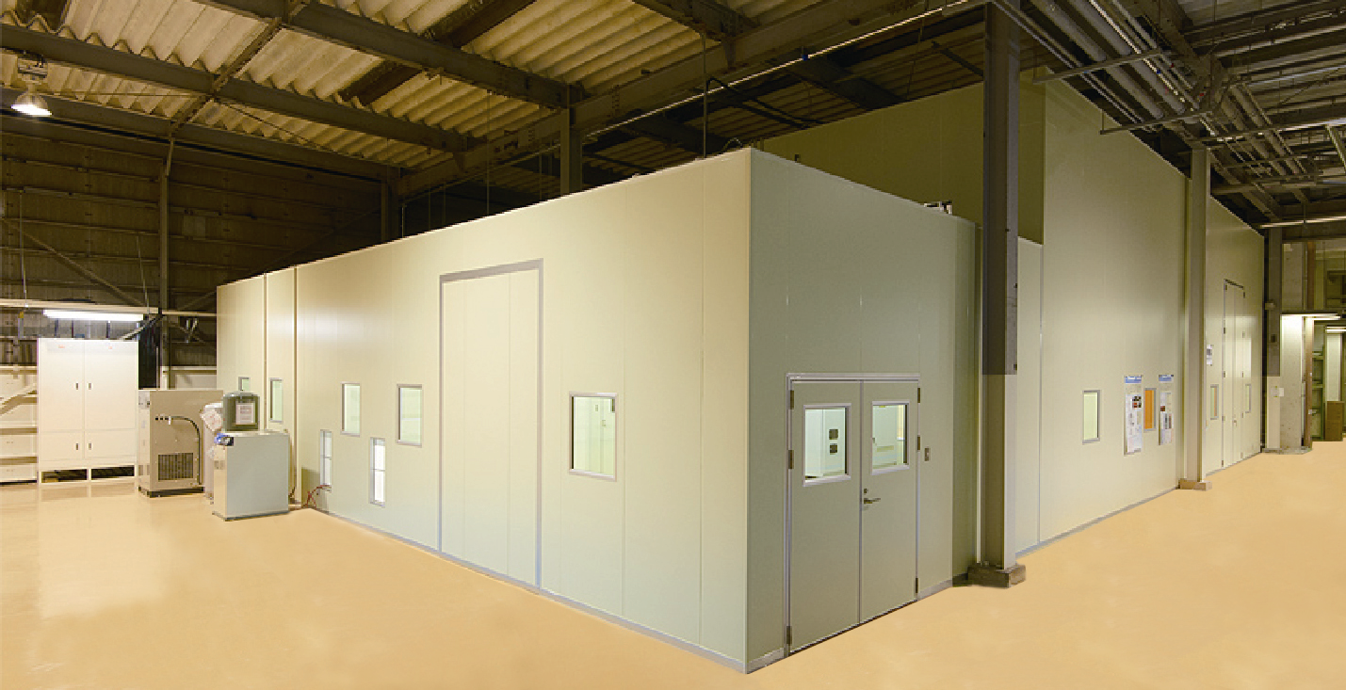
Construction of Cavity Fabrication Facility (CFF)
All machines are in class-100,000 clean-rooms.
Map of KEK
Clean room 19m x 14m x 5m
STF building
Chemical treatment
Press machine
EBW
Cavity Fabrication Facility
(CFF)
Surface inspection
Construction finished in FY2011
Vertical lathe
Clean room floor layout of CFF

Slide 17
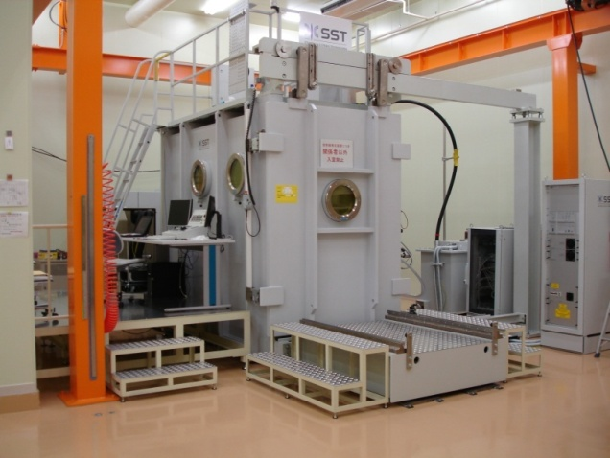
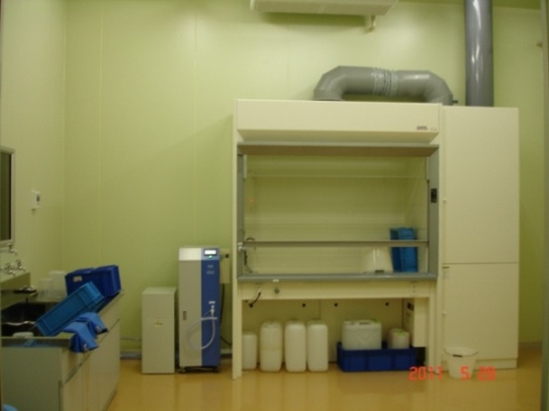
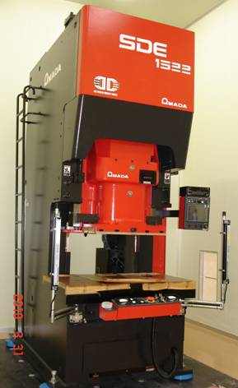
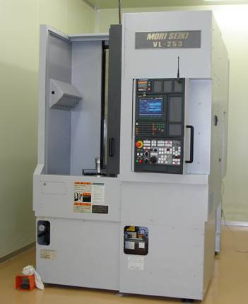
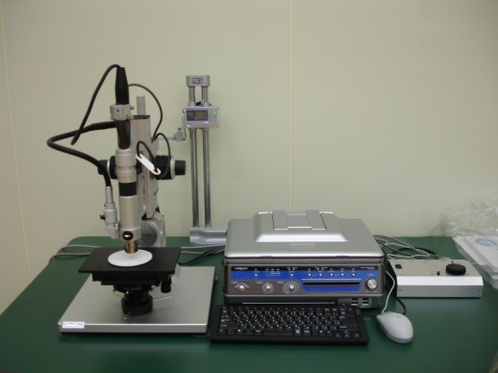
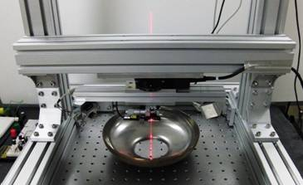
Main Equipments of CFF
EBW room
Installation of EBW machine started from April 2011.
Chemical Polishing room
Measuring system for half cell shape (Under developing)
Inspection equipment for Nb surface
Press machine (servo control)
Vertical lathe

Slide 18
Purpose of Cavity Fabrication Facility (CFF)
High performance / high yield rate = Good QA
Reduction of fabrication cost
R&D of mass-production processes/fixtures
All necessary machines for cavity-fabrication are in one place: Efficient R&D
Cooperation with STF (Surface treatments / VT in Lab.)
Speed up the R&D to establish the standard recipe for mass-production
Studies in CFF
Cooperation with vendors (industries)
Open to other lab. / venders
Target is realization of mass-production technology for 17,000 cavities (ILC).

Slide 19
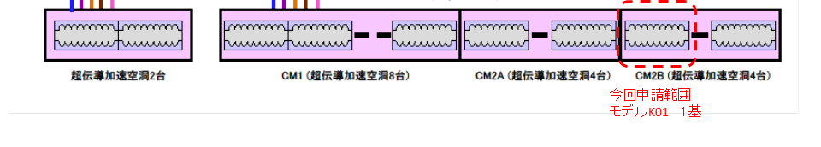
Plan/Purpose of cavities in CFF/KEK
Cavity
FY2012
FY2013
KEK00
VT
Jacket weld training
KEK01
fabrication
VT
KEK02
fabrication
VT
We are here
KEK03
fabrication
VT
Jacket weld
Preparation for complying with high pressure gas code
Demonstration of mass-production
STF/KEK
Cryomodule-1
8 cavities
CM2a
4 cavities
CM2b
4 cavities
KEK-03 cavity (Fabrication in CFF/KEK)

Slide 20
Improvement of EBW Process at KEK

Slide 21
Fabrication of KEK-01 Cavity with HOM

Slide 22
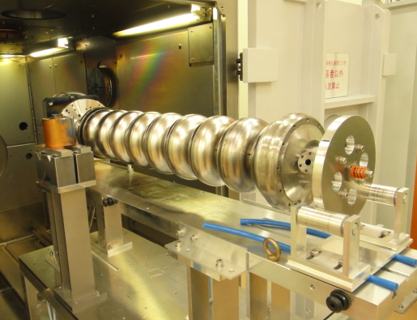
Configuration Choice of Cavity Attitude and Gun Position
Direction of electron beam is vertical.
Direction of electron beam is horizontal.
Direction of gravity.
Setting cavity in horizontal way is rather compllicated (KEK-00).
Setting cavity in vertical way is simple (KEK-01).
Stacking dumbbells is easy in the vertical configuration of cavity.
Better for mass-production.

Slide 23
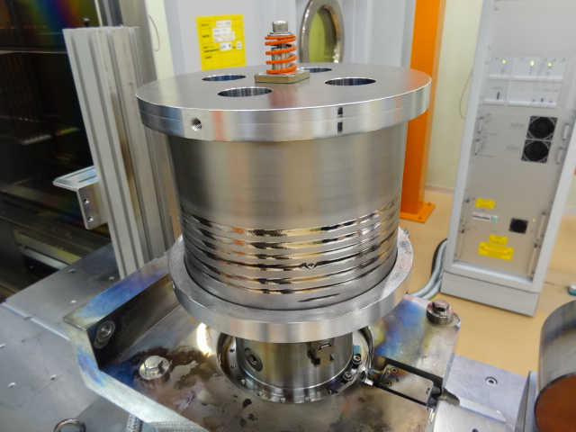
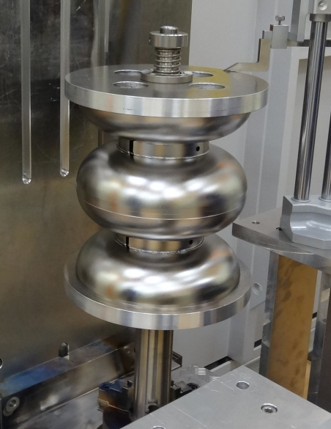
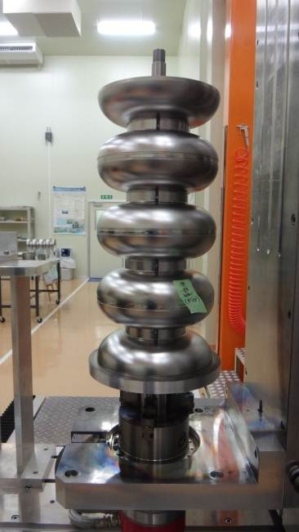
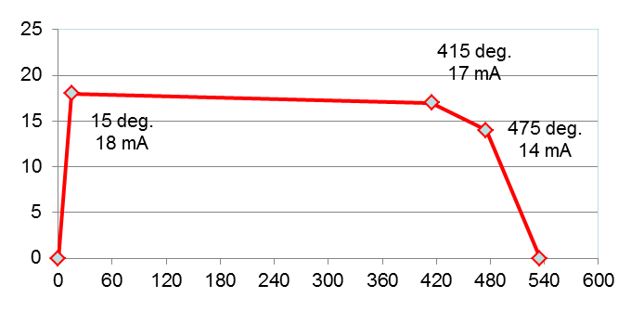
EBW at equator for stacked dumbbells (KEK-01)
120 kV, 5 mm/s
Overlap
Rotation
Beam current (mA)
Direction of electron beam
Parameter for equator
EBW test by a dummy Nb-pipe
Rotation angle (degree)
Smooth inner surface of welding seam was achieved.
Direction of electron beam
Direction of electron beam
EBW of 2-dumbbell
EBW of 4-dumbbell

Slide 24
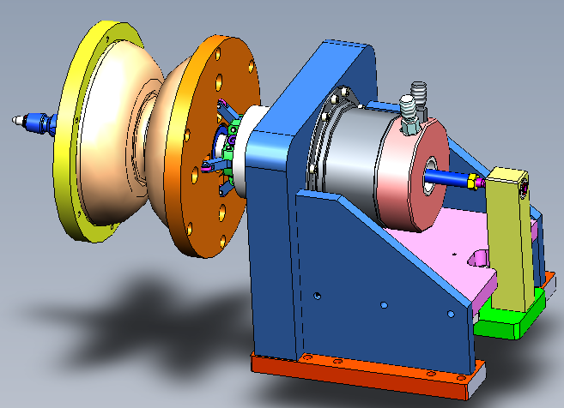
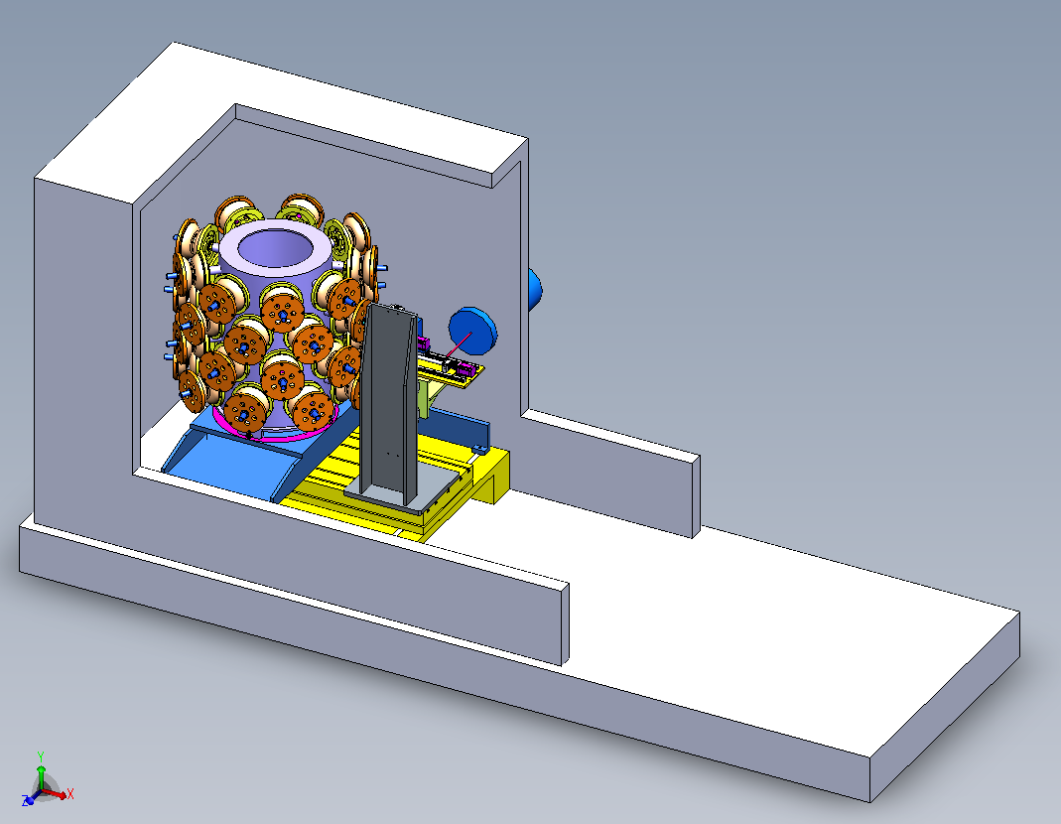
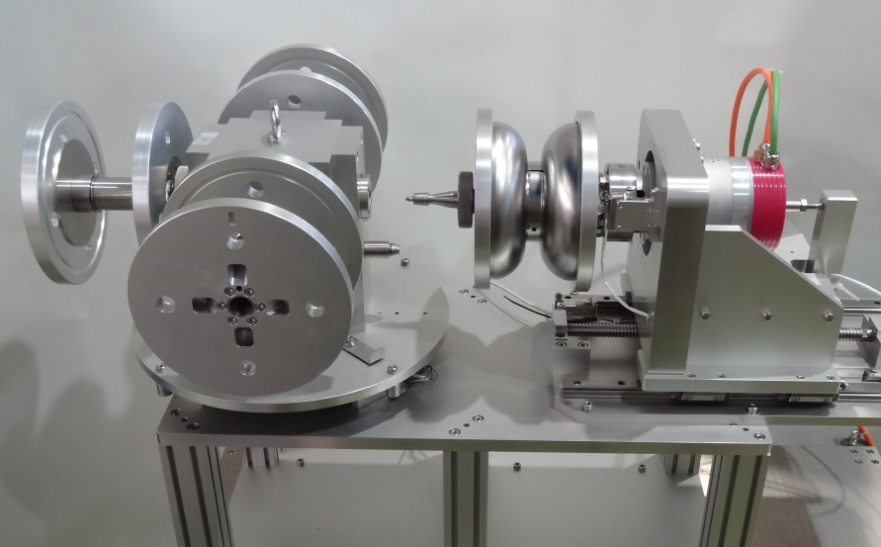
Design of loader for multiple dumb-bells
Pumping time (~30 min.) and cooling time (~30 min.) are duplicated in EBW processes.
e- gun
on side
Proto-type of four-dumbbell loader
Multiple dumbbells are loaded inside the EBW chamber at once and the EBW of dumbbells will be done continuously after pumping down.

Slide 25
New Processes Investigated

Slide 26
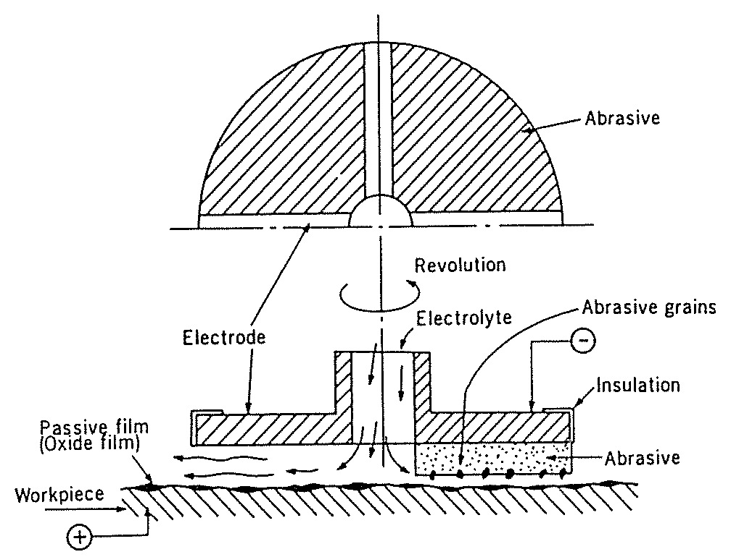
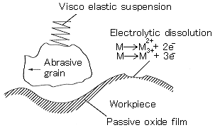
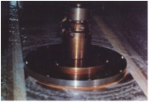
Electro-Chemical Buffing (ECB) by KEK
● A rotating disk with abrasive fine particles on nonwoven fabric is pressed against the workpiece.
● An aqueous solution of sodium nitrate (neutral) is supplied in between.
● The disk and the work function as a cathode and an anode, respectively.
● Abrasive : micropowders of alumina, diamond, silica etc.
● Current : a few of mA/cm to a few of 10mA/cm² depending on the polishing stages.

Slide 27
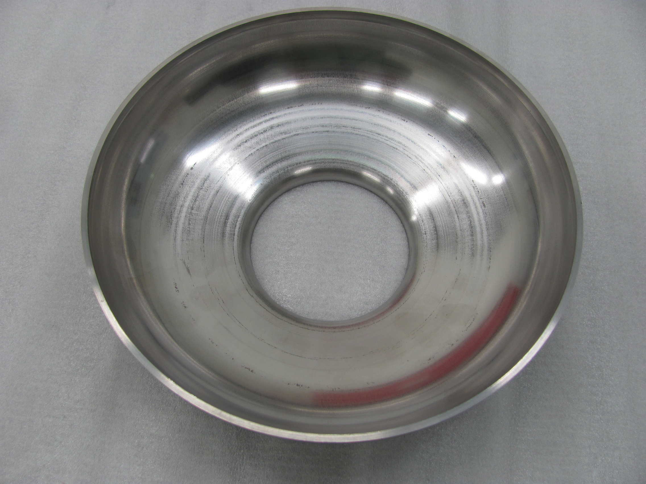
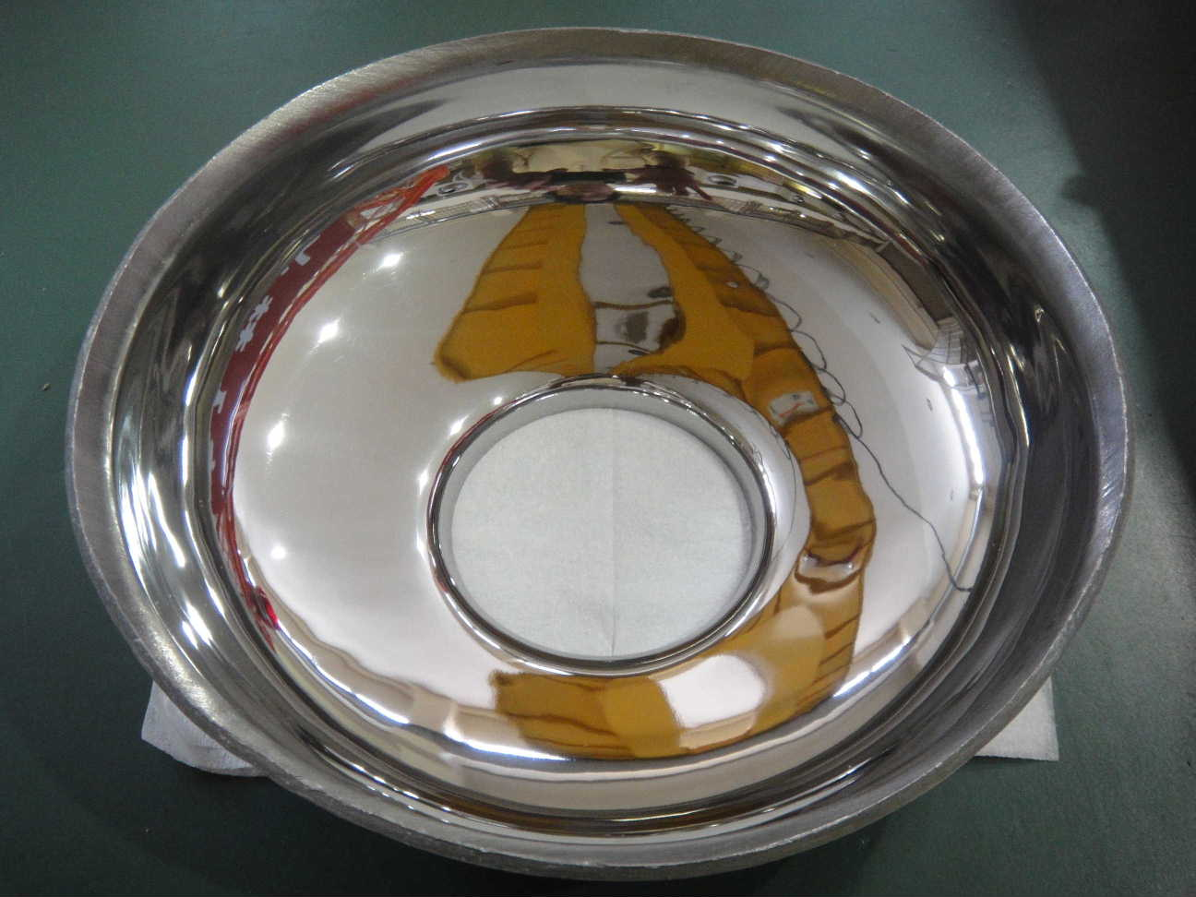
Smooth Surface on Dumbbells
ECB makes it possible to achieve very bright surfaces on dumbbells

Slide 28
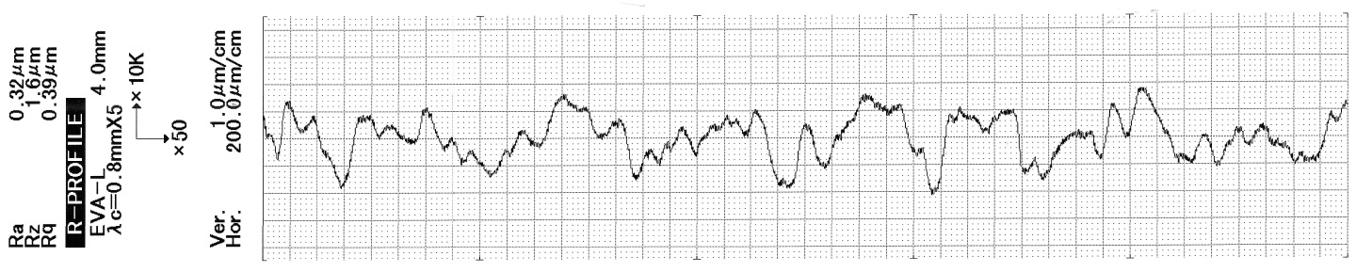
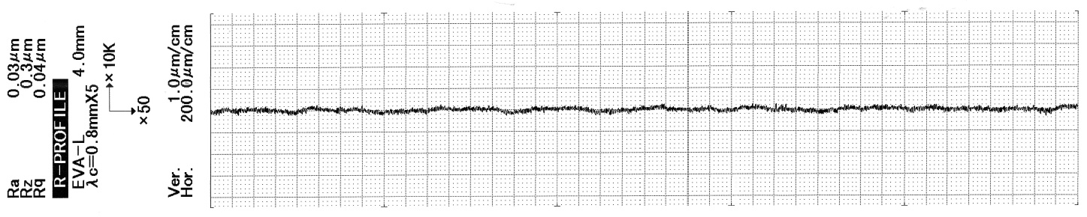
Decreased Roughness
EP
1mm
R_{q}=0.39μm
1μm
ECB
R_{q}=0.04μm

Slide 29
New VEP Method by Marui Company Ltd

Slide 30
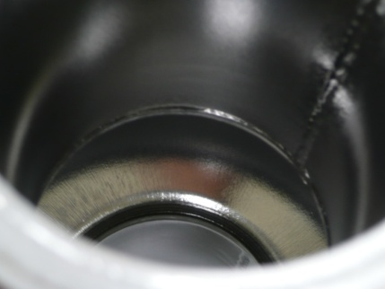

New VEP Process with top-down Electrolyte Circulation by Marui Cy Ltd
A part of features : Integrated New VEP System
Flow direction
To remove hydrogen gas generated during EP process by the method of fluid circulation.
Pump
Acid bath
Flaws observed after VEP with inadequate parameters (voltage, Temp, Cathode shape):
stripes (due to bubbles)
Pitting
This new method should overcome these pbms

Slide 31
Details of the Program

Slide 32
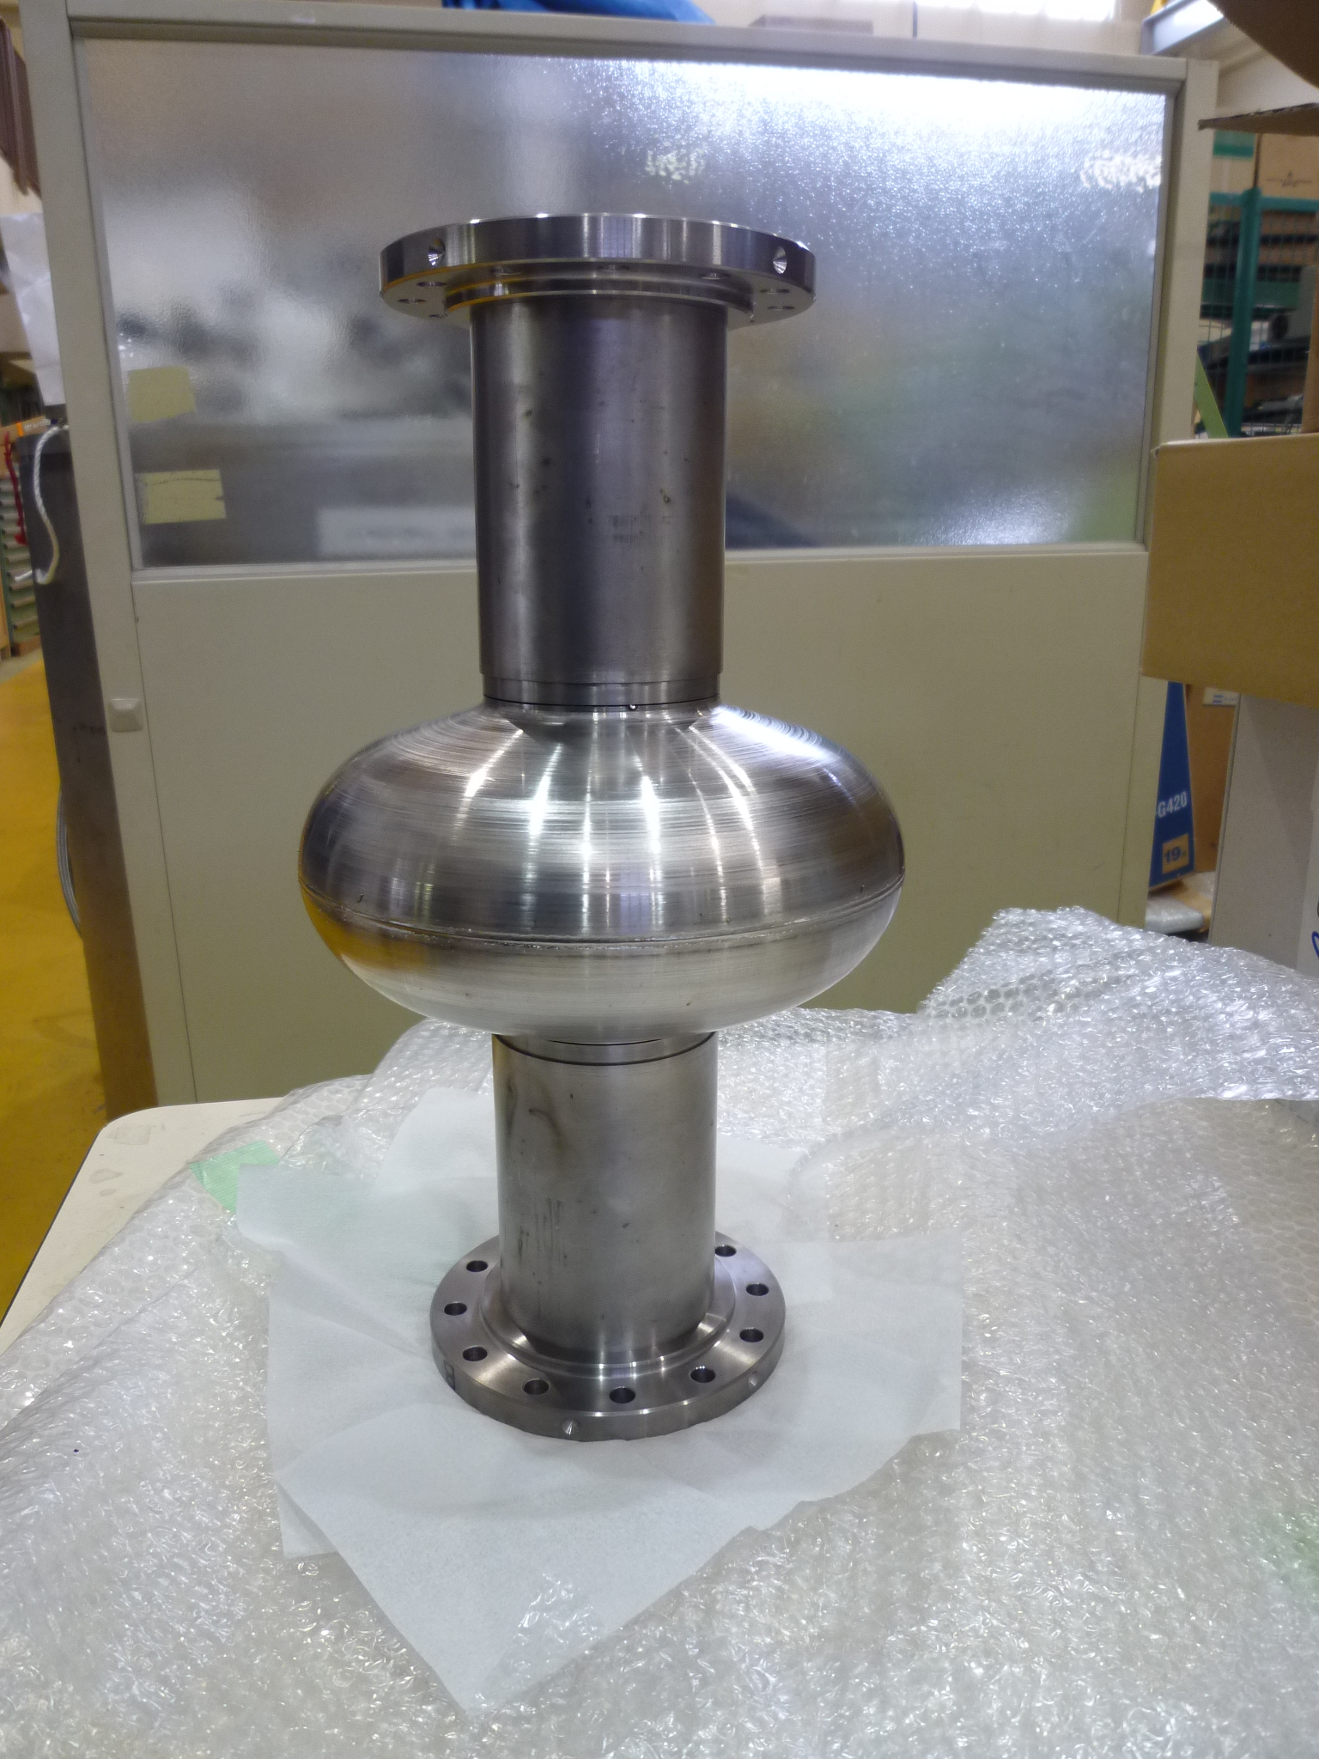
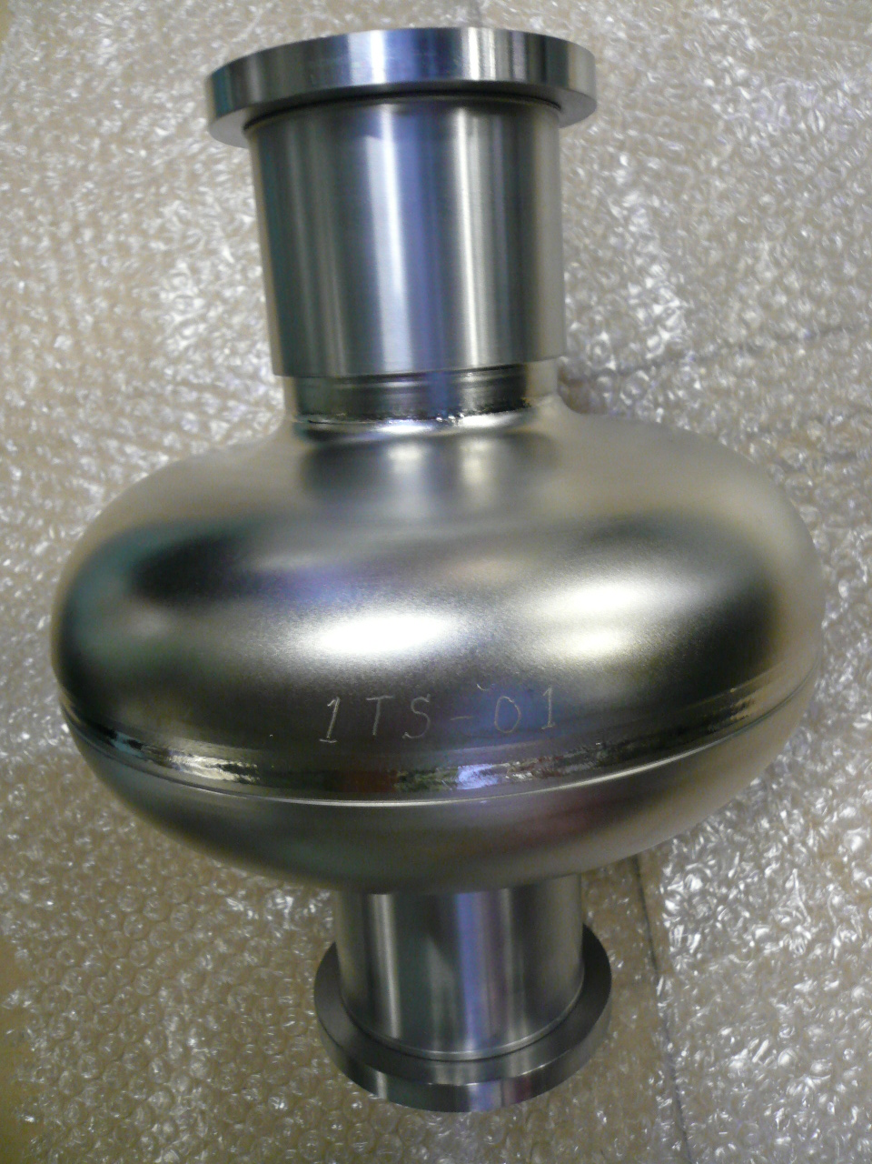
Manufacturing of New 1Cell Cavities
Dedicated to ECB
Two single-cell cavities have been fabricated for ECB experiments:
Tesla shape: K-LBW-S01-ECB
Low Loss shape: 1TS-01-ECB
These cavities will be ECB’ed at KEK and shipped to Irfu for Assembly and VT.

Slide 33
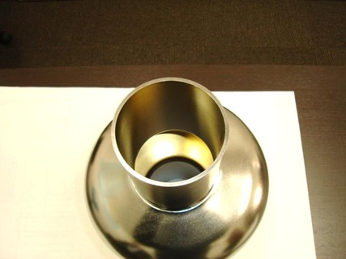
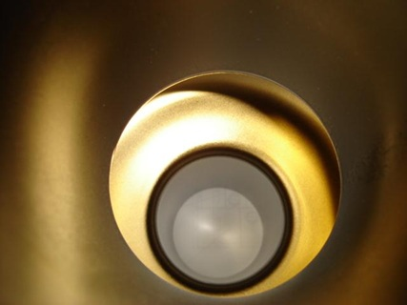
Next Step Plan at Marui – VEP on Nb. Cavity
1-Cell TI00 Cavity purchased from RI company
  VEP at Marui + VT at Saclay
Cavity Exchange program between Marui and CEA.
  TI00 Cavity VEP’ed at Marui, Vertical Test (VT) at Irfu
  1AC3 VEP’ed at Saclay (36MV/m) will be shipped to Japan for VEP
  VT at Irfu
  →Comparison of respective results at Marui / Irfu
If successful results, motivation for 9-cell VEP at Marui & Irfu
MG purchased from RI GmbH
Inside the 1-Cell Cavity

Slide 34
Summary
Previous collaboration within A_RD_5 program was very successful.
New equipments are installed at KEK & Irfu.
Cavity Fabrication Facility (CFF) at KEK
Vertical Test Facility at Irfu.
  Extension of our expertise from cavity fabrication to Vertical Test will realize more effective R&D of ILC mass-production process.
  Equipments of KEK & Irfu are complimentary and this collaboration makes us the efficient R&D possible.
  Detailed cavity-exchange plan are considered.
  The collaboration between KEK & Irfu will play the important role to establish the cavity mass-production of ILC.

Slide 35
Backup slides

Slide 36
Studies on EBW parameters
Search for good EBW parameters was done by changing the welding beam-voltage, beam-current, focus-current, working-piece distance from gun, working-piece moving speed, Nb-plate thickness, and the gun and working-piece configuration.
Vertical beam
Horizontal beam
(See next slide)
Horizontal beam
Downward welding
Horizontal beam
Upward welding
In particular, the gun and working-piece configuration affects the results of welding seam.

Slide 37
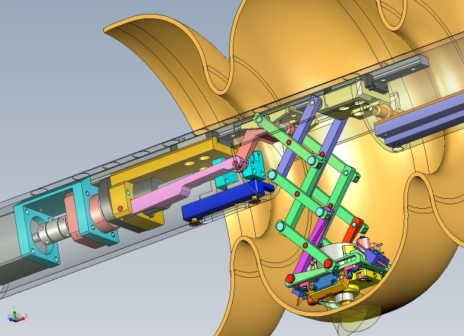
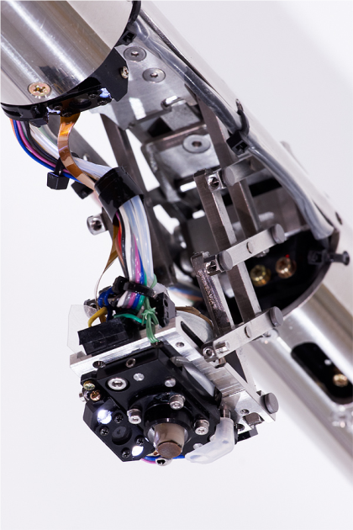
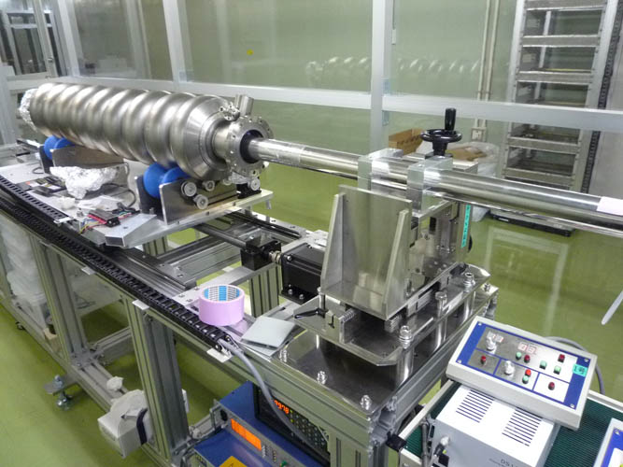



Local grinding at KEK
Grinding only for pit, without touching other surface
~115µm depth pit in MHI-08 cavity
diamond powder compound
with water in between
were used.
Quench at 16 MV/m
This pit caused quench at 16 MV/m
MHI-08 cell #2 grinding example

