Slide 1
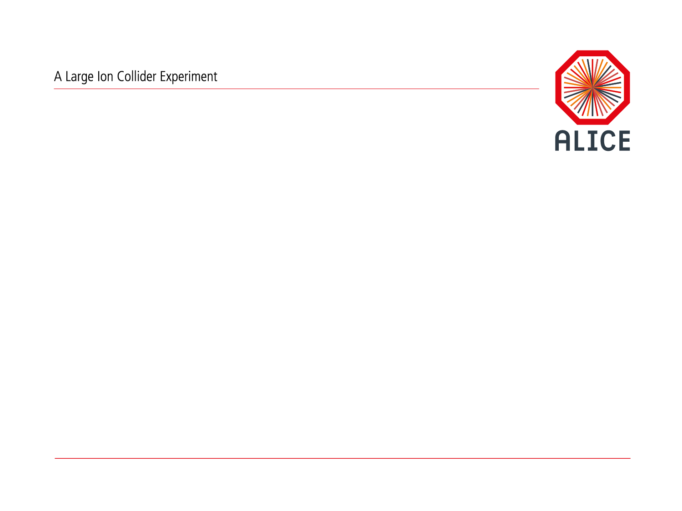
ALICE migration to CVMFS Timeline & Procedures
ALICE© | T1/T2 Workshop | 4-6 June 2013| Predrag Buncic

Slide 2

Why is CVMFS the best thing since sliced bread?

Slide 3

What is CVMFS?

Slide 4

CernVM File System is a network file system based on HTTP and optimized to deliver experiment software in a fast, scalable, and reliable way. In order to minimize network and disk usage, files and file metadata are aggressively cached and downloaded on demand.

Slide 5





iBuilder
TOOL TO BUILD VM IMAGES
FOR VARIOUS HYPERVISORS
CernVM-FS
DISTRIBUTED FILE SYSTEM
FOR SOFTWARE DISTRIBUTION
CernVM
VIRTUAL MACHINE AVAILABLE FOR
ALL MAJOR HYPERVOSORS
Installer
TOOL TO FACILITATE
INSTALLATION ON VIRTUALBOX
CoPilot
TOOLKIT FOR BUILDING VOLUNTEER
COMPUTING CLOUDS
CernVM Online
PORTAL TO MANAGE CERNVM
CONTEXTUALIZATION AND CONFIGURATIION
DETAILS
CernVM File System is a member of CernVM family

Slide 6

Big success, used by ATLAS, LHCb, CMS, OSG,
UK e-Science…

Slide 7
Deployment target date for ATLAS and LHCb achieved (30 April)
  No new software releases will be installed at sites without CVMFS
  Sites without new software releases will stop to be used
CMS target date is April 2014

Slide 9


Current ALICE repository contains 1 000 000 files in 100 packages but only 90 000 of them are unique

Slide 10
Scalability

Slide 11
Failover

Slide 12

Use Cases

Slide 13
Classic CernVM

Slide 14

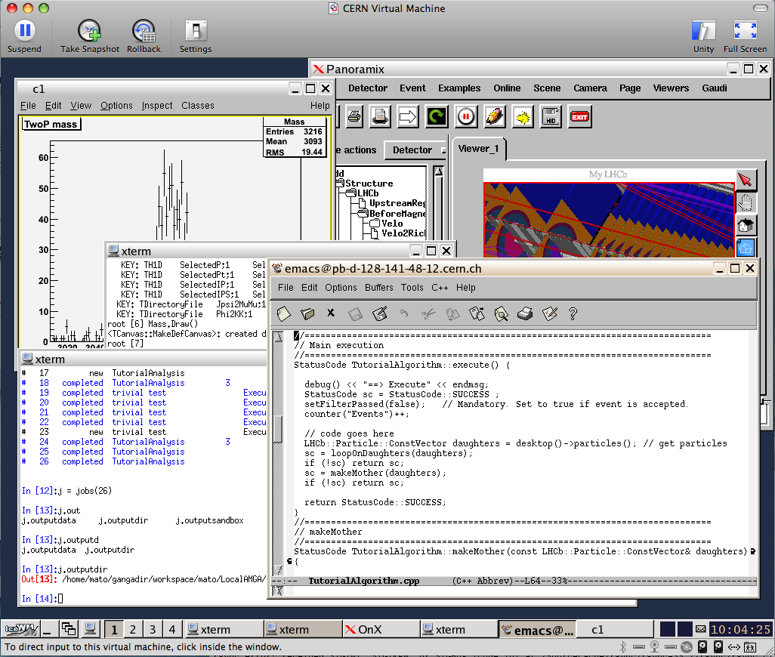
Checkout
Submit to Grid
Display results
Suspend
Test
Compile
Resume
Debug

Slide 15
μCernVM

Slide 16
Time machine

Slide 17
Long Term Data Preservation
.

Slide 18
Use of opportunistic resources
.
More info...

Slide 19
.
More info...

Slide 20
.
More info...

Slide 21
Works for ALICE…
[pbuncic@localhost bin]$ ./parrot_run -p "http://cernvm.lbl.gov:3128;DIRECT" -r "alice.cern.ch:url=http://cernvm-devwebfs.cern.ch/cvmfs/alice.cern.ch" /bin/bash
[pbuncic@localhost bin]$ . /cvmfs/alice.cern.ch/etc/login.sh
[pbuncic@localhost bin]$ time alienv setenv AliRoot/v5-03-Rev-19 -c aliroot -b
*******************************************
* *
* W E L C O M E to R O O T *
* *
* Version 5.34/05 14 February 2013 *
* *
* You are welcome to visit our Web site *
* http://root.cern.ch *
* *
*******************************************
ROOT 5.34/05 (tags/v5-34-05@48582, Feb 15 2013, 17:08:24 on linuxx8664gcc)
CINT/ROOT C/C++ Interpreter version 5.18.00, July 2, 2010
Type ? for help. Commands must be C++ statements.
Enclose multiple statements between { }.
Connection: Wifi
Time to start : 4m55s
Download: 86 MB
Cache: 292 MB

Slide 22
Use of HLT farm for Offline processing
  Current HLT processing power
    ~2500 cores distributed over 200 nodes
    108 FPGAs on H-RORCs for cluster finding
    64 GPGPUs for tracking (NVIDIA GTX480 + GTX580)
  Computing capacity equivalent to US-ALICE share
  Strong request by C-RRB

Slide 23
ALICE HLT will grow even bigger…
  In 2018 ALICE plans to upgrade the detector
  Event rate x100
  HLT will be used for online reconstruction
    No classical trigger selection, online reconstruction farm
    Resulting in factor 20 data compression for all events
  Considerable resources needed
    250000 today’s cores
    Current estimate ~1500 nodes with many cores + GPUs + FPGAs

Slide 24


So far no coordinated effort in ALICE to prepare transition from the common Grid to “our grid on the cloud(s)”

Slide 25
Already available…
https://cern.ch/openstack

Slide 26
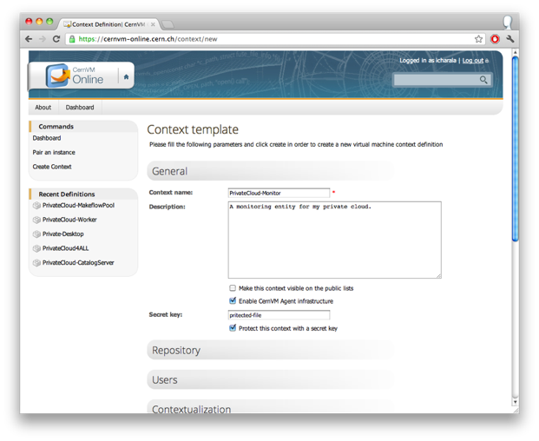
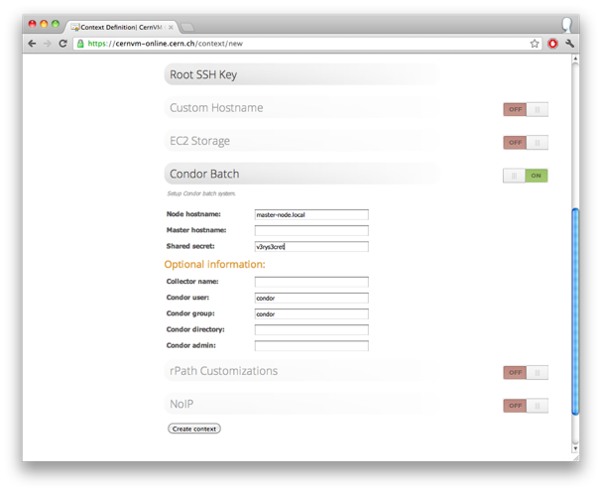
CernVM Online
.

Slide 27
VM (context) definiton
.

Slide 28
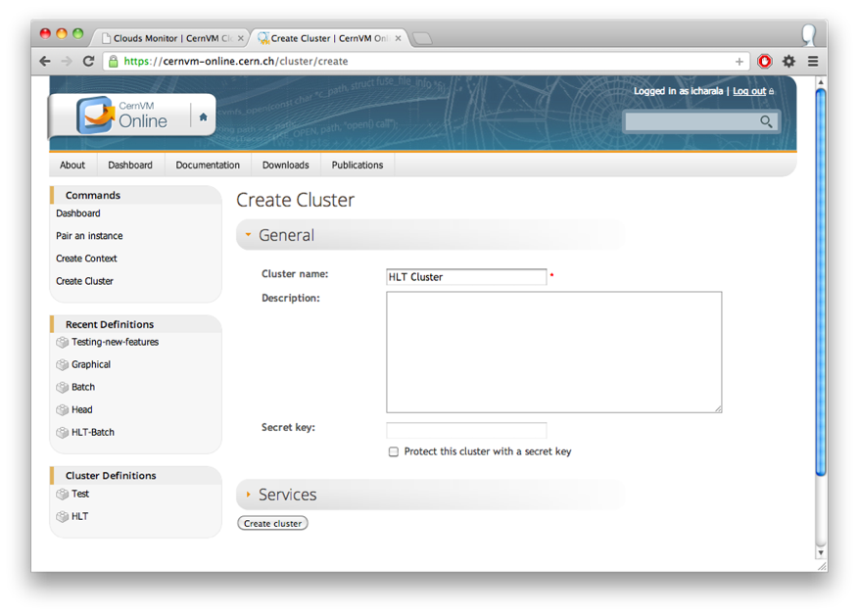
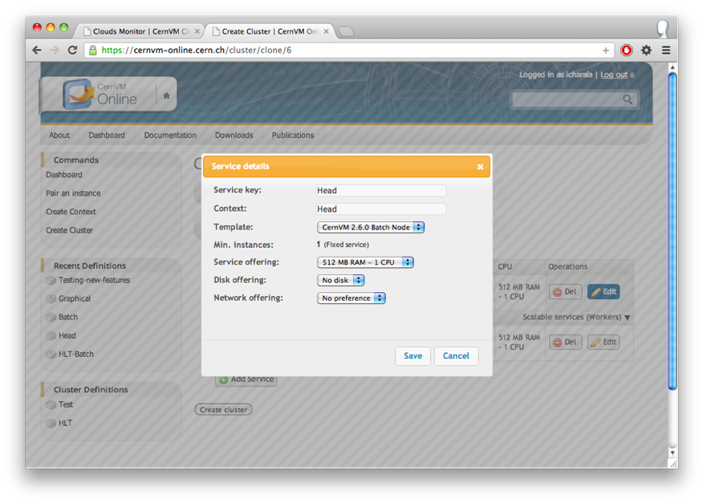
Cluster definition
.

Slide 29


CernVM Cloud Workflow
CernVM Infrastructure
Private Infrastructure
.
SSL
CERN Account
CernVM Online
HTTPS
System user
CernVM Gateway
SSL
API Private / Public Key
Management Tools
REST API
Virtually
SSL
XMPP
Gateway Agent
Cloud Agent
Cloud Agent
Cloud API
AES (Shared secret)
Cloud Infrastructure
Control messages are using PubSub and IQ
(not visible to chat clients)
Cloud Infrastructure

Slide 30






CernVM Cloud Gateway
System overview
Cloud agents expose the resources available in the cloud.
The users request resources via the gateway interface.
The site administrators only takes care of the installation.
Instances
.
Cloud Agent
Public Cloud
Cloud Agent
Private Cloud
Cloud Agent
System user
Site
Administrator
Cloud Agent
Machine
Browser / Tools
Cloud Gateway

Slide 31
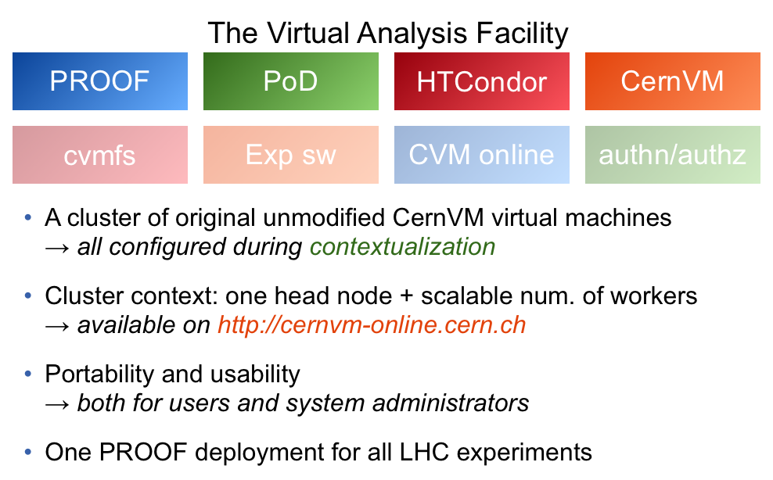

Slide 32






Private CERN
Cloud
QA
Cloud Gateway
AliEn
CAF
On
Demand
Cloud Agent
CernVM/FS
Public Cloud
HLT

Slide 33
Why CVMFS?
  Mature, scalable and supported product
    Used by all other LHC experiments (and beyond)
    One thing less to worry about…
  Based on proven CernVM Family
  Enabling technology that opens a door for implementation of different use cases
    Use of Clouds including HLT Farm for Offline processing
    Use of CernVM as a user interface
    Virtual Analysis Facilities
    Possible use of opportunistic resources
    Volunteer computing
    Part of a Long Term Data Preservation solution

Slide 34
Timeline
  Jan 2013
  ………....
  …………
  Jun 2013
  …………
  July 2013
  …………
  Aug 2013
  …………
  …………
  …………
  Apr 2014
  Setup Stratum 0 for ALICE
  Deploy ALICE S/W on CVMFS
  Migrate ALICE Repository to Stratum 1s
  Test, test, test
  Start deployment process on all ALICE sites
    Deploy CVMFS repository but do not use it in production
  Run AliEn from CVMFS on selected site(s)
    Validate and evaluate stability, performance
  Run AliEn from CVMFS on all site(s)

Slide 35
32/32/32

Slide 36



Deployment Configurations
Grid Site
HTTP
Web Proxies
Repository Mirrors (Stratum 1)
Worker Nodes
HTTP
CernVM-FS fuse module on WNs
recommended deployment
HTTP
HTTP
Grid Site
NFS
Web
Proxies
Repository Mirrors (Stratum 1)
Worker Nodes
HTTP
CernVM-FS exported by NFS
requires CernVM-FS 2.1 on SL6
NFS

Slide 37
Site Installation -- Squid
Squid Setup
  If there are Frontier Squids installed (http://frontier.cern.ch), this step can be skipped
  Install Squid from the Scientific Linux repository on 2 (virtual) machines
  $ yum install squid
  Edit /etc/squid/squid.conf so that it matches the following snippet
  Use squid –k parse to verify the configuration and squid –z to create the cache
  Note: 50G hard disk cache and 4G memory cache is the recommended minimum
  max_filedesc 8192
  maximum_object_size 1024 MB
  # 4 GB memory cache
  cache_mem 4096 MB
  maximum_object_size_in_memory 128 KB
  # 50 GB disk cache
  cache_dir ufs /var/spool/squid 50000 16 256
  acl cvmfs dst cvmfs-stratum-one.cern.ch
  acl cvmfs dst cernvmfs.gridpp.rl.ac.uk
  acl cvmfs dst cvmfs.racf.bnl.gov
  acl cvmfs dst cvmfs02.grid.sinica.edu.tw
  acl cvmfs dst cvmfs.fnal.gov
  acl cvmfs dst cvmfs-atlas-nightlies.cern.ch
  http_access allow cvmfs

Slide 38
Site Installation – yum
Add CernVM-FS yum repository, install cvmfs packages
  Install the cvmfs-release RPM from http://cernvm.cern.ch/portal/filesystem/downloads
  (Optional) If you want to participate in pre-release testing, enable the
  cernvm-testing
  repository in /etc/yum.repos.d/cernvm.repo
  (Optional) For the CernVM-FS 2.1.X client, enable the
  cernvm-ng
  repository in /etc/yum.repos.d/cernvm.repo
  Note: The cvmfs 2.1 RPMs will be part of the production repository as soon as we have full deployment on a Tier 1 site. RAL is close to this point.
  Install cvmfs packages:
  Note: do not use auto update on cvmfs packages
  Run setup in order to configure fuse and autofs for the use with CernVM-FS.
  yum install cvmfs cvmfs-keys cvmfs-init-scripts
  cvmfs_config setup

Slide 39
Site Installation – /etc/cvmfs
Configure /etc/cvmfs/default.local
  CVMFS_REPOSITORIES=atlas.cern.ch,atlas-condb.cern.ch,lhcb.cern.ch,cms.cern.ch,alice.cern.ch,grid.cern.ch,sft.cern.ch
  resp. the subset of supported VOs. See http://cernvm.cern.ch/portal/cvmfs/examples for repository dependencies.
  CVMFS_HTTP_PROXY=”http://squid1:3128|http://squid2:3128”
  These are the squid servers from step 1.
  Note the quotes.
  CVMFS_QUOTA_LIMIT=20000
  These is the limit for the CernVM-FS hard disk cache in Megabyte.
  Note: this should be larger than 12G and not more than 100G.
  Note: for the 2.0 client, the quota applies to all repositories independently (overall space is the sum of all quotas). The 2.1 client uses a shared cache.
  Note: the partition hosting the cache should have at least 10% more space since the CernVM-FS quota is a soft quota that occasionally can be overspent.
  (Optional)
  CVMFS_CACHE_BASE=/my/scratch/directory
  By default, the CernVM-FS cache is in /var/cache/cvmfs2 (2.0 client) resp. in /var/lib/cvmfs (2.1 client). Ensure that tmpwatch is not active on the cache directory.
  Note: changing the cache directory can SELinux make CernVM-FS block.

Slide 40
Site Installation – NFS Mode
(Optional) Additional configuration for the NFS mode
  CVMFS_NFS_SOURCE=yes
  Necessary to activate NFS compliant meta-data handling.
  Note: this implies the loss of a quota enforcement for meta-data. Ensure that you have at least 50G additional hard disk space available, monitor hard disk consumption.
  Turn off the autofs service. Autofs mounted volumes cannot be exported by NFS.
  Mount CernVM-FS volumes via /etc/fstab on the NFS server. Example entry:
  atlas.cern.ch /cvmfs/atlas.cern.ch cvmfs defaults 0 0
  CVMFS_MEMCACHE_SIZE=256
  Assign 256M to CernVM-FS meta-data memory caches. This value works well at DESY with 4k job slots at 350 nodes.
  Increase the number of NFS daemons, set in /etc/sysconfig/nfs
  RPCNFSDCOUNT=128
  Example entries in /etc/exports
  /cvmfs/atlas.cern.ch 172.16.192.0/24(ro,sync,no_root_squash,\ no_subtree_check,fsid=101)
  Note: the fsid has to be different from every other exported CernVM-FS mountpoint.
  Example entry in worker node /etc/fstab
  172.16.192.210:/cvmfs/atlas.cern.ch /cvmfs/atlas.cern.ch nfs \ ro,nfsvers=3,noatime,nodiratime,ac,actimeo=60,lookupcache=all 0 0
  Note: 16G or more memory and CernVM-FS cache directory hosted on SSD for performance

Slide 41
Monitoring and Debugging
Verify CernVM-FS configuration
  cvmfs_config chksetup should report “OK”
  To check if the repositories get mounted, run
  /sbin/service cvmfs probe (2.0 client)
  cvmfs_config probe (2.1 client)
  On errors, check syslog (/var/log/messages) for records from cvmfs
  Check SElinux audit log /var/log/audit/audit.log
  for violations from the cvmfs2 process
  For mounting problems, try to mount manually:
  mkdir –p /mnt/test
  mount –t cvmfs atlas.cern.ch /mnt/test
  Retry with clean caches:
  /sbin/service cvmfs restartclean (2.0 client)
  cvmfs_config wipecache (2.1 client)
  If a problem has been resolved, reload the autofs maps by
  /sbin/service autofs reload
  in order to avoid seeing errors from the autofs cache.
  If the problem persists, send an email describing the problem to cernvm.support@cern.ch together with a bugreport tarball created by cvmfs_config bugreport
  Note: A Nagios check is available at http://cernvm.cern.ch/portal/filesystem/downloads
  Statistics can be gathered by cvmfs_config stat -v

Slide 42
Useful Links
Mailing Lists: cvmfs-talk@cern.ch, cvmfs-testing@cern.ch,
cvmfs-devel@cern.ch
Technical report, known issues, configuration examples:
http://cernvm.cern.ch/portal/filesystem/techinfo
Bug tracker: https://savannah.cern.ch/projects/cernvm
Source code: https://github.com/cvmfs
RPMs: http://cernvm.cern.ch/portal/filesystem/downloads
Yum repositories: http://cvmrepo.web.cern.ch/cvmrepo/yum
Nightly builds: https://ecsft.cern.ch/dist/cvmfs
Cvmfs module for Puppet:
https://github.com/cvmfs/puppet-cvmfs
(straylen@cern.ch)
Cvmfs and Quattor: straylen@cern.ch, ian.collier@stfc.ac.uk

