Slide 1
LHC Open Network Project status and site involvement
Ramiro Voicu (Caltech/USLHCNet)
ALICE T1/T2 workshop
Lyon, June 5th, 2013

Slide 2
Outline
Background
LHCONE Overview
L3VPN service, VRF
Connection recommendations
R&D activities
Summary

Slide 3
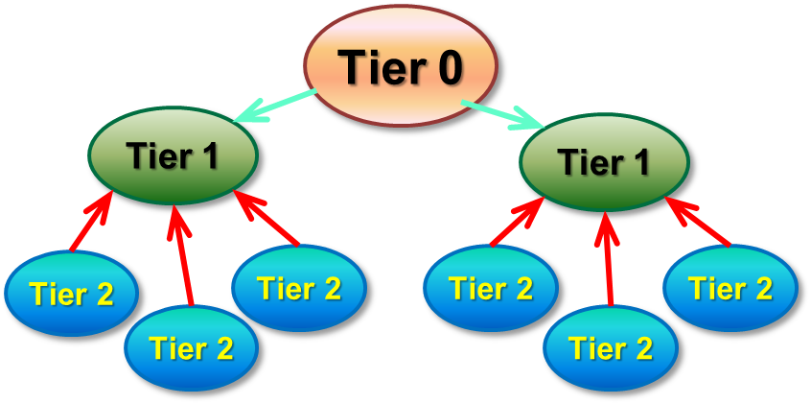
Background: LHCOPN
2004/2005 timeframe the LHC Optical Private Network (LHCOPN) was designed
Hierarchical MONARC model (late 1990 – early 2000)
Every T2 associated to a T1[*]
Evolved from a star to partial mesh
Dedicated network resources for T0 – T1 and T1 – T1 data movement
Federated governance (no single administrative body)
[*] ALICE adopted a different model

Slide 4
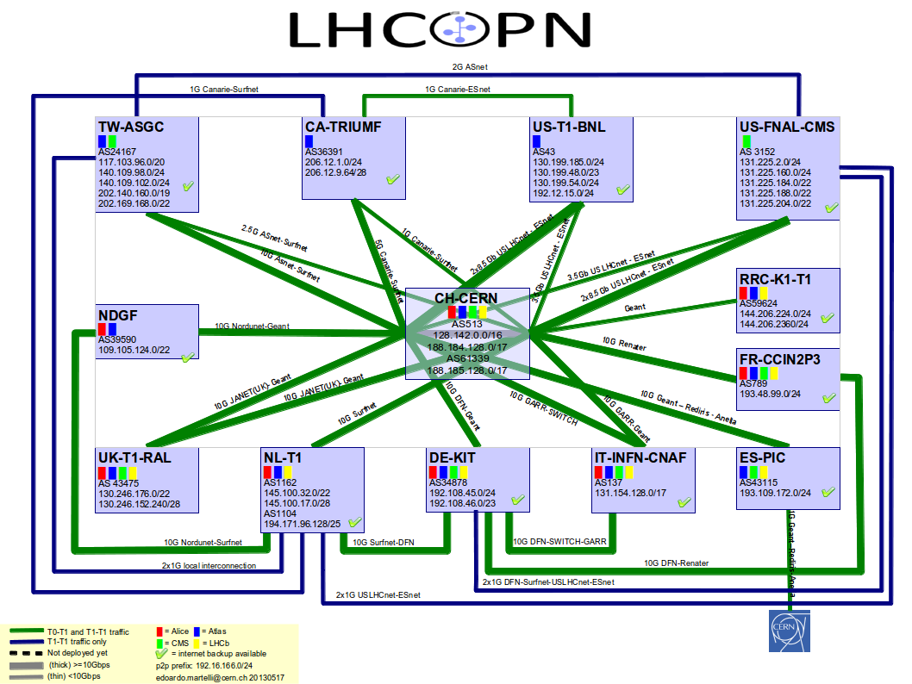
LHCOPN
Edoardo Martelli, CERN

Slide 5
Background
Transatlantic connectivity workshop in 2010 at CERN
Moving from hierarchical pre-placement models towards a flatter, peer-to-peer model: greater availability, locality
Suits ALICE data access model
Tier 0
Tier 0
Tier 1
Tier 1
Tier 1
Tier 1
Tier 2
Tier 2
Tier 2
Tier 2
Tier 2
Tier 2
Tier 2
Tier 2
Tier 2
Tier 2
Tier 2
Tier 2

Slide 6
LHCONE Introduction
LHCONE was born to address two main issues:
ensure that the services to the science community maintain their quality and reliability
“The Network infrastructure is the most reliable service we have”
Ian Bird – WLCG project leader
protect existing R&E infrastructures against very large LHC data flows
accomplished through distinct infrastructure and/or traffic engineering
LHCONE is expected to
provide some guarantees of performance
Large data flows across managed bandwidth that would provide better determinism than shared IP networks
Segregation from competing traffic flows
Manage capacity as # sites x Max flow/site x # Flows increases
provide ways for better utilization of resources
Use all available resources
Provide Traffic Engineering and flow management capability
Leverage investments being made in advanced networking

Slide 7
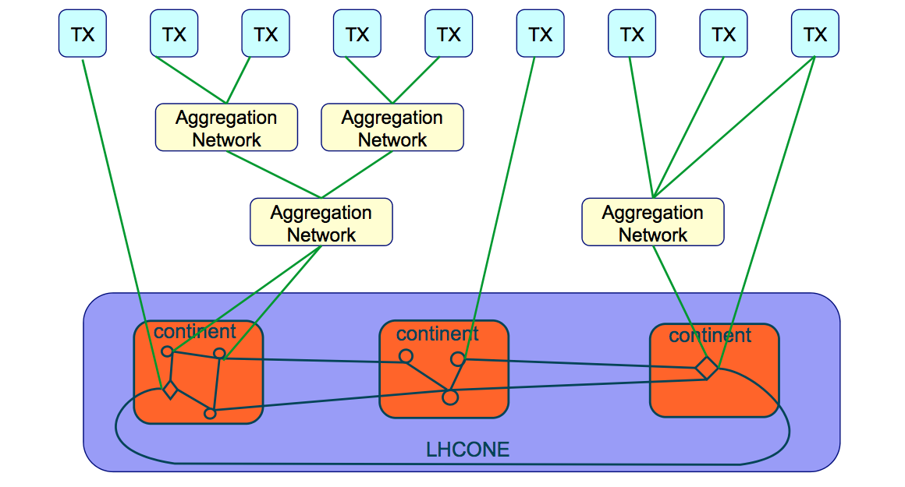
LHCONE Overview
Open Exchange Points
Distributed exchange point
Single node exchange point

Slide 8
LHCONE Overview
Current activities split in several areas:
Multipoint connectivity through L3VPN (Production)
Point-to-point dynamic circuits (R&D)
targeting demonstration this year
Common to both is logical separation of LHC traffic from the General Purpose Network (GPN)
Avoids interference effects
Allows trusted connection and firewall bypass
More R&D in SDN/Openflow for LHC traffic
for tasks which cannot be done with traditional methods

Slide 9
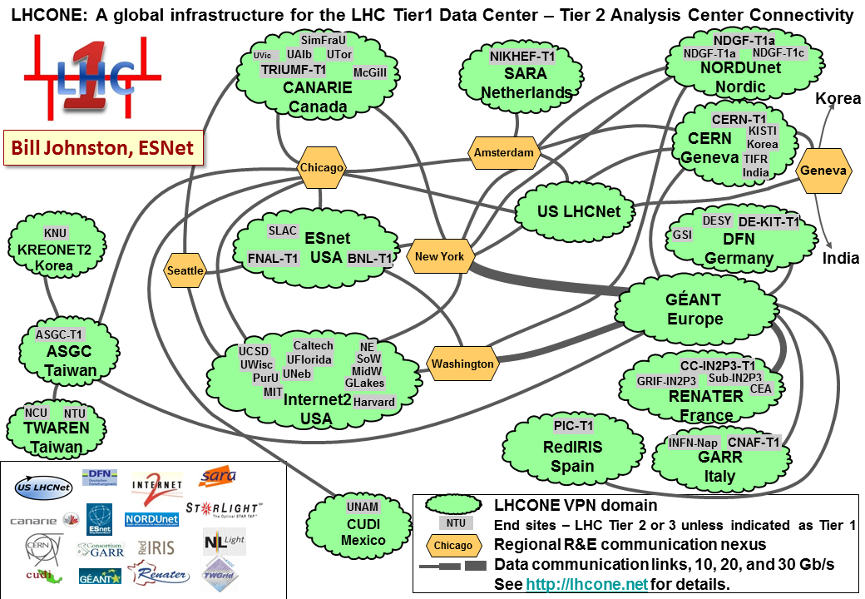
Routed L3VPN Service, VRF
Based on Virtual Routing and Forwarding (VRF)
BGP peerings between the VRF domains
Currently serving 44 LHC computing sites

Slide 10
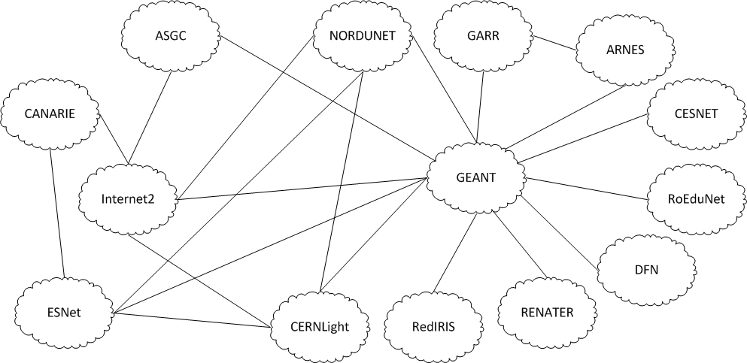
Routed L3VPN Service, VRF, cont.
Current logical connectivity diagram:
Mian Usman, DANTE

Slide 11
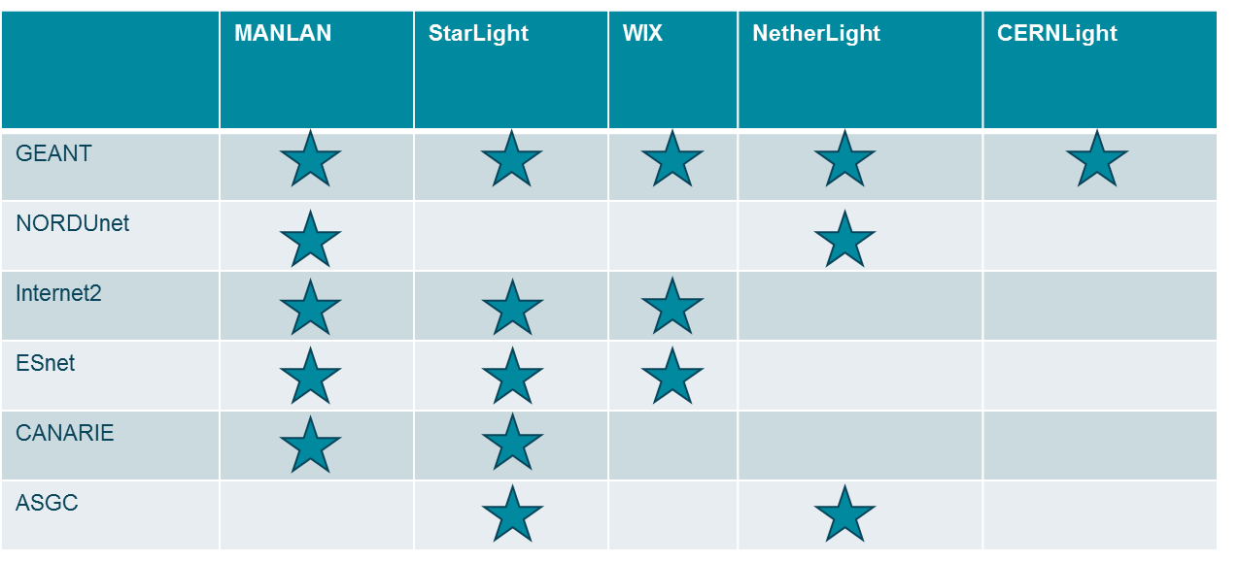
Inter-domain connectivity
Many of the inter-domain peerings are established at Open Lightpath Exchanges
Any R&E Network or End-site can peer with the LHCONE domains at any of the Exchange Points (or directly)

Slide 12
LHCONE L3VPN for Service Providers
See information on wiki:
https://twiki.cern.ch/twiki/bin/view/LHCONE/LhcOneVRF
List of BGP communities on the wiki
Implementation recommendations:
Do not filter by prefix length. Any prefix length must be accepted
Apply maximum-prefix checks. Ad-hocs for TierXs, 3000 between VRFs
Do not allow private AS Numbers

Slide 13
Computing Site Connection HOWTO
Wiki instructions: https://twiki.cern.ch/twiki/bin/view/LHCONE/LhcOneHowToConnect
Any LHC computing site can connect to the LHCONE infrastructure
Connect to one of the VRF domains
see Wiki for list of active VRF domains
directly or at exchange point
A computing site (TierX) needs to have
public IP addresses
a public AS Number
a BGP capable router
LHCONE transports LHC data traffic only
Announce only LCG IP prefixes
Traffic must be symmetric, to avoid problems with stateful firewalls

Slide 14
Connection recommendations
Recommendations to address asymmetric routing:
Define local LAN address ranges that will participate in LHCONE. Advertise these address range prefixes to LHCONE using BGP
Agree to accept all BGP route prefixes advertised by the LHCONE
Ensure that only hosts in your locally defined LHCONE ranges have the ability to forward packets into the LHCONE network
Ensure that the LHCONE paths are preferred over general R&E IP paths
End sites should avoid static configuration of packet filters, BGP prefix lists and policy based routing, where possible.
More details here: https://indico.cern.ch/getFile.py/access?contribId=8&resId=1&materialId=slides&confId=179710
Michael O’Connor, ESnet

Slide 15
LHCONE Operational Aspects
The Operational Model is broadly based on the LHCOPN experience
Basic principle: A sites experiencing problems contacts its first LHCONE upstream provider
Still in the process of being worked out
Current operational handbook draft: https://twiki.cern.ch/twiki/pub/LHCONE/LhcOneVRF/LHCONE_VRF_Operational_Handbook-v0.5.pptx

Slide 16
Point-to-point service
PATH TO A DEMONSTRATION SYSTEM

Slide 17
Dynamic Point-to-Point Service
Point-to-point circuit service complements the L3VPN service and provides predictable performance
Guaranteed bandwidth between a pair of end-points (VRF domains and/or end-sites)
No jitter and predictable delay
Several provisioning systems developed by R&E community: OSCARS (ESnet), OpenDRAC (SURFnet), G-Lambda-A (AIST), G-Lambda-K (KDDI), AutoBAHN (GEANT)
Inter-domain: need accepted standard
OGF NSI: The standards Network Services Interface
Connection Service (NSI CS):
v1 ‘done’ and demonstrated e.g. at GLIF and SC’12
Currently standardizing v2

Slide 18
Point-to-Point Service in LHCONE
Intended to support bulk data transfers at high rate
Separation from GPN-style infrastructure to avoid interferences between flows
Conducted 2 workshops:
1st LHCONE P2P workshop was held in December 2012
https://indico.cern.ch/conferenceDisplay.py?confId=215393
2nd workshop held May 2013 in Geneva
https://indico.cern.ch/conferenceDisplay.py?confId=241490
(Some) Challenges:
multi-domain system
edge connectivity – to and within end-sites
how to use the system from LHC experiments’ perspective
e.g. ANSE project in the US
manage expectations

Slide 19
Point-to-point Demo/Testbed
Demo proposed and led by Inder Monga (ESnet)
Choose a few interested sites
Build static mesh of P2P circuits with small but permanent bandwidth
Use NSI 2.0 mechanisms to
Dynamically increase and reduce bandwidth
Based on Job placement or transfer queue
Based or dynamic allocation of resources
Define adequate metrics!
for meaningful comparison with GPN or/and VRF
Time scale: TDB (“this year”)
Participation: TDB (“any site/domain interested”)
More discussion at the next LHCONE/LHCOPN meeting in Paris (June 2013)

Slide 20
SDN/Openflow
OTHER R&D ACTIVITIES

Slide 21
Meeting on SDN in LHCONE, May 3rd, 2013
Discussed the potential use case: SDN/Openflow could enable solutions to problems where no commercial solution exists
Identify possible issues/problems Openflow could solve, for which no other solution currently exists?
Multitude of transatlantic circuits makes flow management difficult
Impacts the LHCONE VRF, but also the GPN
No satisfactory commercial solution has been found at layers 1-3
Investigate the use of Openflow to address the problem at Layer2
Caltech has a DoE funded project running, developing multipath switching capability (OLiMPS)
Will examine this for use in LHCONE
Second use case: ATLAS is experimenting with OpenStack at several sites.
Openflow/SDN is the natural technology in the network. Could be used to bridge the data centers.

Slide 22
Summary
The LHCONE is currently operating a L3VPN (aka VRF) service
44 LHC computing sites connected
The Point-to-point circuit service will be first shown in a demonstration
Based on NSI
Interested Networks and Sites are welcome to join
Ideas in the SDN/Openflow space are currently investigated
Useful to LHCONE participating networks?
Any direct benefit to the LHC computing model?

Slide 23
Information exchange
Weekly audio conference, 14.30 UTC, alternating every second week:
architecture discussion
operations
mailing lists:
lhcone-operations@cern.ch
lhcone-architecture@cern.ch
LHCONE wiki: https://twiki.cern.ch/twiki/bin/view/LHCONE/WebHome
Next LHCONE/LHCOPN meeting: Paris, June 17/18, 2013
http://indico.cern.ch/conferenceDisplay.py?confId=236955

Slide 24
More details:
http://lhcone.net

