Slide 1
CMS Tape Families proposal
F. Fassi

Slide 2
Goal: To efficiently recover data from tape files
need to be arranged in tape families
Files that will be accessed at similar times should be stored in the same tape grouping
File families:
All AOD in the same tape family
→ AOD data is expected to be on disk continuously, a tape fault is an indication of a storage device failure and individual files from a variety of tapes will need to be recovered

Slide 3
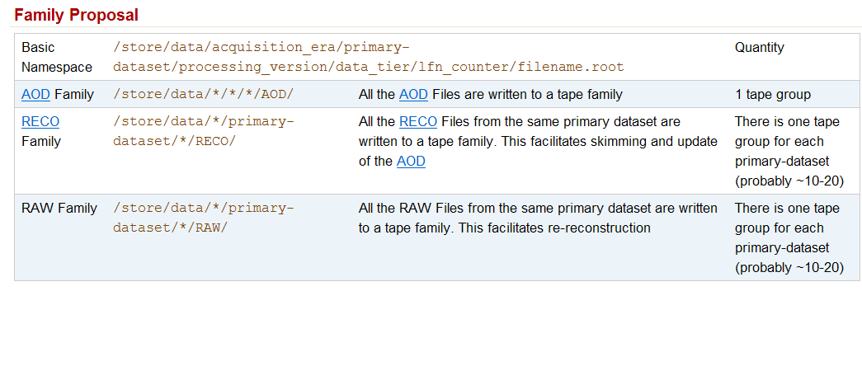
Under some two file reading cases tapes for both RAW and RECO would need to be staged simultaneously, but for the limited number of times this will be done it is more efficient than writing both to the same tape family.
Primary Datasets should be in separate tape families.
Re- reconstruction passes will probably be done by stream. For ease of staging a Tier-1 could be asked to Reconstruct a stream

Slide 4
Feedback on implementation of this proposal
At CC

